Slide 1
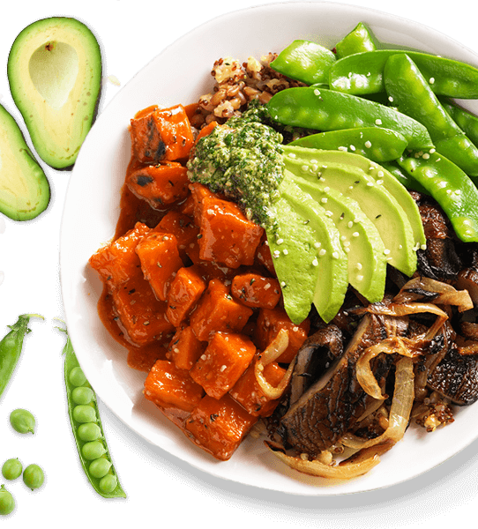
CALKILO
The photo-first
nutrition companion
for everyday eating.
AI calorie estimates, macro tracking, meal planning and progress support — built for global and Persian-language nutrition workflows.
Investor pitch deck | July 2026

Slide 2
CALKILO | INVESTOR DECK
Nutrition tracking still asks people to do too much work.
The friction is the product opportunity.
Manual logging breaks consistency
Generic apps miss local context
Insight arrives too late
Typing ingredients, portions and macros turns a daily habit into a chore.
Food databases and interfaces often under-serve non-English and Persian-speaking users.
Tracking alone does not help users turn food data into an actionable next meal.
Calkilo compresses the workflow: photo → estimate → nutrition record → personalized guidance.
Product framing drawn from Calkilo landing pages and llms.txt.
02

Slide 3
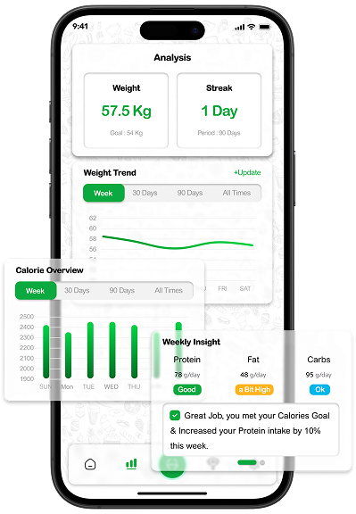
CALKILO | INVESTOR DECK
A single loop turns a food photo into a daily nutrition habit.
01
02
03
Capture
→
Understand
→
Act
Take a photo of a meal.
Estimate calories, portions and macros.
Log meals, track goals and receive AI-supported guidance.
Core workflow is designed for photo-first meal logging, macro tracking, meal planning and ongoing progress visibility.
Source: Calkilo repository — public product, pricing & Search Console data (Feb 4–May 3, 2026).
03

Slide 4
CALKILO | INVESTOR DECK
Calkilo layers high-frequency tracking with premium guidance.
Photo calorie estimation
Macro & food logging
AI-assisted recognition of meals, ingredients, portions and nutrition estimates.
Daily records for calories, protein, carbohydrates and fat.
AI coaching & planning
Motivation & progress
Personalized meal plans and nutrition support built around goals and history.
Goals, analytics, challenges and health-oriented tracking.
Source: Calkilo repository — public product, pricing & Search Console data (Feb 4–May 3, 2026).
04

Slide 5
CALKILO | INVESTOR DECK
Organic search is already validating product demand.
Search Console | Feb 4–May 3, 2026
2,317
89
3.84%
8.04
impressions
clicks
CTR
avg. position
Visibility accelerated in late April
Weekly impressions rose from 58 in the first exported week to 790 in the week beginning Apr 28. The final 30 days delivered 65 clicks versus 12 in the first 30 days.
Source: Calkilo Google Search Console SEO Analysis (exported May 6, 2026).
05

Slide 6
CALKILO | INVESTOR DECK
Persian search demand is the clearest initial beachhead.
Market
Clicks
Impressions
CTR
Position
Iran
54 clicks
864 impressions
6.25% CTR
7.36 avg. position
United States
2 clicks
458 impressions
0.44% CTR
7.80 avg. position
Italy
1 click
110 impressions
0.91% CTR
11.10 avg. position
Why it matters: Persian photo-calorie queries rank near page one and already earn clicks; dedicated localized pages can deepen query-to-page fit.
Source: Calkilo repository — public product, pricing & Search Console data (Feb 4–May 3, 2026).
06

Slide 7
CALKILO | INVESTOR DECK
A simple freemium model keeps the upgrade path legible.
Free
Premium
Habit formation through photo-first calorie estimates, food logging and core nutrition tracking.
Personalized meal plans, deeper analytics and AI coaching.
$4.99 / month
$14.99 / year
Investor note: repository data confirms pricing and feature packaging; it does not include conversion, retention or revenue metrics.
Source: Calkilo public pricing page.
07

Slide 8
CALKILO | INVESTOR DECK
The compounding asset is a localized, habit-forming product surface.
01
02
Photo-first UX
Localized acquisition
Reduces friction at the moment a meal happens.
Public landing content spans English, Persian, Italian, Dutch, Russian, Chinese and Arabic.
03
04
Persian food relevance
Data loop
Dedicated Persian guides and food-calorie examples strengthen regional usefulness.
Goals, history and preferences inform meal suggestions as user data changes.
Source: Calkilo llms.txt and localized landing-page copy.
08

Slide 9
CALKILO | INVESTOR DECK
The near-term plan converts early search visibility into repeatable acquisition.
Now
Next
Then
Sharpen Persian query-to-page fit
Improve conversion surfaces
Repeat localization playbook
Photo-calorie and AI-calorie pages match validated high-intent searches.
Optimize mobile pages, app-store paths, snippets and premium communication.
Extend proven content-product fit to Italian and other high-potential markets.
The operating question for investors: can Calkilo translate localized intent and a lower-friction logging loop into durable subscriptions?
Roadmap synthesized from the repository’s 30-day SEO action plan.
09

Slide 10
CALKILO
A practical AI nutrition
companion with early
localized demand.
Next diligence priorities
Product
Accuracy and repeat-use behavior
Growth
Install, activation and CAC
The investment case
Economics
Back the team to turn photo-first nutrition tracking, regional relevance and early organic validation into a scalable subscription business.
Conversion, retention and LTV
calkilo.com

