Slide 1
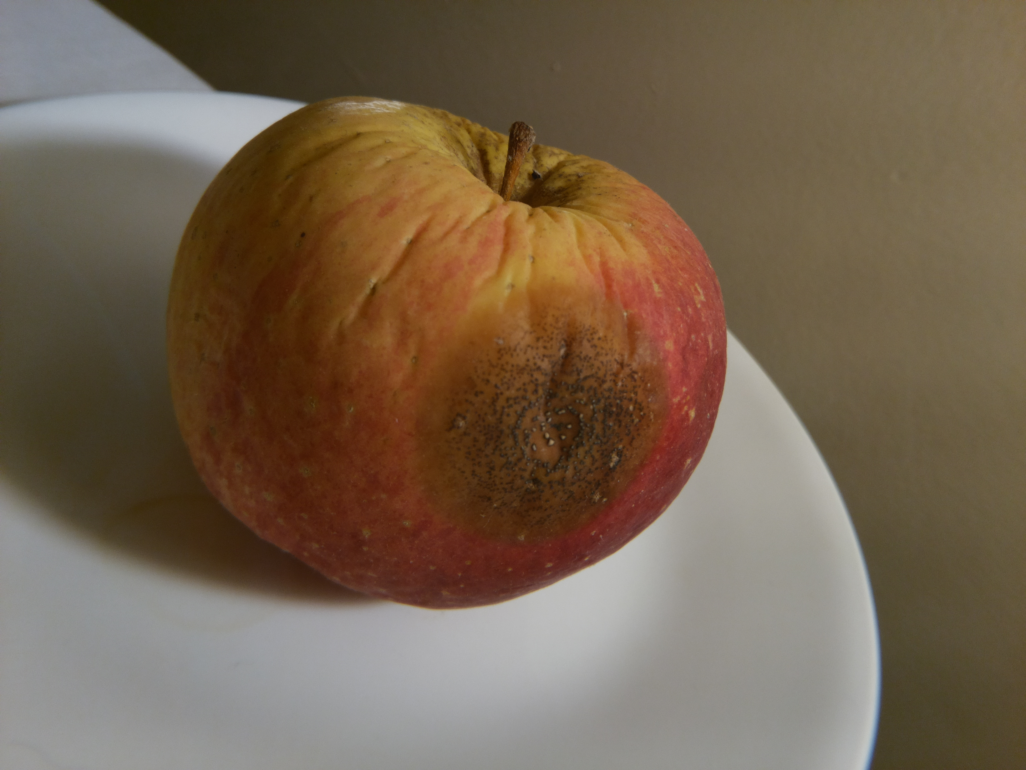
Time lapse Photography using a Raspberry Pi Zero

Slide 2
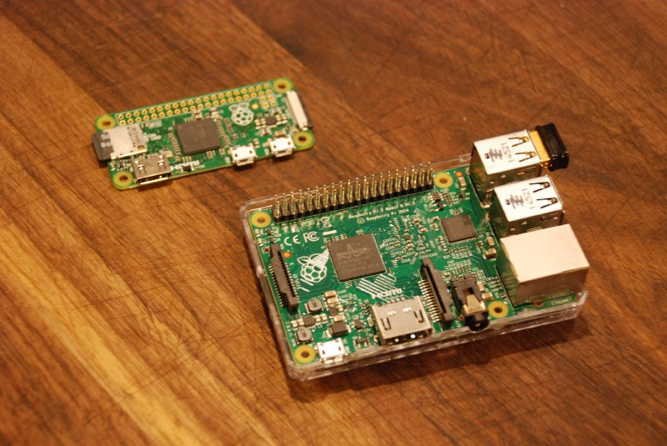
The Raspberry Pi
Notes:
Its an inexpensive lightweight computer. The PI Zero is an even less expensive more lightweight computer.
Pi model 3 is about the size of a deck of cards
Pi Zero about the size of a stick of gum
Both can run linux, and can make use of Python
They have various ports, HDMI, and GPIO pins, usb (or micro usb in case of the zero) that keyboard and mouse can hook up to, and HDMI that a monitor can be connected to.
But you can do a lot without a connected monitor and keyboard and mouse by SSHing into it over USB ethernet or using WIFI.

Slide 3
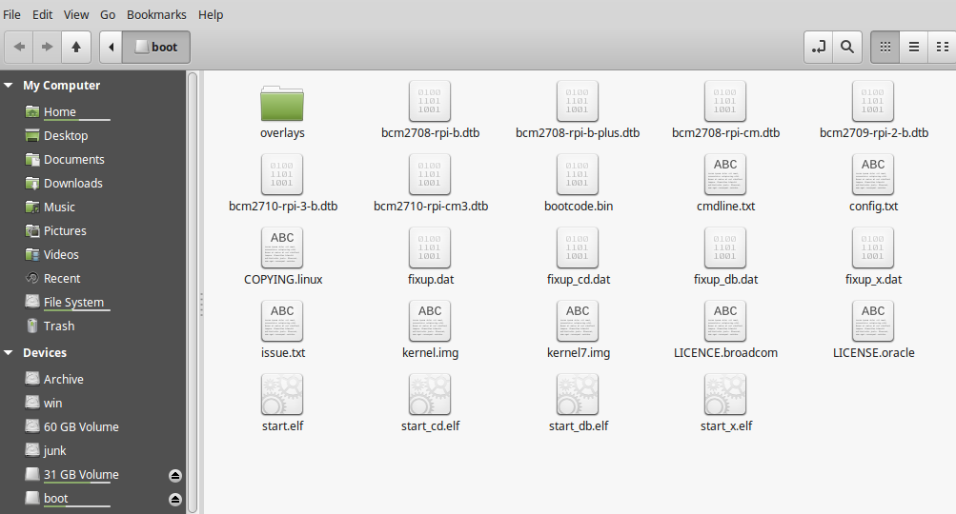
Setup
Flash MicroSD card with the OS
https://www.raspberrypi.org/downloads/
Notes:
If its your first time, you'll need to copy an operating system image onto an empty microSD card. You can get one of these images from raspberrypi.org's website. You can go with NOOBs (which helps you choose what OS you want to use), or a number of other systems. I went with Raspbian directly so can't really speak about the others. There is good documentation on how to setup your SD card once you have an image, so I won't go into that in too great of detail, but will mention a few post install things that made working headlessly a bit easier (as I didn't have an HMDI capable monitor initially).
After installing raspbian, two files need minor edits to enable ethernet over usb (which I found to be useful, but sometimes inconsistent when establishing a connection). Additionally for more recent versions of Raspbian in order to ssh into the device, an empty file named 'ssh' needed added in the /boot directory.

Slide 4
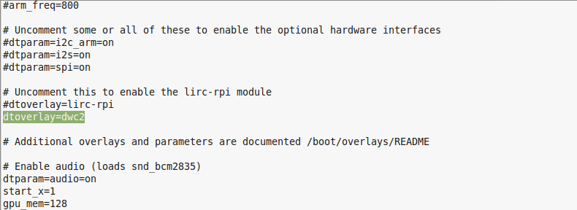
Ethernet over USB
config.txt
cmdline.txt
More info on this at:
http://blog.gbaman.info/?p=791
Notes:
In the boot partition

Slide 5
Wi-fi
# /etc/wpa_supplicant/wpa_supplicant.conf
network={
ssid="The SSID of your network"
psk="the networks password"
id_str="a nickname (optional)"
}

Slide 6
Setup
# if you have enabled ssh and are able to connect
# to the Pi via ethernet over usb,
# you can tunnel into it via:
ssh pi@raspberrypi.local
# the initial password is 'raspberry' which you should change
# for security reasons
Notes:
You should change the password of the user when ssh is enabled, but especially if its on a network that other computers can access.

Slide 7
Setup
/etc/rc.local ← commands put here (such as 'nohup python lapse.py &') will run when the device boots. Very important when running headlessly.
# Set the Pi Zero ACT LED trigger to 'none'.
echo none | sudo tee /sys/class/leds/led0/trigger
# Turn off the Pi Zero ACT LED.
echo 1 | sudo tee /sys/class/leds/led0/brightness
nohup su pi -c 'python -u /home/pi/lapse_project/lapse.py &'
Notes:
One other important file is `/etc/rc.local` - this file runs after boot by the root user. You can have your project scripts executed after boot (good for when you might lose power or have a project that needs to run independent of you kicking off a python script through a ssh command.
Here are some of the things I have in the Pi zero's file. The first two lines I found on the internet and they turn off the tiny green LED that blinks and shows the Pi is busy doing something. I actually use this in the timelapse script to blink to indicate it is taking a photo instead.
The third line kicks off the timelapse script headlessly, and runs it as the 'pi' user (instead of root). Unless you've good reason, you probably shouldn't be running scripts such as the timelapse one as the root user. (-u tells python to force stdout and err to be unbuffered)

Slide 8
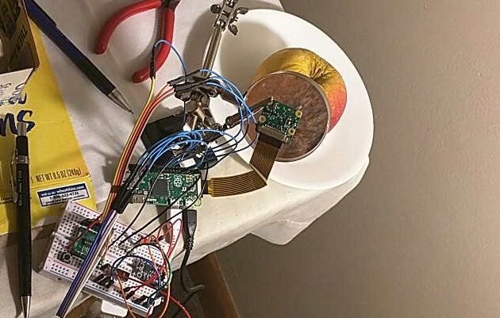
Remote Viewing
Can be helpful when aliging the camera/pointing it through a magnifying glass for a closer view of the subject
Notes:
The cameras focal length isnt to great for close up of fine details, such as a rotting apple. This is a photo of the setup I used. I ended up using a helping hands with a magnifying glass to position and hold the camera, which checking what was in focus by looking at the image through vncviewer. This actually worked pretty well, and the camera did not noticably shift for the several months it was held in place in the gator clips. I used an LED light (about the 100 Watt equivalent) and leaned the lamp to be close enough to give good lighting.
I went with tightvnc and installed it through the command prompt using apt-get (with the sudo command of course). This let me make a few readjustments of the magnifying glass and light source to have a more sharp picture (without a ghost image of the light source showing up through the lens)
Not 100% necessary, with clouds it can be more point and forget.

Slide 9
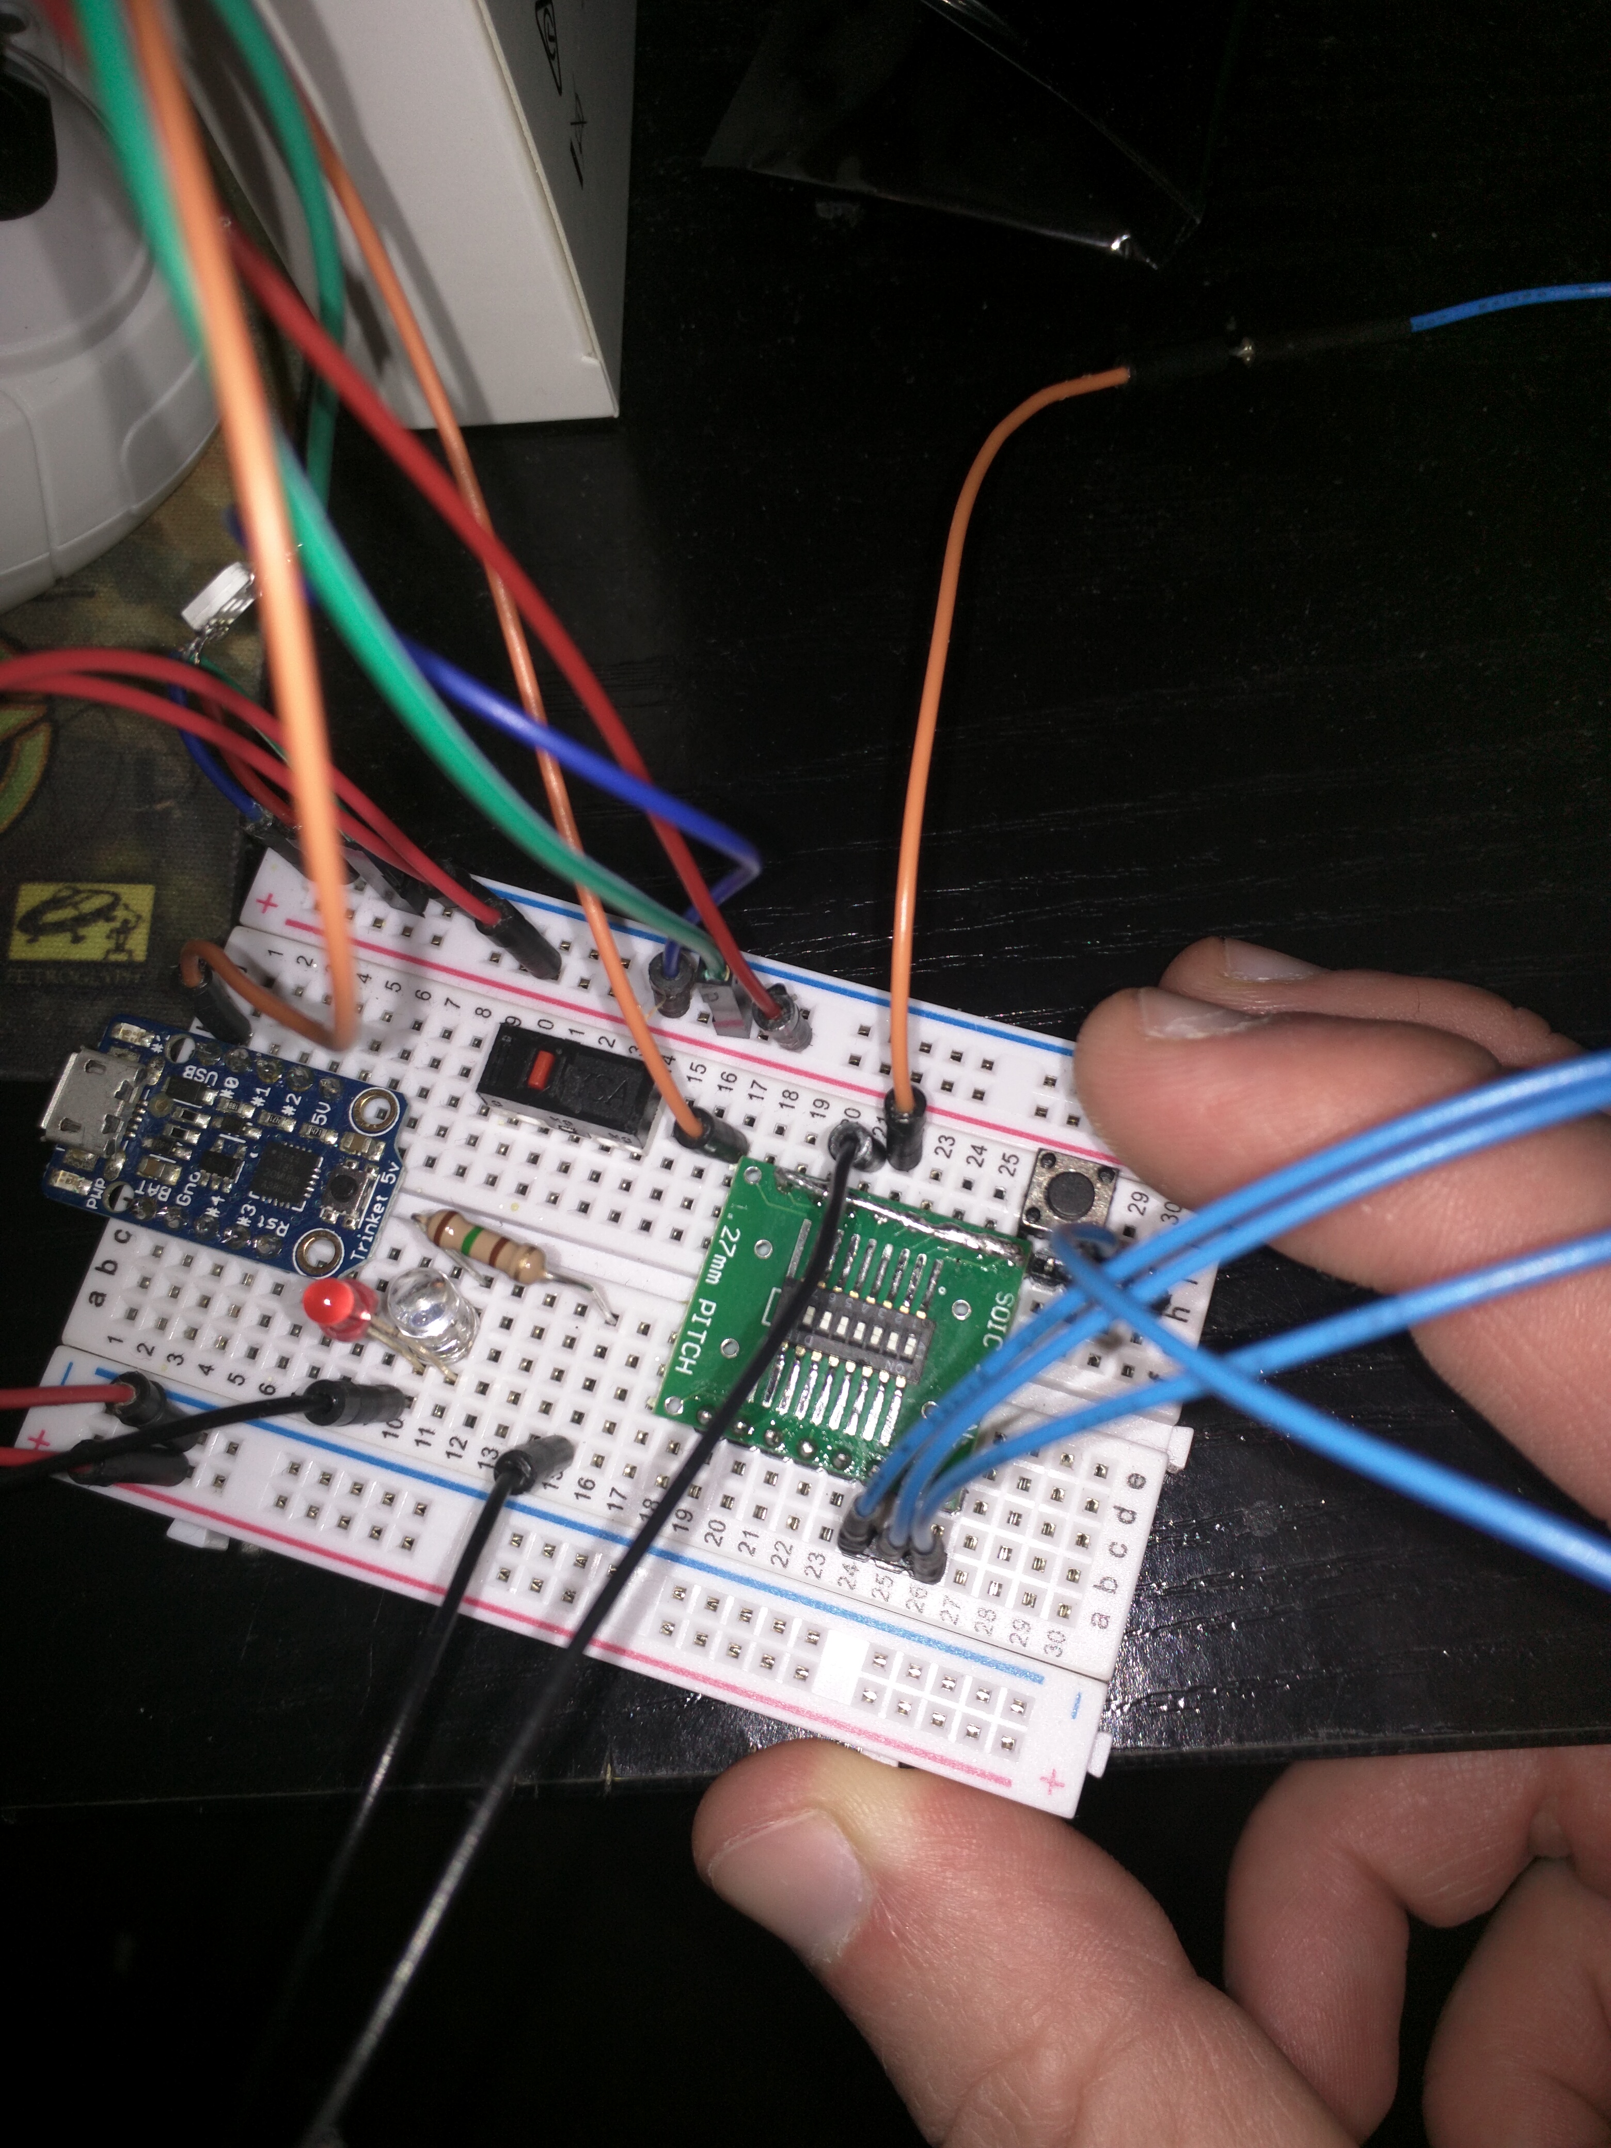
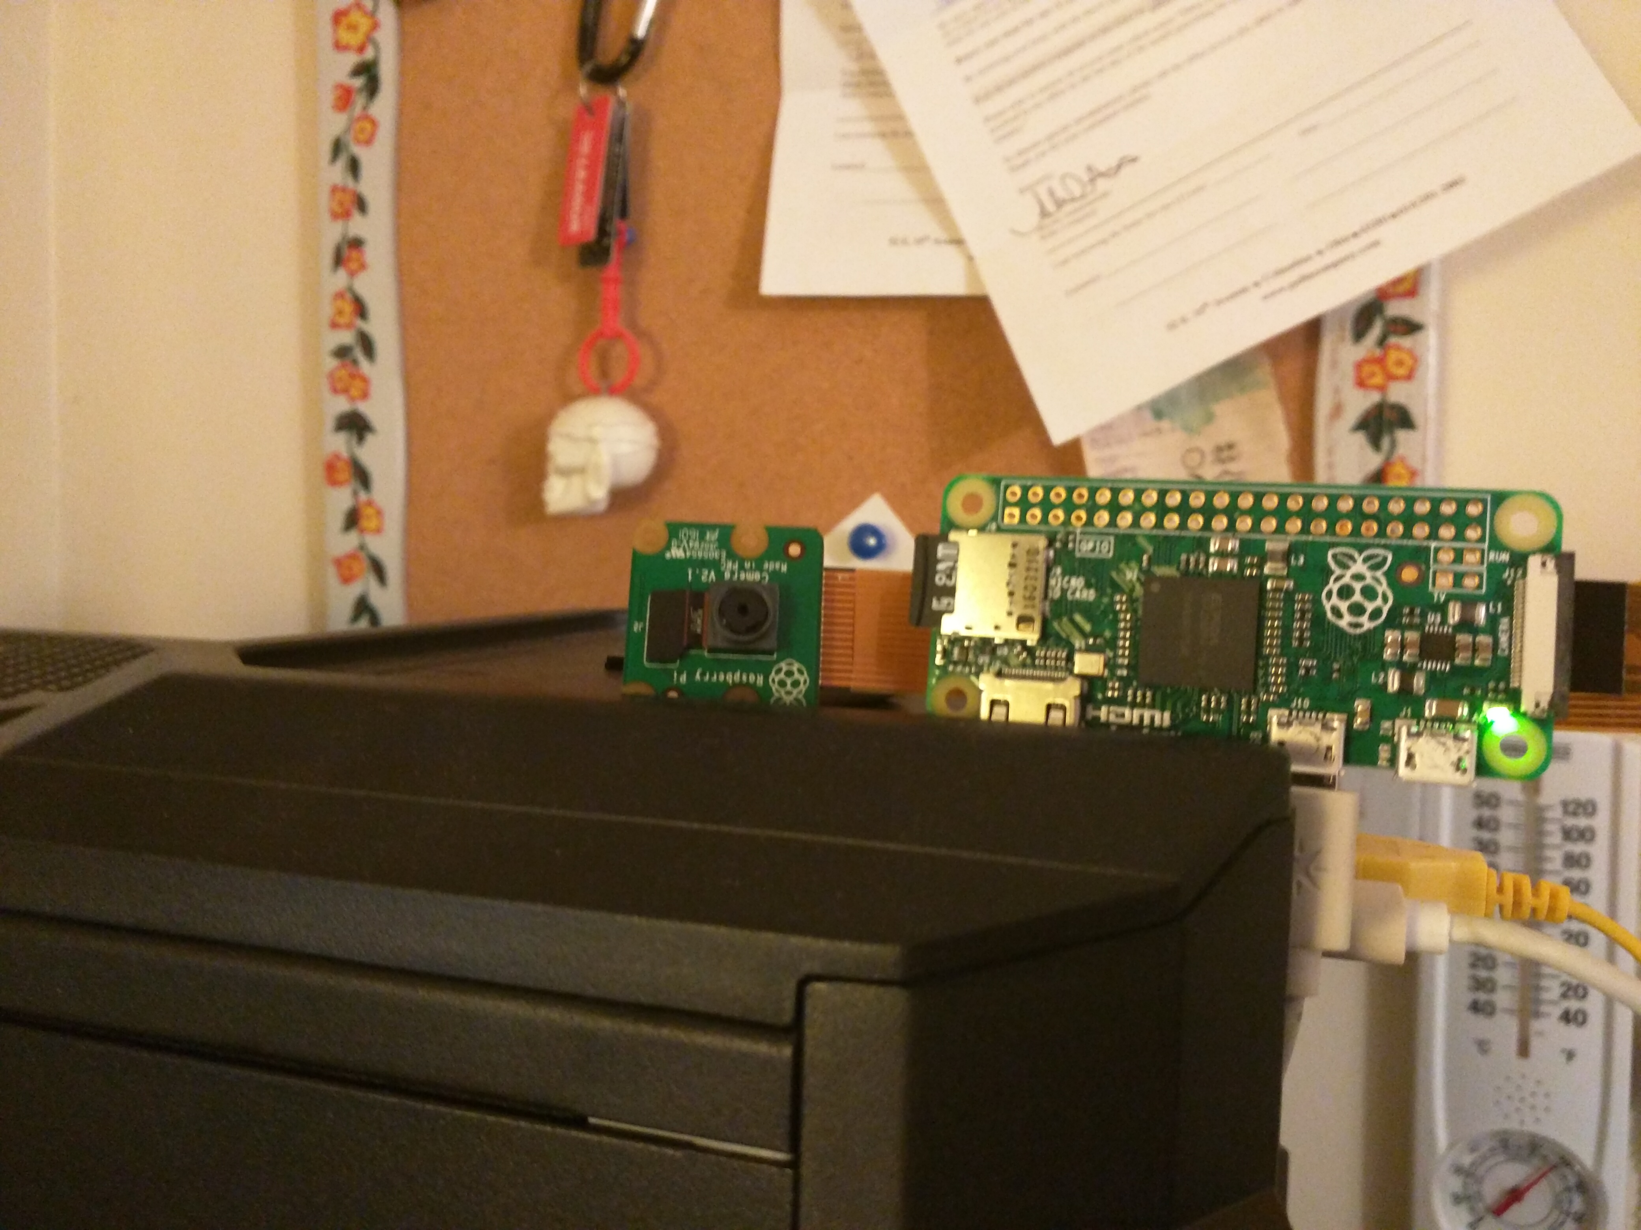
Basic Timelapse
Take a picture at even intervals
Stitch the Pictures together at the end into a video
Notes:
Timelapse photography is a simple project that many people have done with their PI
It seemed like an interesting project, but I also wanted to be able to configure intervals between pictures independently of a UI or computer.
I ended up iterating on the script, from the typical while loop to adding a swtich using the GPIO pins to achieve this.

Slide 10
Basic Timelapse
#Skipping some setup and imports
#…
while(True):
image_file = 'image_{:s}.jpg'.format(time.strftime("%Y-%m-%d_%H-%M-%S"))
c.capture( os.path.join(IMAGE_FOLDER, image_file) )
sleep(SECONDS_TO_SLEEP)
Notes:
Basically you take a lot of pictures at regular intervals. If the subject is something that changes over time, like rotting fruit, you want to set the camera and subject, and not touch them for a while.

Slide 11
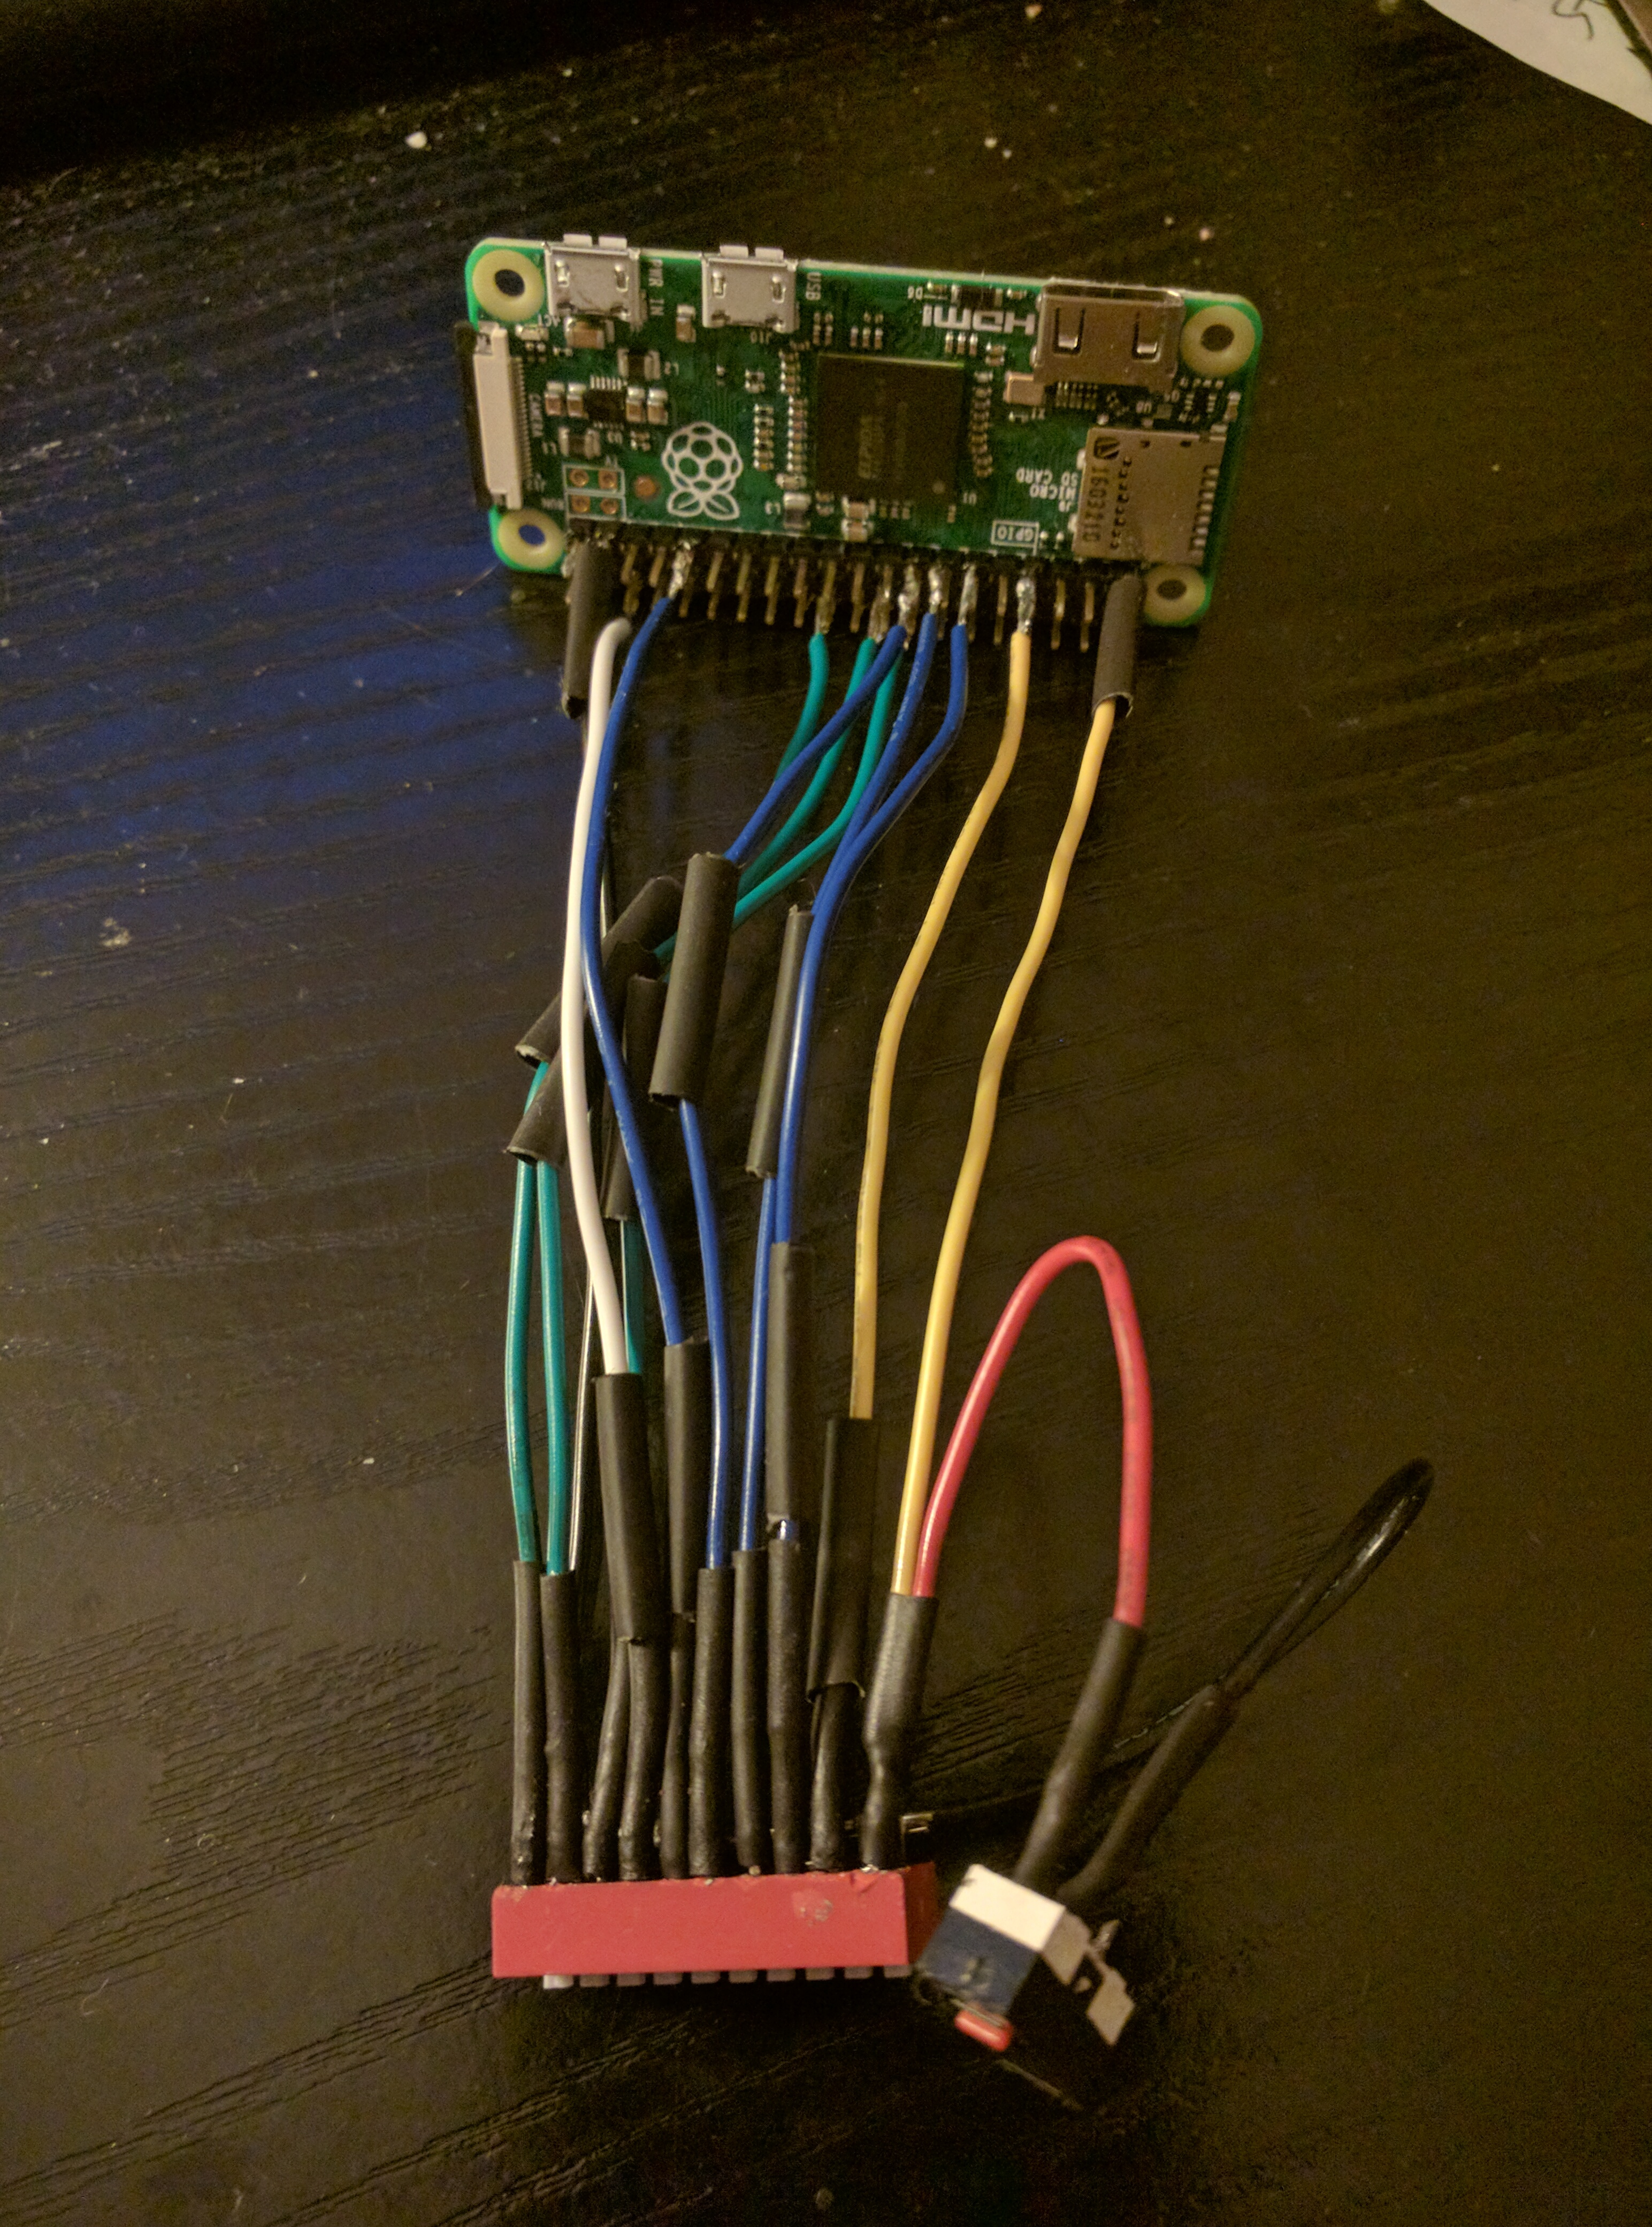
How long to sleep?
Notes:
Sleeping X seconds works. However, over time there is small variance that occurs as slight increments of time are spent capturing the photo and writing to a file. So sleeping every minute would cause the pictures to be taken every minute plus a few milliseconds. Saving the start time at the beginning of the loop, and then calculating how long to sleep at the end of the loop worked better. But there was still some 'drift' on when an image would be captured. There was still some ms in variance, causing the images to be taken roughly at the correct times.

Slide 12
Refined Sleep
# Refinement 1
while(True):
Sleep = time.time()
# capture and save image
sleep(SECONDS_TO_SLEEP - (time.time() - start))
# Refinement 2
while(True):
sleep_time = SECONDS_TO_SLEEP - time.time() % SECONDS_TO_SLEEP
sleep(sleep_time)
# capture and save image
Notes:
To further correct this drift, I calculated how much time to sleep until the next clock mark. Ie, to take a photo every 30 seconds, after taking the picture and saving it to a file, the loop would sleep until 00 or 30 seconds after the minute. The sleep was also moved to the top of the loop.

Slide 13
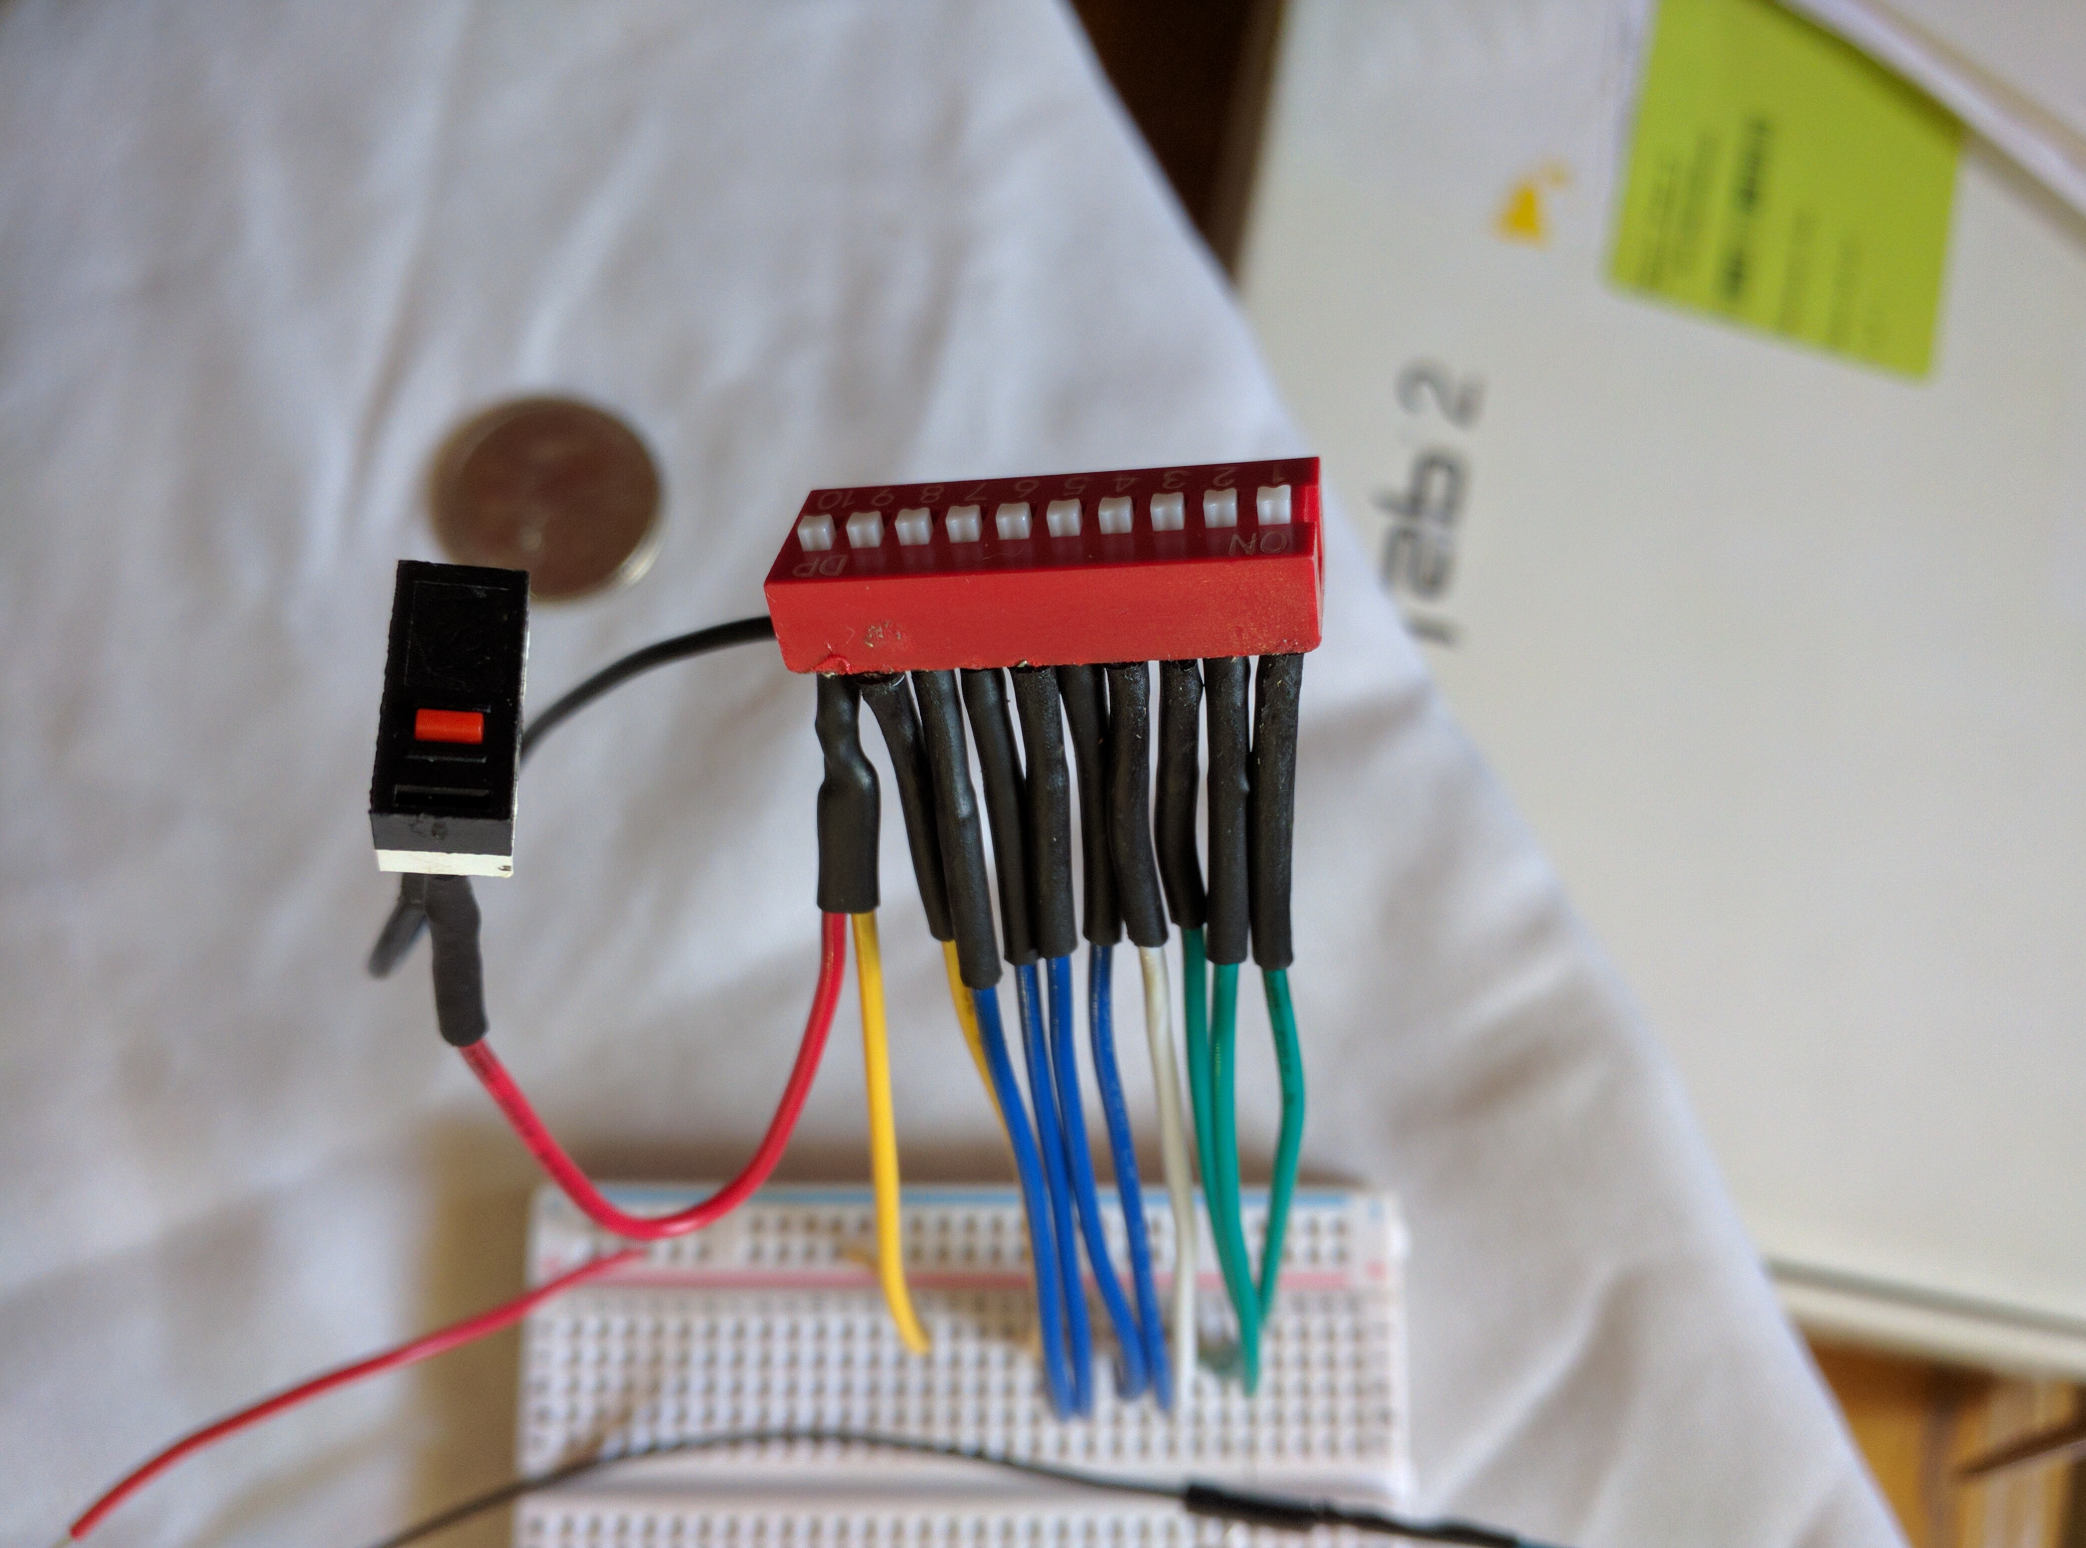
Sleep Duration via GPIO
10 Position Switch
1-3: Minute, Hour, Day
4: Divide or Multiply
5-8: 2,2,3,5 coefficients
9: Use last folder
10: Start when powered on
(There is also a start button)
Notes:
Used 10 GPIOs to configure
The 1-3 were used to indicate the base duration. A minute, an hour, or a day
The 4 was used to indicate to invert the factors from 5-8
5-8 were used as factors. A swich on indicated to multiply by 2, 2, 3 or 5 respectively. This allowed setting the sleep of 1 second by turning all 5-8 on as well as 4 (the inverter), as well as a decent number of settings.
9 was used to reuse the last folder (instead of creating a new one for images)
10 was used to tell the program to start taking pictures as soon as the device was powered on. 9 and 10 often used together, esp as power could sometimes fail over a long period of time.

Slide 14
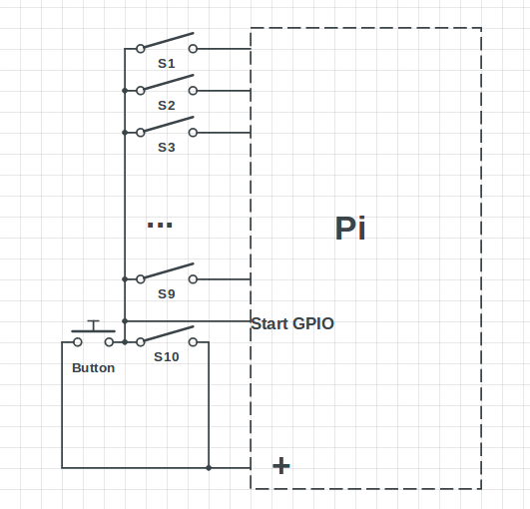
Wiring
GPIO pins are set to pull down resistor
3.3v connected to one side of the switch (and button)
Switch 10 and button both connect to the 'Go' GPIO
Notes:
Switch 10 or the button press start the collection of images by the script. When either one is pushed, or on, that completes the switch between the powered pin and the pin the script listens for. All one side of the switch was soldered together, so when a switch is on it completes the cirtuit for the pull down resistor pin.

Slide 15
A Look at the current Source Code
import time
import os
from picamera import PiCamera
from time import sleep
from pin_config import *
from reuse_folder import imageFolder
c = PiCamera()
c.resolution = (3280,2464)
Notes:
Just the imports. Time, os, picamera, time.
pin_config is the file with all the pin configurations. I pulled it into its own file since I wanted to test that I actually connected all the pins correctly separately. I also pull this file into a script that just prints which switches the Pi detects as on.
reuse_folder is also another script that returns the folder name that will be used to put the images. Its not pretty, and basically tries to find the last folder created to save images if it exists, otherwise just returns the timestamp where the images should go.
PiCamera is initialized, and the resolution is set to the max.

Slide 16
pin_config.py
import RPi.GPIO as GPIO
GPIO.setmode(GPIO.BCM)
GPIO.setup(47, GPIO.OUT)
# BCM pins, connected to the 8 switch DIP switch
# Below are the switches in order 1-8, and which BCM pin
# they connect to
MINUTE = 25
HOUR = 24
DAY = 23
…
# Setup GPIO
GPIO.setup(START_BTN, GPIO.IN, GPIO.PUD_DOWN)
GPIO.setup(MINUTE, GPIO.IN, GPIO.PUD_DOWN)
…
Notes:
pin_config imports the GPIO library, sets some constants for the pin numbers, and sets those pins as pull down resistors. Basically it reads a higher voltage as on (ie, it pulls the voltage down).

Slide 17
reuse_folder.py
import time
import os
def imageFolder(reuse_last_folder):
start_time = time.strftime("%Y-%m-%d_%H-%M-%S")
image_folder = '/home/pi/lapse_project/lapse_{:s}'.format(start_time)
if reuse_last_folder:
print("Attempting to reuse previous image save directory")
lapse_folders = []
for f in os.listdir('/home/pi/lapse_project/'):
if os.path.isdir(f) and 'lapse' in f:
lapse_folders.append(f)
lapse_folders.sort()
if len(lapse_folders) > 0:
image_folder = '/home/pi/lapse_project/' + lapse_folders[-1]
else:
print("Previous image save directory not found, using timestamp")
else:
print("Not attempting to reuse previous image save directory")
print("Image save directory being used is:")
print(image_folder)
return(image_folder)

Slide 18
More lapse.py
if GPIO.input(26) == SWITCH_ON:
print("Detected start switch")
else:
print("Waiting starting button...")
GPIO.wait_for_edge(26,GPIO.RISING)
print("Start detected")
IMAGE_FOLDER = imageFolder(GPIO.input(REUSE_FOLDER))
if not os.path.exists(IMAGE_FOLDER):
print("Image folder not found, creating it.")
os.makedirs(IMAGE_FOLDER)
Notes:
If switch ten, which is the 'start immediately' switch is not on, then this prevents the script from continuing until the start button is pushed. This is to allow the powered on camera to be positioned before starting to collect photos.
Next, it prepares by either reusing the last folder created for images, or makes the new folder.

Slide 19
Reading the switches part 1
# Base interval between pictures,
# One day, one hour, one minute (in seconds)
if GPIO.input(DAY) == SWITCH_ON:
SECONDS_TO_SLEEP = 24 * 60 * 60
elif GPIO.input(HOUR) == SWITCH_ON:
SECONDS_TO_SLEEP = 60 * 60
else: # GPIO.input(MINUTE) == SWITCH_ON:
SECONDS_TO_SLEEP = 60
MODIFIER = 1
# Multipliers from the other switches
if GPIO.input(TWO_1) == SWITCH_ON:
MODIFIER *= 2
if GPIO.input(TWO_2) == SWITCH_ON:
MODIFIER *= 2
if GPIO.input(THREE) == SWITCH_ON:
MODIFIER *= 3
if GPIO.input(FIVE) == SWITCH_ON:
MODIFIER *= 5
Notes:
First it gets the base number of seconds from one of the first three switches.
Next, it multiplies a modifier by every modifier switch that is on (switches 5-8). For example, if both two switches were on, the modifer would be four. This will make more sense on the next slide.

Slide 20
Reading the switches part 2
# Invert the modifier
if GPIO.input(INVERSE) == SWITCH_ON:
MODIFIER = 1.0 / MODIFIER
# Sleep more or less than the base interval
SECONDS_TO_SLEEP *= MODIFIER
print("Sleeping {:.0f} seconds between captures".format(SECONDS_TO_SLEEP))
Notes:
The modifier can be a multiplier, but it can also be inverted. This allows for configuring a wide range of seconds to sleep. For example, the four multiplier could be used to set the sleep at four minutes, or if inverted, 15 seconds.

Slide 21
Main loop
while(True):
sleep_time = SECONDS_TO_SLEEP - time.time() % SECONDS_TO_SLEEP
sleep(sleep_time)
image_file = 'image_{:s}.jpg' \
.format(time.strftime("%Y-%m-%d_%H-%M-%S"))
# blink the ACT led on the board
GPIO.output(47,ACT_ON)
sleep(1)
GPIO.output(47,ACT_OFF)
c.capture( os.path.join(IMAGE_FOLDER, image_file) )
Notes:
The main loop starts by waiting until the next even inteval. If you'll recall from a previous slide, the modulous (%) operator is used on the current time to determine how long until the next picture time (for example, every 15th minute of the hour, or ever 6 hours on the hour).
After sleeping, it makes a timestamped image file name, turns on the onboard LED for a second, and then captures the image and saves it.

Slide 22
What to do with all those images
# Make a file with all the image filenames
# This one gets all the images from the top of the hour
ls -1v lapse_<timestamp>/*00-00* | grep jpg > files-4-3-2017.txt
# Stich the photos together with mencoder
# scale should be the size of the images
# (line breaks added for readability)
time mencoder -nosound -ovc lavc \
-lavcopts vcodec=mpeg4:vbitrate=21600000 \
-o out24fpshourly-4-3-2017.avi \
-mf type=jpeg:fps=24 mf://@files-4-3-2017.txt \
-vf scale=3280:2464
Notes:
Once you have a bunch of images, copy them to a more powerful computer to render them into a video. You can create a file with the image file names (in order), and use mencoder to turn it into a video. Here is an example of what that looks like from the command line (the different options were put on their own lines for readability)

Slide 23
Parts
Pi Zero | $5 | (Actually got mine for $1)
Pi Camera | $15-$30
Adapter Camera Cable for the Zero | $8 | The Pi camera comes with the cable for the standard Pi
DIP Switch | $0.50 | Came in a pack of 8-10 for $5
OTG Adapter | $1-$2 | A micro usb hub could also be used, they run around $8
Power Cable | $9
Total | ~$40-$60 | (not listed wire, heatshrink tubing, solder)
Notes:
Another option is the PI Zero W, which has built in wifi, and costs about $10. Make sure that you change the password from the default if ssh is enabled on it. Its probably cheaper slightly to use the W instead of getting a wifi adapter and an OTG adapter or micro usb hub.

Slide 24
Stuff learned
Tin the header pins before attempting to solder solid core wire to them. Or just skip that, and solder the wire directly into the hold in the board
Python is very picky with its whitespace
VNCServer sometimes causes the Pi to hang after a few days, otherwise no problem running it for weeks without checking in.
Make sure the power goes to the power micro usb, other devices plugged into the power micro usb will do nothing (such as a wifi adapter)

Slide 25
Useful Links
Installing Raspian to you microSD card:
https://www.raspberrypi.org/documentation/installation/installing-images/README.md
Some Raspberry PI History:
https://medium.freecodecamp.com/raspberry-pi-just-turned-5-d4210cc29230
Inspiration:
https://www.raspberrypi.org/learning/timelapse-setup/worksheet/
Minimizing power useage, good for when you want to get better battery life:
https://www.jeffgeerling.com/blogs/jeff-geerling/raspberry-pi-zero-conserve-energy
Setting up your WIFI with the Pi:
https://www.jeffgeerling.com/blogs/jeff-geerling/edimax-ew-7811un-tenda-w311mi-wifi-raspberry-pi
The Pi GPIO pinout:
https://pinout.xyz/#
How to use the GPIO python library:
http://makezine.com/projects/tutorial-raspberry-pi-gpio-pins-and-python/
The Github Repo:
https://github.com/callahat/time_lapse

