Slide 1
Stay in school, kids
Is There a Relationship Between the Rate of Imprisonment and High School Dropout Rate in the United States?

Slide 2

Background
Secondary Education in the United States
The country spends more per student than any other country¹, yet it consistently scores lower in Secondary School assessments, ranking 40th in Math, and 24th in Reading and Comprehension, according to PISA²

Slide 3
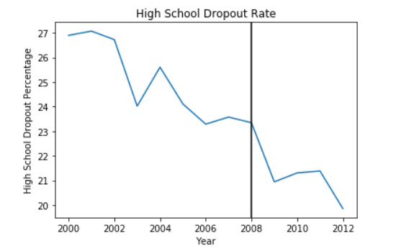
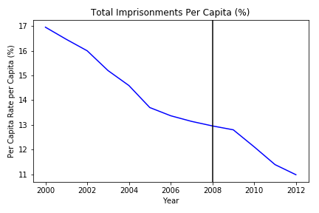
High school dropout rate over the years
360 Independent Surveys Conducted over the span of 12 years.
Observations:
High School Dropout Rate has considerably gone down ~7% within ages 18-24 since 2000.
Biggest change occurred between 2008 to 2009.

Slide 4

Background
Imprisonment and Incarceration in the United States
The country has the highest incarceration rate in the world. According to a 2018 report from the Bureau of Justice Statistics, nearly 2.2 million adults were held in US jails and prisons at the end of 2016.

Slide 5
Imprisonment rate over the years
195 Independent Surveys Conducted over the span of 12 years.
Observations:
Imprisonment Rate has considerably gone down 6% within ages 18-24 since 2000.
Biggest change occurred between 2009 to 2010, with a 0.98 downward slope.

Slide 6
is there a connection?
Is there a strong correlation between US Imprisonment Rate and US High School Dropout Rate in adults between the ages of 18-24?
Will we see a stronger relationship in some races more than others?
Will we see a gender skew in the data?
Does this correlation also reflect in data outside of Education?
Did the 2008 US Financial Crisis strengthen or weaken the relationship?

Slide 7
procedures
Datasets Used:
US Department of Education Data
My Brother’s Keeper TaskForce Initiative (JSON)
Civil Rights Collection Data (JSON)
Data Frame Manipulation:
Pandas (through Jupyter Notebook)
Plotting:
Plotly (through Jupyter Notebook)

Slide 8
findings
Is there a strong correlation between US Imprisonment Rate and US High School Dropout Rate in adults between the ages of 18-24?
Yes.

Slide 9
ToTals
#Insert line graph overlay of both totals
#Insert scatter plot showing line of best fit for totals
#What is R^2?

Slide 10
findings
Will we see a stronger relationship in some races more than others?
Yes.

Slide 11
Side by side by race/ethnicity
#Insert line graph of imprisonment by race (%)
#Insert line graph of dropout race by race(%)

Slide 12
African-American

Slide 13
hispanic

Slide 14
caucasian

Slide 15
‘Other’

