Slide 1

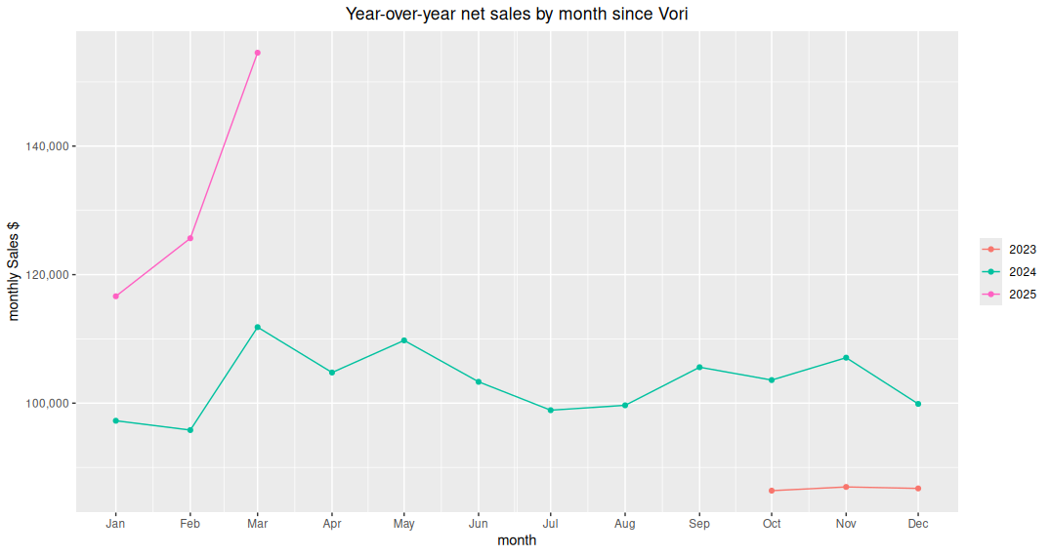
Top line performance consistent 20% y-o-y growth in CY 25

Slide 2
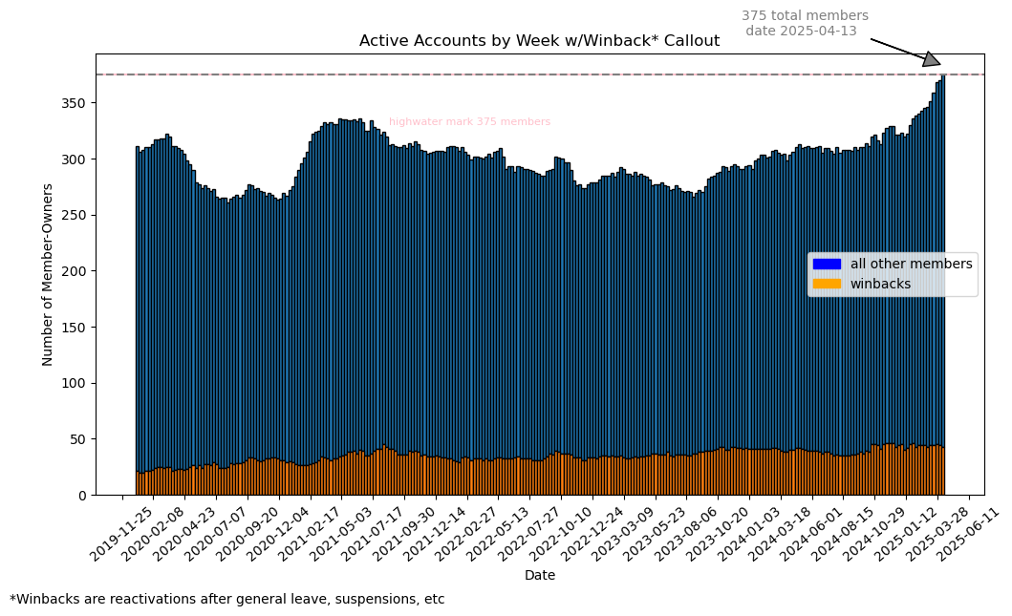
Record growth in member-owners
Parabolic growth since start of year

