Slide 1
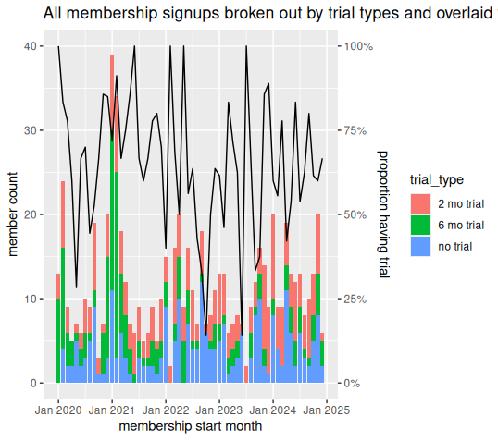
Majority of new member inflow had signed up for a trial
Key Insights
Targeting trial members is likely a worthwhile endeavor as historically 75-50% of new member inflow were on a trial
Note: conversions are not broken out; in the case of conversions, the last and highest trial type is the only record represented

Slide 2
Trial Flow

Slide 3
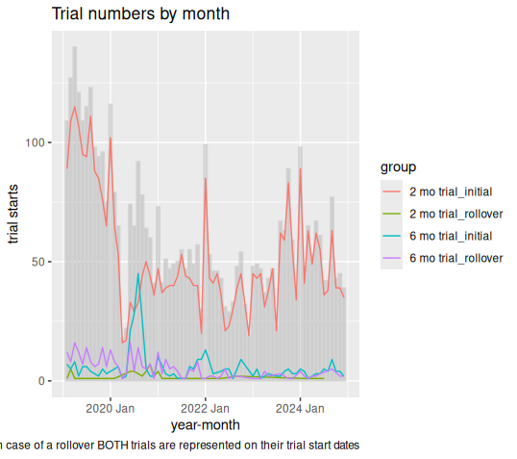

Slide 4
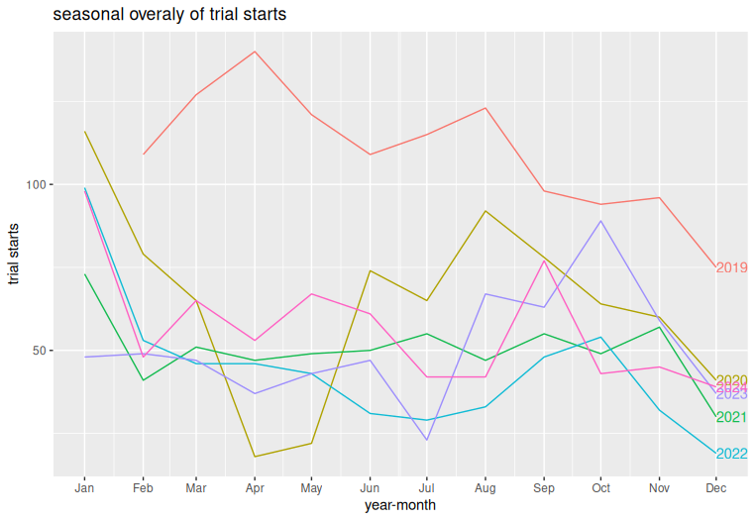

Slide 5
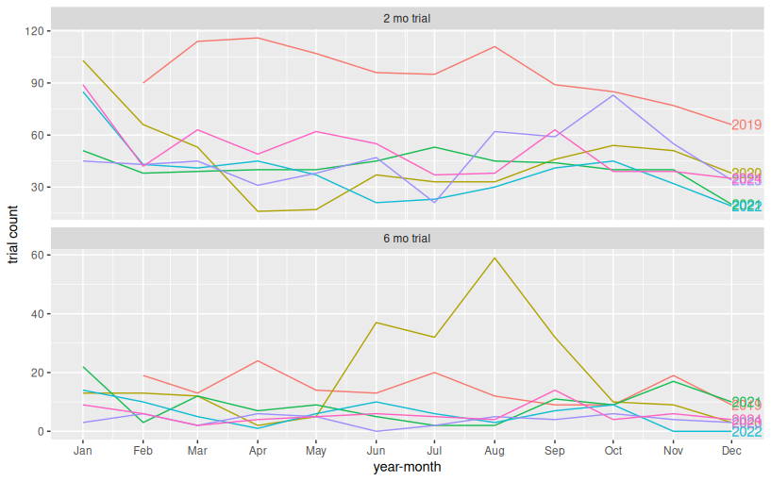
Seasonal overlays of trial flow by trial types (2mo, 6mo) since 2019
Key Insights

Slide 6
APPENDIX

Slide 7
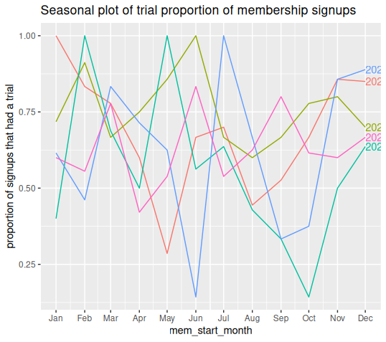
No discernible seasonality in conversion data
Key Insights
No discernible seasonality in previous trial as membership inflows although August, Sept, October bear some inspection, as those months look soft.

