Slide 1


A Walk in the Stellar Halo of the Milky Way with DESI data
Carlos Allende Prieto
Instituto de Astrofisica de Canarias

Slide 2
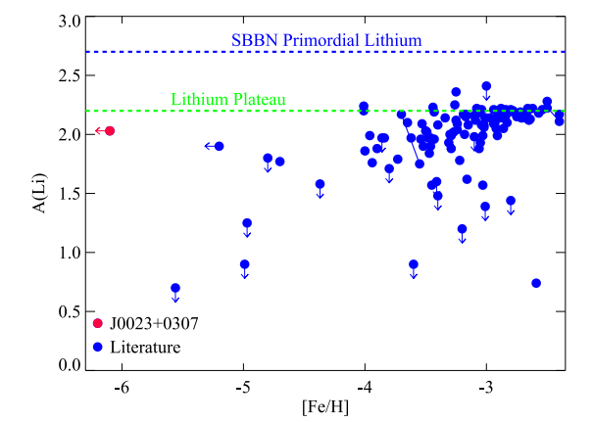
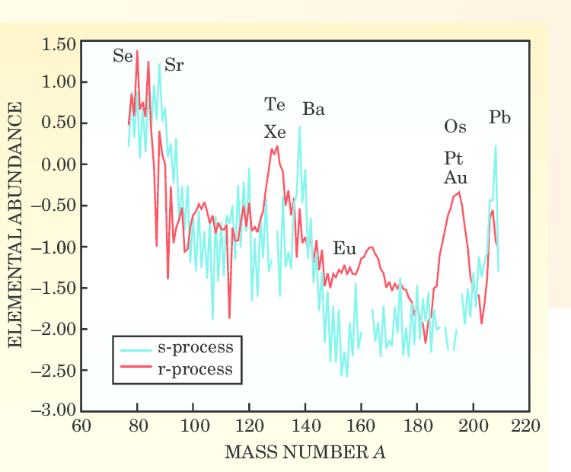
Backyard cosmology
Aguado+ 2019
First stars formed in the bulge and the halo
High-redshift universe vs. local stars
Star formation at zero and near-zero
metallicity
The lithium problem
The origin of neutron-capture elements
Mixing and fall-back in core-collapse
supernovae, etc.
Sneden & Cowan 2003

Slide 3
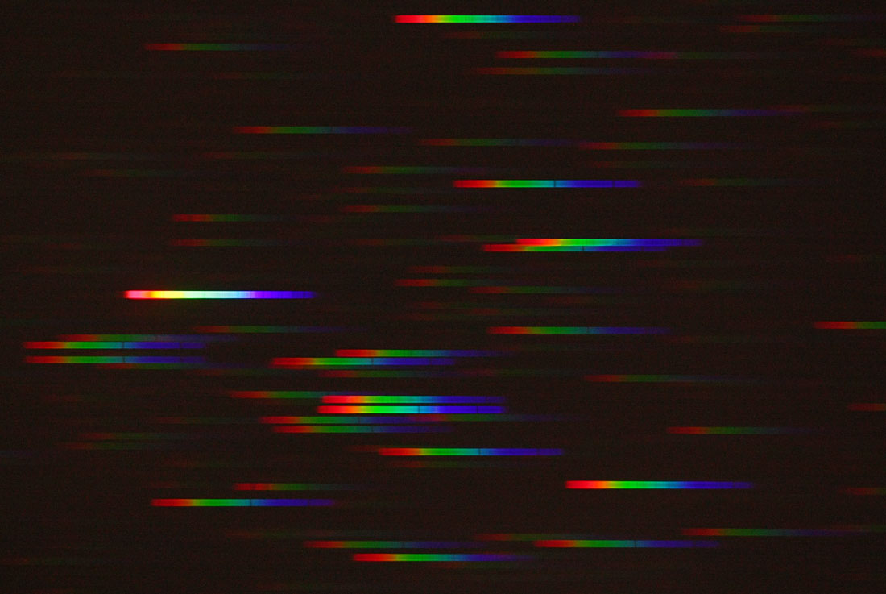
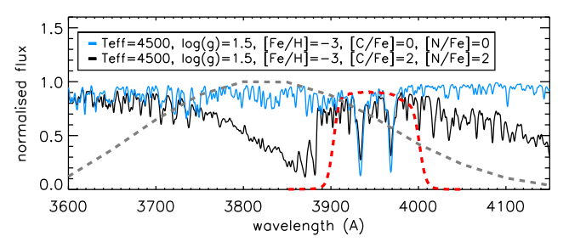
Pop II stars
Early studies (e.g. Chamberlain & Aller 1951)
Beers, Preston & Shectman (1985)
HES
SDSS
Skymapper, Pristine
DESI
Melinda & Dean Ketelsen
Starkenburg et al. 2017

Slide 4
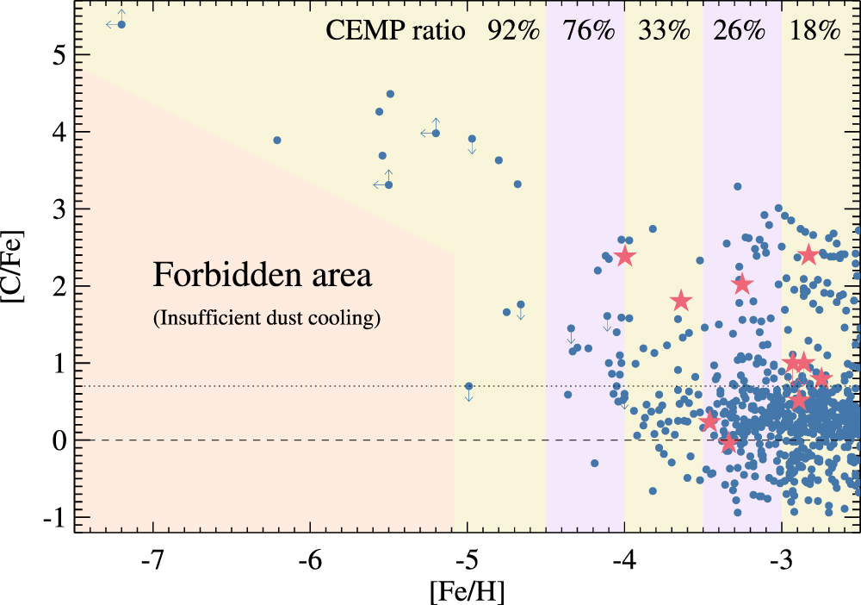
DESI’s yields
About half of the stars at [Fe/H]<-5 have been identified from SDSS optical data
DESI is gathering about 20x as stellar spectra as SDSS
Alllende Prieto+ 2023

Slide 5
DESI stars and the Milky Way Survey
Dark time devoted to the main program (incl. calibration stars)
Bright time includes BGS+MWS (16<g<19)
‘slow’ speed activates the backup program (g<16 mainly)
MWS includes MAIN-BLUE, MAIN-RED, and many other categories
There are various active secondary programs targeting stars

Slide 6
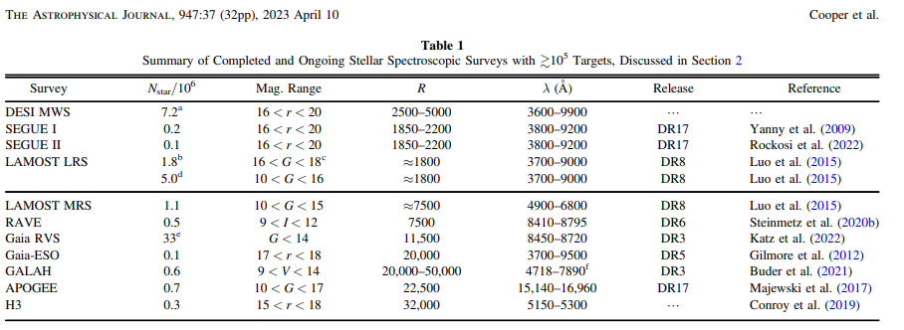
Milky Way Survey in perspective

Slide 7
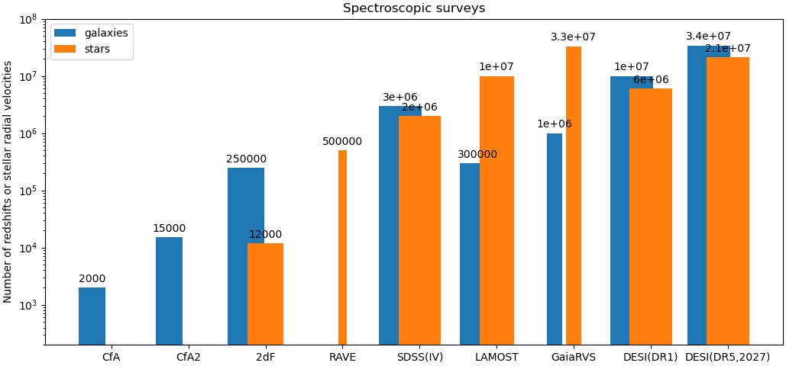
Milky Way Survey in perspective

Slide 8
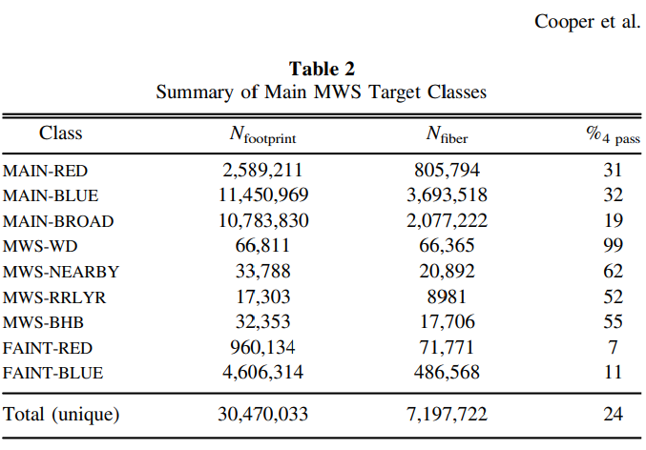
MWS targeting

Slide 9
MWS pipelines
RVS: radial velocity, stellar parameters (Koposov)
SP: stellar parameters (Allende Prieto)
Look for the RVSTAB, SPTAB, FIBERMAP, GAIA extensions
Distances: 3 catalogs available (iron) from Koposov, Songting, Thomas
Data at
/global/cfs/cdirs/desi/science/mws/redux/iron
/global/cfs/cdirs/desi/science/mws/value_added/distances/

Slide 10
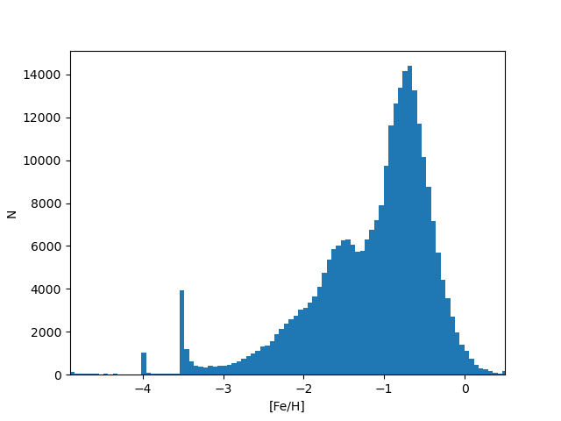
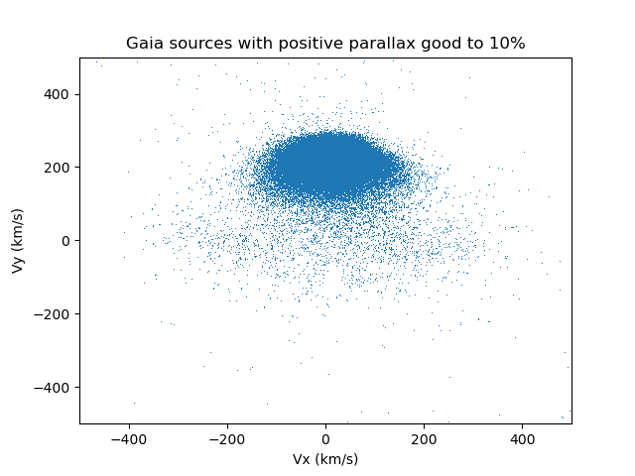
Looking at the data
Github.com/callendeprieto/desi-forum/distributions.py
https://data.desi.lbl.gov/public/edr/vac/edr/mws/fuji/v1.0/mwsall-pix-fuji.fits
https://data.desi.lbl.gov/desi/science/mws/redux/iron/mwsall-pix-iron.fits

Slide 11
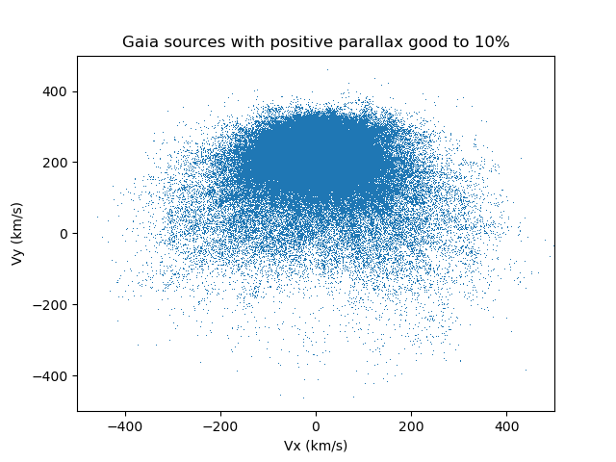
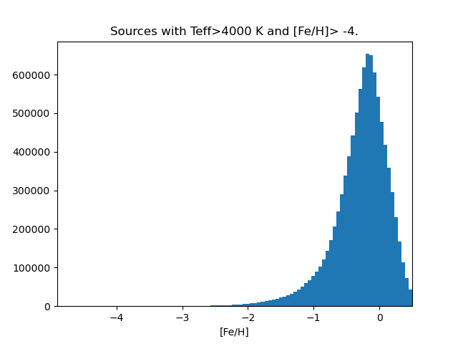
Looking at mock data
Github.com/callendeprieto/desi-forum/aurigaia.py
/global/cfs/cdirs/desi/users/namitha/auridesi/iron/mock_spectroscopic_catalogs

Slide 12
Looking at the data
Github.com/callendeprieto/desi-forum/distributions.py
https://data.desi.lbl.gov/public/edr/vac/edr/mws/fuji/v1.0/mwsall-pix-fuji.fits
https://data.desi.lbl.gov/desi/science/mws/redux/iron/mwsall-pix-iron.fits
thick disk
Gaia Enceladus

Slide 13
Other populations in the halo and beyond ...
Globular clusters: NGC 2419, M53, M6, M13, M92 ...
Dwarf galaxies: UMa II, Sextans, Draco, Sagittarius ...
Streams: Orphan, GD1, Sagittarius ...
BHBs
Red distant giants
RR Lyrae
Extremely metal-poor stars
...

Slide 14
Extremely metal-poor stars
Use the MWS catalogs to select stars with [Fe/H]< -4.
Visually inspect the fittings to weed out hot stars, white dwarfs, spectra with defects, etc.
Usually the most interesting cases, suggesting [Fe/H] < -5, have modest S/N and follow-up observations are necessary
In any case high resolution observations will be necessary to characterize these stars

Slide 15
BAS: quickly fit and look at the spectra
Download and install synple from Github.com/callendeprieto/synple
from synple import bas,plot_spec
bas('coadd-main-bright-26223.fits',target=[39627818182641332])
plot_spec('coadd-main-bright-26223.fits',res=True)

Slide 16
