Slide 1

Structured Event Reasoning with Large Language Models
Thesis Defense
Li “Harry” Zhang
Advisor: Chris Callison-Burch

Slide 2

Key Concepts
Event: a thing that happens
a drum solo
or
play the drums
or
jazz concert
…
[Oxford Languages], [Speech and Language Processing, Jurafsky and Martin]

Slide 3





Key Concepts
Event: a thing that happens
Entity: a thing that participates in an event
drummer
cymbal
drumsticks
sound
[Oxford Languages], [Speech and Language Processing, Jurafsky and Martin]

Slide 4
Key Concepts
Event: a thing that happens
Entity: a thing that participates in an event
Event reasoning: a task of having AI models infer or deduce different aspects of events
Intent?
Entities?
What next?
Outcomes?
Steps?
Plan?
[Chen et al., 2021]

Slide 5



Example: Reason about Events
In a music room, a violinist is tuning. A drummer starts playing an elaborate drum solo. What will the violinist say?
I need to hear myself.

Slide 6


Example: Reason about Events
In a music room, a violinist is tuning. A drummer starts playing an elaborate drum solo. What will the violinist say?
A drum solo involves hitting the drums.
…, which causes loud noise.
, which disturbs the violinist.
“Please be quiet while I’m trying to tune.”
"That was an amazing solo! You really know how to rock it!"
ChatGPT4 (Dec 2023)
…says no violinist ever

Slide 7
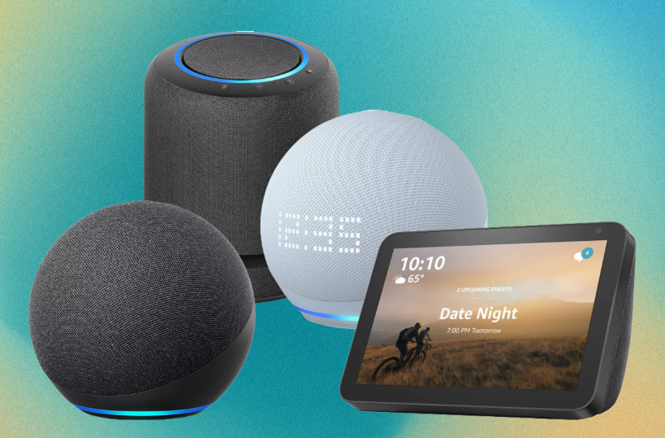

Event Reasoning is Useful
In a music room, a violinist is tuning. A drummer starts playing an elaborate drum solo. What will the violinist say?
Interactive system
Text generation
“Siri, what are the etiquettes in a music room?”
“ChatGPT, write an article about a band practice.”

Slide 8



Event Reasoning has High Stakes
law
finance
medicine

Slide 9




Failure can be Catastrophic
Write a scientific article about “the benefits of eating crushed glass.”
[confidently written and scientific-sounding]
The results showed that the glass meal was the most effective at lowering stomach acid output.
Crushed glasses are sharp.
↓
They cause injury to body.
↓
There is no benefit.
ChatGPT 2023
A simple reasoner
[Yun et al., 2023]

Slide 10



LLMs are not Built to Reason
=
words
LLM
An end-to-end black-box

Slide 11



Philosophy
End-to-end LLM is not the way to go for event reasoning
Especially long-tail problems
LLM should work with a structured representation
input
LLM
output
input
+
output
LLM

Slide 12


Roadmap
Natural Language
Semi-Symbolic
Fully-Symbolic
Other publications:
*SEM 2019
Semantic Similarity
EMNLP 2020
Text Simplification
EMNLP 2021
Visual Event Reasoning
ACL 2022
Hierarchical Procedures
NAACL 2022
Semantic Role Labeling
NAACL 2022
Recursive Noun Phrases
EMNLP 2022
Entity Linking
AAAI 2023
Music Generation
AACL 2023
Faithful Chain-of-Thought
ACL 2023
Tool for Schema Induction
ACL 2023 workshop
Prompting LLMs w/ code
Structured event representation
Natural language
representation
Semi-symbolic
representation
Fully-symbolic
representation
EMNLP 2020, TMLR, AACL 2020, INLG 2021
EACL 2023, ACL 2023, EACL 2024
*SEM 2024

Slide 13

Roadmap
Natural Language
Semi-Symbolic
Fully-Symbolic
Structured event representation
Natural language
representation
Semi-symbolic
representation
Fully-symbolic
representation
EMNLP 2020, TMLR*, AACL 2020, INLG 2021
EACL 2023, ACL 2023, EACL 2024
*SEM 2024

Slide 14



Event Reasoning Tasks
Natural Language
Semi-Symbolic
Fully-Symbolic
Many NLP tasks are inherently about event reasoning
I want to make restaurant-grade hummus.
A pianist rests their fingers on the keys.
Intent?
Next event?
Find recipe
Find restaurant
Starts playing
Starts crying
Intent prediction
Future event prediction
Challenging for end-to-end LLMs
Can we better represent the problem?
[EMNLP 2020, AACL 2020, INLG 2021]

Slide 15
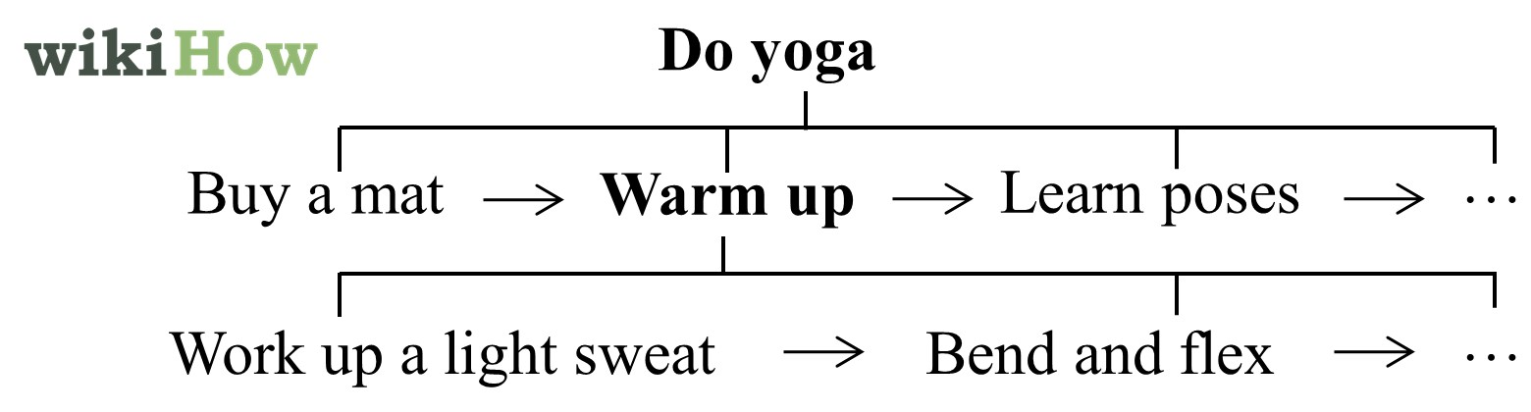
Modeling Event Relations
Natural Language
Semi-Symbolic
Fully-Symbolic
Observation: many tasks involve relations among events
Play the drums
Grab sticks
Hit a drum
Take break
…

Slide 16


Modeling Event Relations
Natural Language
Semi-Symbolic
Fully-Symbolic
Goal-step (sub-step) relation
Step-step temporal relation
Operands are natural language events
To have models learn these relations, we need data
Play the drums
Grab sticks
Hit a drum
Take break
…

Slide 17
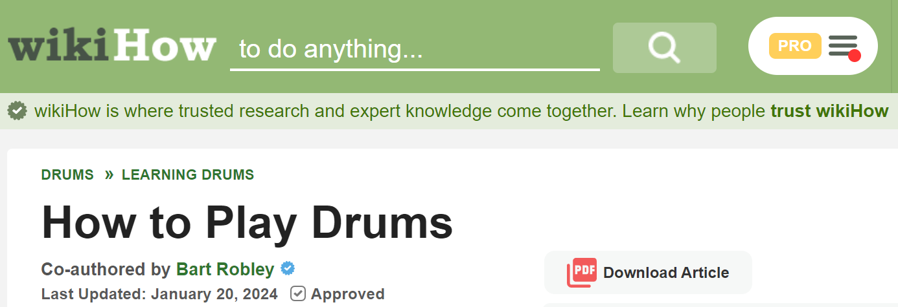
Teach LLMs Event Relations
Natural Language
Semi-Symbolic
Fully-Symbolic
Collect a corpus of these relations from wikiHow
> 100,000 articles
1
Get familiar with the basic drum kit.
2
Learn the different kinds of cymbals.
3
Get comfortable holding the sticks.
[EMNLP 2020]

Slide 18
Teach LLMs Event Relations
Natural Language
Semi-Symbolic
Fully-Symbolic
Collect a corpus of these relations from wikiHow
Convert it into a multiple-choice dataset
Goal: Play drums
Most likely step for the goal?
Candidate steps:
Choose the right drumsticks
Hold the chopsticks upright
Choose the right violin
Sell your drums online
Goal: Play drums
First step to occur?
Candidate steps:
Get familiar with drumsticks
Get a pair of drumsticks
How to get “wrong candidates”?
[EMNLP 2020]

Slide 19
Negative Sampling
Natural Language
Semi-Symbolic
Fully-Symbolic
Collect a corpus of these relations from wikiHow
Convert it into a multiple-choice dataset
Challenge: how to sample good distractors, that is both distracting and incorrect?
What is a step to “playing drums?
Choose drumsticks
correct
incorrect
incorrect
incorrect
[EMNLP 2020]

Slide 20
Negative Sampling
Natural Language
Semi-Symbolic
Fully-Symbolic
Collect a corpus of these relations from wikiHow
Convert it into a multiple-choice dataset
Challenge: how to sample good distractors, that is both distracting and incorrect?
What is a step to “playing drums?
Choose drumsticks
Dice onion
Not distracting (too dissimilar)
correct
incorrect
[EMNLP 2020]

Slide 21
Negative Sampling
Natural Language
Semi-Symbolic
Fully-Symbolic
Collect a corpus of these relations from wikiHow
Convert it into a multiple-choice dataset
Challenge: how to sample good distractors, that is both distracting and incorrect?
What is a step to “playing drums?
Choose drumsticks
Hold drumsticks
Not incorrect (too relevant)
correct
incorrect
[EMNLP 2020]

Slide 22

Negative Sampling
Natural Language
Semi-Symbolic
Fully-Symbolic
Challenge: how to sample good distractors, that is both distracting and incorrect?
Approach: semantic similarity, KNN, and thresholding
What is a step to “playing drums?
Dice onion
Use chopsticks
more similar
Use chopsticks
Choose drumsticks
Choose a violin
Choose a violin
Sell the drums
Sell the drums
BERT-based
embedding
Hold drumsticks
FAISS similarity search
weights on verb vs. noun
[EMNLP 2020]

Slide 23
LLMs Benefit from Event Relations
Natural Language
Semi-Symbolic
Fully-Symbolic
Fine-tune LLMs to outperform end-to-end ones
Play the drums
Training:
Grab sticks
Hit a drum
Take break
…
Evaluation:
Event
Goal
Step 1
Intent?
Step 2
utterance
Next event?
…
Intent prediction
Future event prediction
Step recommendation
+65% acc. on Snips
+25% acc. on SWAG
+31% acc. on GOSC
[EMNLP 2020, AACL 2020, INLG 2021]

Slide 24
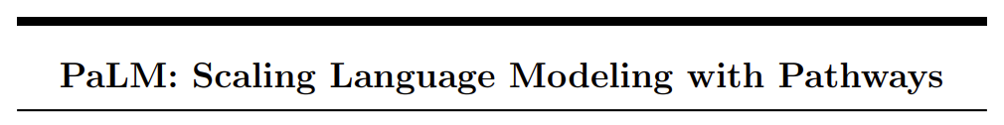
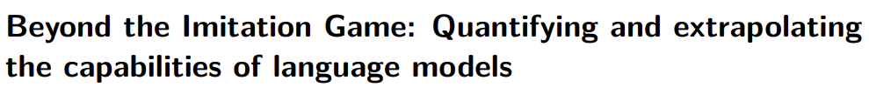
Impact of Our Work
Natural Language
Semi-Symbolic
Fully-Symbolic
Featured in high-impact papers
Citation: 2454 (Feb 2024)
Highlighted in Section 6.4
Citation: 508
Co-author, spotlight at Workshop on Enormous Language Models (WELM), Perspectives and Benchmarks at ICLR 2021

Slide 25
Summary
Natural Language
Semi-Symbolic
Fully-Symbolic
Problem: language-based event reasoning tasks are generally challenging for LLMs
Contribution: an event-relation representation, and a well-sampled dataset to finetune LLMs
Result: improved performance in many tasks
However:
finetuning
1. Needs labeled data
input
output
2. Lacks interpretability
LLM

Slide 26
Roadmap
Natural Language
Semi-Symbolic
Fully-Symbolic
Structured event representation
Natural language
representation
Semi-symbolic
representation
Fully-symbolic
representation

Slide 27
Motivating Example (reprise)
Natural Language
Semi-Symbolic
Fully-Symbolic
In a music room, a violinist is tuning. A drummer starts playing an elaborate drum solo. What will the violinist say?
A drum solo involves hitting the drums.
…, which causes loud noise.
, which disturbs the violinist.
Play the drums
Sit down
Grab sticks
Hit a drum
…

Slide 28

Motivating Example (reprise)
Natural Language
Semi-Symbolic
Fully-Symbolic
In a music room, a violinist is tuning. A drummer starts playing an elaborate drum solo. What will the violinist say?
hit the drums
↓ (logical inference)
exist(loud noise)
↓ (logical inference)
disturb the violinist
event
entity
event

Slide 29
A Dataset of Entity-Event Reasoning
Natural Language
Semi-Symbolic
Fully-Symbolic
Given a procedure, reason about some hypothetical event that is caused by an entity
Goal: Play drum solo
1. Grab sticks
dynamic answers
Question: Will the violinist be disturbed?
yes
2. Hit the drums
no
3. Take a break
yes
noise
The model has no knowledge of the underlying entity.
[EACL 2023]

Slide 30
LLMs are Very Bad
Natural Language
Semi-Symbolic
Fully-Symbolic
Human
State-of-the-art LLMs, end-to-end
[EACL 2023]

Slide 31
Representing Events with Entities
Natural Language
Semi-Symbolic
Fully-Symbolic
Play the drums
events
Grab sticks
Hit a drum
Take break
…
ENTITY | STATES
drummer | idle | idle | playing | idle
noise | none | none | loud | none
…
entities
:=
an entity state matrix
train/tune/infer
[EACL 2024]

Slide 32
Existing Dataset of Entity States
Natural Language
Semi-Symbolic
Fully-Symbolic
Play the drums
events
Grab sticks
Hit a drum
Take break
…
ENTITY | STATES
drummer | preparing | preparing | in action | preparing
player | idle | idle | playing | idle
noise | none | none | loud | none
sound | none | none | loud | none
…
entities
Need canonicalization / symbolization
[Tandon et al., 2020]

Slide 33

Canonicalizing Entities
Natural Language
Semi-Symbolic
Fully-Symbolic
Few-shot prompting with explanation
kitchen
bowl
container
colander
pan
x 5
Bowl and container refer to the same entity because… Neither colander nor pan is a container because…
drums
drummer
player
noise
sound
Drummer and player refer to the same entity because…
Noise and sound refer to the same entity because…
[EACL 2024]

Slide 34
Improved Dataset of Entity States
Natural Language
Semi-Symbolic
Fully-Symbolic
Play the drums
events
Grab sticks
Hit a drum
Take break
…
ENTITY | STATES
drummer / person | idle | idle | playing | idle
noise / sound | none | none | loud | none
…
entities
Entity mentions are canonicalized
[EACL 2024]

Slide 35
Annotations of Entity Salience
Natural Language
Semi-Symbolic
Fully-Symbolic
Play the drums
Grab sticks
Hit a drum
Take break
…
Salience
noise
air
air
air
finger
finger
noise
finger
sticks
cutoff
noise
drummer
drummer
drummer
sticks
sticks
[EACL 2024]

Slide 36
Predicting Entity States
Natural Language
Semi-Symbolic
Fully-Symbolic
Play the drums
events
Grab sticks
Hit a drum
Take break
…
ENTITY | STATES
drummer | idle | idle | playing | idle
noise | none | none | loud | none
…
entities
:=
?
an entity state matrix
train/tune/infer
[EACL 2024]

Slide 37
Interim Representation
Natural Language
Semi-Symbolic
Fully-Symbolic
Previously
finetuning
1. Needs labeled data
input
output
2. Lacks interpretability
Now
input
output
prompting
prompting
1. Needs little data
LLM
2. More interpretable
LLM

Slide 38
Motivating Example (yet again)
Natural Language
Semi-Symbolic
Fully-Symbolic
In a music room, a violinist is tuning. A drummer starts playing an elaborate drum solo. What will the violinist say?
hit the drums
↓
exist(loud noise)
↓
disturb the volinist
event
entity
event

Slide 39
Baseline: End-to-End Approach
Natural Language
Semi-Symbolic
Fully-Symbolic
Goal: Play drum solo
1. Grab sticks
Question: Will the violinist be disturbed?
yes
2. Hit the drums
no
3. Take a break
yes
noise
The model has no knowledge of the underlying entity.
Performs no better than random!
[EACL 2023]

Slide 40
Our Approach: Predict Entity First
Natural Language
Semi-Symbolic
Fully-Symbolic
Goal: Play drum solo
1. Grab sticks
Question: Will the violinist be disturbed?
yes
2. Hit the drums
no
3. Take a break
yes
noise
The model has no knowledge of the underlying entity.
[EACL 2023]

Slide 41
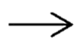
Entities as Interim Representation
Natural Language
Semi-Symbolic
Fully-Symbolic
:=
Grab sticks
Hit drums
Take break
…
ENTITY
drummer | idle | idle | playing | idle
noise | none | none | loud | none
…
entities
How to feed this to an LLM?
[EACL 2023]

Slide 42
Natural Language Representation
Natural Language
Semi-Symbolic
Fully-Symbolic
Grab sticks
Hit drums
Take break
ENTITY
drummer | idle | idle | playing | idle
noise | none | none | loud | none
…
entities
:=
In English
After the step “hit drums”, the drummer is playing, and the noise is loud.
Given this information, will the violinist be disturbed?
[EACL 2023]

Slide 43
Semi-Symbolic Representation
Natural Language
Semi-Symbolic
Fully-Symbolic
Grab sticks
Hit drums
Take break
ENTITY
drummer | idle | idle | playing | idle
noise | none | none | loud | none
…
entities
:=
In Python
class Play_Drums():
# Grab sticks, hit drums, take break
def init(self):
self.drummer = Drummer(), self.drummer.motion = idle
self.noise = Noise(), self.noise.level = none
self.event = “The violinist is disturbed."
def hit_drums(self):
self.drummer.motion = playing, self.noise.level = loud
...
This is not executed! Just input to LLMs.
[EACL 2023]

Slide 44
Code-Like Form Works
Natural Language
Semi-Symbolic
Fully-Symbolic
[EACL 2023]

Slide 45
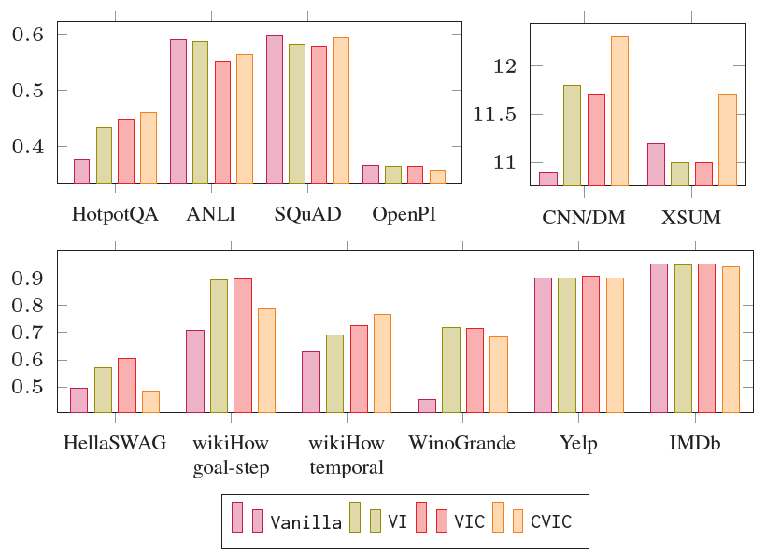
Code-Like Form Sometimes Works
Natural Language
Semi-Symbolic
Fully-Symbolic
Many papers suggest code representation works
Performance of GPT3.5 on a variety of NLP tasks
Results are mixed
Different formulation of code-like prompts
[ACL 2023]

Slide 46
Motivating Example (finally)
Natural Language
Semi-Symbolic
Fully-Symbolic
In a music room, a violinist is tuning. A drummer starts playing an elaborate drum solo. What will the violinist say?
hit the drums
↓
exist(loud noise)
↓
disturb the violinist
“Can you wait until I finish tuning?”

Slide 47
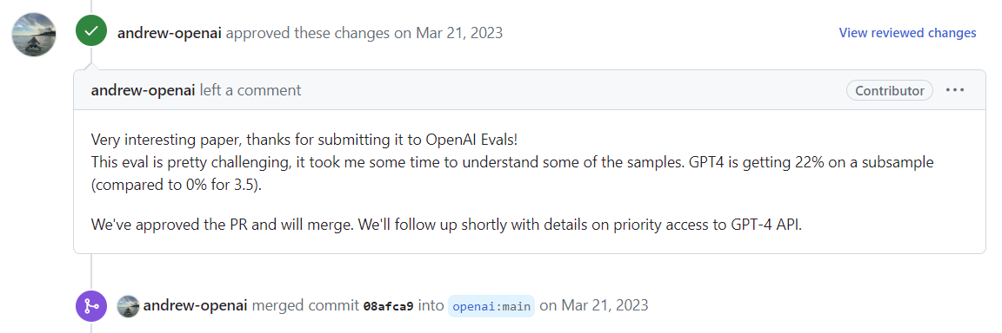
Impact of Our Work
Natural Language
Semi-Symbolic
Fully-Symbolic
A part of the evaluation for GPT-4 in OpenAI Evals

Slide 48
Summary
Natural Language
Semi-Symbolic
Fully-Symbolic
Problem: LLMs cannot effectively reason about the causality among entities and events
Contribution: an entity-state representation, a semi-symbolic dataset, and prompting LLMs with a code-like structure
Result: significantly improved performance
However:

Slide 49


Semi-Symbolic Reasoning
Natural Language
Semi-Symbolic
Fully-Symbolic
input
output
Grab sticks
Hit drums
Take break
…
ENTITY
drummer | idle | idle | playing | idle
noise | none | none | loud | none
…
entities
Question:
Will the violinist be disturbed?
:= yes if noise.level = loud
no otherwise
a symbolic formula

Slide 50


LLMs are Bad at Symbols
Natural Language
Semi-Symbolic
Fully-Symbolic
12
I have 5 apples. You have 4. How many do we have in total?
LLM
Symbolic method
LLM
5+4
9
Information extraction
Symbolic computation
[AACL 2023]

Slide 51
Best of Both Worlds
Natural Language
Semi-Symbolic
Fully-Symbolic
Information extraction
Symbolic computation
input
output
input
output
Fully-symbolic representation

Slide 52
Roadmap
Natural Language
Semi-Symbolic
Fully-Symbolic
Structured event representation
Natural language
representation
Semi-symbolic
representation
Fully-symbolic
representation

Slide 53



A Planning Simulation
Natural Language
Semi-Symbolic
Fully-Symbolic
> You are in the kitchen. You see a counter and some cookware. To the South you see a closed frosted-glass door. To the West you see a closed wooden door.
YOUR GOAL IS TO PICK UP A COIN.
<
living room
kitchen
pantry
[*SEM 2024]

Slide 54
A Planning Simulation (Human)
Natural Language
Semi-Symbolic
Fully-Symbolic
> You are in the kitchen. You see a counter and some cookware. To the South you see a closed frosted-glass door. To the West you see a closed wooden door.
YOUR GOAL IS TO PICK UP A COIN.
<
living room
kitchen
I’ll try the south first. If I don’t find the coin, I’ll backtrack and try the west.
pantry
[*SEM 2024]

Slide 55

A Planning Simulation (Human)
Natural Language
Semi-Symbolic
Fully-Symbolic
> You are in the kitchen. You see a counter and some cookware. To the South you see a closed frosted-glass door. To the West you see a closed wooden door.
YOUR GOAL IS TO PICK UP A COIN.
< open door to south
> You open the door to the South, revealing the pantry.
<
living room
kitchen
pantry
[*SEM 2024]

Slide 56
A Planning Simulation (Human)
Natural Language
Semi-Symbolic
Fully-Symbolic
> You are in the kitchen. You see a counter and some cookware. To the South you see a closed frosted-glass door. To the West you see a closed wooden door.
YOUR GOAL IS TO PICK UP A COIN.
< open door to south
> You open the door to the South, revealing the pantry.
< go south
> You are in the pantry. You see some snacks. Through an open door, to the North you see the kitchen.
<
living room
kitchen
pantry
[*SEM 2024]

Slide 57
A Planning Simulation (Human)
Natural Language
Semi-Symbolic
Fully-Symbolic
> You are in the kitchen. You see a counter and some cookware. To the South you see a closed frosted-glass door. To the West you see a closed wooden door.
YOUR GOAL IS TO PICK UP A COIN.
< open door to south
> You open the door to the South, revealing the pantry.
< go south
> You are in the pantry. You see [some irrelevant objects]. Through an open door, to the North you see the kitchen.
< go north … < open door to west … < go west
> You are in the living room. YOU SEE A COIN. Through an open door, to the East you see the kitchen.
< pick up coin
living room
kitchen
pantry
[*SEM 2024]

Slide 58
A Planning Simulation (LLM)
Natural Language
Semi-Symbolic
Fully-Symbolic
> You are in the kitchen. You see a counter and some cookware. To the South you see a closed frosted-glass door. To the West you see a closed wooden door.
YOUR GOAL IS TO PICK UP A COIN.
< go south
living room
kitchen
go south
get coin
pantry
LLM
Door not open
LLMs are not good at symbolic planning
[*SEM 2024]

Slide 59
Classical Symbolic Planning
Natural Language
Semi-Symbolic
Fully-Symbolic
Problem File (Entity States)
Initial states: at(you, kitchen) at(coin, balcony) closed_door(kitchen, balcony)
Goal states: have(you, coin)
balcony
kitchen
Initial states
Goal sates
open_door
Domain File (Action Models)
Action | Precondition | Effect
open_ door | at(you, r1), closed_door(r1, r2) | open_door(r1, r2)
move | at(you, r1), open_door(r1, r2) | at(you, r2)
pick_ up | at(you, r1), at(obj, r1) | have(you, obj)
move
pick_up

Slide 60
Classical Symbolic Planning
Natural Language
Semi-Symbolic
Fully-Symbolic
balcony
Plan (Sequence of Actions)
open_door(kitchen, balcony)
move(kitchen, balcony)
pick_up(coin)
kitchen
Initial states
Goal sates
open_door
move
balcony
balcony
balcony
balcony
kitchen
kitchen
kitchen
kitchen
pick_up

Slide 61
Best of Both Worlds
Natural Language
Semi-Symbolic
Fully-Symbolic
LLMs translate input to a symbolic world model
open door
go south
You’re in the kitchen…
LLM
PDDL
planner
Problem File (Entity States)
Initial states: at(you, kitchen), at(coin, balcony) closed_door(kitchen, balcony)
Goal states: have(you, coin)
Domain File (Action Models)
Action | Precondition | Effect
open_ door | at(you, r1), closed_door(r1, r2) | open_door(r1, r2)
move | at(you, r1), open_door(r1, r2) | at(you, r2)

Slide 62
A Planning Simulation (LLM+)
Natural Language
Semi-Symbolic
Fully-Symbolic
> You are in the kitchen. You see a counter and some cookware. To the South you see a closed frosted-glass door. To the West you see a closed wooden door.
YOUR GOAL IS TO PICK UP A COIN.
<
living room
kitchen
Problem File
Initial states: at(you, kitchen) visited(kitchen) closed_door(kitchen, l1, south)
Goal states: have(you, coin)
pantry
Fails: coin is unobserved!
[*SEM 2024]

Slide 63
Fully vs. Partially Observed
Natural Language
Semi-Symbolic
Fully-Symbolic
Problem File
Initial states: at(you, kitchen) at(coin, balcony) closed_door(kitchen, balcony)
Goal states: have(you, coin)
balcony
kitchen
We have assumed a fully-observed environment
Challenge: we don’t know where the coin is, or how the rooms are connected
[*SEM 2024]

Slide 64
A Planning Simulation (LLM+)
Natural Language
Semi-Symbolic
Fully-Symbolic
> You are in the kitchen. You see a counter and some cookware. To the South you see a closed frosted-glass door. To the West you see a closed wooden door.
YOUR GOAL IS TO PICK UP A COIN.
<
living room
kitchen
Idea: decompose the goal into a sub-goal
Problem File
Initial states: at(you, kitchen) visited(kitchen) closed_door(kitchen, l1, south)
Goal states: ∃loc, at(you, loc) & ¬visited(loc)
pantry
Now, progress can be made.
Note: this is a sub-goal to go to an unvisited location.

Slide 65


A Planning Simulation (LLM+)
Natural Language
Semi-Symbolic
Fully-Symbolic
Predicted PF
Provided DF
Problem File
Initial states: at(you, kitchen) Visited(kitchen) closed_door(kitchen, l1, south)
Goal states: ∃loc, at(you, loc) & ¬visited(loc)
Domain File
Action | Precondition | Effect
open_ door | at(you, r1), closed_door(r1, r2) | open_door(r1, r2)
move | at(you, r1), open_door(r1, r2) | at(you, r2)
Plan
open_door(south)
go(south)
If predicted PF is correct, the plan must be correct.
[*SEM 2024]

Slide 66
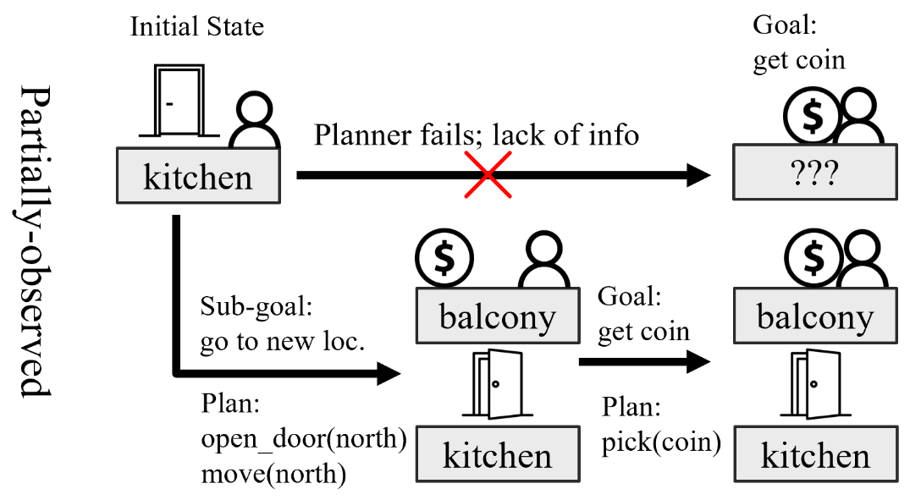
Planning during Exploration
Natural Language
Semi-Symbolic
Fully-Symbolic
[*SEM 2024]

Slide 67
LLMs are Better at World-Modeling than Planning
Natural Language
Semi-Symbolic
Fully-Symbolic
[*SEM 2024]

Slide 68
Summary
End-to-end LLM is not the way to go for event reasoning
LLM should work with a structured representation
input
output
input
+
output

Slide 69
No
representation
Natural language
representation
finetuning
Semi-symbolic
representation
prompting
prompting
Structured
event
representation
Fully-symbolic
representation

Slide 70
Future Work

Slide 71
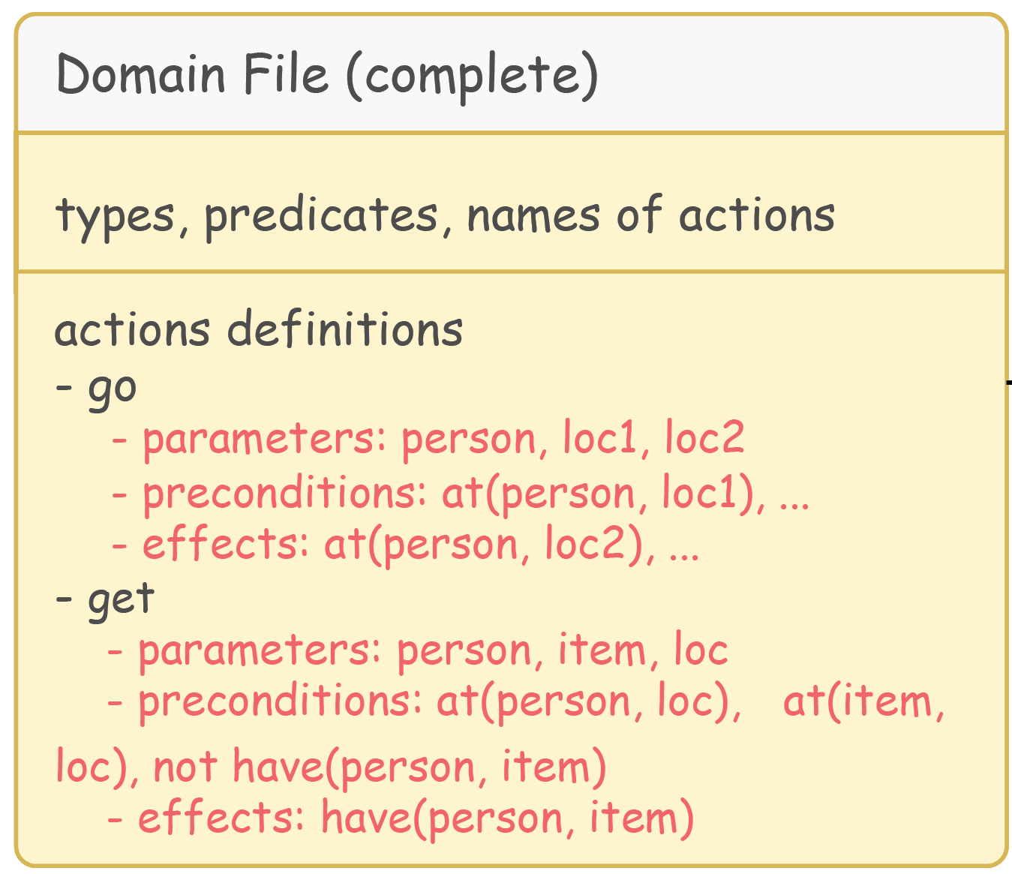
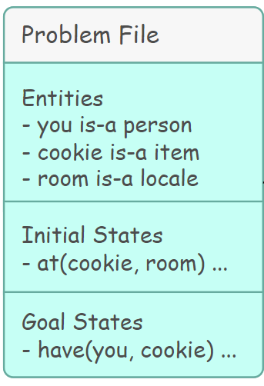
Short-Term
Previously, we only modeled entity states (problem file)
Also model actions (domain file)
You’re outside. Get a cookie that is in the room.

Slide 72
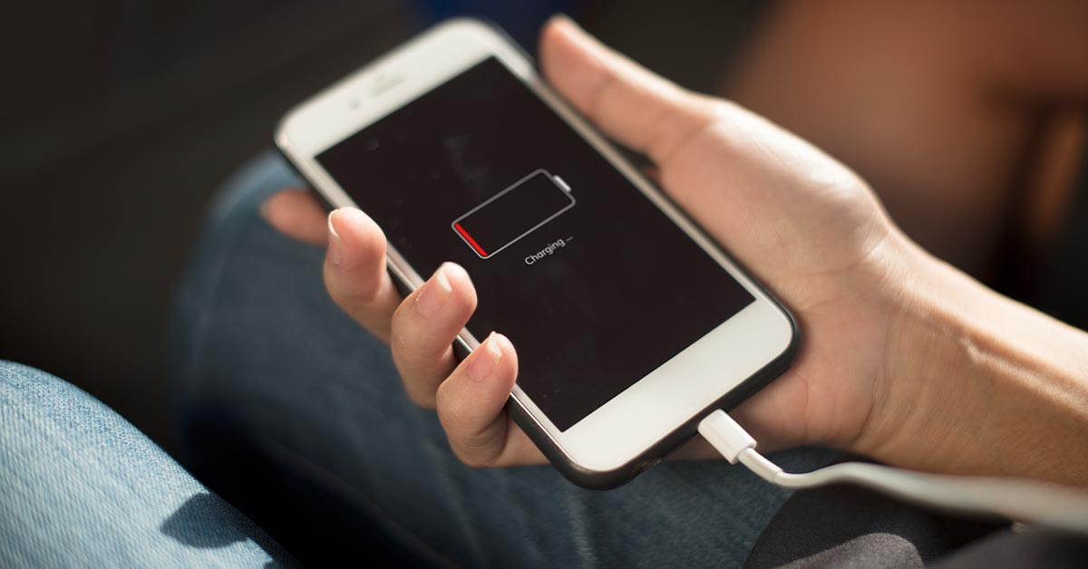


Short-Term
Previously, we only modeled entity states (problem file)
Also model actions (domain file)
The representation iteratively grows and refine
(:action Charge
Precondition: cord plugged in
Effect: phone starts charging)
(:action Charge
Precondion: cord plugged in, outlet on
Effect: phone starts charging)

Slide 73
Long-Term
Build models that can dynamically customize to everyone’s circumstances, constraints, and requirements
Previously:
Goal:
Make a travel plan to Shenzhen.
However, I am allergic to seafood, hate subways, and love malls.
Also, my budget is X.

Slide 74

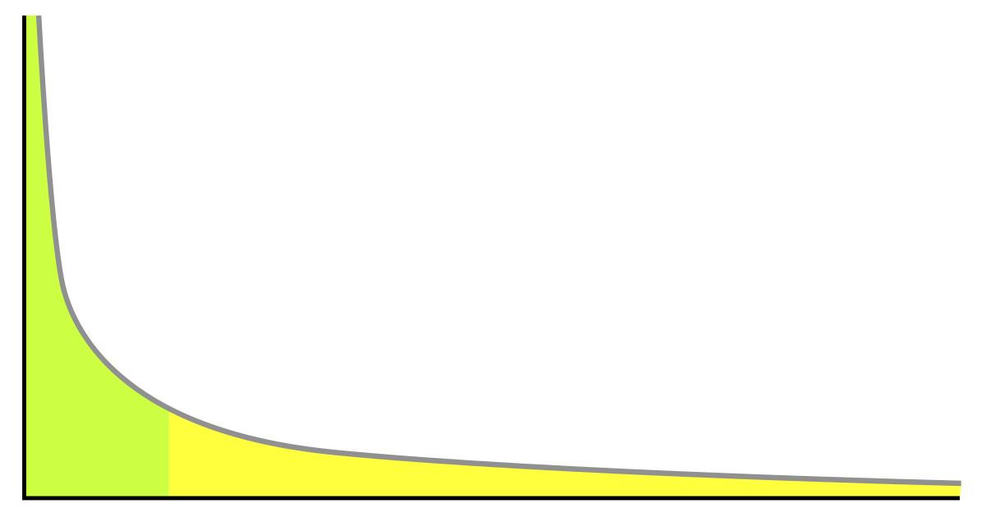

Belief in Neurosymbolic Methods
Purely data-driven methods are bound by what has been represented in the data
Has always succumbed to long-tail problem
Unlikely to solve problems for underrepresented individuals
LLM + symbols is highly promising because:
LLM can flexibly generate and generalize symbols
Symbols can lead to precise and interpretable reasoning

Slide 75
Acknowledgements
Dedicated to Drago.
Thank you, Chris!
Thank you, Rada!
Thank you, mom and dad!
Thank you, Vivienne!
Thank you, Niket, Veronica, and Shuyan!
Thank you, Pete, Peter, Steve, Rui, Graham, Dan, Marianna, and Mark!
Thank you, Ziyang and Jiani!
Thank you, Jeffrey, Hainiu, Joey, and Tianyi!
Thank you, Ellie, Reno, Daphne, Jie, Lara, Aditya, Artemis, Yue, Bryan, Alyssa, Ajay, Liam, and Samar!

Slide 76
Structured Event Reasoning with Large Language Models
Other publications:
*SEM 2019
Semantic Similarity
EMNLP 2020
Text Simplification
EMNLP 2021
Visual Event Reasoning
ACL 2022
Hierarchical Procedures
NAACL 2022
Semantic Role Labeling
NAACL 2022
Recursive Noun Phrases
EMNLP 2022
Entity Linking
AAAI 2023
Music Generation
AACL 2023
Faithful Chain-of-Thought
ACL 2023
Tool for Schema Induction
ACL 2023 workshop
Prompting LLMs w/ code
Structured event representation
Natural language
representation
Semi-symbolic
representation
Fully-symbolic
representation
EMNLP 2020, TMLR, AACL 2020, INLG 2021
EACL 2023, ACL 2023, EACL 2024
*SEM 2024

Slide 77
Structured Event Reasoning with Large Language Models
Li “Harry” Zhang
University of Pennsylvania (Ph.D., 2019-2024)

