Slide 1
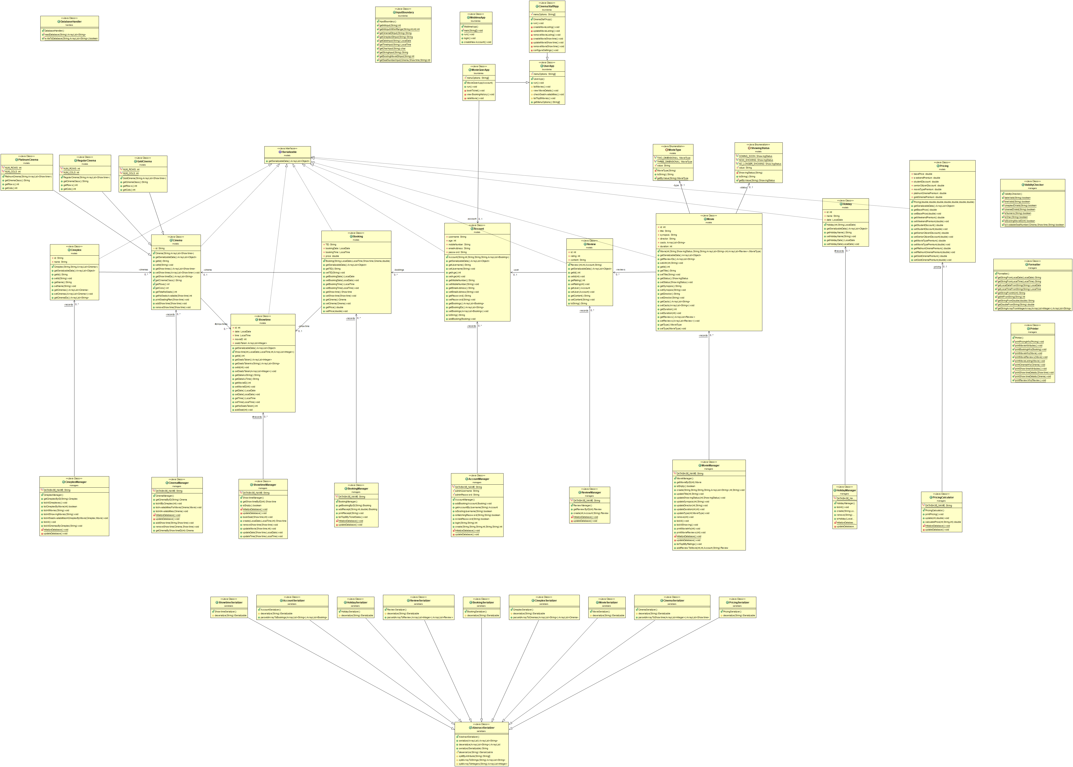
Handlers
boundaries
Class diagram without dependencies
Models
Managers
Serializers

Slide 2
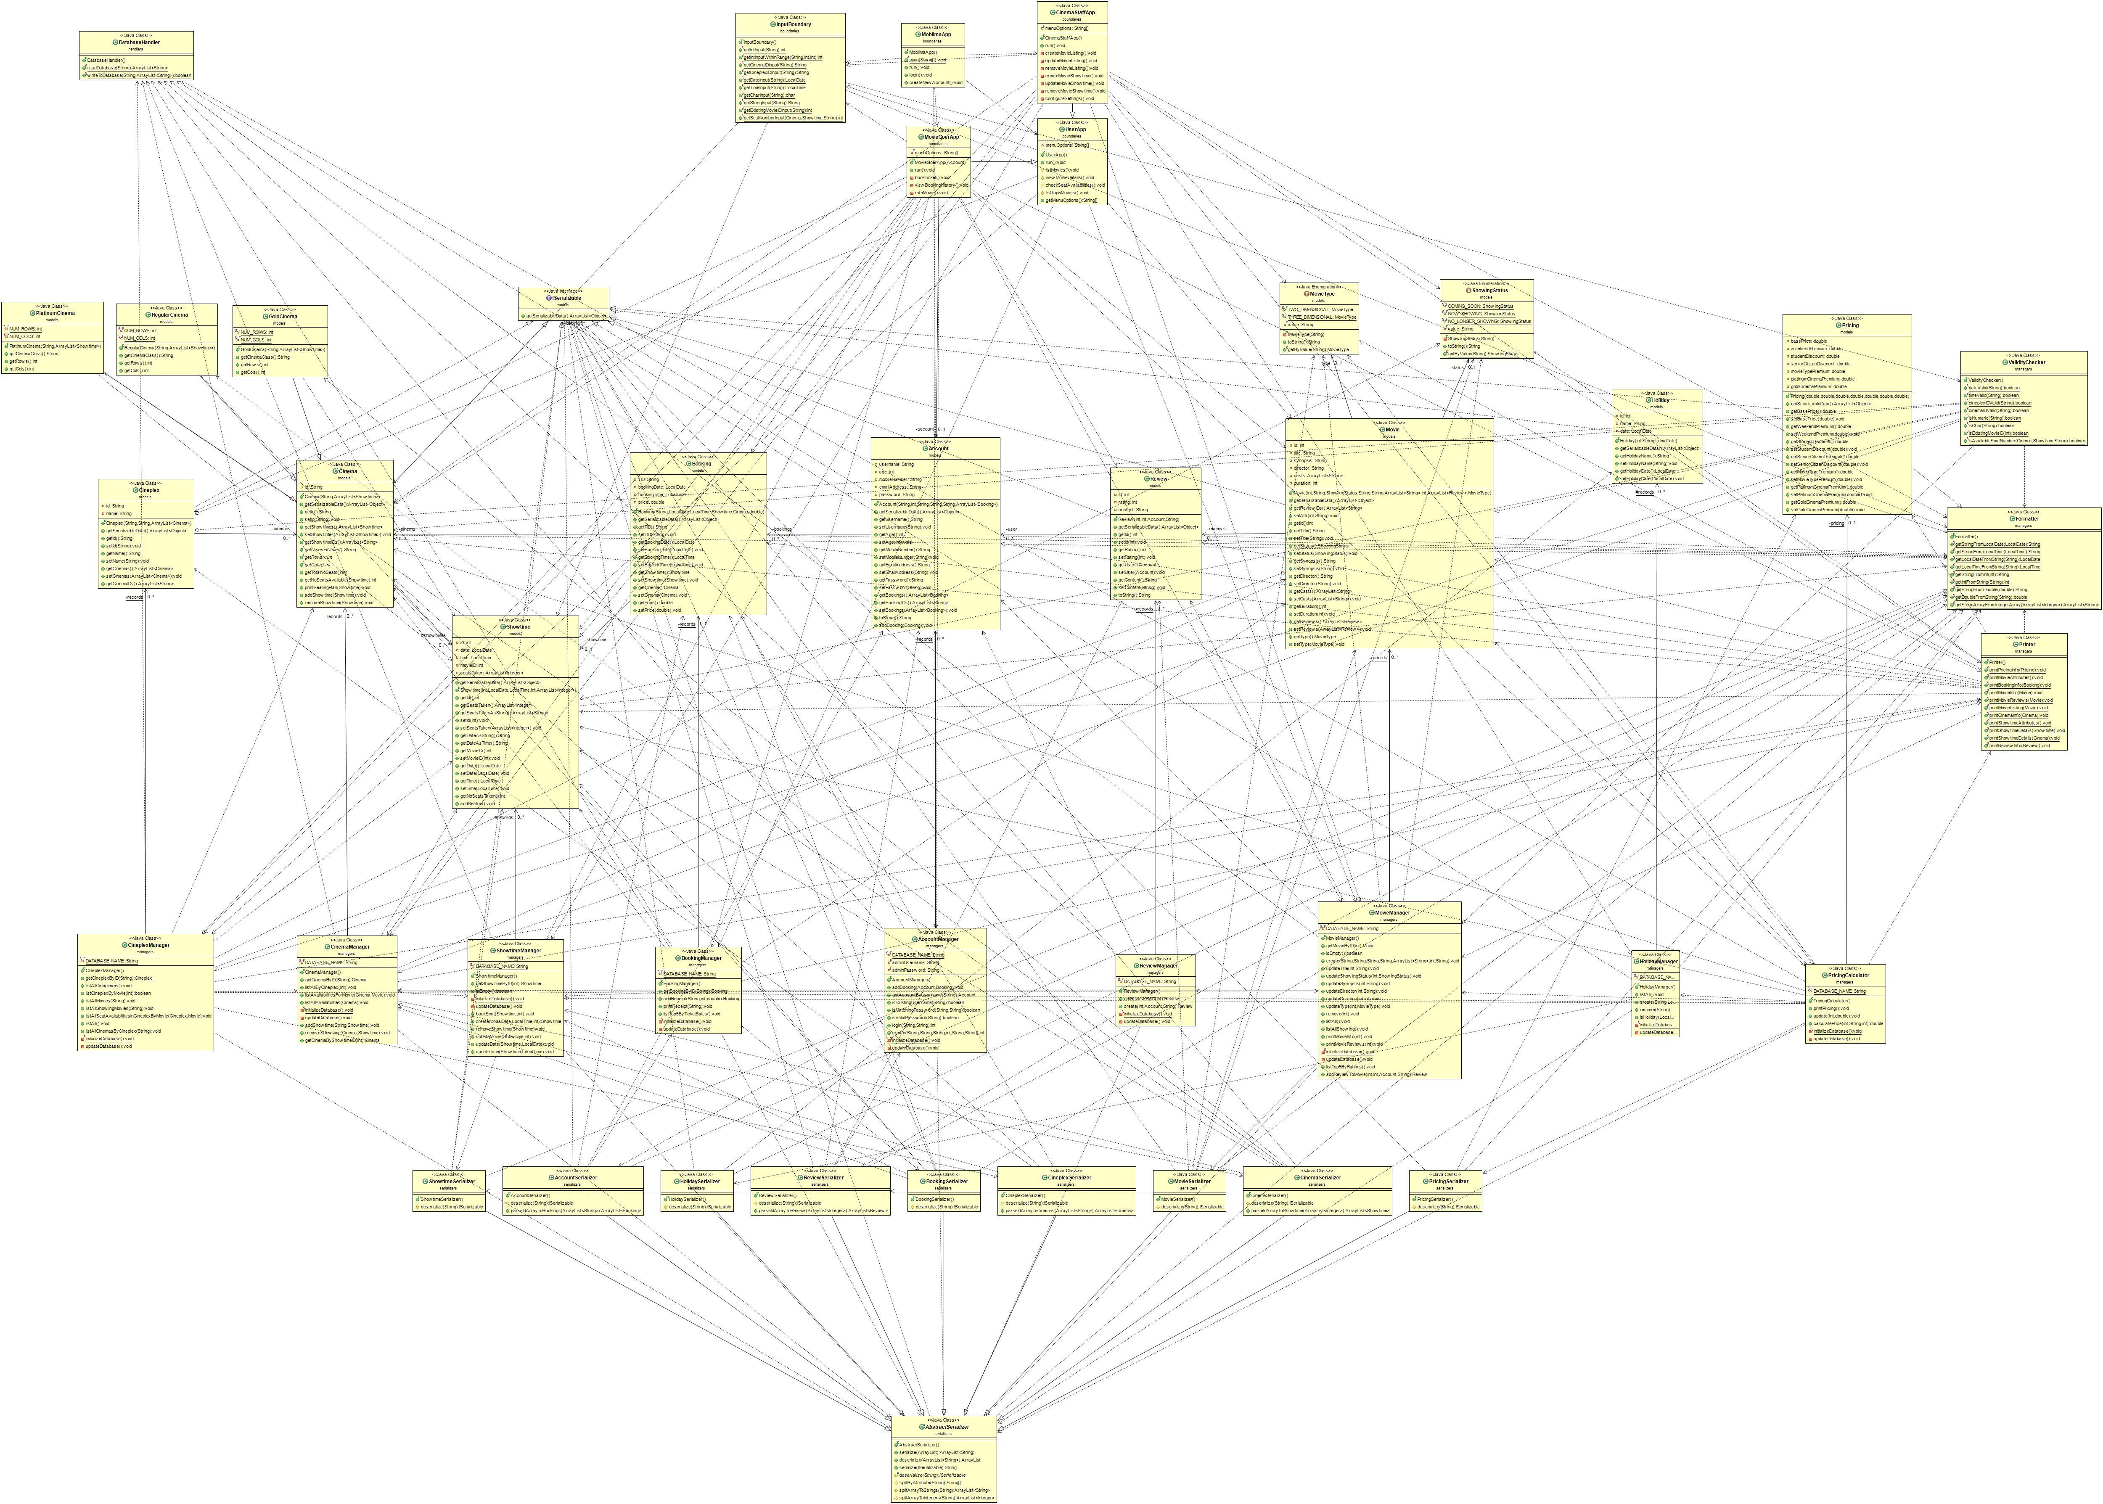
Handlers
boundaries
Class diagram with dependencies
Models
Managers
Serializers

