Slide 1
Groovy with Eclipse IDE
How to install and setup Groovy inside Eclipse
Björn Beskow | bjorn.beskow@callistaenterprise.se | 2014-01-29
Magnus Ekstrand | magnus.ekstrand@callistaenterprise.se
Peter Merikan | peter.merikan@callistaenterprise.se

Slide 2
Table of Contents
Eclipse Installation
Java requirements
Download Eclipse
Install Eclipse
Groovy Installation
Eclipse Plugin Installation

Slide 3
Eclipse Installation Java requirements
Eclipse requires an installed Java runtime. Eclipse 4.2 requires at least Java 5 to run.
Java can be downloaded as a JRE (Java Runtime Environment) or a JDK (Java Development Kit) version.
The Eclipse IDE contains its own Java compiler hence a JRE is sufficient for most tasks with Eclipse.
The JDK version of Java is required if you compile Java source code on the command line and for advanced development scenarios, for example, if you use automatic builds or if you develop Java web applications.
For this tutorial, you should use Java JDK in version 6 or higher.

Slide 4
Eclipse Installation Download Eclipse
The Eclipse IDE consists of several components. The Eclipse.org website provides pre-packaged Eclipse distributions to provide downloads for typical use cases. The Eclipse IDE for Java EE Developers contains everything you need to build Java and Java Enterprise Edition (Java EE) applications.
Download the Eclipse IDE for Java EE Developers package from the following URL. Ensure that you download the correct distribution for your Java version (e.g., 32 bit vs. 64 bit).
http://www.eclipse.org/downloads

Slide 5
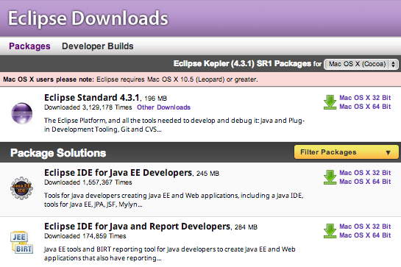
Eclipse Installation Download Eclipse (continued)
The following screenshot shows the Eclipse download website for a Mac OS X system. Press on the link beside the package description (e.g, Mac OS X 64-Bit) to start the download. The download is a .zip file

Slide 6
Eclipse Installation Install Eclipse
After you downloaded the .zip file with the Eclipse distribution, unzip it to a local directory.
Extract Eclipse to a directory without spaces in its path and do not use a mapped network drive (Windows). Eclipse sometimes has problems with such a setup.
After unpacking the zip file, Eclipse is ready to be used; no additional installation procedure is required.
To start Eclipse, double-click on the eclipse.exe (Microsoft Windows) or eclipse (Linux / Mac) file in the directory where you unpacked Eclipse.
The system will prompt you for a workspace. The workspace is the place in which you work. Select an empty directory and click the OK button.

Slide 7
Groovy Installation
Download a binary distribution of Groovy version 2.1.7
Unzip file to a directory on your local file system
Set the GROOVY_HOME environment variable to the directory you unzipped the distribution
Add %GROOVY_HOME%/bin to your PATH environment variable
Set the JAVA_HOME environment variable to point to your JDK
http://dist.codehaus.org/groovy/distributions/groovy-binary-2.1.7.zip

Slide 8
Eclipse Plugin Installation Groovy-Eclipse
Use the Eclipse Update manager to install the Groovy Eclipse plugin.
To install a new functionality, select Help → Install New Software....
Point your Eclipse update manager to the update site appropriate for your Eclipse version
Select the feature “Groovy-Eclipse Feature”
http://groovy.codehaus.org/Eclipse+Plugin

Slide 9
Eclipse Plugin Installation m2e connector for build-helper-maven-plugin
Use the Eclipse Update manager to install the Groovy Eclipse plugin.
To install a new functionality, select Help → Install New Software....
Point your Eclipse update manager to the update site appropriate for your Eclipse version
https://repository.sonatype.org/content/repositories/forge-sites/m2e-extras/0.15.0/N/0.15.0.201206251206/

