Slide 1
Advanced Test Automation with Groovy
Björn Beskow | bjorn.beskow@callistaenterprise.se | 2014-01-29
Magnus Ekstrand | magnus.ekstrand@callistaenterprise.se
Peter Merikan | peter.merikan@callistaenterprise.se

Slide 2

Logistics

Slide 3

Agenda
Test Automation Basics
Groovy Basics
Groovy Unit Testing
Mocking collaborators
Assertions & matchers
Integration Testing
Managing test data
Working with SQL databases
API testing
Working with XML
Working with JSON

Slide 4
Agenda cont.
Acceptance Testing
Specifications
FitNesse and Groovy
Web Acceptance Testing

Slide 5

Exercises & Examples
Exercises
Hands-on implementing or completing typical tasks
Examples
Examination of larger examples for key concepts

Slide 6
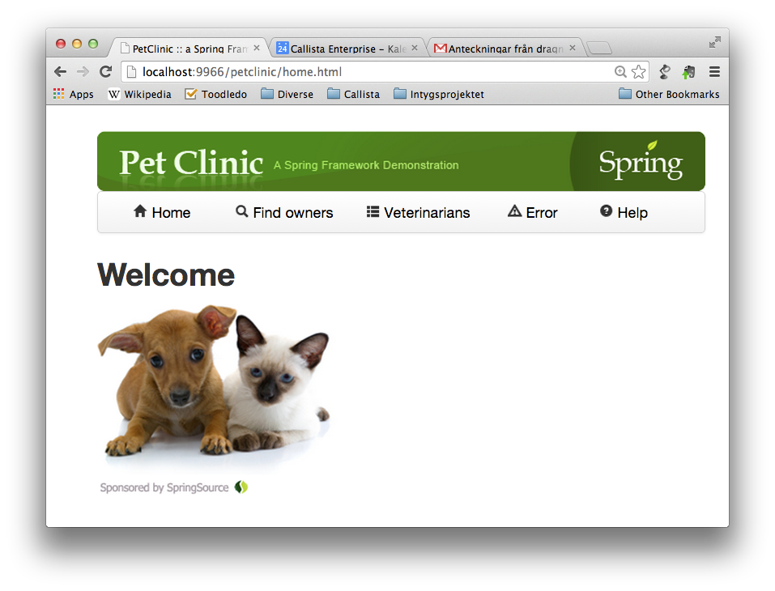
Example app: Spring Pet Clinic

Slide 7
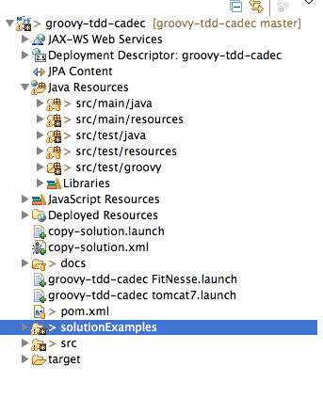
Example app: Project Layout

Slide 8
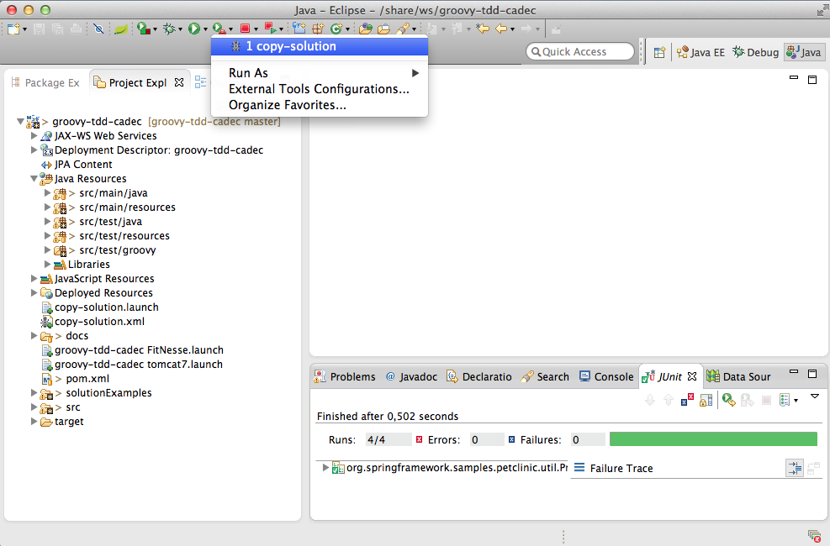
Solution Examples: copy-solution

Slide 9
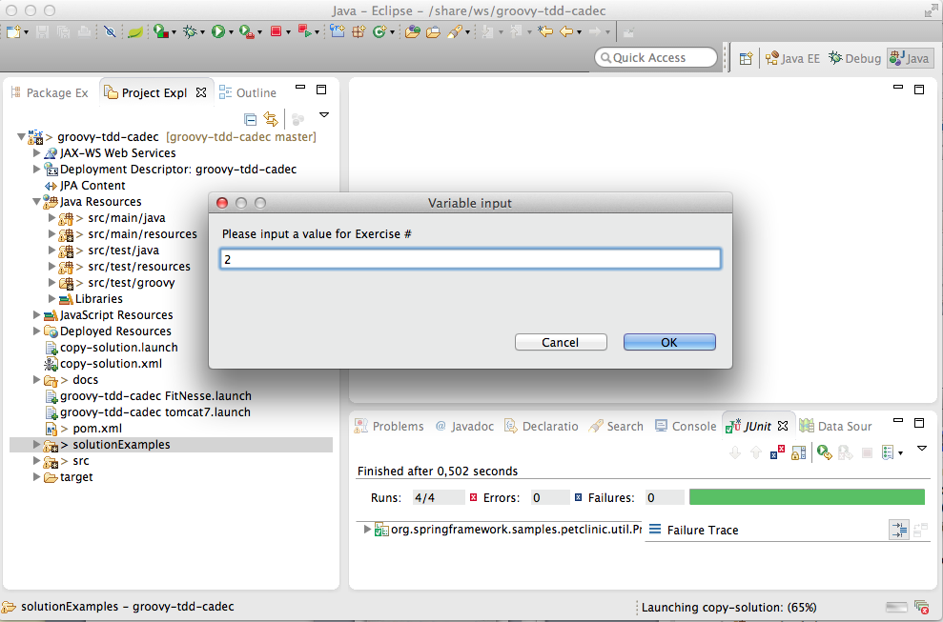

Slide 10

About Tests …
Everybody knows they should, but few actually do
“Why isn’t this tested before”?
Because it has been too expensive, difficult, cumbersome to test
Because we have been too busy

Slide 11
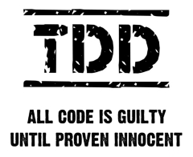
Quality Assurance precedes Quality Assessment
Testing is about Quality Assurance, not just Quality Assessment
Quality Assessment only indirectly affect quality
Testing reveals information
Testing helps focus project activity

Slide 12
Automated Tests must be
easy to write
easy to find
easy to run
easy to maintain
otherwise
they will slow you down
they will get left behind
you’ll go back to manual testing

Slide 13
Critical Success Factors
Repeatability and Consistency
Once the test is complete, it should pass repeatedly, whether it executes by itself or within a test suite.
When a completed test fails, we need to quickly and accurately pinpoint the cause: did the test uncover a bug in the system, or is the test itself faulty?
Readability
The tests are the definitive reference for the system requirements.
Maintainability
Sufficient test coverage usually yields as much (or more) test code than system code, hence we have to be as concerned (or more) with the maintenance costs of test code as compared to system code.

Slide 14
Some aspects of Java may (sometimes) harm productivity and readability
public void testInsertDuplicateVisitShouldThrowException() {
Pet pet = new Pet();
List<Visit> visits = pet.getVisits();
Visit firstVisit = visits.get(0);
Visit copy = null;
try {
copy = (Visit) firstVisit.clone();
} catch (CloneNotSupportedException e) {
// Should never happen
}
copy.setId(0);
visits.add(copy);
this.clinicService.saveVisit(copy);
try {
this.clinicService.savePet(pet);
fail("DataIntegrityViolationException expected");
} catch (DataIntegrityViolationException e) {
// Expected
}
}

Slide 15
Groovy Basics
Groovy is a dynamic Java derivative on and for the JVM
Dynamically typed, with optional static typing
Compiles directly down to bytecode
Inspired by other dynamic OO languages: Smalltalk, Ruby, Python
Totally object-oriented
Goal is to greatly simplify the life for developers, without a steep learning curve

Slide 16
Syntax basics: A Java program
public class HelloWorld {
private String name;
public String getName() {
return name;
}
public void setName(String name) {
this.name = name;
}
public String sayHello() {
return "Hello, " + name + "!";
}
public static void main(String[] args) {
HelloWorld helloWorld = new HelloWorld();
helloWorld.setName("Groovy");
System.out.println(helloWorld.sayHello());
}
}

Slide 17
Corresponding Groovy program
public class HelloWorld {
private String name;
public String getName() {
return name;
}
public void setName(String name) {
this.name = name;
}
public String sayHello() {
return "Hello, " + name + "!";
}
public static void main(String[] args) {
HelloWorld helloWorld = new HelloWorld();
helloWorld.setName("Groovy");
System.out.println(helloWorld.sayHello());
}
}

Slide 18
Syntax: What is the same?
Keywords and statements (but Groovy adds as, in, def and threadsafe)
Try/catch/finally exception handling
Class, interface, field and method definitions
Packaging and imports
Operators, expressions and assignments
Control structures
Annotations, Generics, Enums

Slide 19
Syntax Gotchas: Subtle differences
Array literals: Java: String[] languages = {"java", "groovy", "perl"}; Groovy: String[] languages = ["java", "groovy", "perl"]
Equals and identity: Java: x.equals(y) Java: x == y Groovy: x == y Groovy : x.is(y)

Slide 20
Optional embellishments
Parentheses, return statements and semicolons are optional, as long as the result is unambiguous
public class HelloWorld {
public String sayHello() {
"Hello!"
}
public static void main(String[] args) {
HelloWorld helloWorld = new HelloWorld()
println helloWorld.sayHello()
}
}

Slide 21
Optional import statements
Import statements are optional for the following packages:
groovy.lang.*
groovy.util.*
java.lang.*
java.util.*
java.net.*
java.io.*
java.math.BigDecimal, java.math.BigInteger

Slide 22
Groovy Beans: Properties
In Groovy, a JavaBean have true properties
Syntax support for property access
Corresponding getter and setter method generated automatically
public class HelloWorld {
String name
public String sayHello() {
return "Hello, " + name + "!"
}
public static void main(String[] args) {
HelloWorld helloWorld = new HelloWorld()
// helloWorld.setName("Groovy")
helloWorld.name = "Groovy"
println(helloWorld.sayHello());
}
}

Slide 23
Groovy Beans: Named Parameters
Named parameters for constructors, which sets the corresponding JavaBeans properties
Visit v = new Visit(description:'Broken tail', price: 480.00)
instead of
Visit v = new Visit()
v.description = 'Broken tail'
v.price = 480.00

Slide 24
Groovy Strings (GStrings)
Variable interpolation in strings using ${} notation: int age = 20 println "Age: ${age}"
" enclosed strings performs variable interpolation, ' enclosed strings doesn’t: println 'Literal ${value}'
Can be mixed to avoid escaping quotes: println 'This is a "quotation"'
Use """ for multiline strings: println """This is a string that spans several rows"""

Slide 25
Lists, Maps and Ranges
Lists
List list = [1,2,3,4,5]
println "first element is ${list[0]}"
println "last element is ${list[-1]}”
list << 6 List threeToFive= list[2..4]
Maps
Map frameworks = [groovy:"Grails", ruby:"Rails"]
println """The groovy framework is
${frameworks['groovy']}"""
Ranges
for (i in 1..10) {
println "$i"
}

Slide 26
Exercise 0 – Gettings started
Import the project named 'groovy-tdd-cadec' (File -> Import -> General-> Existing Projects into workspace)
Locate the unit test cadec.GettingStarted in the src/test/groovy folder
Run the unit test by right-clicking it and choose Run As -> JUnit test and see it fail
Fix it

Slide 27
Unit Tests
Black-box or White-box test of a logical unit, which verifies that the logical unit behaves correctly – honors its contract.
A self-contained software module (typically a Class) containing one or more test scenarios which tests a Unit Under Test in isolation.

Slide 28
JUnit Test Example
public class PriceCalculator {
public BigDecimal calculate(DateTime date, Pet pet) {
...
}
}
public class JavaPriceCalculatorTest {
PriceCalculator calculator = new PriceCalculator();
...
@Test
public void testGetBasePriceForThreeYearOldPet() {
assertEquals(new BigDecimal("400.00"),
calculator.calculate(...));
}
}

Slide 29
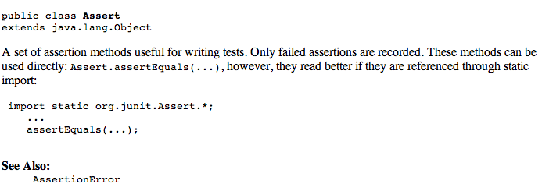
JUnit Assert woes

Slide 30
JUnit Assert woes
Node xml = ...
String expected = "y";
String actual = xml.getText();
assertEquals(expected, actual);
assertTrue("Node is invalid", xml.isValid());

Slide 31
Groovy Power Assert
assert is a Java keyword, but of limited use
In Groovy, the output of a failing assert provides extremely readable output:
def xml = new XmlParser().parseText("<test>x</test>")
assert xml.text() == "y"
Assertion failed: assert xml.text() == "y"
| | |
| x false
test[attributes={}; value=[x]]

Slide 32
Groovy Power Assert
def xml = ...
assert xml.valid, "xml is invalid"
java.lang.AssertionError: xml is invalid.
Expression: xml.valid

Slide 33
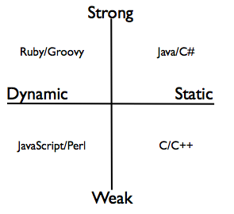
Dynamic vs Static Typing

Slide 34
Dynamic Typing (a.k.a Duck Typing)
”If it walks like a duck and quacks like a duck, it is probably a duck”
public class HelloWorld {
def person
public String sayHello() {
return "Hello, " + person.name + "!"
}
}

Slide 35
Optional static typing
Static types may be optionally provided:
def x = 25
int y = 50
println x + y
Useful for interoperability with Java

Slide 36
AST transformations: @TypeChecked
Brings Static Type Checking into the dynamic world of Groovy
Compiler performs sophisticated type inference

Slide 37
AST transformations: @CompileStatic
One step further:
Statically compile a class or block of code, which makes the bytecode (almost) identical to corresponding compiled Java code, with identical performance
Can prevent dynamic behavior to be inadvertently applied to a block of code (a.k.a. “Monkey Patching”)

Slide 38
Groovy Closures
A reusable / assignable block of code delimitated by curly braces
Can take parameters
Can be assigned to a variable
Can be passed as parameters to methods, or inlined
Can refer to its surrounding context
def greeting = "Hello"
def printGreeting = {toWhom ->
println "${greeting} ${toWhom}" }
printGreeting("Groovy")
["Björn", "Magnus", "Peter"].each {
printGreeting( it )
}

Slide 39
Closures in typical action
Capture prototypical usage, and provide the essential work as a closure:
def sql = new Sql(dataSource)
def list = sql.eachRow("select * from USER") {
println it.name
}
Iterating over collections, performing essential work for each item:
List<Orders> orders = ...
orders.each { order ->
if (order.valid()) order.dispatch()
}

Slide 40
Iterables in Groovy
Every object that implements Iterator provides numerous useful methods that iterates over the items using a closure:
def list = []
5.times {
list << it
}
list.each { println it }
assert list.any { it == 3 }
assert list.every { it >= 0 }
assert list.collect { it * it } == [0, 1, 4, 9, 16]
assert list.findAll { it > 1 && it < 4 } == [2, 3]
assert list.find { it > 1 } == 2
assert (1..9).findAll {it % 2 == 1} == [1,3,5,7,9]

Slide 41
Exercise 1 – Basics
Locate and inspect org.springframework.samples.petclinic.util.PriceCalculator within the src/main/java folder: This is your Unit under Test
Locate the Unit Test org.springframework.samples.petclinic.util.PriceCalculatorTest within the src/test/groovy folder.
Implement test methods to
Verify that pets older than 3 years pay an additional 20%
Verify that from 6th visit, you get 20% rebate
Utilize the Groovy language syntax constructs for creating test data required for the tests
Use dynamic typing when appropriate
Hint: For inspiration, you may look at the already existing Java JUnit test in the src/test/java folder

Slide 42

Test Doubles
Frequently used technique to
Isolate code under test
Make test execute faster
Make execution deterministic
Simulate special conditions

Slide 43
Test Doubles come in different flavors
Dummy objects are passed around but never actually used.
Fake objects actually have working implementations, but usually take some shortcut.
Stubs provide canned answers to calls made during the test.
Spies are stubs that also record some information based on how they were called.
Mocks are pre-programmed with expectations which form a specification of the calls they are expected to receive.

Slide 44
Test Doubles in Java: Mockito et. al.
@Service
public class ClinicServiceImpl implements ClinicService {
@Autowired
public void setVisitRepository(VisitRepository visitRepository) {
this.visitRepository = visitRepository;
}
@Autowired
public void setConfirmationService(ConfirmationService confirmationService) {
this.confirmationService = confirmationService;
}
public void saveVisit(Visit visit) throws DataAccessException {
visitRepository.save(visit);
try {
confirmationService.sendConfirmationMessage(visit);
} catch (Throwable t) {
log.error("Failed to send confirmation message", t);
}
}
...

Slide 45
Test Doubles in Java: Mockito et. al.
public interface VisitRepository {
void save(Visit visit) throws DataAccessException;
...
}
public interface ConfirmationService {
public void sendConfirmationMessage(Visit visit);
}

Slide 46
Test Doubles in Java: Mockito et. al.
@Test
public void testSaveVisitSendsConfirmation() {
VisitRepository visitStub = mock(VisitRepository.class);
ConfirmationService confirmationMock = mock(ConfirmationService.class);
ClinicServiceImpl service = new ClinicServiceImpl();
service.setVisitRepository(visitStub);
service.setConfirmationService(confirmationMock);
service.saveVisit(visit);
verify(confirmationMock).sendConfirmationMessage(visit);
}

Slide 47
Mocks using Groovy Closures
A Closure may be used as an implementation of a Java interface method
A Map of closures may be used as implementations of different methods in an Interface
def visitStub = {} as VisitRepository
def confirmedVisit
def confirmationMock =
[sendConfirmationMessage: { v -> confirmedVisit = v }]
as ConfirmationService
...
assert confirmedVisit == visit

Slide 48
Example – Groovy Interactions
The testSaveVisitSendsConfirmation() test in org.springframework.samples.petclinic.service.ClinicServiceImplTest shows an example of managing interactions in ClinicServiceImpl:
Stub out the VisitRepository
Mock ConfirmationService, and verify that a confirmation is sent on saving a visit

Slide 49
Working with Exceptions
Unexpected exceptions thrown during execution of a test will be caught by the JUnit framework and reported as Errors.
A Test method must declare that it throws any checked exceptions that the Unit under Test may throw. If there are several checked exceptions that may occur, it is perfectly valid for a test method to declare throwing java.lang.Exception.
Expected exceptions (exceptions that the test is expecting the Unit under Test should throw in a certain situation) are expressed using the @Test(expected=ExpectedException.class) attribute
@Test(expected=NastyException.class)
public void doSomethingNastyTest() {
SomeUnit target = new SomeUnit();
target.doSomethingNasty();
}

Slide 50
Working with Exceptions (Contd.)
Or using the following idiom:
SomeUnit unitUnderTest = new SomeUnit();
try {
unitUnderTest.doSomethingNasty();
fail("NastyException expected");
} catch (NastyException expected) {
// Expected
}
assertTrue("Invariant violated", unitUnderTest.isValid());

Slide 51
In Groovy, we can do better:
SomeUnit unitUnderTest = new SomeUnit()
shouldFail(NastyException) {
unitUnderTest.doSomethingNasty()
}
assert unitUnderTest.valid, "Invariant violated"

Slide 52
Simulating exceptional situations
public void saveVisit(Visit visit) throws DataAccessException {
...
visitRepository.save(visit);
...
}
@Test
public void testSaveVisitThrowsDataAccessException() {
def visitStub = {
throw new DataIntegrityViolationException("Oops")
} as VisitRepository
...
}

Slide 53
Example – Simulating Exceptions
The testSaveVisitThrowsDataAccessException() test in org.springframework.samples.petclinic.service.ClinicServiceImplTest shows an example of simulating an exception from a collaborator for ClinicServiceImpl:
Mock the VisitRepository to throw an exception
Verify that a DataAccessException is passed through from the VisitRepository

Slide 54
Injecting collaborators
public class ClinicServiceImpl implements ClinicService {
private static Logger log =
LoggerFactory.getLogger(ClinicServiceImpl.class);
...
public void saveVisit(Visit visit) throws DataAccessException {
calculatePrice(visit);
visitRepository.save(visit);
try {
confirmationService.sendConfirmationMessage(visit);
} catch (Throwable t) {
log.error("Failed to send confirmation message: " +
t.getMessage());
}
}
}

Slide 55
Injecting collaborators: Java
Logger loggerMock = mock(Logger.class);
ClinicServiceImpl service = new ClinicServiceImpl(...);
ReflectionUtils.setStaticAttribute(ClinicServiceImpl.class,
"log", loggerMock);
service.saveVisit(visit);
verify(loggerMock).error(anyString(), any(Throwable.class));

Slide 56

Meta-programming: Meta Object Protocol
Meta-programming: ≈ ”programming the program”
enables extensions to a program at runtime
Groovy gives every class or instance a metaClass property, which allows you to
Add methods and properties
Intercept missing methods
Extremely powerful mechanism, which provides the foundation for DSLs and Builders

Slide 57
The MetaClass
Obtain a Class’ MetaClass with: def metaClass = String.metaClass
Obtain an object’s MetaClass with:
String s = "Hello"
def metaClass = s.metaClass
The MetaClass provides information about the Class or object:
String.metaClass.methods.each {println it.name}
String.metaClass.properties.each {println it.name}

Slide 58
ExpandoMetaClass
The MetaClass is actually an extensible Metaclass (a.k.a. ExpandoMetaClass), which allows us to dynamically add methods, properties and fields:
class Dog {
private String secret = "...";
}
Dog.metaClass.bark = { "Woof!" }
println new Dog().bark()
def dog = new Dog()
dog.metaClass.getBreed = { "Poodle" }
println dog.breed
Dog.metaClass.setAttribute(dog, "secret", "42")

Slide 59
ExpandoMetaClass
Add static methods using the static prefix:
Dog.metaClass.static.create = { new Dog() }
Add constructors using the constructor prefix:
Dog.metaClass.constructor = {n -> new Dog(name:n)}

Slide 60
Exercise 2 – Test Doubles
Implement the testSaveVisitLogsConfirmationError() test method in org.springframework.samples.petclinic.service.ClinicServiceImplTest to verify that an exception thrown from the ConfirmationService collaborator is properly handled by logging the exception
Create a Mock object for the logger, using a closure
Inject the mock logger into ClinicServiceImpl using metaClass.setAttribute

Slide 61
Meta Hooks
The MetaClass also allows intercepting and overriding key dynamic method dispatch hooks:
invokeMethod()
set/getProperty()
methodMissing()
propertyMissing()

Slide 62
Overriding methodMissing
Overriding the methodMissing method allows for dynamic creation of capabilities and behavior
Typical idiom when overriding the methodMissing: Intercept, cache a dynamically created method, then invoke it:
class Dog {}
Dog.metaClass.methodMissing = {String methodName, args ->
Dog.metaClass."$methodName" = {Object[] varargs->
"cached $methodName"
}
"dynamic $methodName"
}
assert new Dog().howl() == "dynamic howl"
assert new Dog().howl() == "cached howl"
assert new Dog().crawl() == "dynamic crawl"

Slide 63
Builders
The need to produce and work with hierarchical (tree) structures are everywhere
XML documents
Test data
...
The Builder pattern can be used to construct such hierarchical data structures
Trivial and elegant to implement in Groovy using methodMissing(), closures and chained method calls

Slide 64
XML Builder example
def builder = new groovy.xml.MarkupBuilder()
builder.employees {
employee(name:'Björn') {
address(street:'Vallhamnsgatan', city:'Västra Frölunda')
phone('0733-519173')
}
}
produces
<employees>
<employee name='Björn'>
<address street='Vallhamnsgatan' city='Västra Frölunda' />
<phone>0733-519173</phone>
</employee>
</employees>

Slide 65
ObjectGraphBuilder example
def builder = new ObjectGraphBuilder()
builder.classNameResolver =
"org.springframework.samples.petclinic.model"
visit = builder.visit(
date: DateTime.now(),
description: "visit description",
{ pet(name: "a pet",
{ petType(name: "type") },
{ owner(firstName: "firstName",
lastName: "lastName",
address: "address",
city: "city",
email: "name@gmail.com") } )
})

Slide 66
Parsing and navigating XML
Given the following XML:
def xml = """<employees>
<employee name='Björn'>
<phone>0733-519173</phone>
</employee>
<employee name='Johan'>
<phone>0733-519175</phone>
</employee>
</employees>"""
Parsing the XML and navigating the object graph using GPath is simple:
def root = new XmlSlurper().parseText(xml)
println root.employee[1].phone.text()
println root.employee.findAll{emp -> emp['@name'] =='Björn' }

Slide 67
Example – Verifying XML content
Consider org.springframework.samples.petclinic.service.ConfirmationServiceImpl and its dependency on the org.springframework.samples.petclinic.service.MessageSender collaborator
The org.springframework.samples.petclinic.service.ConfirmationServiceImplTest shows an example of verifying XML content:
verifies that sendConfirmationMessage(Visit visit) calls its MessageSender collaborator with the correct recipient and a properly formatted XML message representing the visit

Slide 68
Typical Unit test scenario – The Three A’s
Arrange - Instantiate Unit under Test and set up test data
Act - Execute one or more methods on the Unit Under Test
Assert - Verify the results
@Test public void testWithdraw() { AccountImpl account = new AccountImpl("1234", 2000); // Arrange account.withdraw(300); // Act assertEquals(1700, account.balance()); // Assert }

Slide 69

Spock
A Groovy-based testing framework
Fully compatible with JUnit
Utilizes the power of Groovy to
Reduce the lines of test code
Make tests more readable
Turn tests into specifications

Slide 70
Spock: Basics
import spock.lang.*
class MyFirstSpecification extends Specification {
// fields
// fixture methods
// feature methods
// helper methods
}

Slide 71
Spock: Fields
class MyFirstSpecification extends Specification {
def obj = new ClassUnderSpecification()
def coll = new Collaborator()
@Shared res = new VeryExpensiveResource()
static final PI = 3.141592654
// fixture methods
// feature methods
// helper methods
}

Slide 72

Spock: Fixture Methods
import spock.lang.*
class MyFirstSpecification extends Specification {
// fields
def setup() {} //run before every test
def cleanup() {} //run after every test
def setupSpec() {} //run before first test
def cleanupSpec() {} //run after last test
// feature methods
// helper methods
}

Slide 73
Spock: Feature Methods
class MyFirstSpecification extends Specification {
def "specification for a feature"() {
// blocks go here
}
}
A feature method consists of four phases:
Optional: Set up the feature's fixture
Provide a stimulus to the system under specification
Describe the response expected from the system
Optional: Clean up the feature's fixture

Slide 74
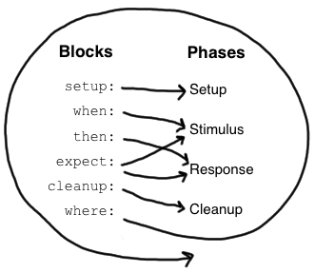
Spock: Feature Blocks
A block is a section of a feature method, prefixed by a label that describe the purpose of the section:
setup:
when:
then:
expect:
cleanup:
where:

Slide 75
Spock: Setup
class StackSpecification extends Specification {
def "specification for a stack"() {
setup:
def stack = new Stack()
def elem = "push me”
...
}
}

Slide 76
Spock: Given alias
class StackSpecification extends Specification {
def "specification for a stack"() {
given:
def stack = new Stack()
def elem = "push me”
...
}
}

Slide 77
Spock: Implicit setup
class StackSpecification extends Specification {
def "specification for a stack"() {
def stack = new Stack()
def elem = "push me”
...
}
}

Slide 78
Spock: Additional documentation
class StackSpecification extends Specification {
def "specification for a stack"() {
given: "an empty stack"
def stack = new Stack()
and: "an element that can be pushed"
def elem = "push me"
...
}
}

Slide 79
Spock: Triggers and Conditions
class StackSpecification extends Specification {
def "push element to empty stack"() {
given: "an empty stack"
...
when: "an element is pushed" // stimulus
stack.push(elem)
then: "stack is not empty" // response
!stack.empty
and: "pushed element is on top"
stack.peek() == elem
}
}

Slide 80
Spock: Exception Conditions
class StackSpecification extends Specification {
def "popping an empty stack"() {
given:
...
when: "popping an empty stack"
stack.pop()
then: "an exception is thrown"
EmptyStackException e = thrown()
e.cause == null
}
}

Slide 81
Spock: expect
class StackSpecification extends Specification {
def "pop returns last pushed element"() {
given: "a stack with one element"
def stack = new Stack()
def elem = "push me"
stack.push(elem)
expect: "pop returns that single element"
stack.pop() == elem
}
}

Slide 82
Spock: corresponding when/then
class StackSpecification extends Specification {
def "pop returns last pushed element"() {
given: "a stack with one element"
def stack = new Stack()
def elem = "push me"
stack.push(elem)
when: "pop is called"
def popped = stack.pop()
then: "that single element is returned"
popped == elem
}
}

Slide 83
Spock: Data-driven testing
A feature method may be parameterized using a where block:
def "data-driven specification for a feature"() {
given:
z.times { sayAbraCadabra() }
expect:
x == someFunction(y)
where:
x << xDataProvider
y << yDataProvider
z << zDataProvider
}

Slide 84
Spock: Data-driven testing example
def "specification for square"() {
expect:
y == x * x
where:
x << [1,2,3,4]
y << [1,4,9,16]
}

Slide 85
Multi-parameterizations
def "specification for square"() {
expect:
y == x * x
where:
[x, y] << [[1,1], [2,4], [3,9], [4,16]]
}

Slide 86
Alternative syntax
def "specification for square"() {
expect:
y == x * x
where:
x | y
1 | 1
2 | 4
3 | 9
4 | 16
}

Slide 87
Unrolling test results
@Unroll
def "#x squared is #y"() {
expect:
y == x * x
where:
x | y
1 | 1
2 | 4
3 | 9
4 | 16
}

Slide 88
More elaborate example
@Unroll
def "frameworks #x, #y and #z are compatible"() {
expect:
areCompatible(x, y, z)
where:
[x, y, z] << [
["junit", "spock”],
["mockito", "easymock"],
["java", "groovy"]
].combinations()
}

Slide 89
Exercise 3 – Spock Data-driven test
Implement the "price for pet with age #age and #noOfVisits visits is #price"() feature method in the org.springframework.samples.petclinic.util.PriceCalculatorSpec specification

Slide 90
Spock: Interaction-based testing
Spock provides built-in support for stubbing/mocking interactions using a highly readable syntax:
given:
def messageSender = Mock(MessageSender)
messageSender.isActive() >> true
when:
messageSender.setFormat("xml")
service.sendConfirmationMessage(visit)
then:
1 * messageSender.sendMessage( owner.email,
{m -> m.contains(visit.description)}
)

Slide 91
Exercise 4 – Spock Interactions
Implement the "a confirmation message ..."() feature method in the org.springframework.samples.petclinic.service.ConfirmationServiceImplSpec specification
Hint: look at the similar JUnit test in ConfirmationServiceImplTest in src/main/java

Slide 92
Integration Tests
An Integration Test is any test which tests a logical unit together with other units that it depends on, such as other software units but more frequently external resources such as Databases or Message Queues.
Thus the integration tests share many of the characteristics of Unit Tests, but the granularity is much bigger.
Due to the performance costs in accessing external resources, the integration tests usually takes much longer time to execute.

Slide 93
Test Data, concurrency and repeatability
Integration tests which have side effects (i.e. which affects persistent data) are problematic:
Modifying data which other tests may depend on, may cause subsequent test failures
Several instances of tests which uses the same data may run concurrently, which may cause test failures
Transaction demarcation is a common idiom to protect test data from modification:
Start a transaction in @Before setUp()
Rollback the transaction in @After tearDown()

Slide 94
Working with SQL data in Java
The JDBC api is far to low-level. Hence add-on libraries such as DbUnit or Spring-test are necessary.
static boolean testDataSetup = false;
@BeforeTransaction
public void setupTestData() {
if (!testDataSetup) {
testDataSetup = true;
JdbcTemplate jdbcTemplate = new JdbcTemplate(dataSource);
Resource script =
new ClassPathResource("/db/h2/populateDb.sql");
JdbcTestUtils.executeSqlScript(jdbcTemplate, script, true);
}
}

Slide 95
DbUnit example
<?xml version='1.0' encoding='UTF-8'?>
<dataset>
<AREA_TYPE AREA_TYPE_ID='11' NAME='test' SORT_ORDER='11' VERSION='1'/>
<AREA AREA_ID='10' NAME ='testParent' AREA_TYPE_ID ='11' Version ='1'/>
<AREA AREA_ID='11'NAME ='testChild' AREA_TYPE_ID ='11'
PARENT_AREA_ID ='10' Version ='1'/>
<AREA_BUDGET AREA_BUDGET_ID='11' BUDGETED_WIP='50' MIN_WIP='0'
MAX_WIP='100' VERSION='1'/>
<REGISTRATION_POINT REGISTRATION_POINT_ID = '1'
MACHINE_NUMBER='55' VERSION='1'/>
</dataset>
IDataSet dataSet = new FlatXmlDataSet(new FileInputStream(FILE));
DatabaseOperation.CLEAN_INSERT.execute(connection, dataSet);

Slide 96
Working with SQL data in Groovy
import groovy.sql.Sql
sql = Sql.newInstance( 'jdbc:hsqldb:mem:petclinic',
'sa', '', 'org.hsqldb.jdbcDriver' )
sql.eachRow( 'select * from OWNER' ) {
println "$it.id -- ${it.firstName} --"
}
def sql = new Sql(dataSource)
def insert = "INSERT INTO owners (id, first_name) VALUES (?, ?)”
sql.executeInsert(sql, [owner.id, owner.firstName])

Slide 97
Example – Working with SQL
The org.springframework.samples.petclinic.service.ClinicServiceJpaTest shows an example of working with SQL:
The setupTestData() method inserts test data from an external file
The insertVisit() test method uses an insert SQL statement to insert a test Pet, and an SQL query to verify the inserted Visit entity

Slide 98
Parsing and navigating JSON
Given the following Json string:
def json = '{"employees" : [{"name" : "Björn", "phone" : "0733-519173"}, {"name" : "Johan", "phone" : "0733-519175"}]}'
Parsing the Json and navigating the object graph is simple:
def root = new JsonSlurper().parseText(json)
println root.employees[1].name
println root.employees.findAll{ it.name =='Björn' }

Slide 99
Example – Working with Json
The org.springframework.samples.petclinic.api.RestControllerPetTest shows an example of working with Json:
The constructor uses the metaClass to inject a toJson() method into all Entities
JsonSlurper is used to parse and navigate Json objects used in assertions

Slide 100
Acceptance Tests
Tests a system or part of a system from the outside, in terms of observable behavior
Typically structured around a comprehensible chunk of system functionality
Ideally written by the customer
Either written in terms of User Interface actions, or in terms of “words” and “facts”
Ideally run near 100% correct at the end of a release/project

Slide 101

Business people wants to express the required behaviour, not necessarily write tests

Slide 102

State required behaviour in a precise enough way, using the vocabulary of the business

Slide 103

State required behaviour using examples

Slide 104
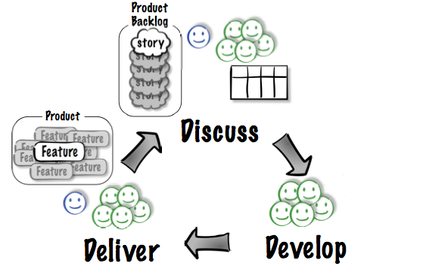
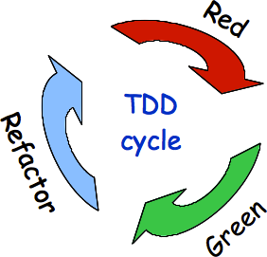
Acceptance Test Driven Development, a.k.a. Behavior Driven Development, a.k.a. Test Driven Requirements
Image courtesy Elisabeth Hendrickson, www.qualitytree.com

Slide 105

FitNesse: A standalone Wiki and FIT runner
Collaborative Testing and Documentation Tool, providing a very simple way to
create documents
specify tests
execute tests

Slide 106
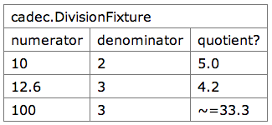
Minimal FitNesse example: Test table
!|cadec.DivisionFixture |
|numerator |denominator |quotient?|
|10 |2 |5.0 |
|12.6 |3 |4.2 |
|100 |3 |~=33.3 |

Slide 107
Minimal example: SLIM Fixture
package cadec
class DivisionFixture {
double numerator
double denominator
double quotient() {
numerator / denominator
}
}

Slide 108
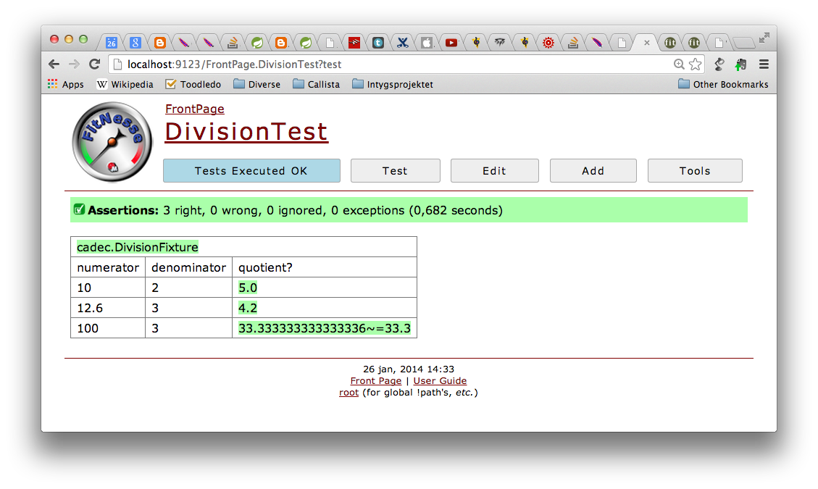
Minimal FitNesse example: Test execution

Slide 109
Exercise 5
Implement and run the test for the minimal Division example!
Start FitNesse using Run -> 'groovy-tdd-cadec FitNesse'
Start a browser, and navigate to http://localhost:9123
Click 'Add' -> 'Test Page', name the page DivisionTest
Add the table for the test
Implement the cadec.DivisionFixture
Run the test

Slide 110
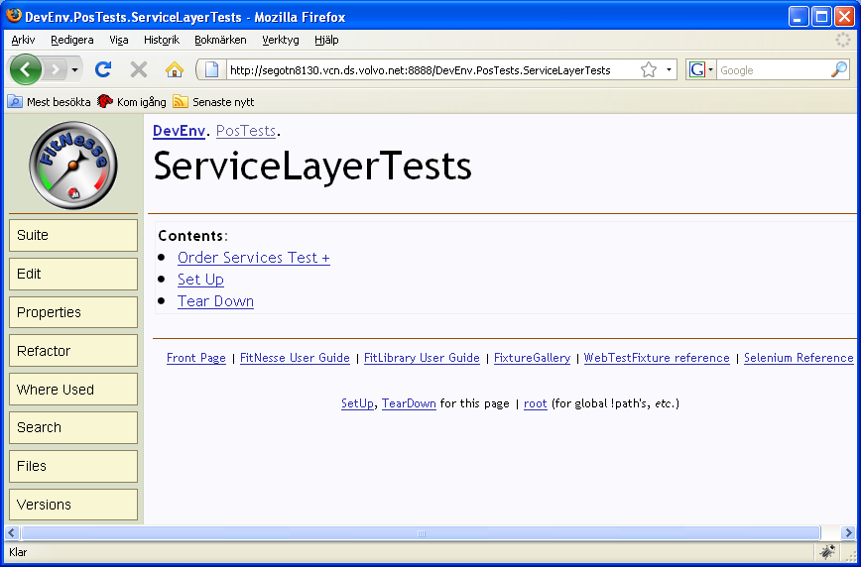
FitNesse: Wiki pages and Subpages
FitNesse is a Wiki Web Server
FIT tests lives on a Wiki page
FitNesse Wiki pages have hierarchical structure
FitNesse Wiki pages have additional metadata (a.k.a. “Properties”)

Slide 111
FitNesse: Wiki markup
Wiki words are in CamelCase: ThisIsAnExample
Hierarchy is expressed using . notation, or > and < for relative links:
.RootPage.SubPage.AnotherSubPage
>SubPage
<ParentPage
Simple markup for formatting
'''bold''' -> bold, ''italic'' -> italic
!c centers a line, !1 gives first heading !2 second heading
|cell 1|cell 2| specifies a table

Slide 112
FitNesse: Wiki markup (cont)
Escape wiki words using !- -!: !-ThisIsNotAWikiWord-!
Escape all content in a table using !: !|a.java.ClassName|
Special markup ‘widgets’:
!path
!contents –R2
!define

Slide 113
Fitnesse variables
FitNesse variables allow variable content to be specified once, then used in multiple tests
FitNesse variables are inherited from parent pages, if not defined explicitly (a.k.a. default inheritance)
Variable Definition
!define name {value}
!define name (value)
!define name [value]
Variable Usage
${name}

Slide 114
Hierarchical structure of variables

Slide 115
Symbolic links
Page structure forms a proper hierarchy (i.e. a tree)
Sometimes, variable information exists in several, crosscutting dimensions
E.g. environmental differences (Test environment vs. Production environment)
FitNesse Symbolic Links provide a way to introduce multiple inheritence between pages

Slide 116
Symbolic Links

Slide 117
Test Suites
A Test Suite is a page that has children containing tests (or other suites)
Test Suites can be executed, just as individual test pages. Doing so will execute each contained test page in sequence

Slide 118
SetUp and TearDown
If a sibling page SetUp exists for a Suite or a Test (or any of its parents), that SetUp page will automatically be included before the actual test(s)
Correspondingly, if a sibling page TearDown exists for a Suite or a Test (or any of its parents), that TearDown page will automatically be included after the actual test(s)
If a sibling page SuiteSetUp exists for a Suite, that SetUp page will automatically be included once before the actual suite
Dito for SuiteTearDown

Slide 119
SetUp and TearDown example

Slide 120
Example – Fixtures in Groovy
The http://localhost:9123/PetClinic.RestApiTests.GetOwner test specification provides a full-blown example of using Groovy power features and api:s in implementing Acceptance Tests for a RESTful API:
The org.springframework.samples.petclinic.slim.InsertOwners and org.springframework.samples.petclinic.slim.DeleteOwners fixtures uses SQL statements to insert and delete test data before and after execution
The org.springframework.samples.petclinic.slim.OwnerRestApiFixture uses groovyx.net.http.RESTClient to issue REST requests and parsing resulting Json data

Slide 121

Testing Web User Interfaces is ...
… still a challenge

Slide 122
Record/Playback
A Test Automation tool records “events” that make up a Test Case into a Test Script
Events can be User Interface interactions or API calls
The scripts can be played back later for regression testing
R & PB
Program
Unit
System
API
GUI

Slide 123
Drawbacks of Record/Playback approaches
Tests tend to be fragile
Maintenance tends to be expensive
Complex, expensive tools
Tests cannot be pre-built

Slide 124


Hence we need some layers of abstraction
Specifications
DOM Abstraction
Browser Automation

Slide 125

Selenium: A framework for Browser Automation
The Selenium engine executes tests directly in a browser, just as real users do.
Native implementations for
Firefox
Chrome
Internet Explorer
Opera
Headless (HtmlUnit)
iOS
Android
…

Slide 126

DOM Abstraction: Geb
Brings together
The power of Selenium / Web Driver
The elegance of JQuery
The robustness of the Page Object pattern
The flexibility and pure joy of Groovy

Slide 127
Navigator API
JQuery-like expressions provide a concise and effective way to navigate the DOM
$("p", text: contains(”Timecard"))
$("input", name: "username").value("bjorn")
$("div.message").text()

Slide 128
Page Objects
Use proper object-orientation techniques to avoid brittleness and duplication
page.login("bjorn", "secret")

Slide 129
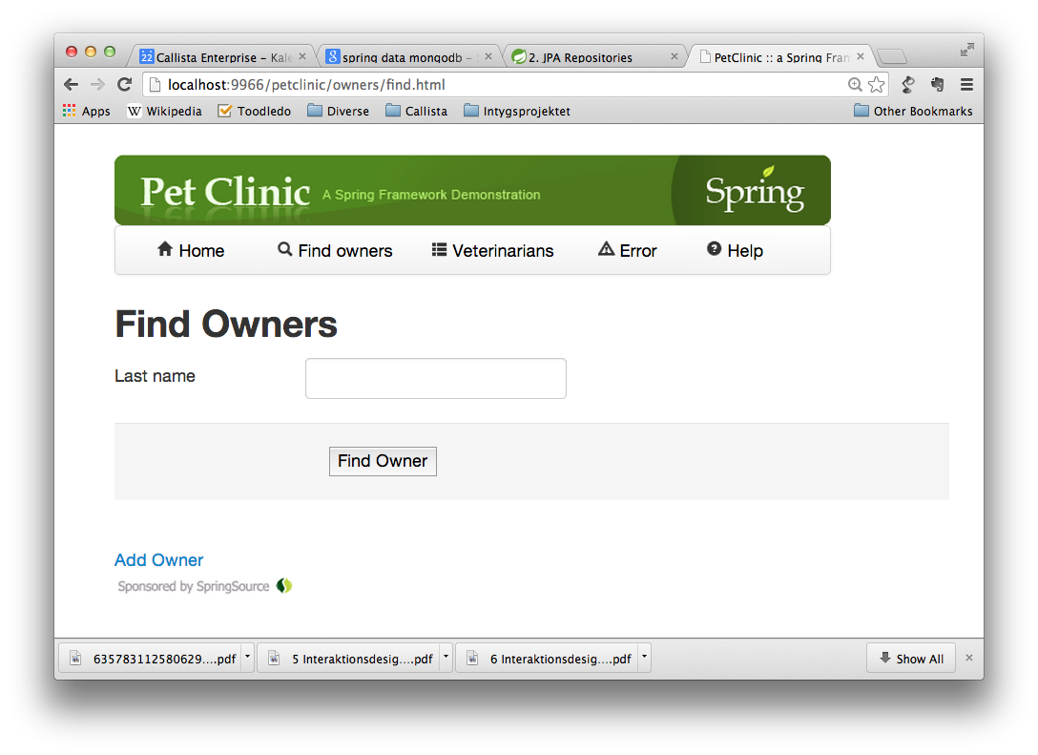

Slide 130
Geb Page definition
import geb.Page
class FindOwnersPage extends PetClinicPage {
static url = "owners/find.html"
static at = { $("h2").text() == "Find Owners" }
static content = {
lastName { $("input", name: "lastName") }
search { $("submit") }
}
def findByLastName(name) {
lastName.value(name)
search.click()
}
}

Slide 131
Geb Page definition: navigation
import geb.Page
class FindOwnersPage extends PetClinicPage {
static url = "owners/find.html"
static at = { $("h2").text() == "Find Owners" }
static content = {
lastName { $("input", name: "lastName") }
search { $("submit") }
}
def findByLastName(name) {
lastName.value(name)
search.click()
}
}

Slide 132
Geb Page definition: at predicate
import geb.Page
class FindOwnersPage extends PetClinicPage {
static url = "owners/find.html"
static at = { $("h2").text() == "Find Owners" }
static content = {
lastName { $("input", name: "lastName") }
search { $("submit") }
}
def findByLastName(name) {
lastName.value(name)
search.click()
}
}

Slide 133
Geb Page definition: logical content
import geb.Page
class FindOwnersPage extends PetClinicPage {
static url = "owners/find.html"
static at = { $("h2").text() == "Find Owners" }
static content = {
lastName { $("input", name: "lastName") }
search { $("submit") }
}
def findByLastName(name) {
lastName.value(name)
search.click()
}
}

Slide 134
Geb Page definition: actions
import geb.Page
class FindOwnersPage extends PetClinicPage {
static url = "owners/find.html"
static at = { $("h2").text() == "Find Owners" }
static content = {
lastName { $("input", name: "lastName") }
search { $("submit") }
}
def findByLastName(name) {
lastName.value(name)
search.click()
}
}

Slide 135
Spock Geb specification
class NavigationSpec extends GebSpec {
def "first page is HomePage"() {
when:
go ""
then:
at HomePage
}
def "from Home page you can navigate to Vets page"() {
given:
to HomePage
when:
navigateToVetsPage()
then:
at VetsPage
}
}

Slide 136
Exercise 7 – Geb Tests
Implement navigation test scenarios for the Error page:
Implement the url and at properties for org.springframework.samples.petclinic.web.pages.ErrorPage
Implement the "from Home page you can navigate to Error page"() and "from Error page you can navigate back to Home page"() feature methods in org.springframework.samples.petclinic.web.spec.NavigationSpec

Slide 137
FitNesse script Fixture using Geb
class Navigation {
boolean firstPageIsHomePage() {
Browser.drive {
go ""
waitFor {
at HomePage
}
}
true
}
void navigateToFindOwnersPage() {
Browser.drive {
page.navigateToFindOwnersPage()
}
}
...
}

Slide 138
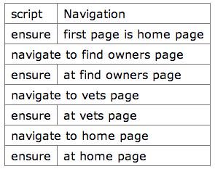
FitNesse specification using Geb

Slide 139
Geb Module definition
import geb.Module
class OwnerRow extends Module {
static content = {
cell { i -> $("td", i) }
name { cell(0).text() }
address { cell(1).text() }
city { cell(2).text() }
telephone { cell(3).text() }
pets { cell(4).text() }
}
}

Slide 140
Using a Module
class OwnersPage extends PetClinicPage {
static url = "owners.html"
static at = { $("h2").text() == "Owners" }
static content = {
owners {
$("#owners tbody tr").collect {
module OwnerRow, it
}
}
}
}

Slide 141
Example – Geb in action, driven by Spock and by FitNesse
The org.springframework.samples.petclinic.web.spec.FindOwnersSpec specification provides a full-blown example of using Geb page with Spock:
The org.springframework.samples.petclinic.web.pages.FindOwnersPage and org.springframework.samples.petclinic.web.pages.OwnersPage pages shows Geb page abstractions
The FindOwnersSpec uses SQL to prepopulate test data, then uses Geb to drive the test scenario
The localhost:9123/PetClinic.WebTests.AllTests.FindOwnersTest test specification provides a corresponding FitNesse based specification:
Prepopulating test data, then using Geb for the test scenario

Slide 142
Resources
http://junit.org/
http://groovy.codehaus.org/
http://groovy.codehaus.org/Eclipse+Plugin
https://code.google.com/p/spock/
http://www.fitnesse.org/
http://www.gebish.org/

Slide 143

Questions

