Slide 1
Groovy with Eclipse IDE
How to install and setup Groovy inside Eclipse
Björn Beskow | bjorn.beskow@callistaenterprise.se | 2014-01-29
Magnus Ekstrand | magnus.ekstrand@callistaenterprise.se
Peter Merikan | peter.merikan@callistaenterprise.se

Slide 2
Table of Contents
Eclipse Installation
Java requirements
Download Eclipse
Install Eclipse
Eclipse Plugin Installation
Groovy-Eclipse
m2e connector for build-helper-maven-plugin
Import project into Eclipse
Start web application

Slide 3
Eclipse Installation Java requirements
Eclipse requires an installed Java runtime. Eclipse 4.2 requires at least Java 5 to run.
Java can be downloaded as a JRE (Java Runtime Environment) or a JDK (Java Development Kit) version.
The Eclipse IDE contains its own Java compiler hence a JRE is sufficient for most tasks with Eclipse.
The JDK version of Java is required if you compile Java source code on the command line and for advanced development scenarios, for example, if you use automatic builds or if you develop Java web applications.
For this tutorial, you should use Java JDK in version 6 or higher.

Slide 4
Eclipse Installation Download Eclipse
The Eclipse IDE consists of several components. The Eclipse.org website provides pre-packaged Eclipse distributions to provide downloads for typical use cases. The Eclipse IDE for Java EE Developers contains everything you need to build Java and Java Enterprise Edition (Java EE) applications.
Download the Eclipse IDE for Java EE Developers package from the following URL. Ensure that you download the correct distribution for your Java version (e.g., 32 bit vs. 64 bit).
http://www.eclipse.org/downloads

Slide 5
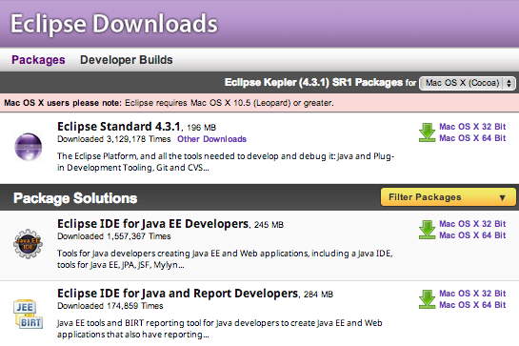
Eclipse Installation Download Eclipse (contd.)
The following screenshot shows the Eclipse download website for a Mac OS X system. Press on the link beside the package description (e.g, Mac OS X 64-Bit) to start the download. The download is a .zip file

Slide 6
Eclipse Installation Install Eclipse
After you downloaded the .zip file with the Eclipse distribution, unzip it to a local directory.
Extract Eclipse to a directory without spaces in its path and do not use a mapped network drive (Windows). Eclipse sometimes has problems with such a setup.
After unpacking the zip file, Eclipse is ready to be used; no additional installation procedure is required.
To start Eclipse, double-click on the eclipse.exe (Microsoft Windows) or eclipse (Linux / Mac) file in the directory where you unpacked Eclipse.

Slide 7
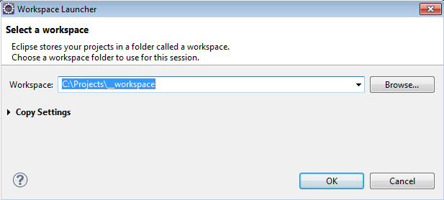
Eclipse Installation Install Eclipse (contd.)
The system will prompt you for a workspace. The workspace is the place in which you work. Select an empty directory and click the OK button.

Slide 8
Groovy Installation
Download a binary distribution of Groovy version 2.0.7
Unzip file to a directory on your local file system
Set the GROOVY_HOME environment variable to the directory you unzipped the distribution
Add %GROOVY_HOME%/bin to your PATH environment variable
Set the JAVA_HOME environment variable to point to your JDK
http://dist.codehaus.org/groovy/distributions/groovy-binary-2.0.7.zip

Slide 9
Eclipse Plugin Installation Groovy-Eclipse via Update Manager
Open a browser and goto:
Copy the Groovy-Eclipse release URL appropriate to your Eclipse version
To install the plugin, select Help → Install New Software...
Paste the Groovy-Eclipse release URL into the “Work with:” field and hit Enter
Select the features:
Extra Groovy compilers (Optional)
Groovy Compiler 2.0 Feature
Groovy-Eclipse (Required)
Groovy Eclipse Feature
http://groovy.codehaus.org/Eclipse+Plugin

Slide 10
Eclipse Plugin Installation Groovy-Eclipse via Marketplace
To install the plugin, select Help → Eclipse Marketplace...
Search for: Groovy-Eclipse
Choose appropriate Groovy-Eclipse plugin
Click Install
Select the features:
Groovy Compiler 2.0 Feature
Groovy-Eclipse Feature

Slide 11
Eclipse Plugin Installation m2e connector for build-helper-maven-plugin via Update Manager
To install the plugin, select Help → Install New Software...
Paste the following URL into the “Work with:” field and hit Enter
Install feature:
M2E Buildhelper Connector
m2e connector for build-helper-maven-plugin
http://repo1.maven.org/maven2/.m2e/connectors/m2eclipse-buildhelper/0.15.0/N/0.15.0.201207090124/

Slide 12
Eclipse Plugin Installation Maven Integration for Eclipse via Update Manager
This plugin is necessary to install if you use the Eclipse Standard package. The plugin provides comprehensive Maven integration for Eclipse.
To install the plugin, select Help → Install New Software...
Paste the following URL into the “Work with:” field and hit Enter
Install feature:
Maven Integration for Eclispe
m2e - Maven Integrations for Eclipse v1.4.0
m2e – slf4j over logback logging (Optional) v1.4.0
http://download.eclipse.org/technology/m2e/releases

Slide 13
Eclipse Plugin Installation Maven Integration for Eclipse via Marketplace
This plugin is necessary to install if you use the Eclipse Standard package. The plugin provides comprehensive Maven integration for Eclipse.
To install the plugin, select Help → Eclipse Marketplace...
Search for: Maven Integration for Eclipse
Choose: Maven Integration for Eclipse (Juno or newer) 1.4
Click Install, accept license terms and then Finish

Slide 14
Firefox Installation Windows
Visit the Firefox download page
Click on the green download link to download the Firefox installer
Start the process by running the installer
Then, just follow the steps…
http://www.getfirefox.com/

Slide 15
Firefox Installation Mac OS X
Visit the Firefox download page
Click on the green download link to download Firefox
Once the download has completed, the file (Firefox.dmg) should open by itself and pop open a Finder window containing the Firefox application. Drag the Firefox Icon on top of the Applications folder in order to copy it there
http://www.getfirefox.com/

Slide 16
Import project into Eclipse
Download source code from
Zip file contains an Eclipse project
Unzip to a working directory
To import an Eclipse project:
Select File → Import → General → Existing Projects into Workspace
Browse to the directory where you have unzipped the source code
Choose the groovy-tdd-cadec project
Click Finish
http://www.callistaenterprise.se/vadgorvi/cadec/xxxxxxxx/cadec2014_groovy_tdd.zip

Slide 17
Import project into Eclipse
Download source code from
Zip file contains a Maven project
Unzip to a working directory
To import a Maven project:
Select File → Import → Maven → Existing Maven Projects
Browse to the working directory and choose the groovy-tdd-cadec project
Click Finish
http://www.callistaenterprise.se/vadgorvi/cadec/xxxxxxxx/cadec2014_groovy_tdd.zip

Slide 18
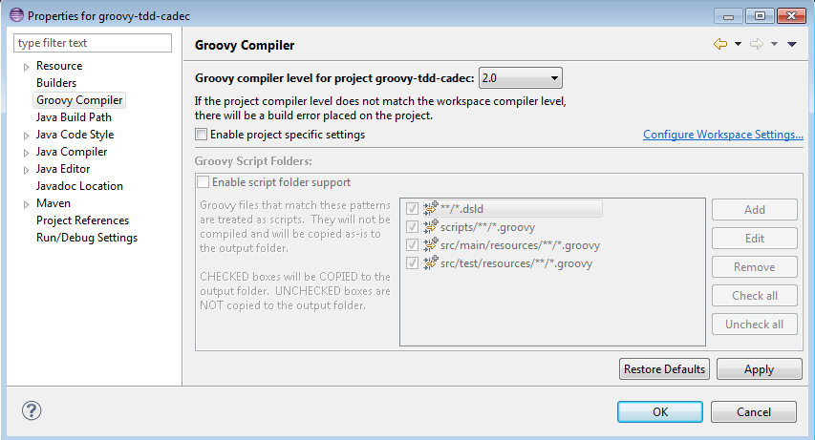
Eclipse problems Groovy compiler mismatch
If Eclipse reports a mismatch, between project’ and workspace Groovy compiler you need to correct it:
Right click groovy-tdd-cadec
Select → Properties →Groovy Compiler
Make sure Groovy compiler is set to version 2.0

Slide 19
Start web application From inside Eclipse
In Project Explorer view, right click groovy-tdd-cadec Tomcat7.launch
Select → Run As → (m2) groovy-tdd-cadec Tomcat7
Open a browser and goto
http://localhost:9966/petclinic/

Slide 20
Start web application From inside Eclipse
Select Run → Run Configurations…
Choose Maven Build
Press the ‘New’ button
Name: groovy-tdd-cadec Tomcat7
Base directory: ${workspace_loc:/groovy-tdd-cadec}
Goals: tomcat7:run
Profiles: testdata
Click Apply and the Run
Open a browser and goto
http://localhost:9966/petclinic/

