Slide 1

Distance sampling:
Covariate inclusion for 2D detection functions
Cal F-J, under the supervision of Professor David Borchers

Slide 2
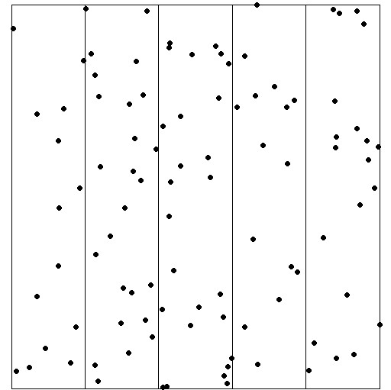
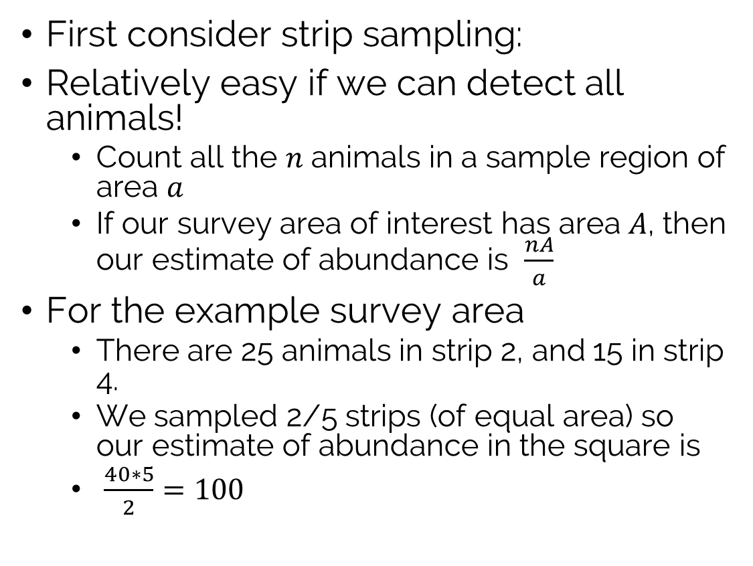
What is distance sampling?
First consider strip sampling:
Relatively easy if we can detect all animals!
Count all the $n$ animals in a sample region of area $a$
If our survey area of interest has area $A$, then our estimate of abundance is $\frac{nA}{a}$
For the example survey area
There are 25 animals in strip 2, and 15 in strip 4.
We sampled 2/5 strips (of equal area) so our estimate of abundance in the square is
$\frac{40∗5}{2}=100$

Slide 3
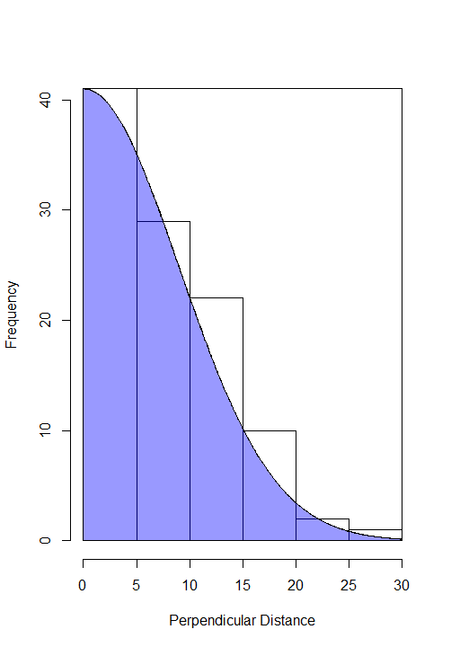
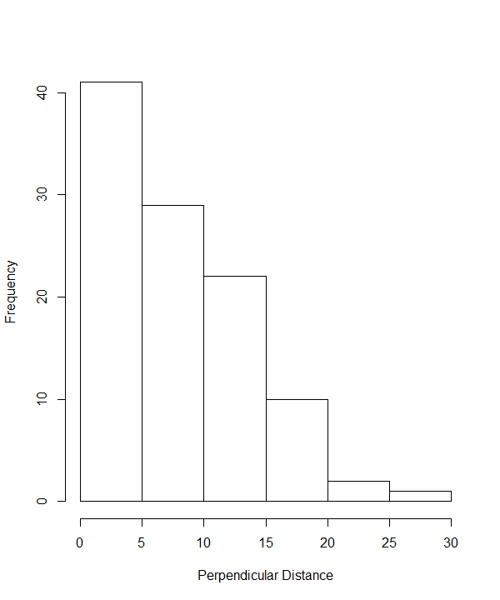
Imperfect detection?
How do we estimate detection probability?
Distance sampling!

Slide 4
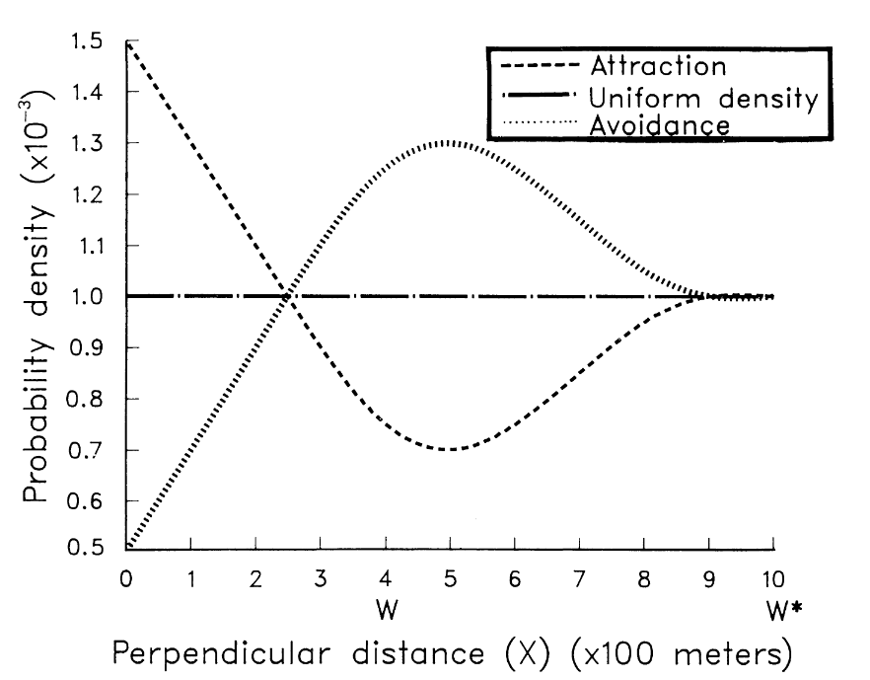
Responsive movement: What is it?
Animals can get scared by observers (very common in primates) and move away before being detected
Animals can be attracted to the transect line (common in dolphins who are drawn to the wake of ships conducting the survey)
Fig 1. Turnock and Quinn (1991)

Slide 5
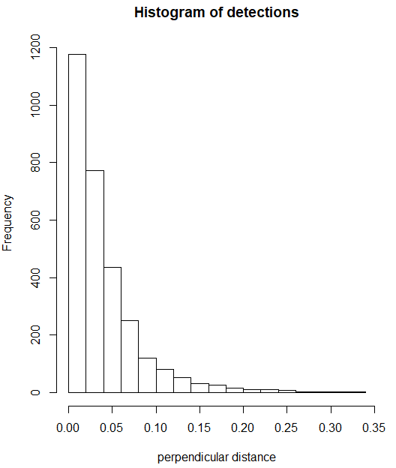
Responsive movement: why is it a problem?
Is this a detection function that falls away extremely quickly?
Or maybe the result of lots of attraction towards the transect?
The issue is that with only perpendicular distance data from the detections, it’s impossible to tell!

Slide 6
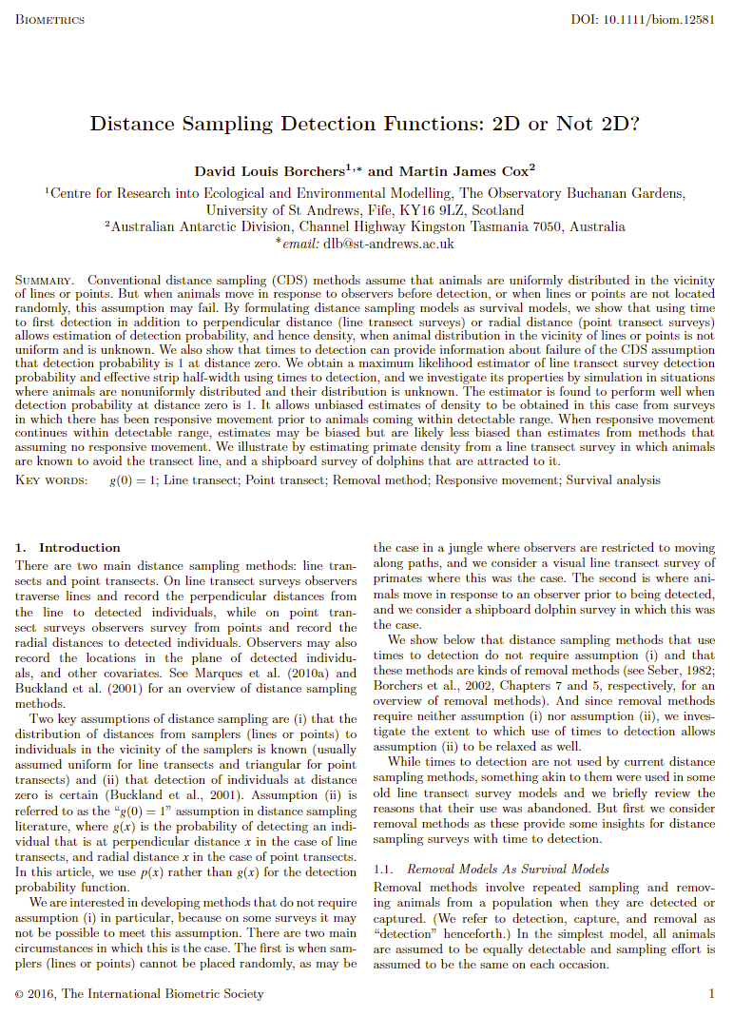
Responsive movement: The solution
(Borchers and Cox, 2016)
Changes the detection functions to be in 2D (forward, and perpendicular distance)
Because observers travel at a constant speed, it can be considered to be analogous to ‘time to detection’ for each detection
This allows them to use survival analysis to reformulate the distance sampling likelihood
We can fit different perpendicular density functions and differentiate between responsive movement and detection probability!

Slide 7
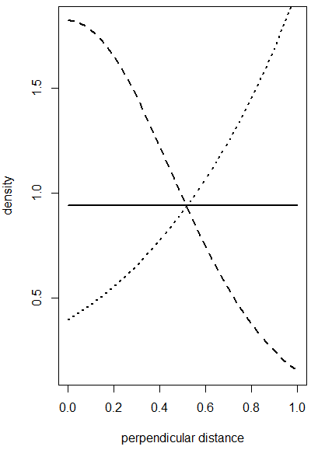
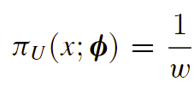
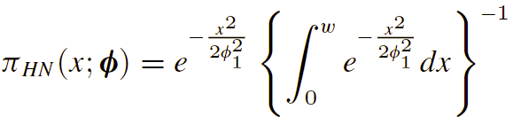

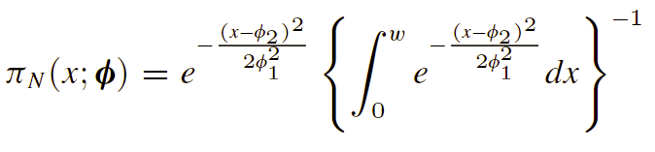
Some of the perpendicular densities

Slide 8
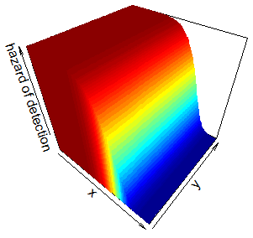
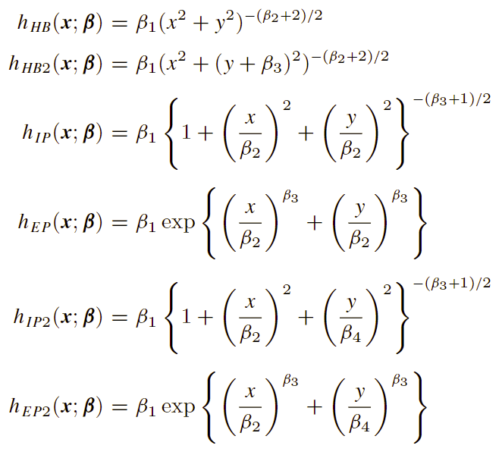
Hazard detection functions

Slide 9
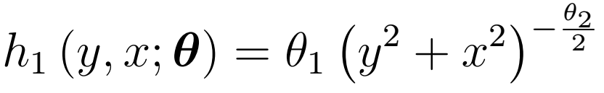
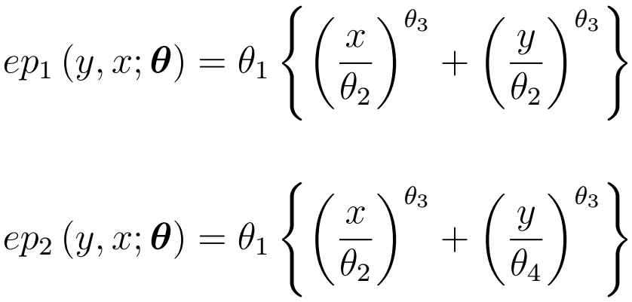


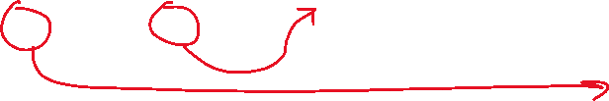
Covariate inclusion
Those formulas look nasty… Where on earth do we include covariates?
Affects the whole function, so can be seen as an intercept
Scale parameter which affects both the x and y in the same way
Scale parameter affecting only the y
Scale parameter affecting only the x

Slide 10
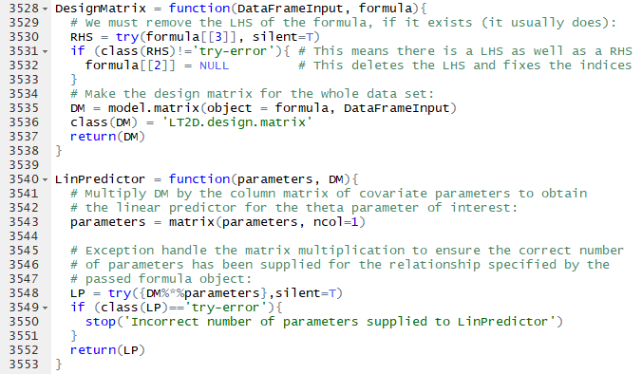
Covariate inclusion
For every detection function we need to be able to let the user:
Pick their own formula for the intercept
Pick their own formula for the x-direction
Pick their own formula for the y-direction
Give them the freedom to have different formulas in each direction at the same time
Check that the user’s choices are possible with the detection function they chose!
LOTS
We need to make design matrices for each formula
Then use linear predictors to combine those with estimated covariate parameters to produce the detection function parameters
OF
CODE

Slide 11



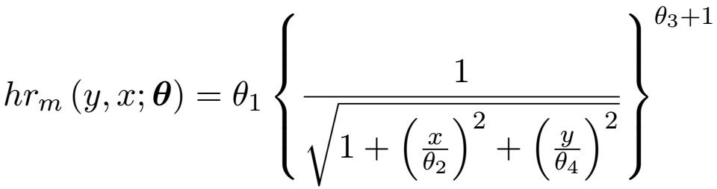

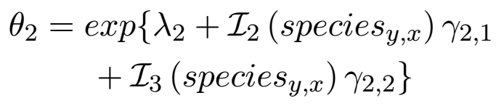

Covariate inclusion
Try an example:
Covariates: ‘forest.cover’ (continuous), ‘species’ (factor with 3 levels) and ‘size’ (continuous)
Formulas:
‘ip2’ detection function:

Slide 12
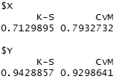
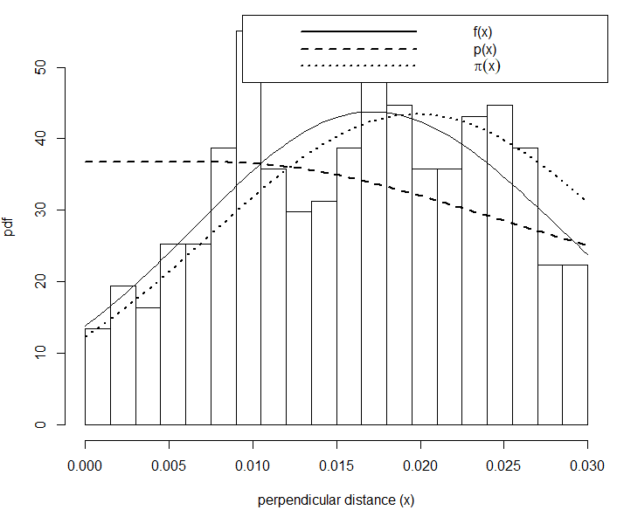
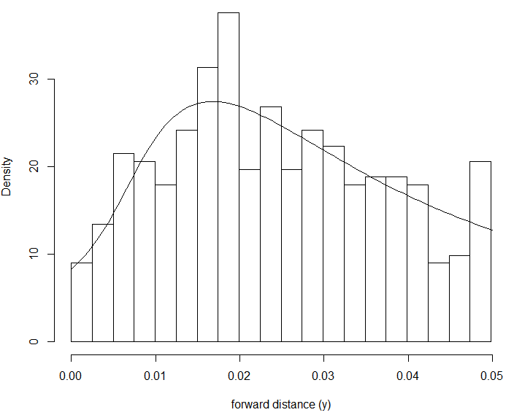
Goodness of fit and plotting functions
Generalized code
Options to plot at given level of covariates

Slide 13
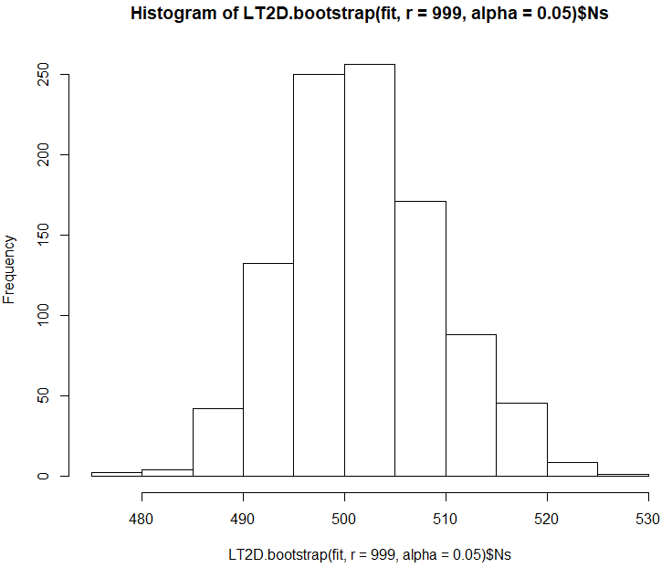

Bootstrap
We need to implement some measure of uncertainty!
Analytical or bootstrap?
Parametric or non-parametric?

Slide 14
Example usage

Slide 15
Simulation study

Slide 16
Conclusion

