Slide 1



Sr DBA Task
Senior Database Administrator Assignment
PostgreSQL Deployment on Kubernetes with Replication
Presented by:
Callixte Muhawenimana
December 2nd, 2024

Slide 2





Sr DBA Task
Objectives
01
Deploy a Kubernetes cluster with PostgreSQL using Minikube.
04
Demonstrate working replication between main and standalone clusters
02
Implement database replication with Helm Charts
05
Provide architectural design and documentation
03
Create a schema with 100,000 records using Python scripts

Slide 3
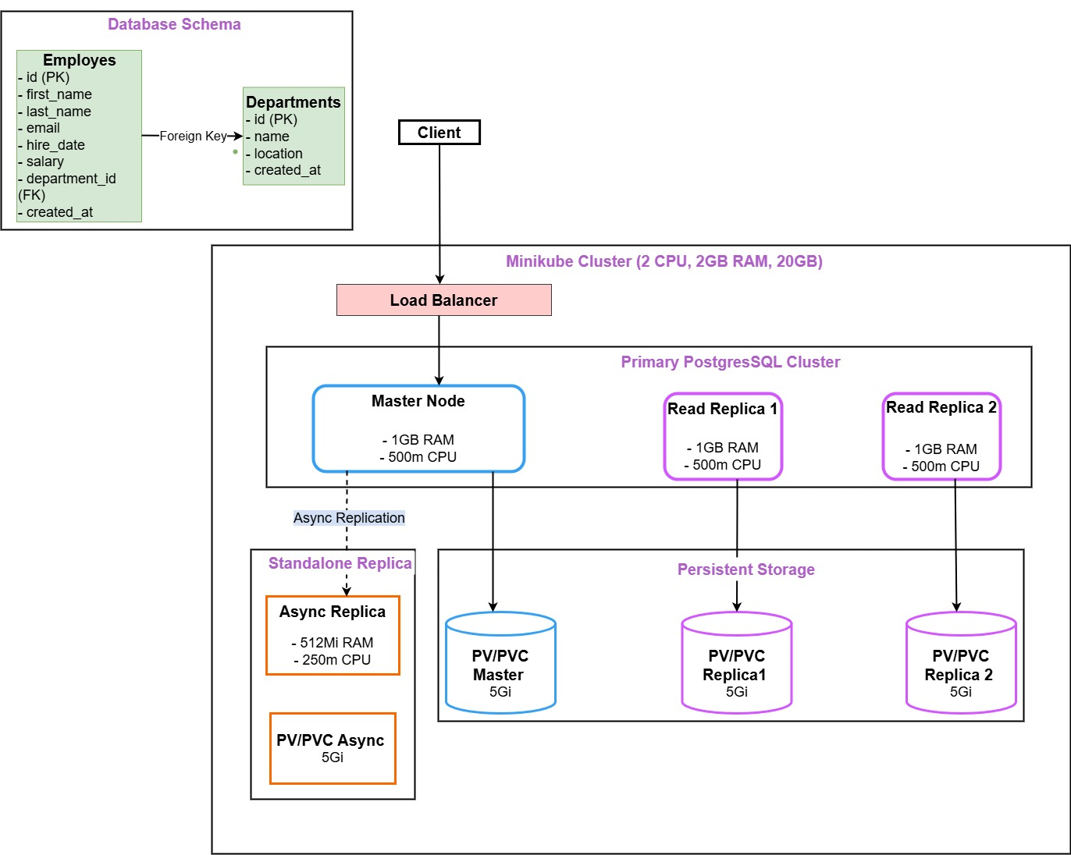
Sr DBA Task
Solution Architecture
High-Level Architecture: Primary Cluster with Load Balancer and Async Replica

Slide 4







Sr DBA Task
Steps To Solution
01
02
03
Deploy Main PostgreSQL Cluster
Helm Chart with replication enabled (2 read replicas)
Deploy Standalone Replica:
Helm Chart for standalone database
Set Up Minikube:
2 CPUs, 2GB RAM, 20GB Disk
minikube start
helm install postgres-main ...
helm install postgres-standalone ...
05
04
Generate and Insert Data
Python script to insert 100,000 records into 2 tables
Configure Replication:
Async replication setup using SQL scripts

Slide 5





Sr DBA Task
Tools and Technologies
Kubernetes (Minikube): Container orchestration
Helm Charts (Bitnami): Simplified PostgreSQL deployments
PostgreSQL 17.2: Open-source database
Python (Faker): Data generation
GitHub: Version control

Slide 6
Sr DBA Task
Demo/Verification
Main Cluster Validation
Check Tables: \dt
Verify Rows: SELECT COUNT(*)
Insert test data and confirm
2. Standalone Replica Validation
Check replicated tables and rows
Confirm new data replication

Slide 7
Sr DBA Task
References
PostgreSQL Documentation (https://www.postgresql.org/docs/)
Kubernetes Documentation (https://kubernetes.io/docs/)
Bitnami Helm Charts (https://github.com/bitnami/charts)
Python Faker Library Documentation (https://faker.readthedocs.io/)
GitHub Repository (https://github.com/callixte12/DBA-Task)
Minikube Documentation (https://minikube.sigs.k8s.io/docs/)

Slide 8
Sr DBA Task
Q/A?
THANK YOU!
+250785660132
cmuhawen@andrew.cmu.edu

