Slide 1

COMP9313: Big Data Management Lecturer: Xin Cao Course web site: http://www.cse.unsw.edu.au/~cs9313/

Slide 2
Chapter 2: MapReduce I

Slide 3
What is MapReduce
Origin from Google, [OSDI’04]
MapReduce: Simplified Data Processing on Large Clusters
Jeffrey Dean and Sanjay Ghemawat
Programming model for parallel data processing
Hadoop can run MapReduce programs written in various languages: e.g. Java, Ruby, Python, C++
For large-scale data processing
Exploits large set of commodity computers
Executes process in distributed manner
Offers high availability

Slide 4

Motivation for MapReduce
A Google server room:
https://www.youtube.com/watch?t=3&v=avP5d16wEp0

Slide 5
Motivation for MapReduce
Typical big data problem challenges:
How do we break up a large problem into smaller tasks that can be executed in parallel?
How do we assign tasks to workers distributed across a potentially large number of machines?
How do we ensure that the workers get the data they need?
How do we coordinate synchronization among the different workers?
How do we share partial results from one worker that is needed by another?
How do we accomplish all of the above in the face of software errors and hardware faults?

Slide 6
Motivation for MapReduce
There was need for an abstraction that hides many system-level details from the programmer.
MapReduce addresses this challenge by providing a simple abstraction for the developer, transparently handling most of the details behind the scenes in a scalable, robust, and efficient manner.
MapReduce separates the what from the how

Slide 7

Jeffrey (Jeff) Dean
He is currently a Google Senior Fellow in the Systems and Infrastructure Group
Designed MapReduce, BigTable, etc.
One of the most genius engineer, programmer, computer scientist…
Google “Who is Jeff Dean” and “Jeff Dean facts”

Slide 8
Jeff Dean Facts
Kenton Varda created "Jeff Dean Facts" as a Google-internal April Fool's joke in 2007.
The speed of light in a vacuum used to be about 35 mph. Then Jeff Dean spent a weekend optimizing physics
Jeff Dean once bit a spider, the spider got super powers and C readability
Jeff Dean puts his pants on one leg at a time, but if he had more than two legs, you would see that his approach is actually O(log n)
Compilers don’t warn Jeff Dean. Jeff Dean warns compilers
The rate at which Jeff Dean produces code jumped by a factor of 40 in late 2000 when he upgraded his keyboard to USB2.0

Slide 9
Typical Big Data Problem
Iterate over a large number of records
Extract something of interest from each
Shuffle and sort intermediate results
Aggregate intermediate results
Generate final output
Map
Reduce
Key idea: provide a functional abstraction for these two operations

Slide 10
Distributed Word Count
Huge Document
Block1
Block2
Block3
Block4
…
Comptuer1
Comptuer2
Comptuer3
Comptuer4
…
Merge
Partial Count1
Partial Count2
Partial Count3
Partial Count4
…
Final Result

Slide 11
The Idea of MapReduce
Inspired by the map and reduce functions in functional programming
We can view map as a transformation over a dataset
This transformation is specified by the function f
Each functional application happens in isolation
The application of f to each element of a dataset can be parallelized in a straightforward manner
We can view reduce as an aggregation operation
The aggregation is defined by the function g
Data locality: elements in the list must be “brought together”
If we can group elements of the list, also the reduce phase can proceed in parallel
The framework coordinates the map and reduce phases:
Grouping intermediate results happens in parallel

Slide 12
Data Structures in MapReduce
Key-value pairs are the basic data structure in MapReduce
Keys and values can be: integers, float, strings, raw bytes
They can also be arbitrary data structures
The design of MapReduce algorithms involves:
Imposing the key-value structure on arbitrary datasets
E.g.: for a collection of Web pages, input keys may be URLs and values may be the HTML content
In some algorithms, input keys are not used (e.g., wordcount), in others they uniquely identify a record
Keys can be combined in complex ways to design various algorithms

Slide 13
Map and Reduce Functions
Programmers specify two functions:
map (k₁, v₁) → list [<k₂, v₂>]
Map transforms the input into key-value pairs to process
reduce (k₂, list [v₂]) → [<k₃, v₃>]
Reduce aggregates the list of values for each key
All values with the same key are sent to the same reducer
list [<k₂, v₂>] will be grouped according to key k₂ as (k₂, list [v₂])
The MapReduce environment takes in charge of everything else…
A complex program can be decomposed as a succession of Map and Reduce tasks

Slide 14
Everything Else?
Handles scheduling
Assigns workers to map and reduce tasks
Handles “data distribution”
Moves processes to data
Handles synchronization
Gathers, sorts, and shuffles intermediate data
Handles errors and faults
Detects worker failures and restarts
Everything happens on top of a distributed file system (HDFS)
You don’t know:
Where mappers and reducers run
When a mapper or reducer begins or finishes
Which input a particular mapper is processing
Which intermediate key a particular reducer is processing

Slide 15
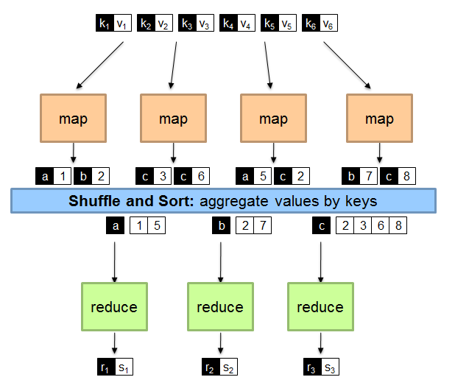
A Brief View of MapReduce

Slide 16
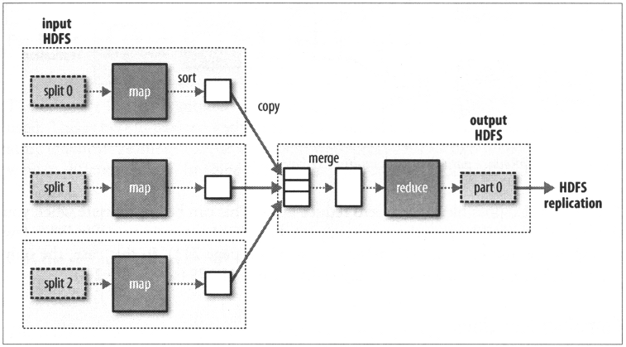
Shuffle and Sort
Shuffle
Input to the Reducer is the sorted output of the mappers. In this phase the framework fetches the relevant partition of the output of all the mappers, via HTTP.
Sort
The framework groups Reducer inputs by keys (since different Mappers may have output the same key) in this stage.
Hadoop framework handles the Shuffle and Sort step .

Slide 17
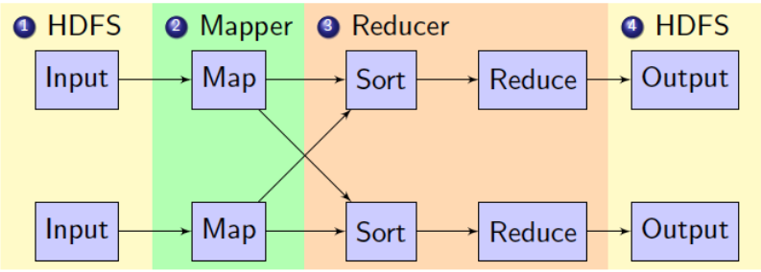
Hadoop MapReduce Brief Data Flow
1. Mappers read from HDFS
2. Map output is partitioned by key and sent to Reducers
3. Reducers sort input by key
4. Reduce output is written to HDFS
Intermediate results are stored on local FS of Map and Reduce workers

Slide 18
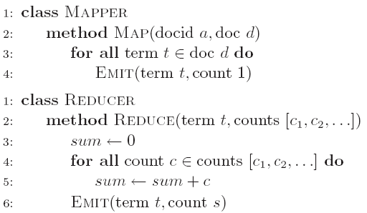
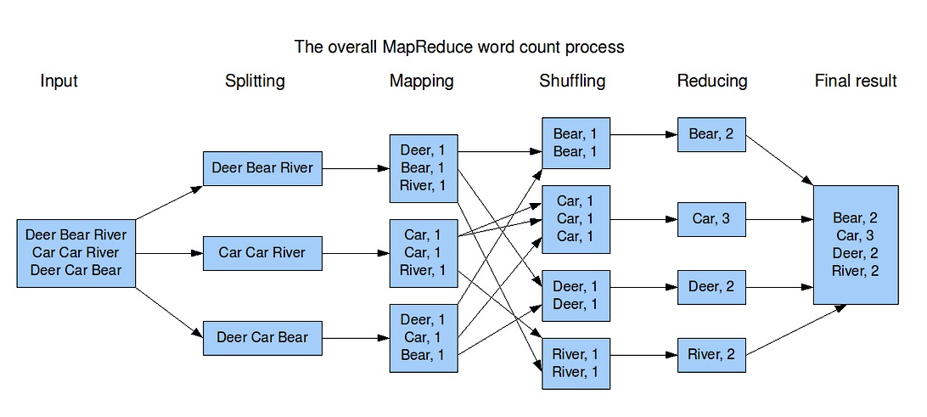
“Hello World” in MapReduce

Slide 19
“Hello World” in MapReduce
Input:
Key-value pairs: (docid, doc) of a file stored on the distributed filesystem
docid : unique identifier of a document
doc: is the text of the document itself
Mapper:
Takes an input key-value pair, tokenize the line
Emits intermediate key-value pairs: the word is the key and the integer is the value
The framework:
Guarantees all values associated with the same key (the word) are brought to the same reducer
The reducer:
Receives all values associated to some keys
Sums the values and writes output key-value pairs: the key is the word and the value is the number of occurrences

Slide 20
Coordination: Master
Master node takes care of coordination:
Task status: (idle, in-progress, completed)
Idle tasks get scheduled as workers become available
When a map task completes, it sends the master the location and sizes of its R intermediate files, one for each reducer
Master pushes this info to reducers
Master pings workers periodically to detect failures

Slide 21
Dealing with Failures
Map worker failure
Its task is reassigned to another map worker
Reduce workers are notified when task is rescheduled on another worker
Reduce worker failure
Its task is reassigned to another reduce worker
Reduce task is restarted (usually require restarting mapper tasks as well)
Master failure
MapReduce task is aborted and client is notified
Robust
Google’s experience: lost 1600 of 1800 machines once!, but finished fine

Slide 22
Where the Magic Happens
Implicit between the map and reduce phases is a parallel “group by” operation on intermediate keys
Intermediate data arrive at each reducer in order, sorted by the key
No ordering is guaranteed across reducers
Output keys from reducers are written back to HDFS
The output may consist of r distinct files, where r is the number of reducers
Such output may be the input to a subsequent MapReduce phase
Intermediate keys (used in shuffle and sort) are transient:
They are not stored on the distributed filesystem
They are “spilled” to the local disk of each machine in the cluster

Slide 23
Write Your Own WordCount in Java?

Slide 24
MapReduce Program
A MapReduce program consists of the following 3 parts:
Driver → main (would trigger the map and reduce methods)
Mapper
Reducer
It is better to include the map reduce and main methods in 3 different classes
Check detailed information of all classes at: https://hadoop.apache.org/docs/r2.7.2/api/allclasses-noframe.html

Slide 25
Mapper
public static class TokenizerMapper
extends Mapper<Object, Text, Text, IntWritable>{
private final static IntWritable one = new IntWritable(1);
private Text word = new Text();
public void map(Object key, Text value, Context context) throws IOException, InterruptedException {
StringTokenizer itr = new StringTokenizer(value.toString());
while (itr.hasMoreTokens()) {
word.set(itr.nextToken());
context.write(word, one);
}
}
}

Slide 26
Mapper Explanation
Maps input key/value pairs to a set of intermediate key/value pairs.
//Map class header
public static class TokenizerMapper
extends Mapper<Object, Text, Text, IntWritable>{
Class Mapper<KEYIN,VALUEIN,KEYOUT,VALUEOUT>
KEYIN,VALUEIN -> (k1, v1) -> (docid, doc)
KEYOUT,VALUEOUT ->(k2, v2) -> (word, 1)
// IntWritable: A serializable and comparable object for integer
private final static IntWritable one = new IntWritable(1);
//Text: stores text using standard UTF8 encoding. It provides methods to serialize, deserialize, and compare texts at byte level
private Text word = new Text();
//hadoop supported data types for the key/value pairs, in package org.apache.hadoop

Slide 27
What is Writable?
Hadoop defines its own “box” classes for strings (Text), integers (IntWritable), etc.
All values must implement interface Writable
All keys must implement interface WritableComparable
Writable is a serializable object which implements a simple, efficient, serialization protocol

Slide 28
Mapper Explanation (Cont’)
//Map method header
public void map(Object key, Text value, Context context) throws IOException, InterruptedException
Object key/Text value: Data type of the input Key and Value to the mapper
Context: An inner class of Mapper, used to store the context of a running task. Here it is used to collect data output by either the Mapper or the Reducer, i.e. intermediate outputs or the output of the job
Exceptions: IOException, InterruptedException
This function is called once for each key/value pair in the input split. Your application should override this to do your job.

Slide 29
Mapper Explanation (Cont’)
//Use a string tokenizer to split the document into words
StringTokenizer itr = new StringTokenizer(value.toString());
//Iterate through each word and a form key value pairs
while (itr.hasMoreTokens()) {
//Assign each work from the tokenizer(of String type) to a Text ‘word’
word.set(itr.nextToken());
//Form key value pairs for each word as <word, one> using context
context.write(word, one);
}
Map function produces Map.Context object
Map.context() takes (k, v) elements
Any (WritableComparable, Writable) can be used

Slide 30
Reducer
public static class IntSumReducer
extends Reducer<Text,IntWritable,Text,IntWritable> {
private IntWritable result = new IntWritable();
public void reduce(Text key, Iterable<IntWritable> values, Context context) throws IOException, InterruptedException{
int sum = 0;
for (IntWritable val : values) {
sum += val.get();
}
result.set(sum);
context.write(key, result);
}
}

Slide 31
Reducer Explanation
//Reduce Header similar to the one in map with different key/value data type
public static class IntSumReducer
extends Reducer<Text, IntWritable, Text, IntWritable>
//data from map will be <”word”,{1,1,..}>, so we get it with an Iterator and thus we can go through the sets of values
public void reduce(Text key, Iterable<IntWritable> values, Context context) throws IOException, InterruptedException{
//Initaize a variable ‘sum’ as 0
int sum = 0;
//Iterate through all the values with respect to a key and sum up all of them
for (IntWritable val : values) {
sum += val.get();
}
// Form the final key/value pairs results for each word using context
result.set(sum);
context.write(key, result);

Slide 32
Main (Driver)
public static void main(String[] args) throws Exception {
Configuration conf = new Configuration();
Job job = Job.getInstance(conf, "word count");
job.setJarByClass(WordCount.class);
job.setMapperClass(TokenizerMapper.class);
job.setReducerClass(IntSumReducer.class);
job.setOutputKeyClass(Text.class);
job.setOutputValueClass(IntWritable.class);
FileInputFormat.addInputPath(job, new Path(args[0]));
FileOutputFormat.setOutputPath(job, new Path(args[1]));
System.exit(job.waitForCompletion(true) ? 0 : 1);
}

Slide 33
Main(The Driver)
Given the Mapper and Reducer code, the short main() starts the MapReduction running
The Hadoop system picks up a bunch of values from the command line on its own
Then the main() also specifies a few key parameters of the problem in the Job object
Job is the primary interface for a user to describe a map-reduce job to the Hadoop framework for execution (such as what Map and Reduce classes to use and the format of the input and output files)
Other parameters, i.e. the number of machines to use, are optional and the system will determine good values for them if not specified
Then the framework tries to faithfully execute the job as-is described by Job

Slide 34
Main Explanation
//Creating a Configuration object and a Job object, assigning a job name for identification purposes
Configuration conf = new Configuration();
Job job = Job.getInstance(conf, "word count");
Job Class: It allows the user to configure the job, submit it, control its execution, and query the state. Normally the user creates the application, describes various facets of the job via Job and then submits the job and monitor its progress.
//Setting the job's jar file by finding the provided class location
job.setJarByClass(WordCount.class);
//Providing the mapper and reducer class names
job.setMapperClass(TokenizerMapper.class);
job.setReducerClass(IntSumReducer.class);
//Setting configuration object with the Data Type of output Key and Value for map and reduce
job.setOutputKeyClass(Text.class);
job.setOutputValueClass(IntWritable.class);

Slide 35
Main Explanation (Cont’)
//The hdfs input and output directory to be fetched from the command line
FileInputFormat.addInputPath(job, new Path(args[0]));
FileOutputFormat.setOutputPath(job, new Path(args[1]));
//Submit the job to the cluster and wait for it to finish.
System.exit(job.waitForCompletion(true) ? 0 : 1);

Slide 36
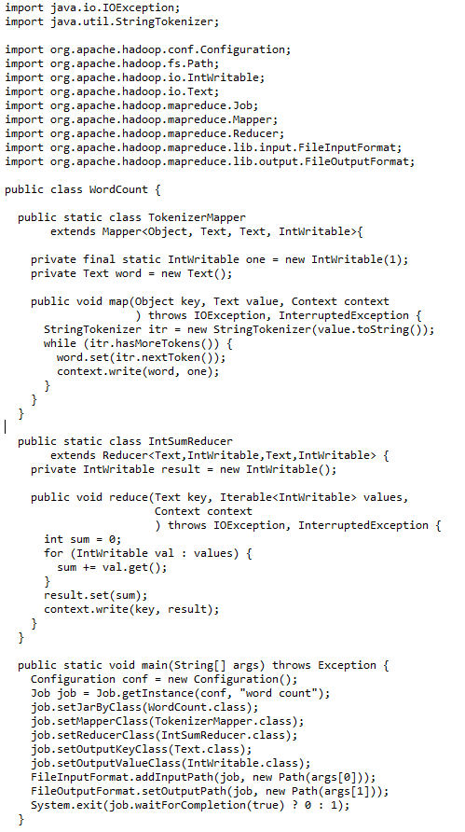
Make It Running！
Configure environment variables
export JAVA_HOME=…
export PATH=${JAVA_HOME}/bin:${PATH}
export HADOOP_CLASSPATH=${JAVA_HOME}/lib/tools.jar
Compile WordCount.java and create a jar:
$ hadoop com.sun.tools.javac.Main WordCount.java
$ jar cf wc.jar WordCount*.class
Put files to HDFS
$ hdfs dfs –put YOURFILES input
Run the application
$ hadoop jar wc.jar WordCount input output
Check the results
$ hdfs dfs –cat output/*

Slide 37
Make It Running！
Given two files:
file1: Hello World Bye World
file2: Hello Hadoop Goodbye Hadoop
The first map emits:
< Hello, 1> < World, 1> < Bye, 1> < World, 1>
The second map emits:
< Hello, 1> < Hadoop, 1> < Goodbye, 1> < Hadoop, 1>
The output of the job is:
< Bye, 1> < Goodbye, 1> < Hadoop, 2> < Hello, 2> < World, 2>

Slide 38
Mappers and Reducers
Need to handle more data? Just add more Mappers/Reducers!
No need to handle multithreaded code ☺
Mappers and Reducers are typically single threaded and deterministic
Determinism allows for restarting of failed jobs
Mappers/Reducers run entirely independent of each other
In Hadoop, they run in separate JVMs

Slide 39
Combiners
Often a Map task will produce many pairs of the form (k,v₁), (k,v₂), … for the same key k
E.g., popular words in the word count example
Combiners are a general mechanism to reduce the amount of intermediate data, thus saving network time
They could be thought of as “mini-reducers”
Warning!
The use of combiners must be thought carefully
Optional in Hadoop: the correctness of the algorithm cannot depend on computation (or even execution) of the combiners
A combiner operates on each map output key. It must have the same output key-value types as the Mapper class.
A combiner can produce summary information from a large dataset because it replaces the original Map output
Works only if reduce function is commutative and associative
In general, reducer and combiner are not interchangeable

Slide 40
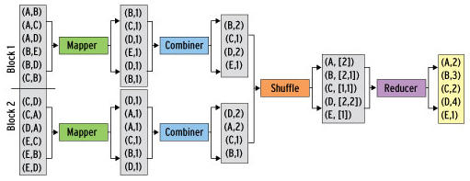
Combiners in WordCount
Combiner combines the values of all keys of a single mapper node (single machine):
Much less data needs to be copied and shuffled!
If combiners take advantage of all opportunities for local aggregation we have at most m × V intermediate key-value pairs
m: number of mappers
V: number of unique terms in the collection
Note: not all mappers will see all terms

Slide 41
Combiners in WordCount
In WordCount.java, you only need to add the follow line to Main:
job.setCombinerClass(IntSumReducer.class);
This is because in this example, Reducer and Combiner do the same thing
Note: Most cases this is not true!
You need to write an extra combiner class
Given two files:
file1: Hello World Bye World
file2: Hello Hadoop Goodbye Hadoop
The first map emits:
< Hello, 1> < World, 2> < Bye, 1>
The second map emits:
< Hello, 1> < Hadoop, 2> < Goodbye, 1>

Slide 42
Partitioner
Partitioner controls the partitioning of the keys of the intermediate map-outputs.
The key (or a subset of the key) is used to derive the partition, typically by a hash function.
The total number of partitions is the same as the number of reduce tasks for the job.
This controls which of the m reduce tasks the intermediate key (and hence the record) is sent to for reduction.
System uses HashPartitioner by default:
hash(key) mod R
Sometimes useful to override the hash function:
E.g., hash(hostname(URL)) mod R ensures URLs from a host end up in the same output file
https://www.unsw.edu.au/faculties and https://www.unsw.edu.au/about-us will be stored in one file
Job sets Partitioner implementation (in Main)

Slide 43
MapReduce: Recap
Programmers must specify:
map (k₁, v₁) → [(k₂, v₂)]
reduce (k₂, [v₂]) → [<k₃, v₃>]
All values with the same key are reduced together
Optionally, also:
combine (k₂, [v₂]) → [<k₃, v₃>]
Mini-reducers that run in memory after the map phase
Used as an optimization to reduce network traffic
partition (k₂, number of partitions) → partition for k₂
Often a simple hash of the key, e.g., hash(k₂) mod n
Divides up key space for parallel reduce operations
The execution framework handles everything else…

Slide 44
MapReduce: Recap (Cont’)
Divides input into fixed-size pieces, input splits
Hadoop creates one map task for each split
Map task runs the user-defined map function for each record in the split
Size of splits
Small size is better for load-balancing: faster machine will be able to process more splits
But if splits are too small, the overhead of managing the splits dominate the total execution time
For most jobs, a good split size tends to be the size of a HDFS block, 64MB(default)
Data locality optimization
Run the map task on a node where the input data resides in HDFS
This is the reason why the split size is the same as the block size

Slide 45
MapReduce: Recap (Cont’)
Map tasks write their output to local disk (not to HDFS)
Map output is intermediate output
Once the job is complete the map output can be thrown away
So storing it in HDFS with replication would be overkill
If the node of map task fails, Hadoop will automatically rerun the map task on another node
Reduce tasks don’t have the advantage of data locality
Input to a single reduce task is normally the output from all mappers
Output of the reduce is stored in HDFS for reliability
The number of reduce tasks is not governed by the size of the input, but is specified independently

Slide 46
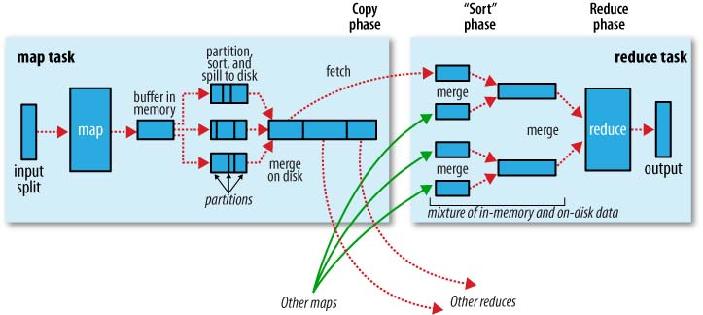
MapReduce: Recap (Cont’)
When there are multiple reducers, the map tasks partition their output:
One partition for each reduce task
The records for every key are all in a single partition
Partitioning can be controlled by a user-defined partitioning function

Slide 47
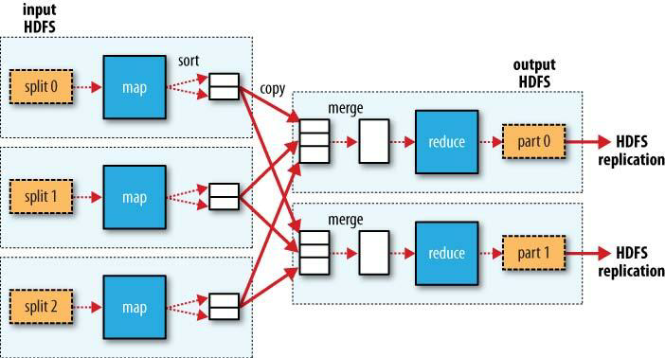
More Detailed MapReduce Dataflow

Slide 48
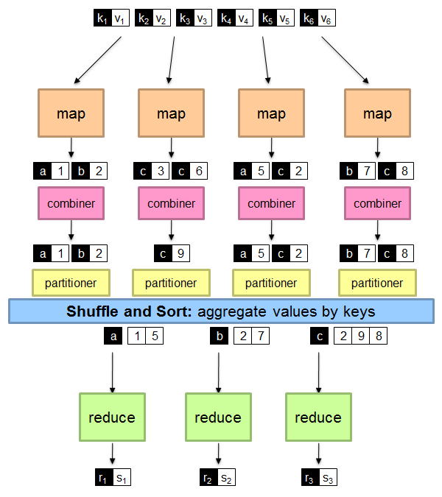
MapReduce: Recap

Slide 49
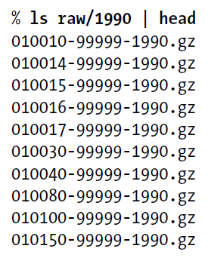
Another Example： Analysis of Weather Dataset
Data from NCDC(National Climatic Data Center)
A large volume of log data collected by weather sensors: e.g. temperature
Data format
Line-oriented ASCII format
Each record has many elements
We focus on the temperature element
Data files are organized by date and weather station
There is a directory for each year from 1901 to 2001, each containing a gzipped file for each weather station with its readings for that year
Query
What’s the highest recorded global temperature for each year in the dataset?
Year
Temperature
0067011990999991950051507004...9999999N9+00001+99999999999...
0043011990999991950051512004...9999999N9+00221+99999999999...
0043011990999991950051518004...9999999N9-00111+99999999999...
0043012650999991949032412004...0500001N9+01111+99999999999...
0043012650999991949032418004...0500001N9+00781+99999999999...
Contents of data files
List of data files

Slide 50
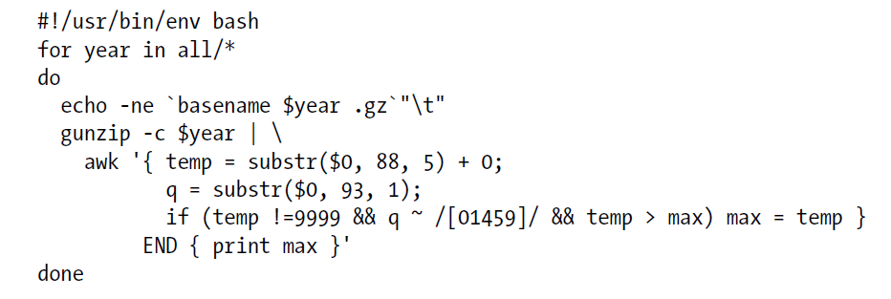
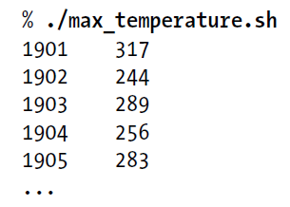
Analyzing the Data with Unix Tools
To provide a performance baseline
Use awk for processing line-oriented data
Complete run for the century took 42 minutes on a single EC2 High-CPU Extra Large Instance

Slide 51
How Can We Parallelize This Work?
To speed up the processing, we need to run parts of the program in parallel
Challenges?
Divide the work into even distribution is not easy
File size for different years varies
Combining the results is complicated
Get the result from the maximum temperature for each chunk
We are still limited by the processing capacity of a single machine
Some datasets grow beyond the capacity of a single machine
To use multiple machines, we need to consider a variety of complex problems
Coordination: Who runs the overall job?
Reliability: How do we deal with failed processes?
Hadoop can take care of these issues

Slide 52
MapReduce Design
We need to answer these questions:
What are the map input key and value types?
What does the mapper do?
What are the map output key and value types?
Can we use a combiner?
Is a partitioner required?
What does the reducer do?
What are the reduce output key and value types?
And: What are the file formats?
For now we are using text files
We may use binary files

Slide 53


MapReduce Types
≠
General form
Combine function
The same form as the reduce function, except its output types
Output type is the same as Map
The combine and reduce functions may be the same
Partition function
Input intermediate key and value types
Returns the partition index
map: (K1, V1) → list(K2, V2)
reduce: (K2, list(V2)) → list(K3, V3)
=

Slide 54
MapReduce Design
Identify the input and output of the problem
Text input format of the dataset files (input of mapper)
Key: offset of the line (unnecessary)
Value: each line of the files (string)
Output (output of reducer)
Key: year (string or integer)
Value: maximum temperature (integer)
Decide the MapReduce data types
Hadoop provides its own set of basic types
optimized for network serialization
org.apache.hadoop.io package
In WordCount, we have used Text and IntWritable
Key must implement interface WritableComparable
Value must implement interface Writable

Slide 55
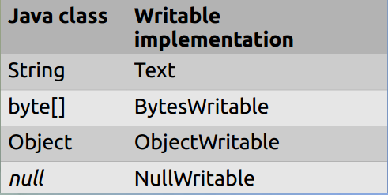
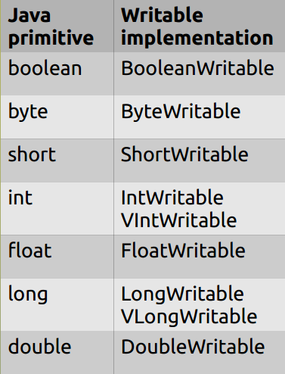
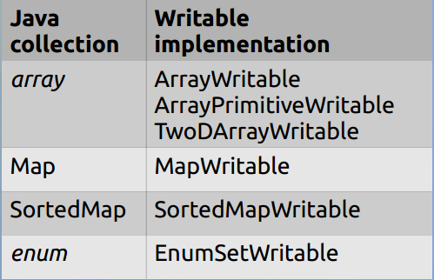
Writable Wrappers

Slide 56
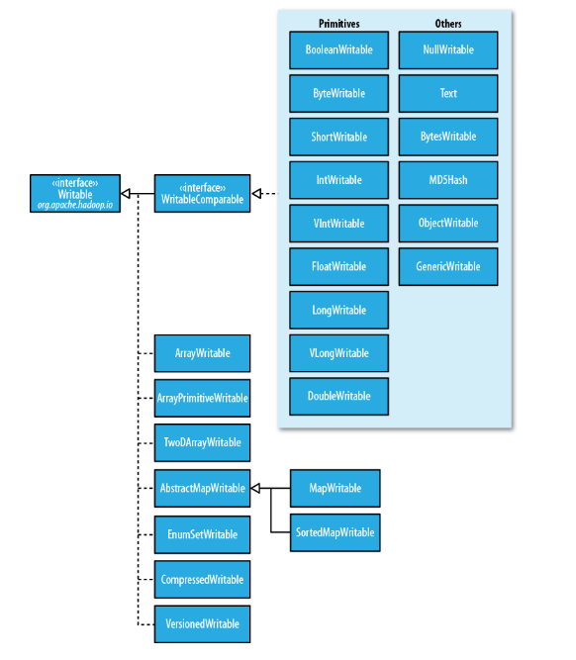
Writable Class Hierarchy

Slide 57
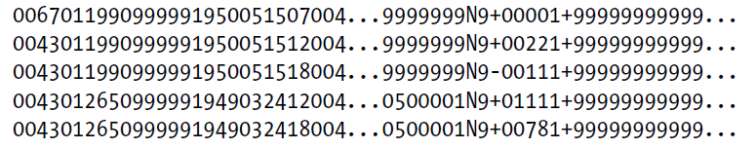
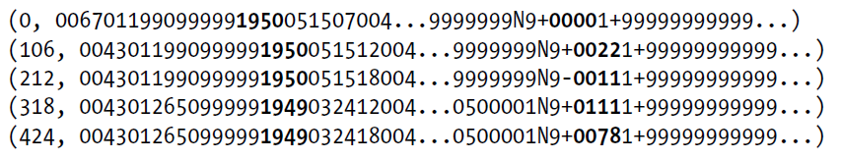
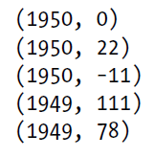
What does the Mapper Do?
Pull out the year and the temperature
Indeed in this example, the map phase is simply data preparation phase
Drop bad records(filtering)
Input File
Output of Map Function (key, value)
Input of Map Function (key, value)
Map

Slide 58
Map Input and Output
Input
Key: offset of the line (unnecessary)
The dataset is quite large and contains a huge number of lines
LongWritable
Value: each line of the files (string)
Text
Output
Key: year
Both string or integer format
Text/IntWritable
Value: temperature
Integer is already enough to store it
IntWritable
Combiner and Partitioner?

Slide 59
What does the Reducer Do?
Reducer input
(year, [temperature1, temperature2, temperature3, …])
Scan all values received for the key, and find out the maximum one
Reducer output
Key: year
String/IntWritable
Value: maximum temperature
IntWritable

Slide 60


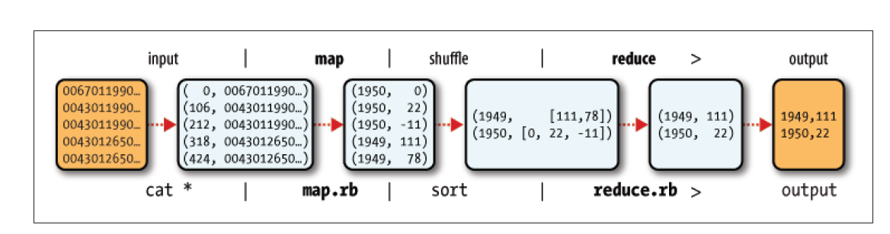
MapReduce Design of NCDC Example
The output from the map function is processed by MapReduce framework
Sorts and groups the key-value pairs by key
Sort and Group By
Reduce function iterates through the list and pick up the maximum value
Reduce

Slide 61
Java Implementation of the Example
public class MaxTemperatureMapper extends Mapper<LongWritable, Text, Text, IntWritable> {
private static final int MISSING = 9999;
@Override
public void map(LongWritable key, Text value, Context context) throws IOException, InterruptedException {
String line = value.toString();
String year = line.substring(15, 19);
int airTemperature;
if (line.charAt(87) == '+') {
airTemperature = Integer.parseInt(line.substring(88, 92));
} else {
airTemperature = Integer.parseInt(line.substring(87, 92));
}
String quality = line.substring(92, 93);
if (airTemperature != MISSING && quality.matches("[01459]")) {
context.write(new Text(year), new IntWritable(airTemperature));
}
}
}

Slide 62
Java Implementation of the Example
public class MaxTemperatureReducer
extends Reducer<Text, IntWritable, Text, IntWritable> {
@Override
public void reduce(Text key, Iterable<IntWritable> values,
Context context) throws IOException, InterruptedException {
int maxValue = Integer.MIN_VALUE;
for (IntWritable value : values) {
maxValue = Math.max(maxValue, value.get());
}
context.write(key, new IntWritable(maxValue));
}
}

Slide 63
Java Implementation of the Example
public class MaxTemperatureWithCombiner {
//specify the usage of the job
public static void main(String[] args) throws Exception {
if (args.length != 2) {
System.err.println("Usage: MaxTemperatureWithCombiner <input path> " + "<output path>");
System.exit(-1);
}
//Construct a job object to configure, control and run the job
Job job = new Job();
job.setJarByClass(MaxTemperatureWithCombiner.class);
job.setJobName("Max temperature");
//Specify input and output paths
FileInputFormat.addInputPath(job, new Path(args[0]));
FileOutputFormat.setOutputPath(job, new Path(args[1]));
//Specify map and reduce classes, also a combiner
job.setMapperClass(MaxTemperatureMapper.class);
job.setCombinerClass(MaxTemperatureReducer.class);
job.setReducerClass(MaxTemperatureReducer.class);
//Specify output type
job.setOutputKeyClass(Text.class);
job.setOutputValueClass(IntWritable.class);
//submit the job and wait for completion
System.exit(job.waitForCompletion(true) ? 0 : 1);
}
}
Codes can be found here:
http://hadoopbook.com/code.html

Slide 64
MapReduce Algorithm Design Patterns

Slide 65
Design Pattern 1: In-mapper Combining

Slide 66
Importance of Local Aggregation
Ideal scaling characteristics:
Twice the data, twice the running time
Twice the resources, half the running time
Why can’t we achieve this?
Data synchronization requires communication
Communication kills performance
Thus… avoid communication!
Reduce intermediate data via local aggregation
Combiners can help

Slide 67
WordCount Baseline
What’s the impact of combiners?

Slide 68
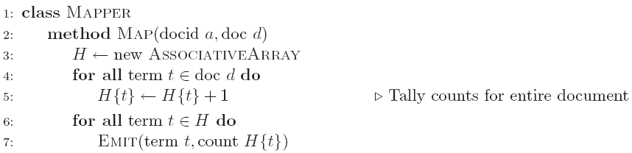
Word Count: Version 1
Are combiners still needed?

Slide 69
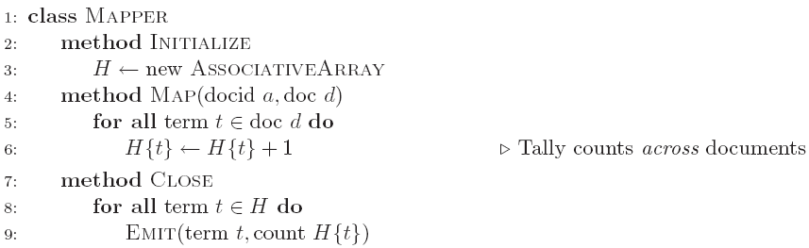
Word Count: Version 2
Key: preserve state across input key-value pairs!
Are combiners still needed?

Slide 70
Design Pattern for Local Aggregation
“In-mapper combining”
Fold the functionality of the combiner into the mapper by preserving state across multiple map calls
Advantages
Speed
Why is this faster than actual combiners?
Disadvantages
Explicit memory management required
Potential for order-dependent bugs

Slide 71
Combiner Design
Combiners and reducers share same method signature
Sometimes, reducers can serve as combiners
Often, not…
Remember: combiner are optional optimizations
Should not affect algorithm correctness
May be run 0, 1, or multiple times
Example: find average of all integers associated with the same key

Slide 72
References
Chapter 2, Hadoop The Definitive Guide
Chapters 2, 3.1 and 3.2. Data-Intensive Text Processing with MapReduce. Jimmy Lin and Chris Dyer. University of Maryland, College Park.

Slide 73
End of Chapter2

