Slide 1

COMP9313: Big Data Management Lecturer: Xin Cao Course web site: http://www.cse.unsw.edu.au/~cs9313/

Slide 2
About the First Assignment
Problem setting
Ignore terms starting with non-alphabetical characters
Convert all terms to lower case
The length of the term is obtained by the length() function of String
Length of “text234sdf” is 10
Use the tokenizer give in Lab 3
Example input and output are given
Number of reducers: 1
Make sure that each file can be compiled independently
Remove all debugging relevant code
Submission
Two java files
Two ways
Deadline: 27 Aug 2017, 09:59:59 pm

Slide 3
Review of Lab 2
Package a MapReduce job as a jar via command line
Eclipse + Hadoop plugin
Connect to HDFS and manage files
Create MapReduce project
Writing MapReduce program
Debugging MapReduce job
Eclipse debug perspective
Print debug info to stdout/stderr and Hadoop system logs
Package a MapReduce job as a jar
Check logs of a MapReduce job
Count the number of words that start with each letter

Slide 4
Letter Count
Identify the input and output for a given problem:
Input: (docid, doc)
Output: (letter, count)
Mapper design:
Input: (docid, doc)
Output: (letter, 1)
Map idea: for each word in doc, emit a pair in which the key is the starting letter, and the value is 1
Reducer design:
Input: (letter, (1,1,…,1))
Output: (letter, count)
Reduce idea: aggregate all the values for the same key “letter”
Combiner, Reducer and Main are the same as that in WordCount.java

Slide 5
Mapper
public static class TokenizerMapper
extends Mapper<Object, Text, Text, IntWritable>{
private final static IntWritable one = new IntWritable(1);
private Text word = new Text();
public void map(Object key, Text value, Context context) throws IOException, InterruptedException {
StringTokenizer itr = new StringTokenizer(value.toString());
while (itr.hasMoreTokens()) {
//convert to lowercase
char c = itr.nextToken().toLowerCase().charAt(0);
//check whether the first letter is a character
if(c <= 'z' && c >= 'a'){
word.set(String.valueOf(c));
context.write(word, one);
}
}
}
}

Slide 6
MapReduce Algorithm Design Patterns
In-mapper combining, where the functionality of the combiner is moved into the mapper.
The related patterns “pairs” and “stripes” for keeping track of joint events from a large number of observations.
“Order inversion”, where the main idea is to convert the sequencing of computations into a sorting problem.
“Value-to-key conversion”, which provides a scalable solution for secondary sorting.

Slide 7
Chapter 4: MapReduce III

Slide 8
MapReduce in Real World: Search Engine
Information retrieval (IR)
Focus on textual information (= text/document retrieval)
Other possibilities include image, video, music, …
Boolean Text retrieval
Each document or query is treated as a “bag” of words or terms. Word sequence is not considered
Query terms are combined logically using the Boolean operators AND, OR, and NOT.
E.g., ((data AND mining) AND (NOT text))
Retrieval
Given a Boolean query, the system retrieves every document that makes the query logically true.
Called exact match
The retrieval results are usually quite poor because term frequency is not considered and results are not ranked

Slide 9
Boolean Text Retrieval: Inverted Index
The inverted index of a document collection is basically a data structure that
attaches each distinctive term with a list of all documents that contains the term.
The documents containing a term are sorted in the list
Thus, in retrieval, it takes constant time to
find the documents that contains a query term.
multiple query terms are also easy handle as we will see soon.

Slide 10
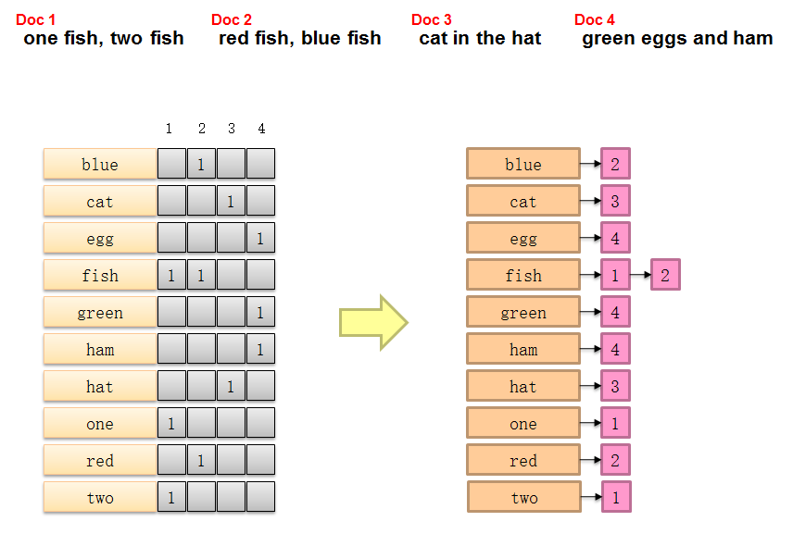
Boolean Text Retrieval: Inverted Index

Slide 11
Search Using Inverted Index
Given a query q, search has the following steps:
Step 1 (vocabulary search): find each term/word in q in the inverted index.
Step 2 (results merging): Merge results to find documents that contain all or some of the words/terms in q.
Step 3 (Rank score computation): To rank the resulting documents/pages, using:
content-based ranking
link-based ranking
Not used in Boolean retrieval

Slide 12
Boolean Query Processing: AND
Consider processing the query: Brutus AND Caesar
Locate Brutus in the Dictionary;
Retrieve its postings.
Locate Caesar in the Dictionary;
Retrieve its postings.
“Merge” the two postings:
Walk through the two postings simultaneously, in time linear in the total number of postings entries
2
4
4
8
16
16
128
2
8
32
64
128
32
64
Brutus
2
8
1
2
5
8
13
21
34
Caesar
1
2
3
5
8
13
21
34
3
If the list lengths are x and y, the merge takes O(x+y) operations.
Crucial: postings sorted by docID.

Slide 13
MapReduce it?
The indexing problem
Scalability is critical
Must be relatively fast, but need not be real time
Fundamentally a batch operation
Incremental updates may or may not be important
For the web, crawling is a challenge in itself
The retrieval problem
Must have sub-second response time
For the web, only need relatively few results
Perfect for MapReduce!
Uh… not so good…

Slide 14
MapReduce: Index Construction
Input: documents: (docid, doc), ..
Output: (term, [docid, docid, …])
E.g., (long, [1, 23, 49, 127, …])
The docid are sorted !! (used in query phase)
docid is an internal document id, e.g., a unique integer. Not an external document id such as a URL
How to do it in MapReduce?

Slide 15
MapReduce: Index Construction
A simple approach:
Each Map task is a document parser
Input: A stream of documents
(1, long ago …), (2, once upon …)
Output: A stream of (term, docid) tuples
(long, 1) (ago, 1) … (once, 2) (upon, 2) …
Reducers convert streams of keys into streams of inverted lists
Input: (long, [1, 127, 49, 23, …])
The reducer sorts the values for a key and builds an inverted list
Longest inverted list must fit in memory
Output: (long, [1, 23, 49, 127, …])
Problems?
Inefficient
docids are sorted in reducers

Slide 16
Ranked Text Retrieval
Order documents by how likely they are to be relevant
Estimate relevance(q, d_{i})
Sort documents by relevance
Display sorted results
User model
Present hits one screen at a time, best results first
At any point, users can decide to stop looking
How do we estimate relevance?
Assume document is relevant if it has a lot of query terms
Replace relevance(q, d_{i}) with sim(q, d_{i})
Compute similarity of vector representations
Vector space model/cosine similarity, language models, …

Slide 17
Term Weighting
Term weights consist of two components
Local: how important is the term in this document?
Global: how important is the term in the collection?
Here’s the intuition:
Terms that appear often in a document should get high weights
Terms that appear in many documents should get low weights
How do we capture this mathematically?
TF: Term frequency (local)
IDF: Inverse document frequency (global)

Slide 18
TF.IDF Term Weighting
weight assigned to term i in document j
number of occurrence of term i in document j
number of documents in entire collection
number of documents with term i

Slide 19
Retrieval in a Nutshell
Look up postings lists corresponding to query terms
Traverse postings for each query term
Store partial query-document scores in accumulators
Select top k results to return

Slide 20
MapReduce: Index Construction
Input: documents: (docid, doc), ..
Output: (t, [(docid, w_{t}), (docid, w), …])
w_{t} represents the term weight of t in docid
E.g., (long, [(1, 0.5), (23, 0.2), (49, 0.3), (127,0.4), …])
The docid are sorted !! (used in query phase)
How this problem differs from the previous one?
TF computing
Easy. Can be done within the mapper
IDF computing
Known only after all documents containing a term t processed
Input and output of map and reduce?

Slide 21
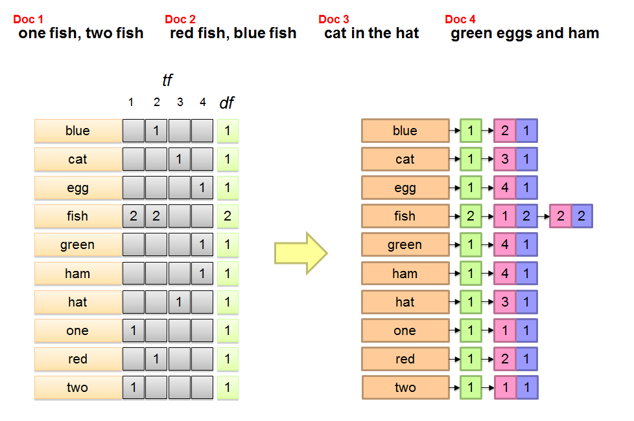
Inverted Index: TF-IDF

Slide 22
MapReduce: Index Construction
A simple approach:
Each Map task is a document parser
Input: A stream of documents
(1, long ago …), (2, once upon …)
Output: A stream of (term, [docid, tf]) tuples
(long, [1,1]) (ago, [1,1]) … (once, [2,1]) (upon, [2,1]) …
Reducers convert streams of keys into streams of inverted lists
Input: (long, {[1,1], [127,2], [49,1], [23,3] …})
The reducer sorts the values for a key and builds an inverted list
Compute TF and IDF in reducer!
Output: (long, [(1, 0.5), (23, 0.2), (49, 0.3), (127,0.4), …])

Slide 23
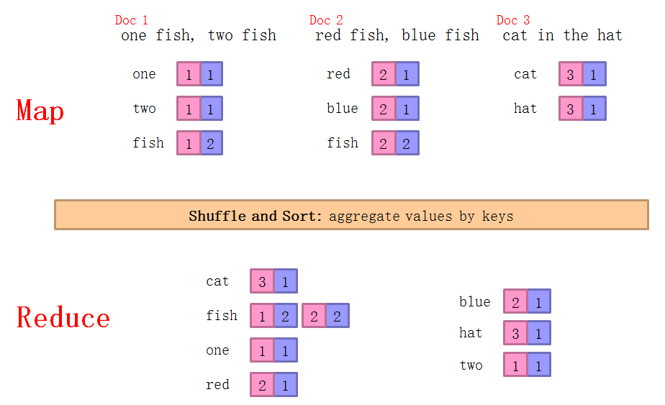
MapReduce: Index Construction

Slide 24
MapReduce: Index Construction
Inefficient: terms as keys, postings as values
docids are sorted in reducers
IDF can be computed only after all relevant documents received
Reducers must buffer all postings associated with key (to sort)
What if we run out of memory to buffer postings?
Improvement?

Slide 25
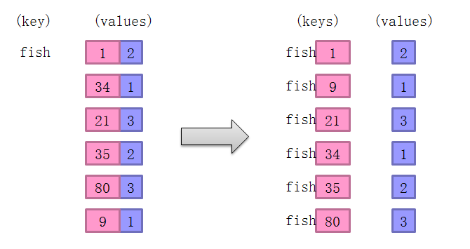
The First Improvement
How to make Hadoop sort the docid, instead of doing it in reducers?
Design pattern: value-to-key conversion, secondary sort
Mapper output a stream of ([term, docid], tf) tuples
Remember: you must implement a partitioner on term!

Slide 26
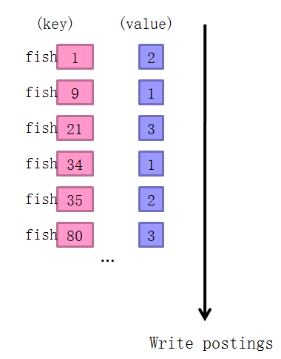
The Second Improvement
How to avoid buffering all postings associated with key?
We’d like to store the DF at the front of the postings list
But we don’t know the DF until we’ve seen all postings!
Sound familiar?
Design patter: Order inversion

Slide 27
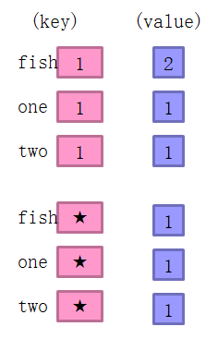
The Second Improvement
Getting the DF
In the mapper:
Emit “special” key-value pairs to keep track of DF
In the reducer:
Make sure “special” key-value pairs come first: process them to determine DF
Remember: proper partitioning!
Emit normal key-value pairs…
Emit “special” key-value pairs to keep track of df…
Doc1: one fish, two fish

Slide 28
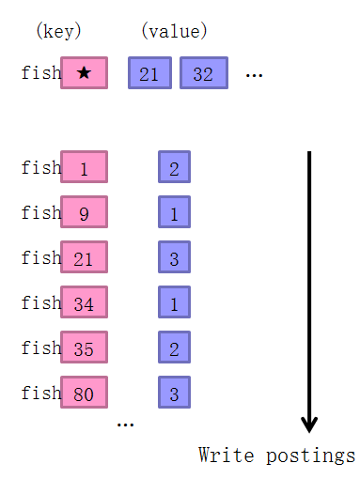
The Second Improvement
First, compute the DF by summing contributions from all “special” key-value pair…
Write the DF…
Important: properly define sort order to make sure “special” key-value pairs come first!

Slide 29
Retrieval with MapReduce?
MapReduce is fundamentally batch-oriented
Optimized for throughput, not latency
Startup of mappers and reducers is expensive
MapReduce is not suitable for real-time queries!
Use separate infrastructure for retrieval…
Real world search engines much more complex and sophisticated

Slide 30
Miscellaneous

Slide 31
MapReduce Counters
Instrument Job’s metrics
Gather statistics
Quality control – confirm what was expected.
E.g., count invalid records
Application level statistics.
Problem diagnostics
Try to use counters for gathering statistics instead of log files
Framework provides a set of built-in metrics
For example bytes processed for input and output
User can create new counters
Number of records consumed
Number of errors or warnings

Slide 32
Built-in Counters
Hadoop maintains some built-in counters for every job.
Several groups for built-in counters
File System Counters – number of bytes read and written
Job Counters – documents number of map and reduce tasks launched, number of failed tasks
Map-Reduce Task Counters– mapper, reducer, combiner input and output records counts, time and memory statistics

Slide 33
User-Defined Counters
You can create your own counters
Counters are defined by a Java enum
serves to group related counters
E.g.,
enum Temperature { MISSING, MALFORMED }
Increment counters in Reducer and/or Mapper classes
Counters are global: Framework accurately sums up counts across all maps and reduces to produce a grand total at the end of the job

Slide 34
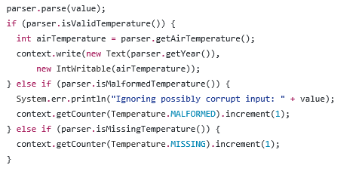
Implement User-Defined Counters
Retrieve Counter from Context object
Framework injects Context object into map and reduce methods
Increment Counter’s value
Can increment by 1 or more

Slide 35
Implement User-Defined Counters
Get Counters from a finished job in Java
Counter counters = job.getCounters()
Get the counter according to name
Counter c1 = counters.findCounter(Temperature.MISSING)
Enumerate all counters after job is completed
for (CounterGroup group : counters) {
System.out.println("* Counter Group: " + group.getDisplayName() + " (" + group.getName() + ")");
System.out.println(" number of counters in this group: " + group.size());
for (Counter counter : group) {
System.out.println(" - " + counter.getDisplayName() + ": " + counter.getName() + ": "+counter.getValue());
}
}

Slide 36
MapReduce SequenceFile
File operations based on binary format rather than text format
SequenceFile class prvoides a persistent data structure for binary key-value pairs, e.g.,
Key: timestamp represented by a LongWritable
Value: quantity being logged represented by a Writable
Use SequenceFile in MapReduce:
job.setinputFormatClass(SequenceFileOutputFormat.class);
job.setOutputFormatClass(SequenceFileOutputFormat.class);
In Mapreduce by default TextInputFormat

Slide 37
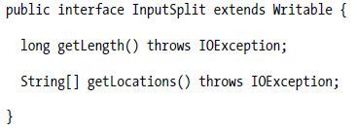
MapReduce Input Formats
InputSplit
A chunk of the input processed by a single map
Each split is divided into records
Split is just a reference to the data (doesn’t contain the input data)
RecordReader
Iterate over records
Used by the map task to generate record key-value pairs
As a MapReduce application programmer, we do not need to deal with InputSplit directly, as they are created in InputFormat
In MapReduce, by default TextInputFormat and LineRecordReader

Slide 38
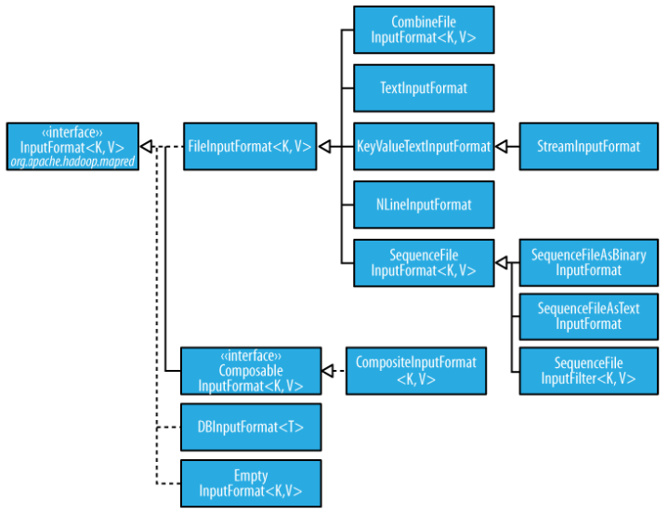
MapReduce InputFormat

Slide 39
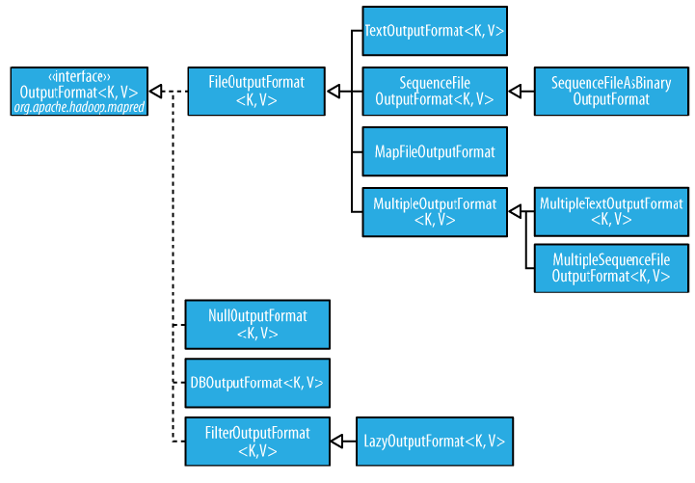
MapReduce OutputFormat

Slide 40
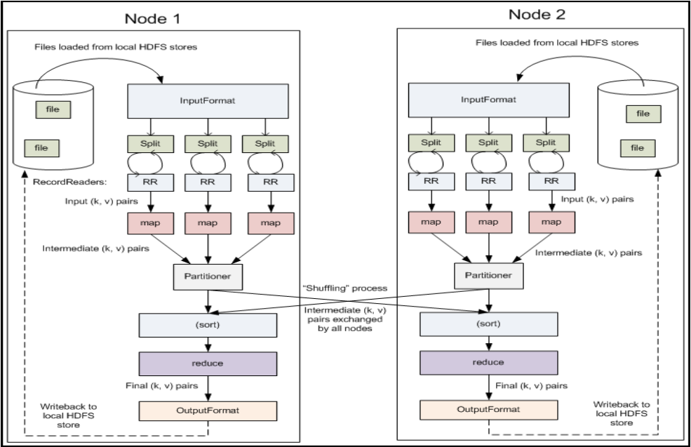
Detailed Hadoop MapReduce Data Flow

Slide 41
Creating Inverted Index
Given you a large text file containing the contents of huge amount of webpages, in which each webpage starts with “<DOC>” and ends with “</DOC>”, your task is to create an inverted index for these documents.
A sample file
Procedure:
Implement a custom RecordReader
Implement a custom InputFormat, and overwrite the CreateRecordReader() function to return your self-defined RecordReader object
Configure the InputFormat class in the main function using job.setInputFormatClass()
Try to finish this task using the sample file

Slide 42
Compression
Two major benefits of file compression
Reduce the space needed to store files
Speed up data transfer across the network
When dealing with large volumes of data, both of these savings can be significant, so it pays to carefully consider how to use compression in Hadoop

Slide 43
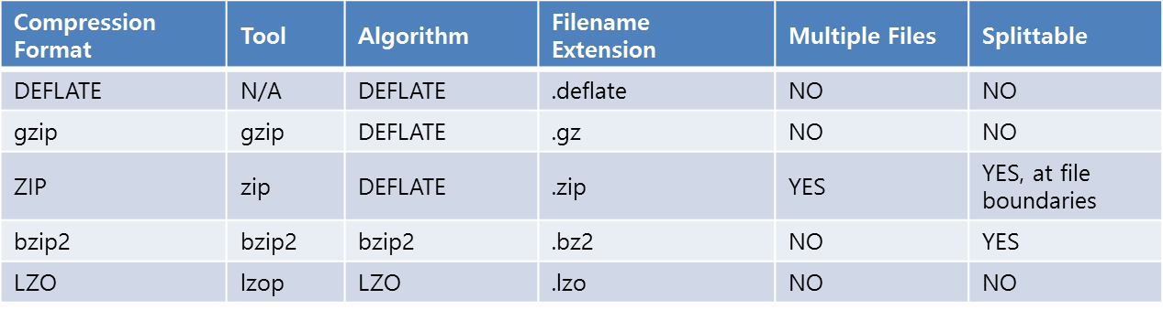
Compression Formats
Compression formats
“Splittable” column
Indicates whether the compression format supports splitting
Whether you can seek to any point in the stream and start reading from some point further on
Splittable compression formats are especially suitable for MapReduce

Slide 44
Compression and Input Splits
When considering how to compress data that will be processed by MapReduce, it is important to understand whether the compression format supports splitting
Example of not-splitable compression problem
A file is a gzip-compressed file whose compressed size is 1 GB
Creating a split for each block won’t work since it is impossible to start reading at an arbitrary point in the gzip stream, and therefore impossible for a map task to read its split independently of the others

Slide 45
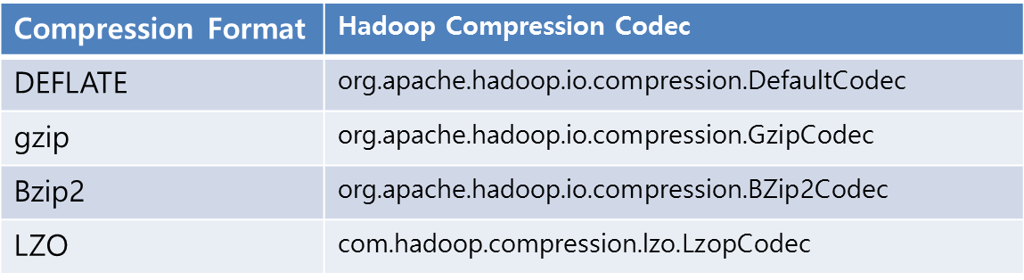
Codecs
A codec is the implementation of a compression-decompression algorithm
CompressionCodec
createOutputStream(OutputStream out): create a CompressionOutputStream to which you write your uncompressed data to have it written in compressed form to the underlying stream
createInputStream(InputStream in): obtain a CompressionInputStream, which allows you to read uncompressed data from the underlying stream

Slide 46
Example
The program get the codec from the argument and compress the input from stdin
public class StreamCompressor {
public static void main(String[] args) throws Exception {
String codecClassname = args[0];
Class<?> codecClass = Class.forName(codecClassname);
Configuration conf = new Configuration();
CompressionCodec codec = (CompressionCodec)
ReflectionUtils.newInstance(codecClass, conf);
CompressionOutputStream out = codec.createOutputStream(System.out);
IOUtils.copyBytes(System.in, out, 4096, false);
out.finish();
}
}
% echo "Text" | hadoop StreamCompressor org.apache.hadoop.io.compress.GzipCodec \
| gunzip -
Text

Slide 47
Use Compression in MapReduce
If the input files are compressed, they will be decompressed automatically as they are read by MapReduce, using the filename extension to determine which codec to use.
We do not need to do anything unless to guarantee that the filename extension is correct
In order to compress the output of a MapReduce job, you need to:
Set the mapreduce.output.fileoutputformat.compress property to true
Set the mapreduce.output.fileoutputformat.compress.codec property to the classname of the compression codec
Use the static method of FileOutputFormat to set these properties

Slide 48
Use Compression in MapReduce
In WordCount.java, you can do:
public static void main(String[] args) throws Exception {
Configuration conf = new Configuration();
Job job = Job.getInstance(conf, "word count");
job.setJarByClass(WordCount.class);
job.setMapperClass(TokenizerMapper.class);
job.setReducerClass(IntSumReducer.class);
job.setOutputKeyClass(Text.class);
job.setOutputValueClass(IntWritable.class);
FileInputFormat.addInputPath(job, new Path(args[0]));
FileOutputFormat.setOutputPath(job, new Path(args[1]));
FileOutputFormat.setCompressOutput(job, true);
FileOutputFormat.setOutputCompressorClass(job, GzipCodec.class);
System.exit(job.waitForCompletion(true) ? 0 : 1);
}

Slide 49
Methods to Write MapReduce Jobs
Typical – usually written in Java
MapReduce 2.0 API
MapReduce 1.0 API
Streaming
Uses stdin and stdout
Can use any language to write Map and Reduce Functions
C#, Python, JavaScript, etc…
Pipes
Often used with C++
Abstraction libraries
Hive, Pig, etc… write in a higher level language, generate one or more MapReduce jobs

Slide 50
Number of Maps and Reduces
Maps
The number of maps is usually driven by the total size of the inputs, that is, the total number of blocks of the input files.
The right level of parallelism for maps seems to be around 10-100 maps per-node, although it has been set up to 300 maps for very cpu-light map tasks.
If you expect 10TB of input data and have a blocksize of 128MB, you’ll end up with 82,000 maps, unless Configuration.set(MRJobConfig.NUM_MAPS, int) (which only provides a hint to the framework) is used to set it even higher.
Reduces
The right number of reduces seems to be 0.95 or 1.75 multiplied by (<no. of nodes> * <no. of maximum containers per node>)
With 0.95 all of the reduces can launch immediately and start transferring map outputs as the maps finish. With 1.75 the faster nodes will finish their first round of reduces and launch a second wave of reduces doing a much better job of load balancing.
Use job.setNumReduceTasks(int) to set the number

Slide 51
MapReduce Advantages
Automatic Parallelization:
Depending on the size of RAW INPUT DATA ➔ instantiate multiple MAP tasks
Similarly, depending upon the number of intermediate <key, value> partitions ➔ instantiate multiple REDUCE tasks
Run-time:
Data partitioning
Task scheduling
Handling machine failures
Managing inter-machine communication
Completely transparent to the programmer/analyst/user

Slide 52
The Need
Special-purpose programs to process large amounts of data: crawled documents, Web Query Logs, etc.
At Google and others (Yahoo!, Facebook):
Inverted index
Graph structure of the WEB documents
Summaries of #pages/host, set of frequent queries, etc.
Ad Optimization
Spam filtering

Slide 53
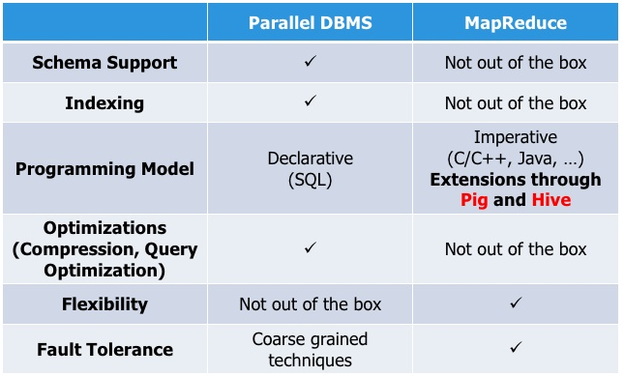
Map Reduce vs Parallel DBMS
Pavlo et al., SIGMOD 2009, Stonebraker et al., CACM 2010, …

Slide 54
Practice： Design MapReduce Algorithms
Counting total enrollments of two specified courses
Input Files: A list of students with their enrolled courses
Jamie: COMP9313, COMP9318
Tom: COMP9331, COMP9313
… …
Mapper selects records and outputs initial counts
Input: Key – student, value – a list of courses
Output: (COMP9313, 1), (COMP9318, 1), …
Reducer accumulates counts
Input: (COMP9313, [1, 1, …]), (COMP9318, [1, 1, …])
Output: (COMP9313, 16), (COMP9318, 35)

Slide 55
Practice： Design MapReduce Algorithms
Remove duplicate records
Input: a list of records
2013-11-01 aa 2013-11-02 bb 2013-11-03 cc 2013-11-01 aa 2013-11-03 dd
Mapper
Input (record_id, record)
Output (record, “”)
E.g., (2013-11-01 aa, “”), (2013-11-02 bb, “”), …
Reducer
Input (record, [“”, “”, “”, …])
E.g., (2013-11-01 aa, [“”, “”]), (2013-11-02 bb, [“”]), …
Output (record, “”)

Slide 56
Practice： Design MapReduce Algorithms
Assume that in an online shopping system, a huge log file stores the information of each transaction. Each line of the log is in format of “userID\t product\t price\t time”. Your task is to use MapReduce to find out the top-5 expensive products purchased by each user in 2016
Mapper:
Input(transaction_id, transaction)
initialize an associate array H(UserID, priority queue Q of log record based on price)
map(): get local top-5 for each user
cleanup(): emit the entries in H
Reducer:
Input(userID, list of queues[])
get top-5 products from the list of queues

Slide 57
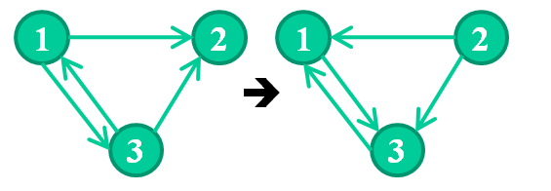
Practice： Design MapReduce Algorithms
Reverse graph edge directions & output in node order
Input: adjacency list of graph (3 nodes and 4 edges)
(3, [1, 2]) (1, [3])
(1, [2, 3]) ➔ (2, [1, 3])
(3, [1])
Note, the node_ids in the output values are also sorted. But Hadoop only sorts on keys!
Solutions: Secondary sort

Slide 58
Practice： Design MapReduce Algorithms
Map
Input: (3, [1, 2]), (1, [2, 3]).
Intermediate: (1, [3]), (2, [3]), (2, [1]), (3, [1]). (reverse direction)
Output: (<1, 3>, [3]), (<2, 3>, [3]), (<2, 1>, [1]), (<3, 1>, [1]).
Copy node_ids from value to key.
Partition on Key.field1, and Sort on whole Key (both fields)
Input: (<1, 3>, [3]), (<2, 3>, [3]), (<2, 1>, [1]), (<3, 1>, [1])
Output: (<1, 3>, [3]), (<2, 1>, [1]), (<2, 3>, [3]), (<3, 1>, [1])
Grouping comparator
Merge according to part of the key
Output: (<1, 3>, [3]), (<2, 1>, [1, 3]), (<3, 1>, [1]) this will be the reducer’s input
Reducer
Merge according to part of the key
Output: (1, [3]), (2, [1, 3]), (3, [1])

Slide 59
HDFS Introduction

Slide 60
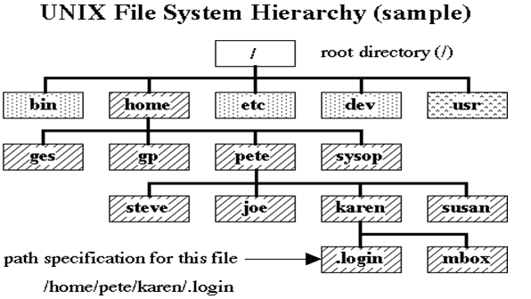
File System
A filesystem is the methods and data structures that an operating system uses to keep track of files on a disk or partition; that is, the way the files are organized on the disk.

Slide 61

How to Move Data to Workers?
In many traditional cluster architectures, storage is viewed as a distinct and separate component from computation.
NAS
SAN
Compute Nodes
What’s the problem here?
As dataset sizes increase, the link between the compute nodes and the storage becomes a bottleneck!

Slide 62
Distributed File System
Don’t move data to workers… move workers to the data!
Store data on the local disks of nodes in the cluster
Start up the workers on the node that has the data local
Why?
Not enough RAM to hold all the data in memory
Disk access is slow (low-latency), but disk throughput is reasonable (high throughput)
A distributed file system is the answer
A distributed file system is a client/server-based application that allows clients to access and process data stored on the server as if it were on their own computer
GFS (Google File System) for Google’s MapReduce
HDFS (Hadoop Distributed File System) for Hadoop

Slide 63
Latency and Throughput
Latency is the time required to perform some action or to produce some result.
Measured in units of time -- hours, minutes, seconds, nanoseconds or clock periods.
I/O latency: the time that it takes to complete a single I/O.
Throughput is the number of such actions executed or results produced per unit of time.
Measured in units of whatever is being produced (e.g., data) per unit of time.
Disk throughput: the maximum rate of sequential data transfer, measured by Mb/sec etc.

Slide 64
GFS: Assumptions
Commodity hardware over “exotic” hardware
Scale “out”, not “up”
High component failure rates
Inexpensive commodity components fail all the time
“Modest” number of huge files
Multi-gigabyte files are common, if not encouraged
Files are write-once, mostly appended to
Perhaps concurrently
Large streaming reads over random access
High sustained throughput over low latency

Slide 65
GFS: Design Decisions
Files stored as chunks
Fixed size (64MB)
Reliability through replication
Each chunk replicated across 3+ chunkservers
Single master to coordinate access, keep metadata
Simple centralized management
No data caching
Little benefit due to large datasets, streaming reads
Simplify the API
Push some of the issues onto the client
HDFS = GFS clone (same basic ideas)

Slide 66
From GFS to HDFS
Terminology differences:
GFS master = Hadoop Namenode
GFS chunkservers = Hadoop Datanodes
Functional differences:
HDFS performance is (likely) slower

Slide 67
Assumptions and Goals of HDFS
Very large datasets
10K nodes, 100 million files, 10PB
Streaming data access
Designed more for batch processing rather than interactive use by users
The emphasis is on high throughput of data access rather than low latency of data access.
Simple coherency model
Built around the idea that the most efficient data processing pattern is a write-once read-many-times pattern
A file once created, written, and closed need not be changed except for appends and truncates
“Moving computation is cheaper than moving data”
Data locations exposed so that computations can move to where data resides

Slide 68
Assumptions and Goals of HDFS (Cont’)
Assumes Commodity Hardware
Files are replicated to handle hardware failure
Hardware failure is normal rather than exception. Detect failures and recover from them
Portability across heterogeneous hardware and software platforms
designed to be easily portable from one platform to another
HDFS is not suited for:
Low-latency data access (HBase is a better option)
Lots of small files (NameNodes hold metadata in memory)

Slide 69
HDFS Features
The Hadoop Distributed File System (HDFS) is a distributed file system designed to run on commodity hardware.
Basic Features:
Suitable for applications with large data sets
Streaming access to file system data
High throughput
Can be built out of commodity hardware
Highly fault-tolerant

Slide 70
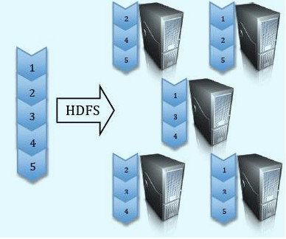
HDFS Architecture
HDFS is a block-structured file system: Files broken into blocks of 64MB or 128MB
A file can be made of several blocks, and they are stored across a cluster of one or more machines with data storage capacity.
Each block of a file is replicated across a number of machines, To prevent loss of data.

Slide 71
HDFS Architecture
HDFS has a master/slave architecture.
There are two types (and a half) of machines in a HDFS cluster
NameNode: the heart of an HDFS filesystem, it maintains and manages the file system metadata. E.g., what blocks make up a file, and on which datanodes those blocks are stored.
Only one in an HDFS cluster
DataNode: where HDFS stores the actual data. Serves read, write requests, performs block creation, deletion, and replication upon instruction from Namenode
A number of DataNodes usually one per node in a cluster.
A file is split into one or more blocks and set of blocks are stored in DataNodes.
Secondary NameNode: NOT a backup of NameNode!!
Checkpoint node. Periodic merge of Transaction log
Help NameNode start up faster next time

Slide 72
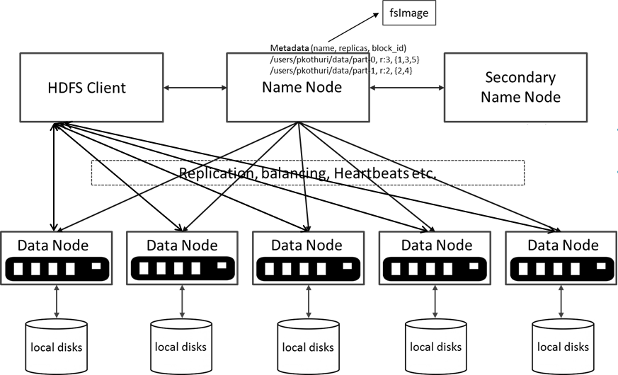
HDFS Architecture

Slide 73
Functions of a NameNode
Managing the file system namespace:
Maintain the namespace tree operations like opening, closing, and renaming files and directories.
Determine the mapping of file blocks to DataNodes (the physical location of file data).
Store file metadata.
Coordinating file operations:
Directs clients to DataNodes for reads and writes
No data is moved through the NameNode
Maintaining overall health:
Collect block reports and heartbeats from DataNodes
Block re-replication and rebalancing
Garbage collection

Slide 74
NameNode Metadata
HDFS keeps the entire namespace in RAM, allowing fast access to the metadata.
4GB of local RAM is sufficient
Types of metadata
List of files
List of Blocks for each file
List of DataNodes for each block
File attributes, e.g. creation time, replication factor
A Transaction Log (EditLog)
Records file creations, file deletions etc

Slide 75
Functions of DataNodes
Responsible for serving read and write requests from the file system’s clients.
Perform block creation, deletion, and replication upon instruction from the NameNode.
Periodically sends a report of all existing blocks to the NameNode (Blockreport)
Facilitates Pipelining of Data
Forwards data to other specified DataNodes

Slide 76
Communication between NameNode and DataDode
Heartbeats
DataNodes send heartbeats to the NameNode to confirm that the DataNode is operating and the block replicas it hosts are available.
Once every 3 seconds
The NameNode marks DataNodes without recent Heartbeats as dead and does not forward any new IO requests to them
Blockreports
A Blockreport contains a list of all blocks on a DataNode
The Namenode receives a Heartbeat and a BlockReport from each DataNode in the cluster periodically

Slide 77
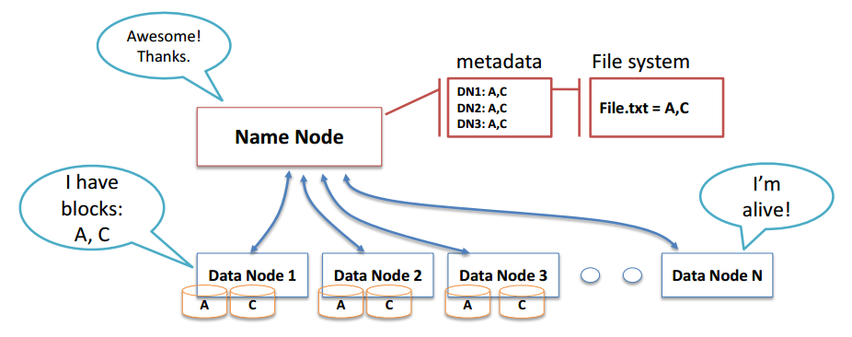
Communication between NameNode and DataDode
TCP – every 3 seconds a Heartbeat
Every 10th heartbeat is a Blockreport
Name Node builds metadata from Blockreports
If Name Node is down, HDFS is down

Slide 78
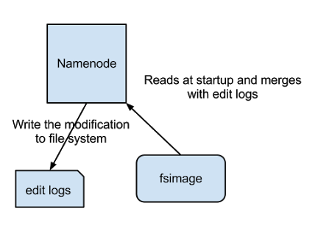
Inside NameNode
FsImage - the snapshot of the filesystem when NameNode started
A master copy of the metadata for the file system
EditLogs - the sequence of changes made to the filesystem after NameNode started

Slide 79
Inside NameNode
Only in the restart of NameNode, EditLogs are applied to FsImage to get the latest snapshot of the file system.
But NameNode restart are rare in production clusters which means EditLogs can grow very large for the clusters where NameNode runs for a long period of time.
EditLog become very large , which will be challenging to manage it
NameNode restart takes long time because lot of changes has to be merged
In the case of crash, we will lost huge amount of metadata since FsImage is very old
How to overcome this issue?

Slide 80
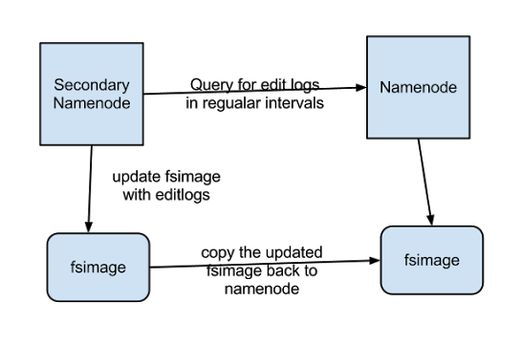
Secondary NameNode
Secondary NameNode helps to overcome the above issues by taking over responsibility of merging EditLogs with FsImage from the NameNode.
It gets the EditLogs from the NameNode periodically and applies to FsImage
Once it has new FsImage, it copies back to NameNode
NameNode will use this FsImage for the next restart, which will reduce the startup time

Slide 81
File System Namespace
Hierarchical file system with directories and files
/user/comp9313
Create, remove, move, rename etc.
NameNode maintains the file system
Any meta information changes to the file system recorded by the NameNode (EditLog).
An application can specify the number of replicas of the file needed: replication factor of the file.

Slide 82
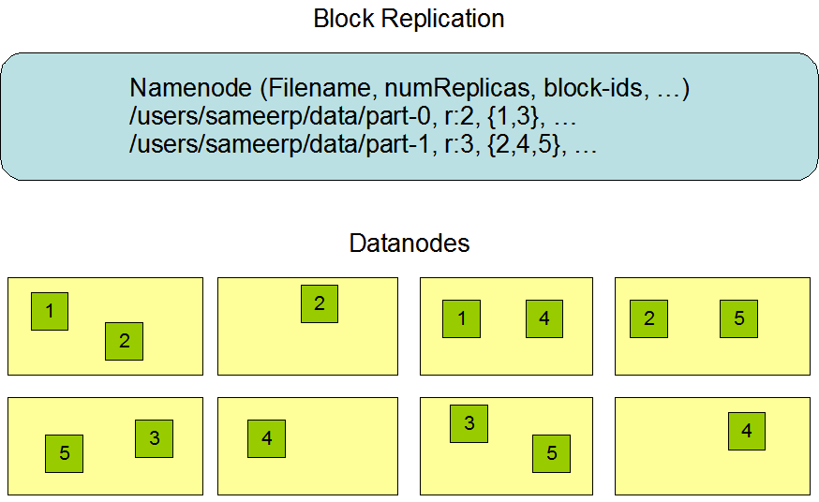
Data Replication
The NameNode makes all decisions regarding replication of blocks.

Slide 83
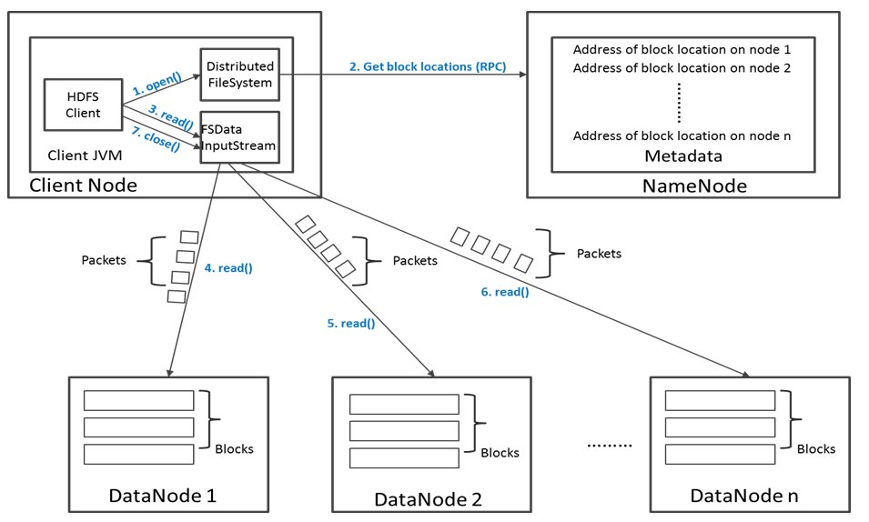
File Read Data Flow in HDFS

Slide 84
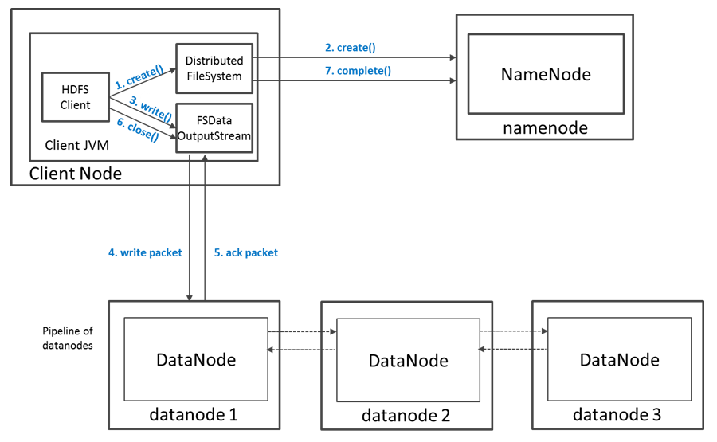
File Write Data Flow in HDFS

Slide 85
Data Pipelining
Client retrieves a list of DataNodes on which to place replicas of a block
Client writes block to the first DataNode
The first DataNode forwards the data to the next node in the Pipeline
When all replicas are written, the Client moves on to write the next block in file

Slide 86
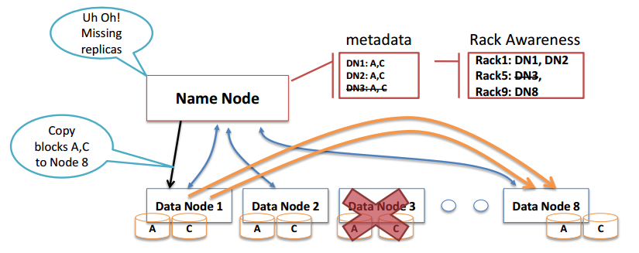
Replication Engine
NameNode detects DataNode failures
Missing Heartbeats signify lost Nodes
NameNode consults metadata, finds affected data
Chooses new DataNodes for new replicas
Balances disk usage
Balances communication traffic to DataNodes

Slide 87
Data Correctness
Use Checksums to validate data
Use CRC32
File Creation
Client computes checksum per 512 byte
DataNode stores the checksum
File access
Client retrieves the data and checksum from DataNode
If Validation fails, Client tries other replicas

Slide 88
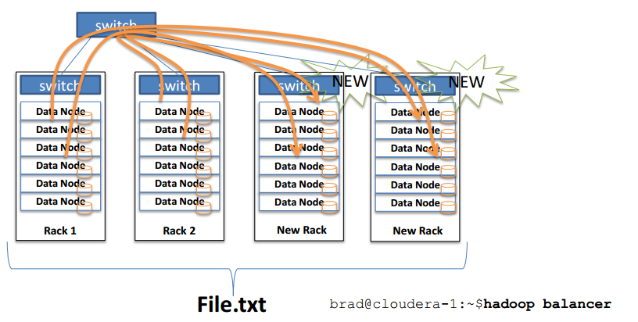
Cluster Rebalancing
Goal: % disk full on DataNodes should be similar
Usually run when new DataNodes are added
Rebalancer is throttled to avoid network congestion
Does not interfere with MapReduce or HDFS
Command line tool

Slide 89
Fault tolerance
Failure is the norm rather than exception
A HDFS instance may consist of thousands of server machines, each storing part of the file system’s data.
Since we have huge number of components and that each component has non-trivial probability of failure means that there is always some component that is non-functional.
Detection of faults and quick, automatic recovery from them is a core architectural goal of HDFS.

Slide 90
Metadata Disk Failure
FsImage and EditLog are central data structures of HDFS. A corruption of these files can cause a HDFS instance to be non-functional.
A NameNode can be configured to maintain multiple copies of the FsImage and EditLog
Multiple copies of the FsImage and EditLog files are updated synchronously

Slide 91
Unique features of HDFS
HDFS has a bunch of unique features that make it ideal for distributed systems:
Failure tolerant - data is duplicated across multiple DataNodes to protect against machine failures. The default is a replication factor of 3 (every block is stored on three machines).
Scalability - data transfers happen directly with the DataNodes so your read/write capacity scales fairly well with the number of DataNodes
Space - need more disk space? Just add more DataNodes and re-balance
Industry standard - Other distributed applications are built on top of HDFS (HBase, Map-Reduce)
HDFS is designed to process large data sets with write-once-read-many semantics, it is not for low latency access

Slide 92
References
HDFS design: https://hadoop.apache.org/docs/current/hadoop-project-dist/hadoop-hdfs/HdfsDesign.html
Hadoop The Definitive Guide. HDFS, Hadoop I/O, and MapReduce Features chapters.
Understanding Hadoop Clusters and the Network. By Brad Hedlund.

Slide 93
End of Chapter 4

