Slide 1

COMP9313: Big Data Management Lecturer: Xin Cao Course web site: http://www.cse.unsw.edu.au/~cs9313/

Slide 2

Chapter 6: Spark

Slide 3
Part 1: Spark Introduction

Slide 4
Motivation of Spark
MapReduce greatly simplified big data analysis on large, unreliable clusters. It is great at one-pass computation.
But as soon as it got popular, users wanted more:
More complex, multi-pass analytics (e.g. ML, graph)
More interactive ad-hoc queries
More real-time stream processing
All 3 need faster data sharing across parallel jobs
One reaction: specialized models for some of these apps, e.g.,
Pregel (graph processing)
Storm (stream processing)

Slide 5
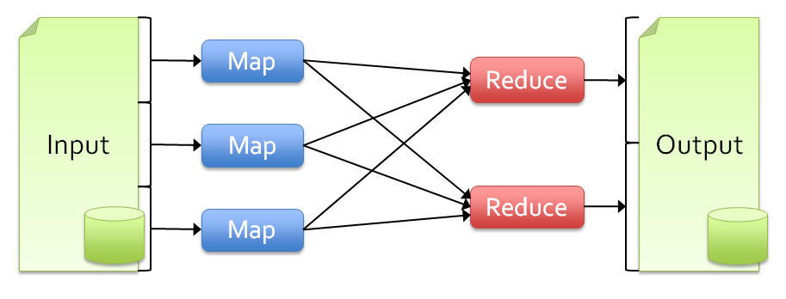
Limitations of MapReduce
As a general programming model:
It is more suitable for one-pass computation on a large dataset
Hard to compose and nest multiple operations
No means of expressing iterative operations
As implemented in Hadoop
All datasets are read from disk, then stored back on to disk
All data is (usually) triple-replicated for reliability
Not easy to write MapReduce programs using Java
Benefits of data flow: runtime can decide where to run tasks and can automatically recover from failures

Slide 6
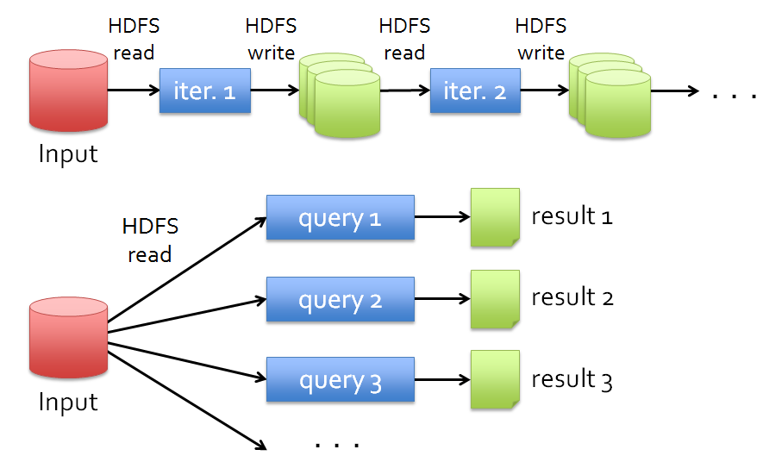
Data Sharing in MapReduce
Slow due to replication, serialization, and disk IO
Complex apps, streaming, and interactive queries all need one thing that MapReduce lacks:
Efficient primitives for data sharing

Slide 7
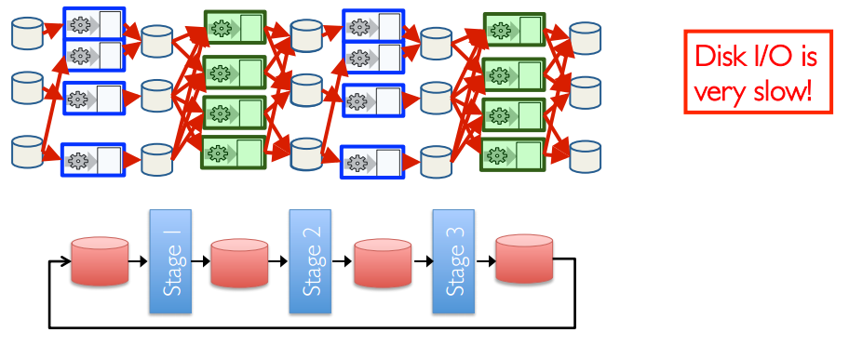
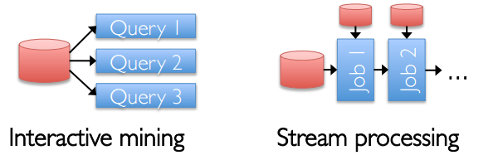
Data Sharing in MapReduce
Iterative jobs involve a lot of disk I/O for each repetition
Interactive queries and online processing involves lots of disk I/O

Slide 8
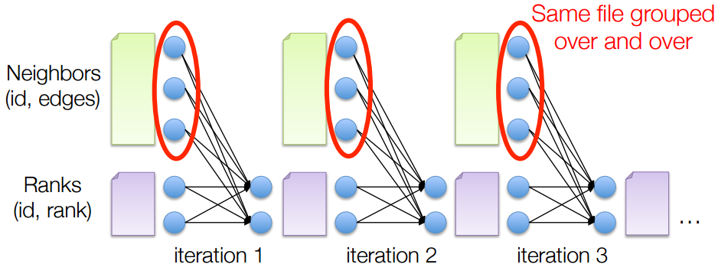
Example: PageRank
Repeatedly multiply sparse matrix and vector
Requires repeatedly hashing together page adjacency lists and rank vector

Slide 9



Hardware for Big Data
Lots of hard drives
Lots of CPUs
And lots of memory!

Slide 10
Goals of Spark
Keep more data in-memory to improve the performance!
Extend the MapReduce model to better support two common classes of analytics apps:
Iterative algorithms (machine learning, graphs)
Interactive data mining
Enhance programmability:
Integrate into Scala programming language
Allow interactive use from Scala interpreter

Slide 11
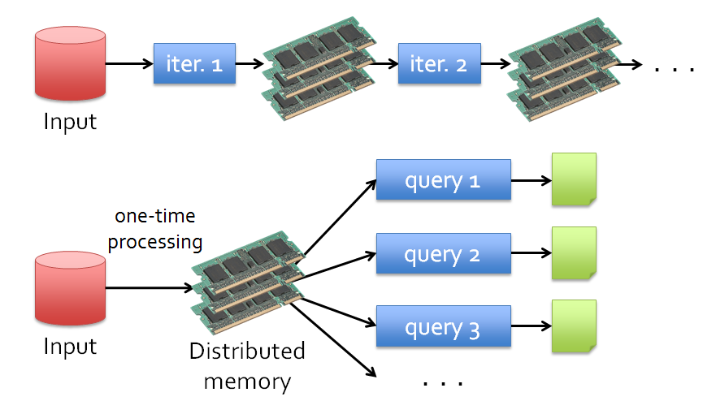
Data Sharing in Spark Using RDD
10-100× faster than network and disk

Slide 12
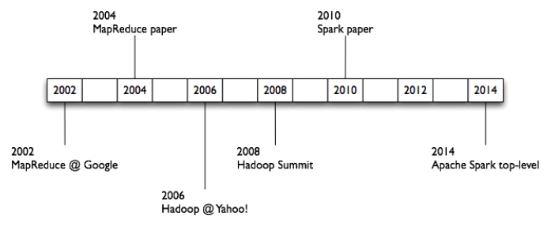
What is Spark
One popular answer to “What’s beyond MapReduce?”
Open-source engine for large-scale data processing
Supports generalized dataflows
Written in Scala, with bindings in Java and Python
Brief history:
Developed at UC Berkeley AMPLab in 2009
Open-sourced in 2010
Became top-level Apache project in February 2014
Commercial support provided by DataBricks

Slide 13
What is Spark
Fast and expressive cluster computing system interoperable with Apache Hadoop
Improves efficiency through:
In-memory computing primitives
General computation graphs
Improves usability through:
Rich APIs in Scala, Java, Python
Interactive shell
Spark is not
a modified version of Hadoop
dependent on Hadoop because it has its own cluster management
Spark uses Hadoop for storage purpose only
Up to 100× faster
(10× on disk)
Often 5× less code

Slide 14
What is Spark
Spark is the basis of a wide set of projects in the Berkeley Data Analytics Stack (BDAS)
Spark SQL (SQL on Spark)
Spark Streaming (stream processing)
GraphX (graph processing)
MLlib (machine learning library)
Shark (SQL)
Spark Streaming
(real-time)
GraphX
(graph)
MLlib
(machine learning)
…
Spark Core

Slide 15
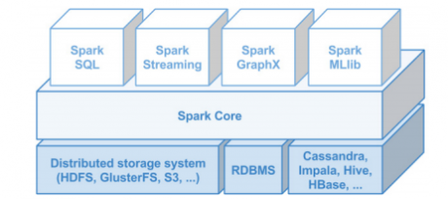
Data Sources
Local Files
file:///opt/httpd/logs/access_log
S3
Hadoop Distributed Filesystem
Regular files, sequence files, any other Hadoop InputFormat
HBase, Cassandra, etc.

Slide 16
Spark Ideas
Expressive computing system, not limited to map-reduce model
Facilitate system memory
avoid saving intermediate results to disk
cache data for repetitive queries (e.g. for machine learning)
Layer an in-memory system on top of Hadoop.
Achieve fault-tolerance by re-execution instead of replication

Slide 17
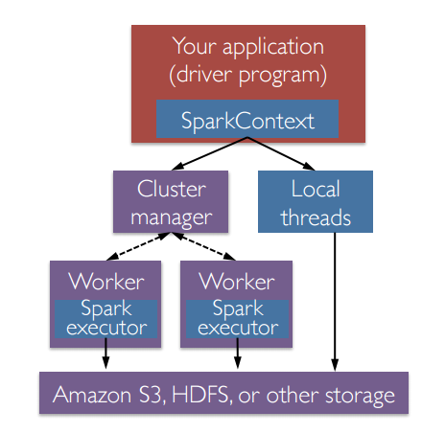
Spark Workflow
A Spark program first creates a SparkContext object
Tells Spark how and where to access a cluster
Connect to several types of cluster managers (e.g., YARN, Mesos, or its own manager)
Cluster manager:
Allocate resources across applications
Spark executor:
Run computations
Access data storage

Slide 18
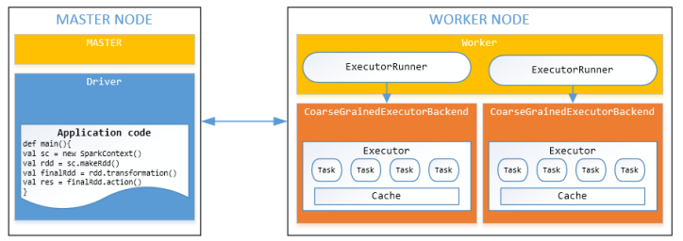
Worker Nodes and Executors
Worker nodes are machines that run executors
Host one or multiple Workers
One JVM (1 process) per Worker
Each Worker can spawn one or more Executors
Executors run tasks
Run in child JVM (1 process）
Execute one or more task using threads in a ThreadPool

Slide 19
Challenge
Existing Systems
Existing in-memory storage systems have interfaces based on fine-grained updates
Reads and writes to cells in a table
E.g., databases, key-value stores, distributed memory
Requires replicating data or logs across nodes for fault tolerance
-> expensive!
10-100x slower than memory write
How to design a distributed memory abstraction that is both fault-tolerant and efficient?

Slide 20
Part 2: Scala Introduction

Slide 21

Scala (Scalable language)
Scala is a general-purpose programming language designed to express common programming patterns in a concise, elegant, and type-safe way 
Scala supports both Object Oriented Programming and Functional Programming 
Scala is Practical
Can be used as drop-in replacement for Java
Mixed Scala/Java projects
Use existing Java libraries
Use existing Java tools (Ant, Maven, JUnit, etc…)
Decent IDE Support (NetBeans, IntelliJ, Eclipse)

Slide 22
Why Scala
Scala supports object-oriented programming. Conceptually, every value is an object and every operation is a method-call. The language supports advanced component architectures through classes and traits 
Scala is also a functional language. Supports functions, immutable data structures and preference for immutability over mutation 
Seamlessly integrated with Java 
Being used heavily for Big data, e.g., Spark, etc.

Slide 23
Scala Basic Syntax
When considering a Scala program, it can be defined as a collection of objects that communicate via invoking each other’s methods.
Object − same as in Java
Class − same as in Java
Methods − same as in Java
Fields − Each object has its unique set of instant variables, which are called fields. An object's state is created by the values assigned to these fields.
Traits − Like Java Interface. A trait encapsulates method and field definitions, which can then be reused by mixing them into classes.
Closure − A closure is a function, whose return value depends on the value of one or more variables declared outside this function.
closure = function + enviroment

Slide 24
Scala is Statically Typed
You don't have to specify a type in most cases
Type Inference
val sum = 1 + 2 + 3
val nums = List(1, 2, 3)
val map = Map("abc" -> List(1,2,3))
Explicit Types
val sum: Int = 1 + 2 + 3
val nums: List[Int] = List(1, 2, 3)
val map: Map[String, List[Int]] = ...

Slide 25
Scala is High level
// Java – Check if string has uppercase character
boolean hasUpperCase = false;
for(int i = 0; i < name.length(); i++) {
if(Character.isUpperCase(name.charAt(i))) {
hasUpperCase = true;
break;
}
}
// Scala
val hasUpperCase = name.exists(_.isUpper)

Slide 26
Scala is Concise
// Java
public class Person {
private String name;
private int age;
public Person(String name, Int age) {
this.name = name;
this.age = age;
}
public String getName() { // name getter
return name;
}
public int getAge() { // age getter
return age;
}
public void setName(String name) { // name setter
this.name = name;
}
public void setAge(int age) { // age setter
this.age = age;
}
}
// Scala
class Person(var name: String, private var _age: Int) {
def age = _age // Getter for age
def age_=(newAge:Int) { // Setter for age
println("Changing age to: "+newAge)
_age = newAge
}
}

Slide 27
Variables and Values
Variables: values stored can be changed
var foo = "foo"
foo = "bar" // okay
Values: immutable variable
val foo = "foo"
foo = "bar" // nope

Slide 28
Scala is Pure Object Oriented
// Every value is an object
1.toString
// Every operation is a method call
1 + 2 + 3 → (1).+(2).+(3)
// Can omit . and ( )
"abc" charAt 1 → "abc".charAt(1)
// Classes (and abstract classes) like Java
abstract class Language(val name:String) {
override def toString = name
}
// Example implementations
class Scala extends Language("Scala")
// Anonymous class
val scala = new Language("Scala") { /* empty */ }

Slide 29
Scala Traits
// Like interfaces in Java
trait JVM {
// But allow implementation
override def toString = super.toString+" runs on JVM" }
trait Static {
override def toString = super.toString+" is Static" }
// Traits are stackable
class Scala extends Language with JVM with Static {
val name = "Scala"
}
println(new Scala) → "Scala runs on JVM is Static"

Slide 30
Scala is Functional
First Class Functions. Functions are treated like objects:
passing functions as arguments to other functions
returning functions as the values from other functions
assigning functions to variables or storing them in data structures
// Lightweight anonymous functions
(x:Int) => x + 1
// Calling the anonymous function
val plusOne = (x:Int) => x + 1
plusOne(5) → 6

Slide 31
Scala is Functional
Closures: a function whose return value depends on the value of one or more variables declared outside this function.
// plusFoo can reference any values/variables in scope
var foo = 1
val plusFoo = (x:Int) => x + foo
plusFoo(5) → 6
// Changing foo changes the return value of plusFoo
foo = 5
plusFoo(5) → 10

Slide 32
Scala is Functional
Higher Order Functions
A function that does at least one of the following:
takes one or more functions as arguments
returns a function as its result
val plusOne = (x:Int) => x + 1
val nums = List(1,2,3)
// map takes a function: Int => T
nums.map(plusOne) → List(2,3,4)
// Inline Anonymous
nums.map(x => x + 1) → List(2,3,4)
// Short form
nums.map(_ + 1) → List(2,3,4)

Slide 33
More Examples on Higher Order Functions
val nums = List(1,2,3,4)
// A few more examples for List class
nums.exists(_ == 2) → true
nums.find(_ == 2) → Some(2)
nums.indexWhere(_ == 2) → 1
// functions as parameters, apply f to the value “1”
def call(f: Int => Int) = f(1)
call(plusOne) → 2
call(x => x + 1) → 2
call(_ + 1) → 2

Slide 34
More Examples on Higher Order Functions
val basefunc = (x:Int) => ((y:Int) => x + y)
// interpreted by:
basefunc(x){
sumfunc(y){ return x+y;}
return sumfunc;
}
val closure1 = basefunc(1) closure1(5) = ?
6
val closure2 = basefunc(4) closure2(5) = ?
9
basefunc returns a function, and closure1 and closure2 are of function type.
While closure1 and closure2 refer to the same function basefunc, the associated environments differ, and the results are different

Slide 35
The Usage of “_” in Scala
In anonymous functions, the “_” acts as a placeholder for parameters
nums.map(x => x + 1)
is equivalent to:
nums.map(_ + 1)
List(1,2,3,4,5).foreach(print(_))
is equivalent to:
List(1,2,3,4,5).foreach( a => print(a) )
You can use two or more underscores to refer different parameters.
val sum = List(1,2,3,4,5).reduceLeft(_+_)
is equivalent to:
val sum = List(1,2,3,4,5).reduceLeft((a, b) => a + b)
The reduceLeft method works by applying the function/operation you give it, and applying it to successive elements in the collection

Slide 36
Part 3: RDD Introduction

Slide 37
Solution: Resilient Distributed Datasets
Resilient Distributed Datasets (RDDs)
Distributed collections of objects that can be cached in memory across cluster
Manipulated through parallel operators
Automatically recomputed on failure based on lineage
RDDs can express many parallel algorithms, and capture many current programming models
Data flow models: MapReduce, SQL, …
Specialized models for iterative apps: Pregel, …

Slide 38
What is RDD
Resilient Distributed Datasets: A Fault-Tolerant Abstraction for In-Memory Cluster Computing. Matei Zaharia, et al. NSDI’12
RDD is a distributed memory abstraction that lets programmers perform in-memory computations on large clusters in a fault-tolerant manner.
Resilient
Fault-tolerant, is able to recompute missing or damaged partitions due to node failures.
Distributed
Data residing on multiple nodes in a cluster.
Dataset
A collection of partitioned elements, e.g. tuples or other objects (that represent records of the data you work with).
RDD is the primary data abstraction in Apache Spark and the core of Spark. It enables operations on collection of elements in parallel.

Slide 39
RDD Traits
In-Memory, i.e. data inside RDD is stored in memory as much (size) and long (time) as possible.
Immutable or Read-Only, i.e. it does not change once created and can only be transformed using transformations to new RDDs.
Lazy evaluated, i.e. the data inside RDD is not available or transformed until an action is executed that triggers the execution.
Cacheable, i.e. you can hold all the data in a persistent "storage" like memory (default and the most preferred) or disk (the least preferred due to access speed).
Parallel, i.e. process data in parallel.
Typed, i.e. values in a RDD have types, e.g. RDD[Long] or RDD[(Int, String)].
Partitioned, i.e. the data inside a RDD is partitioned (split into partitions) and then distributed across nodes in a cluster (one partition per JVM that may or may not correspond to a single node).

Slide 40
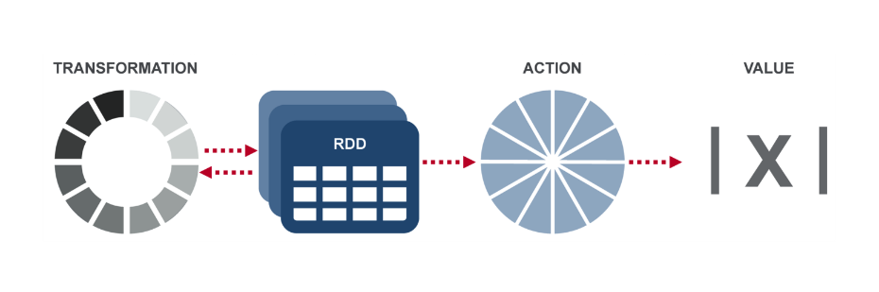
RDD Operations
Transformation: returns a new RDD.
Nothing gets evaluated when you call a Transformation function, it just takes an RDD and return a new RDD.
Transformation functions include map, filter, flatMap, groupByKey, reduceByKey, aggregateByKey, filter, join, etc.
Action: evaluates and returns a new value.
When an Action function is called on a RDD object, all the data processing queries are computed at that time and the result value is returned.
Action operations include reduce, collect, count, first, take, countByKey, foreach, saveAsTextFile, etc.

Slide 41
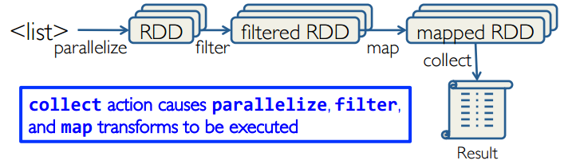
Working with RDDs
Create an RDD from a data source
by parallelizing existing collections (lists or arrays)
by transforming an existing RDDs
from files in HDFS or any other storage system
Apply transformations to an RDD: e.g., map, filter
Apply actions to an RDD: e.g., collect, count
Users can control two other aspects:
Persistence
Partitioning

Slide 42
Creating RDDs
From HDFS, text files, Amazon S3, Apache HBase, SequenceFiles, any other Hadoop InputFormat
Creating an RDD from a File
val inputfile = sc.textFile("...", 4)
RDD distributed in 4 partitions
Elements are lines of input
Lazy evaluation means no execution happens now
Turn a collection into an RDD
sc.parallelize([1, 2, 3]), creating from a Python list
sc.parallelize(Array(“hello”, “spark”)), creating from a Scala Array
Creating an RDD from an existing Hadoop InputFormat
sc.hadoopFile(keyClass, valClass, inputFmt, conf)

Slide 43
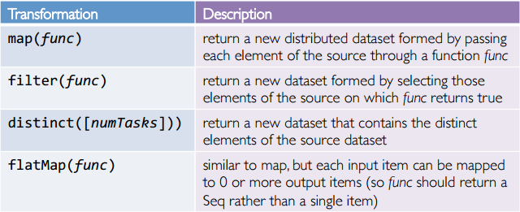
Spark Transformations
Create new datasets from an existing one
Use lazy evaluation: results not computed right away – instead Spark remembers set of transformations applied to base dataset
Spark optimizes the required calculations
Spark recovers from failures
Some transformation functions

Slide 44
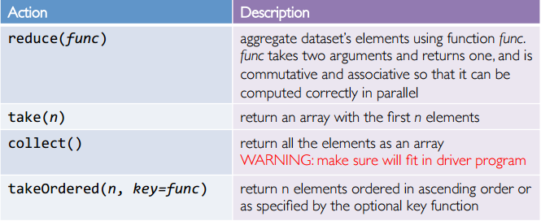
Spark Actions
Cause Spark to execute recipe to transform source
Mechanism for getting results out of Spark
Some action functions
Example: words.collect().foreach(println)

Slide 45
Example
Web service is experiencing errors and an operators want to search terabytes of logs in the Hadoop file system to find the cause.
Line1: RDD backed by an HDFS file (base RDD lines not loaded in memory)
Line3: Asks for errors to persist in memory (errors are in RAM)
//base RDD
val lines = sc.textFile(“hdfs://…”)
//Transformed RDD
val errors = lines.filter(_.startsWith(“Error”))
errors.persist()
errors.count()
errors.filter(_.contains(“HDFS”))
.map(_.split(‘\t’)(3))
.collect()

Slide 46
Lineage Graph
RDDs keep track of lineage
RDD has enough information about how it was derived from to compute its partitions from data in stable storage.
Example:
If a partition of errors is lost, Spark rebuilds it by applying a filter on only the corresponding partition of lines.
Partitions can be recomputed in parallel on different nodes, without having to roll back the whole program.
RDD1
RDD2
RDD3
RDD4

Slide 47
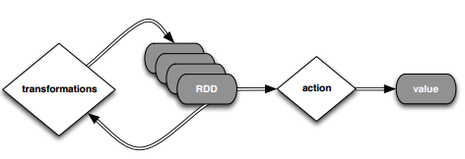
Deconstructed
//base RDD
val lines = sc.textFile(“hdfs://…”)
//Transformed RDD
val errors = lines.filter(_.startsWith(“Error”))
errors.persist()
errors.count()
errors.filter(_.contains(“HDFS”))
.map(_.split(‘\t’)(3))
.collect()

Slide 48

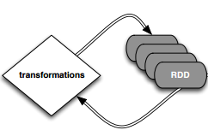
Deconstructed
//base RDD
val lines = sc.textFile(“hdfs://…”)
//Transformed RDD
val errors = lines.filter(_.startsWith(“Error”))
errors.persist()
errors.count()
count() causes Spark to: 1) read data; 2) sum within partitions; 3) combine sums in driver
Put transform and action together: errors.filter(_.contains(“HDFS”)).map(_split(‘\t’)(3)).collect()

Slide 49
SparkContext
SparkContext is the entry point to Spark for a Spark application.
Once a SparkContext instance is created you can use it to
Create RDDs
Create accumulators
Create broadcast variables
access Spark services and run jobs
A Spark context is essentially a client of Spark’s execution environment and acts as the master of your Spark application
The first thing a Spark program must do is to create a SparkContext object, which tells Spark how to access a cluster
In the Spark shell, a special interpreter-aware SparkContext is already created for you, in the variable called sc

Slide 50
RDD Persistence: Cache/Persist
One of the most important capabilities in Spark is persisting (or caching) a dataset in memory across operations.
When you persist an RDD, each node stores any partitions of it. You can reuse it in other actions on that dataset
Each persisted RDD can be stored using a different storage level, e.g.
MEMORY_ONLY:
Store RDD as deserialized Java objects in the JVM.
If the RDD does not fit in memory, some partitions will not be cached and will be recomputed when they're needed.
This is the default level.
MEMORY_AND_DISK:
If the RDD does not fit in memory, store the partitions that don't fit on disk, and read them from there when they're needed.
cache() = persist(StorageLevel.MEMORY_ONLY)

Slide 51
Why Persisting RDD?
val lines = sc.textFile(“hdfs://…”)
val errors = lines.filter(_.startsWith(“Error”))
errors.persist()
errors.count()
If you do errors.count() again, the file will be loaded again and computed again.
Persist will tell Spark to cache the data in memory, to reduce the data loading cost for further actions on the same data
erros.persist() will do nothing. It is a lazy operation. But now the RDD says "read this file and then cache the contents". The action will trigger computation and data caching.

Slide 52
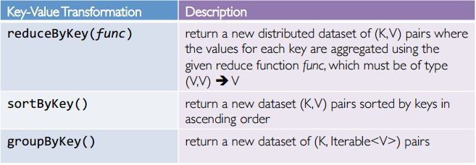
Spark Key-Value RDDs
Similar to Map Reduce, Spark supports Key-Value pairs
Each element of a Pair RDD is a pair tuple
Some Key-Value transformation functions:

Slide 53
More Examples on Pair RDD
Create a pair RDD from existing RDDs
Output?
reduceByKey() function: reduce key-value pairs by key using give func
Output?
mapValues() function: work on values only
Output?
groupByKey() function: When called on a dataset of (K, V) pairs, returns a dataset of (K, Iterable<V>) pairs
val pairs = sc.parallelize( List( (“This”, 2), (“is”, 3), (“Spark”, 5), (“is”, 3) ) )
pairs.collect().foreach(println)
val pair1 = pairs.reduceByKey((x,y) => x + y)
pairs1.collect().foreach(println)
val pair2 = pairs.mapValues( x => x -1 )
pairs2.collect().foreach(println)
pairs.groupByKey().collect().foreach(println)

Slide 54
Setting the Level of Parallelism
All the pair RDD operations take an optional second parameter for number of tasks
words.reduceByKey((x,y) => x + y, 5)
words.groupByKey(5)

Slide 55
Part 4: Spark Programming Model

Slide 56
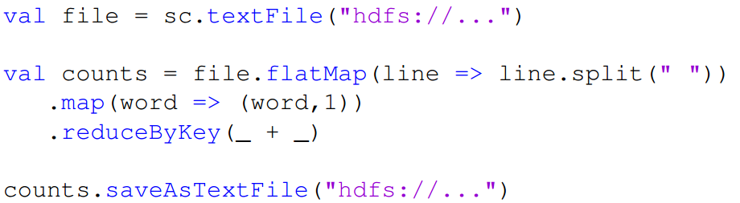
How Spark Works
User application create RDDs, transform them, and run actions.
This results in a DAG (Directed Acyclic Graph) of operators.
DAG is compiled into stages
Each stage is executed as a series of Task (one Task for each Partition).

Slide 57
Word Count in Spark
val file = sc.textFile(“hdfs://…”, 4)
RDD[String]
textFile

Slide 58
Word Count in Spark
val file = sc.textFile(“hdfs://…”, 4)
val words = file.flatMap(line => line.split(“ ”))
RDD[String]
RDD[List[String]]
textFile
flatMap

Slide 59
Word Count in Spark
val file = sc.textFile(“hdfs://…”, 4)
val words = file.flatMap(line => line.split(“ ”))
val pairs = words.map(t => (t, 1))
RDD[String]
RDD[List[String]]
RDD[(String, Int)]
textFile
flatMap
map

Slide 60
Word Count in Spark
val file = sc.textFile(“hdfs://…”, 4)
val words = file.flatMap(line => line.split(“ ”))
val pairs = words.map(t => (t, 1))
val count = pairs. reduceByKey(_+_)
RDD[String]
RDD[List[String]]
RDD[(String, Int)]
RDD[(String, Int)]
textFile
flatMap
map
reduceByKey

Slide 61
Word Count in Spark
val file = sc.textFile(“hdfs://…”, 4)
val words = file.flatMap(line => line.split(“ ”))
val pairs = words.map(t => (t, 1))
val count = pairs. reduceByKey(_+_)
count.collect()
RDD[String]
RDD[List[String]]
RDD[(String, Int)]
RDD[(String, Int)]
Array[(String, Int)]
collect
textFile
flatMap
map
reduceByKey

Slide 62
Execution Plan
Stage 1
Stage 2
collect
textFile
flatMap
map
reduceByKey
The scheduler examines the RDD’s lineage graph to build a DAG of stages.
Stages are sequences of RDDs, that don’t have a Shuffle in between
The boundaries are the shuffle stages.

Slide 63
Execution Plan
Stage 1
Stage 2
collect
textFile
flatMap
map
reduceByKey
Read HDFS split
Apply both the maps
Start Partial reduce
Write shuffle data
Read shuffle data
Final reduce
Send result to driver program
Stage 1
Stage 2

Slide 64
Stage Execution
Task 1
Task 2
Task 3
Task 4
Create a task for each Partition in the new RDD
Serialize the Task
Schedule and ship Tasks to Slaves
All this happens internally

Slide 65
Word Count in Spark (As a Whole View)
Word Count using Scala in Spark
Transformation
Action
“to” “be” “or”
(to, 1) (be, 1) (or, 1)
(be, 2) (not, 1)
“to be or”
“not” “to” “be”
(not, 1) (to, 1) (be, 1)
“not to be”
(or, 1)
(to, 2)

Slide 66


map vs. flatMap
Sample input file:
map: Return a new distributed dataset formed by passing each element of the source through a function func.
flatMap: Similar to map, but each input item can be mapped to 0 or more output items (so func should return a Seq rather than a single item).

Slide 67
RDD Operations
Spark RDD API Examples:
http://homepage.cs.latrobe.edu.au/zhe/ZhenHeSparkRDDAPIExamples.html

Slide 68
Using Local Variables
Any external variables you use in a closure will automatically be shipped to the cluster:
query = sys.stdin.readline()
pages.filter(x => x.contains(query)).count()
Some caveats:
Each task gets a new copy (updates aren’t sent back)
Variable must be Serializable

Slide 69
Shared Variables
When you perform transformations and actions that use functions (e.g., map(f: T=>U)), Spark will automatically push a closure containing that function to the workers so that it can run at the workers.
Any variable or data within a closure or data structure will be distributed to the worker nodes along with the closure
When a function (such as map or reduce) is executed on a cluster node, it works on separate copies of all the variables used in it.
Usually these variables are just constants but they cannot be shared across workers efficiently.

Slide 70
Shared Variables
Consider These Use Cases
Iterative or single jobs with large global variables
Sending large read-only lookup table to workers
Sending large feature vector in a ML algorithm to workers
Problems? Inefficient to send large data to each worker with each iteration
Solution: Broadcast variables
Counting events that occur during job execution
How many input lines were blank?
How many input records were corrupt?
Problems? Closures are one way: driver -> worker
Solution: Accumulators

Slide 71
Broadcast Variables
Broadcast variables allow the programmer to keep a read-only variable cached on each machine rather than shipping a copy of it with tasks.
For example, to give every node a copy of a large input dataset efficiently
Spark also attempts to distribute broadcast variables using efficient broadcast algorithms to reduce communication cost
Broadcast variables are created from a variable v by calling SparkContext.broadcast(v). Its value can be accessed by calling the value method.
The broadcast variable should be used instead of the value v in any functions run on the cluster, so that v is not shipped to the nodes more than once.
scala > val broadcastVar =sc.broadcast(Array(1, 2, 3))
broadcastVar: org.apache.spark.broadcast.Broadcast[Array[Int]] = Broadcast(0)
scala > broadcastVar.value
res0: Array[Int] = Array(1, 2, 3)

Slide 72
Accumulators
Accumulators are variables that are only “added” to through an associative and commutative operation and can therefore be efficiently supported in parallel.
They can be used to implement counters (as in MapReduce) or sums.
Spark natively supports accumulators of numeric types, and programmers can add support for new types.
Only driver can read an accumulator’s value, not tasks
An accumulator is created from an initial value v by calling SparkContext.accumulator(v).
scala> val accum = sc.longAccumulator("My Accumulator")
accum: org.apache.spark.util.LongAccumulator = LongAccumulator(id: 0, name: Some(My Accumulator), value: 0)
scala> sc.parallelize(Array(1, 2, 3, 4)).foreach(x => accum.add(x))
... 10/09/29 18:41:08 INFO SparkContext: Tasks finished in 0.317106 s
scala> accum.value
res2: Long = 10

Slide 73
Accumulators Example (Python)
Counting empty lines
blankLines is created in the driver, and shared among workers
Each worker can access this variable
file = sc.textFile(inputFile)
# Create Accumulator[Int] initialized to 0
blankLines = sc.accumulator(0)
def extractCallSigns(line):
global blankLines # Make the global variable accessible
if (line == ""):
blankLines += 1
return line.split(" ")
callSigns = file.flatMap(extractCallSigns)
print "Blank lines: %d" % blankLines.value

Slide 74
References
http://spark.apache.org/docs/latest/index.html
http://www.scala-lang.org/documentation/
http://www.scala-lang.org/docu/files/ScalaByExample.pdf
A Brief Intro to Scala, by Tim Underwood.
Learning Spark. Chapters 1-7.

Slide 75
End of Chapter 6

