Slide 1

COMP9313: Big Data Management Lecturer: Xin Cao Course web site: http://www.cse.unsw.edu.au/~cs9313/

Slide 2

Chapter 7: Spark II

Slide 3
Part 1: Review of Chapter 6

Slide 4
Spark Ideas
Expressive computing system, not limited to map-reduce model
Facilitate system memory
avoid saving intermediate results to disk
cache data for repetitive queries (e.g. for machine learning)
Layer an in-memory system on top of Hadoop.
Achieve fault-tolerance by re-execution instead of replication

Slide 5
Spark Components
Spark SQL(SQL on Spark)
Spark Streaming (stream processing)
GraphX (graph processing)
MLlib (machine learning library)
Spark SQL (SQL)
Spark Streaming
(real-time)
GraphX
(graph)
MLlib
(machine learning)
…
Spark Core

Slide 6
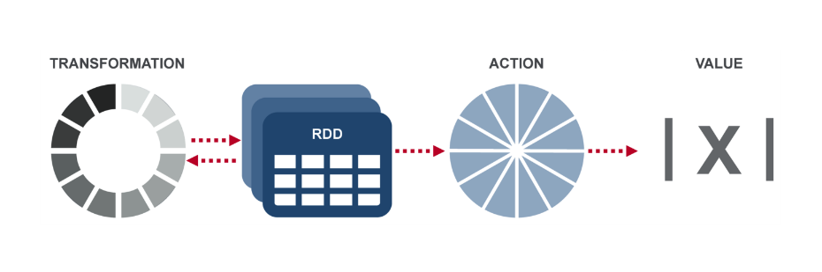
RDD
Resilient Distributed Datasets (RDDs):
A distributed memory abstraction that lets programmers perform in-memory computations on large clusters in a fault-tolerant manner.
RDD operations:
Transformation: returns a new RDD
Action: evaluates and returns a new value

Slide 7
Pair RDD
RDDs of key/value pairs
Spark provides special operations on pair RDDs
Creating pair RDD
val pairs = lines.map(x => (x.split(" ")(0), x))
Transformations on pair RDDs (example: {(1, 2), (3, 4), (3, 6)})
reduceByKey(_+_), {(1, 2), (3, 10)}
groupByKey, {(1, [2]), (3, [4, 6])}
mapValues(x=>x+1), {(1, 3), (3, 5), (3, 7)}
flatMapValues(x=>(x to 5)), {(1, 2), (1, 3), (1, 4), (1, 5), (3, 4), (3, 5)}
Actions on pair RDDs (example: {(1, 2), (3, 4), (3, 6)})
countByKey(), {(1, 1), (3, 2)}
collectAsMap(), Map{(1, 2), (3, 4), (3, 6)}
lookup(3), [4, 6]

Slide 8
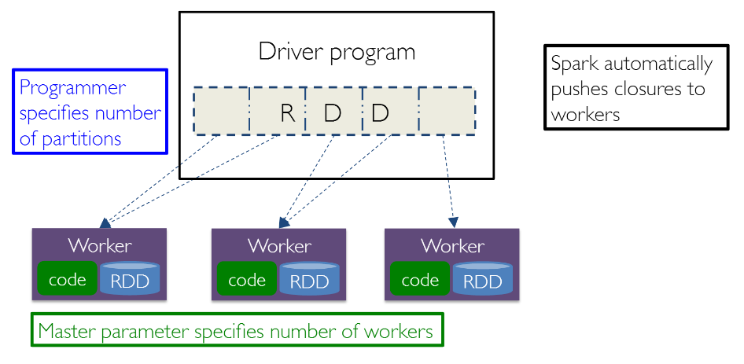
Summary

Slide 9
Part 2: Self-Contained Applications

Slide 10
WordCount (Scala)
Standalone code
You need to create a SparkContext object first
import org.apache.spark.SparkContext
import org.apache.spark.SparkContext._
import org.apache.spark.SparkConf
object WordCount {
def main(args: Array[String]) {
val inputFile = args(0)
val outputFolder = args(1)
val conf = new SparkConf().setAppName(“wordCount”).setMaster(“local”)
// Create a Scala Spark Context.
val sc = new SparkContext(conf)
// Load our input data.
val input = sc.textFile(inputFile)
// Split up into words.
val words = input.flatMap(line => line.split(" "))
// Transform into word and count.
val counts = words.map(word => (word, 1)).reduceByKey(_+_)
counts.saveAsTextFile(outputFolder)
}
}

Slide 11
WordCount (Scala)
Linking with Apache Spark
The first step is to explicitly import the required spark classes into your Spark program
Creating a Spark Context Object
Create a Spark context object with the desired spark configuration that tells Apache Spark on how to access a cluster
SparkConf: Spark configuration class
setAppName: set the name for your application
setMaster: set the cluster master URL
import org.apache.spark.SparkContext
import org.apache.spark.SparkContext._
import org.apache.spark.SparkConf
val conf = new SparkConf().setAppName(“wordCount”).setMaster(“local”)
val sc = new SparkContext(conf)

Slide 12
setMaster
Set the cluster master URL to connect to
Parameters for setMaster:
local(default) - run locally with only one worker thread (no parallel)
local[k] - run locally with k worker threads
spark://HOST:PORT - connect to Spark standalone cluster URL
mesos://HOST:PORT - connect to Mesos cluster URL
yarn - connect to Yarn cluster URL
Specified in SPARK_HOME/conf/yarn-site.xml
setMaster parameters configurations:
In source code
SparkConf().setAppName(“wordCount”).setMaster(“local”)
spark-submit
spark-submit --master local
In SPARK_HOME/conf/spark-default.conf
Set value for spark.master

Slide 13
WordCount (Scala)
Creating a Spark RDD
Create an input Spark RDD that reads the text file input.txt using the Spark Context created in the previous step
Spark RDD Transformations in Wordcount Example
flatMap() is used to tokenize the lines from input text file into words
map() method counts the frequency of each word
reduceByKey() method counts the repetitions of word in the text file
Save the results to disk
val input = sc.textFile(inputFile)
counts.saveAsTextFile(outputFolder)

Slide 14
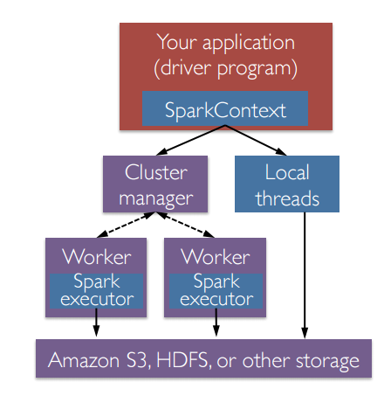
Run the Application on a Cluster
A Spark application is launched on a set of machines using an external service called a cluster manager
Local threads
Standalone
Mesos
Yarn
Driver
Executor

Slide 15
Launching a Program
Spark provides a single script you can use to submit your program to it called spark-submit
The user submits an application using spark-submit
spark-submit launches the driver program and invokes the main() method specified by the user
The driver program contacts the cluster manager to ask for resources to launch executors
The cluster manager launches executors on behalf of the driver program
The driver process runs through the user application. Based on the RDD actions and transformations in the program, the driver sends work to executors in the form of tasks
Tasks are run on executor processes to compute and save results
If the driver’s main() method exits or it calls SparkContext.stop(), it will terminate the executors and release resources from the cluster manager

Slide 16
Package Your Code and Dependencies
Ensure that all your dependencies are present at the runtime of your Spark application
Java Application (Maven)
Scala Application (sbt)
a newer build tool most often used for Scala projects
libraryDependencies: list all dependent libraries (including third party libraries)
A jar file simple-project_2.11-1.0.jar will be created after compilation
name := "Simple Project"
version := "1.0"
scalaVersion := "2.11.8"
libraryDependencies += "org.apache.spark" %% "spark-core" % "2.2.0"

Slide 17
Deploying Applications in Spark
spark-submit
spark-submit --master spark://hostname:7077 \
--class YOURCLASS \
--executor-memory 2g \
YOURJAR "options" "to your application" "go here"
Common flags | Explanation
--master | Indicates the cluster manager to connect to
--class | The “main” class of your application if you’re running a Java or Scala program
--name | A human-readable name for your application. This will be displayed in Spark’s web UI.
--executor-memory | The amount of memory to use for executors, in bytes. Suffixes can be used to specify larger quantities such as “512m” (512 megabytes) or “15g” (15 gigabytes)
--driver-memory | The amount of memory to use for the driver process, in bytes.

Slide 18

Practice
Problem 1: Given a pair RDD of type [(String, Int)], compute the per-key average
key | value
panda | 0
pink | 3
pirate | 3
panda | 1
pink | 4
key | value
panda | 0.5
pink | 3.5
pirate | 3
pair.mapValues(x=>(x,1))
.reduceByKey((x,y)=>(x._1+y._1, x._2+y._2))
.mapValues(x=>x._1.toDouble/x._2)
mapValues
mapValues
key | value
panda | (0, 1)
pink | (3, 1)
pirate | (3, 1)
panda | (1, 1)
pink | (4, 1)
key | value
panda | (1, 2)
pink | (7, 2)
pirate | (3, 1)
reduceByKey

Slide 19
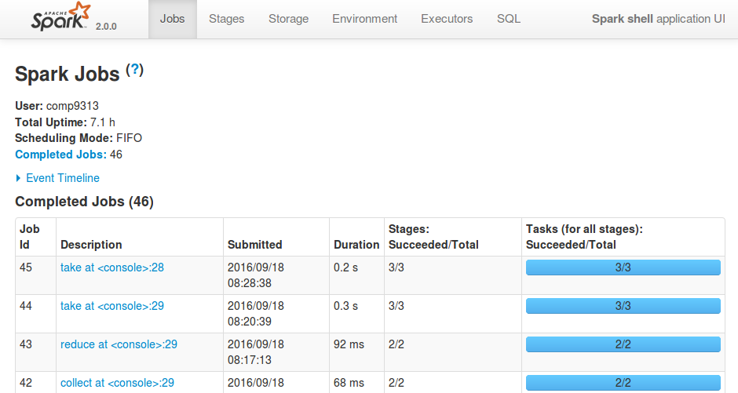
Spark Web Console
You can browse the web interface for the information of Spark Jobs, storage, etc. at: http://localhost:4040

Slide 20
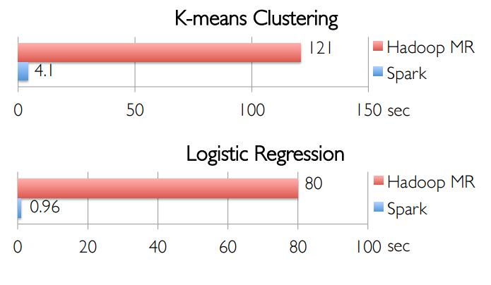
In-Memory Can Make a Big Difference
Two iterative Machine Learning algorithms:

Slide 21
Part 3: Spark SQL and DataFrames

Slide 22
Spark SQL Overview
Part of the core distribution since Spark 1.0 (April 2014)
Tightly integrated way to work with structured data (tables with rows/columns)
Transform RDDs using SQL
Data source integration: Hive, Parquet, JSON, and more
Spark SQL is not about SQL.
Aims to Create and Run Spark Programs Faster:

Slide 23
Relationship to Shark
Shark has been subsumed by Spark SQL
Shark modified the Hive backend to run over Spark, but had two challenges:
Limited integration with Spark programs
Hive optimizer not designed for Spark
Spark SQL reuses the best parts of Shark:
Borrows
Hive data loading
In-memory column store
Adds
RDD-aware optimizer
Rich language interfaces

Slide 24
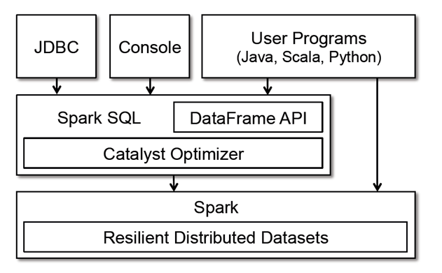
Spark Programming Interface

Slide 25
Datasets and DataFrames
A Dataset is a distributed collection of data
provides the benefits of RDDs (e.g., strong typing) with the benefits of Spark SQL’s optimized execution engine
A Dataset can be constructed from JVM objects and then manipulated using functional transformations (map, flatMap, etc.)
The Dataset API is available in Scala and Java
A DataFrame is a Dataset organized into named columns
It is conceptually equivalent to a table in a relational database or a data frame in R/Python, but with richer optimizations
An abstraction for selecting, filtering, aggregating and plotting structured data
In Scala and Java, a DataFrame is represented by a Dataset of Rows
Scala: DataFrame is simply a type alias of Dataset[Row]
Java: use Dataset<Row> to represent a DataFrame

Slide 26
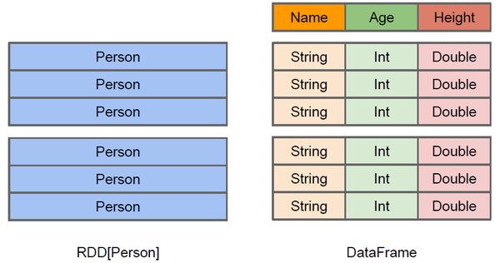
Difference between DataFrame and RDD
DataFrame more like a traditional database of two-dimensional form, in addition to data, but also to grasp the structural information of the data, that is, schema
RDD[Person] although with Person for type parameters, but the Spark framework itself does not understand internal structure of Person class
DataFrame has provided a detailed structural information, making Spark SQL can clearly know what columns are included in the dataset, and what is the name and type of each column. Thus Spark SQL query optimizer can target optimization

Slide 27
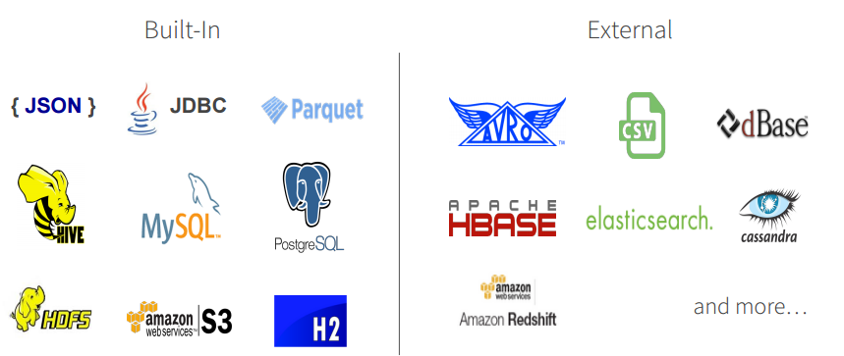
DataFrame Data Sources
Spark SQL’s Data Source API can read and write DataFrames using a variety of formats.
E.g., structured data files, tables in Hive, external databases, or existing RDDs
In the Scala API, DataFrame is simply a type alias of Dataset[Row]

Slide 28
Starting Point: SparkSession
The entry point into all functionality in Spark is the SparkSession class.
SparkSession in Spark 2.0 provides built-in support for Hive features including the ability to write queries using HiveQL, access to Hive UDFs, and the ability to read data from Hive tables
import org.apache.spark.sql.SparkSession
val spark = SparkSession
.builder()
.appName("Spark SQL basic example")
.config("spark.some.config.option", "some-value")
.getOrCreate()
// For implicit conversions like converting RDDs to DataFrames
import spark.implicits._

Slide 29
Creating DataFrames
With a SparkSession, applications can create DataFrames from an existing RDD, from a Hive table, or from Spark data sources.
creates a DataFrame based on the content of a JSON file:
val df = spark.read.json("examples/src/main/resources/people.json")
// Displays the content of the DataFrame to stdout
df.show()
// +----+-------+
// | age| name|
// +----+-------+
// |null|Michael|
// | 30| Andy|
// | 19| Justin|
// +----+-------+

Slide 30
DataFrame Operations
DataFrames are just Dataset of Rows in Scala and Java API.
These operations are also referred as “untyped transformations” in contrast to “typed transformations” come with strongly typed Scala/Java Datasets
df.printSchema()
// root
// |-- age: long (nullable = true)
// |-- name: string (nullable = true)
// Select only the "name" column
df.select("name").show()
// +-------+
// | name|
// +-------+
// |Michael|
// | Andy|
// | Justin|
// +-------+

Slide 31
DataFrame Operations
// Select everybody, but increment the age by 1
df.select($"name", $"age" + 1).show()
// +-------+---------+
// | name|(age + 1)|
// +-------+---------+
// |Michael| null|
// | Andy| 31|
// | Justin| 20|
// +-------+---------+
// Select people older than 21
df.filter($"age" > 21).show()
// +---+----+
// |age|name|
// +---+----+
// | 30|Andy|
// +---+----+
// Count people by age
df.groupBy("age").count().show()
// +----+-----+
// | age|count|
// +----+-----+
// | 19| 1|
// |null| 1|
// | 30| 1|
// +----+-----+

Slide 32
Running SQL Queries Programmatically
The sql function on a SparkSession enables applications to run SQL queries programmatically and returns the result as a DataFrame.
Find full example code at https://github.com/apache/spark/blob/master/examples/src/main/scala/org/apache/spark/examples/sql/SparkSQLExample.scala
// Register the DataFrame as a SQL temporary view
df.createOrReplaceTempView("people")
val sqlDF = spark.sql("SELECT * FROM people")
sqlDF.show()
// +----+-------+
// | age| name|
// +----+-------+
// |null|Michael|
// | 30| Andy|
// | 19| Justin|
// +----+-------+

Slide 33
Part 4: Spark Streaming

Slide 34
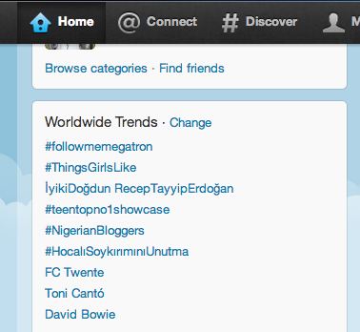
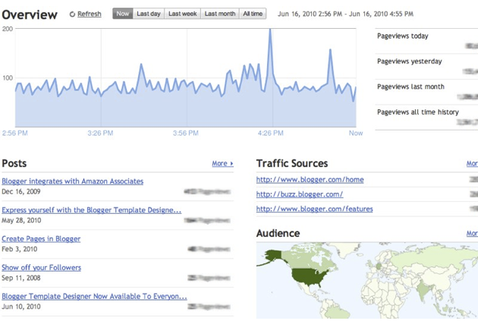
Motivation
Many important applications must process large streams of live data and provide results in near-real-time
Social network trends
Website statistics
Ad impressions
… …
Distributed stream processing framework is required to
Scale to large clusters (100s of machines)
Achieve low latency (few seconds)

Slide 35
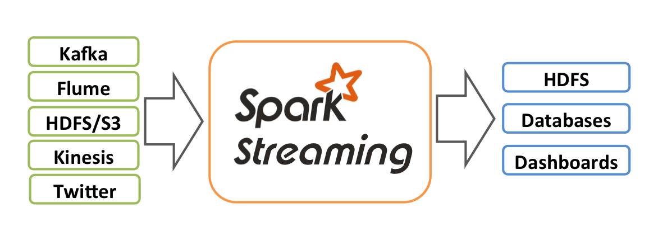
What is Spark Streaming
Spark Streaming is an extension of the core Spark API that enables scalable, high-throughput, fault-tolerant stream processing of live data streams
Receive data streams from input sources, process them in a cluster, push out to filesystems, databases, and live dashboards
Data can be ingested from many sources like Kafka, Flume, Kinesis, or TCP sockets
Data can be processed using complex algorithms expressed with high-level functions like map, reduce, join and window

Slide 36
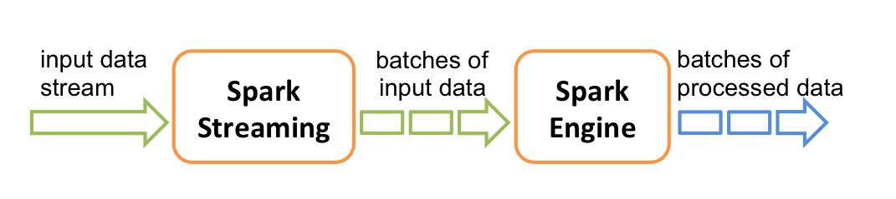
How does Spark Streaming Work
Run a streaming computation as a series of very small, deterministic batch jobs
Chop up the live stream into batches of X seconds
Spark treats each batch of data as RDDs and processes them using RDD operations
Finally, the processed results of the RDD operations are returned in batches

Slide 37
Spark Streaming Programming Model
Spark Streaming provides a high-level abstraction called discretized stream (Dstream)
Represents a continuous stream of data.
DStreams can be created either from input data streams from sources such as Kafka, Flume, and Kinesis, or by applying high-level operations on other DStreams.
Internally, a DStream is represented as a sequence of RDDs.
DStreams API very similar to RDD API
Functional APIs in Scala, Java
Create input DStreams from different sources
Apply parallel operations

Slide 38
An Example: Streaming WordCount
Use StreamingContext, rather then SparkContext
import org.apache.spark._
import org.apache.spark.streaming._
object NetworkWordCount {
val conf = new SparkConf().setMaster("local[2]").setAppName("NetworkWordCount")
val ssc = new StreamingContext(conf, Seconds(10))
val lines = ssc.socketTextStream("localhost", 9999)
val words = lines.flatMap(_.split(" "))
val wordCounts = words.map(x => (x, 1)).reduceByKey(_ + _)
wordCounts.print()
ssc.start()
ssc.awaitTermination()
}

Slide 39
Streaming WordCount
Linking with Apache Spark
The first step is to explicitly import the required spark classes into your Spark program
Create a local StreamingContext with two working thread and batch interval of 10 second.
A StreamingContext object has to be created which is the main entry point of all Spark Streaming functionality.
At least two local threads must be used (two cores)
Do the count for each 10 seconds
The batch interval must be set based on the latency requirements of your application and available cluster resources
import org.apache.spark._
import org.apache.spark.streaming._
val conf = new SparkConf().setMaster("local[2]").setAppName("NetworkWordCount")
val ssc = new StreamingContext(conf, Seconds(10))

Slide 40
Streaming WordCount
After a streaming context is defined, you have to do the following:
Define the input sources by creating input DStreams.
Define the streaming computations by applying transformation and output operations to DStreams.
Start receiving data and processing it using streamingContext.start().
Wait for the processing to be stopped (manually or due to any error) using streamingContext.awaitTermination().
The processing can be manually stopped using streamingContext.stop().

Slide 41
Streaming WordCount
Using this context, we can create a DStream that represents streaming data from a TCP source, specified as hostname (e.g. localhost) and port (e.g. 9999).
This lines DStream represents the stream of data that will be received from the data server. Each record in this DStream is a line of text.
Split the lines by space characters into words and do the count
No real processing has started yet now. To start the processing after all the transformations have been setup, we finally call
The complete code can be found in the Spark Streaming example NetworkWordCount.
val lines = ssc.socketTextStream("localhost", 9999)
val words = lines.flatMap(_.split(" "))
val wordCounts = words.map(x => (x, 1)).reduceByKey(_ + _)
ssc.start()
ssc.awaitTermination()

Slide 42
Linking the Application
Add the following dependency to your SBT configuration:
libraryDependencies += "org.apache.spark" % "spark-streaming_2.11" % "2.2.0"
For data sources like Kafka, Flume, and Kinesis that are not present in the Spark Streaming core API, you will have to add the corresponding artifact spark-streaming-xyz_2.11 to the dependencies
Kafka | spark-streaming-kafka-0-8_2.11
Flume | spark-streaming-flume_2.11
Kinesis | spark-streaming-kinesis-asl_2.11 [Amazon Software License]

Slide 43
Run Streaming WordCount
First need to run Netcat (a small utility found in most Unix-like systems) as a data server by using:
$ nc -lk 9999
sbt configuration file:
Then, in a different terminal, you can start the example by using
$ spark-submit --class NetworkWordCount ~/sparkapp/target/scala-2.11/network-wordcount_2.11-1.0.jar
name := “Network WordCount"
version := "1.0"
scalaVersion := "2.11.8"
libraryDependencies += "org.apache.spark" %% "spark-streaming" % "2.1.0"

Slide 44
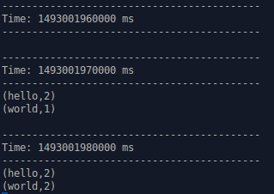

Results of Streaming WordCount
The first 10 seconds, receives no data
The next 10 seconds, receives one line
The last 10 seconds, receives two lines

Slide 45
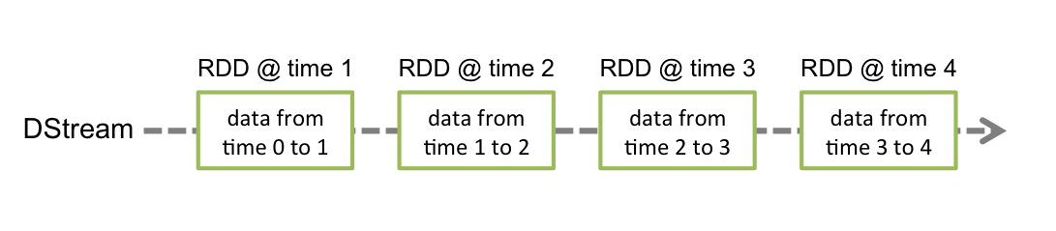
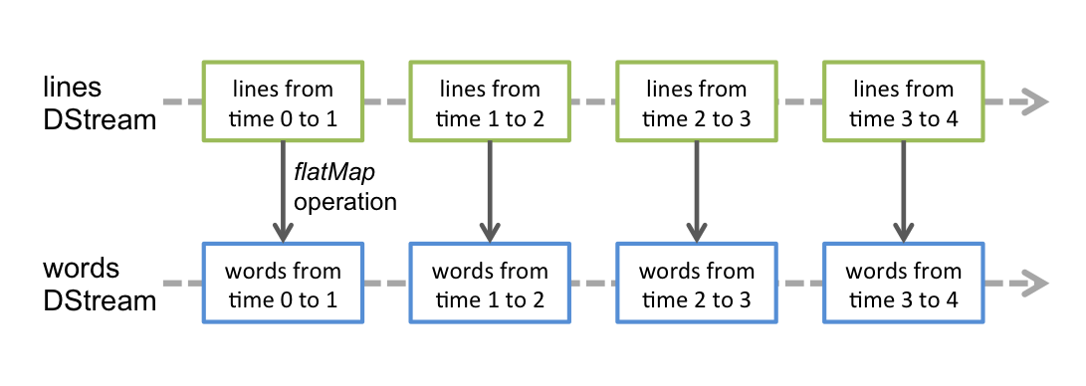
Discretized Streams (DStreams)
A DStream is represented by a continuous series of RDDs
Each RDD in a DStream contains data from a certain interval, as shown in the following figure.
Any operation applied on a DStream translates to operations on the underlying RDDs.
in the earlier example of converting a stream of lines to words, the flatMap operation is applied on each RDD in the lines DStream to generate the RDDs of the words DStream

Slide 46
Input DStreams and Receivers
Input DStreams are DStreams representing the stream of input data received from streaming sources.
E.g., lines was an input DStream as it represented the stream of data received from the netcat server
Every input DStream is associated with a Receiver object which receives the data from a source and stores it in Spark’s memory for processing
Spark Streaming provides two categories of built-in streaming sources.
Basic sources: Sources directly available in the StreamingContext API. Examples: file systems, and socket connections.
Advanced sources: Sources like Kafka, Flume, Kinesis, etc. are available through extra utility classes. These require linking against extra dependencies

Slide 47
Input DStreams and Receivers
When running a Spark Streaming program locally, do not use “local” or “local[1]” as the master URL
If you are using an input DStream based on a receiver (e.g., sockets), then the single thread will be used to run the receiver, leaving no thread for processing the received data
When running locally, always use “local[n]” as the master URL, where n > number of receivers to run
The number of cores allocated to the Spark Streaming application must be more than the number of receivers. Otherwise the system will only receive data, but not be able to process it

Slide 48

Example – Get hashtags from Twitter
val ssc = new StreamingContext(conf, Seconds(10))
val tweets :DStream[Status] = TwitterUtils.createStream(ssc, None)
DStream: a sequence of RDDs representing a stream of data
Twitter Streaming API
batch @ t+1
batch @ t
batch @ t+2
tweets DStream
stored in memory as an RDD (immutable, distributed)

Slide 49
Example – Get hashtags from Twitter
val hashTags = tweets.flatMap (status => getTags(status))
new DStream
transformation: modify data in one DStream to create another DStream
batch @ t
batch @ t+1
batch @ t+2
tweets DStream
flatMap
flatMap
flatMap
hashTags Dstream
[#cat, #dog, … ]
…
new RDDs created for every batch

Slide 50
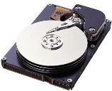
Example – Get hashtags from Twitter
val hashTags = tweets.flatMap (status => getTags(status))
hashTags.saveAsHadoopFiles("hdfs://...")
output operation: to push data to external storage
batch @ t
batch @ t+1
batch @ t+2
tweets DStream
flatMap
flatMap
flatMap
hashTags DStream
save
save
save
every batch saved to HDFS

Slide 51
Example – Get hashtags from Twitter
val tweets = ssc.twitterStream()
val hashTags = tweets.flatMap (status => getTags(status))
hashTags.saveAsHadoopFiles("hdfs://...")
foreach: do whatever you want with the processed data
batch @ t
batch @ t+1
batch @ t+2
tweets DStream
flatMap
flatMap
flatMap
hashTags DStream
foreach
foreach
foreach
Write to database, update analytics UI, do whatever you want

Slide 52
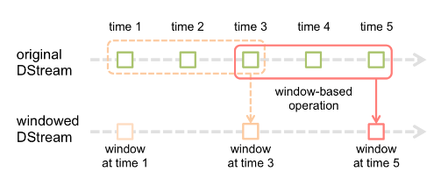
Window Operations
Spark Streaming also provides windowed computations, which allow you to apply transformations over a sliding window of data
Every time the window slides over a source DStream, the source RDDs that fall within the window are combined and operated upon to produce the RDDs of the windowed DStream.
E.g., the operation is applied over the last 3 time units of data, and slides by 2 time units
Any window operation needs to specify two parameters
window length - The duration of the window (3 in the figure).
sliding interval - The interval at which the window operation is performed (2 in the figure).

Slide 53
Window-based Transformations
val hashTags = tweets.flatMap (status => getTags(status))
val tagCounts = hashTags.window(Minutes(1), Seconds(5)).countByValue()
sliding window operation
window length
sliding interval
window length
DStream of data
sliding interval

Slide 54
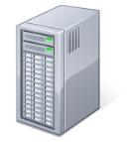
Fault-tolerance: Worker
RDDs remember the operations that created them
Batches of input data are replicated in memory for fault-tolerance
Data lost due to worker failure, can be recomputed from replicated input data
All transformed data is fault-tolerant, and exactly-once transformations
tweets
RDD
input data replicated
in memory
flatMap
hashTags
RDD
lost partitions recomputed on other workers

Slide 55
Fault-tolerance: Master
Master saves the state of the DStreams to a checkpoint file
Checkpoint file saved to HDFS periodically
If master fails, it can be restarted using the checkpoint file
More information in the Spark Streaming guide
Automated master fault recovery coming soon

Slide 56
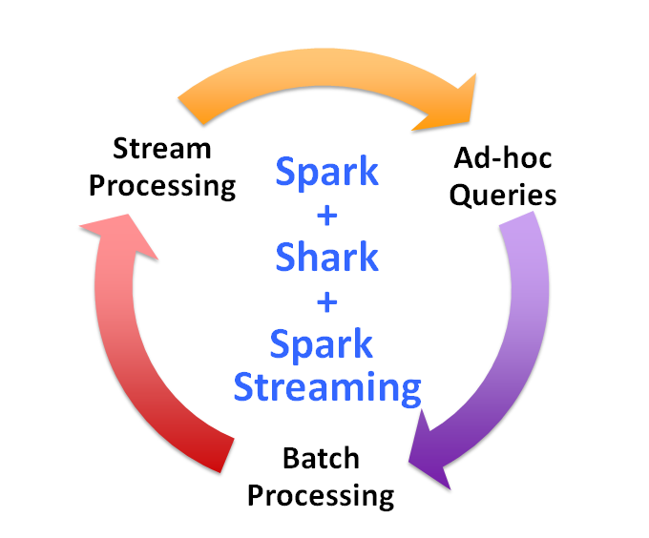
Vision - one stack to rule them all

Slide 57
Part 5: Spark Structured Streaming

Slide 58
Structured Streaming
Structured Streaming provides fast, scalable, fault-tolerant, end-to-end exactly-once stream processing without the user having to reason about streaming.
Structured Streaming is a scalable and fault-tolerant stream processing engine built on the Spark SQL engine.
You can express your streaming computation the same way you would express a batch computation on static data.
The Spark SQL engine will take care of running it incrementally and continuously and updating the final result as streaming data continues to arrive.

Slide 59
An Example: Streaming WordCount
Use StreamingContext, rather then SparkContext
import org.apache.spark._
import org.apache.spark.streaming._
object StructuredNetworkWordCount {
val spark = SparkSession.builder
.appName("StructuredNetworkWordCount").getOrCreate()
import spark.implicits._
// Create DataFrame representing the stream of input lines from connection to localhost:9999
val lines = spark.readStream.format("socket").option("host", "localhost").option("port", 9999).load()
// Split the lines into words
val words = lines.as[String].flatMap(_.split(" "))
// Generate running word count
val wordCounts = words.groupBy("value").count()
// Start running the query that prints the running counts to the console
val query = wordCounts.writeStream.outputMode("complete")
.format("console").start()
query.awaitTermination()
}

Slide 60
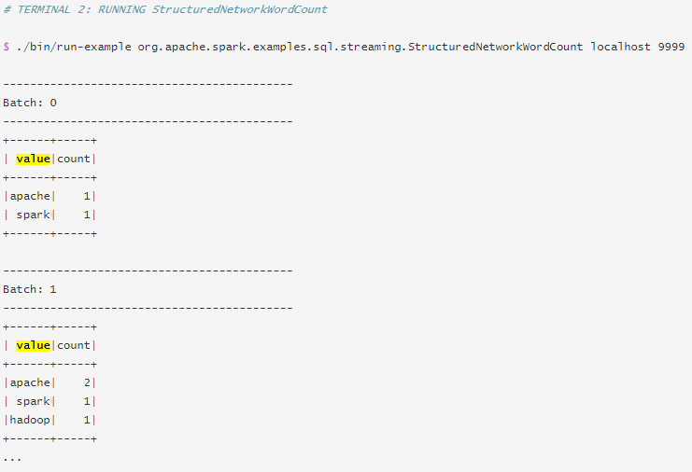
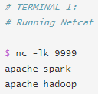
An Example: Streaming WordCount

Slide 61
Part 6: Spark GraphX

Slide 62
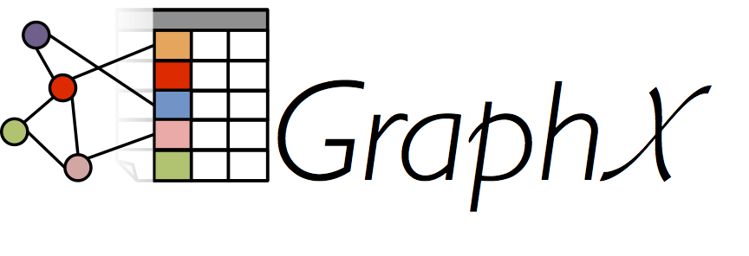
Spark GraphX
GraphX is Apache Spark's API for graphs and graph-parallel computation.
At a high level, GraphX extends the Spark RDD by introducing a new Graph abstraction: a directed multigraph with properties attached to each vertex and edge
To support graph computation, GraphX exposes a set of fundamental operators (e.g., subgraph, joinVertices) as well as an optimized variant of the Pregel API
GraphX includes a growing collection of graph algorithms and builders to simplify graph analytics tasks.

Slide 63
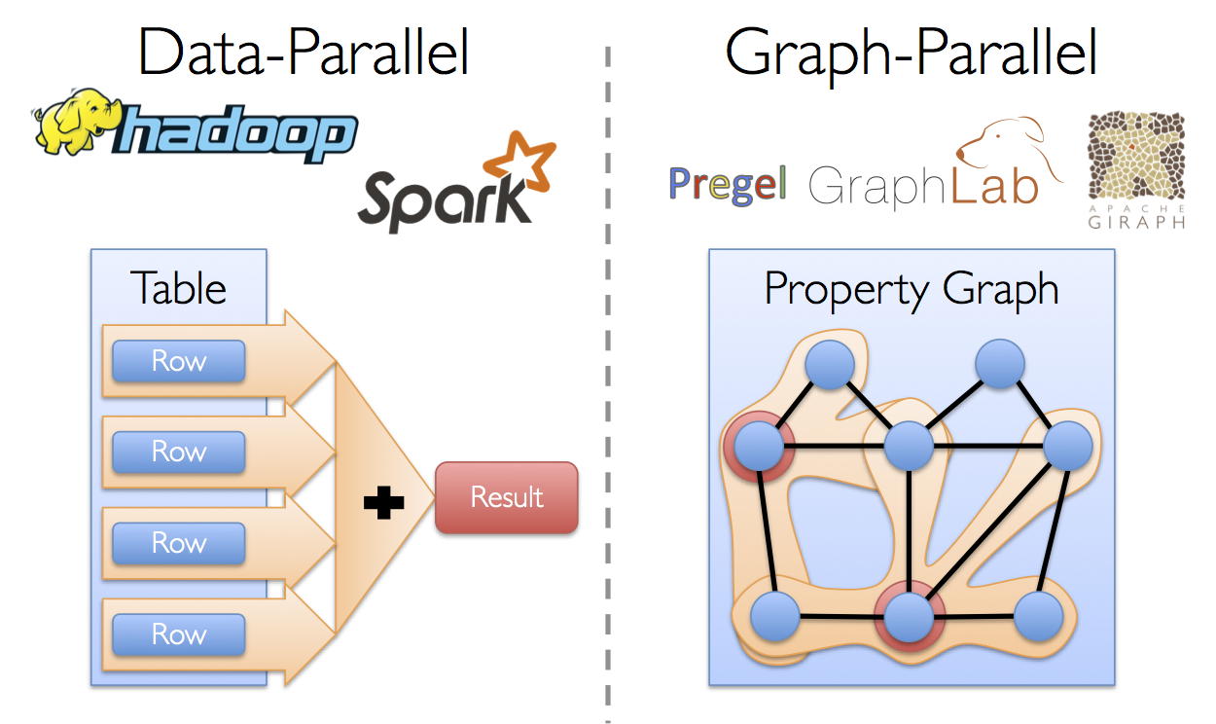
Graph-Parallel Computation
The growing scale and importance of graph data has driven the development of numerous new graph-parallel systems (e.g., Giraph and GraphLab)
These systems can efficiently execute sophisticated graph algorithms orders of magnitude faster than more general data-parallel systems.
Expose specialized APIs to simplify graph programming

Slide 64
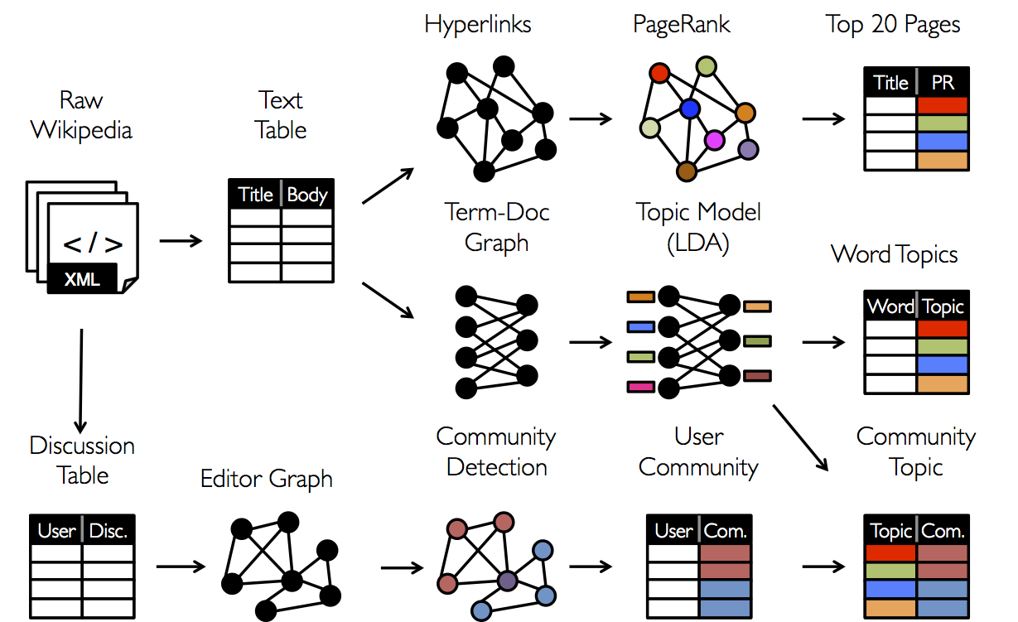
Specialized Systems May Miss the Bigger Picture
It is often desirable to be able to move between table and graph views of the same physical data and to leverage the properties of each view to easily and efficiently express computation

Slide 65
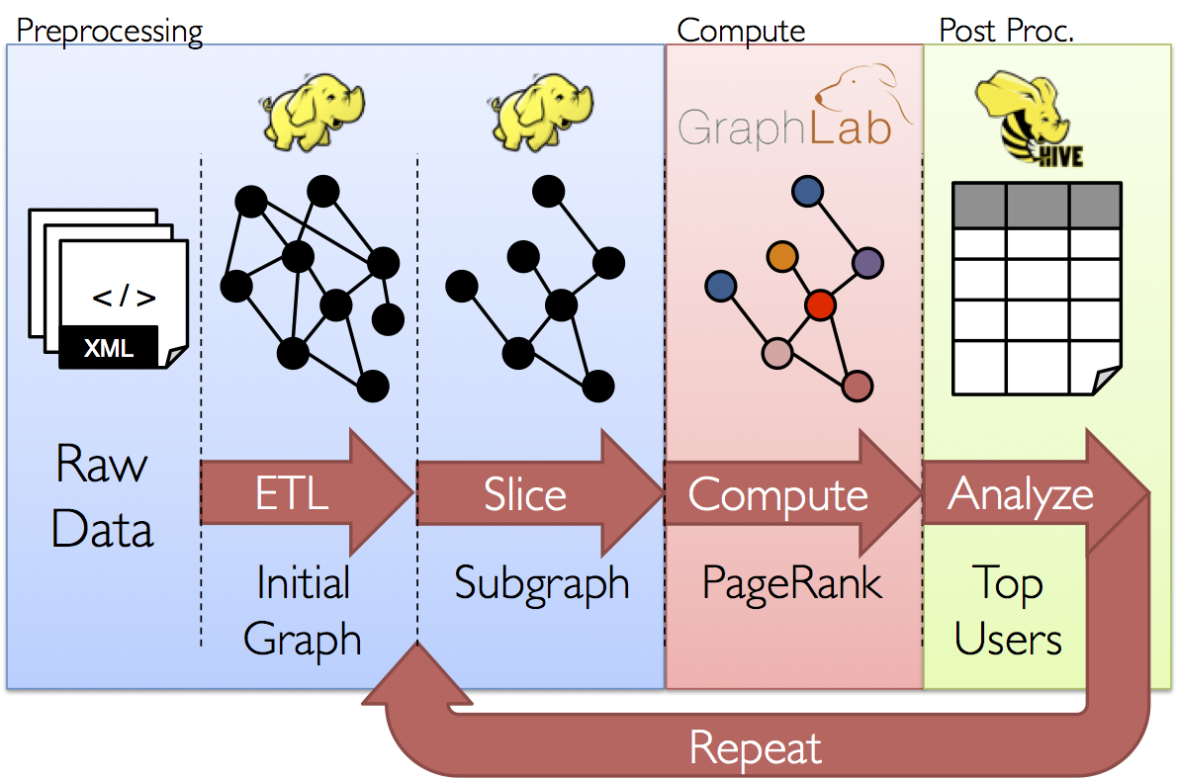
GraphX Motivation
The goal of the GraphX project is to unify graph-parallel and data-parallel computation in one system with a single composable API.
The GraphX API enables users to view data both as graphs and as collections (i.e., RDDs) without data movement or duplication.

Slide 66
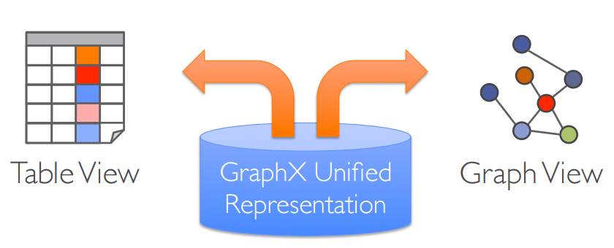
GraphX Motivation
Tables and Graphs are composable views of the same physical data
Each view has its own operators that exploit the semantics of the view to achieve efficient execution

Slide 67
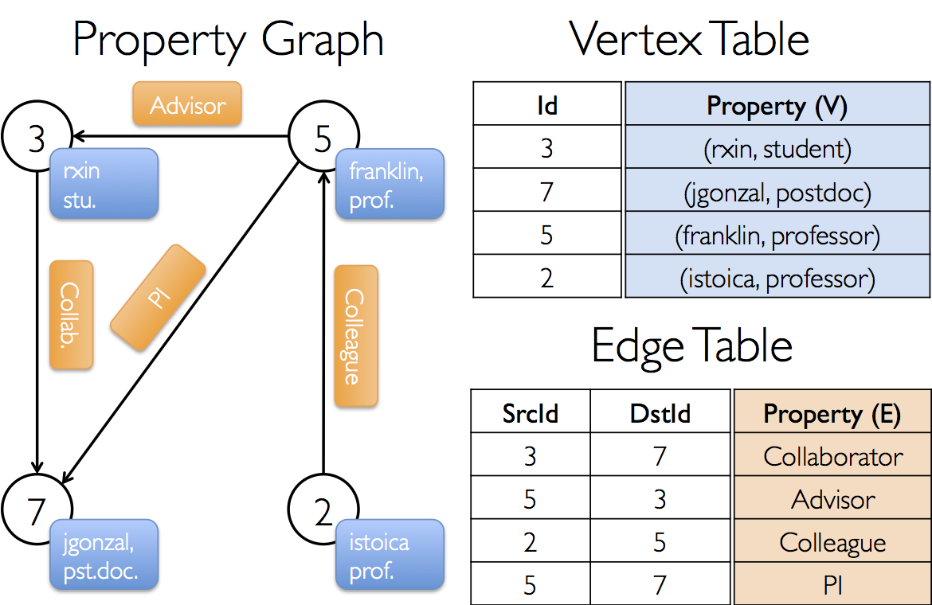
View a Graph as a Table

Slide 68
Table Operators
Table (RDD) operators are inherited from Spark:
map
filter
groupBy
sort
union
join
leftOuterJoin
rightOuterJoin
reduce
count
fold
reduceByKey
groupByKey
cogroup
cross
zip
sample
take
first
partitionBy
mapWith
pipe
save
...

Slide 69
Graph Operators
class Graph[VD, ED] {
// Information about the Graph
val numEdges: Long
val numVertices: Long
val inDegrees: VertexRDD[Int]
val outDegrees: VertexRDD[Int]
val degrees: VertexRDD[Int]
// Views of the graph as collections
val vertices: VertexRDD[VD]
val edges: EdgeRDD[ED]
val triplets: RDD[EdgeTriplet[VD, ED]]
// Transform vertex and edge attributes
def mapVertices[VD2](map: (VertexID, VD) => VD2): Graph[VD2, ED]
def mapEdges[ED2](map: Edge[ED] => ED2): Graph[VD, ED2]
def mapEdges[ED2](map: (PartitionID, Iterator[Edge[ED]]) => Iterator[ED2]): Graph[VD, ED2]
def mapTriplets[ED2](map: EdgeTriplet[VD, ED] => ED2): Graph[VD, ED2]
// Modify the graph structure
def reverse: Graph[VD, ED]
def subgraph(
epred: EdgeTriplet[VD,ED] => Boolean = (x => true),
vpred: (VertexID, VD) => Boolean = ((v, d) => true))
: Graph[VD, ED]
def groupEdges(merge: (ED, ED) => ED): Graph[VD, ED]
// …other operators…
}

Slide 70
The Property Graph
The property graph is a directed multigraph with user defined objects attached to each vertex and edge.
A directed multigraph is a directed graph with potentially multiple parallel edges sharing the same source and destination vertex
The property graph is parameterized over the vertex (VD) and edge (ED) types. These are the types of the objects associated with each vertex and edge respectively.
Each vertex is keyed by a unique 64-bit long identifier (VertexID). Similarly, edges have corresponding source and destination vertex identifiers.
Logically the property graph corresponds to a pair of typed collections (RDDs) encoding the properties for each vertex and edge.
class Graph[VD, ED] {
val vertices: VertexRDD[VD]
val edges: EdgeRDD[ED]
}

Slide 71
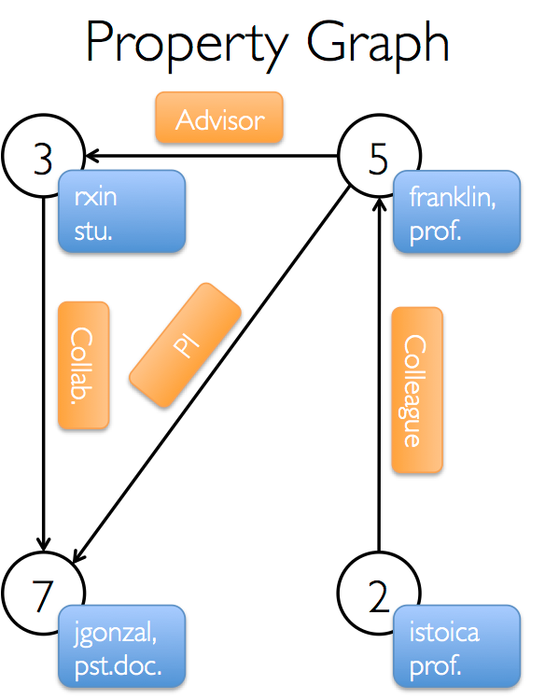
Example Property Graph

Slide 72
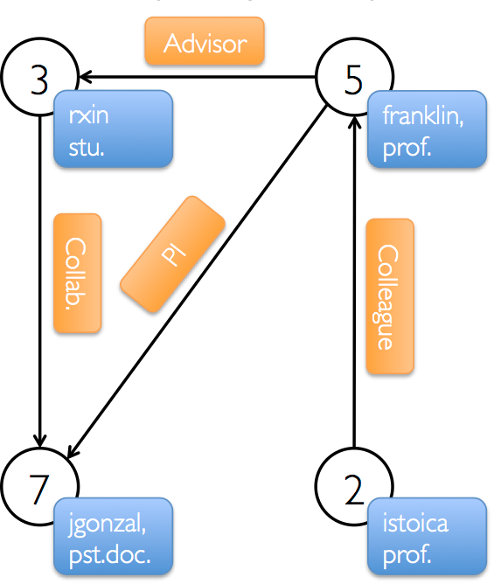
GraphX Example
Import Spark and GraphX into your project
We begin by creating the property graph from arrays of vertices and edges
import org.apache.spark._
import org.apache.spark.graphx._
// To make some of the examples work we will also need RDD
import org.apache.spark.rdd.RDD
val vertexArray = Array(
(3L, ("rxin", "student")),
(7L, ("jgonzal", "postdoc")),
(5L, ("franklin", "prof")),
(2L, ("istoica", "prof"))
)
val edgeArray = Array(
Edge(3L, 7L, "collab"),
Edge(5L, 3L, "advisor"),
Edge(2L, 5L, "colleague"),
EdgeEdge(5L, 7L, "pi"),
)

Slide 73
Construct a Property Graph
The most general method of constructing a property graph is to use the Graph object
Edges have a srcId and a dstId corresponding to the source and destination vertex identifiers.
In addition, the Edge class has an attr member which stores the edge property
// Assume the SparkContext has already been constructed
val sc: SparkContext
// Create an RDD for the vertices
val users: RDD[(VertexId, (String, String))] =
sc.parallelize(vertexArray)
// Create an RDD for edges
val relationships: RDD[Edge[String]] =
sc.parallelize(edgeArray)
// Define a default user in case there are relationship with missing user
val defaultUser = ("John Doe", "Missing")
// Build the initial Graph
val graph = Graph(users, relationships, defaultUser)

Slide 74
Deconstruct a Property Graph
We can deconstruct a graph into the respective vertex and edge views by using the graph.vertices and graph.edges members respectively
Note that graph.vertices returns an VertexRDD[(String, String)] which extends RDD[(VertexId, (String, String))] and so we use the scala case expression to deconstruct the tuple.
graph.edges returns an EdgeRDD containing Edge[String]objects. We could have also used the case class type constructor as in the following:
graph.edges.filter { case Edge(src, dst, prop) => src > dst }.count
// Constructed from above
val graph: Graph[(String, String), String]
// Count all users which are postdocs
graph.vertices.filter { case (id, (name, pos)) => pos == "postdoc" }.count
// Count all the edges where src > dst
graph.edges.filter(e => e.srcId > e.dstId).count

Slide 75
Graph Views
In many cases we will want to extract the vertex and edge RDD views of a graph
The graph class contains members (graph.vertices and graph.edges) to access the vertices and edges of the graph
Example: use graph.vertices to display the names of the users who are professors
graph.vertices.filter {
case (id, (name, pos)) => pos == “prof”
}.collect.foreach {
case (id, (name, age)) => println(s"$name is Professor")
}

Slide 76
Triplet View
The triplet view logically joins the vertex and edge properties yielding an RDD[EdgeTriplet[VD, ED]] containing instances of the EdgeTriplet class
This join can be expressed in the following SQL expression:
or graphically as:
SELECT src.id, dst.id, src.attr, e.attr, dst.attr
FROM edges AS e LEFT JOIN vertices AS src, vertices AS dst
ON e.srcId = src.Id AND e.dstId = dst.Id

Slide 77
EdgeTriplet class
The EdgeTriplet class extends the Edge class by adding the srcAttr and dstAttr members which contain the source and destination properties respectively.
We can use the triplet view of a graph to render a collection of strings describing relationships between users.
// Constructed from above
val graph: Graph[(String, String), String]
// Use the triplets view to create an RDD of facts.
val facts: RDD[String] =
graph.triplets.map(triplet =>
triplet.srcAttr._1 + " is the " + triplet.attr + " of " + triplet.dstAttr._1)
facts.collect.foreach(println(_))

Slide 78
Pregel Operators
Bulk Synchronous Parallel Model (BSP)
Leslie G. Valiant: A Bridging Model for Parallel Computation. Commun. ACM 33 (8): 103-111 (1990)
Processing: a series of supersteps
Vertex: computation is defined to run on each vertex
Superstep S: all vertices compute in parallel; each vertex v may
receive messages sent to v from superstep S – 1;
perform some computation: modify its states and the states of its outgoing edges
Send messages to other vertices ( to be received in the next superstep)
The Pregel operator in GraphX is a BSP messaging abstraction constrained to the topology of the graph.
Solve the single-source shortest path problem https://github.com/apache/spark/blob/master/graphx/src/main/scala/org/apache/spark/graphx/lib/ShortestPaths.scala
Vertex-centric, message passing

Slide 79
References
http://spark.apache.org/docs/latest/index.html
Spark SQL guide: http://spark.apache.org/docs/latest/sql-programming-guide.html
Spark Streaming guide: http://spark.apache.org/docs/latest/streaming-programming-guide.html
Spark Structured Streaming: https://spark.apache.org/docs/latest/structured-streaming-programming-guide.html
Spark GraphX guide: http://spark.apache.org/docs/latest/graphx-programming-guide.html
Graph Analytics with Graphx. http://ampcamp.berkeley.edu/big-data-mini-course/graph-analytics-with-graphx.html
Learning Spark. O'Reilly Media.

Slide 80
End of Chapter 7

Slide 81
Practice
Problem 2: Given a collection of documents, compute the average length of words starting with each letter.
val textFile = sc.textFile(inputFile)
val words = textFile.flatMap(_.split(“ “).toLowerCase)
val counts = words.filter(x=> x.length >=1 && x.charAt(0)<=’z’ && x.charAt(0)>=’a’).map(x=>(x.charAt(0), (x.length, 1)))
val avgLen = counts.reduceByKey((a, b)=>(a._1+b._1, a._2+b._2)).foreach(x=>(x._1, x._2._1.toDouble/x._2._2))
avgLen.foreach(x => println(x._1, x._2))

