Slide 1

COMP9313: Big Data Management Lecturer: Xin Cao Course web site: http://www.cse.unsw.edu.au/~cs9313/

Slide 2
Chapter 9: Finding Similar Items: Locality Sensitive Hashing

Slide 3
A Common Metaphor
Many problems can be expressed as finding “similar” sets:
Find near-neighbors in high-dimensional space
Examples:
Pages with similar words
For duplicate detection, classification by topic
Customers who purchased similar products
Products with similar customer sets
Images with similar features
Google image search

Slide 4
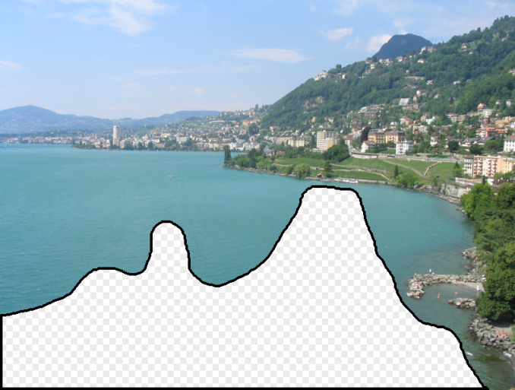

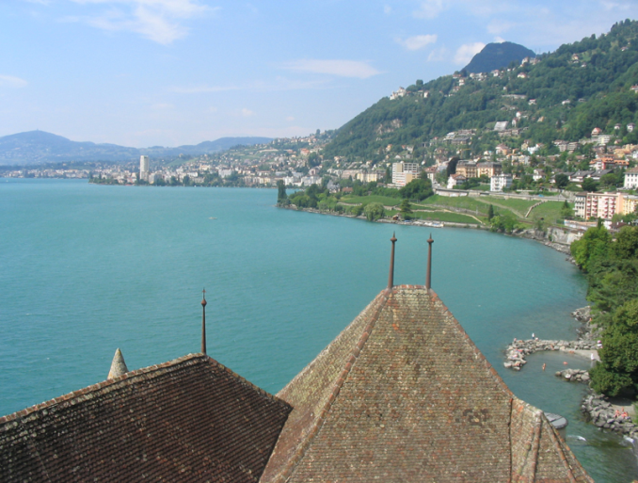
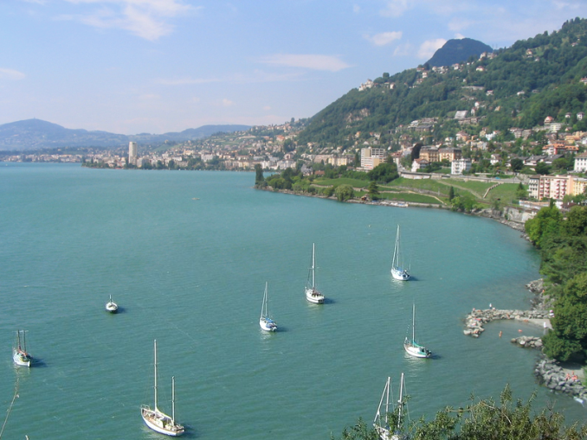
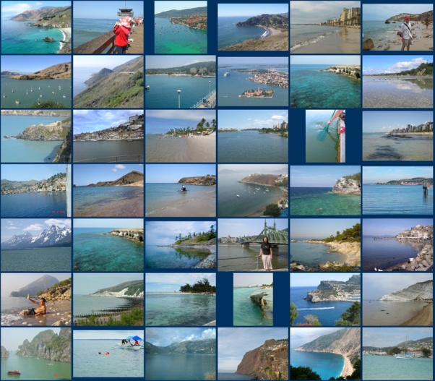
Images with Similar Features

Slide 5
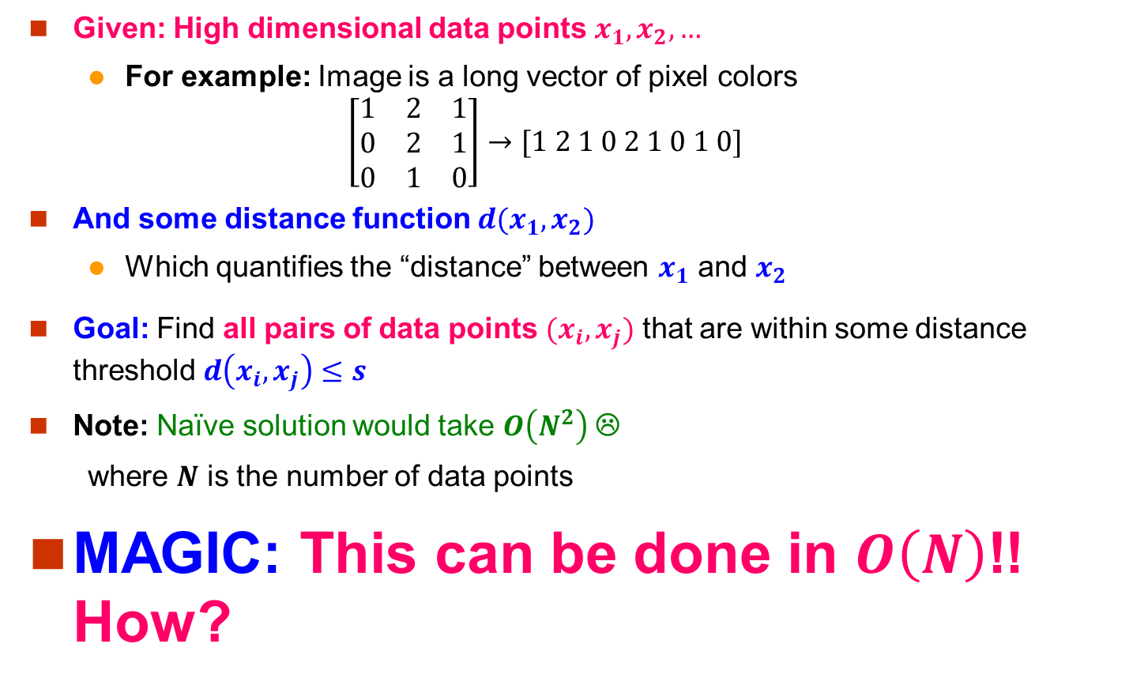
Problem for Today’s Lecture
Given: High dimensional data points $x_{1}, x_{2}, …$
For example: Image is a long vector of pixel colors
$$\left[\begin{matrix}1 & 2 & 1 \\ 0 & 2 & 1 \\ 0 & 1 & 0\end{matrix}\right]→[1 2 1 0 2 1 0 1 0]$$
And some distance function $d(x_{1},x_{2})$
Which quantifies the “distance” between $x_{1}$ and $x_{2}$
Goal: Find all pairs of data points $(x_{i},x_{j})$ that are within some distance threshold $d\left(x_{i},x_{j}\right)≤s$
Note: Naïve solution would take $O\left(N^{2}\right)$ ☹
where $N$ is the number of data points
MAGIC: This can be done in $O\left(N\right)$!! How?

Slide 6
Distance Measures
Goal: Find near-neighbors in high-dim. space
We formally define “near neighbors” as points that are a “small distance” apart
For each application, we first need to define what “distance” means
Today: Jaccard distance/similarity
The Jaccard similarity of two sets is the size of their intersection divided by the size of their union: sim(C₁, C₂) = |C₁∩C₂|/|C₁∪C₂|
Jaccard distance: d(C₁, C₂) = 1 - |C₁∩C₂|/|C₁∪C₂|
3 in intersection
8 in union
Jaccard similarity= 3/8
Jaccard distance = 5/8

Slide 7
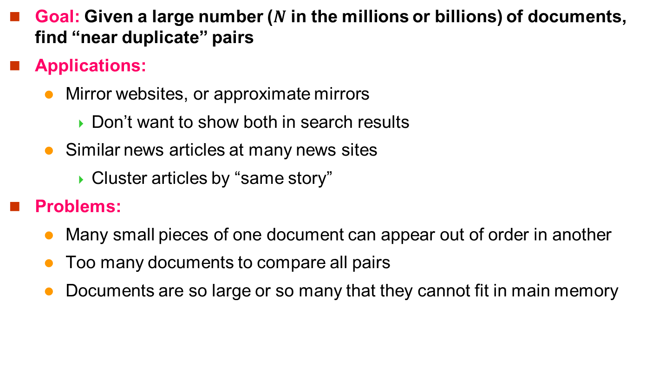
Task: Finding Similar Documents
Goal: Given a large number ($N$ in the millions or billions) of documents, find “near duplicate” pairs
Applications:
Mirror websites, or approximate mirrors
Don’t want to show both in search results
Similar news articles at many news sites
Cluster articles by “same story”
Problems:
Many small pieces of one document can appear out of order in another
Too many documents to compare all pairs
Documents are so large or so many that they cannot fit in main memory

Slide 8
3 Essential Steps for Similar Docs
Shingling: Convert documents to sets
Min-Hashing: Convert large sets to short signatures, while preserving similarity
Locality-Sensitive Hashing: Focus on pairs of signatures likely to be from similar documents
Candidate pairs!

Slide 9
The Big Picture
Candidate
pairs:
those pairs
of signatures
that we need
to test for
similarity
Shingling
Min Hashing
Locality-
Sensitive
Hashing
Docu-
ment
The set
of strings
of length k
that appear
in the doc-
ument
Signatures:
short integer
vectors that
represent the
sets, and
reflect their
similarity

Slide 10
Shingling
Docu-
ment
The set
of strings
of length k
that appear
in the doc-
ument
Step 1: Shingling: Convert documents to sets

Slide 11
Documents as High-Dim Data
Step 1: Shingling: Convert documents to sets
Simple approaches:
Document = set of words appearing in document
Document = set of “important” words
Don’t work well for this application. Why?
Need to account for ordering of words!
A different way: Shingles!

Slide 12
Define: Shingles
A k-shingle (or k-gram) for a document is a sequence of k tokens that appears in the doc
Tokens can be characters, words or something else, depending on the application
Assume tokens = characters for examples
Example: k=2; document D₁ = abcab Set of 2-shingles: S(D₁) = {ab, bc, ca}
Option: Shingles as a bag (multiset), count ab twice: S’(D₁) = {ab, bc, ca, ab}

Slide 13
Shingles and Similarity
Documents that are intuitively similar will have many shingles in common.
Changing a word only affects k-shingles within distance k-1 from the word.
Reordering paragraphs only affects the 2k shingles that cross paragraph boundaries.
Example: k=3, “The dog which chased the cat” versus “The dog that chased the cat”.
Only 3-shingles replaced are g_w, _wh, whi, hic, ich, ch_, and h_c.
Notes:
We need to assure ourselves that replacing a document by its shingles still lets us detect pairs of documents that are intuitively similar. It fact, similarity of shingle sets captures many of the kinds of document changes that we would regard as keeping the documents similar.
Click 1
For example, if we are using k-shingles, and we change one word, only the k shingles to the left and right of the word, as well as shingles within the word, can be effected.
Click 2
And we can reorder entire paragraphs without affecting any shingles except the shingles that cross the boundaries between the paragraph we moved and the paragraphs just before and just after, in both the new and old positions.
Click 3
For example, suppose we use k=3, and we correctly change the “which” in this sentence to “that”. The only shingles that can be affected are the ones that begin at most two characters before “which” and end at most two characters after “which” (DRAW). These are g-blank-w (POINT), blank-w-h, and so on, up to h-blank-c (POINT), a total of seven shingles. These are replaced by six different shingles, g-blank-t (POINT), and so on. However, all other shingles remain the same in the two sentences.

Slide 14
Compressing Shingles
To compress long shingles, we can hash them to (say) 4 bytes
Represent a document by the set of hash values of its k-shingles
Idea: Two documents could (rarely) appear to have shingles in common, when in fact only the hash-values were shared
Example: k=2; document D₁= abcab Set of 2-shingles: S(D₁) = {ab, bc, ca} Hash the singles: h(D₁) = {1, 5, 7}

Slide 15
Similarity Metric for Shingles
Document D₁ is a set of its k-shingles C₁=S(D₁)
Equivalently, each document is a 0/1 vector in the space of k-shingles
Each unique shingle is a dimension
Vectors are very sparse
A natural similarity measure is the Jaccard similarity:
sim(D₁, D₂) = |C₁∩C₂|/|C₁∪C₂|

Slide 16
Working Assumption
Documents that have lots of shingles in common have similar text, even if the text appears in different order
If we pick k too small, then we would expect most sequences of k characters to appear in most documents
We could have documents whose shingle-sets had high Jaccard similarity, yet the documents had none of the same sentences or even phrases
Extreme case: when we use k = 1, almost all Web pages will have high similarity.
Caveat: You must pick k large enough, or most documents will have most shingles
k = 5 is OK for short documents
k = 10 is better for long documents

Slide 17
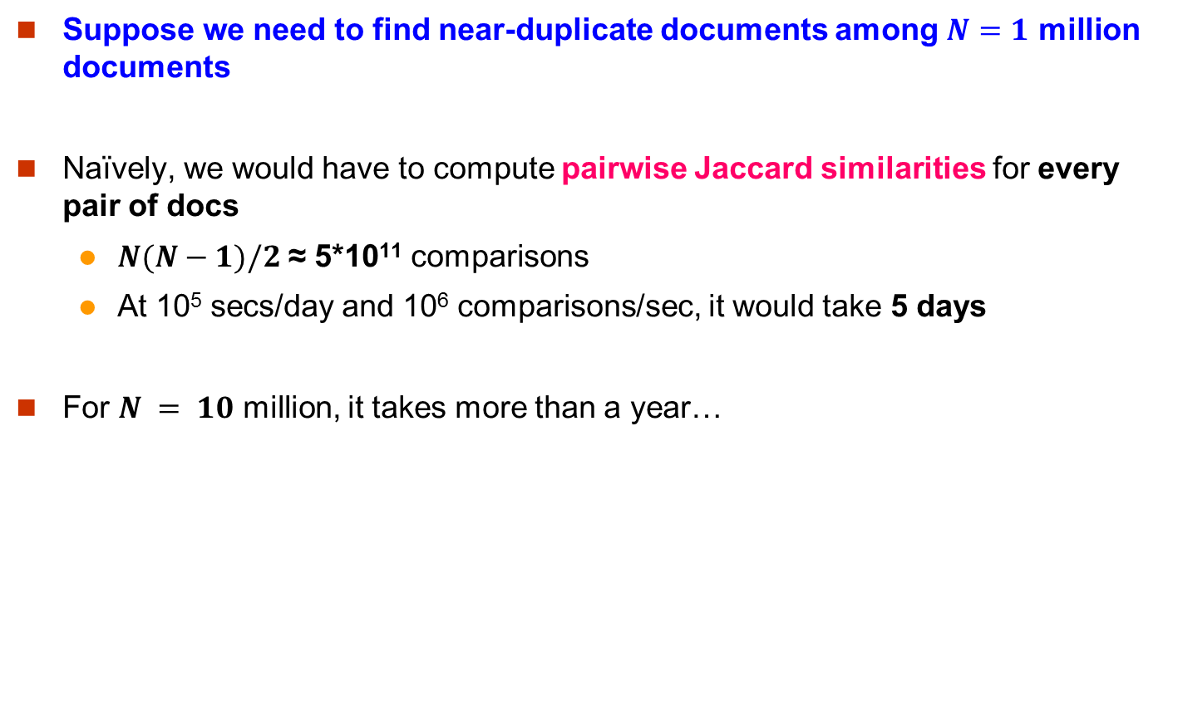
Motivation for Minhash/LSH
Suppose we need to find near-duplicate documents among $N=1$ million documents
Naïvely, we would have to compute pairwise Jaccard similarities for every pair of docs
$N(N−1)/2$ ≈ 5*10¹¹ comparisons
At 10⁵ secs/day and 10⁶ comparisons/sec, it would take 5 days
For $N = 10$ million, it takes more than a year…

Slide 18
Shingling
Min-Hash-
ing
Docu-
ment
The set
of strings
of length k
that appear
in the doc-
ument
Signatures:
short integer
vectors that
represent the
sets, and
reflect their
similarity
Step 2: Minhashing: Convert large sets to short signatures, while preserving similarity

Slide 19
Encoding Sets as Bit Vectors
Many similarity problems can be formalized as finding subsets that have significant intersection
Encode sets using 0/1 (bit, boolean) vectors
One dimension per element in the universal set
Interpret set intersection as bitwise AND, and set union as bitwise OR
Example: C₁ = 10111; C₂ = 10011
Size of intersection = 3; size of union = 4,
Jaccard similarity (not distance) = 3/4
Distance: d(C₁,C₂) = 1 – (Jaccard similarity) = 1/4

Slide 20
From Sets to Boolean Matrices
Rows = elements (shingles)
Columns = sets (documents)
1 in row e and column s if and only if e is a member of s
Column similarity is the Jaccard similarity of the corresponding sets (rows with value 1)
Typical matrix is sparse!
Each document is a column:
Documents
1
1
1
0
1
1
0
1
0
1
0
1
0
0
0
1
Shingles
1
0
0
1
1
1
1
0
1
0
1
0

Slide 21
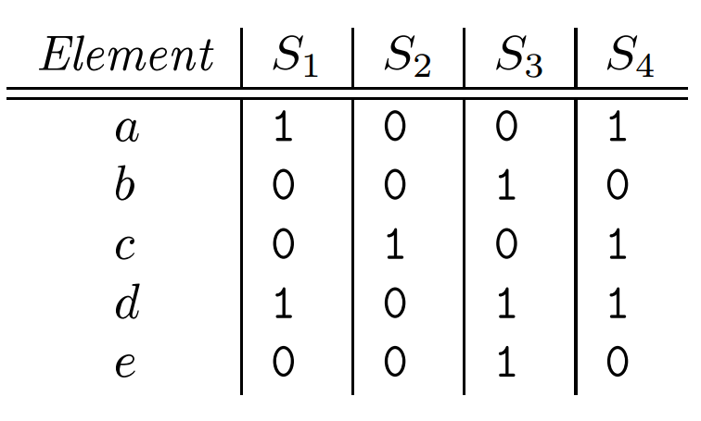
From Sets to Boolean Matrices
Example: S₁ = {a, d}, S₂ = {c}, S₃ = {b, d, e}, and S₄ = {a, c, d}
sim(S₁, S₃) = ?
Size of intersection = 1; size of union = 4, Jaccard similarity (not distance) = 1/4
d(S₁, S₂) = 1 – (Jaccard similarity) = 3/4

Slide 22
Outline: Finding Similar Columns
So far:
Documents → Sets of shingles
Represent sets as boolean vectors in a matrix
Next goal: Find similar columns while computing small signatures
Similarity of columns == similarity of signatures

Slide 23
Outline: Finding Similar Columns
Next Goal: Find similar columns, Small signatures
Naïve approach:
1) Signatures of columns: small summaries of columns
2) Examine pairs of signatures to find similar columns
Essential: Similarities of signatures and columns are related
3) Optional: Check that columns with similar signatures are really similar
Warnings:
Comparing all pairs may take too much time: Job for LSH
These methods can produce false negatives, and even false positives (if the optional check is not made)

Slide 24
Hashing Columns (Signatures)
Key idea: “hash” each column C to a small signature h(C), such that:
(1) h(C) is small enough that the signature fits in RAM
(2) sim(C₁, C₂) is the same as the “similarity” of signatures h(C₁) and h(C₂)
Goal: Find a hash function h(·) such that:
If sim(C₁,C₂) is high, then with high prob. h(C₁) = h(C₂)
If sim(C₁,C₂) is low, then with high prob. h(C₁) ≠ h(C₂)
Hash docs into buckets. Expect that “most” pairs of near duplicate docs hash into the same bucket!

Slide 25
Min-Hashing
Goal: Find a hash function h(·) such that:
if sim(C₁,C₂) is high, then with high prob. h(C₁) = h(C₂)
if sim(C₁,C₂) is low, then with high prob. h(C₁) ≠ h(C₂)
Clearly, the hash function depends on the similarity metric:
Not all similarity metrics have a suitable hash function
There is a suitable hash function for the Jaccard similarity: Min-Hashing

Slide 26
Min-Hashing
Imagine the rows of the boolean matrix permuted under random permutation π
Define a “hash” function h_{π}(C) = the index of the first (in the permuted order π) row in which column C has value 1:
h_{π} (C) = min_{π} π(C)
Use several (e.g., 100) independent hash functions (that is, permutations) to create a signature of a column

Slide 27
Min-Hashing Example
1
0
1
1
0
2
0
0
1
1
3
1
1
2
3
1
0
0
0
4
0
1
0
1
5
0
0
0
1
6
1
1
0
0
7
0
0
1
0
Signature Matrix
Input Matrix

Slide 28
Min-Hashing Example
7
1
0
1
1
0
6
2
0
0
1
1
3
1
1
2
5
3
1
0
0
0
2
2
1
3
4
4
0
1
0
1
3
5
0
0
0
1
2
6
1
1
0
0
1
7
0
0
1
0
Signature Matrix
Input Matrix

Slide 29
Min-Hashing Example
6
7
1
0
1
1
0
3
6
2
0
0
1
1
3
1
1
2
1
5
3
1
0
0
0
2
2
1
3
7
4
4
0
1
0
1
2
3
5
0
0
0
1
1
5
3
2
5
2
6
1
1
0
0
4
1
7
0
0
1
0
Signature Matrix
Input Matrix

Slide 30
Min-Hashing Example
Note: Another (equivalent) way is to store row indexes:
1 | 5 | 1 | 5
2 | 3 | 1 | 3
6 | 4 | 6 | 4
2nd element of the permutation is the first to map to a 1
Permutation π
Input matrix (Shingles x Documents)
Signature matrix M
2
4
3
4
7
2
6
1
5
1
0
1
0
2
1
2
1
3
2
1
0
0
1
2
1
4
1
7
1
0
1
0
1
1
2
1
2
6
3
0
1
0
1
1
6
0
1
0
1
4th element of the permutation is the first to map to a 1
5
7
1
0
1
0
4
5
1
0
1
0

Slide 31
The Min-Hash Property
0
0
0
0
1
1
Choose a random permutation π
Claim: Pr[h_{π}(C₁) = h_{π}(C₂)] = sim(C₁, C₂)
Why?
Let X be a doc (set of shingles), y∈ X is a shingle
Then: Pr[π(y) = min(π(X))] = 1/|X|
It is equally likely that any y∈ X is mapped to the min element
Let y be s.t. π(y) = min(π(C₁∪C₂))
Then either: π(y) = min(π(C₁)) if y ∈ C₁ , or
π(y) = min(π(C₂)) if y ∈ C₂
So the prob. that both are true is the prob. y ∈ C₁ ∩ C₂
Pr[min(π(C₁))=min(π(C₂))]=|C₁∩C₂|/|C₁∪C₂|= sim(C₁, C₂)
0
0
0
1
1
0
One of the two cols had to have 1 at position y
Notes:
Size of the universe of all possible vals of min(π(C₁∪C₂)) is |C₁∪C₂| and in |C₁∩C₂| of cases it can be that min(π(C₁))=min(π(C₂)) which exactly the jaccard between C1 and C2
For two columns A and B, we have h_π(A) = h_π(B) exactly when the minimum hash value of the union A ∪ B lies in the intersection A ∩ B. Thus Pr[h_π(A) = h_π(B)] = |A ∩ B| / |A ∪ B|.

Slide 32
Four Types of Rows
Given cols C₁ and C₂, rows may be classified as:
C₁ C₂
A 1 1
B 1 0
C 0 1
D 0 0
a = # rows of type A, etc.
Note: sim(C₁, C₂) = a/(a +b +c)
Then: Pr[h(C₁) = h(C₂)] = Sim(C₁, C₂)
Look down the cols C₁ and C₂ until we see a 1
If it’s a type-A row, then h(C₁) = h(C₂) If a type-B or type-C row, then not

Slide 33
Similarity for Signatures
Permutation π
Input matrix (Shingles x Documents)
Signature matrix M
2
4
3
4
7
2
6
1
5
1
0
1
0
2
1
2
1
3
2
1
0
0
1
2
1
4
1
7
1
0
1
0
1
1
2
1
2
6
3
0
1
0
1
1
6
0
1
0
1
Similarities:
1-3 2-4 1-2 3-4
Col/Col 0.75 0.75 0 0
Sig/Sig 0.67 1.00 0 0
5
7
1
0
1
0
4
5
1
0
1
0

Slide 34
Similarity for Signatures
We know: Pr[h_{π}(C₁) = h_{π}(C₂)] = sim(C₁, C₂)
Now generalize to multiple hash functions
The similarity of two signatures is the fraction of the hash functions in which they agree
Note: Because of the Min-Hash property, the similarity of columns is the same as the expected similarity of their signatures
Notes:
Each agress with prob s.
So to estimate s we compute what fraction of hash functions agree

Slide 35
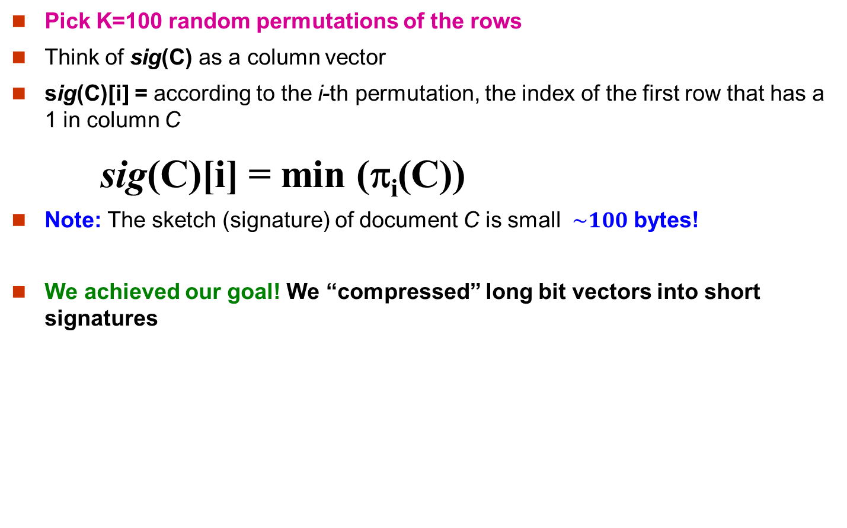
Min-Hash Signatures
Pick K=100 random permutations of the rows
Think of sig(C) as a column vector
sig(C)[i] = according to the i-th permutation, the index of the first row that has a 1 in column C
sig(C)[i] = min (π_{i}(C))
Note: The sketch (signature) of document C is small $\sim 100$ bytes!
We achieved our goal! We “compressed” long bit vectors into short signatures

Slide 36
Implementation Trick
Permuting rows even once is prohibitive
Row hashing!
Pick K = 100 hash functions k_{i}
Ordering under k_{i} gives a random row permutation!
One-pass implementation
For each column C and hash-func. k_{i} keep a “slot” for the min-hash value
Initialize all sig(C)[i] = ∞
Scan rows looking for 1s
Suppose row j has 1 in column C
Then for each k_{i} :
If k_{i}(j) < sig(C)[i], then sig(C)[i] ← k_{i}(j)
How to pick a random hash function h(x)?
Universal hashing:
h_{a,b}(x)=((a·x+b) mod p) mod N
where:
a,b … random integers
p … prime number (p > N)

Slide 37
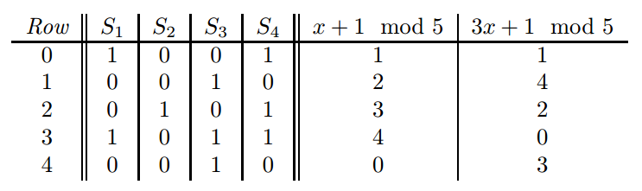
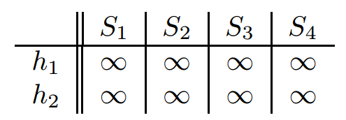
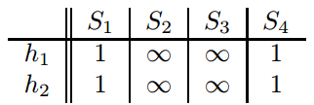
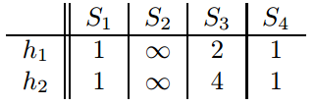
Implementation Example
0. Initialize all sig(C)[i] = ∞
Row 0: we see that the values of h₁(0) and
h₂(0) are both 1, thus sig(S₁)[0] = 1,
sig(S₁)[1] = 1, sig(S₄)[0] = 1, sig(S₄)[0] = 1,
Row 1, we see h₁(1) = 2 and h₂(1) = 4，
thus sig(S₃)[0] = 2, sig(S₃)[1] = 4

Slide 38
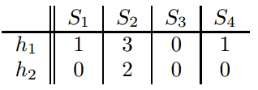
Implementation Example
We can estimate the Jaccard similarities of the underlying sets from this signature matrix.
Signature matrix: SIM(S₁, S₄) = 1.0
Jaccard Similarity: SIM(S₁, S₄) = 2/3

Slide 39
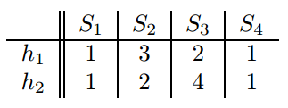
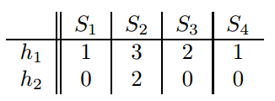
Implementation Example
Row 2: h₁(2) = 3 and h₂(2) = 2, thus
sig(S₂)[0] = 3, sig(S₂)[1] = 2, no update for S₄
Row 3: h₁(2) = 4 and h₂(2) = 0, update
sig(S₁)[1] = 0, sig(S₃)[1] = 0, sig(S₄)[1] = 0,
Row 4: h₁(2) = 0 and h₂(2) = 3, update
sig(S₃)[0] = 0,

Slide 40
Implementation Practice
Sig1 Sig2
h(1) = 1 ∞ ∞
g(1) = 3 ∞ ∞
Row C1 C2
1 1 0
2 0 1
3 1 1
4 1 0
5 0 1
h(1) = 1 1 ∞
g(1) = 3 3 ∞
h(2) = 2 1 2
g(2) = 0 3 0
h(3) = 3 1 2
g(3) = 2 2 0
h(x) = x mod 5
g(x) = (2x+1) mod 5
h(4) = 4 1 2
g(4) = 4 2 0
h(5) = 0 1 0
g(5) = 1 2 0

Slide 41
Candidate
pairs:
those pairs
of signatures
that we need
to test for
similarity
Shingling
Min-Hash-
ing
Locality-
Sensitive
Hashing
Docu-
ment
The set
of strings
of length k
that appear
in the doc-
ument
Signatures:
short integer
vectors that
represent the
sets, and
reflect their
similarity
Step 3: Locality-Sensitive Hashing: Focus on pairs of signatures likely to be from similar documents

Slide 42
LSH: First Cut
2
1
4
1
1
2
1
2
2
1
2
1
Goal: Find documents with Jaccard similarity at least s (for some similarity threshold, e.g., s=0.8)
LSH – General idea: Use a function f(x,y) that tells whether x and y is a candidate pair: a pair of elements whose similarity must be evaluated
For Min-Hash matrices:
Hash columns of signature matrix M to many buckets
Each pair of documents that hashes into the same bucket is a candidate pair

Slide 43
Candidates from Min-Hash
2
1
4
1
Pick a similarity threshold s (0 < s < 1)
Columns x and y of M are a candidate pair if their signatures agree on at least fraction s of their rows: M (i, x) = M (i, y) for at least frac. s values of i
We expect documents x and y to have the same (Jaccard) similarity as their signatures
1
2
1
2
2
1
2
1

Slide 44
LSH for Min-Hash
2
1
4
1
Big idea: Hash columns of signature matrix M several times
Arrange that (only) similar columns are likely to hash to the same bucket, with high probability
Candidate pairs are those that hash to the same bucket
1
2
1
2
2
1
2
1

Slide 45
Partition M into b Bands
r rows
per band
b bands
One
signature
Signature matrix M

Slide 46
Partition M into Bands
Divide matrix M into b bands of r rows
For each band, hash its portion of each column to a hash table with k buckets
Make k as large as possible
Candidate column pairs are those that hash to the same bucket for ≥ 1 band
Tune b and r to catch most similar pairs, but few non-similar pairs

Slide 47
Hashing Bands
Buckets
Columns 2 and 6
are probably identical
(candidate pair)
Columns 6 and 7 are
surely different.
Matrix M
r rows
b bands

Slide 48
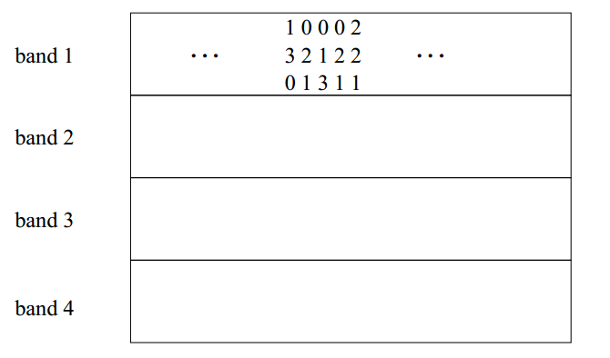
Hashing Bands
Regardless of what those columns look like in the other three bands, this pair of columns will be a candidate pair
Two columns that do not agree in band 1 have three other chances to become a candidate pair; they might be identical in any one of these other bands.

Slide 49
Simplifying Assumption
There are enough buckets that columns are unlikely to hash to the same bucket unless they are identical in a particular band
Hereafter, we assume that “same bucket” means “identical in that band”
Assumption needed only to simplify analysis, not for correctness of algorithm

Slide 50
Example of Bands
Assume the following case:
Suppose 100,000 columns of M (100k docs)
Signatures of 100 integers (rows)
Therefore, signatures take 40Mb
Choose b = 20 bands of r = 5 integers/band
Goal: Find pairs of documents that are at least s = 0.8 similar

Slide 51
C₁, C₂ are 80% Similar
Find pairs of ≥ s=0.8 similarity, set b=20, r=5
Assume: sim(C₁, C₂) = 0.8
Since sim(C₁, C₂) ≥ s, we want C₁, C₂ to be a candidate pair: We want them to hash to at least 1 common bucket (at least one band is identical)
Probability C₁, C₂ identical in one particular band: (0.8)⁵ = 0.328
Probability C₁, C₂ are not similar in all of the 20 bands: (1-0.328)²⁰ = 0.00035
i.e., about 1/3000th of the 80%-similar column pairs are false negatives (we miss them)
We would find 99.965% pairs of truly similar documents

Slide 52
C₁, C₂ are 30% Similar
Find pairs of ≥ s=0.8 similarity, set b=20, r=5
Assume: sim(C₁, C₂) = 0.3
Since sim(C₁, C₂) < s we want C₁, C₂ to hash to NO common buckets (all bands should be different)
Probability C₁, C₂ identical in one particular band: (0.3)⁵ = 0.00243
Probability C₁, C₂ identical in at least 1 of 20 bands: 1 - (1 - 0.00243)²⁰ = 0.0474
In other words, approximately 4.74% pairs of docs with similarity 0.3% end up becoming candidate pairs
They are false positives since we will have to examine them (they are candidate pairs) but then it will turn out their similarity is below threshold s

Slide 53
LSH Involves a Tradeoff
Pick:
The number of Min-Hashes (rows of M)
The number of bands b, and
The number of rows r per band to balance false positives/negatives
Example: If we had only 15 bands of 5 rows, the number of false positives would go down, but the number of false negatives would go up

Slide 54
Analysis of LSH – What We Want
Probability = 1 if t > s
Probability
of sharing
a bucket
No chance
if t < s
Similarity threshold s
Similarity t =sim(C₁, C₂) of two sets

Slide 55
What 1 Band of 1 Row Gives You
Probability
of sharing
a bucket
Remember:
Probability of
equal hash-values
= similarity
Similarity t =sim(C₁, C₂) of two sets

Slide 56
b bands, r rows/band
The probability that the minhash signatures for the documents agree in any one particular row of the signature matrix is t (sim(C₁, C₂) )
Pick any band (r rows)
Prob. that all rows in band equal = t^{r}
Prob. that some row in band unequal = 1 - t^{r}
Prob. that no band identical = (1 - t^{r})^{b}
Prob. that at least 1 band identical = 1 - (1 - t^{r})^{b}

Slide 57
What b Bands of r Rows Gives You
No bands
identical
At least
one band
identical
(
)^{b}
Probability
of sharing
a bucket
s ~ (1/b)^{1/r}
1 -
1 -
t^{r}
All rows
of a band
are equal
Some row
of a band
unequal
Similarity t=sim(C₁, C₂) of two sets

Slide 58
Example: b = 20, r = 5
Similarity threshold s
Prob. that at least 1 band is identical:
s | 1-(1-s^{r})^{b}
.2 | .006
.3 | .047
.4 | .186
.5 | .470
.6 | .802
.7 | .975
.8 | .9996

Slide 59
Picking r and b: The S-curve
Picking r and b to get the best S-curve
50 hash-functions (r=5, b=10)
Prob. sharing a bucket
Blue area: False Negative rate
Green area: False Positive rate
Similarity

Slide 60
LSH Summary
Tune M, b, r to get almost all pairs with similar signatures, but eliminate most pairs that do not have similar signatures
Check in main memory that candidate pairs really do have similar signatures
Optional: In another pass through data, check that the remaining candidate pairs really represent similar documents

Slide 61
Summary: 3 Steps
Shingling: Convert documents to sets
We used hashing to assign each shingle an ID
Min-Hashing: Convert large sets to short signatures, while preserving similarity
We used similarity preserving hashing to generate signatures with property Pr[h_{π}(C₁) = h_{π}(C₂)] = sim(C₁, C₂)
We used hashing to get around generating random permutations
Locality-Sensitive Hashing: Focus on pairs of signatures likely to be from similar documents
We used hashing to find candidate pairs of similarity ≥ s

Slide 62
Distance Measures
Generalized LSH is based on some kind of “distance” between points.
Similar points are “close.”
Example: Jaccard similarity is not a distance; 1 minus Jaccard similarity is.
d is a distance measure if it is a function from pairs of points to real numbers such that:
d(x,y) > 0.
d(x,y) = 0 iff x = y.
d(x,y) = d(y,x).
d(x,y) < d(x,z) + d(z,y) (triangle inequality).

Slide 63
Some Euclidean Distances
L₂ norm: d(x,y) = square root of the sum of the squares of the differences between x and y in each dimension.
The most common notion of “distance.”
L₁ norm: sum of the differences in each dimension.
Manhattan distance = distance if you had to travel along coordinates only.
b = (9,8)
L₂-norm:
dist(a,b) =
√(4²+3²)= 5
5
3
4
L₁-norm:
dist(a,b) =4+3 = 7
a = (5,5)
Notes:
The most common Euclidean distance is the L2 norm, which is the square root of the sum of the squares of the distances between the two points x and y, measured in each dimension.
Click 1
Another common choice for Euclidean spaces is the L1-norm, or Manhattan distance. If you’ve ever visited Manhattan in New York, you know that the streets are laid out in a grid. You can’t walk directly between two points. You need to first walk in one direction or dimension, say north-south, and then in the other direction, say east-west. As a result, the L1 norm between points x and y is the sum of the distances between x and y along each dimension.

Slide 64
Some Non-Euclidean Distances
Jaccard distance for sets = 1 minus Jaccard similarity.
Cosine distance for vectors = angle between the vectors.
Edit distance for strings = number of inserts and deletes to change one string into another.
Notes:
Now, let’s introduce a cast of characters for the non-Euclidean distances.
Click 1
First, the Jaccard distance. As we mentioned, this is just 1 minus the Jaccard similarity. We have to use “1 minus” so identical sets have distance 0 and sets with no intersection have distance 1, which in this case is the greatest possible distance.
Click 2
And in this corner, the Cosine distance. This distance requires points to be vectors. If the vectors have real numbers as components, then they are essentially points in a Euclidean space, but the vectors could, say, have integer components, in which case the space is not Euclidean. But either way, the cosine distance is the angle between the vectors. It’s called the cosine distance, because as we shall see, it is generally easiest to compute the cosine of the angle between vectors and then use the cosine to figure out the actual angle.
Click 3
The edit distance applies to points that are character strings. The edit distance between two strings is the minimum number of inserts and deletes needed to transform one of the strings into the other. There are some other notions of edit distance as well. For example, sometimes we allow a “mutation” as one edit, where a mutation changes one character to another (DRAW abc => adc). Without mutations, we would have to make 2 edits: first delete the old character and then insert the new one (DRAW abc => ac => adc) We’re only going to talk about the insert/delete version of edit distance in this course.
Click 4
Finally, consider the Hamming distance. It’s named after Richard Hamming, the third winner of the Turing award, by the way. It applies to points that are bit vectors of the same length. The Hamming distance between two bit vectors is the number of positions in which they differ.

Slide 65
Cosine Distance
Think of a point as a vector from the origin [0,0,…,0] to its location.
Two points’ vectors make an angle, whose cosine is the normalized dot-product of the vectors: p₁.p₂/|p₂||p₁|.
Example: p₁ = [1,0,2,-2,0]; p₂ = [0,0,3,0,0].
p₁.p₂ = 6; |p₁| = |p₂| = √9 = 3.
cos(θ) = 6/9; θ is about 48 degrees.
Notes:
Another important distance measure is the cosine distance. This distance is useful for data that is in the form of a vector. Often the vector is in very high dimensions. For example, documents are often viewed as the vector of counts of each of the words appearing in the document, so each word is a dimension.
Click 1
To define the cosine distance, think of a data point as a vector from the origin in some space to the point in question.
Click 2
Any two points have an angle, formed at the origin, between their vectors (DRAW below, then clear slide). We can compute the cosine of this angle from the components of the two vectors. To do so, we take the dot product of the vectors (POINT). The dot product is the sum of the products of the corresponding components. Then, we divide by the lengths of the two vectors. The length of a vector from the origin is actually the normal Euclidean distance – what we called the L2 norm – of the point at the head of the vector to the origin. That is, it is the square root of the sum of the squares of the components of the vector.
Click 3
For example, here are two vectors, p1 and p2 (POINT).
Click 4
The dot product of the vectors is 2. The products of each of the first three components is 0 (DRAW links between corresponding components), but in the last two components, each vector is 1, so the dot product is the sum of 1 times 1 plus 1 times 1. That’s 2. For the lengths of the vector, p1 has three 1’s so we sum three 1-squared’s, and then take the square root, giving us the square root of 3. p2 also has three 1’s and two 0’s as components, so its length is the same square root of 3.
Click 5
Thus, the cosine of the angle between p1 and p2 is 2 – the dot product – divided by the product of the two vector lengths. Each of those lengths is the square root of 3, so their product is 3, and the cosine of the angle is 2/3. If you look that up in a table of cosines, you find this angle is about 48 degrees.

Slide 66
Edit Distance
The edit distance of two strings is the number of inserts and deletes of characters needed to turn one into the other.
An equivalent definition: d(x,y) = |x| + |y| - 2|LCS(x,y)|.
LCS = longest common subsequence = any longest string obtained both by deleting from x and deleting from y.
Example:
x = abcde ; y = bcduve.
Turn x into y by deleting a, then inserting u and v after d.
Edit distance = 3.
Or, computing edit distance through the LCS, note that LCS(x,y) = bcde.
Then:|x| + |y| - 2|LCS(x,y)| = 5 + 6 –2*4 = 3 = edit distance.

Slide 67
Hash Functions Decide Equality
There is a subtlety about what a “hash function” is, in the context of LSH families.
A hash function h really takes two elements x and y, and returns a decision whether x and y are candidates for comparison.
Example: the family of minhash functions computes minhash values and says “yes” iff they are the same.
Shorthand: “h(x) = h(y)” means h says “yes” for pair of elements x and y.
Notes:
Before proceeding, we need to explain something about what a “hash function” in the sense of an LSH family really is.
Click 1
Technically, a hash function h in this sense takes two arguments x and y, which are elements whose similarity or distance we are interested in. The hash function returns a decision about this pair. “yes” means they are a candidate pair, and we need to calculate their similarity. We can think of “yes” as saying x and y belong in the same bucket when hash function h is used. The answer “no” means x and y are not a candidate pair according to this hash function.
Click 2
For example, a minhash function can be viewed as taking two sets x and y, computing their minhash values according to some permutation, and saying “yes” if and only if those minhash values are the same. In many cases, there will be a calculation of values behind the scenes, and the “yes” answers are made when the values are the same. However, the view we are taking now is more general, since there need not be a computation of values that are then compared. As we shall see, we really need this generality. For example, we shall look at LSH families that render their decisions by looking at many values and saying “yes” if there is at least one equality.
Click 3
However, to make things look more normal, we shall often use the expression h(x) = h(y) to mean that h(x,y) = “yes.”

Slide 68
LSH Families Defined
Suppose we have a space S of points with a distance measure d.
A family H of hash functions is said to be (d₁,d₂,p₁,p₂)-sensitive if for any x and y in S:
If d(x,y) < d₁, then the probability over all h in H, that h(x) = h(y) is at least p₁.
If d(x,y) > d₂, then the probability over all h in H, that h(x) = h(y) is at most p₂.

Slide 69
LS Families: Illustration
p₁
High
probability;
at least p₁
Low
probability;
at most p₂
???
p₂
d₁
d₂
Notes:
Here’s a picture of what we know about the probability of h(x) equaling h(y). For distances d1 and below, we know the probability is at least p1, and for distances d2 and above, we know the probability is at most p2. Between distances d1 and d2, we know nothing. However, we shall try to make the difference between d1 and d2 very small, and the distance between p1 and p2 as large as we can. That will give us the S-curve we want, although since we are now talking about distances rather than similarities, the S-curve is backwards. It drops down precipitously between the distances d1 and d2, rather than rising precipitously (DRAW in BLUE).

Slide 70
Example: LS Family – (2)
Claim: H is a (1/3, 3/4, 2/3, 1/4)-sensitive family for S and d.
Then probability
that minhash values
agree is < 1/4
If distance > 3/4
(so similarity < 1/4)
Then probability
that minhash values
agree is > 2/3
If distance < 1/3
(so similarity > 2/3)
For Jaccard similarity, minhashing gives us a
(d₁,d₂,(1-d₁),(1-d₂))-sensitive family for any d₁ < d₂.

Slide 71
References
Chapter 3 of Mining of Massive Datasets.

Slide 72
End of Chapter 9

