Slide 1
版本管理文件夹
日志文件夹
保存每个分支的日志
保存HEAD指针的日志
保存key-value Object类型文件
保存分支头指针
保存当前处于哪个分支

Slide 2
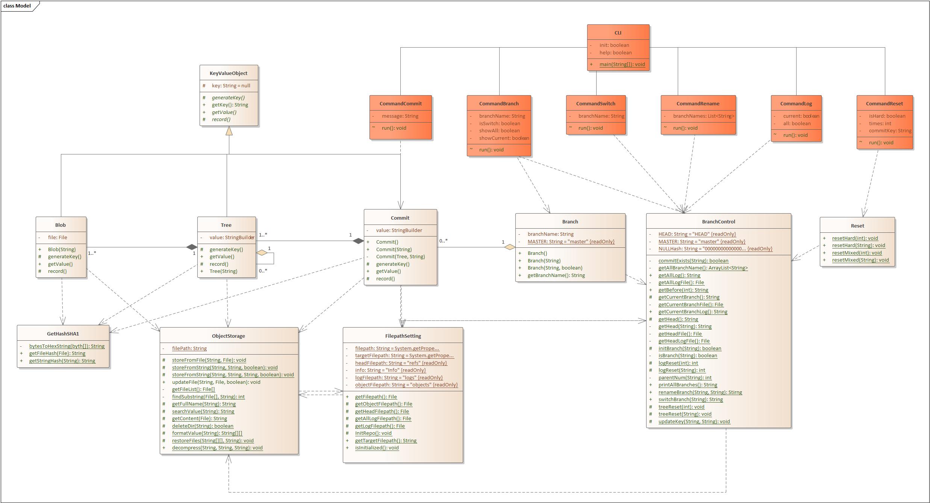

Slide 7
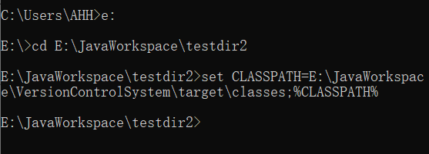

Slide 8
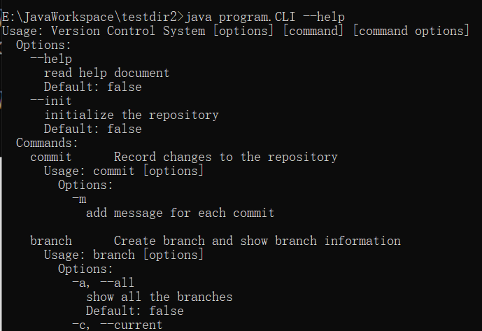

Slide 9
Usage: Version Control System [options] [command] [command options]
Options:
--help
read help document
Default: false
--init
initialize the repository
Default: false
Commands:
commit Record changes to the repository
Usage: commit [options]
Options:
-m
add message for each commit
branch Create branch and show branch information
Usage: branch [options]
Options:
-a, --all
show all the branches
Default: false
-c, --current
show the current branch
Default: false
-n, --new
create new branch with branch name
-s, --switch
create and switch to the new branch
Default: false
switch Switch between branches
Usage: switch branch name
rename Rename branch
Usage: rename rename branch
reset Reset commit to history
Usage: reset [options]
Options:
-HARD
choose the reset mode
Default: false
-c, --commit
reset to the specific commit history
-t, --times
reset to the specific times of commit history
Default: 0
log Read logs
Usage: log [options]
Options:
-a, --all
read the log of all branches
Default: false
-c, --current
read the log of current branch
Default: false

Slide 10
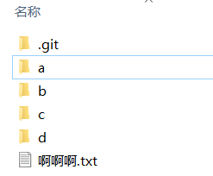

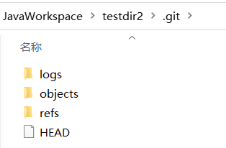

Slide 11
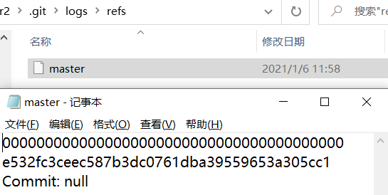
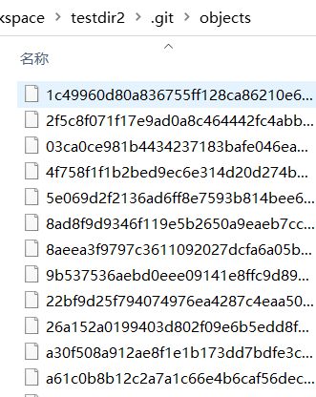
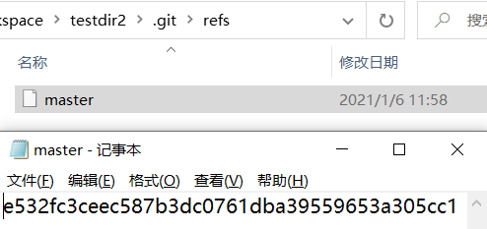

Slide 12
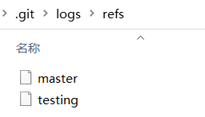
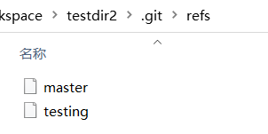
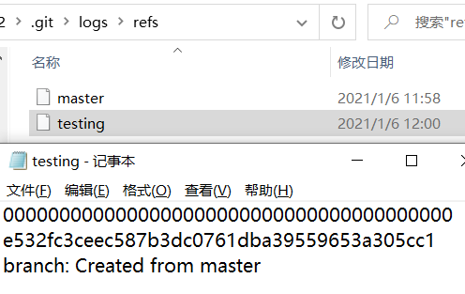

Slide 13
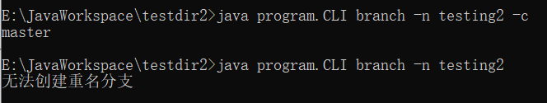

Slide 14
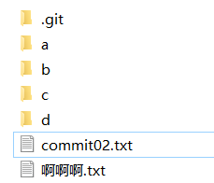

Slide 15
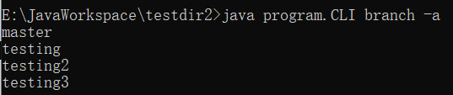

Slide 16


Slide 17
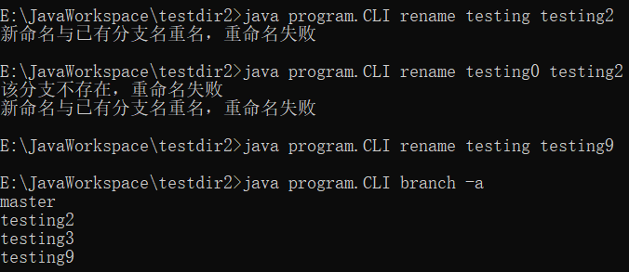

Slide 18

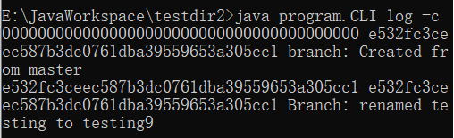

Slide 19

