Slide 1
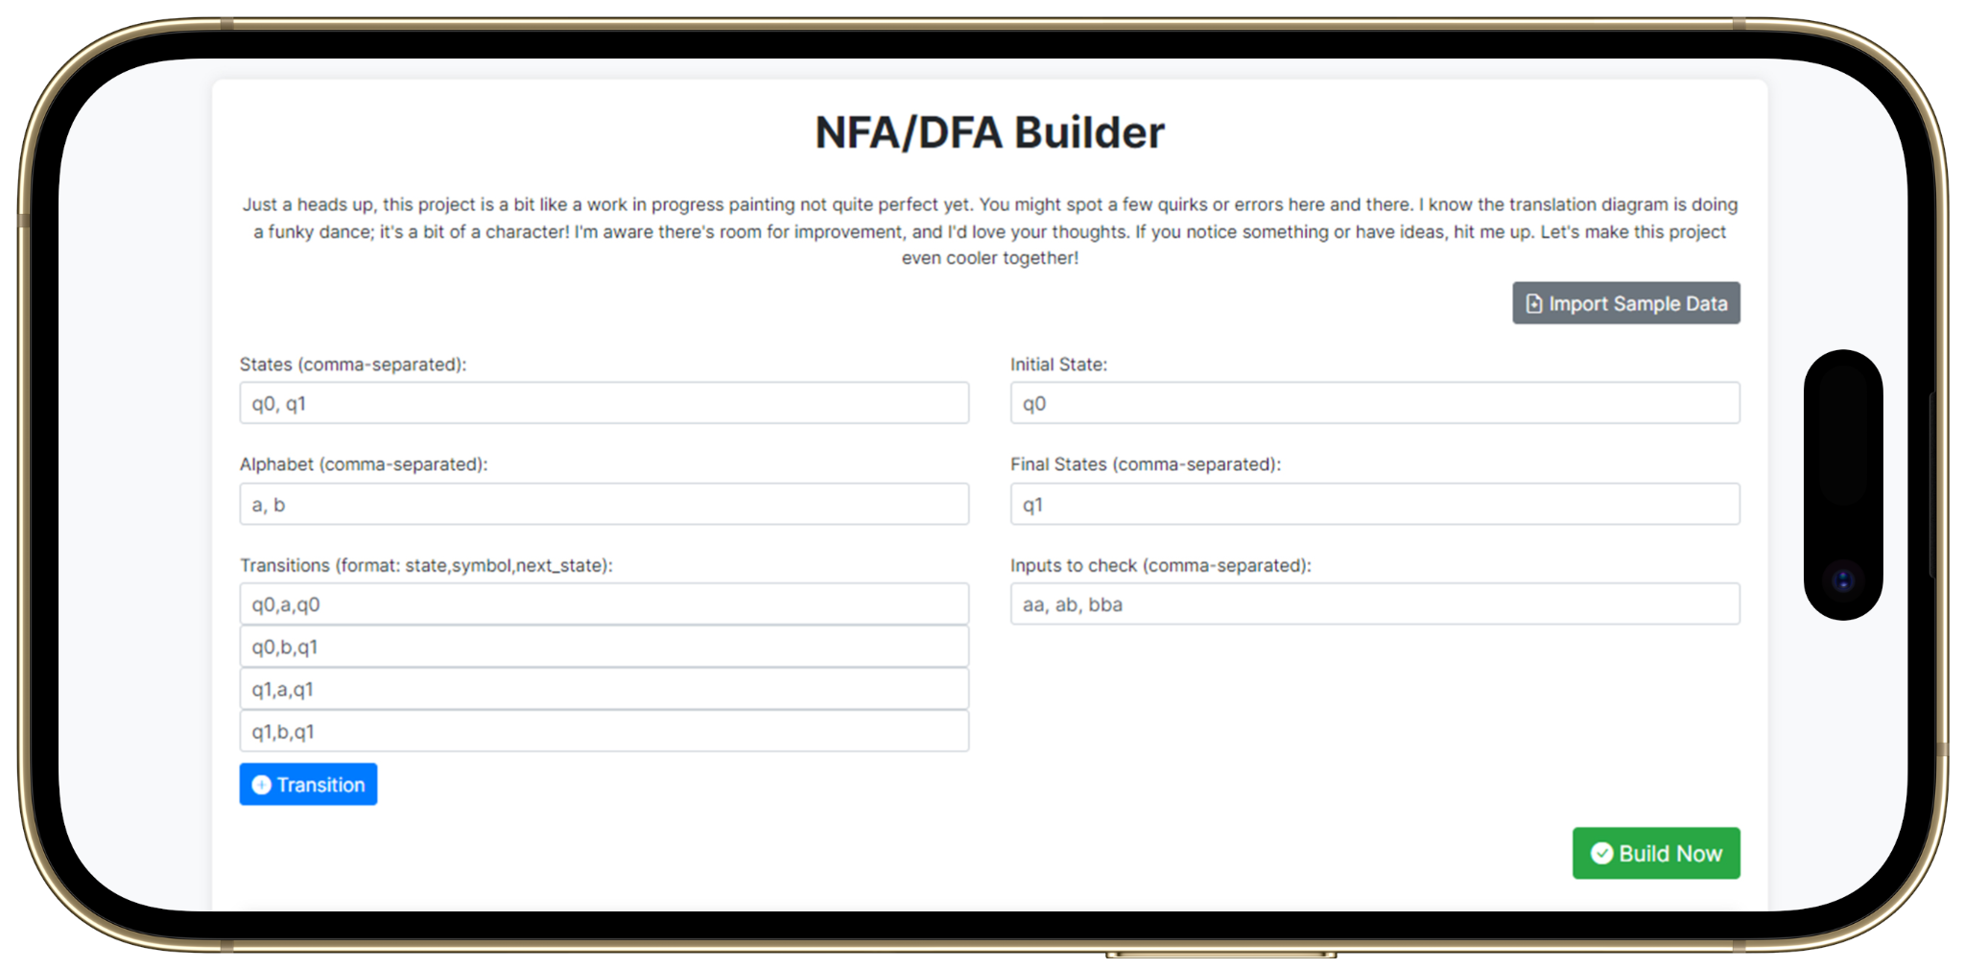
NFA/DFA Builder
Constructing and Visualizing Finite Automata

Slide 2
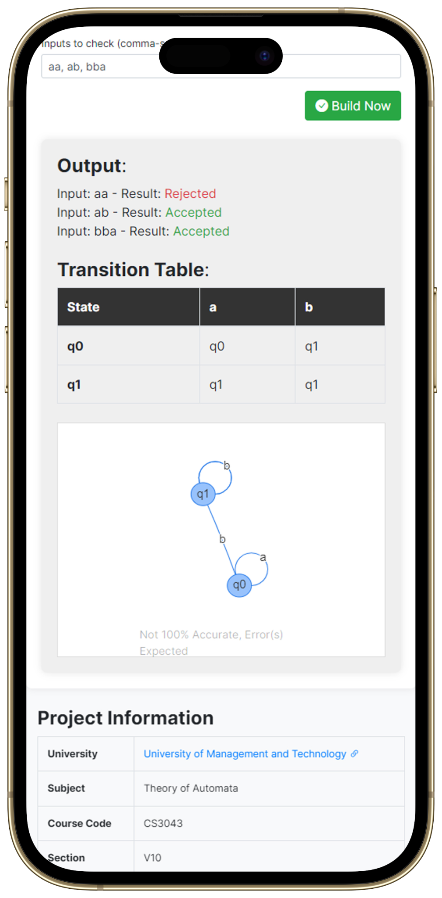
Key Features
Checking the Strings Acceptance
Construction of Transition Table
Visualization of the Automata

Slide 3
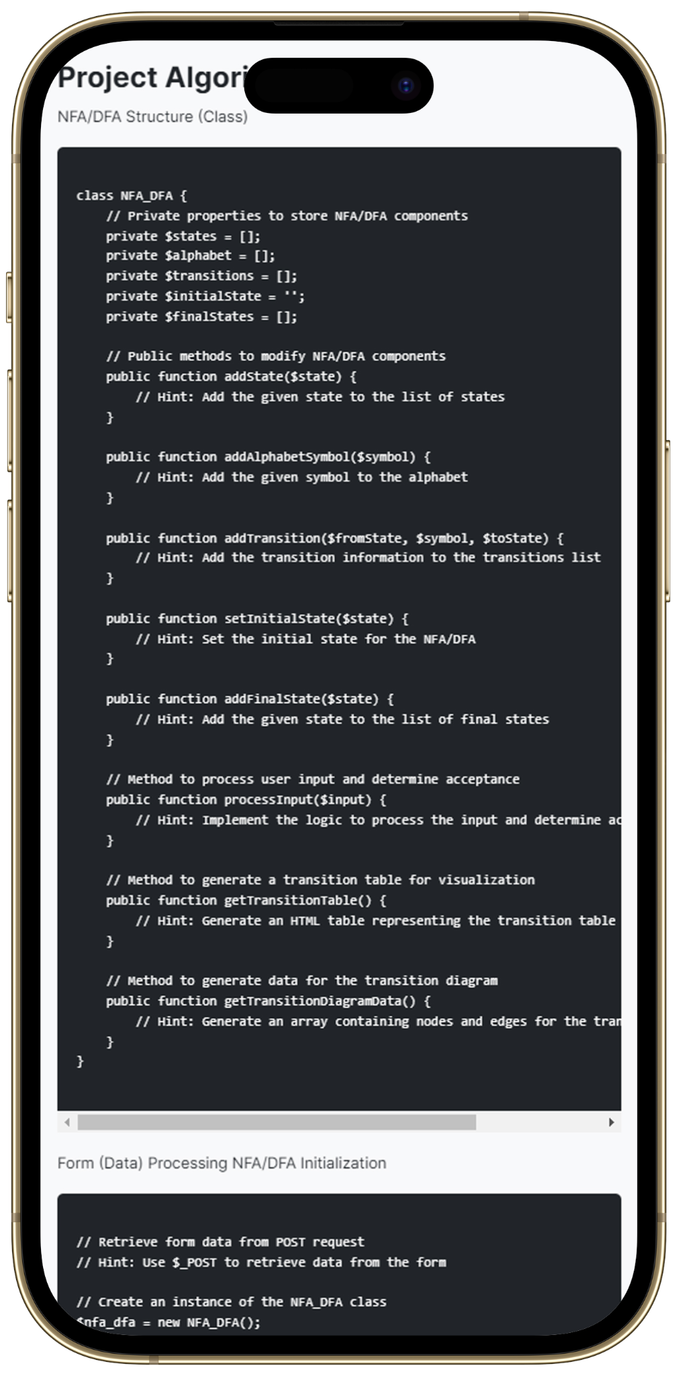
Tech Stack
PHP Core (Functionality / Backend)
AJAX (Data Handling)
Bootstrap (Front-end)
ChatGPT (Documentation + Assistance)

Slide 4
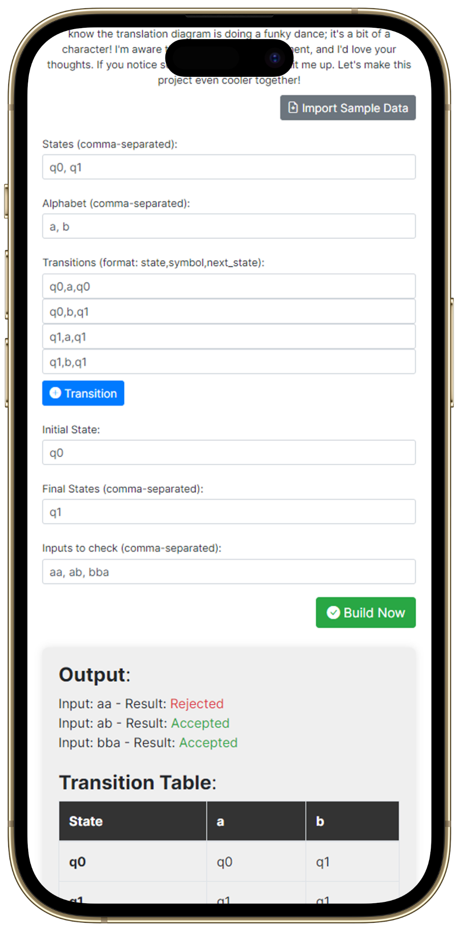
Sample Input (for Testing)
We have included sample input data for testing out the features without having to type anything

Slide 5
Conclusion
This Project Simplifies the process of Automata Construction. Improves understanding through real-time visualization and Empowers users to grasp core concepts of Automata Theory effectively.

Slide 6
Thank You!

