Slide 1









Furniture
Management
Team:
Arabinda Nayak
Abhishek Kumar Singh
Jemimah Nemuri

Slide 2
Overview
Objective
Project Overview
Onboarding-Architecture
Project Flow Chart
Technology and Tools Used
Conclusion

Slide 3
Objective
The main objective of this project is to provide flexibility to the user. The Furniture Management application is basically to create, update and delete the furniture details . Here user is able to do all the operations. Its main aim is to simplify and improve the efficiency of the User, It ensure data accuracy and security where user have to login so that user can access to all the operations and can view all the furniture details.

Slide 4
Project Overview
Authentication API
Furniture API
Adding
Furnitures
Login
Listing
Furnitures
User
Editing
Furnitures
Register
Deleting
Furnitures
SQL
Server

Slide 5
Onboardring-Architecture
Authentication API
Register
Login
Cookies Validator
Login/Register
POST request
Cookies
Generated
Front End
SQL Server
Furniture API
Get Furniture
Add Furniture
Edit Furniture
Delete Furniture
POST /GET/
ADD/
EDIT/
DELETE
Get/Add/
Edit/Delete

Slide 6
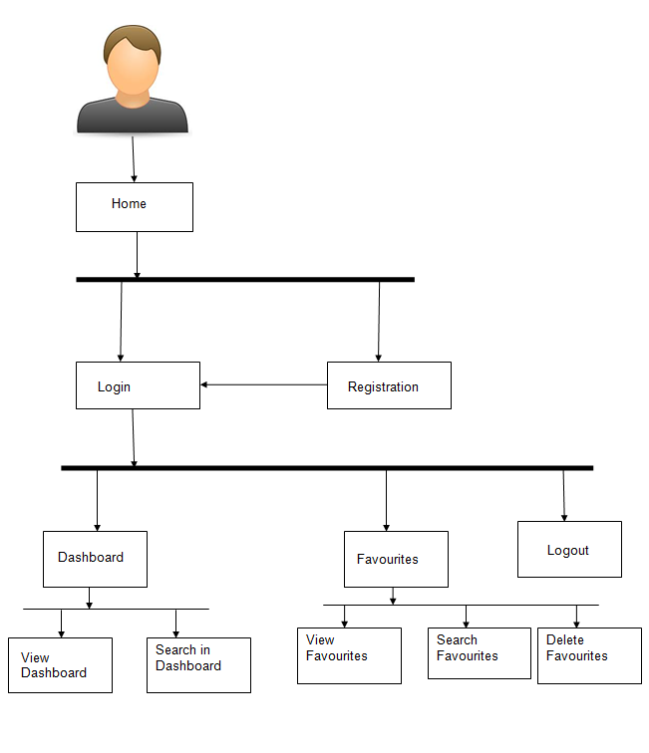
Project Flow
User
Login
Register
Furnitures
Recommends
Add
Furnitures
View
Furnitures
Edit
Furnitures
Delete
Furnitures
Search Books

Slide 7
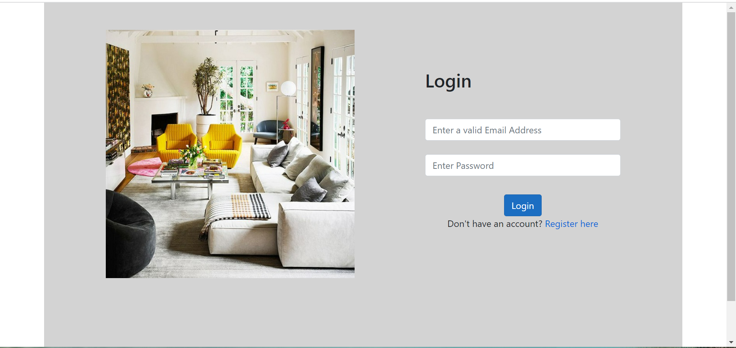

Slide 8
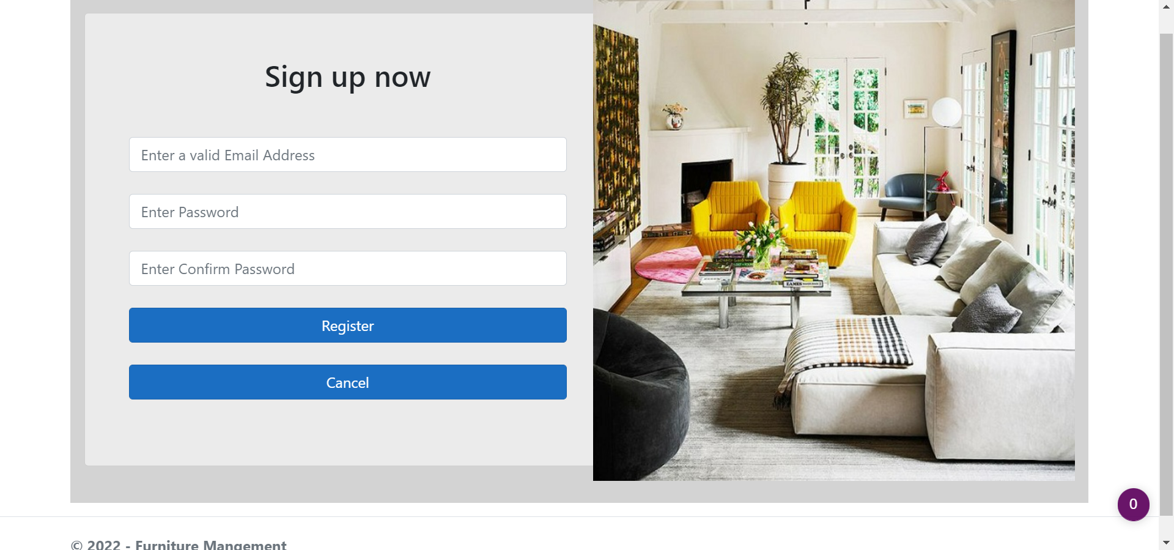

Slide 9
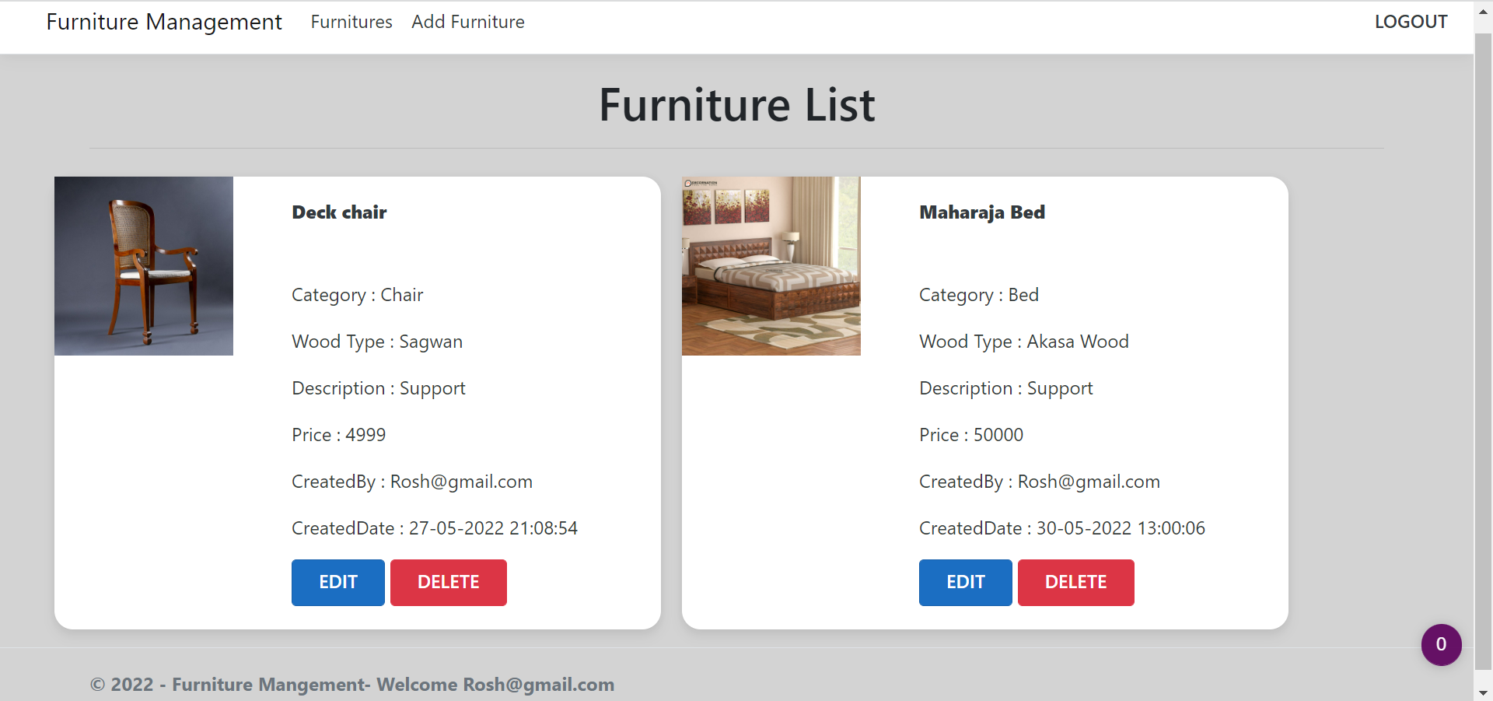

Slide 10
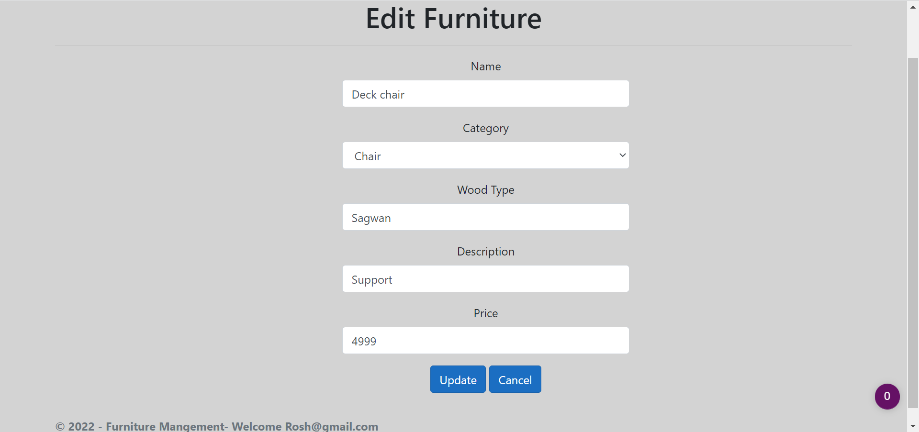

Slide 11
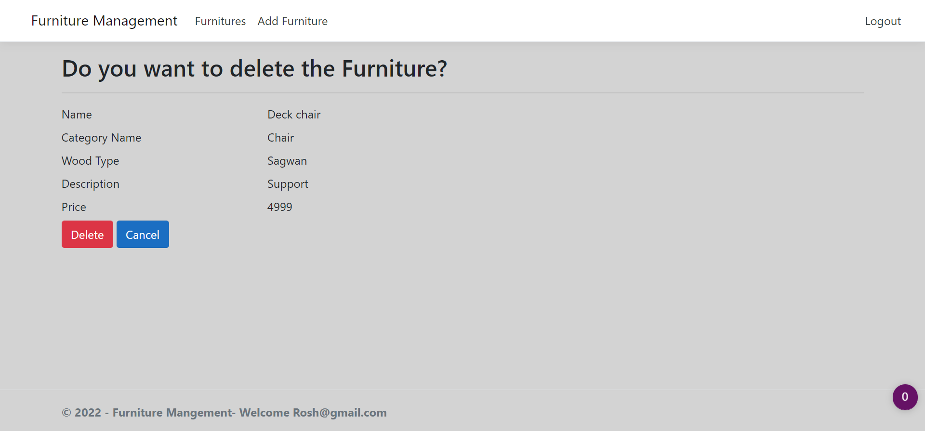

Slide 12




Technologies and Tools Used

Slide 13
Conclusion
Finally, in the furniture management system, the following conclusions can be deduced from the development of the project.
It provides a friendly graphical User Interface.
It gives appropriate access to the authorized users depending on their permissions.
Adding, Updating and Deleting of information becomes so easier.
System security and data security are the striking features

Slide 14
Thank You

Slide 15

Any Queries

