Slide 1

TrustCabinet
SEP490-G116
TrustCabinet
INTERNAL MEETING & DOCUMENT MANAGEMENT SYSTEM
FOR TRUSTSOFT COMPANY
Hanoi, 2026
Notes:
C:/Users/admin/Documents/GitHub/TrustCabinet/docs/08-reports/Report-1_Project_Introduction.md — I. Project Overview
Reference layout: ACCE_Slide.pdf, slides 1–33. Palette: Report 3 source DOCX UI illustrations and frontend/src/styles/global.css.

Slide 2
OUR TEAM
ADD PHOTO
Nguyen Quang Hung
Supervisor
ADD PHOTO
Dinh Van Toi
ADD PHOTO
Tran Viet Hai
ADD PHOTO
Pham Gia Khanh
Product Owner · TrustSoft
Team Leader · Frontend Lead
Business Analyst · UI/UX
ADD PHOTO
Hoang Duc Loc
ADD PHOTO
Nguyen Truong Huy
ADD PHOTO
Nguyen Quang Huy
Backend Lead
Test Lead · Quality Assurance
Architect · Backend · Frontend
Page 2
Notes:
C:/Users/admin/Documents/GitHub/TrustCabinet/docs/08-reports/Report-1_Project_Introduction.md — I.3 Project Stakeholders

Slide 3
PROJECT ORGANIZATION
SUPERVISOR
Nguyen Quang Hung
PRODUCT OWNER (TRUSTSOFT)
Dinh Van Toi
TEAM LEADER / FRONTEND LEAD
Tran Viet Hai
BUSINESS ANALYST
Pham Gia Khanh
BACKEND LEAD
Hoang Duc Loc
TEST LEAD / QA
Nguyen Truong Huy
ARCHITECT
Nguyen Quang Huy
Five-member delivery team
Page 3
Notes:
C:/Users/admin/Documents/GitHub/TrustCabinet/docs/08-reports/Report-1_Project_Introduction.md — I.3 Project Stakeholders

Slide 4
Table of Contents
I
PROJECT INTRODUCTION
Business context and product scope
II
PROJECT MANAGEMENT PLAN
Delivery plan, coordination and quality
III
SOFTWARE REQUIREMENT SPECIFICATION
Context, use cases, workflows and quality targets
Page 4
Notes:
C:/Users/admin/Documents/GitHub/TrustCabinet/docs/08-reports/Report-1_Project_Introduction.md
C:/Users/admin/Documents/GitHub/TrustCabinet/docs/08-reports/Report-2_Project_Management_Plan.md
C:/Users/admin/Documents/GitHub/TrustCabinet/docs/08-reports/Report-3_Software_Requirement_Specification.md

Slide 5
I. PROJECT INTRODUCTION
01. Project Background
PROJECT INFORMATION
02. Existing Solutions
English name
TrustCabinet — Internal Meeting and Document Management System for TrustSoft Company
Vietnamese name
TrustCabinet – Hệ thống quản lý cuộc họp và tài liệu nội bộ cho Công ty TrustSoft
03. Our Solution
Project code
IMDMS
04. Major Features
Group name
SEP490-G116
Software type
Web App
05. Out of Scope
Page 5
Notes:
C:/Users/admin/Documents/GitHub/TrustCabinet/docs/08-reports/Report-1_Project_Introduction.md
C:/Users/admin/Documents/GitHub/TrustCabinet/docs/08-reports/source/Report_3_Software_Requirement_Specification.docx — Create Meeting UI illustration

Slide 6
01. Project Background
•
TrustSoft teams hold 3–5 internal meetings each week, including sprint planning, client syncs and internal reviews.
Google Calendar
Scheduling
Zalo / Teams
Meeting links & updates
•
Schedules, meeting links, agendas and supporting files are spread across separate calendars, chats and folders.
No single
meeting record
•
Project leads search past documents, notes and chat history to recover decisions and unresolved topics.
Chat, email & shared folders
Agendas & supporting files
Google Docs & paper notes
Discussion notes & outcomes
•
Discussion notes and informal votes are consolidated manually; minutes may arrive 1–2 days later without one consistent meeting record.
Meeting information is spread across separate tools
Page 6
Notes:
C:/Users/admin/Documents/GitHub/TrustCabinet/docs/08-reports/Report-1_Project_Introduction.md — II. Product Background
C:/Users/admin/Documents/GitHub/TrustCabinet/docs/08-reports/source/Report_3_Software_Requirement_Specification.docx — Meeting Detail illustration

Slide 7
Current Meeting Workflow
Stage | Current practice | Consequence
Before | Search chat threads and folders | Latest document version is hard to confirm
During | Manual notes and informal votes | Discussion and vote evidence can be incomplete
After | Manually consolidate and share minutes | Minutes may arrive 1–2 days later
A connected meeting record
TrustCabinet keeps preparation, documents, outcomes and signed minutes around the same Meeting.
Page 7
Notes:
C:/Users/admin/Documents/GitHub/TrustCabinet/docs/08-reports/Report-1_Project_Introduction.md — II. Product Background

Slide 8
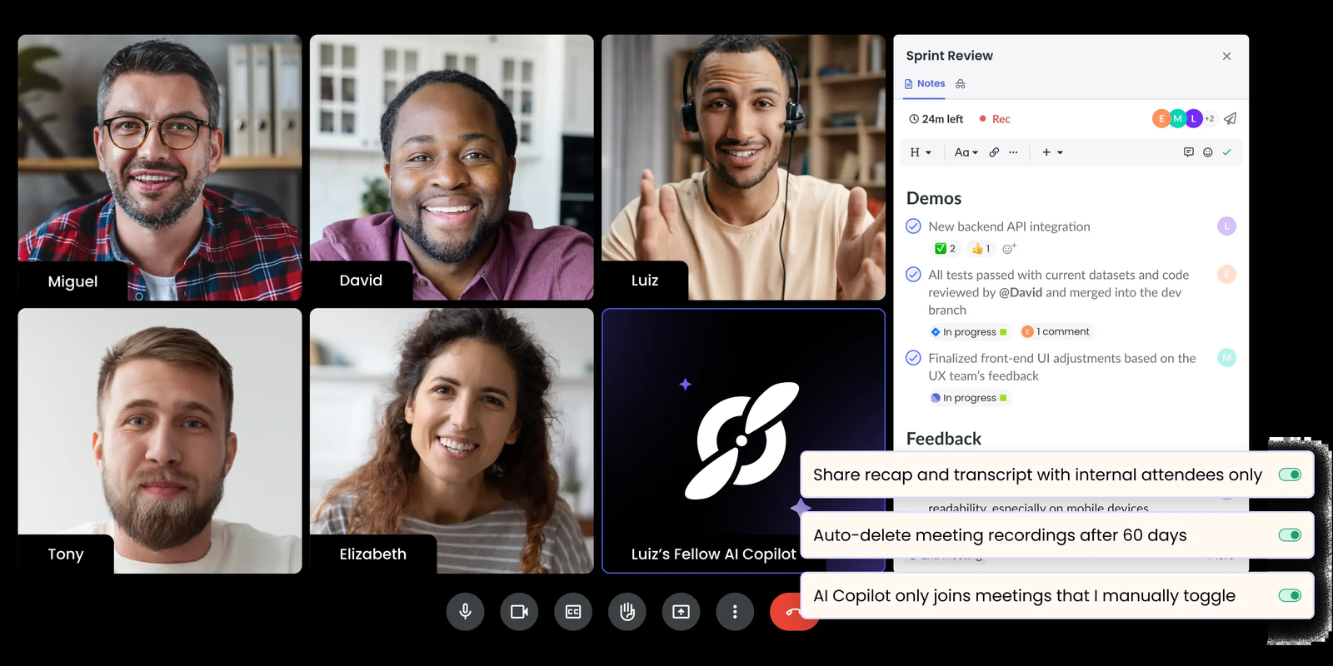
02. Existing Solutions
Feature:
Meeting recaps, transcription and collaborative notes.
Strength:
Specialized tools for capturing and reviewing meeting content.
Project gap:
Fellow & Fireflies.ai
Meeting-specific voting, document governance and signed minutes in one internally hosted record.
Page 8
Notes:
C:/Users/admin/Documents/GitHub/TrustCabinet/docs/08-reports/Report-1_Project_Introduction.md — III. Existing Solutions. This is the project research baseline, not a new market survey.

Slide 9
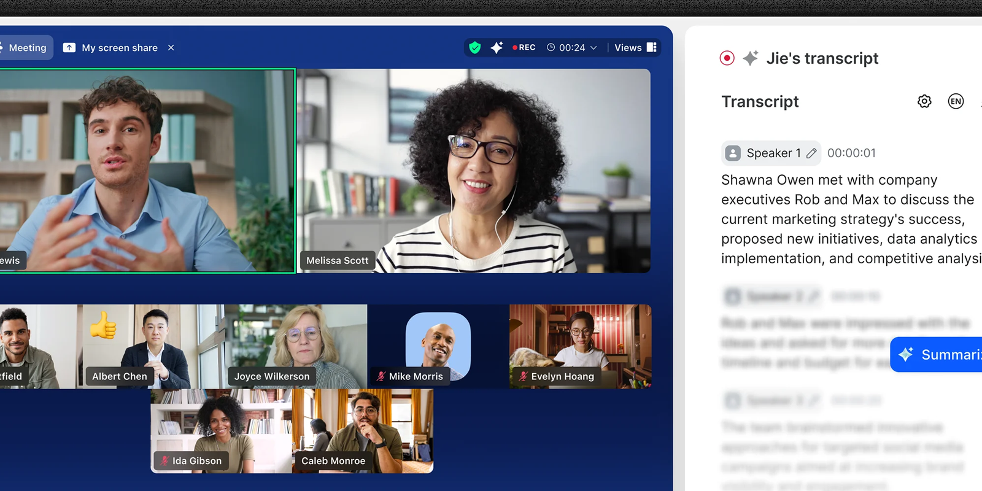
02. Existing Solutions
Feature:
Separate collaboration tools or a broader productivity and document platform.
Strength:
Flexible workflows and established collaboration capabilities.
Project gap:
ASANA + ZOOM + CLICKUP
A cohesive meeting record with internal access control and formal meeting governance.
Page 9
Notes:
C:/Users/admin/Documents/GitHub/TrustCabinet/docs/08-reports/Report-1_Project_Introduction.md — III. Existing Solutions. This is the project research baseline, not a new market survey.

Slide 10

03. Our Solution
Prepare and approve meetings, agendas and authorized documents in one workspace. Define participants and access before the meeting.
Conduct browser-based meetings, review shared documents and record live vote results with Chair conclusions.
Review AI-assisted transcripts and summaries, then sign and seal formal meeting minutes for a traceable meeting record.
One connected record: preparation → meeting → approved minutes.
Page 10
Notes:
C:/Users/admin/Documents/GitHub/TrustCabinet/docs/08-reports/Report-1_Project_Introduction.md — IV. Proposed Solution
C:/Users/admin/Documents/GitHub/TrustCabinet/docs/08-reports/Report-3_Software_Requirement_Specification.md — FE-10, FE-12; UI image43

Slide 11
TrustCabinet — Meeting Preparation
Meeting Preparation Flow
1
2
3
4
→
→
→
Create Draft
Prepare Materials
Submit & Review
Publish Meeting
Organizer creates a Draft Meeting and assigns the first Secretary.
Secretary prepares agenda, participants and authorized documents; they stay editable throughout the flow.
Organizer submits to the assigned Approver, who approves or rejects. A rejected Meeting can be revised and resubmitted.
Organizer publishes only after approval and issues invitations.
Page 11
Notes:
C:/Users/admin/Documents/GitHub/TrustCabinet/docs/08-reports/Report-1_Project_Introduction.md — IV. Proposed Solution
C:/Users/admin/Documents/GitHub/TrustCabinet/docs/01-requirements/00-master-use-case-inventory.md — lifecycle and dependency flows

Slide 12
TrustCabinet — Meeting Execution & Documentation
Meeting Completion Flow
1
2
3
4
→
→
→
Conduct Meeting
Upload Audio
Review AI Output
Sign & Seal
Chair runs the agenda and manages votes while the Meeting is InProgress.
After Ended, Secretary uploads audio with consent and retention safeguards.
Secretary corrects transcript, requests summary, then edits, approves and publishes it.
Secretary prepares minutes. Designated signers sign. Secretary seals after all sign.
Page 12
Notes:
C:/Users/admin/Documents/GitHub/TrustCabinet/docs/08-reports/Report-1_Project_Introduction.md — IV. Proposed Solution
C:/Users/admin/Documents/GitHub/TrustCabinet/docs/01-requirements/00-master-use-case-inventory.md — lifecycle and dependency flows

Slide 13
04. Major Features
Identity & Access
Meeting Operations
Meeting Intelligence
Governance & Visibility
FE-01 Authentication
FE-04 Meeting Management
FE-09 Audio Upload
FE-11 Voting
FE-02 User & Profile
FE-05 Agenda
FE-10 Transcript & Summary
FE-12 Minutes & Signing
FE-03 Role-Based Access Control
FE-06 Participants
FE-13 Notifications
FE-07 Documents
FE-14 Dashboard
FE-08 Online Meeting Room
FE-15 Reports
Page 13
Notes:
C:/Users/admin/Documents/GitHub/TrustCabinet/docs/08-reports/Report-1_Project_Introduction.md — V.1 Major Features
C:/Users/admin/Documents/GitHub/TrustCabinet/docs/01-requirements/00-master-use-case-inventory.md — revised baseline 10/10/2026

Slide 14
05. Out of Scope
•
No automatic or server-side recording: the Secretary uploads audio after the meeting (LI-01).
•
No real-time transcription, live captions or in-meeting AI analysis (LI-02).
•
Vietnamese only: no multi-language support, translation or subtitles (LI-04).
•
No large-scale conferencing such as webinars, live streaming or breakout rooms (LI-08).
•
No task assignment, action-item tracking or deadline management (LI-12).
•
No CA-issued signatures, native mobile app or multi-tenant deployment (LI-06, LI-10, LI-11).
Page 14
Notes:
C:/Users/admin/Documents/GitHub/TrustCabinet/docs/08-reports/Report-1_Project_Introduction.md — V. Limitations / Exclusions
C:/Users/admin/Documents/GitHub/TrustCabinet/docs/01-requirements/00-master-use-case-inventory.md — Outside Use Case Scope

Slide 15

II. PROJECT MANAGEMENT PLAN
Page 15
Notes:
C:/Users/admin/Documents/GitHub/TrustCabinet/docs/08-reports/Report-2_Project_Management_Plan.md
Reference layout: ACCE_Slide.pdf, slides 1–33. Palette: Report 3 source DOCX UI illustrations and frontend/src/styles/global.css. Icon extracted unchanged from supplied PDF page 15.

Slide 16
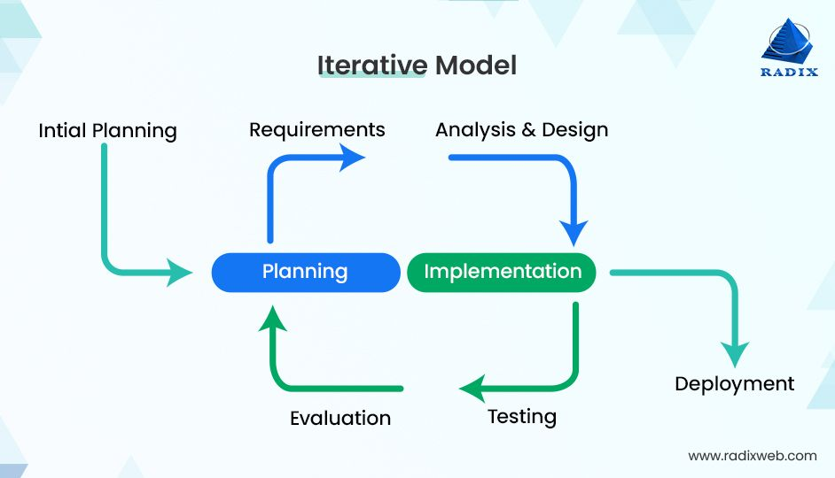
ITERATIVE INCREMENTAL MODEL
Page 16
Notes:
User-provided Iterative Model image.

Slide 17
PROJECT TIMELINE
INITIAL PLANNING
14–20 Sep 2026
ITERATION 1
21 Sep–4 Oct 2026
ITERATION 2
5–18 Oct 2026
ITERATION 3
19 Oct–1 Nov 2026
Environment & feasibility
Identity & Access
Meetings, Documents & Notifications
Audio & AI
DEPLOYMENT
14–27 Dec 2026
ITERATION 6
30 Nov–13 Dec 2026
ITERATION 5
16–29 Nov 2026
ITERATION 4
2–15 Nov 2026
Acceptance & Handover
Dashboard & Reports
Voting & Minutes
Online Meeting Room
Planned delivery baseline · 14 September–27 December 2026
Page 17
Notes:
C:/Users/admin/Documents/GitHub/TrustCabinet/docs/08-reports/Report-2_Project_Management_Plan.md — I.3 Cost & Time Estimations; II.1 Iterations. Dates are planned milestones, not completion evidence.

Slide 18
INITIAL PLANNING & CAPACITY
Capacity | Baseline
Team | 5 part-time members
Duration | 15 weeks
Gross effort | 262.5 person-days
Effective capacity | 210 person-days
Buffer | 52.5 person-days (20%)
INITIAL PLANNING
•
Development environment and repository conventions
•
Architecture and processing boundaries
•
Media and Vietnamese transcription feasibility
•
Acceptance thresholds and first UI mock-ups
Page 18
Notes:
C:/Users/admin/Documents/GitHub/TrustCabinet/docs/08-reports/Report-2_Project_Management_Plan.md — I.4 Capacity Planning; II.1 Initial Planning

Slide 19
PROGRESS REPORTING
Jira record | What the team records
Task | Use Case task, owner, estimate and acceptance criteria from Report 3
Progress | Completed work, current stage and remaining work
Defect | Description, reproduction steps, evidence, severity and handler
Blocker | Problem, impact, owner and next action
Change request | Requirement change, impact, approval and affected documents
Report 3 (SRS) is the requirement baseline · Jira tracks tasks, progress and defects
Page 19
Notes:
C:/Users/admin/Documents/GitHub/TrustCabinet/docs/DEVELOPMENT_WORKFLOW.md — Sprint Planning / Review / Responsibilities
C:/Users/admin/Documents/GitHub/TrustCabinet/docs/08-reports/Report-2_Project_Management_Plan.md — Management Approach

Slide 20
PROJECT TOOLS
Category | TrustCabinet baseline
Technologies | ASP.NET Core 10 · C# · EF Core 10 React 19 · TypeScript · Vite
Data & Security Sessions | PostgreSQL 17 · Redis
Source & Quality | GitHub · GitHub Actions Backend tests · frontend build and lint
Project & Documentation | Jira · Google Drive
Supporting Services | SMTP configurable · Google sign-in LiveKit · speech/AI provider
Page 20
Notes:
C:/Users/admin/Documents/GitHub/TrustCabinet/docs/08-reports/Report-2_Project_Management_Plan.md — Technology and tool baseline
C:/Users/admin/Documents/GitHub/TrustCabinet/docs/08-reports/Report-3_Software_Requirement_Specification.md — IV.1 External Interfaces

Slide 21
COMMUNICATION PLAN
Meeting | Participants | Purpose | When
Team Progress | All team members | Report progress, raise blockers, keep Jira current | Mon, Wed, Fri · 21:00–21:30
Iteration Planning | All team members | Set the goal, select features, estimate and allocate tasks | First day of each iteration
Requirement Confirmation | PO, BA, Test Lead, feature builders | Confirm detailed requirements and acceptance criteria | First 3 days of each iteration
Design Review | BE Lead, FE Lead, BA, Test Lead | Review data model, API contract and screens | After the requirements phase
Iteration Evaluation | Team + Product Owner | Demo the increment, review effort, defects and open items | Last day of each iteration
Supervisor Meeting | Supervisor + team | Report progress, demo, raise risks, get report feedback | Weekly
Document Review | BA + section authors | Check content, consistency and template before submission | Before each report submission
Page 21
Notes:
C:/Users/admin/Documents/GitHub/TrustCabinet/docs/DEVELOPMENT_WORKFLOW.md — Team Pipeline / Responsibilities / Review
C:/Users/admin/Documents/GitHub/TrustCabinet/docs/08-reports/Report-2_Project_Management_Plan.md — II.1 Iterative Incremental Model

Slide 22
RISK MANAGEMENT PLAN
Risk | Impact / Likelihood | Response plan
Online meeting room | High / High | Prototype a proven media server. Agree reduced-room fallback.
Vietnamese speaker attribution | High / Medium | Evaluate early using real audio. Allow transcript and speaker edits.
AI provider not selected | High / Medium | Decide before Iteration 3. Keep a replaceable internal interface.
Broad feature scope | High / High | Must-have FE-01–13. Should-have FE-14–15. Preserve 20% buffer.
Page 22
Notes:
C:/Users/admin/Documents/GitHub/TrustCabinet/docs/08-reports/Report-2_Project_Management_Plan.md — I.6 Risks and Mitigations

Slide 23
QUALITY MANAGEMENT
Requirement clarity
Acceptance criteria in Jira
Implementation
BE and FE integrate the Use Case
Peer Review
Review the change before merge
Testing & Retest
Happy path, edges and important bugs
Done
Docs, tests and Jira are complete
Page 23
Notes:
C:/Users/admin/Documents/GitHub/TrustCabinet/docs/DEVELOPMENT_WORKFLOW.md — Definition of Done
C:/Users/admin/Documents/GitHub/TrustCabinet/.github/workflows/ci.yml

Slide 24
TASK MANAGEMENT
JIRA WORKFLOW
To Do
Business Analyst
Backend
Frontend
Testing
Done
•
Tester verifies functionality and important bug fixes before Done.
•
BE / FE requirement changes are recorded as ticket comments.
•
API contracts and requirement documents are updated as each Use Case is integrated.
Page 24
Notes:
C:/Users/admin/Documents/GitHub/TrustCabinet/docs/DEVELOPMENT_WORKFLOW.md — §2 Pipeline; §2.1 Changing a Requirement; §6 Definition of Done

Slide 25

III. SOFTWARE REQUIREMENT
SPECIFICATION
Page 25
Notes:
C:/Users/admin/Documents/GitHub/TrustCabinet/docs/08-reports/Report-3_Software_Requirement_Specification.md
Reference layout: ACCE_Slide.pdf, slides 1–33. Palette: Report 3 source DOCX UI illustrations and frontend/src/styles/global.css. Section illustration extracted unchanged from supplied PDF page 25.

Slide 26
SOFTWARE REQUIREMENT SPECIFICATION
1
Context Diagram
2
Use Case Diagrams
3
Business Flows
4
State Machines
5
Entity Relationship Diagram
6
Non-Functional Requirements
Page 26
Notes:
C:/Users/admin/Documents/GitHub/TrustCabinet/docs/08-reports/Report-3_Software_Requirement_Specification.md
C:/Users/admin/Documents/GitHub/TrustCabinet/docs/01-requirements/00-master-use-case-inventory.md — revised baseline 10/10/2026

Slide 27
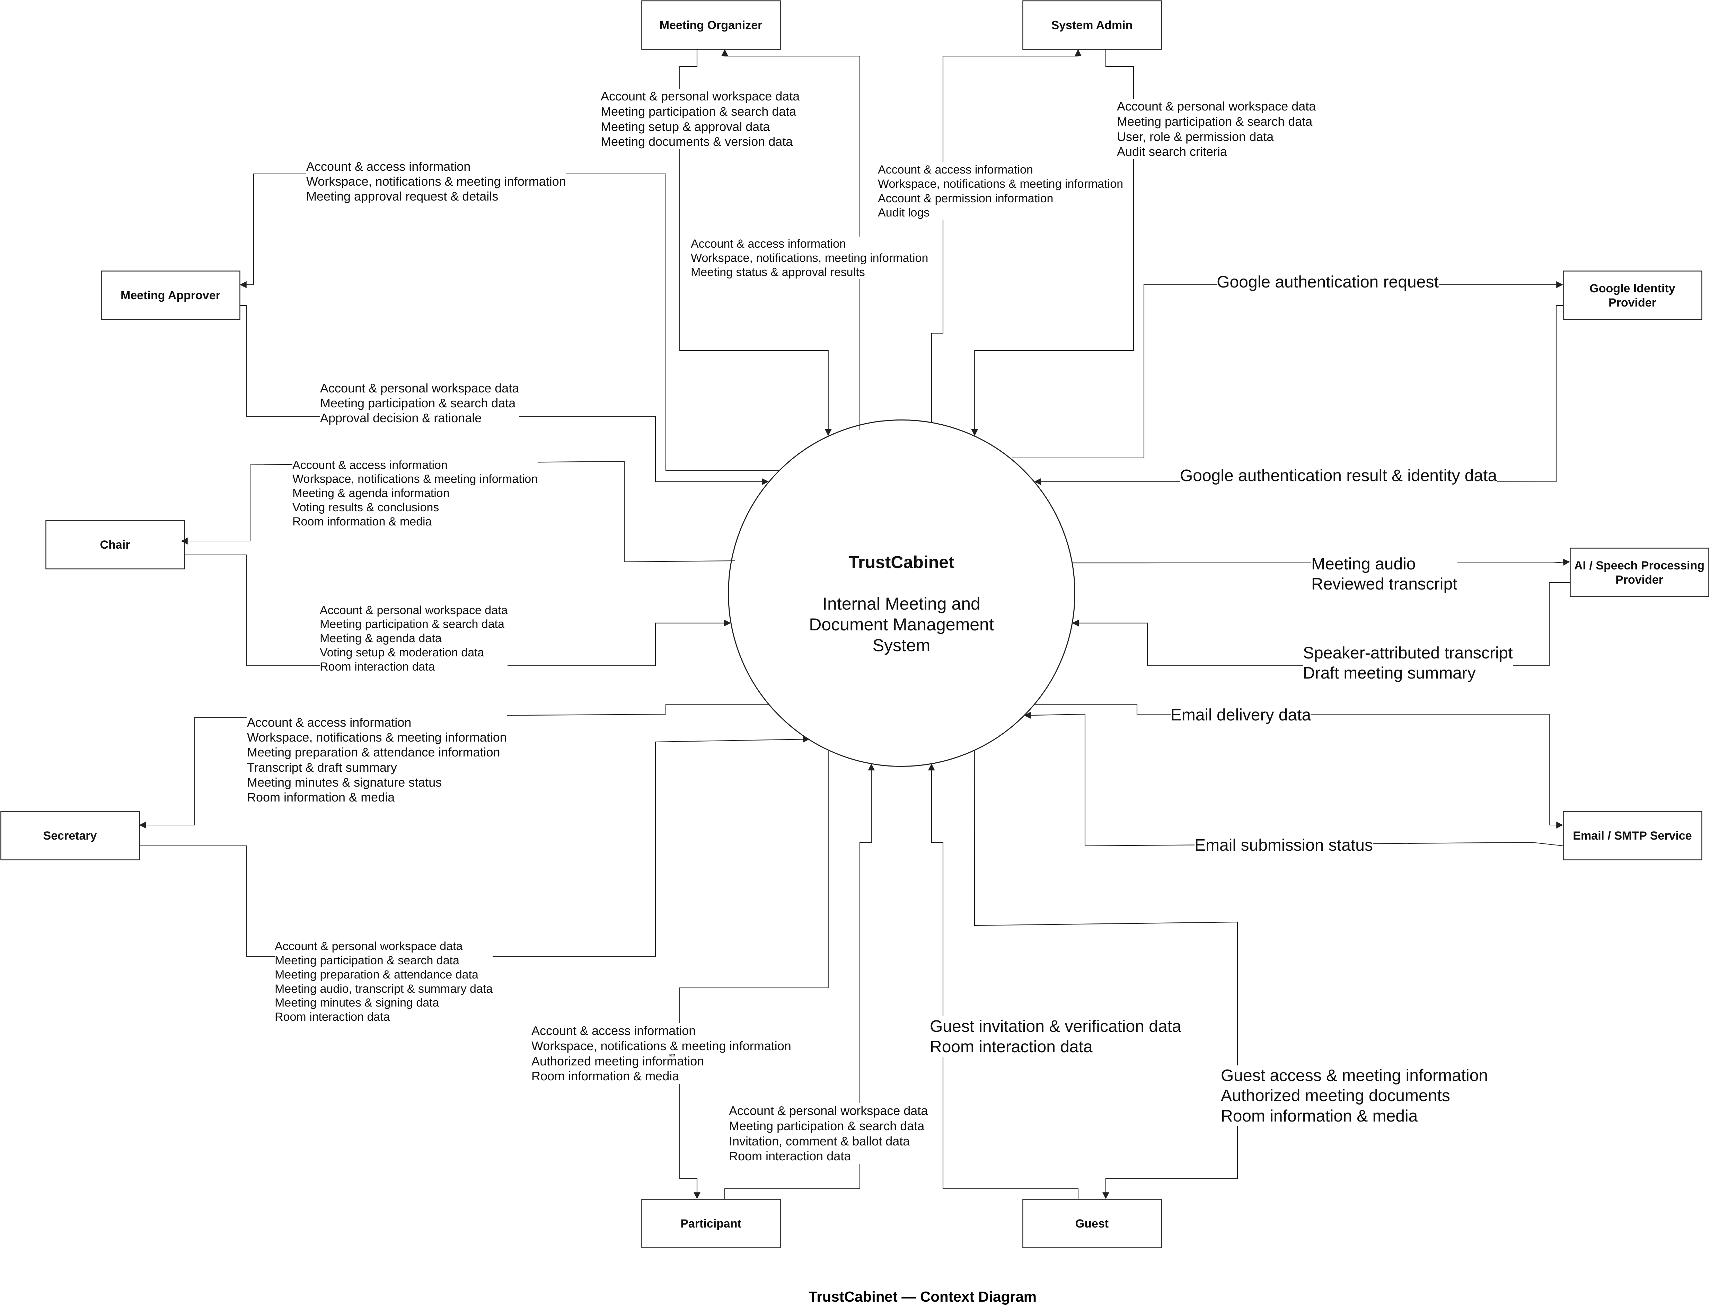
CONTEXT DIAGRAM
Page 27
Notes:
Figure embedded unchanged from: C:/Users/admin/Documents/GitHub/TrustCabinet/docs/11-contextdiagram/trustcabinet-context.drawio.png
Editable diagram source: C:/Users/admin/Documents/GitHub/TrustCabinet/docs/11-contextdiagram/trustcabinet-context.drawio
Full original image retained without cropping. No source node, transition, relation or label was rewritten.

Slide 28
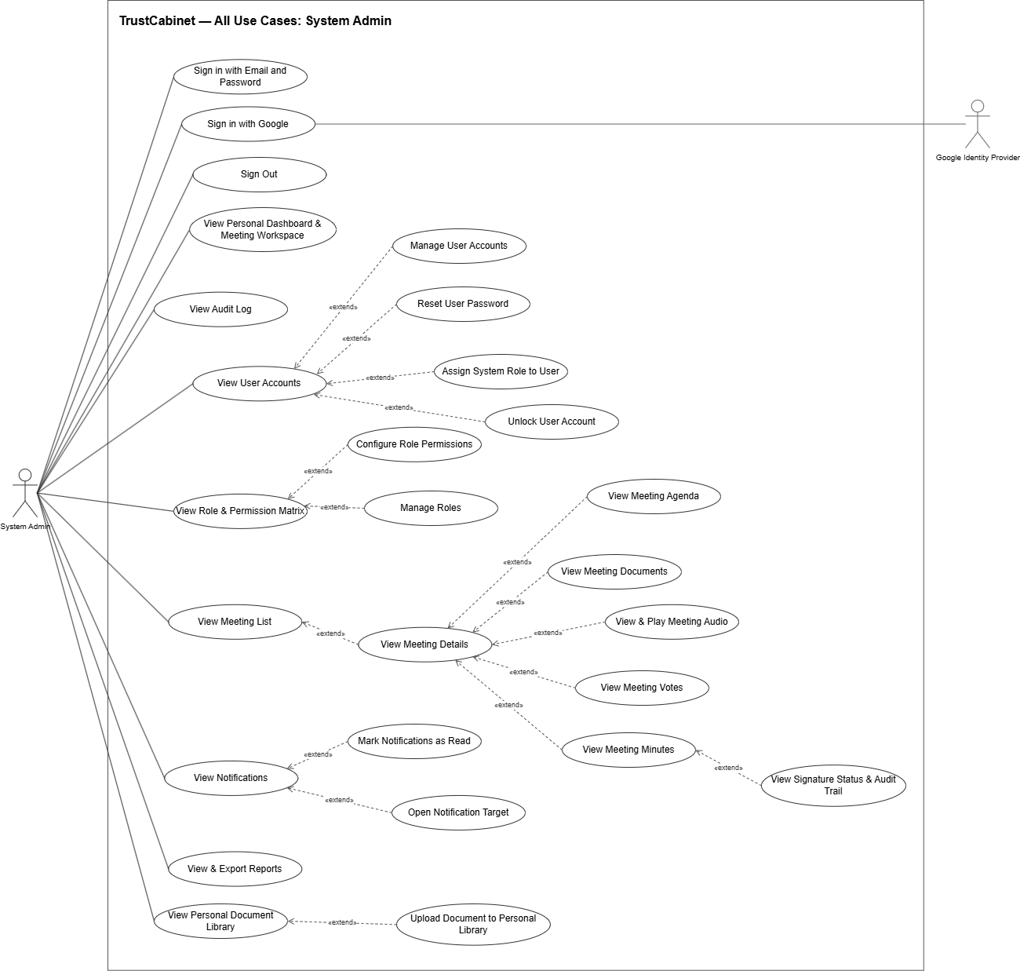
USE CASE DIAGRAM — SYSTEM ADMIN
Page 28
Notes:
C:/Users/admin/Documents/GitHub/TrustCabinet/docs/08-reports/source/Report_3_Software_Requirement_Specification.docx — §I.4.3
C:/Users/admin/Documents/GitHub/TrustCabinet/docs/assets/use-case-diagrams/trustcabinet-use-cases.drawio — System Admin page
C:/Users/admin/Documents/GitHub/TrustCabinet/docs/01-requirements/00-master-use-case-inventory.md
Source image is retained in full without cropping.

Slide 29
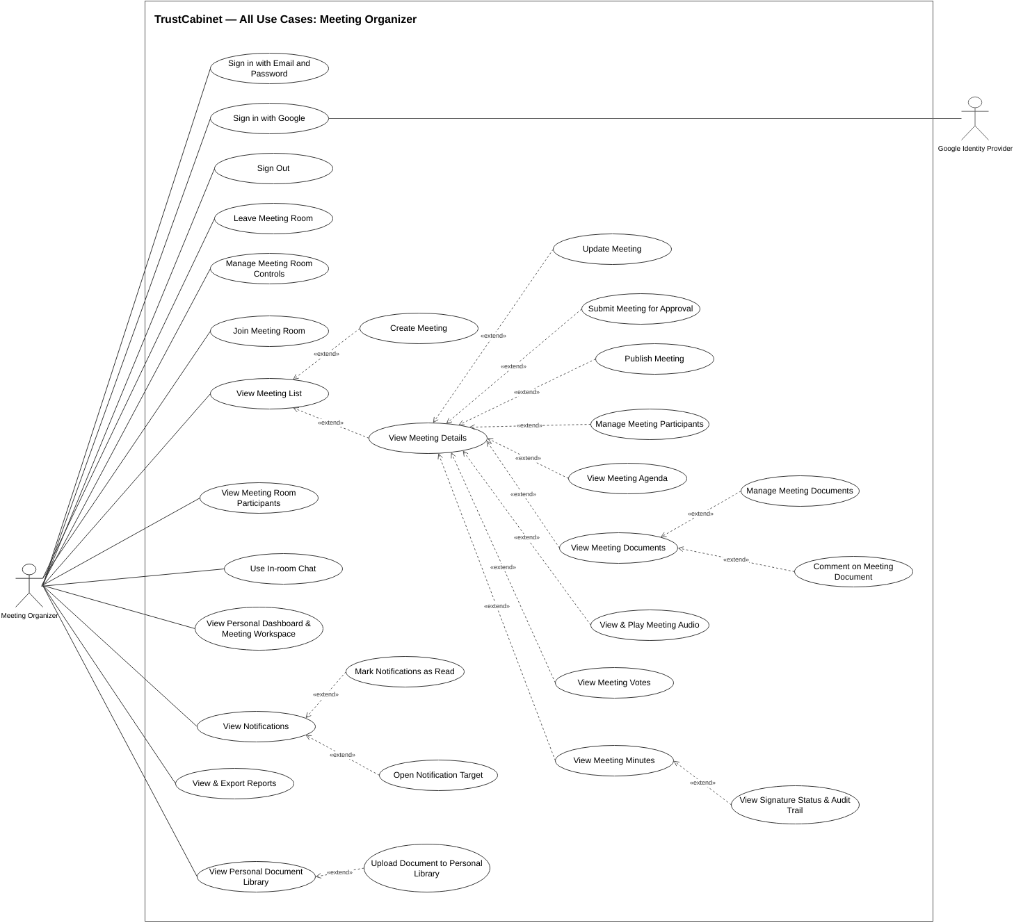
USE CASE DIAGRAM — MEETING ORGANIZER
Page 29
Notes:
C:/Users/admin/Documents/GitHub/TrustCabinet/docs/08-reports/source/Report_3_Software_Requirement_Specification.docx — §I.4.3
C:/Users/admin/Documents/GitHub/TrustCabinet/docs/assets/use-case-diagrams/trustcabinet-use-cases.drawio — Meeting Organizer page
C:/Users/admin/Documents/GitHub/TrustCabinet/docs/01-requirements/00-master-use-case-inventory.md
Source image is retained in full without cropping.

Slide 30
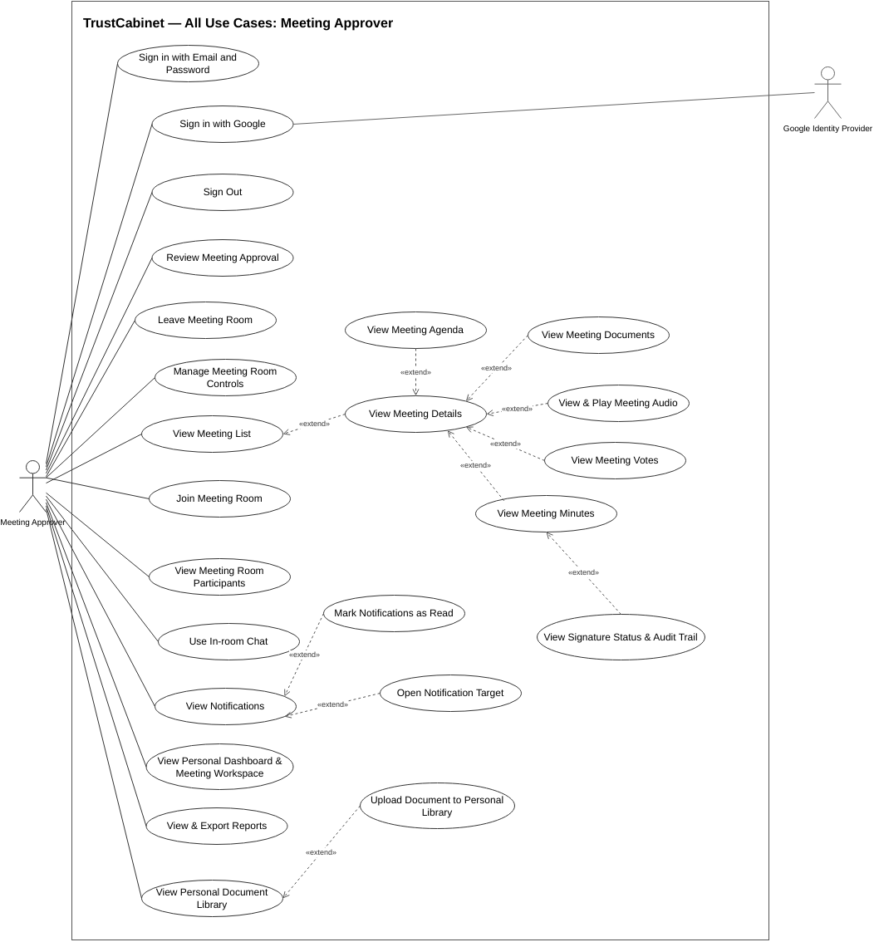
USE CASE DIAGRAM — MEETING APPROVER
Page 30
Notes:
C:/Users/admin/Documents/GitHub/TrustCabinet/docs/08-reports/source/Report_3_Software_Requirement_Specification.docx — §I.4.3
C:/Users/admin/Documents/GitHub/TrustCabinet/docs/assets/use-case-diagrams/trustcabinet-use-cases.drawio — Meeting Approver page
C:/Users/admin/Documents/GitHub/TrustCabinet/docs/01-requirements/00-master-use-case-inventory.md
Source image is retained in full without cropping.

Slide 31
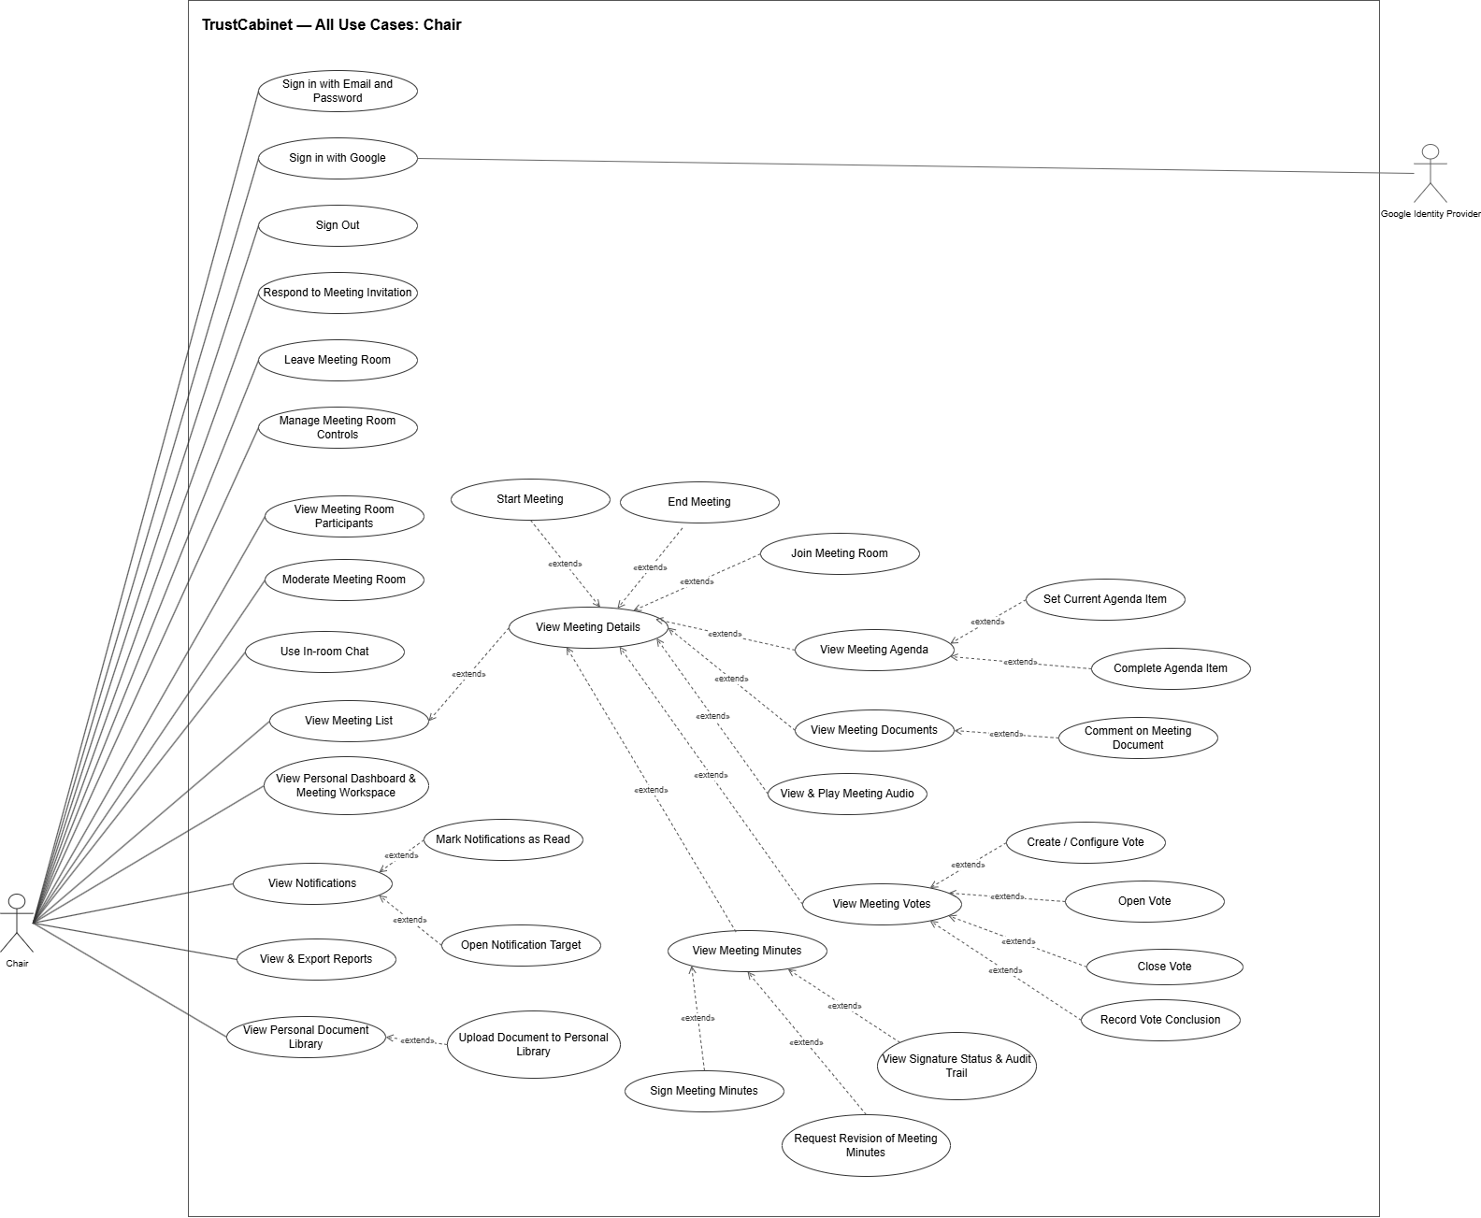
USE CASE DIAGRAM — CHAIR
Page 31
Notes:
C:/Users/admin/Documents/GitHub/TrustCabinet/docs/08-reports/source/Report_3_Software_Requirement_Specification.docx — §I.4.3
C:/Users/admin/Documents/GitHub/TrustCabinet/docs/assets/use-case-diagrams/trustcabinet-use-cases.drawio — Chair page
C:/Users/admin/Documents/GitHub/TrustCabinet/docs/01-requirements/00-master-use-case-inventory.md
Source image is retained in full without cropping.

Slide 32
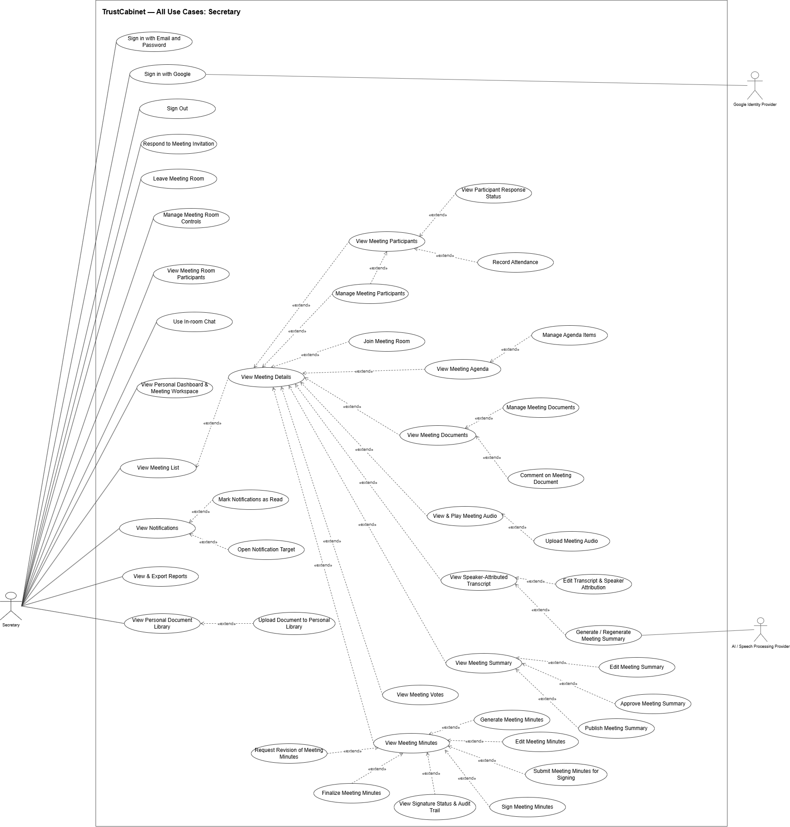
USE CASE DIAGRAM — SECRETARY
Page 32
Notes:
C:/Users/admin/Documents/GitHub/TrustCabinet/docs/08-reports/source/Report_3_Software_Requirement_Specification.docx — §I.4.3
C:/Users/admin/Documents/GitHub/TrustCabinet/docs/assets/use-case-diagrams/trustcabinet-use-cases.drawio — Secretary page
C:/Users/admin/Documents/GitHub/TrustCabinet/docs/01-requirements/00-master-use-case-inventory.md
Source image is retained in full without cropping.

Slide 33
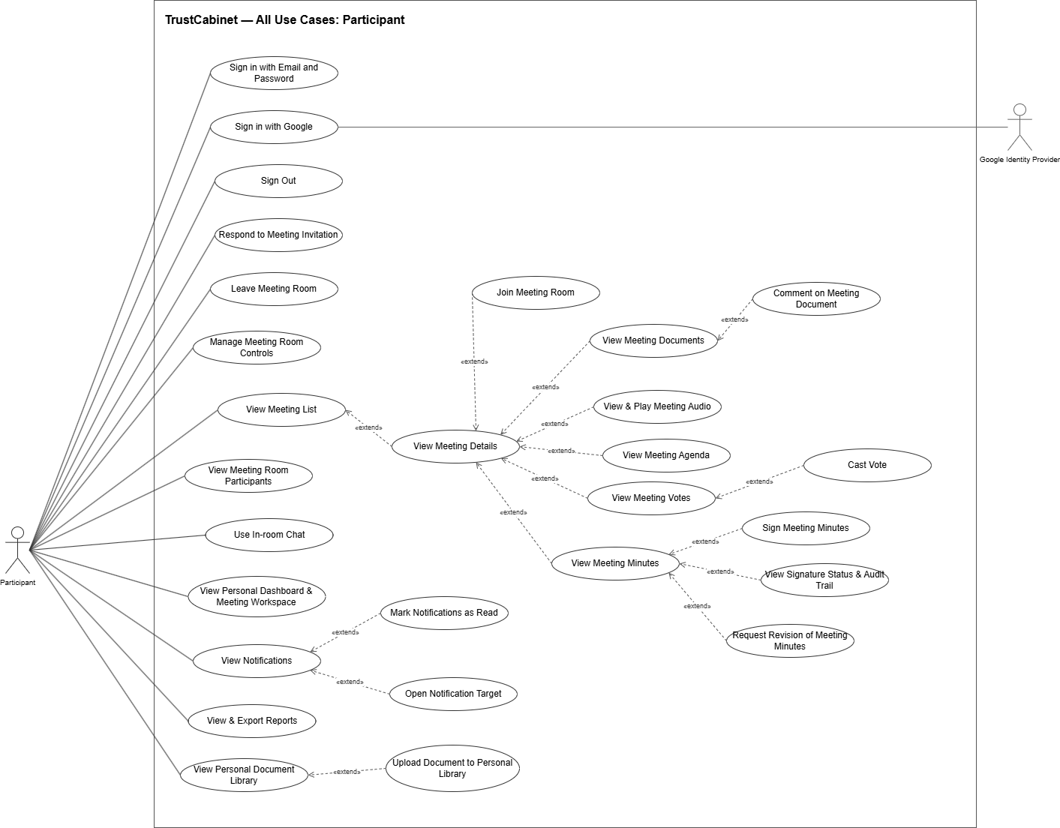
USE CASE DIAGRAM — PARTICIPANT
Page 33
Notes:
C:/Users/admin/Documents/GitHub/TrustCabinet/docs/08-reports/source/Report_3_Software_Requirement_Specification.docx — §I.4.3
C:/Users/admin/Documents/GitHub/TrustCabinet/docs/assets/use-case-diagrams/trustcabinet-use-cases.drawio — Participant page
C:/Users/admin/Documents/GitHub/TrustCabinet/docs/01-requirements/00-master-use-case-inventory.md
Source image is retained in full without cropping.

Slide 34
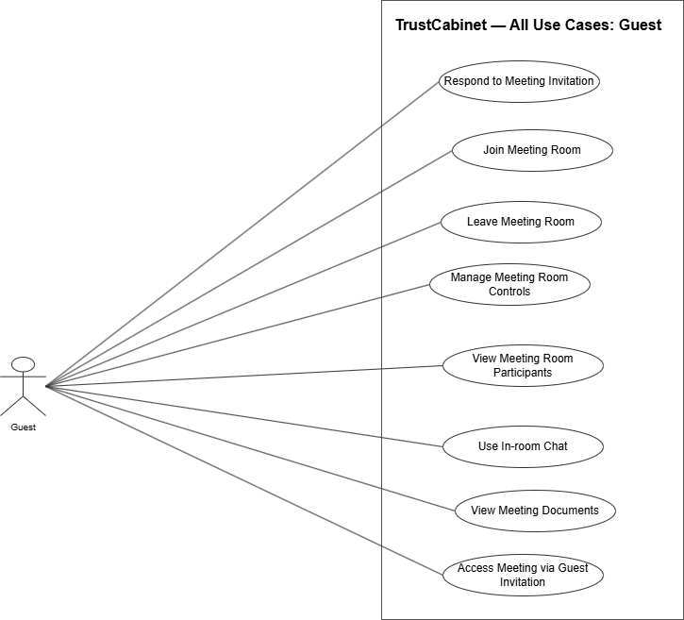
USE CASE DIAGRAM — GUEST
Page 34
Notes:
C:/Users/admin/Documents/GitHub/TrustCabinet/docs/08-reports/source/Report_3_Software_Requirement_Specification.docx — §I.4.3
C:/Users/admin/Documents/GitHub/TrustCabinet/docs/assets/use-case-diagrams/trustcabinet-use-cases.drawio — Guest page
C:/Users/admin/Documents/GitHub/TrustCabinet/docs/01-requirements/00-master-use-case-inventory.md
Source image is retained in full without cropping.

Slide 35
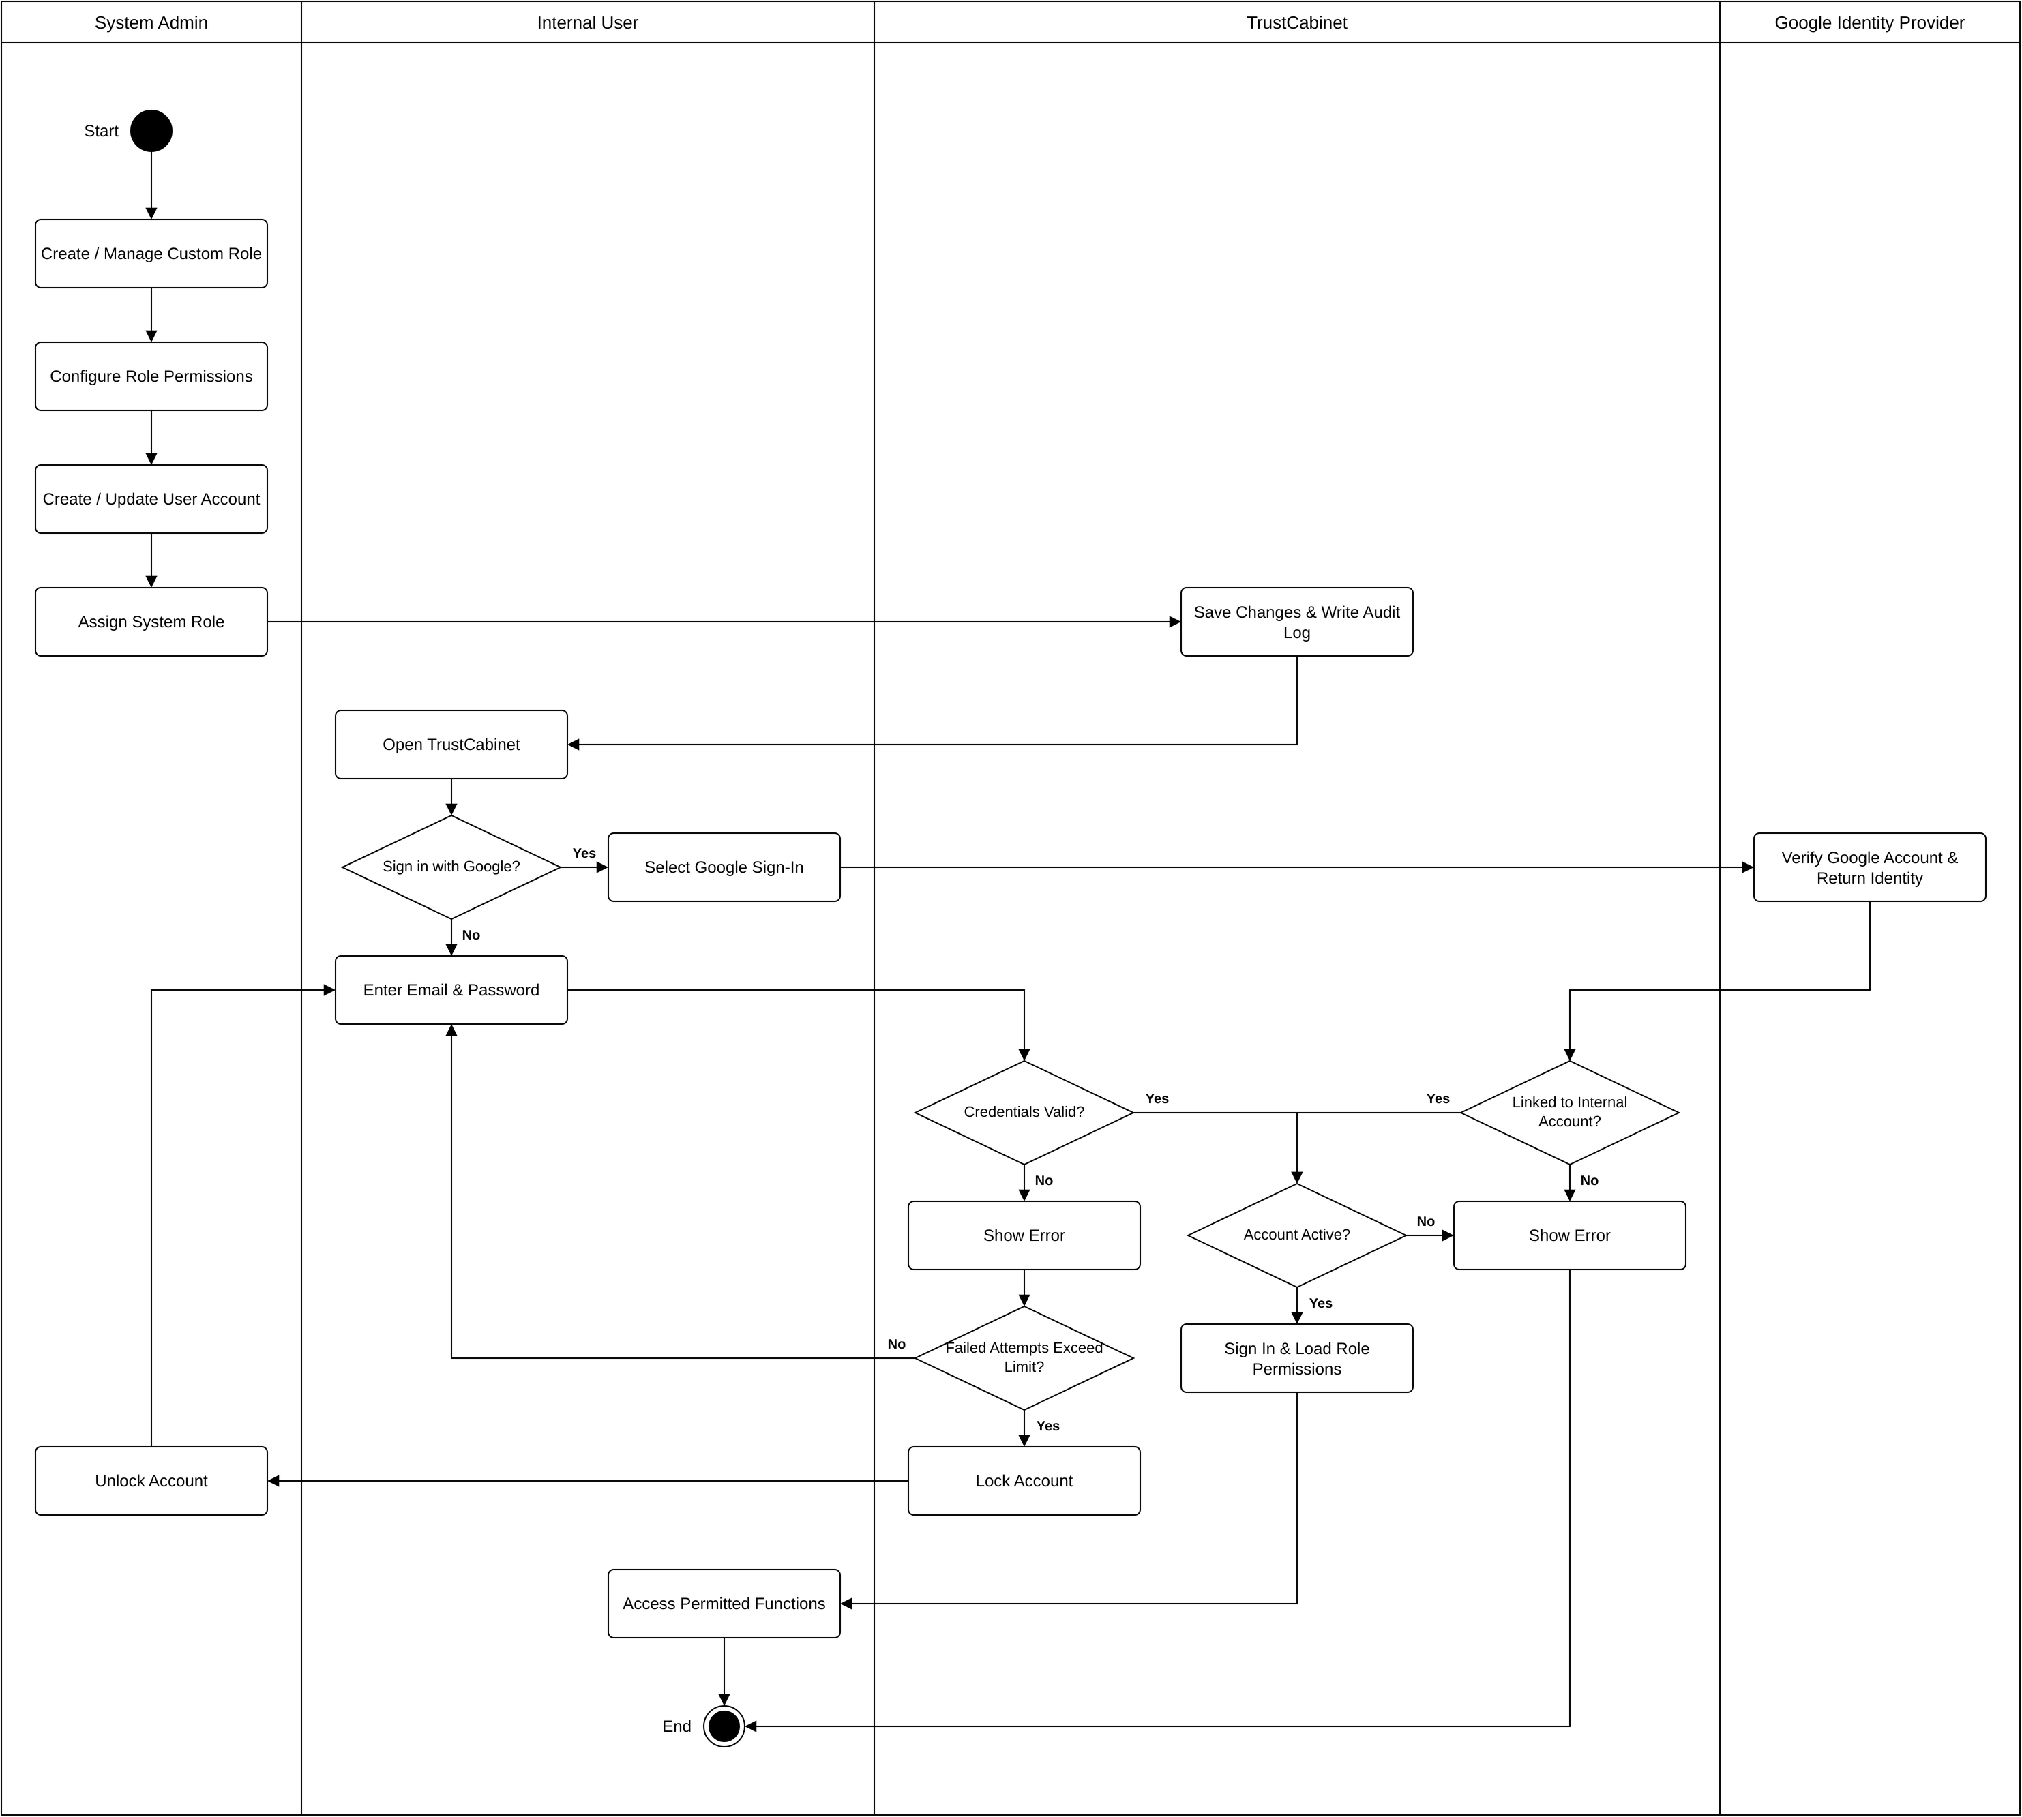
BF-01 — SYSTEM ACCESS & ADMINISTRATION
Page 35
Notes:
C:/Users/admin/Documents/GitHub/TrustCabinet/docs/09-bussinessflow/BF-01_System_Access_Administration.drawio
C:/Users/admin/Documents/GitHub/TrustCabinet/docs/02-design/04-luong-nghiep-vu-chinh.md
C:/Users/admin/Documents/GitHub/TrustCabinet/docs/08-reports/Report-3_Software_Requirement_Specification.md

Slide 36
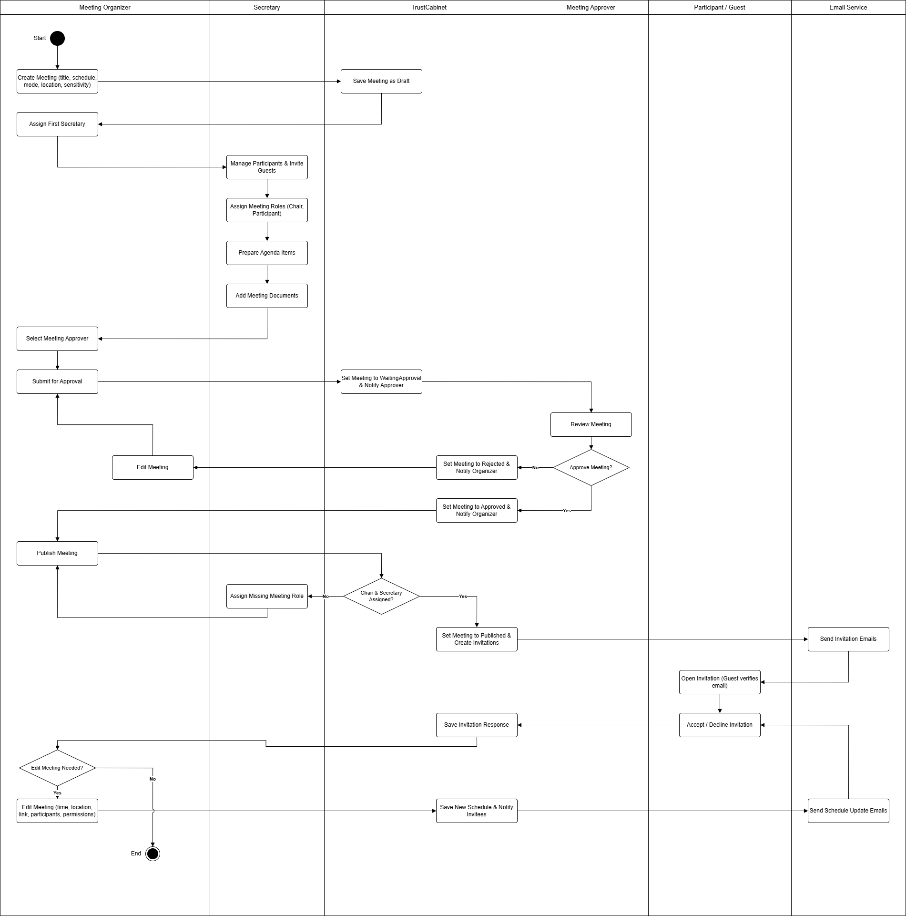
BF-02 — MEETING PREPARATION & APPROVAL
Page 36
Notes:
C:/Users/admin/Documents/GitHub/TrustCabinet/docs/09-bussinessflow/BF-02_Meeting_Preparation_Approval.drawio
C:/Users/admin/Documents/GitHub/TrustCabinet/docs/02-design/04-luong-nghiep-vu-chinh.md
C:/Users/admin/Documents/GitHub/TrustCabinet/docs/08-reports/Report-3_Software_Requirement_Specification.md

Slide 37
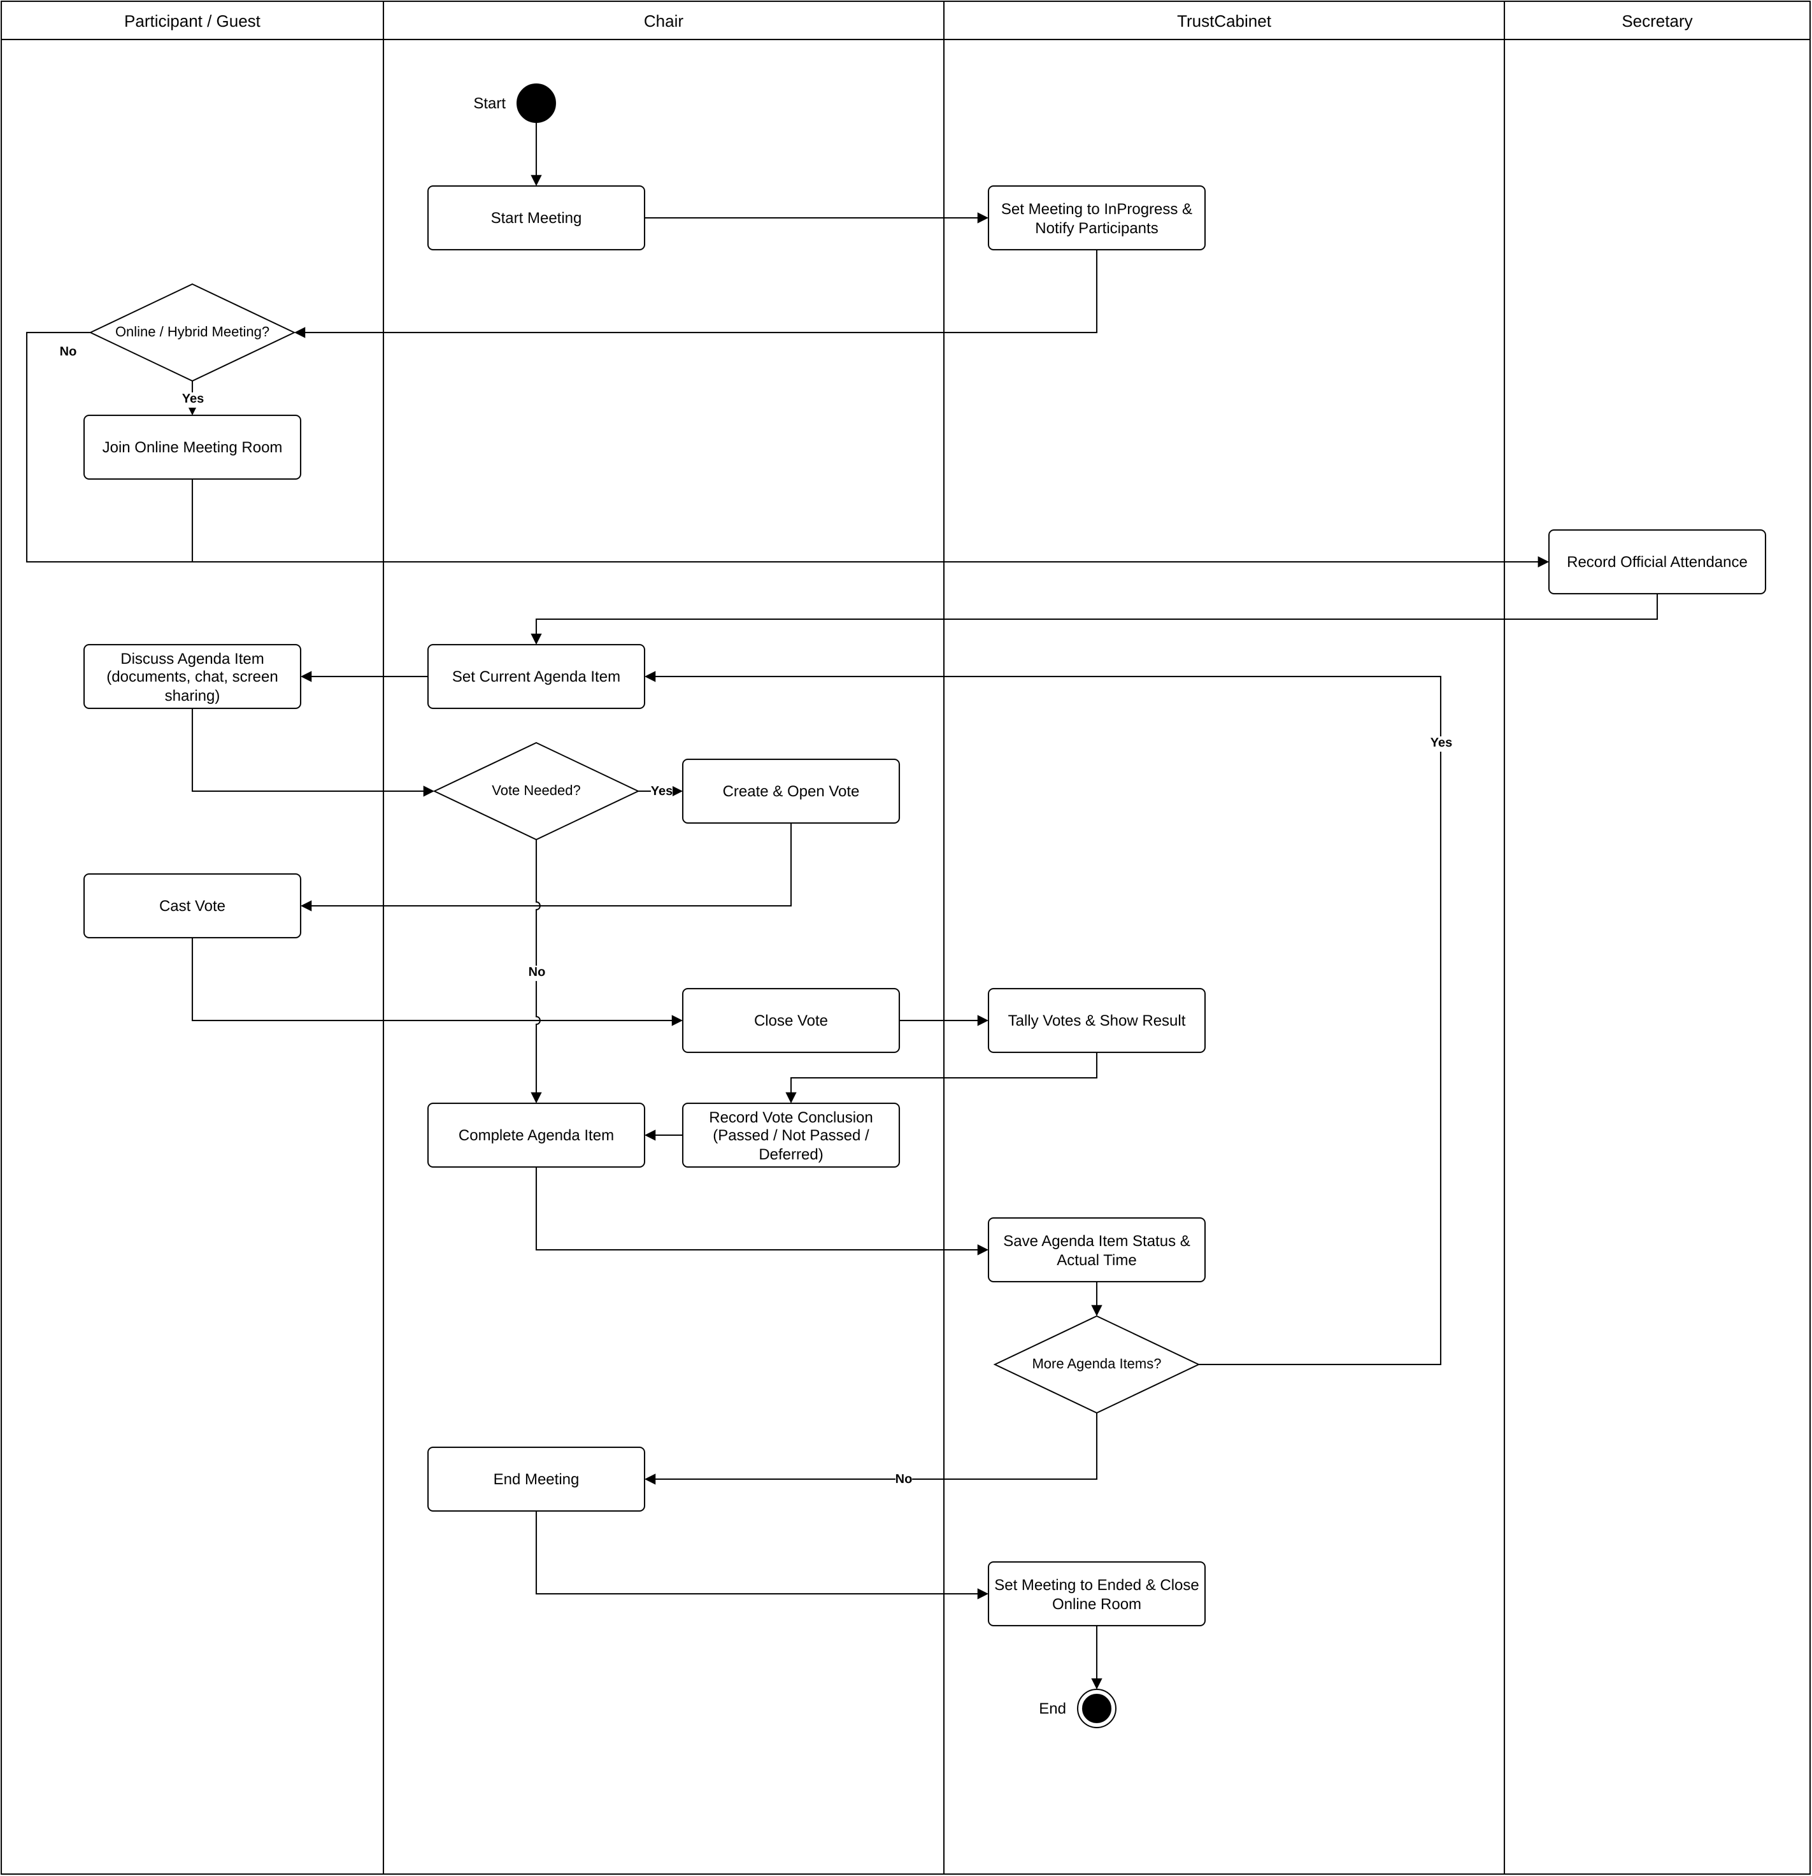
BF-03 — MEETING EXECUTION & DECISION MAKING
Page 37
Notes:
C:/Users/admin/Documents/GitHub/TrustCabinet/docs/09-bussinessflow/BF-03_Meeting_Execution_Decision_Making.drawio
C:/Users/admin/Documents/GitHub/TrustCabinet/docs/02-design/04-luong-nghiep-vu-chinh.md
C:/Users/admin/Documents/GitHub/TrustCabinet/docs/08-reports/Report-3_Software_Requirement_Specification.md

Slide 38
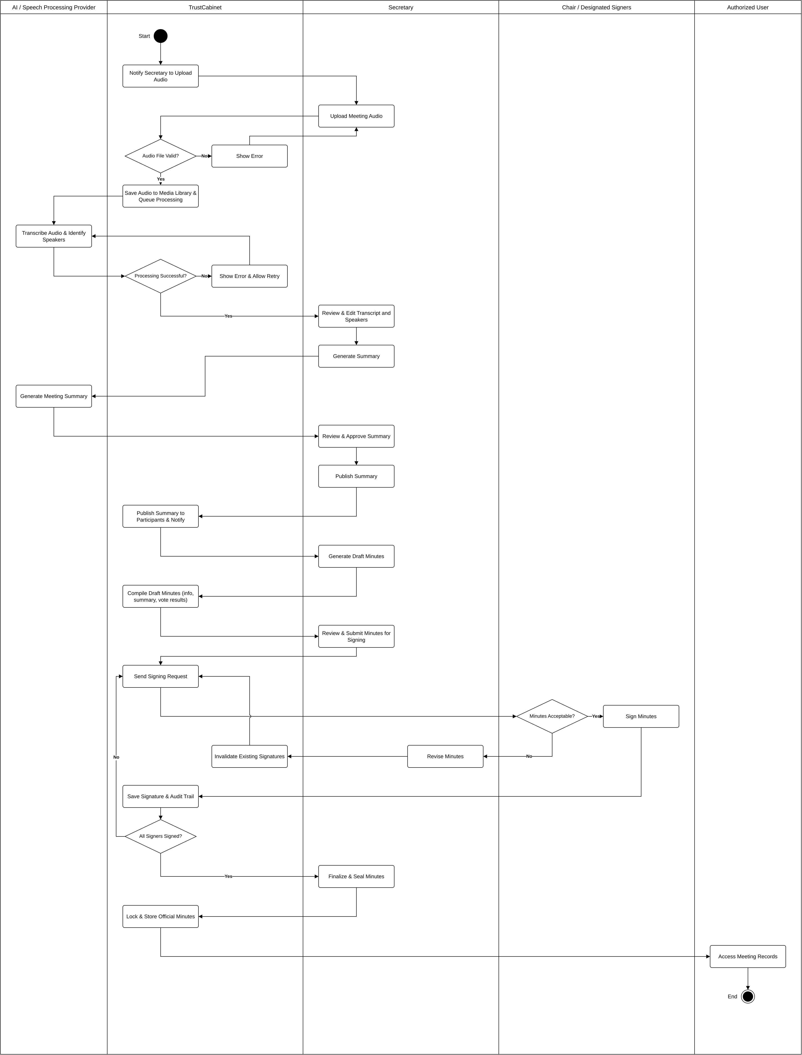
BF-04 — POST-MEETING PROCESSING & RECORDS
Page 38
Notes:
C:/Users/admin/Documents/GitHub/TrustCabinet/docs/09-bussinessflow/BF-04_Post_Meeting_Processing_Formal_Records.drawio
C:/Users/admin/Documents/GitHub/TrustCabinet/docs/02-design/04-luong-nghiep-vu-chinh.md
C:/Users/admin/Documents/GitHub/TrustCabinet/docs/08-reports/Report-3_Software_Requirement_Specification.md

Slide 39
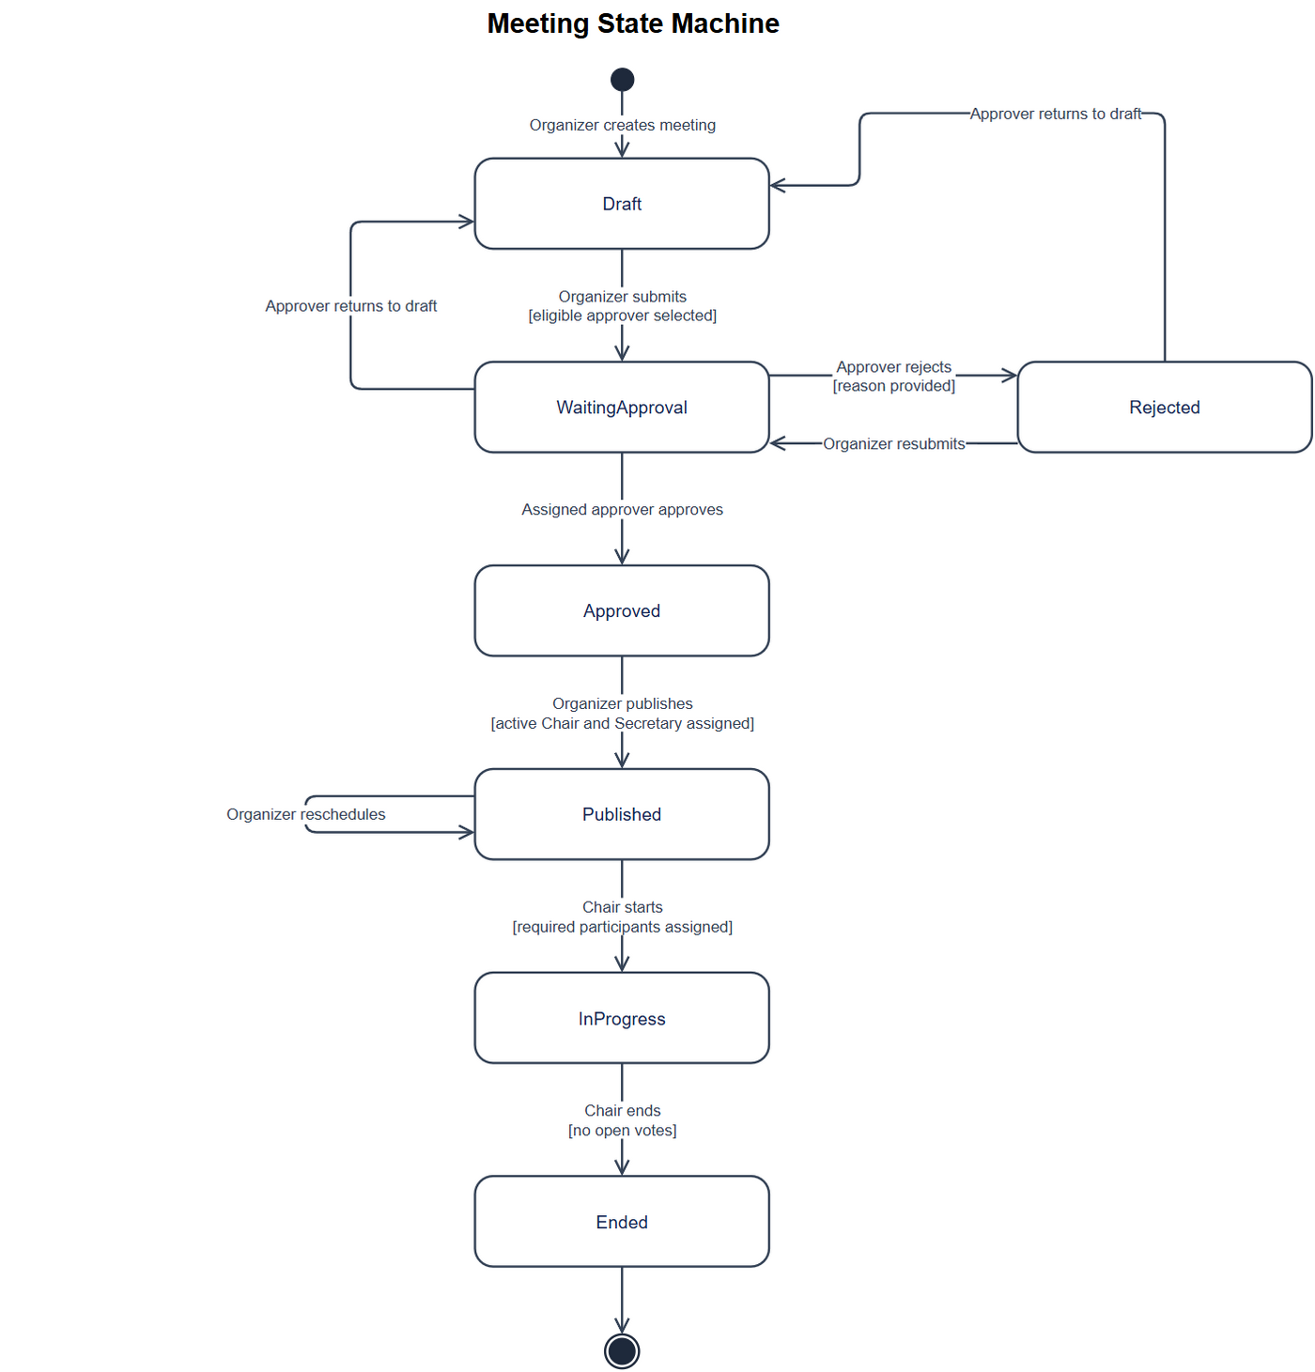
STATE MACHINE — MEETING
Page 39
Notes:
Figure embedded unchanged from: C:/Users/admin/Documents/GitHub/TrustCabinet/docs/10-statemachine/SM-01_Meeting.png
Editable diagram source: C:/Users/admin/Documents/GitHub/TrustCabinet/docs/10-statemachine/SM-01_Meeting.drawio
Full original image retained without cropping. No source node, transition, relation or label was rewritten.

Slide 40
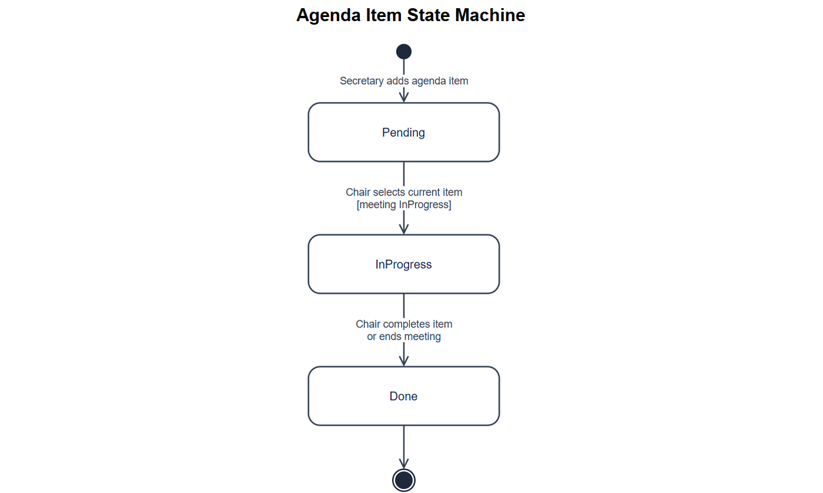
STATE MACHINE — AGENDA ITEM
Page 40
Notes:
Figure embedded unchanged from: C:/Users/admin/Documents/GitHub/TrustCabinet/docs/10-statemachine/SM-02_Agenda.png
Editable diagram source: C:/Users/admin/Documents/GitHub/TrustCabinet/docs/10-statemachine/SM-02_Agenda.drawio
Full original image retained without cropping. No source node, transition, relation or label was rewritten.

Slide 41
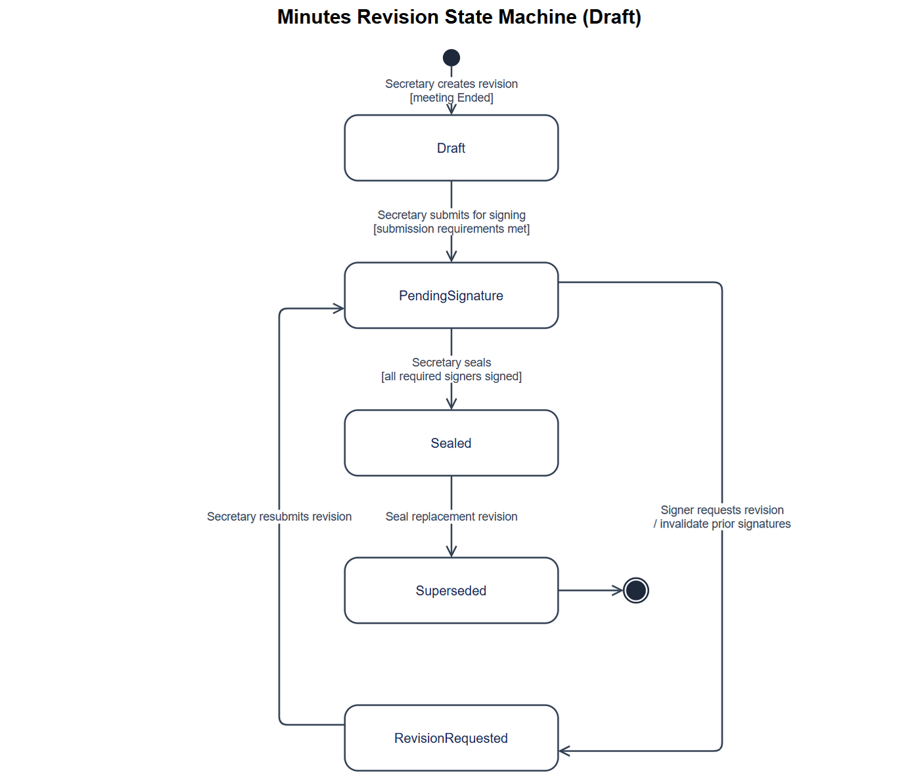
STATE MACHINE — MINUTES REVISION
Minutes Revision State Machine
Page 41
Notes:
Figure embedded unchanged from: C:/Users/admin/Documents/GitHub/TrustCabinet/docs/10-statemachine/SM-13_Minutes.png
Editable diagram source: C:/Users/admin/Documents/GitHub/TrustCabinet/docs/10-statemachine/SM-13_Minutes.drawio
Full original image retained without cropping. No source node, transition, relation or label was rewritten.

Slide 42
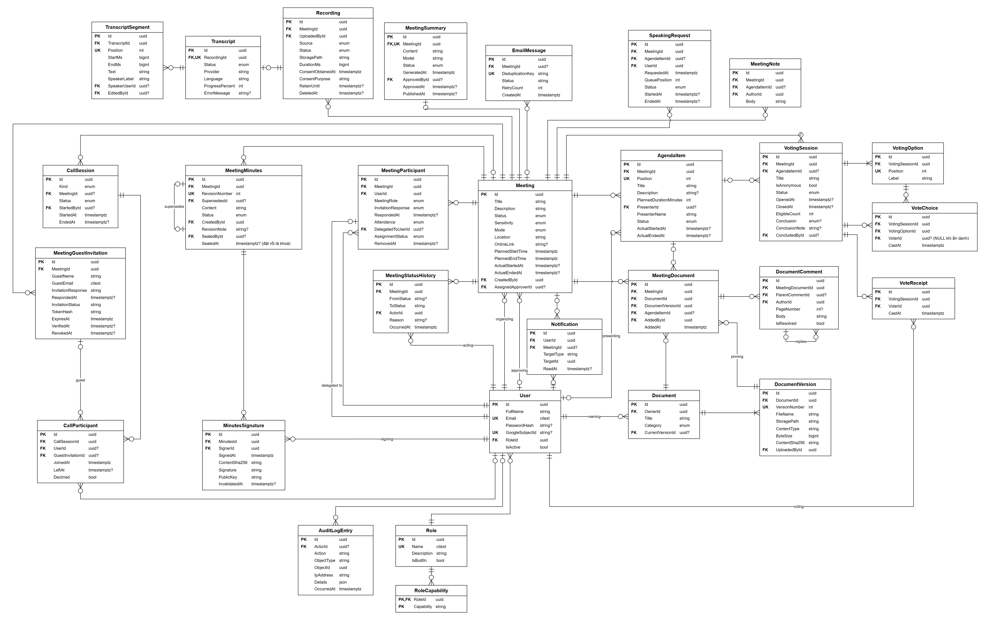
ERD — TARGET CONCEPTUAL / LOGICAL MODEL
Page 42
Notes:
Figure embedded unchanged from: C:/Users/admin/Documents/GitHub/TrustCabinet/docs/assets/erd-muc-tieu/trustcabinet-erd-muc-tieu .drawio.png
Editable diagram source: C:/Users/admin/Documents/GitHub/TrustCabinet/docs/assets/erd-muc-tieu/trustcabinet-erd-muc-tieu .drawio
Full original image retained without cropping. No source node, transition, relation or label was rewritten.

Slide 43
NON-FUNCTIONAL REQUIREMENTS
1
External Interfaces & Reliability
2
Usability & User Experience
•
Optional Google sign-in with password fallback
•
Vietnamese UI with consistent terminology
•
SMTP notifications and queued retries
•
Desktop-first, with specified mobile-capable flows
•
Planned media server and replaceable AI provider
•
Keyboard access, visible focus and 4.5:1 text contrast
3
Performance & Capacity
4
Security & Privacy
•
Initial load ≤3 s; screen data ≤2 s p95
•
Server-side capabilities and row-level access
•
API ≤1 s p95 with up to 100 active users
•
Guest sessions are scoped to one invited Meeting
•
200 signed-in users; room target 30, hard cap 50
•
HTTPS / WSS, audit evidence and secure sessions
•
Transcript ≤1.5× audio duration; summary ≤5 min
•
Audio consent, retention and recorded deletion
Page 43
Notes:
C:/Users/admin/Documents/GitHub/TrustCabinet/docs/08-reports/Report-3_Software_Requirement_Specification.md — IV. Non-Functional Requirements. Performance conditions: recommended deployment hardware, up to 100 active users. Transcription duration excludes queue wait and upload transfer. Targets are requirements, not measured test results.

