Slide 1

Studying Code Switching in K-pop Hits on Billboard Charts
Global Beats,
Local Tongue
Aditya Narayan Sankaran
Reza Farahbakhsh
Noël Crespi
SAMOVAR, Télécom SudParis
Institut Polytechnique de Paris
Notes:
Hello everybody, I am Aditya, you can call me Adi, if you find my name hard :))
As Reza said, I am a PhD student at the SAMOVAR lab at telecom sudparis. My Research is primarily on code switching in Low Resource Languages and Hate Speech. But during my masters I also worked with digital humanities, where I studied the presence of gender stereotypes in childrens rhymes and poems and provided a framework to rectify using LLMs.
This is a look into our work “Global Beats, Local Tongue” published at the conference for computational humanities and resources last year at Luxembourg.

Slide 2

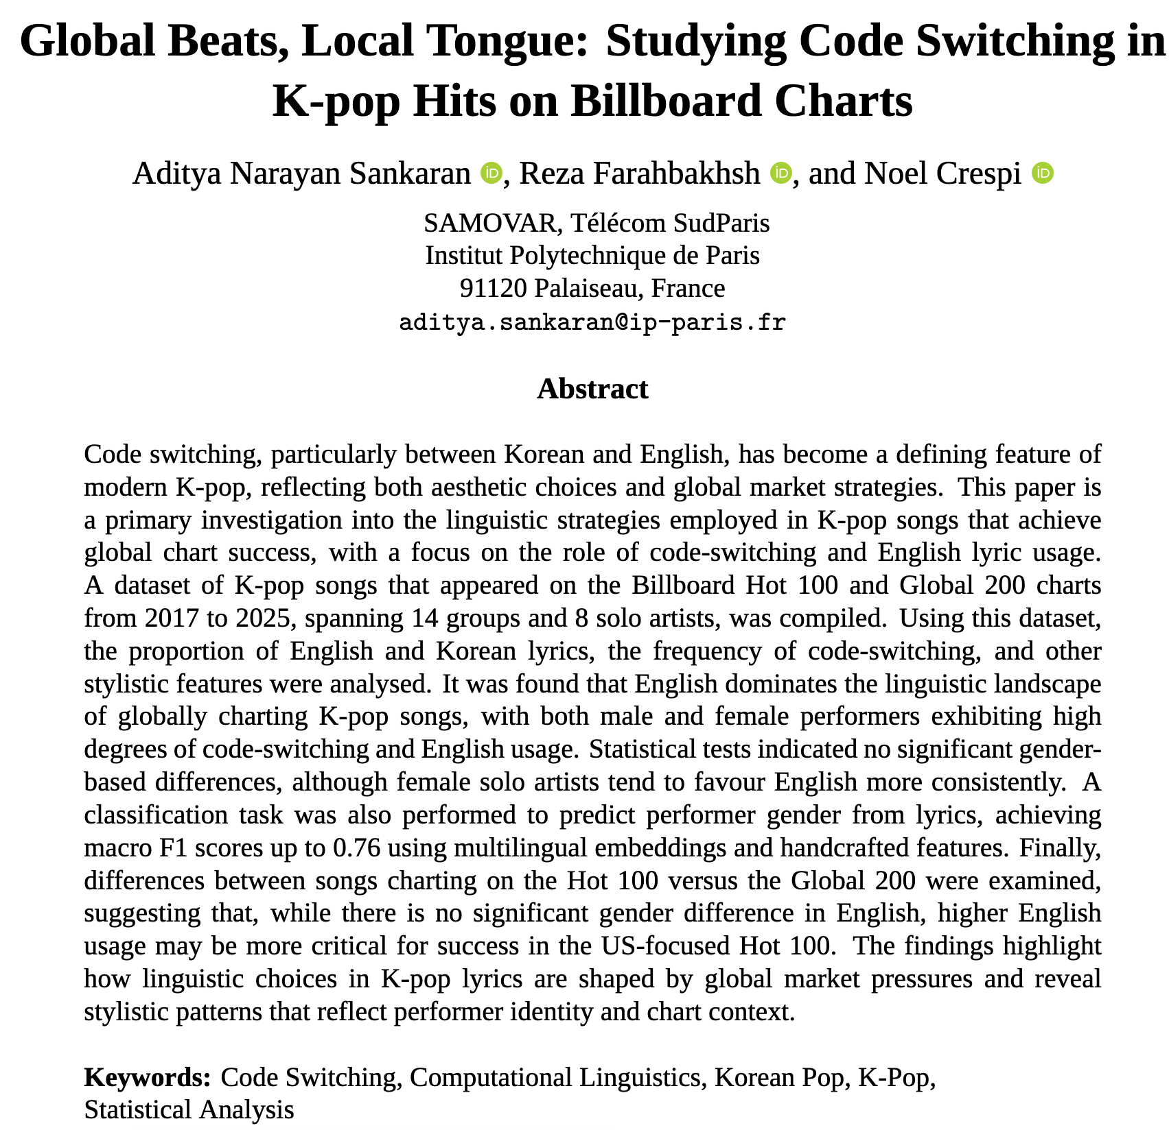
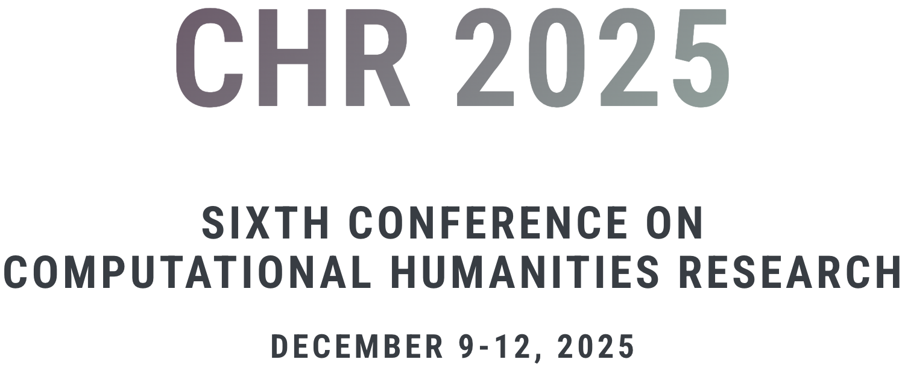
Outline
Background and Motivation
Code Switching vs Code Mixing
Data collection
Statistical Test
Conclusion and Future Direction
https://2025.computational-humanities-research.org/
Notes:
This is how I am looking to take you all along with my work. On a side note, I am very very open to comments and suggestions, since we were invited by the conference to submit an extended version of this work as part of their journal proceedings. So, please do not hesitate to pitch in Ideas at the end :))

Slide 3

Background and Motivation

Slide 4

Notes:
If you do not know who this is, you probably live under a rock or you have not given into peer pressure, yet. Kudos to you.
For those who do know, please give me 2 minutes to geek out about this movie.
Kpop demon hunters. A simple fantasy movie about 3 girls fighting demons while being kpop idols.
Big hit movie for netflix. The sequel movie is scheduled for 2027.
But not only that, (next slide)

Slide 5
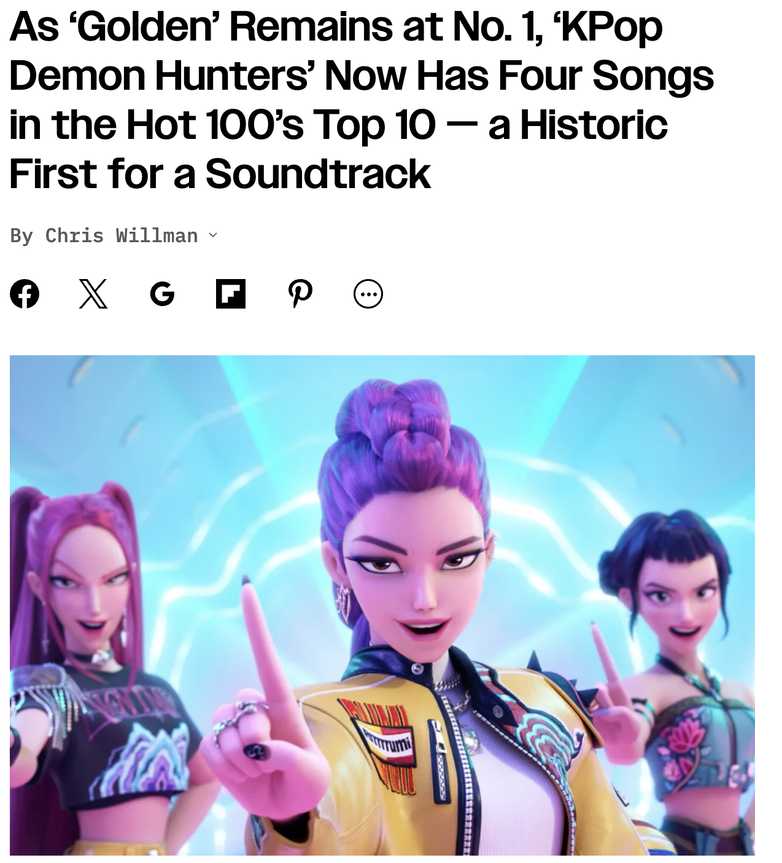
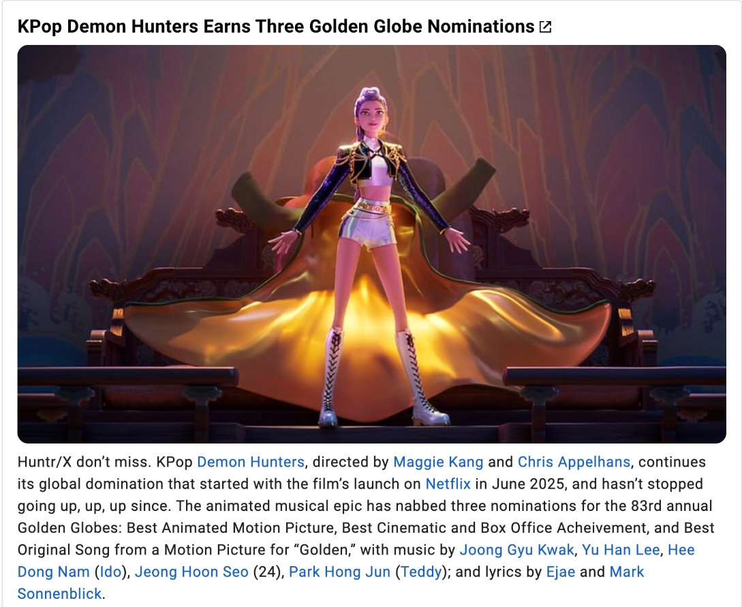
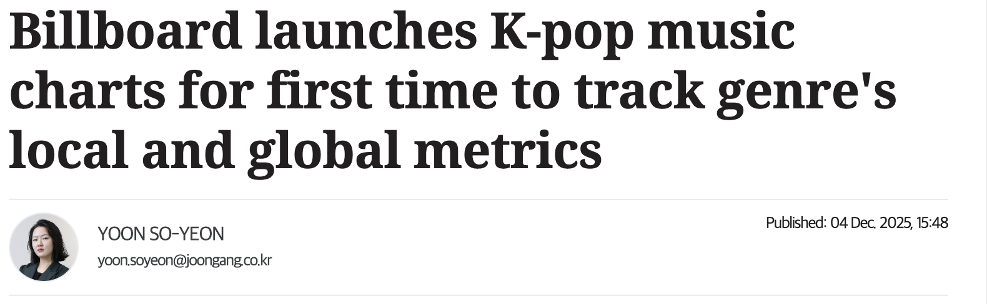
Notes:
The soundtrack from the movie was on the billboard charts for weeks and was recently nominated for 3 golden globes, including best original sound track for the song GOLDEN.
Ever since the "Hallyu" wave has started peaking, even billboard has given into this growth and started a separate k-pop music chart to track global metrics for songs from these groups.

Slide 6
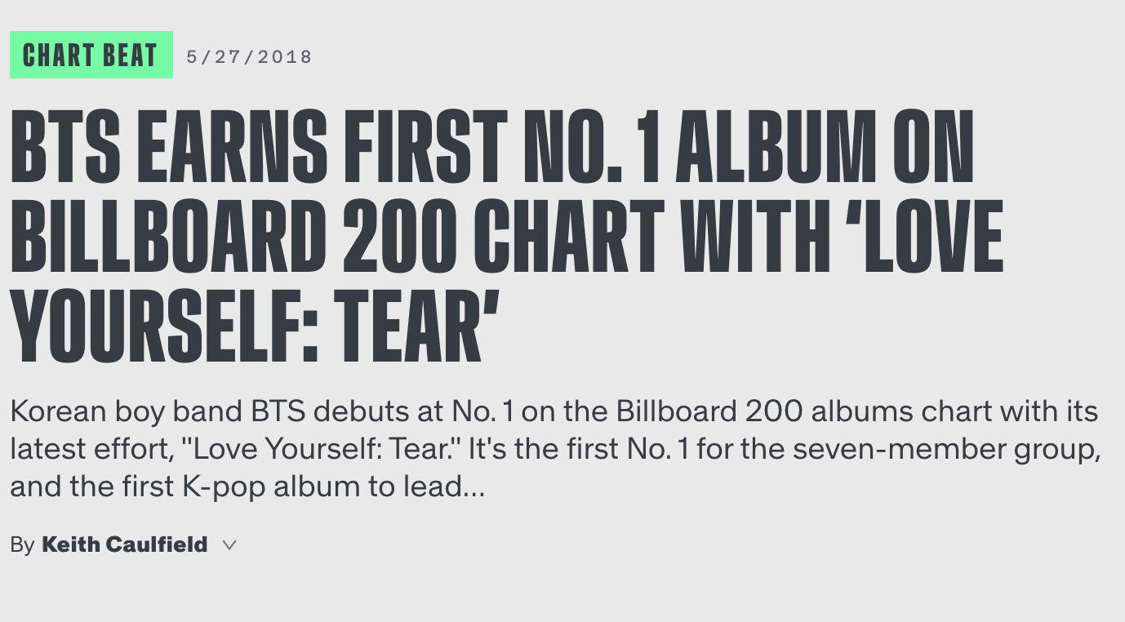
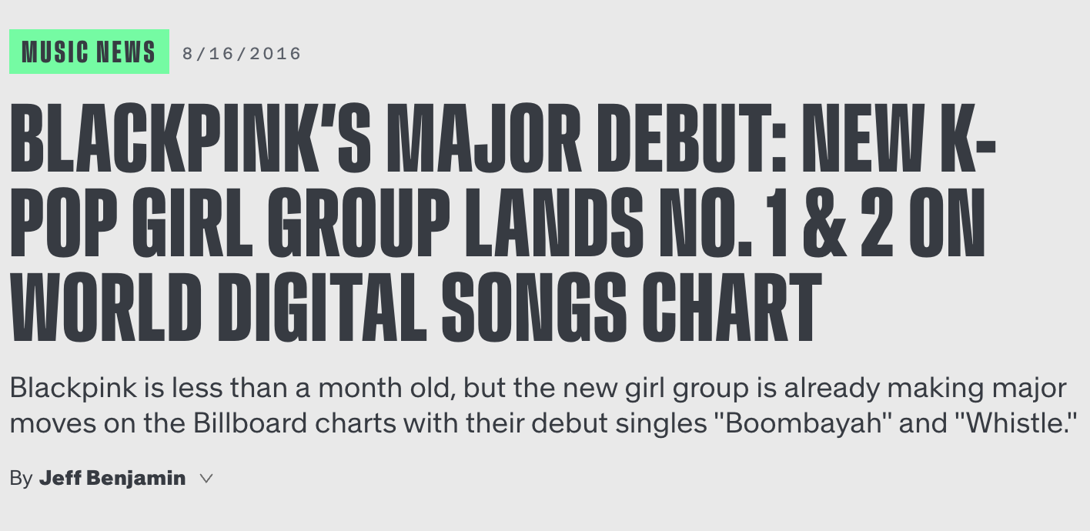
Notes:
While k-pop demon hunters has become popular quite recently,
there have been several instances in the past that have shown k-pop to be very successful in the western market, with bright colorful visuals, a mix of 3-4 genres in one song and other such distinct quirks.
We have the k-pop superpower groups BTS and BLACKPINK charting way back in 2016 and 2018, as seen here.

Slide 7
Global Rise of K-pop
Rapid expansion into Western markets (Hot 100, Global 200).
Increasing visibility of multilingual lyrics (Korean + English).
English used for “global vibe,” fun indexing, fan connection.
Music videos + sonic experimentation → global appeal.
Notes:
This lead to a rapid expansion to the western markets and start tracking on billboard very early on.
As researchers, the one thing we found interesting was the lyrics. It was very multilingual and it was interesting to see the mix of two languages.
It is very clear that they mix korean and english for the global vibe and easy sing along.
This paired with the elaborate music videos, dances and INSANE genre switches, it gives a certain charisma that appeals to a much larger global audience

Slide 8
Why Study Code-Switching in K-pop?
English–Korean code switching has become a norm, not an exception.
  Frequent code-switch events (≈17–25 per song depending on groups/solo acts)
Lack of computational analysis of this phenomenon.
Research questions:
  Do male vs. female performers differ in English/Korean usage?
  Does code-switching differ by gender or chart type?
  Can performer gender be predicted purely from lyrics?
Notes:
We observed in our work that code switching in k-pop has become more of a norm and there is a lack of "computational" analysis on this field, which we can see is gaining massive attraction on a global scale.
Hence, we present our first ever computational linguistic research on code-switching in k-pop.
In this work, we tried to answer 3 main research questions. That is,
Do male vs. female performers differ in English/Korean usage?
Does code-switching differ by gender or chart type?
Can performer gender be predicted purely from lyrics?

Slide 9
Code Switching vs Code Mixing

Slide 10
Definitions
Code-Switching (CS)
Alternating between languages at boundaries (line, phrase, clause).
Code-Mixing
Blending languages within phrases/words.
K-pop lyrics typically show:
Inter-sentential switching (“Korean verse → English pre-chorus”)
Intra-sentential switching (“Hangul + English words together”)
Tag-switching (“baby,” “yeah,” “okay,” “let’s go”)
Notes:
So, a little bit about what code switching and code mixing are. Sometimes they are used interchangeably in computational linguistics, even though there is a “slight” yet significant difference.
CS is when you alternate between languages at boundaries. Like using words like touché, capiche, compris, Habibi etc
Code mixing is when you blend languages within phrases. Examples are language forms like franglais, hinglish (hindi+english) and even whole languages like tagalog.
Kpop lyrics typically show inter sentinatal and intra sentinetal code switching and usage of "tag" switching, with what we call in our work "filler words" like yeah, oh, lessgo etc.

Slide 11
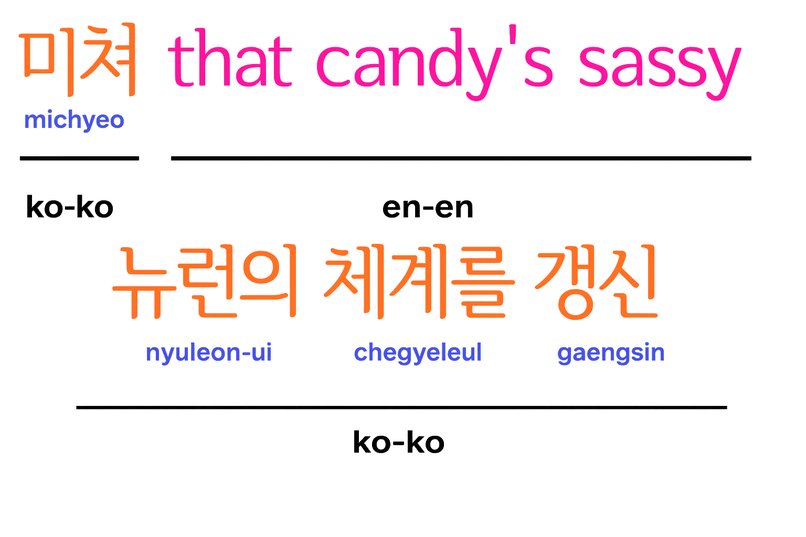
Example
Notes:
Here is a snippet from a song to visually show you code switching present in K-Pop. Just a shot in the dark, but does anyone know what song this is from? No?
This song is called Crazy from a group called LESSERAFIM and here is a small section of the song to show how code switching happens in a song. I unfortunately can neither sing nor rap, so excuse me to be unable to put up a performance. But this part comes in a rap section of the song.
As you can see, the phrase “that candy’s sassy” that comes between a Korean section, is something that we can take a look at. This is an example of what we are trying to understand.

Slide 12
Why CS Matters for K-pop
Used for rhythm, emphasis, hooks.
English often marks “global-ness.”
Can influence chart performance and cultural indexing.
Notes:
So, we can see that these code switching practices come in handy in K-Pop to help with emphasis, rhythm (like in the rap section) and catchy hooks, like from the previous example.
This also signifies global-ness with the use of english in the songs, which then in turn influences the billboard chart performance.

Slide 13
Data Collection

Slide 14
Artist & Song Selection
Time period: Jan 2017 – May 2025.
Sources:
Lyrics → Genius (via LyricsGenius).
Chart data → Billboard Hot 100 + Global 200.
22 artists total:
Groups: 7 female, 4 male
Soloists: 4 female, 6 male
All songs the artists had on either chart (hot 100 or global 200) were retrieved.
Notes:
For the data, we used Genius, the online fan based community that has lyrics of songs on their site and an API to extract that as well. We also collected billboard data from 2017-may 2025. In total we collected data from 22 artists and all of the songs were present on either global 200 and hot 100. Global 200 is a chart that aggregates streaming data from all countries except the US and hot-100 is a US centric chart.

Slide 15
Dataset Construction
Final dataset includes:
Title
Artist gender (M/F)
Category (Group/Solo)
Peak position
Weeks on chart
Chart trajectory (time series)
Raw + cleaned lyrics
Separate files for Hot 100 and Global 200.
Notes:
And this is how the final dataset looks like, we make separate files for hot-100 and global-200 since streaming data might be tricky as one song might have been 1st on hot-100 but never appear on global-200.

Slide 16
Dataset Stats
Most represented:
BTS (29 songs), BLACKPINK (24).
Soloists:
V (15), Jungkook (14), Jennie (14).
Nearly all artists appear on Global 200;
Notes:
Some tiny stats, more can be found on the paper.

Slide 17
Statistical Tests

Slide 18
Feature Engineering for classification
Korean Lyric Ratio
English Lyric Ratio
Code-switch count
Repetition count
Alliteration
Filler words (“oh,” “yeah,” “la,” etc.)
Combined with multilingual embeddings for the classification task.
Notes:
We curated handcrafted heuristic features such as korean and english lyric ratio (count english and korean words and compute ratio), code switch count (which is when we notice there is a language change in the lyric), repetition count, alliteration count (when there is words like wow-wow-wow, du-du-du(blackpink duddududu), pow-pow-pow(stray kids thunderous) etc) and filler words like yeah, whoa, whooo, la-la etc.
Then we extracted multilingual embeddings using ALIBABA's General Text Embedding gte-multilingual-base and xlm-roberta.
Then we fused the embeddings and classified using logistic regression, random forest, xgboost and a voting classifier.

Slide 19
Statistical Methods
Normality check → Shapiro–Wilk
This revealed that most features were non-normal.
Welch’s t-test
This test showed us unequal variance.
Proceeded with a Mann–Whitney U for a nonparametric test.
Set the Significance threshold to α = 0.05.
Notes:
Then we used the handcrafted features and performed statistical tests for our hypotheses.
Firstly we performed a normality check with Shapiro-Wilk and Welch's t-test. It revealed that our data was not-normal and had unequal variance.
This led us to choose Mann-Whitney's U for a non-parametric test, with our significance level set to point zero five.

Slide 20
Key Hypotheses
Boy vs. Girl Groups → English/Korean ratio differences?
Gender differences in number of code-switches?
Soloists vs groups?
Hot 100 vs Global 200 linguistic differences?
Notes:
These are the hypotheses that we focused on for the statistical testing. Please note that we are comparing boy/girl groups solely as groups and by no means is this a measure of gender biases.
What is the ratio of korean words to english words in boy vs groups groups? Does this show if either boy groups or girl groups use more english compared to korean?
Do boy groups tend to use more english than korean or is it vice versa?
Do soloists or group acts use more english words?
Is there more english in hot 100 or global 200?

Slide 21
Findings

Slide 22
Findings — Classification
Boy vs girl groups:
  Hot 100: 76% accuracy and a macro F1-score of 0.76
  Global 200: 72% accuracy and a macro F1-score of 0.71.
Conclusion
  Although individual linguistic features (such as the Korean lyric ratio) did not yield significant differences across genders, their combination with learned representations allowed models to predict performer gender at a level significantly above chance.
Notes:
Classifying the lyrics based on boy vs girl groups revaled to us accuracy rates of 76% and 72%, in the hot 100 an global 200 with pretty good macro f1 recall too.
We find that the handcrafted features did not yield any significant differences. But combined with textual features, we were able to show that there is a clear difference in the way boy act lyrics compared to girl acts.

Slide 23
Findings — Code-Switching Frequency
Boy vs girl groups:
  Hot 100: 19.05 vs 16.96 switches → NOT significant.
  Global 200: 20.57 vs 25.32 → NOT significant.
Conclusion: High code-switching across all categories; gender doesn’t matter.
Notes:
From the statistical tests, we also found that there was not much significant differences in switches, with boy groups vs girl groups. Basically both boy and girl acts code switch a lot.

Slide 24
Findings — Korean vs English Ratio
Trend:
  Boy groups use slightly more Korean.
  Girl groups use slightly more English.
But Mann–Whitney: NOT statistically significant, therefore we need more data and variety of groups to study on.
Female soloists, however, are far more English-heavy in their songs (generally >95% in some tracks).
Notes:
But boy groups tend to slightly use more Korean whereas girl groups use more english.
We cannot claim it with high certainity and need more data to confirm this claim, but it is numerically significant to warrant a future investigation.
However, female soloists on the other hand have songs that are english-heavy containing about 95% of the lyrics in english.

Slide 25
Chart Context Effects
Boy groups: No difference Hot100 vs G200 → stable Korean ratio.
Girl groups: Slight trend toward more English on Hot 100 (however not statistically significant).
  Hot 100 is a US-centric chart.
  This could suggest a strategic push for English usage for U.S.-oriented releases.
Notes:
When it comes to how songs perform on the chart, boy groups tend to have more of a stable korean to english ratio compared to girl groups. There is generally no significant difference in the language ratio in both hot 100 an global 200.
On the other hand, Girl groups slightly trend towards more english on the English Centric Hot-100 chart, however not statistically significant. But this slight significance is worth studying in our future works. It shows a possibility that having more english could be a strategic push for US oriented releases.

Slide 26
Interpretation
English dominance consistent across gender and chart.
Trends exist but lack statistical power due to less data and limited time period.
Strong stylistic similarity across groups → English as a global identity marker.
Notes:
An overview of the findings could be summarized as follows:
English exists significantly across gender and chart. That is very clear.
Most of the results in our work have not achieved statistical significance due to lack of variety of data and limited time period, but we were able to make claims based on numerical significance.
There is a strong stylistic similarity between both our control groups (i.e boy acts vs girl acts). English tends to be a global identity marker.

Slide 27
Conclusion and Future Directions

Slide 28
Main Takeaways
English has become a dominant linguistic component of global K-pop.
Both male and female acts code-switch heavily and frequently.
Gender differences in language ratio exist but are not statistically significant.
Classification models achieve up to 76% macro F1, showing latent stylistic cues exist beyond raw language ratios.

Slide 29
Contributions
First computational analysis linking:
Code-switching
Billboard chart context
Novel dataset combining chart metadata + multilingual lyrics.
Notes:
Our contribution to the field of humanities and computational pop linguistics is that this is a first work in code switching in kpop and linking both linguisticis and billboard metrics and analytics.
We also propose the first ever dataset of K-pop combining metrics and multilingual lyrics.

Slide 30
Limitations
Only internationally successful songs → bias.
Small sample size.
No audio/visual context (important for K-pop’s multimodality).
Simplifies linguistic structure of Korean.
Notes:
These are some limitations of our work. We are quite aware that we only study charting songs, so it is a bias we are aware of for this paper.
It is a small sample of songs that we are tracking and working with. So future works will involve more songs. Should not be a problem since we are having a Hallyu wave right now.
We are not studying the audio-viusal aspects of kpop. This is a purely linguistic study. So, we cannot make observations about the visual and audio aspects of kpop in this work.
In this work, we are aware we broke down the linguistic structure of korean to just words and phrases. This is something we are looking at working in the next version of our work with korean linguists.

Slide 31
Future Work
Expand dataset (domestic charts, pre-2017, smaller agencies).
Include multimodal features (audio, choreography, MV aesthetics).
Chart-success prediction using linguistic + non-linguistic features.
Collaboration with Korean linguists for deeper semantic analysis.
Temporal analysis: English rise over time.
Listener reception analysis across markets.

Slide 32
Thank You
Send me an email or dog pictures or playlists or job offers :)
asankaran@telecom-sudparis.eu
https://callmesanfornow.github.io

