Slide 1






A Game By:
Notes:
Project manager introduces the group

Slide 2
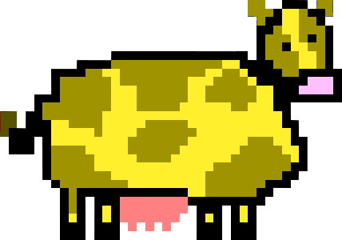
Project:
Cow Panic!
Cowsual Gamers
NO funding necessary
Unity (Moonity?) w/ C#
Pixel Art
PC (Personal Cowmputer)
Notes:
Drew

Slide 3

The Game:
Cows walk across screen
Control UFO
Use tractor beam to abduct
Don’t let cows off-screen
Notes:
Jonah

Slide 4
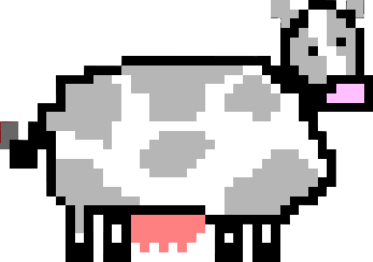
Approach:
Technical:
Moonity – Game Engine
Using C#
GameMaker Studio, GrahpicsGale
Sprites and Animation
Famitracker
Music
Notes:
Hugo

Slide 5
Approach:
Moonagement:
Project Moonager
Jake Cowfagno
Prograhaming
Jake Cowfagno
Drew Graham
Dan Sipe
Game Designer
Drew Graham
Notes:
Hugo

Slide 6
Approach:
Moonagement:
Art and Sound Design
Hugo Armella
Joshua Karmel
Testing Cowordinator
Dan Sipe
Testing
Jonah Musto
Cow Pun Specialist
Jake Cowfagno
Notes:
Hugo

Slide 7
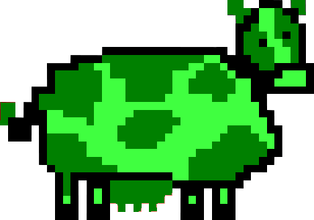
Scope:
Initial Projection:
Additional Mechanics
Cow-tapult
Day-Night background alternatives
UFO status effects
Android Port
Notes:
Dan

Slide 8
Scope:
“Nice to Have”:
Main Menu
Different cow types
(chocolate, sick, etc.)
Moosic/Sound Effects
(cow moos, tractor beam, etc.)
Notes:
Dan

Slide 9

Final Product:
Main Menu
Different cow types
Moosic
Scoreboard
Pixel Art & Animootions
PC
Notes:
Drew

Slide 10

Lessons Learned:
Keep Art and Programming separate
New ideas = Cool, but also = Scope creep
Spread tasks out more evenly
Scope too large initially; ok to reduce it afterward
Bugs. They’re everywhere.
Notes:
Jake

Slide 11
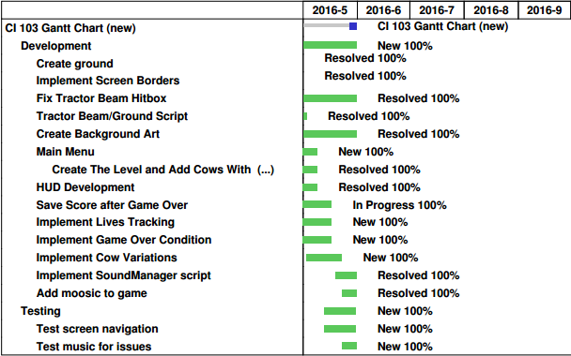
Gantt:
Notes:
Jake

Slide 12
Demoo:
Notes:
Drew

Slide 13
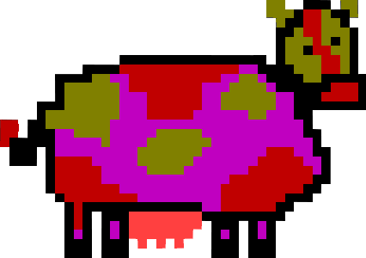


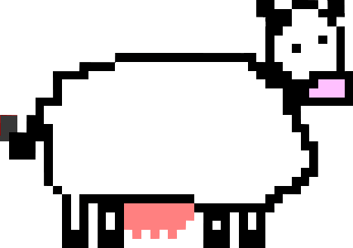
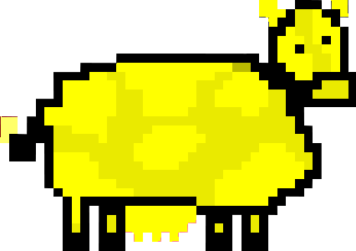

Thank Moo!
Notes:
All

