Slide 1




COW PANIC!
A Game by CI 102’s
The Udder Guys
Notes:
Project manager introduces the group

Slide 2
Project:
Cow Panic!
Casual Gamers
NO funding necessary
Unity (Moonity?) w/ C#
Pixel Art
PC w/ Android stretch goal
Notes:
Drew

Slide 3
Scope:
Critical Priority:
Functioning, playable
PC
Animated pixel-art
8-bit Moosic
Notes:
Hugo

Slide 4
Scope:
Critical Priority:
Improved abduction
Heads-Up-Display
Boundaries
Ground and Walls
Falling Cows (Gravity)
Notes:
Dan

Slide 5
Scope:
“Nice to Have”:
Main Menu
Different cow types
(chocolate, sick, etc.)
Moosic/Sound Effects
(cow moos, tractor beam, etc.)
Notes:
Josh

Slide 6
Scope:
Future Cownsiderations:
Android Port:
Little experience in Moonity
Projected 1-2 weeks
Increase player base
Best way to play
Notes:
Jonah

Slide 7
Approach:
Technical:
Unity – Game Engine
Using C#
GameMaker Studio, GrahpicsGale
Sprites and Animation
Notes:
Hugo

Slide 8
Approach:
Moonagement:
Project Moonager
Jake Cowfagno
Programming
Jake Cowfagno
Drew Graham
Dan Sipe
Notes:
Dan

Slide 9
Approach:
Moonagement:
Art and Sound Design
Hugo Armella
Joshua Karmel
Testing Coordinator
Dan Sipe
Testing
Jonah Musto
Cow Pun Specialist
Jake Cowfagno
Notes:
Josh

Slide 10
The Deliverable:
Implement ‘Ground’
Screen Borders
Heads-Up Display (HUD)
Main Menu
Scoreboard
Notes:
Drew

Slide 11
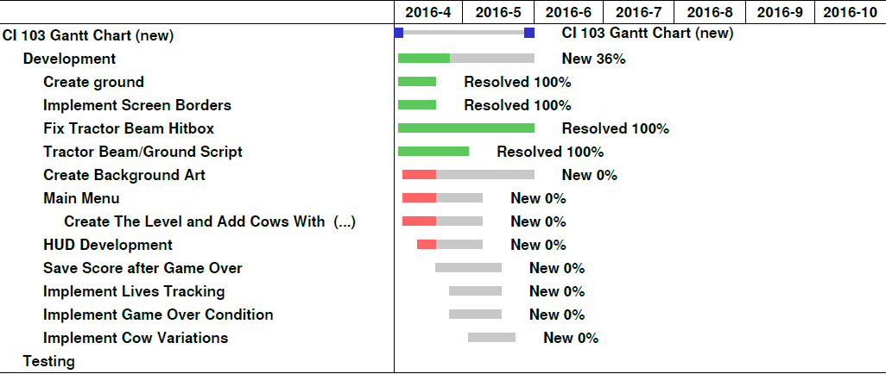
Gantt:
Notes:
Jake

