Slide 1

BETA PERFORMANCE REPORT
PgBee: Business Growth & Expansion Analytics
Evaluating PgBee's beta performance and identifying the highest-impact growth opportunities across Kerala's student accommodation market.

Slide 2
CURRENT BUSINESS PERFORMANCE
Beta Results: Strong Demand, Healthy Margins
The pilot demonstrated strong demand and profitable operations — validating PgBee's core business model before scaling.
38
74
Hostels Onboarded
Successful Bookings
Across Kerala during the beta phase
Completed through the platform
₹36,926
72.92%
Revenue Generated
Profit Margin
Total platform revenue in beta
₹26,926 profit on ₹36,926 revenue

Slide 3
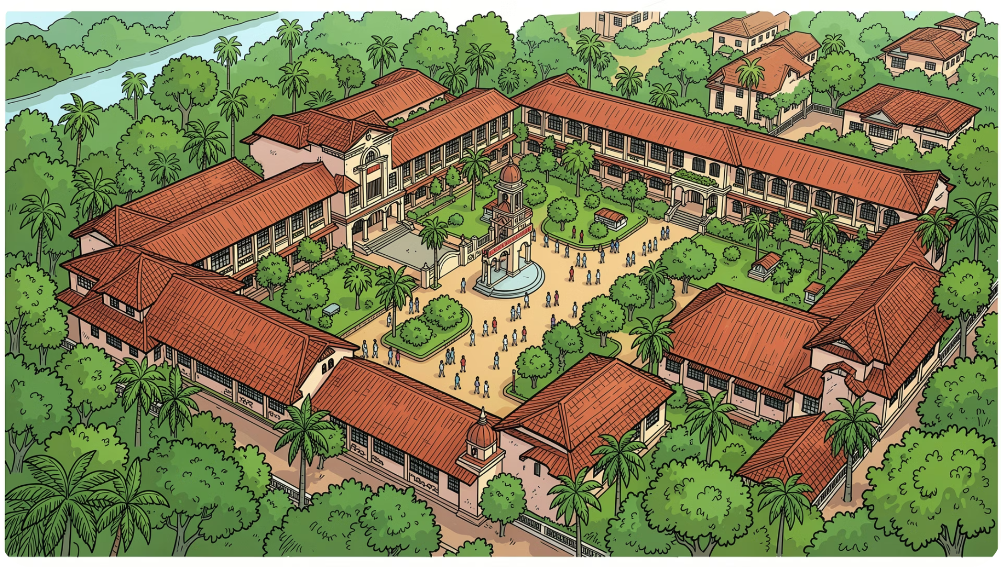
MARKET OPPORTUNITY
Kerala's Student Accommodation Market Is Underserved
Key Market Drivers
Growing student migration to urban education hubs
Rising demand for organized, digital-first hostel discovery
Limited competition from existing digital platforms
Priority Districts by Demand
Thiruvananthapuram — Highest student concentration
Ernakulam — Major commercial & education center
Kozhikode — Fast-growing student hub

Slide 4
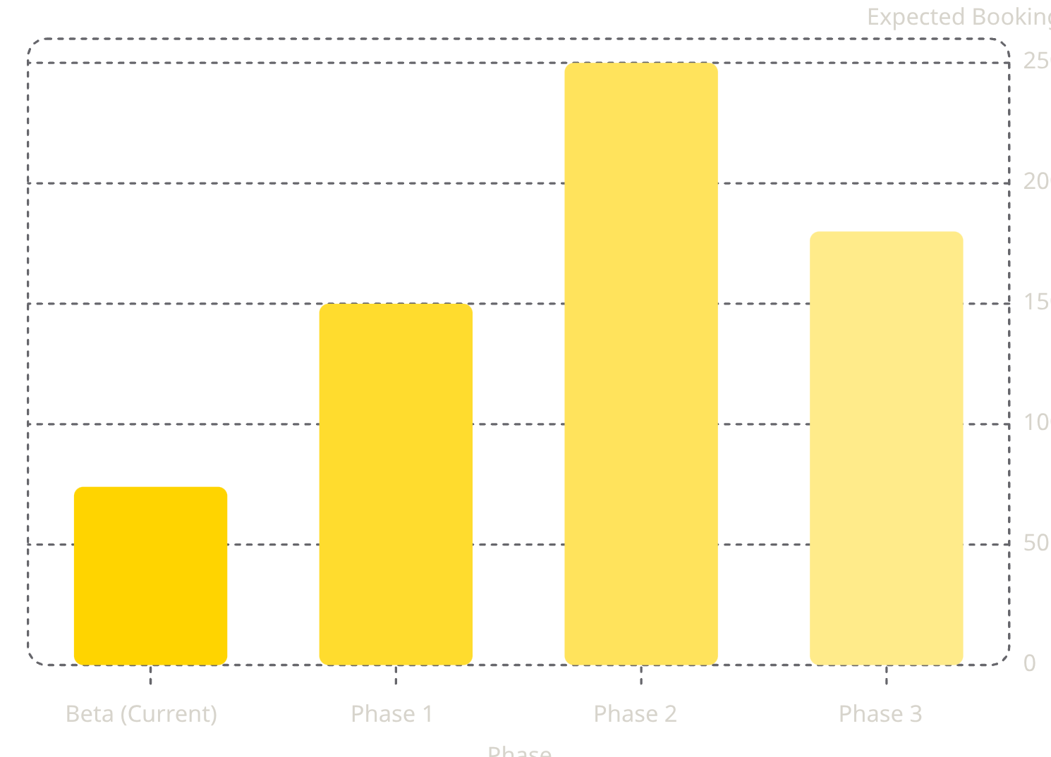


FINANCIAL OUTLOOK
Expansion Can Multiply Revenue by Nearly 8× Beta
Revenue Projection by Expansion Area
Revenue = Bookings × ₹499 per booking
Trivandrum
₹74,850 projected revenue
Ernakulam
₹124,750 projected revenue
Kozhikode
₹89,820 projected revenue
Combined expansion revenue potential: ₹2,89,420+ — nearly 8× the beta stage.

Slide 5




STRATEGIC ROADMAP
Three-Phase Expansion Plan
Phase 1 · 0–6 Months
Strengthen Trivandrum
Grow hostels from 38 → 50
Improve booking conversion rate
Phase 2 · 6–12 Months
Launch Ernakulam
Build college partnerships
Onboard hostel owners proactively
Phase 3 · 12–24 Months
Launch Kozhikode
Regional marketing campaigns
Student referral programs

Slide 6

CONCLUSION & RECOMMENDATION
Expand in Kerala First. Build South India's Leading Platform.
Strengths Validated
Priority Expansion Order
Proven, profitable business model
72.92% margin with scalable commission structure
Strong early demand signal from 74 bookings
01
Thiruvananthapuram
Risks to Manage
Highest demand — consolidate first
Competition from informal hostel networks
Hostel onboarding speed
Student awareness & trust building
02
Ernakulam
Largest revenue potential
03
Kozhikode
Fast-growing student hub
Long-term vision: Build South India's leading student accommodation platform.

