Slide 1

PgBee Customer Journey Analysis
Understanding the student accommodation experience — from first search to long-term loyalty.
PGBEE BUSINESS GROWTH & ANALYTICS
PREPARED BY SIDHARTH · JUNE 2026

Slide 2


FOUNDATION
What Is a Customer Journey?
A customer journey maps the complete experience a student has while using PgBee — from discovering the platform to booking and beyond. It reveals behavior, pain points, and opportunities at every touchpoint.
Primary Persona
Core Objective
Budget-conscious student seeking verified, trustworthy accommodation with a fast booking process.
Understand student behavior, identify friction, and surface opportunities for improvement.

Slide 3
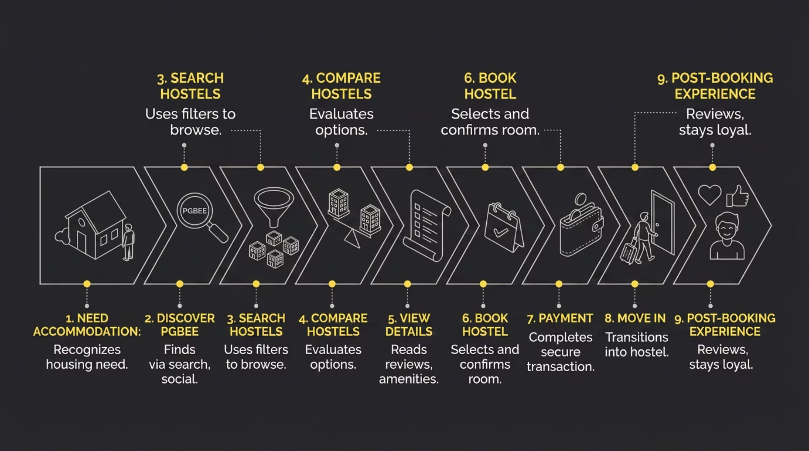

JOURNEY MAP
End-to-End Student Journey
The journey spans nine stages — from recognizing a housing need to becoming a loyal PgBee advocate. Each stage is an opportunity to earn trust and reduce friction.
Key Insight: The journey doesn't end at booking. Post-booking satisfaction drives referrals, reviews, and long-term platform growth.

Slide 4
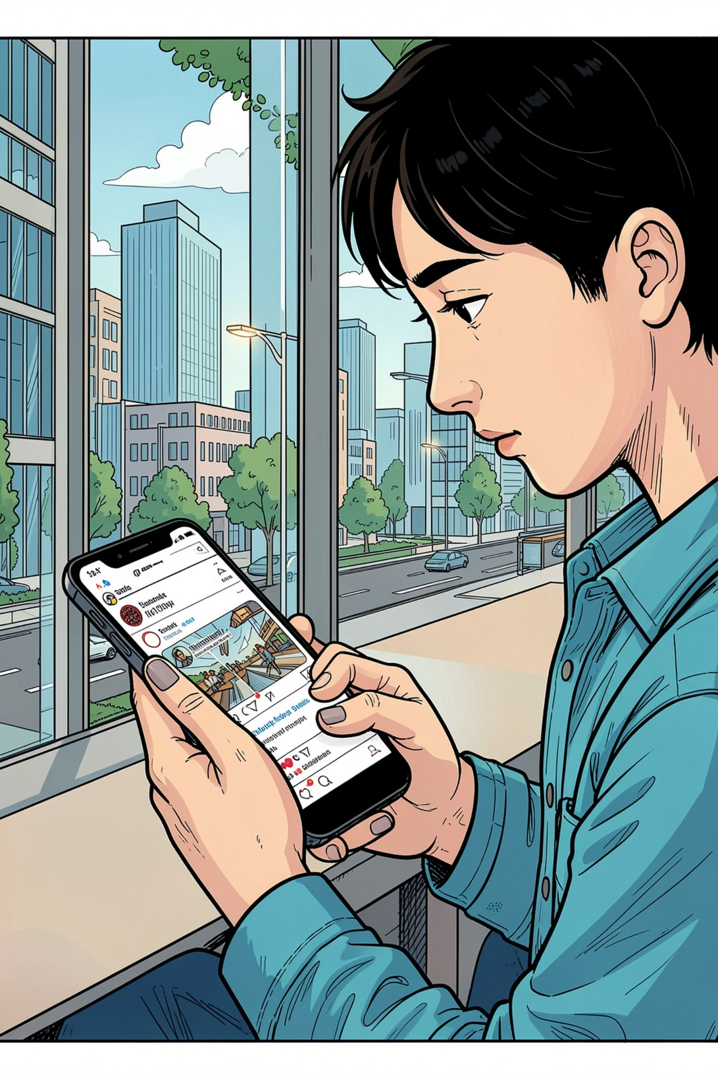
STAGE 1
Awareness: Discover PgBee
How Students Find Us
Student Questions
Online search & SEO
Friend referrals
Social media
College partnerships
Is this platform reliable?
Are hostels verified?
Can I trust the listings?
Opportunities
SEO & content marketing
Referral incentive programs
Verified badge system
College ambassador network

Slide 5

STAGE 2
Consideration: Search & Compare
What Students Do
Students search, filter, and compare hostels based on price, location, safety, and facilities — looking for the best fit within their budget.
Decision Factors
Key Pain Points
Insufficient hostel details and photos
No verified reviews or ratings
Limited filtering options
Price
Location
Safety
Reviews

Slide 6

STAGE 3
Booking & Payment
Students are excited but cautious. A smooth, transparent booking experience is critical to converting interest into confirmed reservations.
1
2
Select Hostel
Confirm Booking
Student chooses their preferred option after comparing listings.
Instant confirmation builds trust and reduces anxiety.
3
4
Complete Payment
Track Status
Secure, transparent checkout with no hidden charges.
Real-time booking status visibility through confirmation.
Pain Points to Address: Payment failures, hidden charges, and booking uncertainty are the top drop-off triggers at this stage.

Slide 7
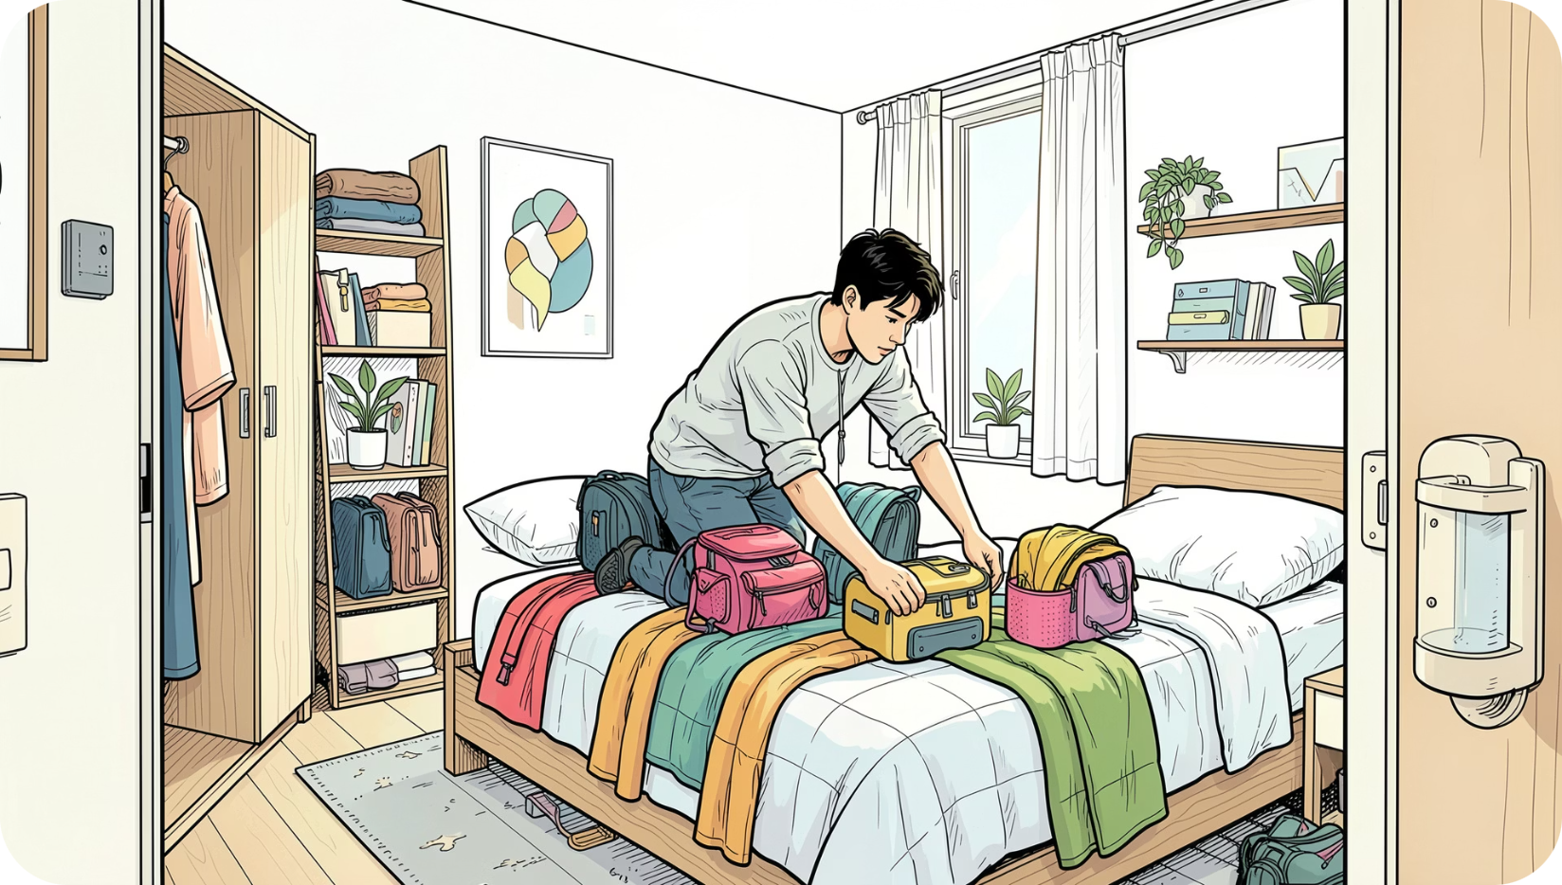
STAGES 4 & 5
Move-In & Retention
Stage 4: Move-In Experience
The first physical interaction with the hostel sets the tone for the entire stay. Gaps between listing and reality erode trust fast.
Pain Points: Communication gaps, listing mismatches, move-in issues
Opportunities: Owner messaging tools, check-in support, feedback collection
Stage 5: Retention & Referral
Happy students become PgBee's best growth channel. Turning users into advocates is the ultimate business goal.
Opportunities: Referral rewards, loyalty programs, review incentives

Slide 8
INSIGHTS & NEXT STEPS
Pain Points & Strategic Recommendations
Each stage has clear friction points — and clear opportunities. Prioritizing these improvements will directly impact conversion, retention, and referral growth.
Stage
Pain Point
Priority Action
Awareness
Lack of trust
Verified badges & college partnerships
Search
Limited information
Richer listings with photos & amenities
Comparison
No ratings/reviews
Verified review system & ratings
Booking
Payment concerns
Transparent pricing & secure checkout
Move-In
Communication gaps
In-app owner messaging & check-in support
Retention
Low engagement
Referral rewards & loyalty programs
Short-Term
Mid-Term
Long-Term
Fix payment flow, add reviews, improve listing details
Launch referral program, college partnerships, virtual tours
Build loyalty ecosystem, owner tools, post-booking support

