Slide 1

PROJECT PGBEE
PgBee Stakeholder Analysis
Understanding key stakeholders in the PgBee ecosystem — mapping needs, influence, and engagement strategies to drive business growth, profitability, and expansion.
Prepared by Sidharth · June 2026

Slide 2
Who Are the Stakeholders?
Stakeholders are individuals or groups who influence or are affected by PgBee's success. Understanding their needs, expectations, and influence levels is essential for strategic decision-making.
Primary Stakeholders
Secondary Stakeholders
Students
Hostel Owners
PgBee Management
Admin Team
Parents
Educational Institutions
Payment Gateway Partners
Local Businesses

Slide 3
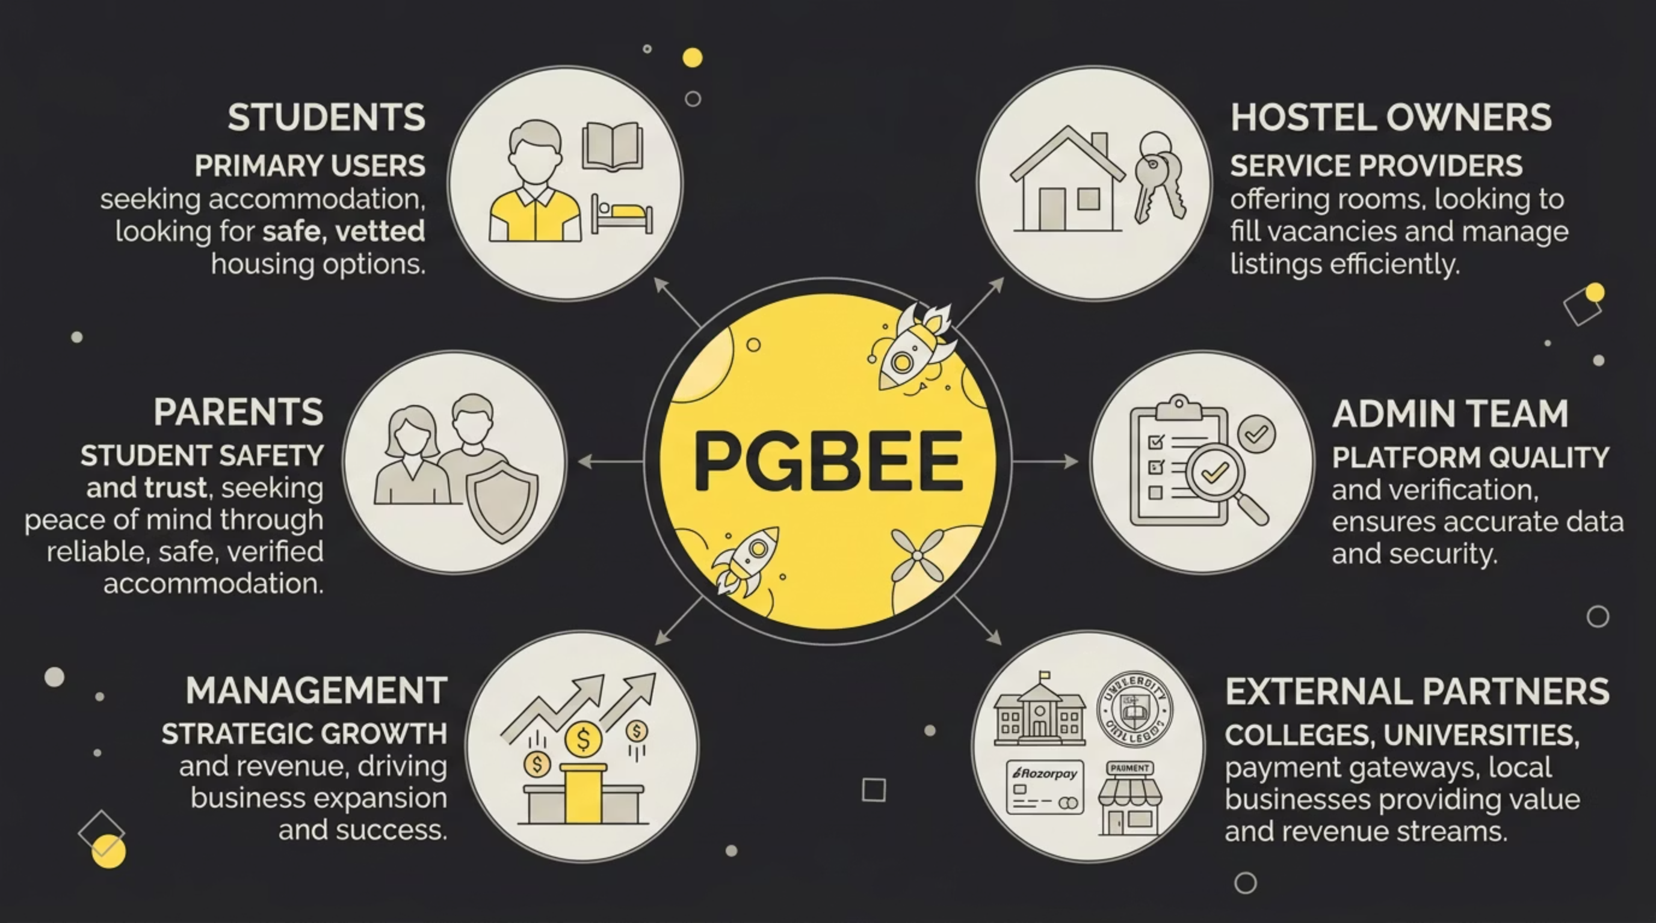
Stakeholder Ecosystem Map
PgBee acts as the central platform connecting all stakeholders — from students searching for accommodation to institutions, payment partners, and local businesses. Every group plays a role in the ecosystem's health and growth.

Slide 4

Stakeholder Needs Analysis
Each stakeholder group has distinct expectations. Meeting these needs drives platform quality, trust, and revenue.
Stakeholder
Core Need
Value Expected
Students
Affordable hostels, easy booking
Safe, verified accommodation
Hostel Owners
Higher occupancy, more bookings
Revenue growth, lead generation
Admin Team
Easy verification workflows
Platform quality, efficiency
Management
Business growth, revenue
Scalable operations, KPIs
Parents
Student safety, trusted platform
Verified listings, peace of mind
Colleges
Student accommodation support
Better student experience
Key Insight: Students and Hostel Owners are the most critical stakeholders — their satisfaction directly drives platform adoption and revenue.

Slide 5
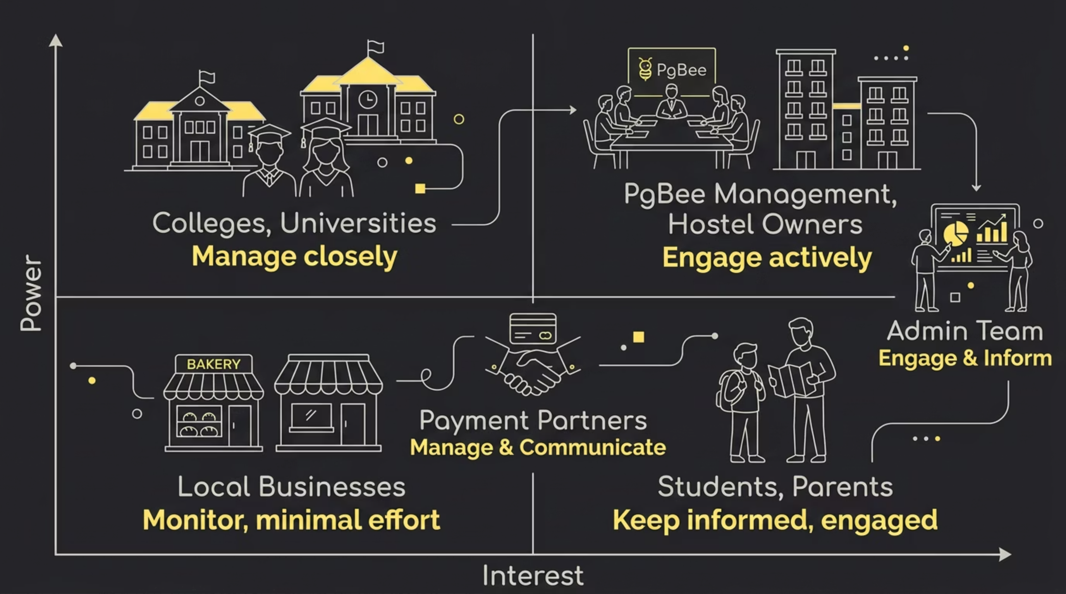
Power vs. Interest Matrix
Prioritizing stakeholders by their level of power and degree of interest helps PgBee allocate engagement resources effectively and avoid overlooking critical voices.
Stakeholder
Power
Interest
Students
Medium
High
Hostel Owners
High
High
Management
High
High
Admin Team
Medium
High
Parents
Low
Medium
Colleges
High
Medium
Payment Partners
Medium
Medium

Slide 6



Stakeholder Engagement Strategy
Targeted actions for each stakeholder group ensure PgBee builds trust, drives adoption, and sustains growth.
Students
Mobile app improvements, faster booking, and reviews & ratings
Hostel Owners
Increased visibility, occupancy reports, and premium plans
Management
KPI dashboards, revenue reporting, and growth analytics
Parents & Colleges
Verified hostels, safety assurance, and partnership programs
Business success depends on: Student acquisition · Hostel onboarding · Revenue growth · Stakeholder satisfaction

