Slide 1

PgBee KPI Tree Framework
Business Growth, Profitability & Expansion Analytics
Connect every business goal to measurable KPIs — ensuring every department contributes to PgBee's growth, profitability, and expansion.

Slide 2
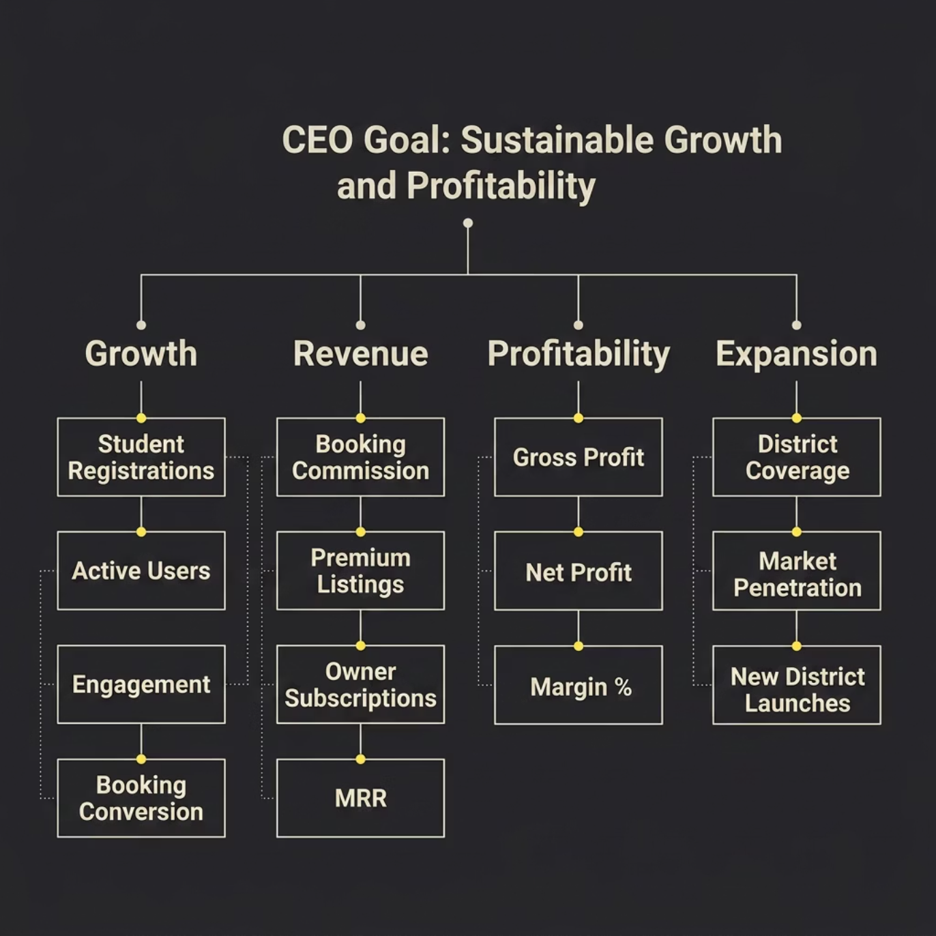
EXECUTIVE OVERVIEW
The CEO KPI Tree
Every metric at PgBee rolls up to one of four strategic pillars — giving leadership a single, unified view of business health and performance.
Four Pillars of Success
Each pillar has its own KPI tree, owned by a specific team — but all contribute to the same CEO-level goal of sustainable growth and profitability.

Slide 3
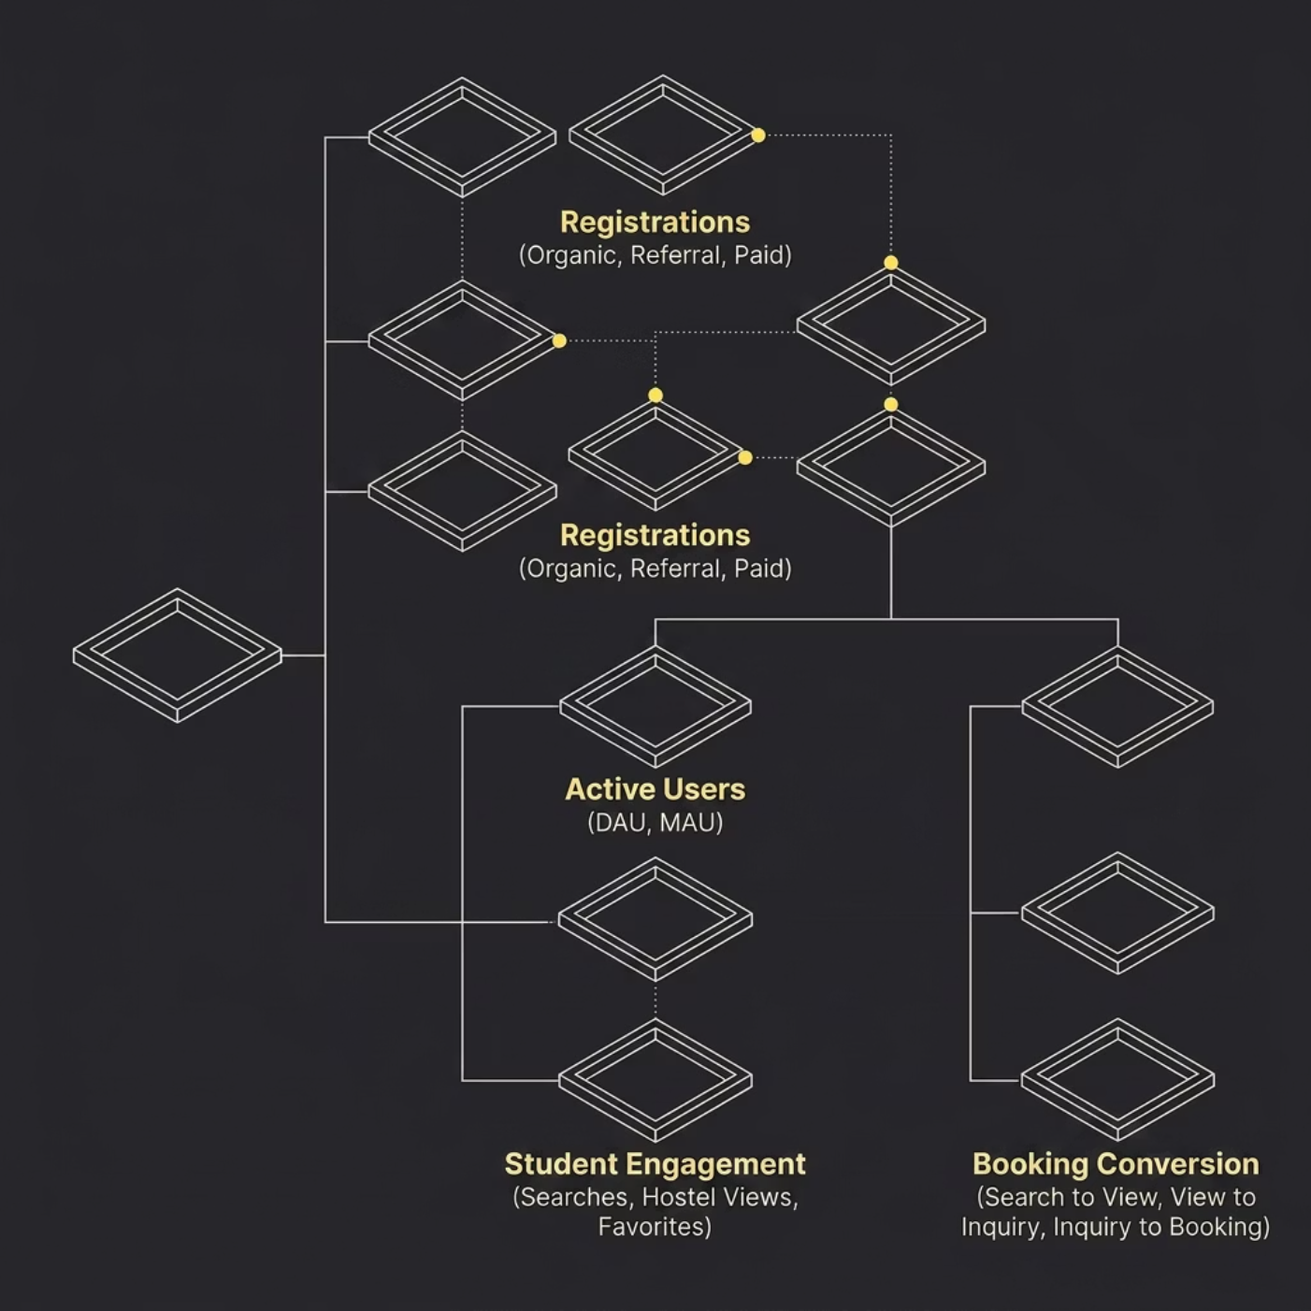
GROWTH
Growth KPI Tree
Objective: Increase student acquisition and platform engagement — from first registration to confirmed booking.
Key KPIs
Total Registrations — Organic, Referral, Paid
Active Users — DAU and MAU
Student Engagement — Searches, Hostel Views, Favorites
Booking Conversion Rate — Search → View → Inquiry → Booking
Referral Conversion — Share of organic growth

Slide 4
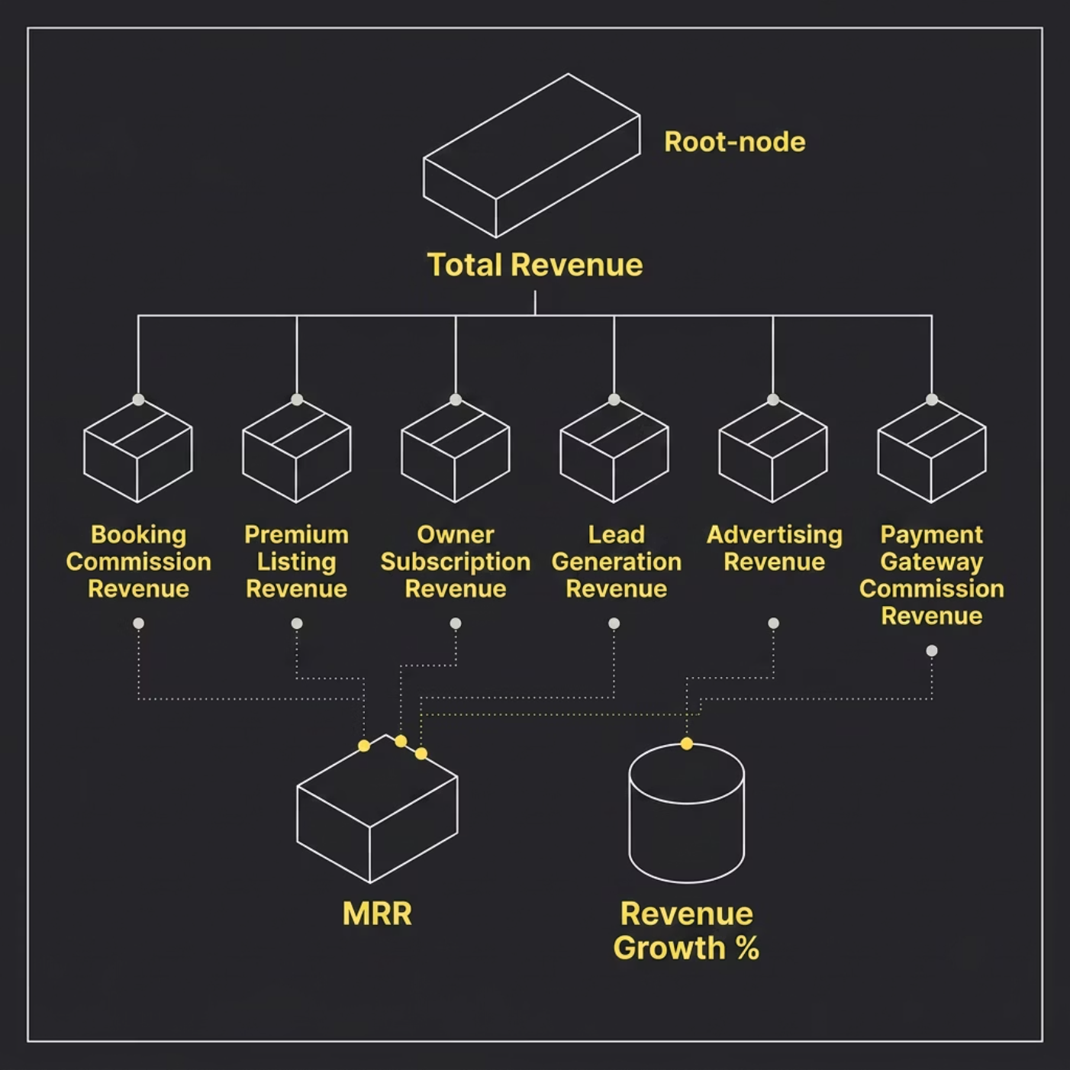
REVENUE
Revenue KPI Tree
Objective: Increase recurring and scalable revenue across all monetization channels.
Key KPIs
Total Revenue — All streams combined
Revenue Growth % — Month-over-month trajectory
Revenue Per Booking — Average yield per transaction
Revenue Per Hostel — Supply-side productivity
MRR — Monthly Recurring Revenue baseline

Slide 5

CONVERSION
Student Funnel KPI Tree
Objective: Optimize booking conversion at every stage — from first visit to confirmed payment.
Visitors
Bookings
Registrations
Each stage has a measurable conversion rate — Visitor to Registration (Signup Rate), Registration to Search (Activation Rate), Search to View (Engagement Rate), View to Inquiry (Interest Rate), Inquiry to Booking (Conversion Rate), Booking to Payment (Payment Success Rate) — enabling teams to identify and fix drop-off points.

Slide 6
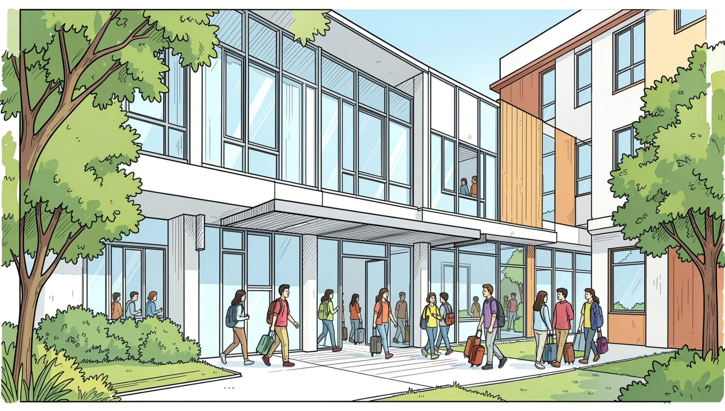
SUPPLY
Hostel KPI Tree
Objective: Increase hostel inventory, quality, and occupancy across the platform.
Hostel Growth
Total, Verified, and Active Hostels
Occupied Beds and Vacancy Rate
Average Hostel Rating
Key KPIs
Occupancy Rate — Beds filled vs. total capacity
Vacancy Rate — Unfilled inventory signal
Active Listings — Live, bookable inventory
Average Rating — Quality and trust indicator

Slide 7
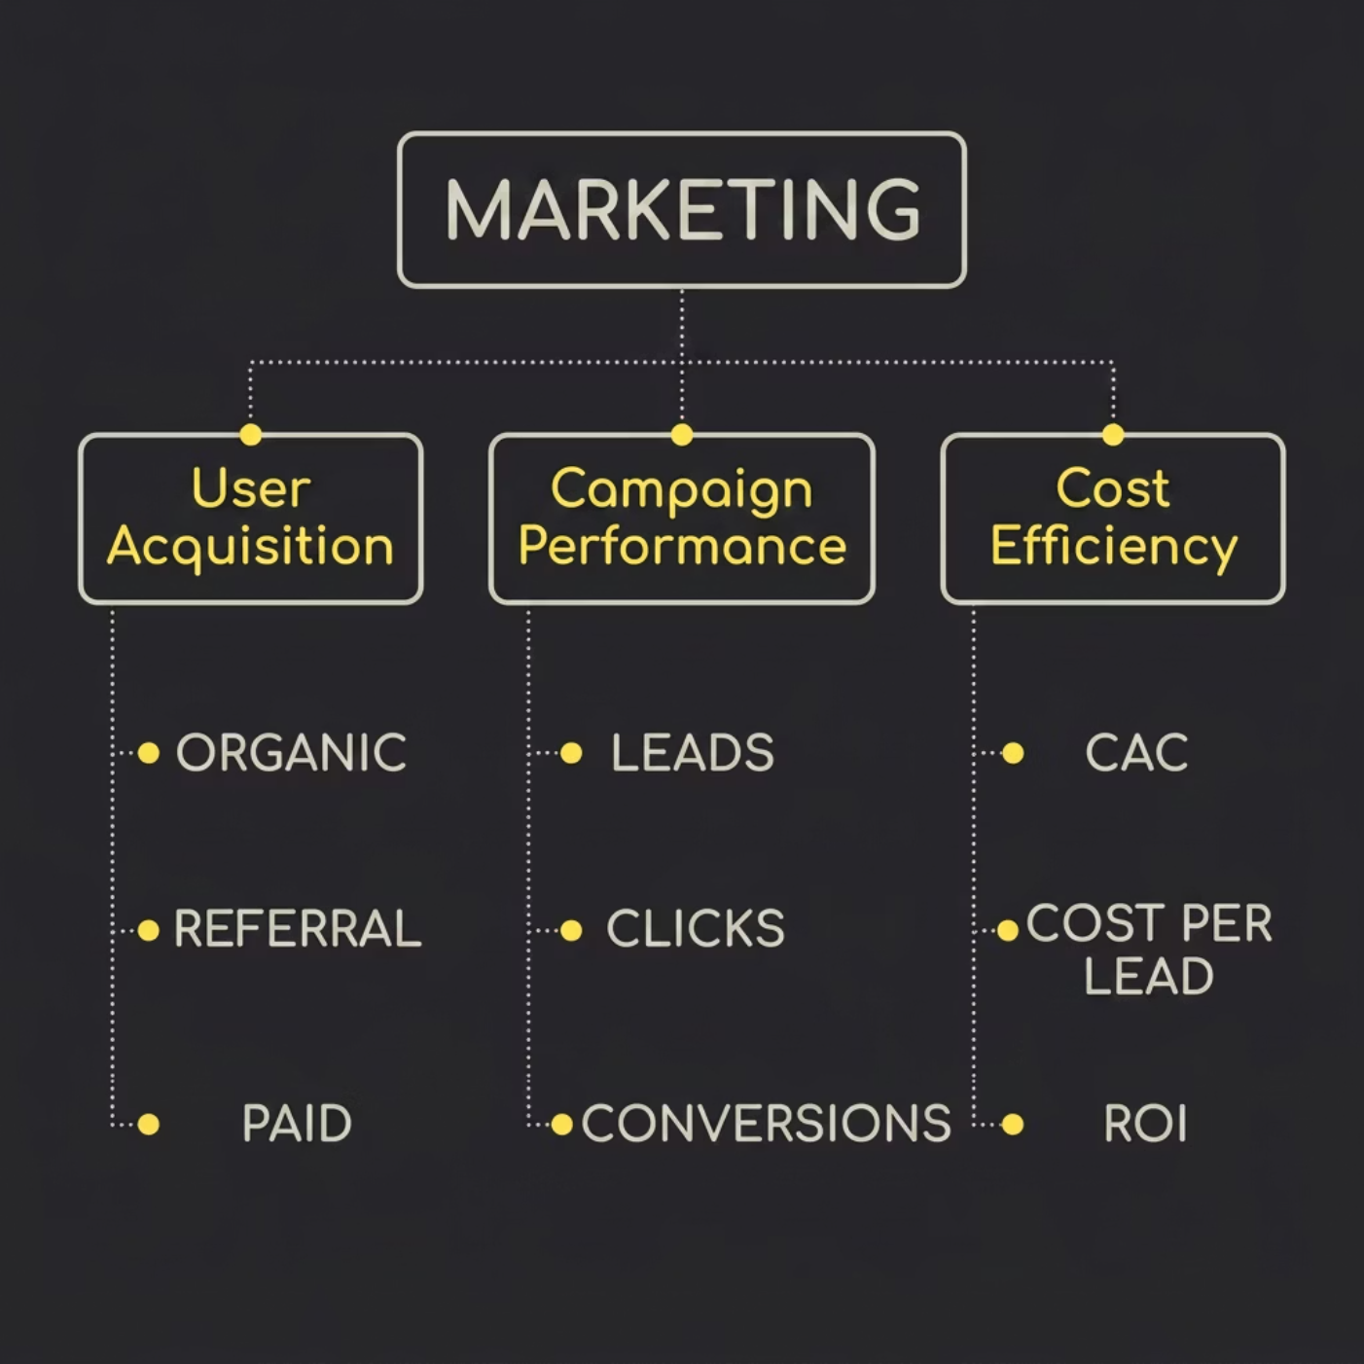
MARKETING
Marketing KPI Tree
Objective: Acquire students efficiently — balancing cost, volume, and quality of acquisition channels.
Key KPIs
CAC — Customer Acquisition Cost
Cost Per Lead — Efficiency of lead generation
Campaign ROI — Return on marketing spend
Referral Share % — Organic growth contribution

Slide 8
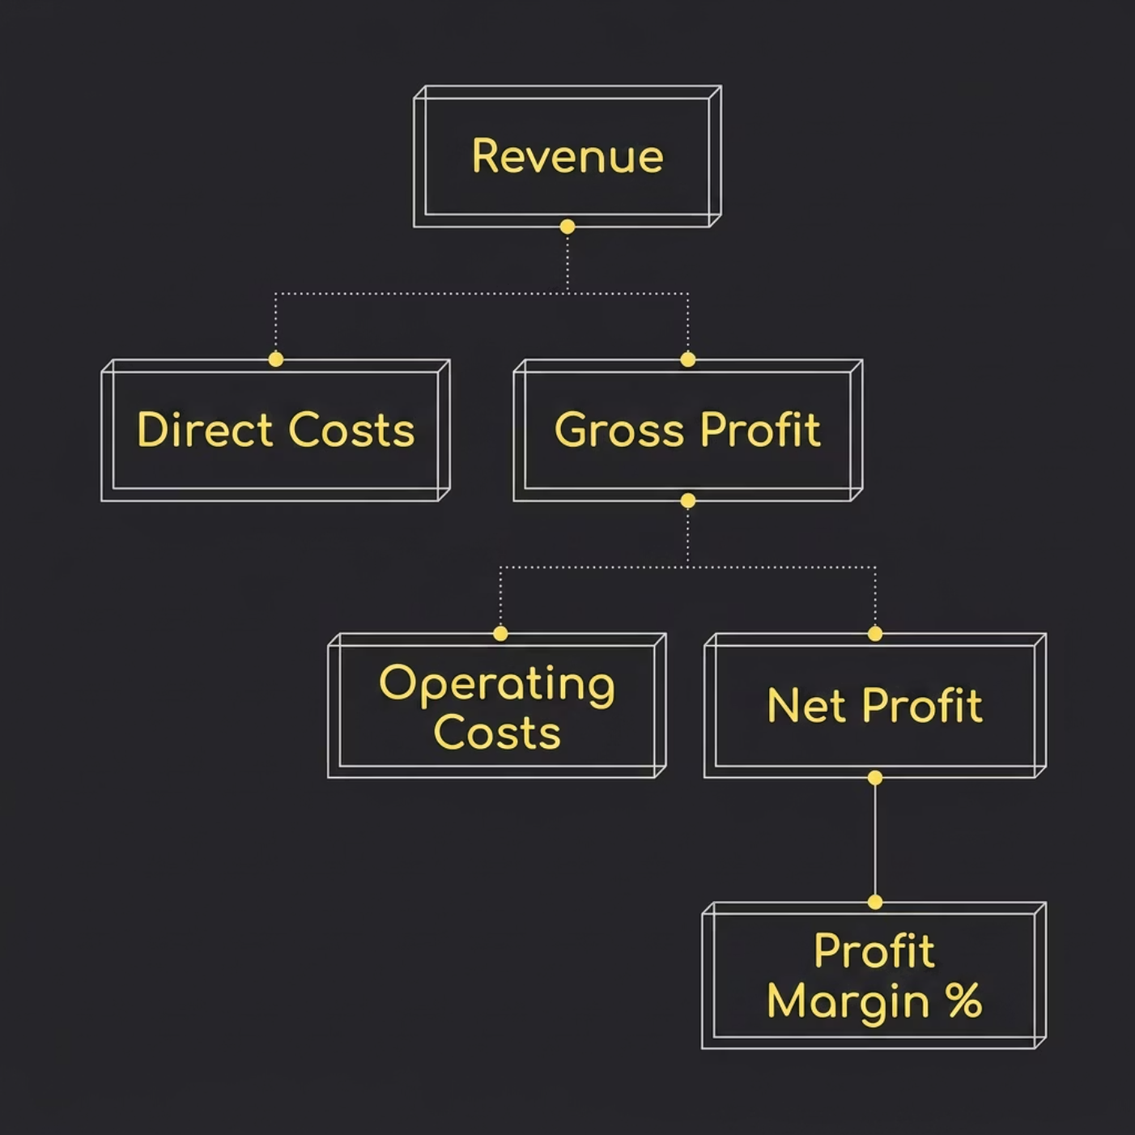
PROFITABILITY
Profitability KPI Tree
Objective: Build a profitable, scalable business model — tracking every dollar from revenue to net margin.
Key KPIs
Gross Profit — Revenue minus direct costs
Net Profit — After all operating expenses
Gross Margin % — Efficiency of core operations
Net Margin % — Overall business profitability
Break-even Point — Revenue threshold for profitability

Slide 9

OWNER SUCCESS
Owner Success KPI Tree
Objective: Improve hostel owner retention and satisfaction — because a thriving supply side drives platform growth.
Owner Journey KPIs
Hostels Onboarded — New supply added
Active Listings — Live, bookable inventory
Student Leads — Inquiries per hostel
Bookings — Confirmed reservations
Revenue Generated — Owner earnings via platform
Owner Satisfaction — Retention and NPS signal

Slide 10

EXPANSION & STRATEGY
Expansion KPIs & Strategic Alignment
Expansion KPIs
Strategic Goal → KPI Alignment
Objective: Expand across Kerala and later India.
Strategic Goal
Primary KPI
District Coverage — Geographic reach
Market Penetration — Share of student population
New District Launches — Active expansion velocity
Expansion Score — Composite demand vs. competition metric
Increase Students
Registrations, MAU
Increase Bookings
Booking Conversion
Increase Revenue
Revenue Growth %
Improve Profitability
Net Profit Margin
Increase Occupancy
Occupancy Rate
Expand Market
District Coverage
Improve Retention
Referral & Retention Rate
Core Success Formula: More Students → More Bookings → More Revenue → Higher Profitability → Faster Expansion

