Slide 1


JACANT
Name:Jane

Slide 2
Team Introduction
01
CONTENTS
02
Project progress
03
Problem elaboration & solution
04
Project outlook
.

Slide 3
1.
Team
Introduction
Next→

Slide 4
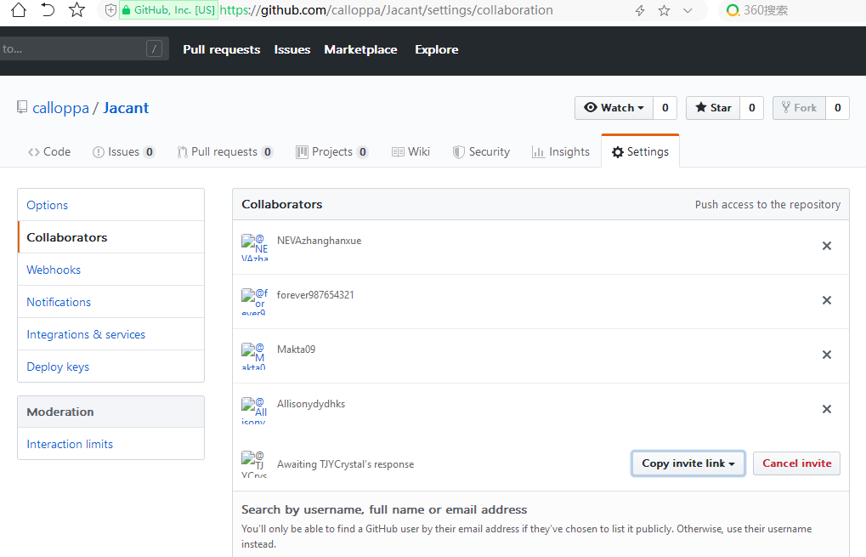
Team Introduction
We formed a team on Github with six members:
Tiffany-collopa (Leader)
Neva-NEVAzhanghanxue
Jane-forever987654321
Ashlee-Makta09
Alison-Allisonydydhks
Crystal-TJYCrystal's respons

Slide 5
2.
Project
progress
Next→

Slide 6
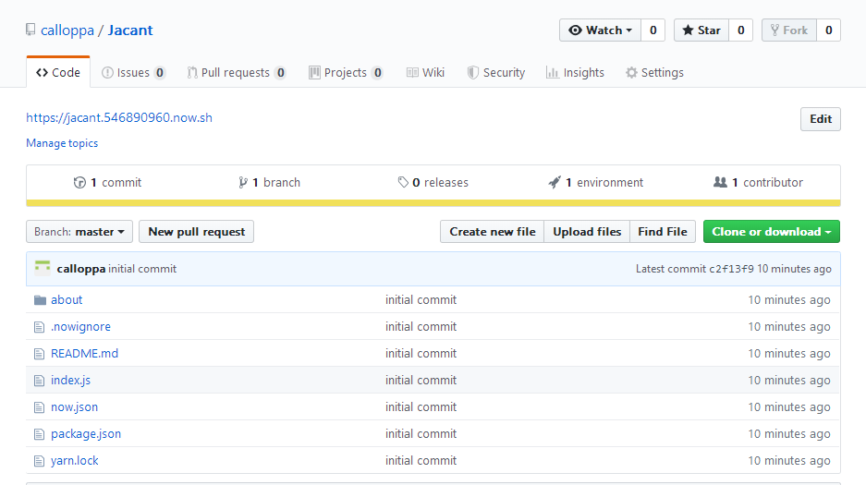
Project progress
Setting up a server

Slide 7
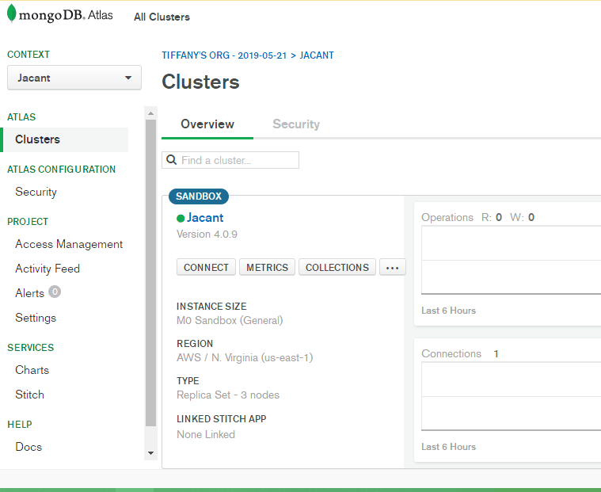
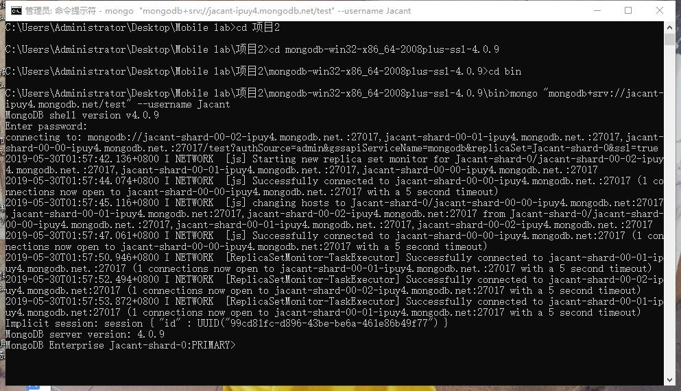
Project progress
Successful database connection

Slide 8
3.
Problem elaboration
&solution
Next→

Slide 9

Problem elaboration&solution
There is no problem with the technology for the time being, and it is difficult to understand part of the theory content. We haven't fully understood the theory, so we haven't figured out how to implement some functions this week.

Slide 10
4.
Project
outlook
Next→

Slide 11
Project outlook
This week, the focus is on the preliminary work. We plan to finish it within the next week. Next week, we will mainly ask everyone to write part of the code.We're going to make it possible for our app to retrieve information and publish information.

Slide 12
Thank You
To be continued....

