Slide 1
Gym Management Web App

Slide 2
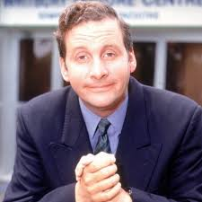
Gordon Brittas
Behaviours
Replace this with your image or drawing after you print
Leisure Centre/
Gym Manager
Very work-driven, little time for niceties
Mobile, takes briefcase everywhere
Keen on micro-management
Demographic information
Needs and goals
Mid-forties
Married, no children
Lives in Hampshire, England
Busy lifestyle
Requires a reliable and easy to use website/interface to manage gym members and classes
Would like to see up to date information
Needs to update member or class info, and add/delete as required
Ideally would like to view gym/class capacity too

Slide 3
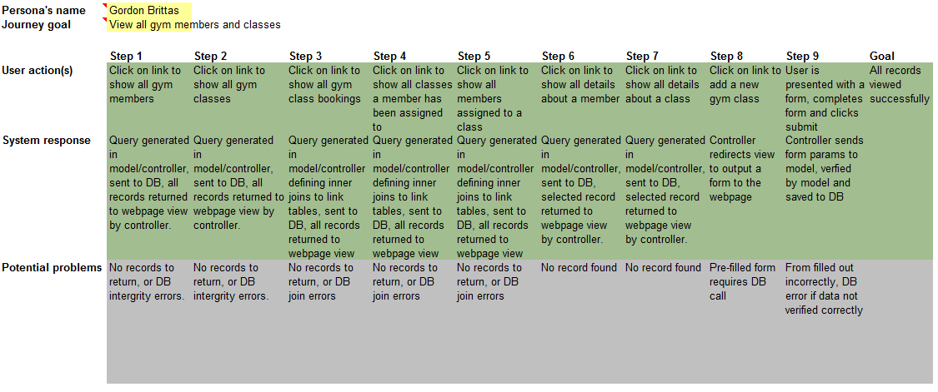
User Journeys – View Records

Slide 4
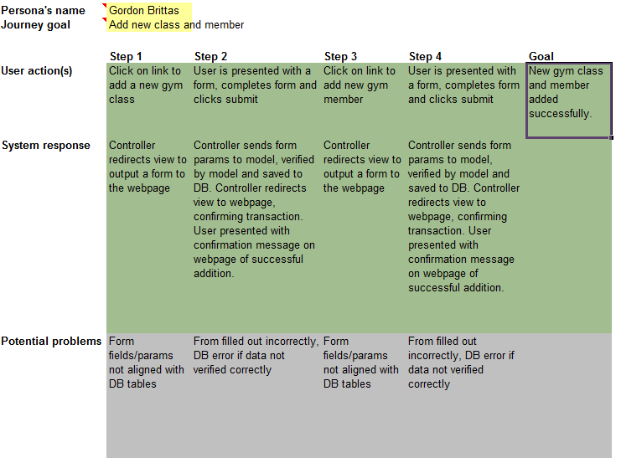
User Journeys – New Class/Member

Slide 5
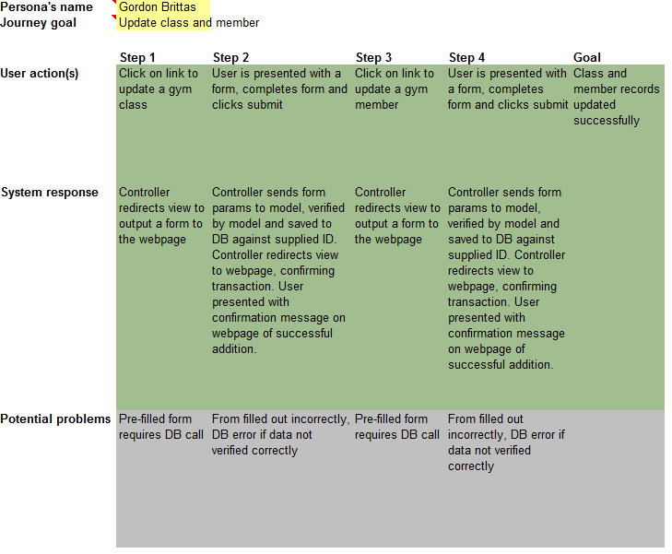
User Journeys – Update Class/Member

Slide 6
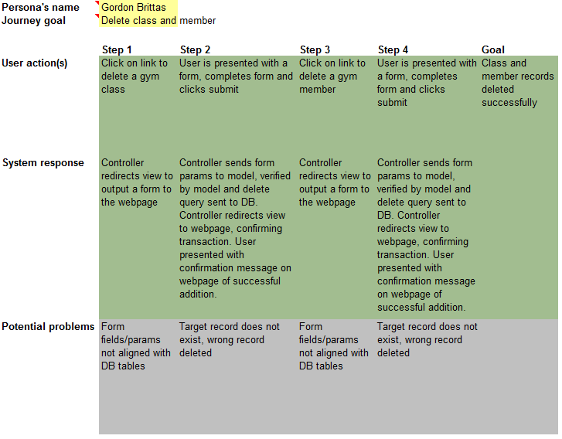
User Journeys – Delete Class/Member

Slide 7
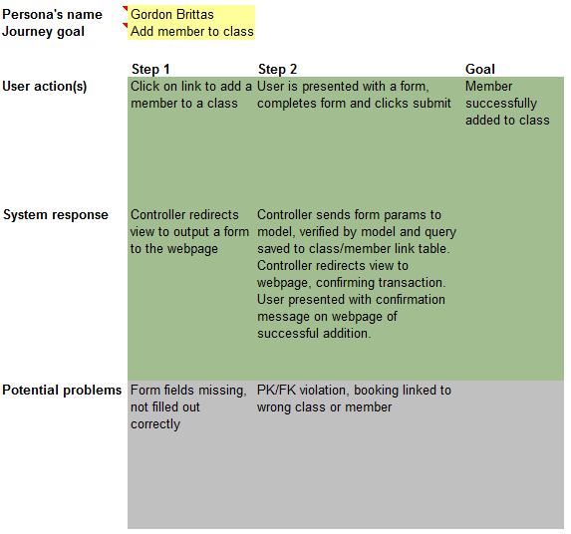
User Journeys – Add Member To Class

Slide 8
User Journeys – Remove Member From Class

Slide 9
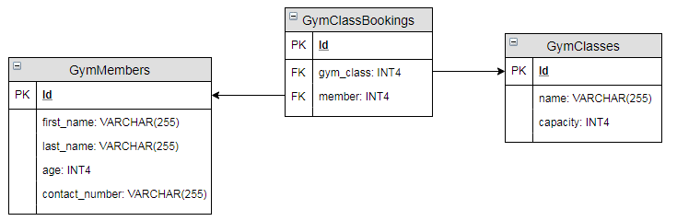
Database Table Relationships
Initial Model

Slide 10
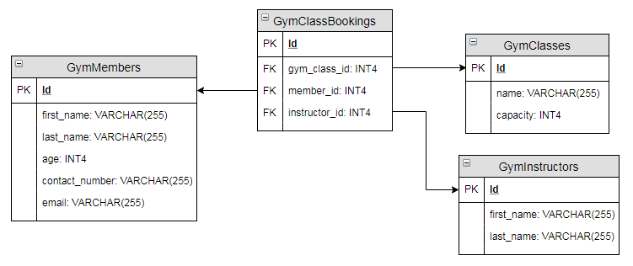
Database Table Relationships
Revised/Final Model

Slide 11
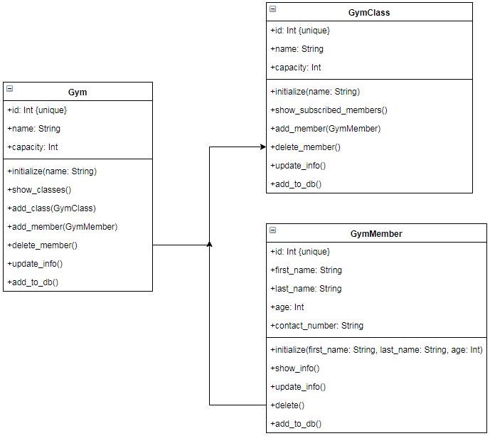
App Model - Class
Initial Model

Slide 12
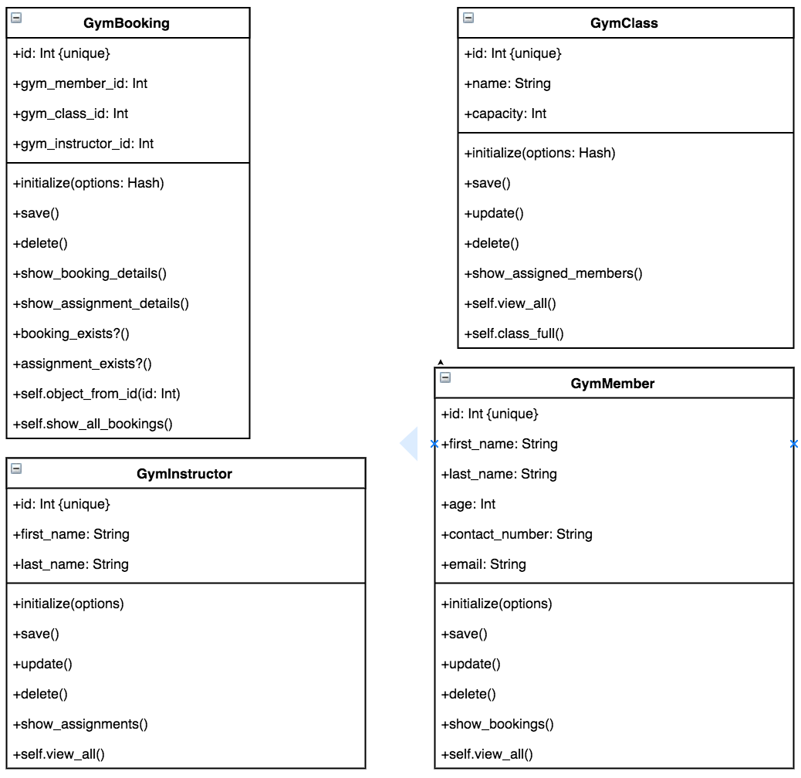
App Model - Class
Revised/Final Model

Slide 14

Regrets…
…I’ve had a few.

Slide 15
Questions?

