Slide 1
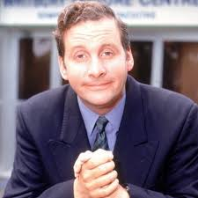
Replace this with your image or drawing after you print
Gordon Brittas
Behaviours
Leisure Centre/Gym Manager
Very work-driven, little time for niceties
Mobile, takes briefcase everywhere
Keen on micro-management
Demographic information
Needs and goals
Mid-forties
Married, no children
Lives in Hampshire, England
Busy lifestyle
Requires a reliable and easy to use website/interface to manage gym members and classes
Would like to see up to date information
Needs to update member or class info, and add/delete as required
Ideally would like to view gym/class capacity too
Notes:
When naming your proto-persona, keep it real. The goal is to empathise with them, and if their name is Bilbo Baggins it’s rather hard.
Remember to download only non-watermarked, free-to-use photographs. Use Creative Commons search in Google or Flickr to find such photos. Make these appear and feel 'real'.
When establishing basic characteristics, keep it short and simple. Who are they?
Demographic information should be relevant to the project. Think of all aspects that might affect how people interact with your product. Think of the following first:
Where do they work/what they do?
What’s their relationship status? Do they have children?
How much do they earn — and is this relevant?
What’s their level of familiarity with digital technologies?
Add your own.
Behaviours are simply things that they do. Keep it relevant to the project.
Needs and goals — this is what they want from the product and your organisation.

