Slide 1
Cellular Automata Accelerator in RISC-V Processor
Callum Stew
3rd Year Project

Slide 2
Presentation Structure
Background on Cellular Automata
Background on FPGAs, Verilog and RISC-V
Project Management
Hardware Implementation
Software Driver and Implementation
Results
Conclusion

Slide 3
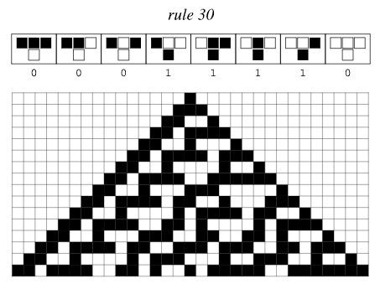
Cellular Automata
Grid of cells in one or more dimensions with multiple states
Simple rules dictate how a cells state changes on each iteration
First used by Von Neumann in his Universal Constructor from 1966
Wolfram extensively studied "elementary cellular automata“
Conway's Game of Life (CGOL)
Biham-Middleton-Levine Traffic Model_{[1]}
Disease Spreading Process_{[1]}
Forest fire modelling to find fire-fighting strategy effectiveness_{[2]}
Images from: mathworld.wolfram.com/CellularAutomaton.html
Notes:
Grid of cells in one or more dimensions
Multiple states
Simple rules dictate how states change
Used von neumann in 1966 (universal constructor 29 state)
Elementary cellular automata
Binary, one dimension, nearest neighbour
256 possible rules
binary, 2-dimensional, Moore Neighbourhood
Uses average - totalistic cellular automaton
Sum less than 2 or greater then 3 the cell is set to a state of 0
Sum exactly 3 the cell is set to 1
Traffic modelling Rule 184, BML Model
Disease spread
Forest fire model to simulate fire-fighting strategies

Slide 4
Cellular Automata Acceleration
Each cell can independently calculate its next state
Inherently parallel process to calculate next step
Excellent opportunity to exploit this using a hardware accelerator
Greatly decreases time to compute large simulations allowing for faster development and testing of different situations
Aim: Implement a hardware accelerator into a processor for basic cellular automata
Notes:
Independently calculate next state
Inherent parallelism
Exploited using hardware
Greatly decrease computation time
Aim: implement accelerator

Slide 5
FPGAs and Verilog
An FPGA (Field Programmable Gate Array) is a semiconductor device based around a matrix of configurable logic blocks_{[3]}
The structure and configuration of these logic blocks are defined through register-transfer level (RTL) code to form any combinatorial or sequential logic
Hardware Description Languages (HDL) such as Verilog are used to program the FPGA
Allows for hardware to be developed and iterated on rapidly
The Vivado software by Xilinx was used for this project
Nexys A7-100T FPGA used for this project
Block Design
HDL Code
Behavioural Simulation
Synthesis
Functional Verification
Implementation
Bitstream
In Circuit Verification
Notes:
Matrix of configuralble logic blocks
Restructured and configured with RTL code
Form any combinatorial or sequential logic
HDL Verilog
Rapid development
Nexys A7-100T board and Vivado
Development flow

Slide 6
RISC-V
Open standard Instruction Set Architecture
Can be freely implemented by anyone allowing for wide adoption and modification
Rocket Chip is an open-source System-on-Chip design generator that can produce synthesisable RTL
Open-source project ‘vivado-risk-v’ used to generate a Rocket Core for the FPGA development board used
A 64-bit single core processor was generated for this project due to the resource constraints of the FPGA used.
AXI4 is an interface specification made by ARM
Commonly used to connect custom hardware to the processor by making it available through virtual memory addresses
Three types of interface: AXI4, AXI4-Lite, AXI4-Stream
Notes:
Open-source Instruction Set
Implemented by anyone leading to wide adoption
Rocket chip gens synthesisable RTL
Vivado-risk-v uses rocket chip to generate core for the FPGA board used
64-bit single core
AXI4 interface standard ARM
Very commonly used
Vertial memory address
Three types

Slide 7
Project Management
Incremental development methodology using the inherent hierarchical design of the system
Test driven development
GitHub used for version control
Kanban board used for tracking progress
Weekly meetings with project supervisor to discuss progress
Issues with the initial project idea was found as the Linux implementation for this project had functionality issues so bare metal code was used as an alternative
Roughly followed the updated timeline from the progress report
Notes:
Project followed a hierarchical design
Incremental development
Test driven dev
Github and kanban
Weekly meetings
Linux issues, bare metal
Roughly flowed update timeline in progress report

Slide 8
Implementation – Block Design
Hierarchy of modules
AXI Register -> Board -> Cell
Plan interfaces between modules
AXI registers
Board control signals
Cell control signals
Individual testing ensures that hard hardware is fully functional before build off from it.
AXI Lite Register
AXI Lite Interface
Registers 0-65
Board
Cell 1 State
Cell
Cell
Cell
Cell
Cell
Board State Register
Cell 2 State
Cell
Cell
Cell
Cell
Cell
Cell 3 State
Cell 4 State
Cell
Cell
Cell
Cell
Cell
Cell 5 State
…
Cell
Cell
Cell
Cell
Cell
Cell
Cell
Cell
Cell
Cell
Cell
Cell
Cell
Cell
Cell
Notes:
Conways game of life choses and rule set
Block design of overall project
Hierarchy
Plan interfaces/connections
Individual module testing

Slide 9
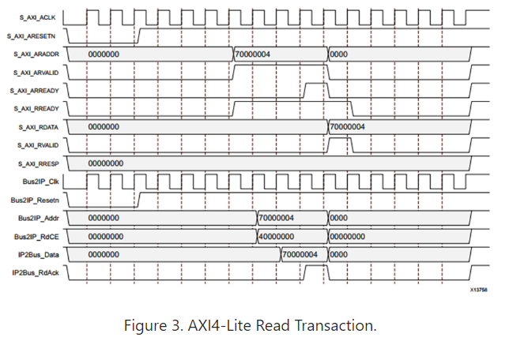
Implementation – AXI
AXI Lite standard used to interface with processor
Up to 512 32-bit wide registers
Does not support burst transfers
Xilinx AXI Lite IP generator used to create the interface RTL
Four Interactions need:
Set initial state
Read board state
Send control signals
Read if board has finished generating
Flag needed when a value is set to the initial state or control registers
Image from: www.realdigital.org/doc/a9fee931f7a172423e1ba73f66ca4081
Notes:
AXI Lite was used
Did not need greater then 32-bit registers or burst transfers
Xilinx generator used
Accelerator needed 4 interactions
Set initial state
Read state
Control signals
Check if finished
Modified to flag when a specific reg is set.

Slide 10
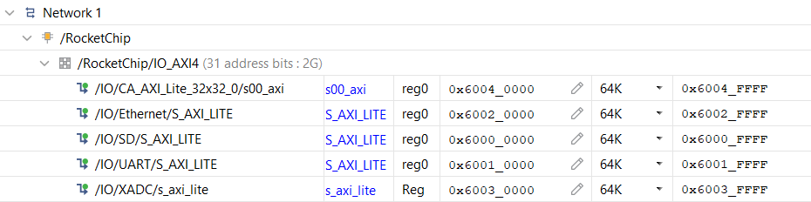
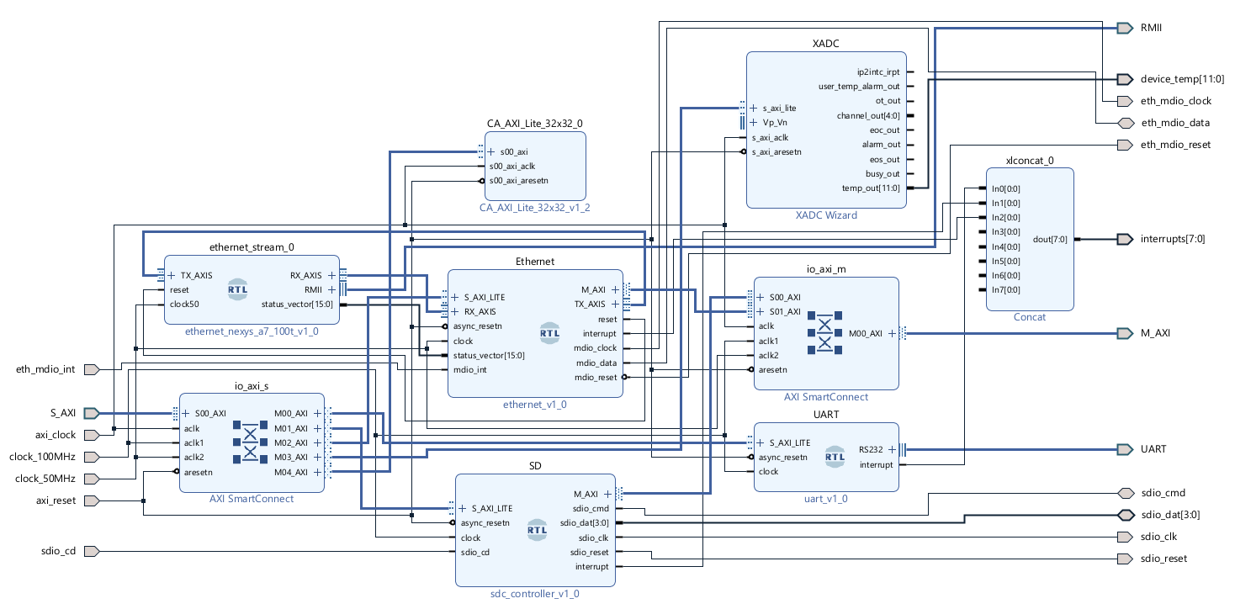
Integration into RISC-V Processor
Notes:
Connect the AXI interface clock and reset line
Assign the base address

Slide 11
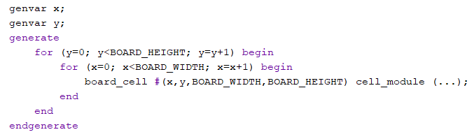
Implementation – Board
AXI Lite Register
Interfaces with the registers set by the AXI interface
Holds a register storing the state of every cell in the board
Uses ‘generate’ block to instantiate the cell module
Translates the command register to control signals
Reset board
Set new state
Iterate n times
Asserts response register
O(1)
AXI Lite Interface
Registers 0-65
Board
Cell 1 State
Cell
Cell
Cell
Cell
Cell
Board State Register
Cell 2 State
Cell
Cell
Cell
Cell
Cell
Cell 3 State
Cell 4 State
Cell
Cell
Cell
Cell
Cell
Cell 5 State
…
Cell
Cell
Cell
Cell
Cell
Cell
Cell
Cell
Cell
Cell
Cell
Cell
Cell
Cell
Cell
Notes:
Interfaces with axi registers
Holds a reg for the board state, every cell can be simultaneously modified
Dynamically instantiates cell modules and assigns their x and y param
Runs command read from axi and set response reg

Slide 12

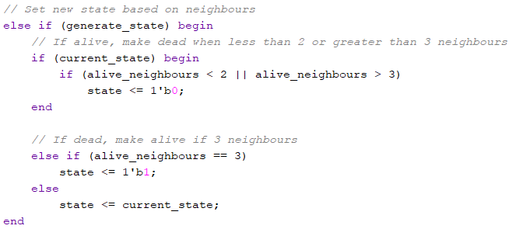
Implementation – Cell – CGOL
Pre-calculate neighbour indexes with ‘localparam’
Retrieves the state from the board state register at calculated index
Sums number of alive neighbours
Sets next state of the cell
Notes:
Localparams calculated at compile time to find neigboure indexes using the parameters X and Y
Every cell can view full board state and set its own cell state
Sets next state following rules

Slide 13
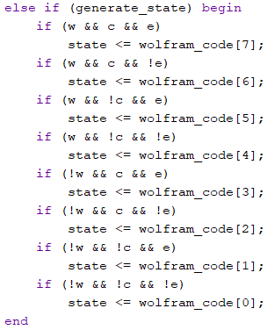
Implementation – Wolfram Code
Additional AXI Lite register used to hold the 8-bit Wolfram code
Board is generated using only 1 dimension
Cell calculates left and right neighbour indexes
Checks which 3-bit pattern is matched
Sets state to relevant bit from Wolfram code

Slide 14
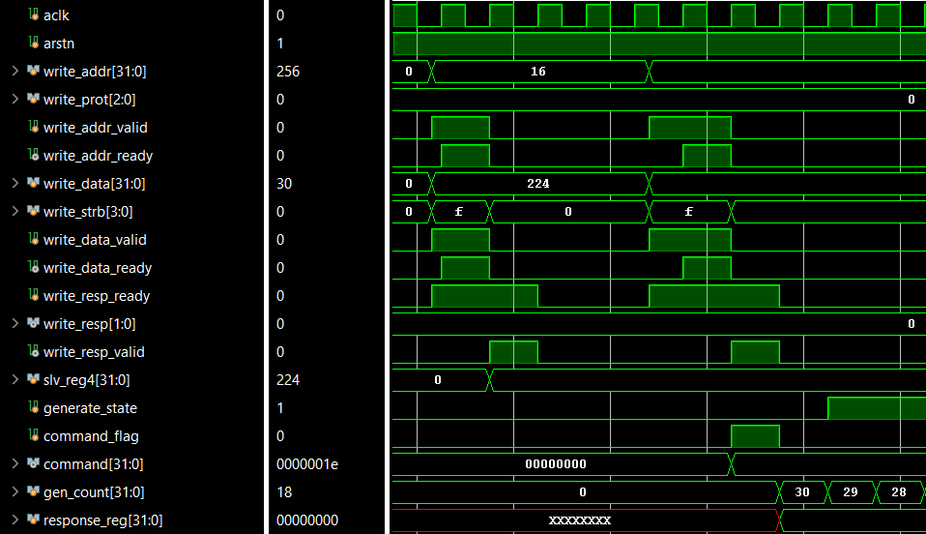
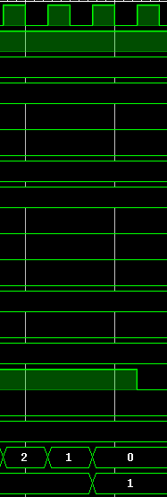
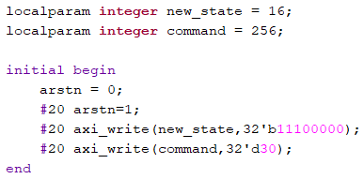
Testing
Testbench simulates the AXI Write signals
Sets the State of register 4
Sends command to generate 30 iterations
Notes:
All modules tested using testbench before being implemented on FPGA
Example shows seting a cell state and running 30 iterations

Slide 15
Bare-metal Driver
AXI Interface
Struct with 32-bit ints defined at the AXI base address for the accelerator
Each int points to the relevant address of the AXI Lite register
This can be used to set the initial state, read state and send control signals
Accelerator Test
Get a time stamp by reading the machine cycle counter register
Send the number of iterations to complete to the accelerator
Busy wait on the response register getting set
Get finish time stamp
#define AXI_BASEADDRESS 0x6004000
#define NUM_ITER 10
typedef struct reg {
volatile uint32_t reg_1;
volatile uint32_t reg_2;
} REG;
REG * reg = (REG *)AXI_BASEADDRESS
int done = 0;
uintptr_t time_start;
uintptr_t time_end;
asm volatile ("csrr %0, 0xB00" : "=r" (time_start));
reg->control = 15;
while(!done) {
if (reg->response) {
asm volatile ("csrr %0, 0xB00" : "=r" (time_end));
done = 1;
}
}
Notes:
Bare metal c code run on processor
Interfcaes with the axi virtual memory address by creating a struct pointer at the base address
Use struct variables to interact with accelerator in this case setting it to iterate 15 times and waiting for the response reg to be set
To time how long it took the risk-v machine cycle counter is read using an assembly command

Slide 16
Bare-metal Software Implementation
Calculate Sum of Neighbours
It first iterates over the board to find the number of alive neighbours for each cell
Checks that the indexes are valid
Writes sum to a different array
Write new state
Iterate over the board again assigning the new states
O(2n²)
int nvalid = (y-1)>=0;
int evalid = (x+1)<32;
int svalid = (y+1)<32;
int wvalid = (x-1)>=0;
int n = nvalid ? board[y-1][x] : 0;
int e = evalid ? board[y][x+1] : 0;
int s = svalid ? board[y+1][x] : 0;
int w = wvalid ? board[y][x-1] : 0;
int ne = nvalid && evalid ? board[y-1][x+1] : 0;
int nw = nvalid && wvalid ? board[y-1][x-1] : 0;
int se = svalid && evalid ? board[y+1][x+1] : 0;
int sw = svalid && wvalid ? board[y+1][x-1] : 0;
board_counts[y][x] = n+e+s+w+ne+nw+se+sw;
if (board[y][x]) { // Alive
if (board_counts[y][x] < 2 || board_counts[y][x] > 3) { board[y][x] = 0 }
} else { // Dead
if (board_counts[y][x] == 3) { board[y][x] = 1 }
}
Notes:
Written to different array as if it directly changes the cell it will cause future cells to be calculated incorrectly
Could be made more efficient by writing new state to a different bard then swapping the pointers in the variables holding the boards removing the need for the second full iteration of the board.

Slide 17
Results
1 Iteration
Accel: 158 clock cycles
Soft: 325426 clock cycles
20 Iterations
Accel: 158 clock cycles
Soft: 6452393 clock cycles
1000 Iterations
Accel: 1093 clock cycles
Soft: 322508521 clock cycles
Notes:
1, 20 and 1000 iterations
Logaritghimc scale used due to exponential decrease in time
1 and 20 iterations to same number of clock cycles as the bottle neck in the system is axi read time
About 26 iterations in one axi read
Could increase the clock speed of accelerator to allow for more iterations

Slide 18
Results - Synthesis
Notes:
Wolfram code also implemented
Individual cells took same amount of resources
Board of 1024 cells had wolfram codes using less resources
Possible due to less neighbours allowing for optimisation of lut usage
Chart shows resources used overall of accelerator and processor

Slide 19
Conclusion
Completed the aim of this project by creating a functional accelerator providing significant decrease in calculation time.
Using an AXI register connected directly to the processor it is relatively simple to the connect custom hardware allowing for easy adaption to any new cellular automata rule set.
Maximum size of board is limited by FPGA resources
Future Work
Implement a more complicated rule set such as those described at the start
Modify the Linux device tree and create a driver to allow use of the accelerator in Linux
Use direct memory access to allow the accelerator to directly read and write a board state to memory allowing for larger boards to be split into sections which can be loaded into the accelerator without needed into do it manually in code.
Notes:
Completed all Specified functionality
Worked Significantly faster than a software implementation
Relatively simple to couple an accelerator to a risk-v processor using the AXI bus
Maximum size limited by FPGA resources
Future work
More complicated CA rule sets
Linux driver

Slide 20
Demo and Questions

Slide 21
References
[1] – Li, X., Wu, J., Li, X. (2018). The Application Fields of Cellular Automata. In: Theory of Practical Cellular Automaton. Springer, Singapore. https://doi.org/10.1007/978-981-10-7497-4_8
[2] – K. Mutthulakshmi, Megan Rui En Wee, Yew Chong Kester Wong, Joel Weijia Lai, Jin Ming Koh, U. Rajendra Acharya, Kang Hao Cheong, Simulating forest fire spread and fire-fighting using cellular automata, Chinese Journal of Physics, Volume 65, 2020, Pages 642-650, ISSN 0577-9073, https://doi.org/10.1016/j.cjph.2020.04.001
[3] – Xilinx, AMD. What is an fpga?, https://xilinx.com/products/silicon-devices/fpga/what-is-an-fpga.html

