Slide 1
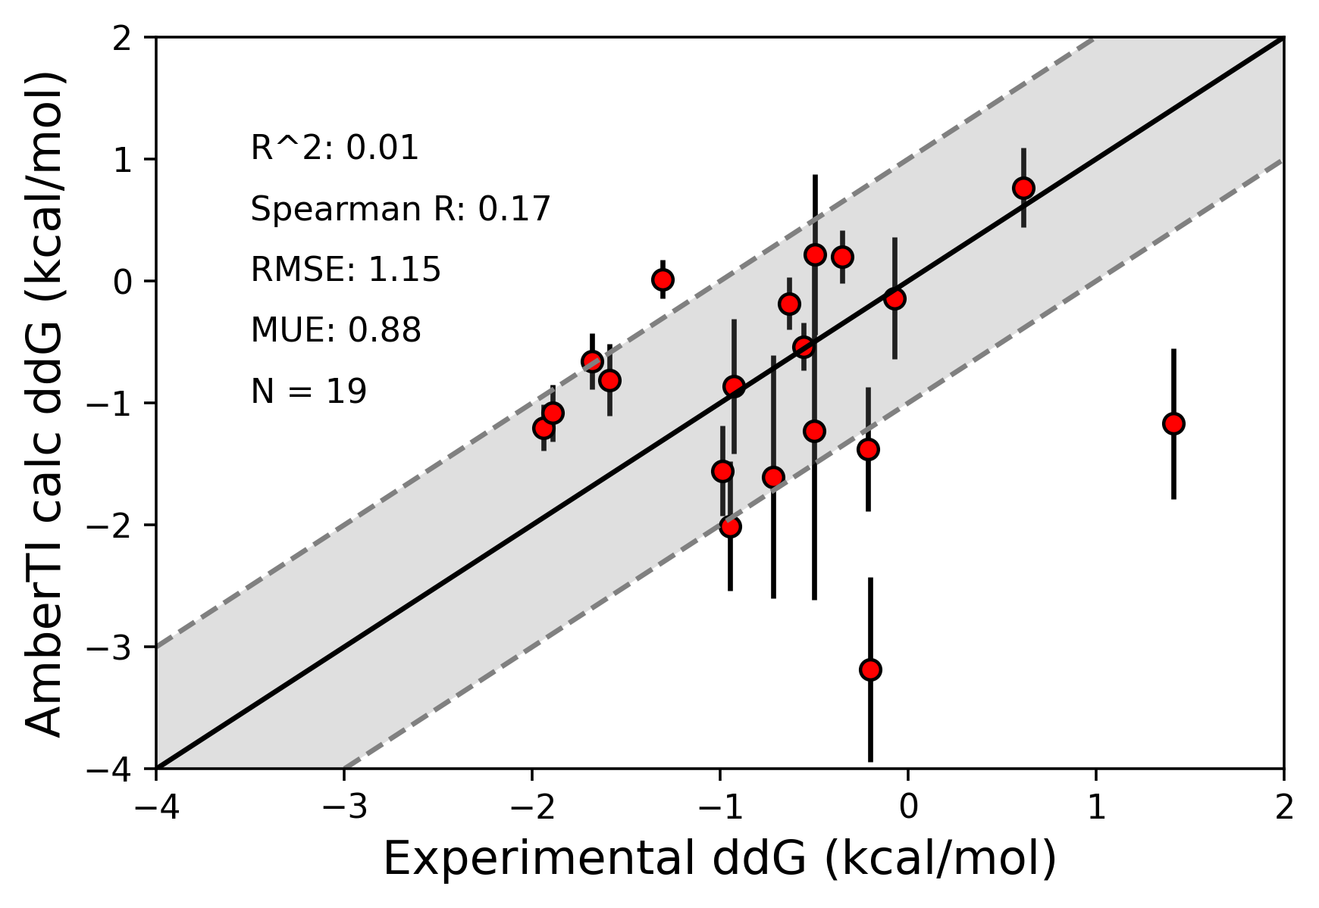
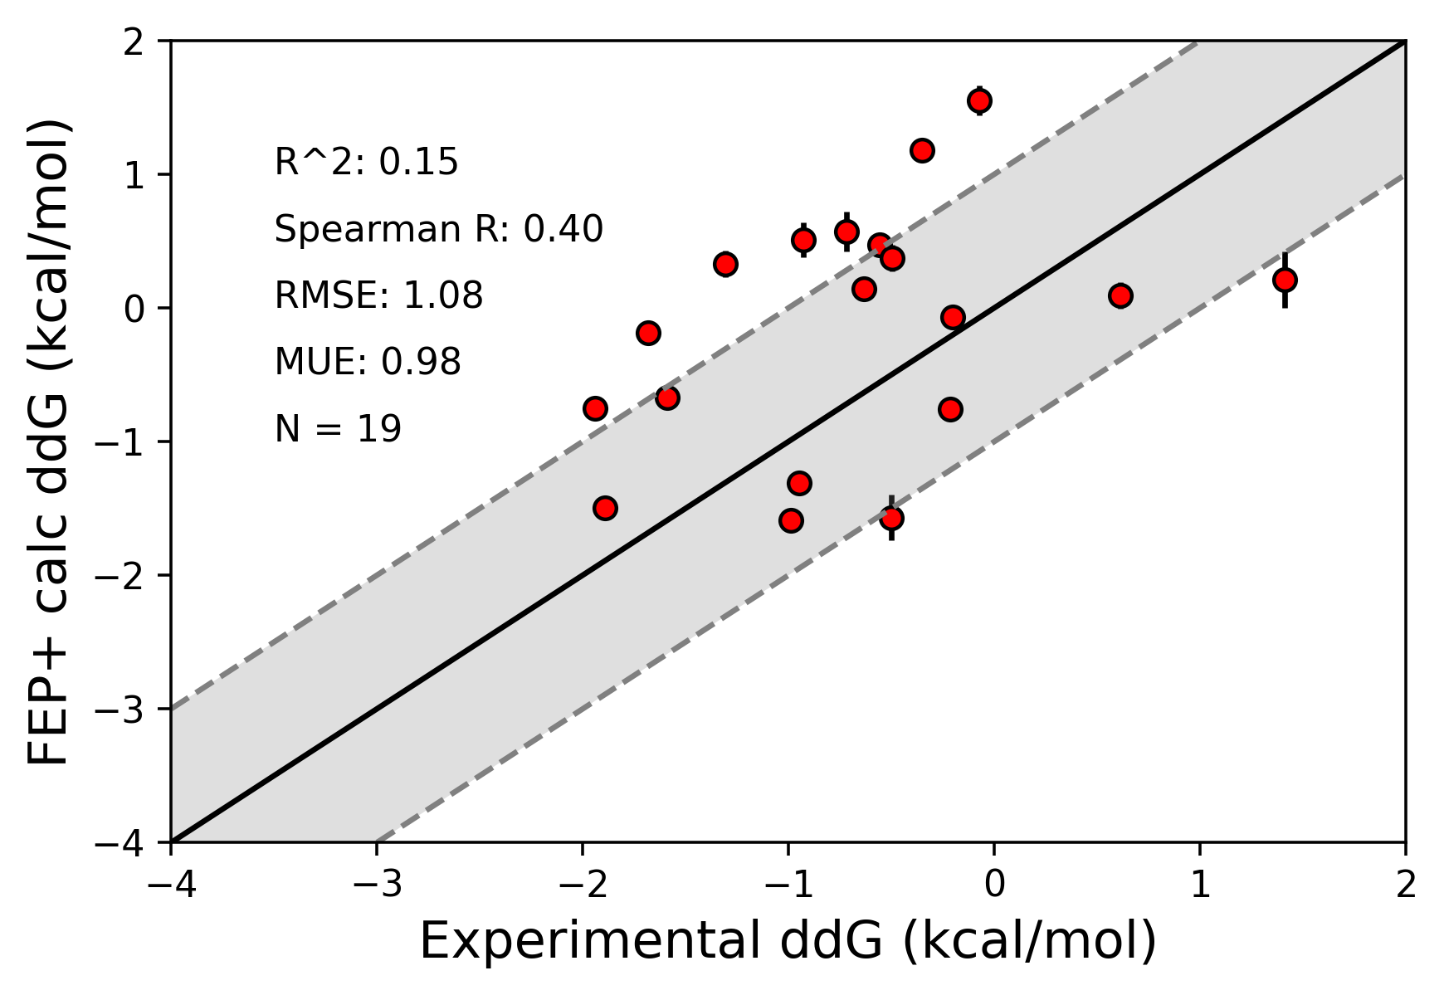
A
B
AmberTI calc ΔΔG (kcal/mol)
FEP+ calc ΔΔG (kcal/mol)
240
195
experimental ΔΔG (kcal/mol)
experimental ΔΔG (kcal/mol)

Slide 2
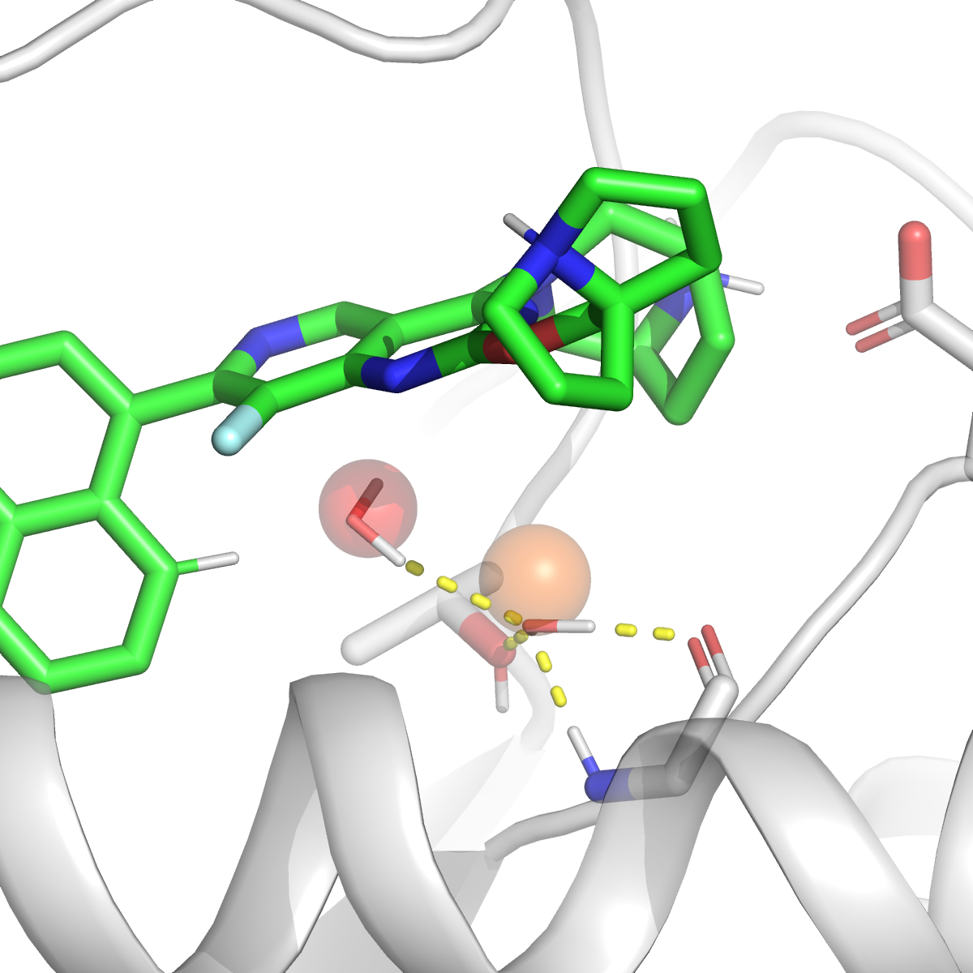
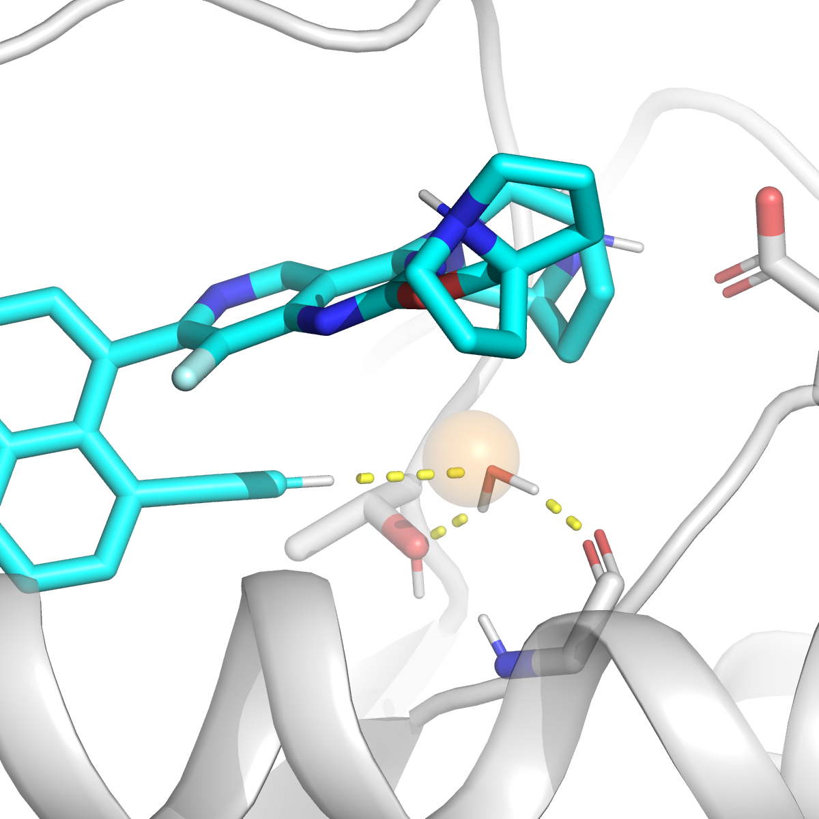
A
B
D12
D12
W2
W1
W1
T58
G10
T58
G10

Slide 3
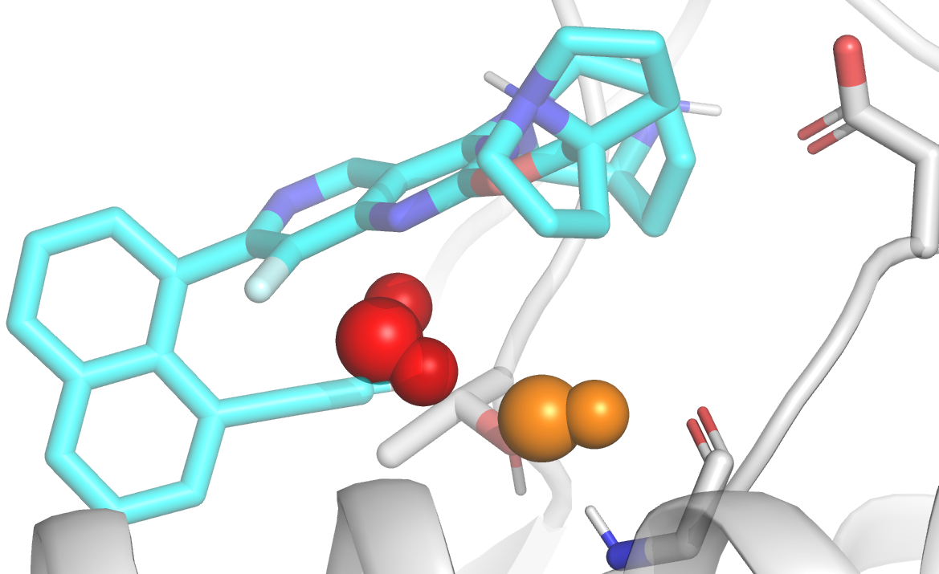
Disruption of water network:
ΔG water sites?
Potency ranking of chemical series?

Slide 4
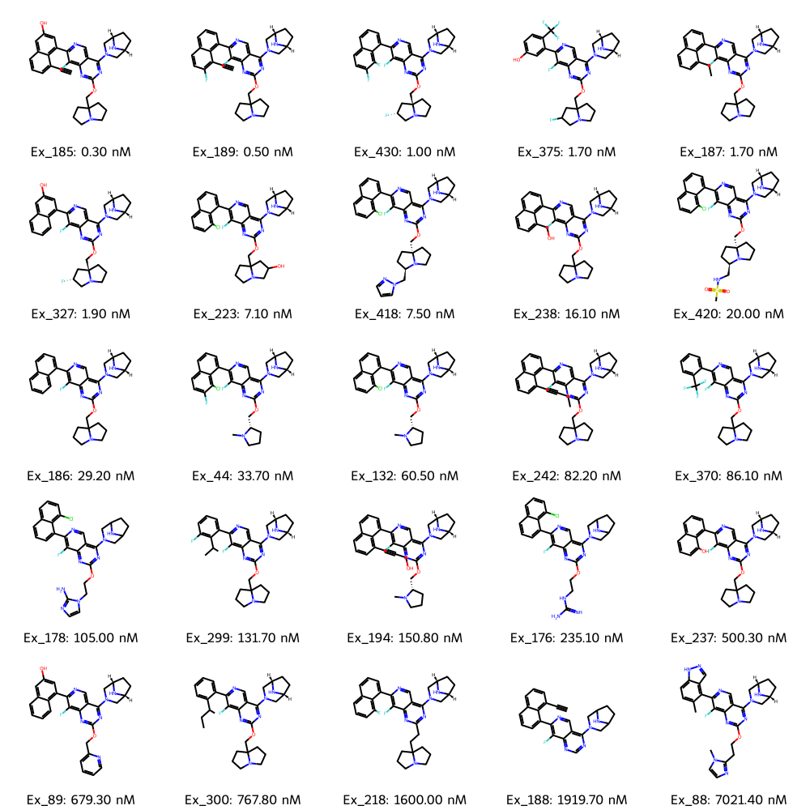
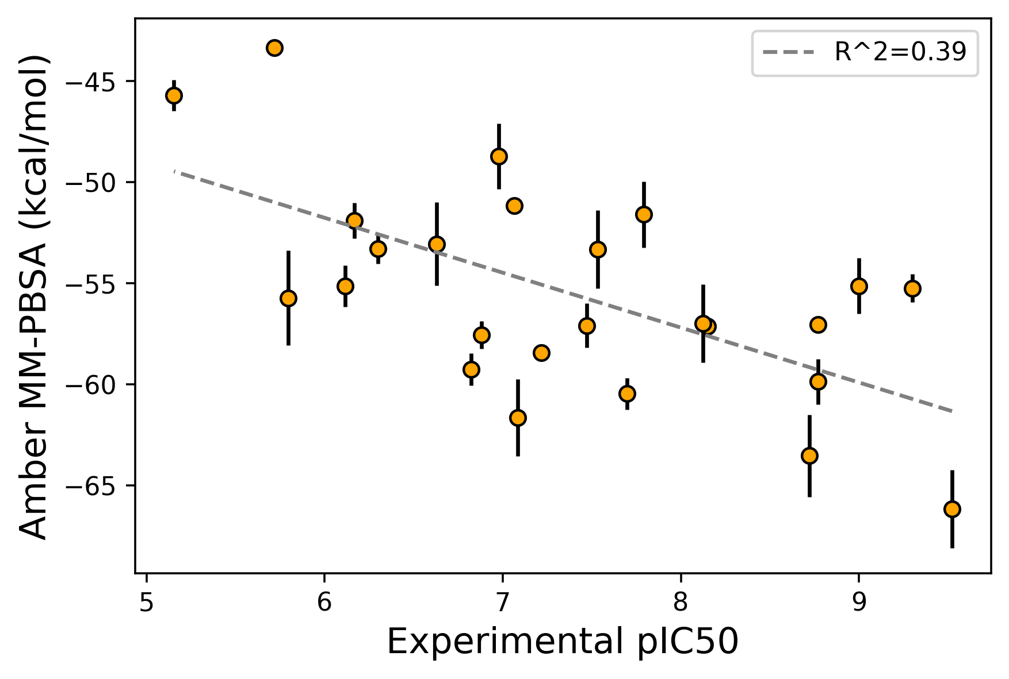
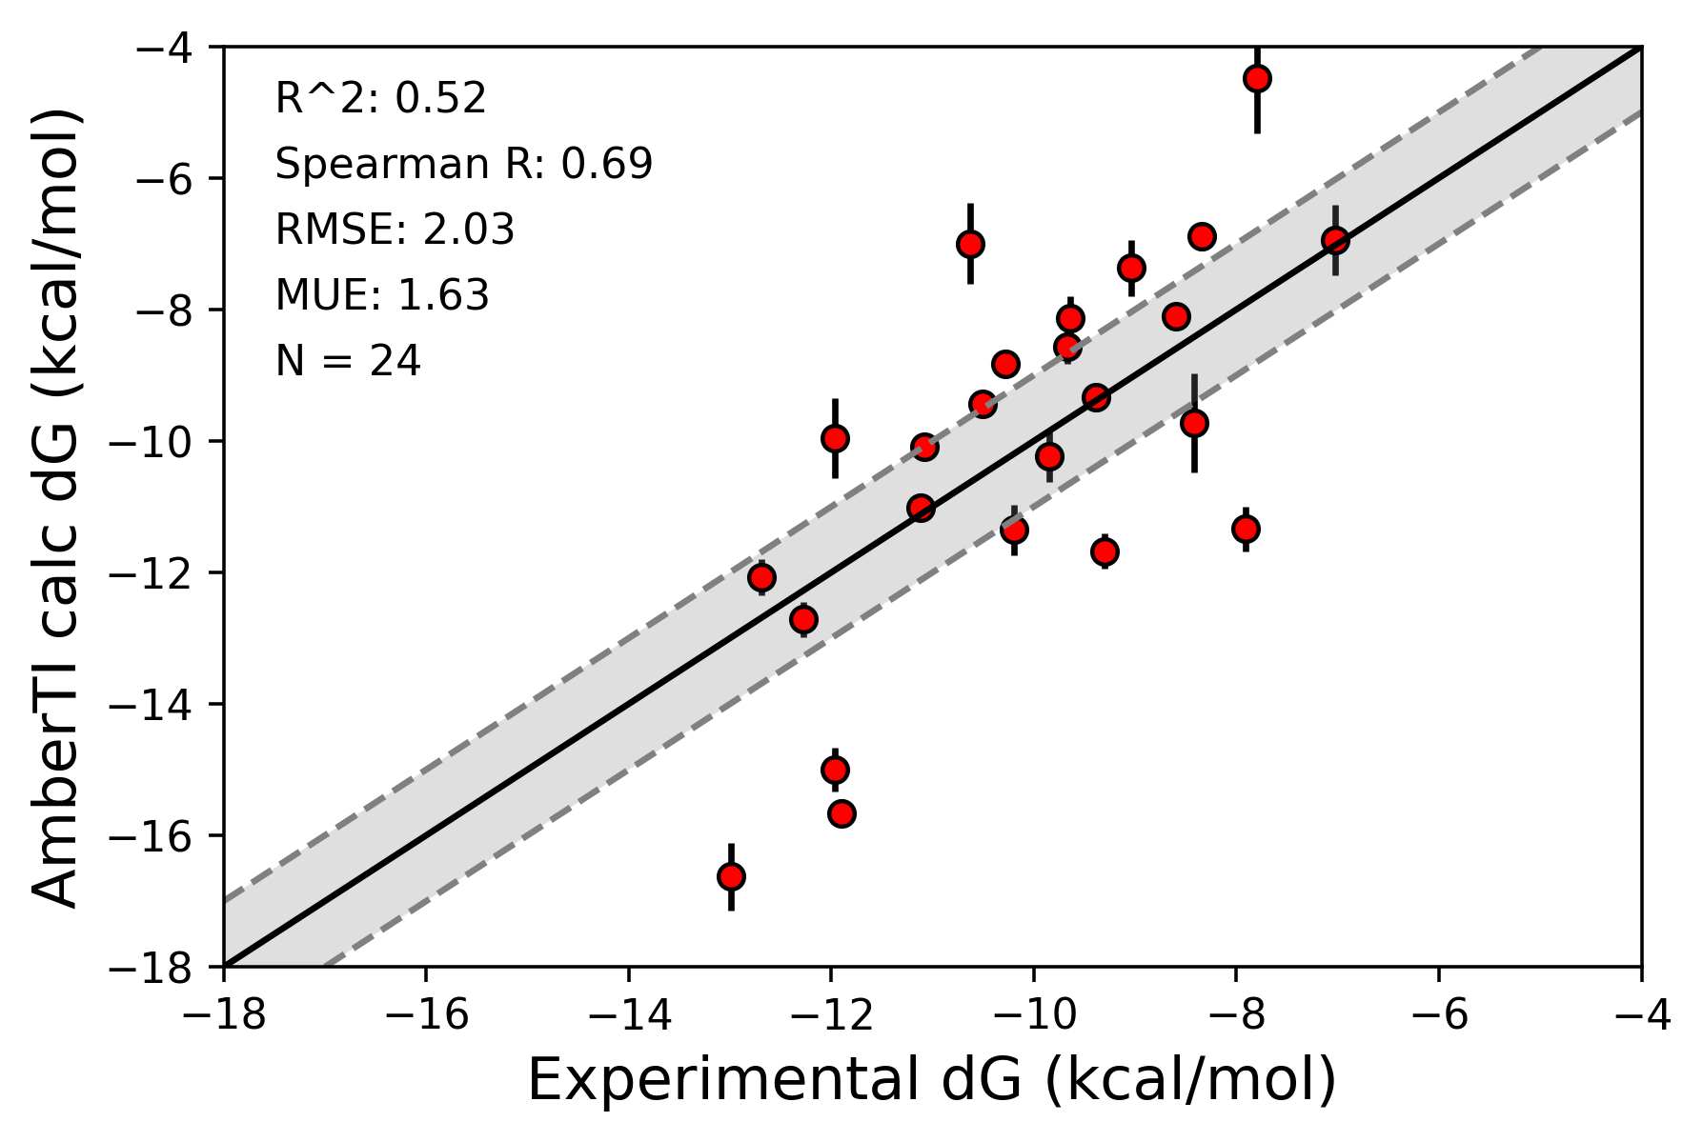
Affinity set (N=25)

