Slide 1
Application of physics-based methods in drug discovery
Callum Dickson
Seminar: Principal Scientist, Modeling and Informatics
Merck Research Laboratories, Boston MA
12th March 2025

Slide 2





University of Edinburgh
Masters of Chemical Physics
Novartis Biomedical Research
2014-2017: Postdoctoral Scholar
2017-2020: Principal Scientist I
2020-2023: Principal Scientist II
2023-Present: Senior Principal Scientist
Imperial College London
Institute Chemical Biology
PhD Computational Chemistry
Research & Methods:
Molecular understanding of passive permeability, GPCR-drug interactions
Internal implementation of Amber MD & Free energy platform
Drug discovery project impact:
Computational strategies for allosteric inhibitors, molecular glues & degraders, GPCR modulators, covalent binders, ion channel targets
Leadership/mentorship:
Postdoc, since hired as CADD scientist. Three additional direct reports
Ian Gould / Ross Walker (Amber MD)
Molecular dynamics of drug-membrane interactions
Lipid force field development
Interest in MRL Principal Scientist:
Focus on science & medicine discovery, novel methods & application

Slide 3
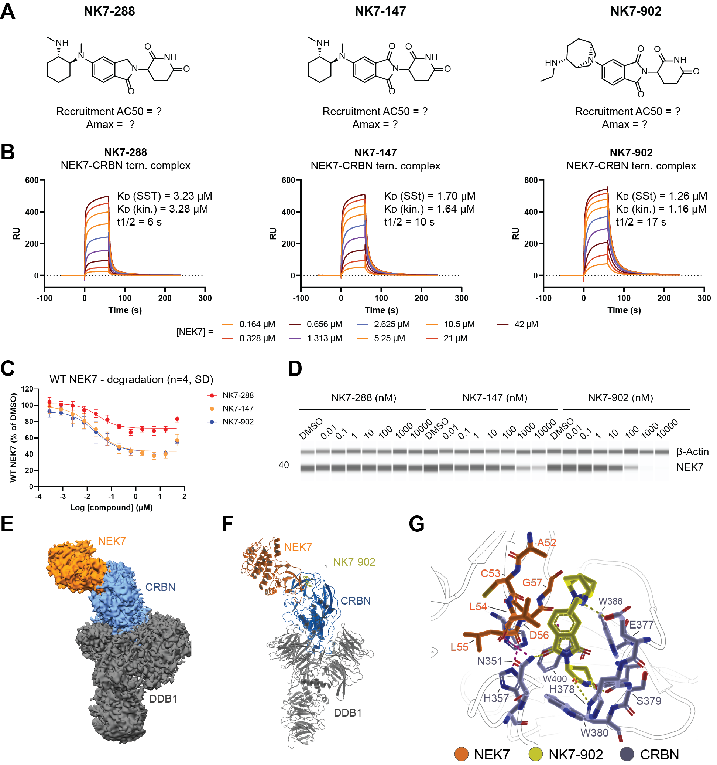
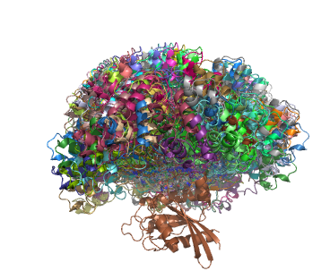
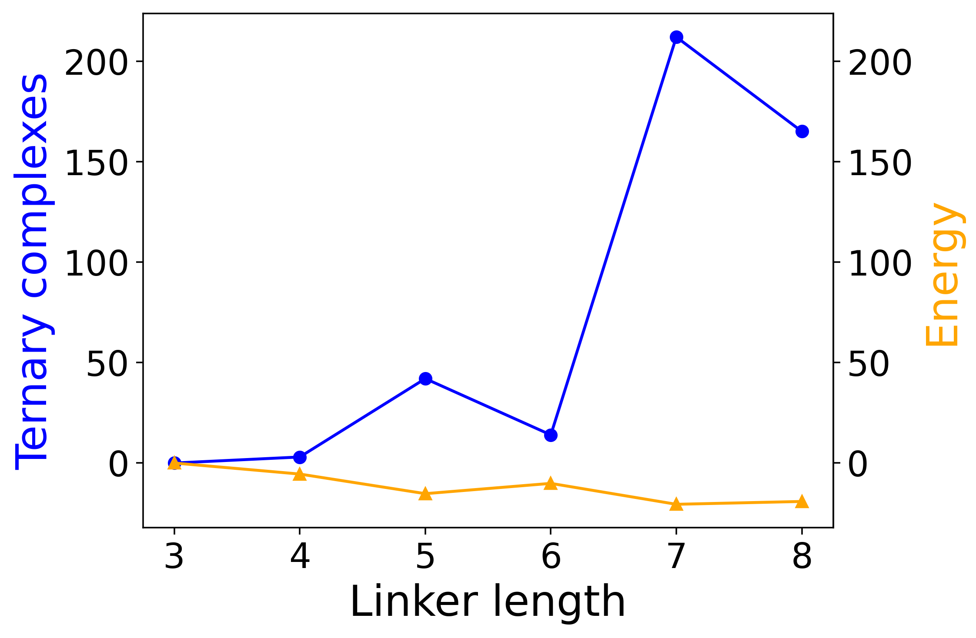
Ion channel modulators
Project was not structurally enabled – machine learning models for potency and properties beneficial
Prediction of CNS exposure enabled by calculating hydrogen bond donor / acceptor strength
Glue degraders
Homology model of ternary complex provided chemistry direction; however, did not enable SBDD
Subsequent cryo-EM was close to model prediction
Bifunctional degraders
Guide linker library design w/ ternary complex prediction
Crystal structure subsequently enabled docking, SBDD
POI
Allosteric inhibitors
Numerous internal crystal structures enabled SBDD
Docking, molecular dynamics, free energy
Focus of this talk

Slide 4
Outline
Understanding and predicting atropisomers with quantum mechanics
Scaling simulations: molecular dynamics and free energy platform
Application of virtual screening to identify a selectivity handle
Combining free energy and machine learning to identify novel, potent R-groups
Current research: one-sliders
Ψ
vs

Slide 5
Quantum mechanics
Ψ

Slide 6
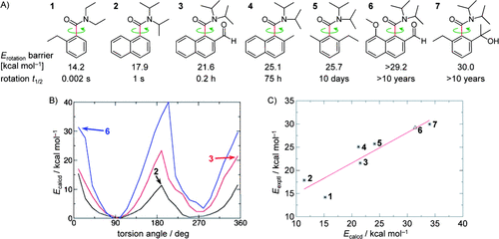
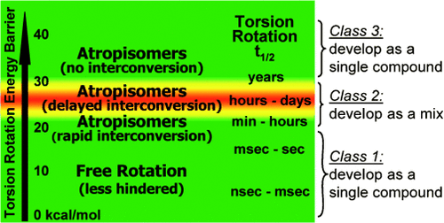
Atropisomers are conformationally locked molecules
Stereoisomers due to hindered rotation
Energy barrier to rotation about a single bond is so great as to allow isolation of single conformers
Revealing Atropisomer Axial Chirality in Drug Discovery - LaPlante - 2011 - ChemMedChem - Wiley Online Library

Slide 7
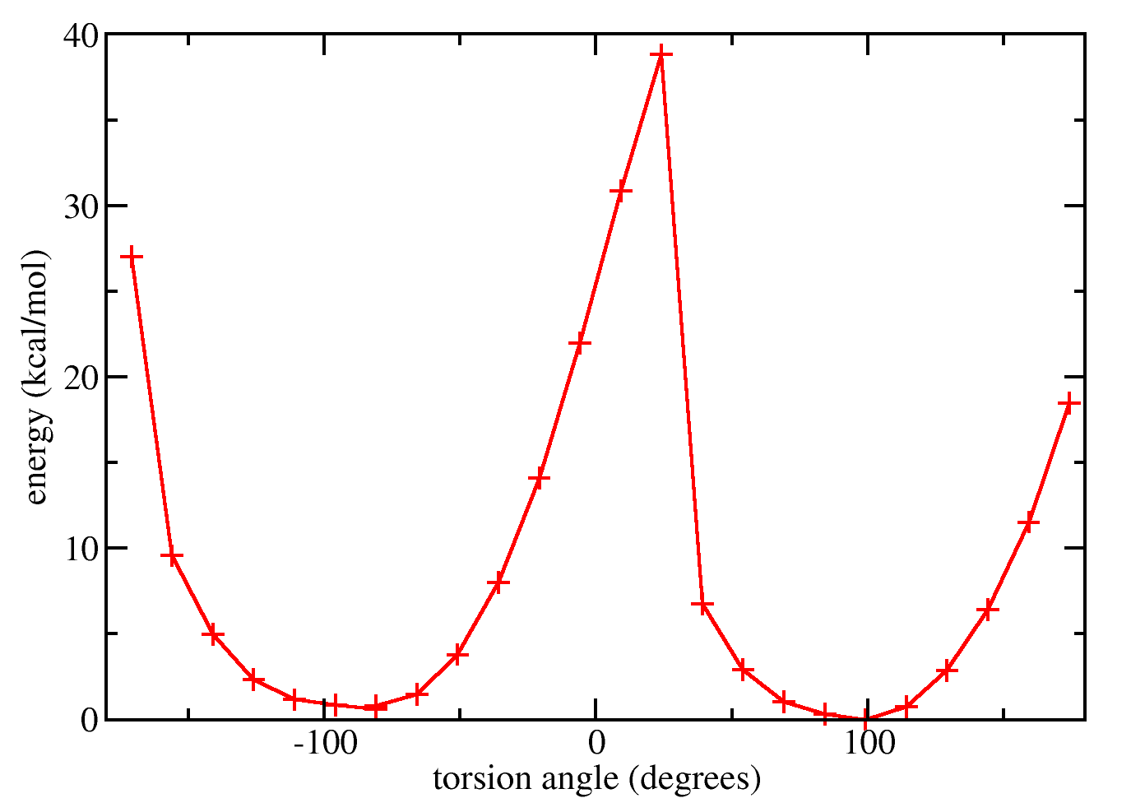
Predicting atropisomers with quantum mechanics
Quantum mechanical torsion scans (Gaussian09)
B3LYP/6-31G* EmpiricalDispersion=GD3
Barrier to interconversion: 27 kcal/mol
Atropisomer class
Locked (>30 kcal/mol)
Interconversion (20 - 30 kcal/mol)
Free rotation (<20 kcal/mol)
Peak1: 38.8
Peak2: 27
A consistent and accurate ab initio parametrization of density functional dispersion correction (DFT-D) for the 94 elements H-Pu | The Journal of Chemical Physics | AIP Publishing

Slide 8
Predicting atropisomers with quantum mechanics
Good agreement with Variable Temperature NMR (VT-NMR)*
Mixture
calc ΔE_{rot} = 26.6 kcal/mol
Single
calc ΔE_{rot} = 28.3 kcal/mol
Single
calc ΔE_{rot} = 30.2 kcal/mol
*It was not possible to also obtain free barriers to interconversion from VT-NMR

Slide 9

Going large: 15 K torsion scans enable chemical space view
?
What if R₁ is a CF3? With cPro at R₃, what is the best R₂ group?
Enumerate all substituents at R₁, R₂, R₃ on multiple cores of interest
R1 | R2 | R3 | Erot | Class
Me | NH2 | cPro | 30.2 | 3
cPro | NH2 | cPro | 27.45 | 2
Me | F | cPro | 20.1 | 2
F | F | cPro | 16.4 | 1
H | H | cPro | 14.5 | 1
Torsion scanning with G09
15 K
Potential next steps:
Fill in missing substituents with Free-Wilson or machine learning model

Slide 10
Going large: 15 K torsion scans enable chemical space view
?
What if R₁ is a CF3? With cPro at R₃, what is the best R₂ group?
This combination both fixed the atropisomer and improved potency due to a novel interaction from the amino group
R1 | R2 | R3 | Erot | Class
Me | NH2 | cPro | 30.2 | 3
cPro | NH2 | cPro | 27.45 | 2
Me | F | cPro | 20.1 | 2
F | F | cPro | 16.4 | 1
H | H | cPro | 14.5 | 1
How can we also score protein-ligand binding?

Slide 11
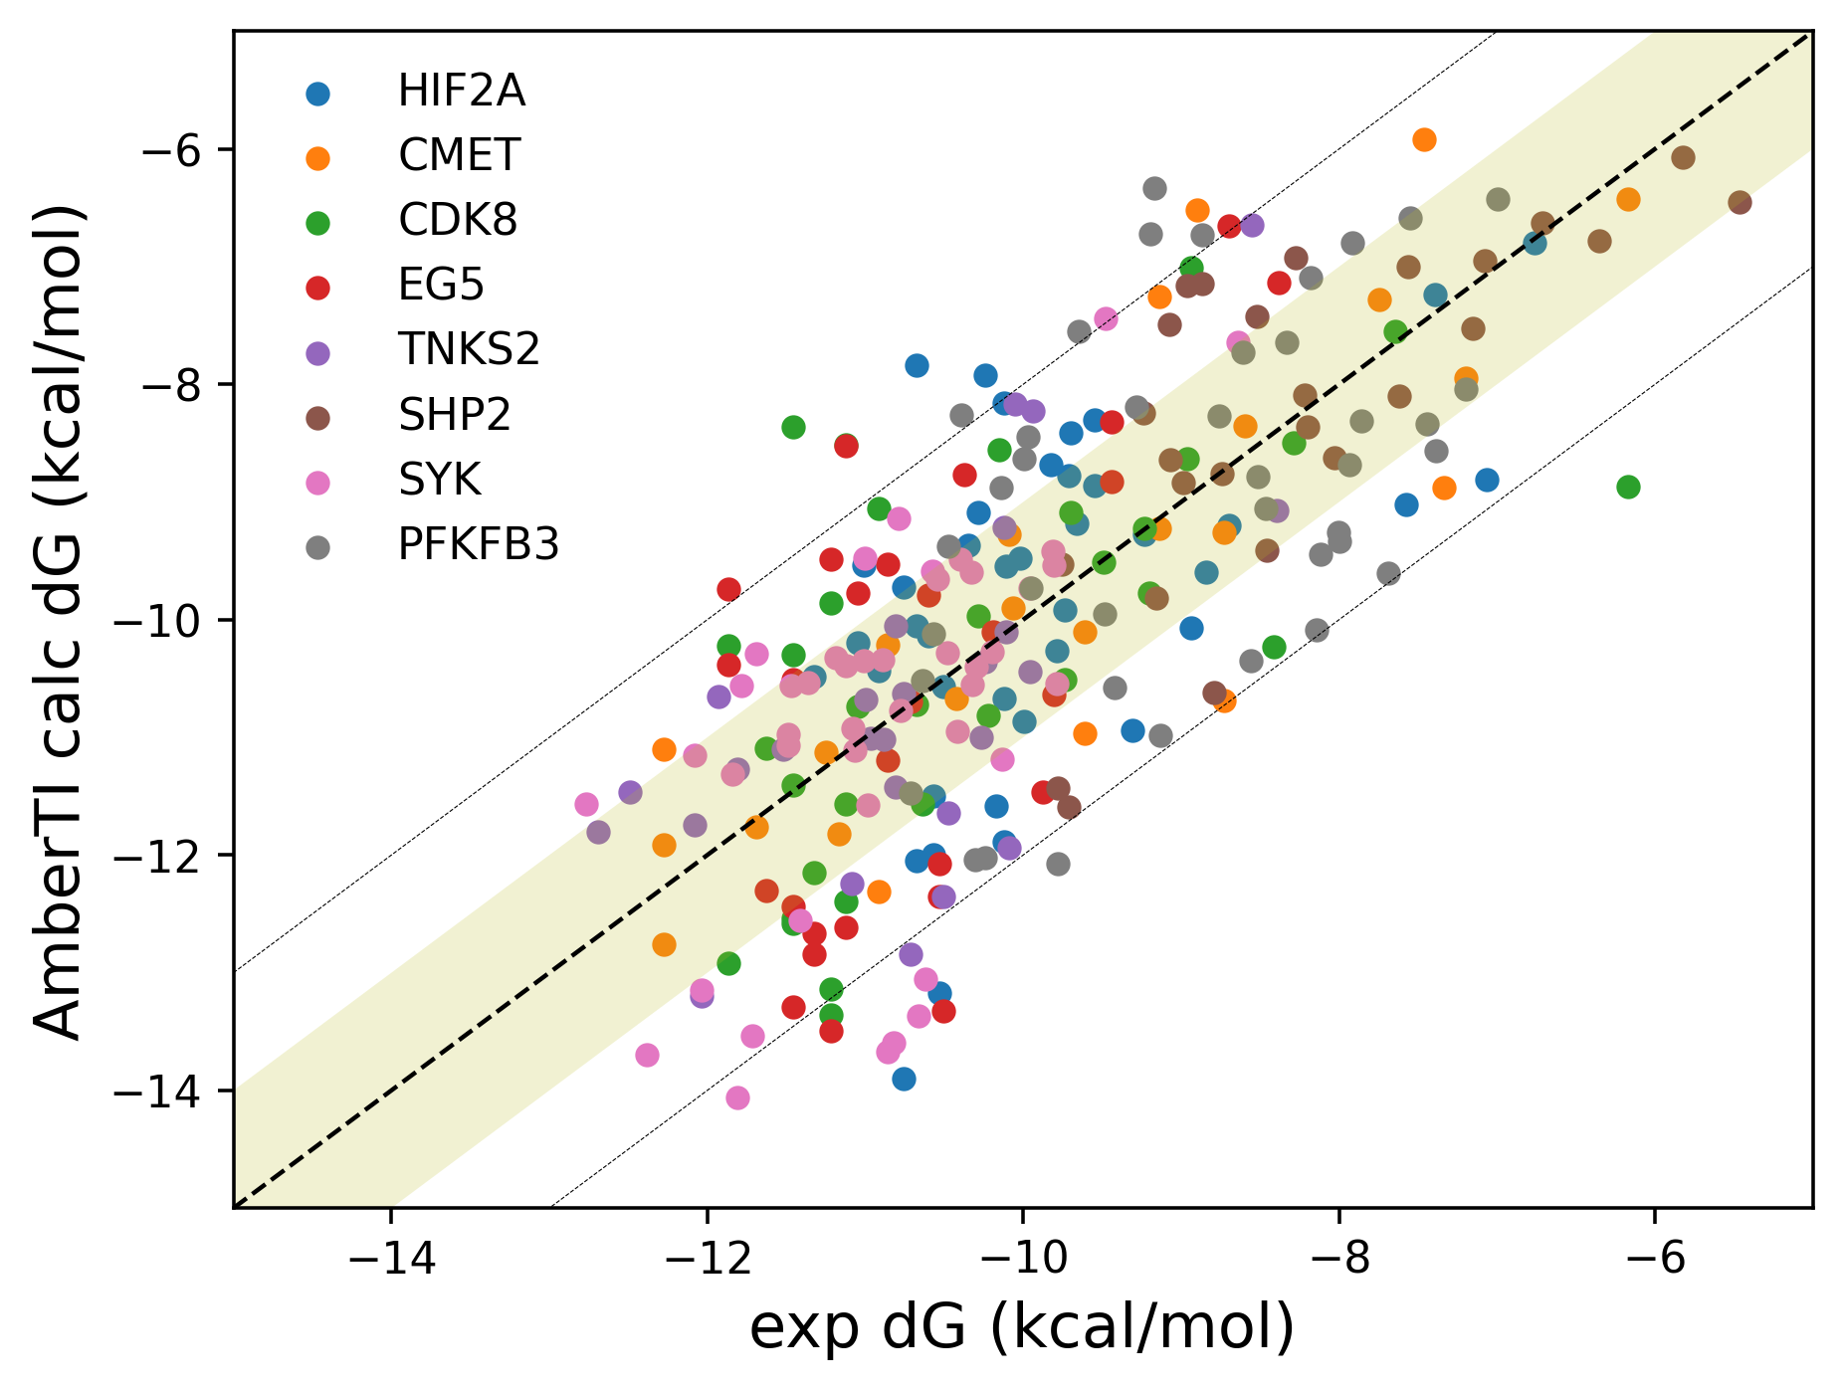
Molecular dynamics and free energy platform

Slide 12
Automating molecular dynamics and free energy with Amber
Vision
Launch molecular dynamics (MD) jobs from the command line given suitably prepared PDB system files and single or multi-ligand SDF file (docking poses, output from Spark, etc)
Generate report with ligand RMSD, hydrogen bond counts, MM-GBSA/MM-PBSA score
Launch relative binding free energy (RBFE) jobs with AmberTI from the command line
Generate report of calculated ΔΔG and ΔG values, cycle closure errors, convergence
Pros
Given suitable GPU resource, screen thousands of docking poses with 2 ns MD
Run large “R-group” scanning RBFE jobs, with no license restriction
Cons
Must be “Amber savvy” to suitably prepare system for MD
When running RBFE, ligands must have atom matching alignment; restricted to amber force fields

Slide 13
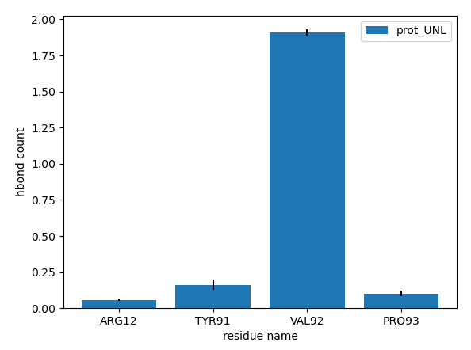
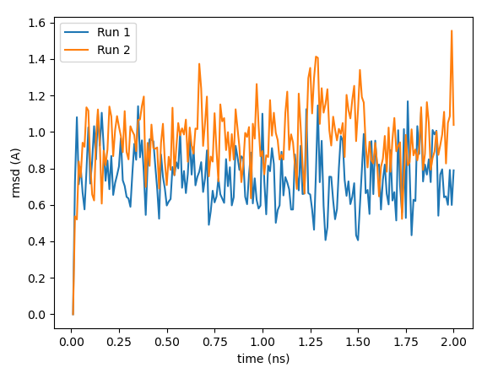
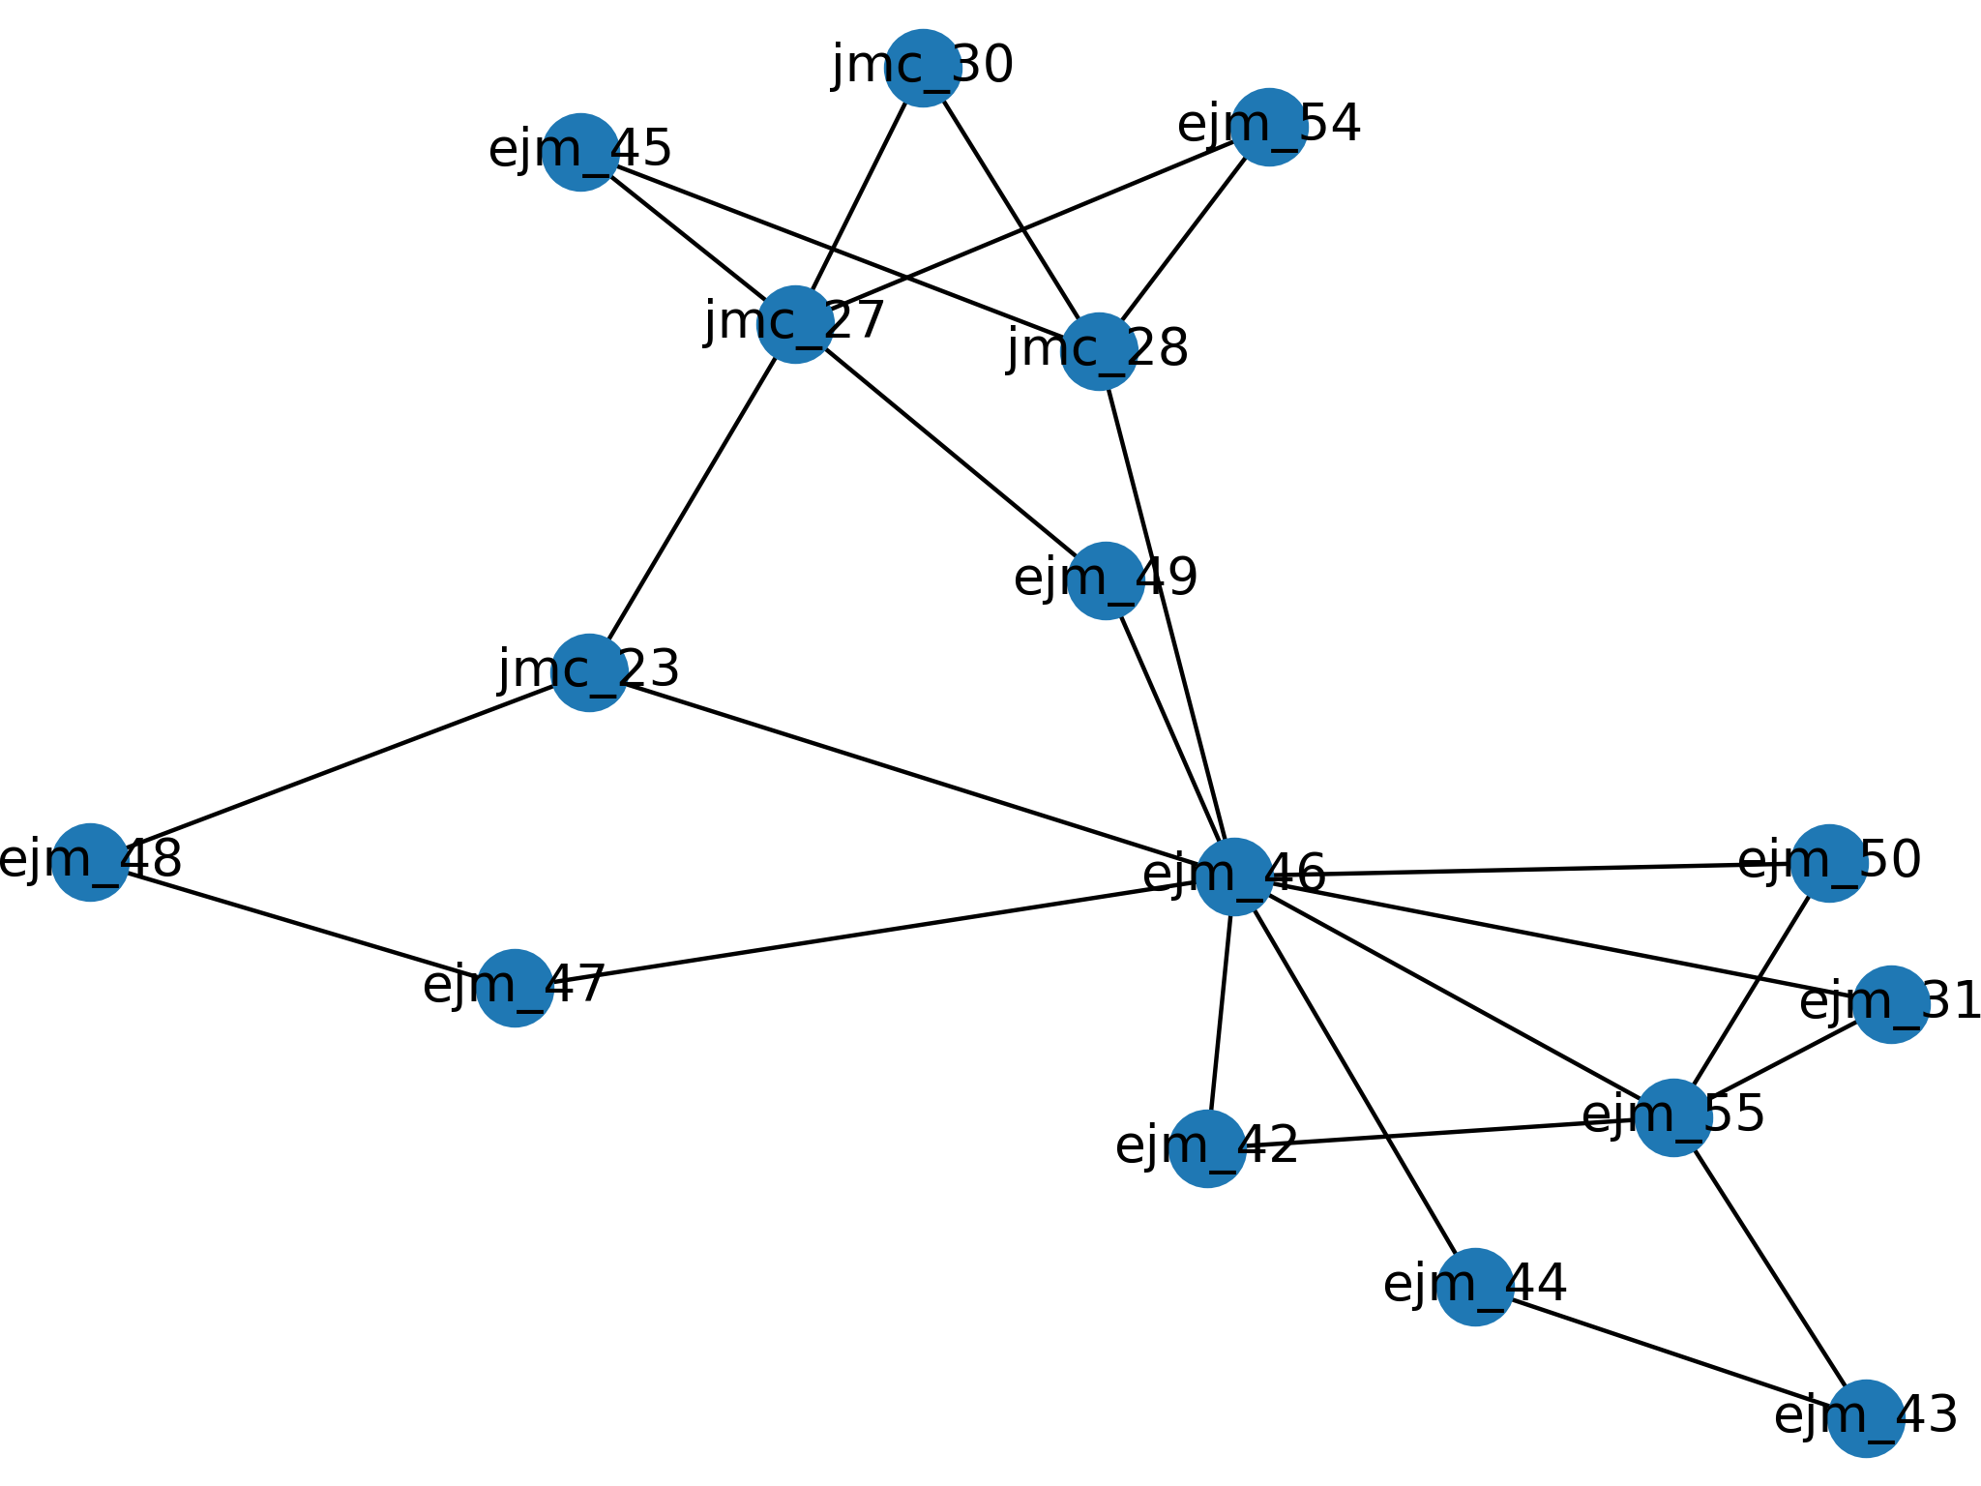
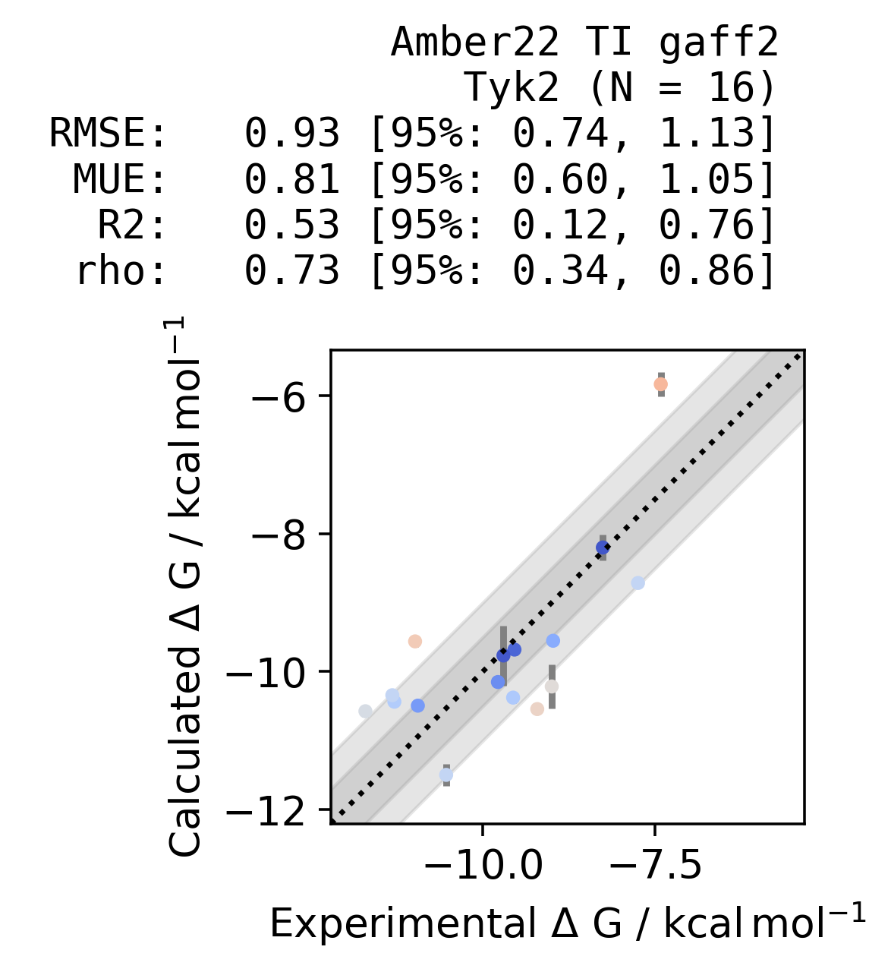
md_vanilla –p protein_prepared.pdb –l ligand_file.sdf –r 2 –t 5 –ff gaff2 -pbsa
Average and representative PDBs
Hydrogen bond counting
Ligand, protein RMSD
MM-GBSA, MM-PBSA score
rbfe_amberTI –p protein_prepared.pdb –sdf ligand_series.sdf –r 2 –w 12
Automated cycle mapping, or star mode
ΔG and ΔΔG report
Cycle closure
ΔG convergence and breakdown

Slide 14
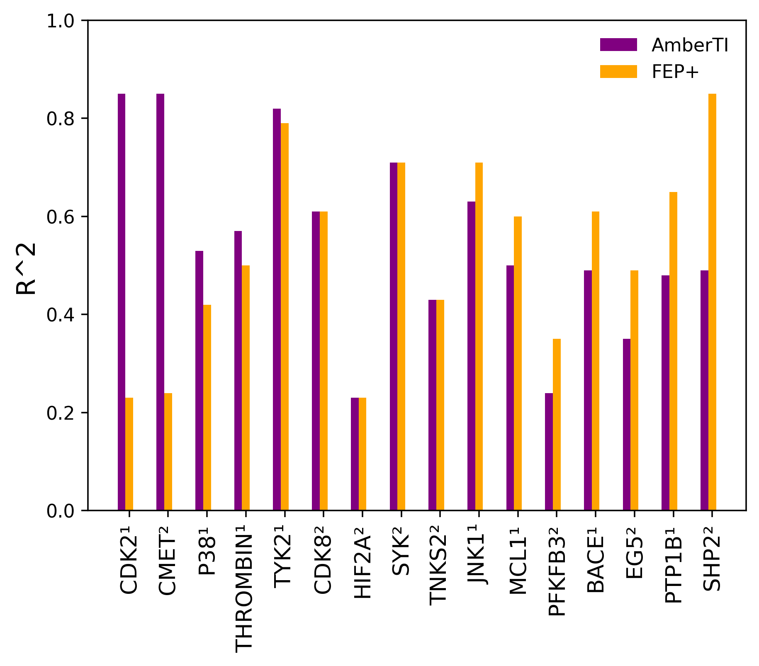
AmberTI on sixteen benchmark systems
¹Benchmarks 2015
FEP+
OPLS2.1, 12 λ windows, 5 ns production
AmberTI
ff19SB, parm@frosst, 12 λ windows, 5 ns production, 2x repeats
²Benchmarks 2023
FEP+
OPLS4, 12 λ windows, 20 ns production
AmberTI
ff19SB, gaff2, 12 λ windows, 5 ns production, 2x repeats
Charge moving/changing used three-step protocol
higher is better
¹Wang et al, JACS, 2015
²Ross et al, Nat Comm Chem, 2023

Slide 15
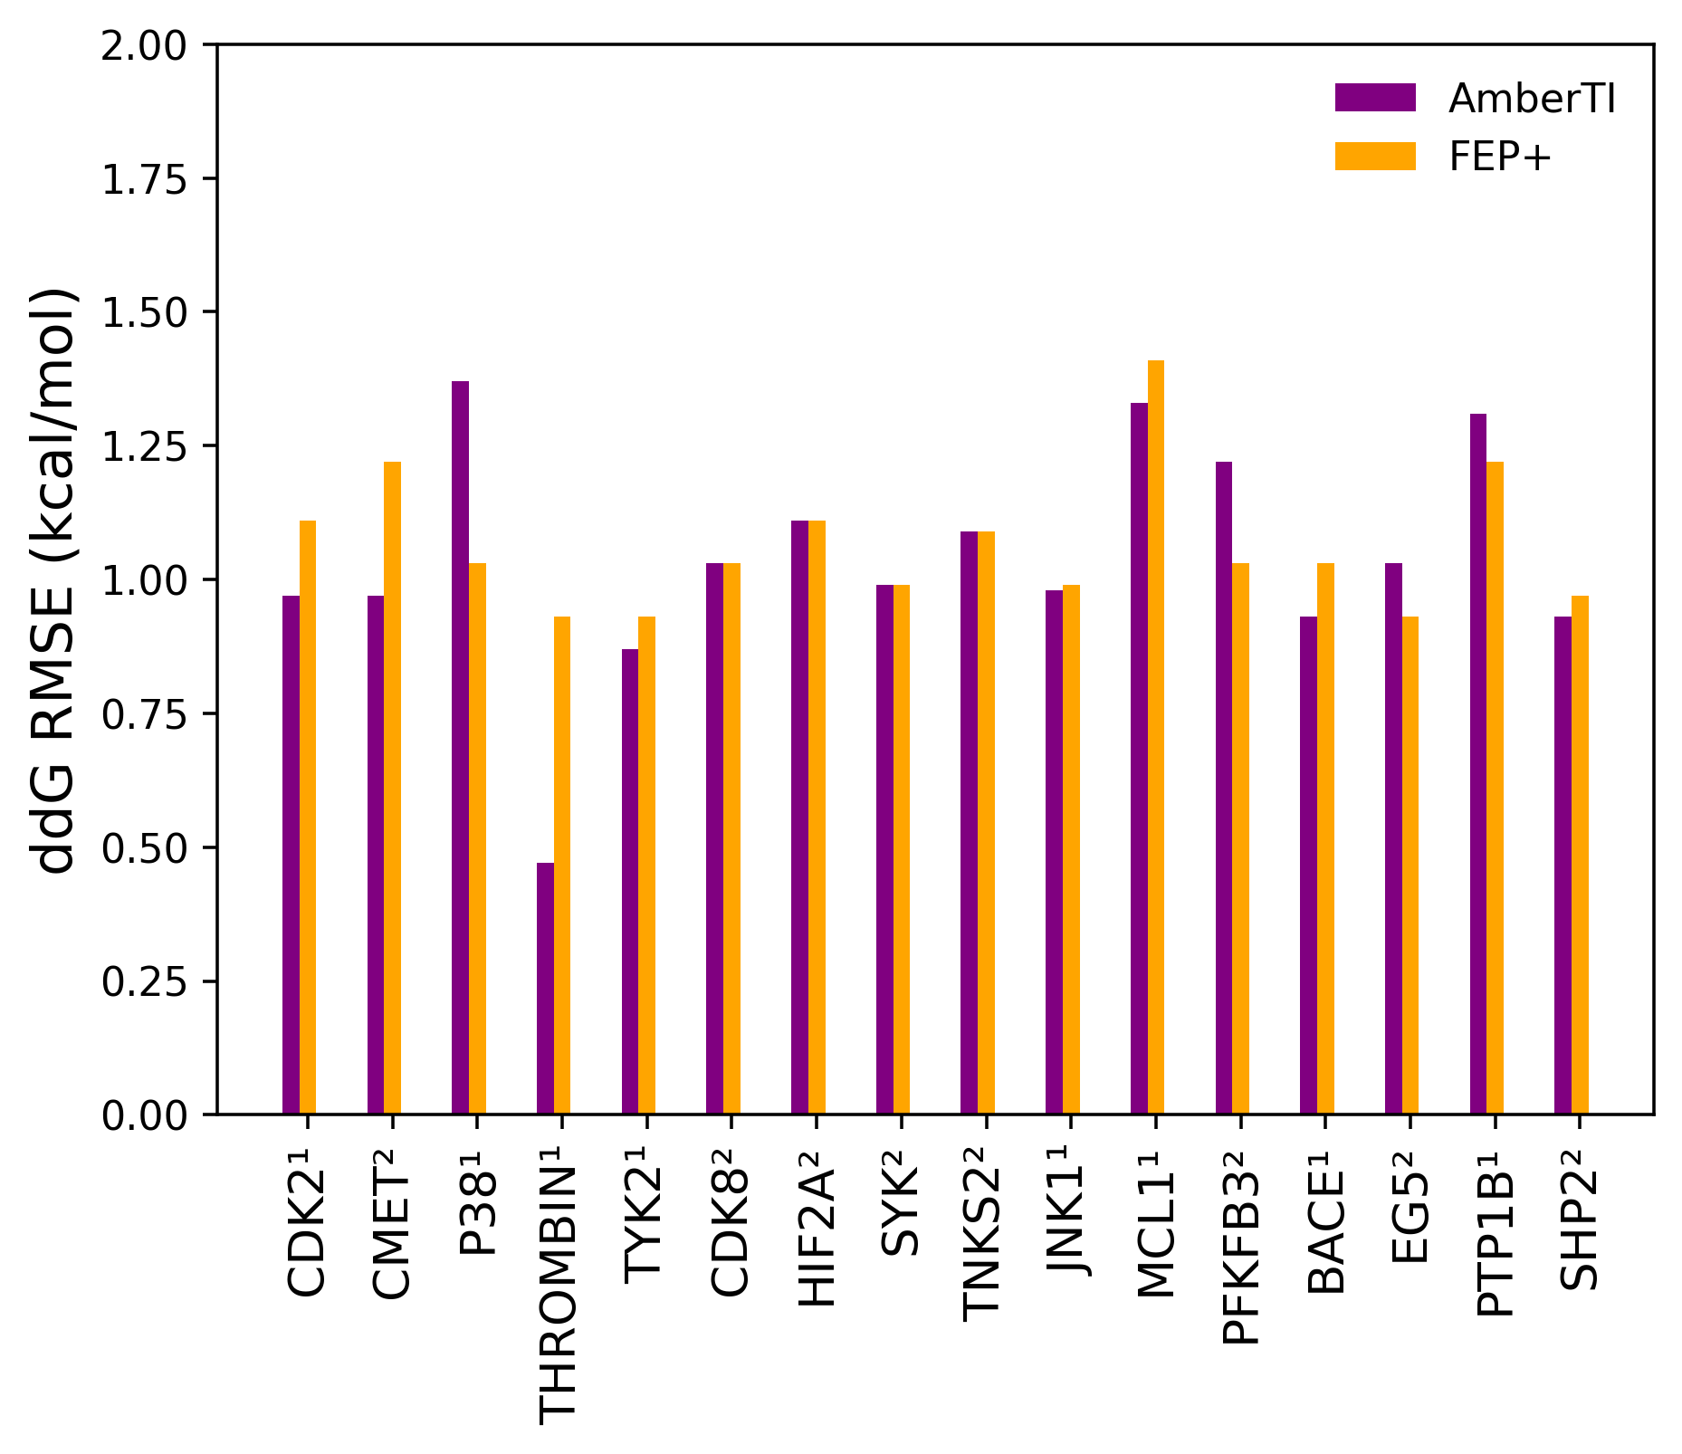
AmberTI on sixteen benchmark systems
¹Benchmarks 2015
FEP+
OPLS2.1, 12 λ windows, 5 ns production
AmberTI
ff19SB, parm@frosst, 12 λ windows, 5 ns production, 2x repeats
²Benchmarks 2023
FEP+
OPLS4, 12 λ windows, 20 ns production
AmberTI
ff19SB, gaff2, 12 λ windows, 5 ns production, 2x repeats
Charge moving/changing used three-step protocol
lower is better
¹Wang et al, JACS, 2015
²Ross et al, Nat Comm Chem, 2023

Slide 16
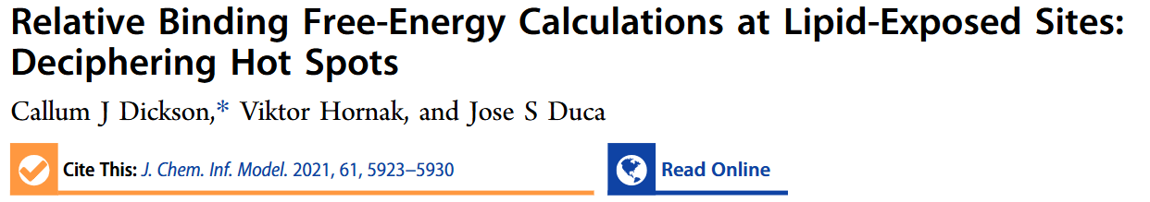
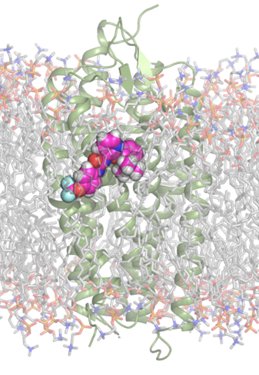
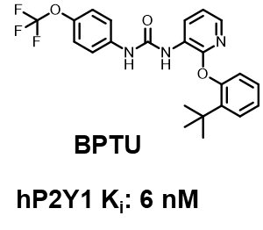
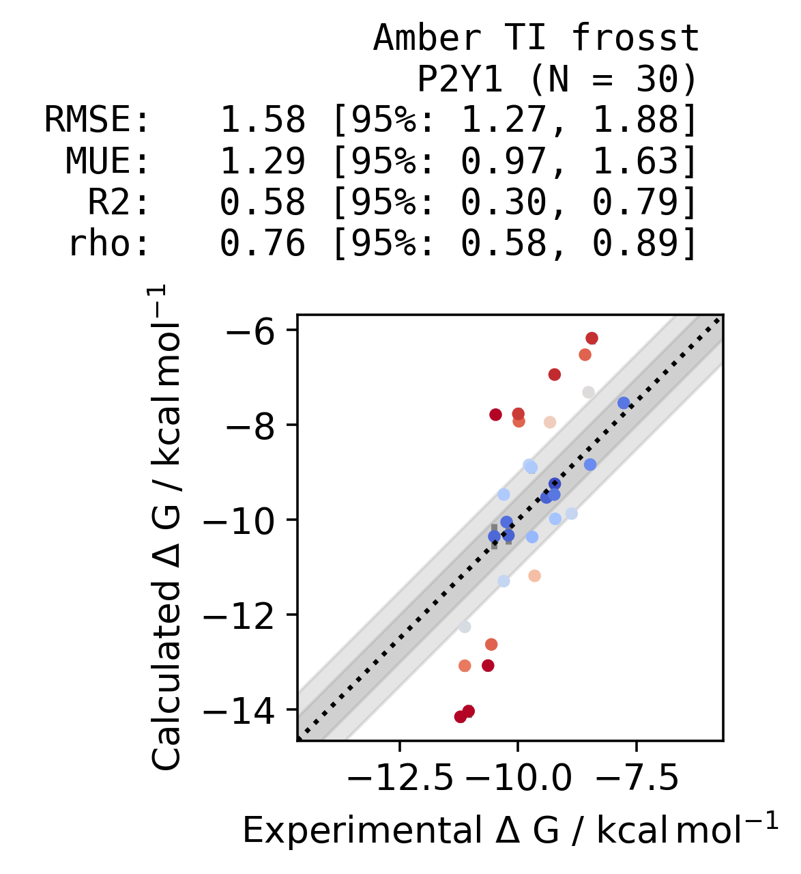
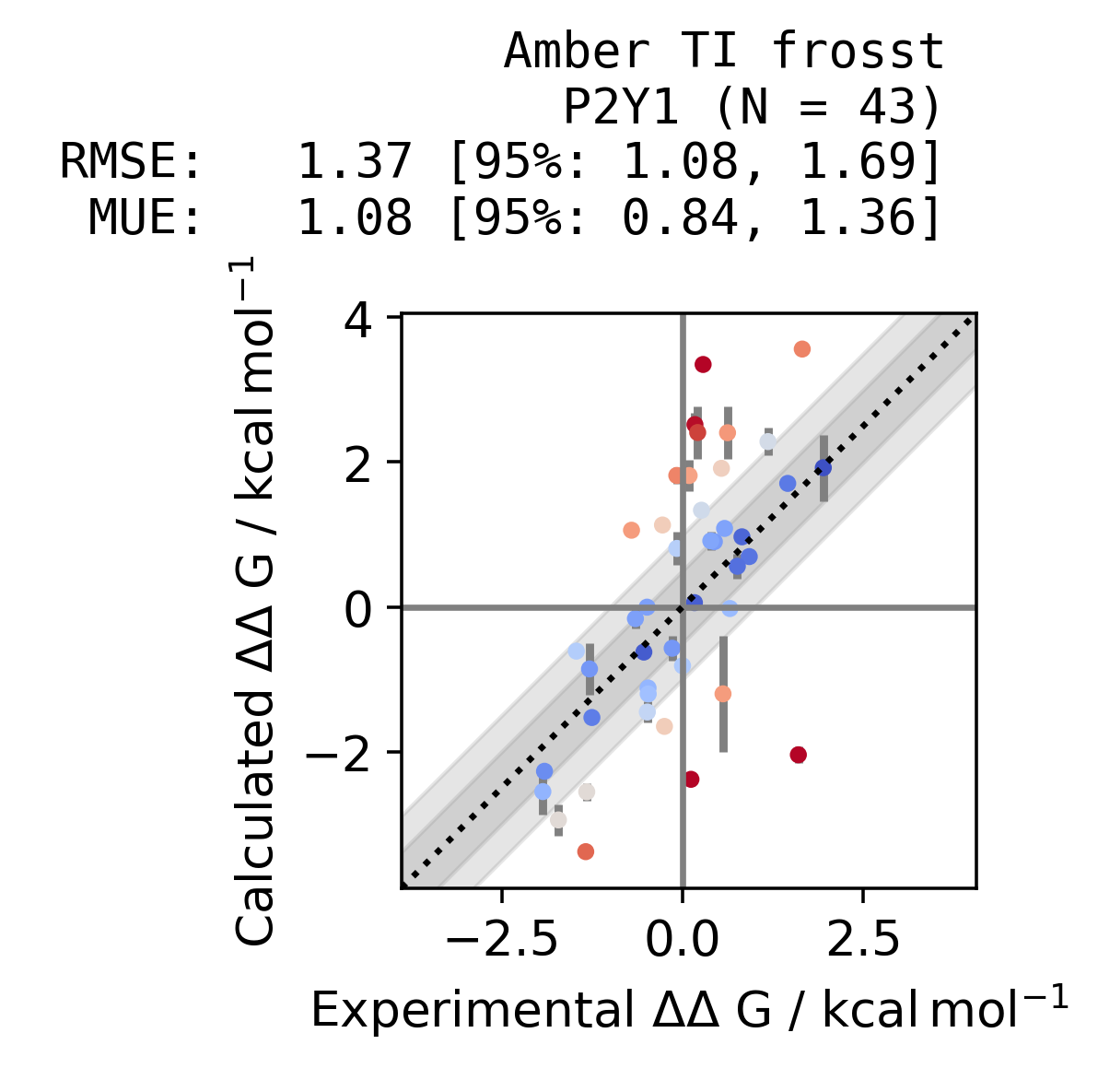
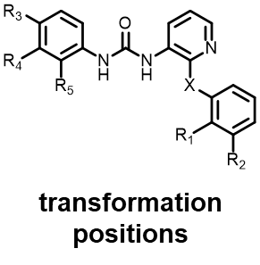
Application to a membrane exposed GPCR allosteric site

Slide 17
Identifying a selectivity handle
Series A
vs

Slide 18
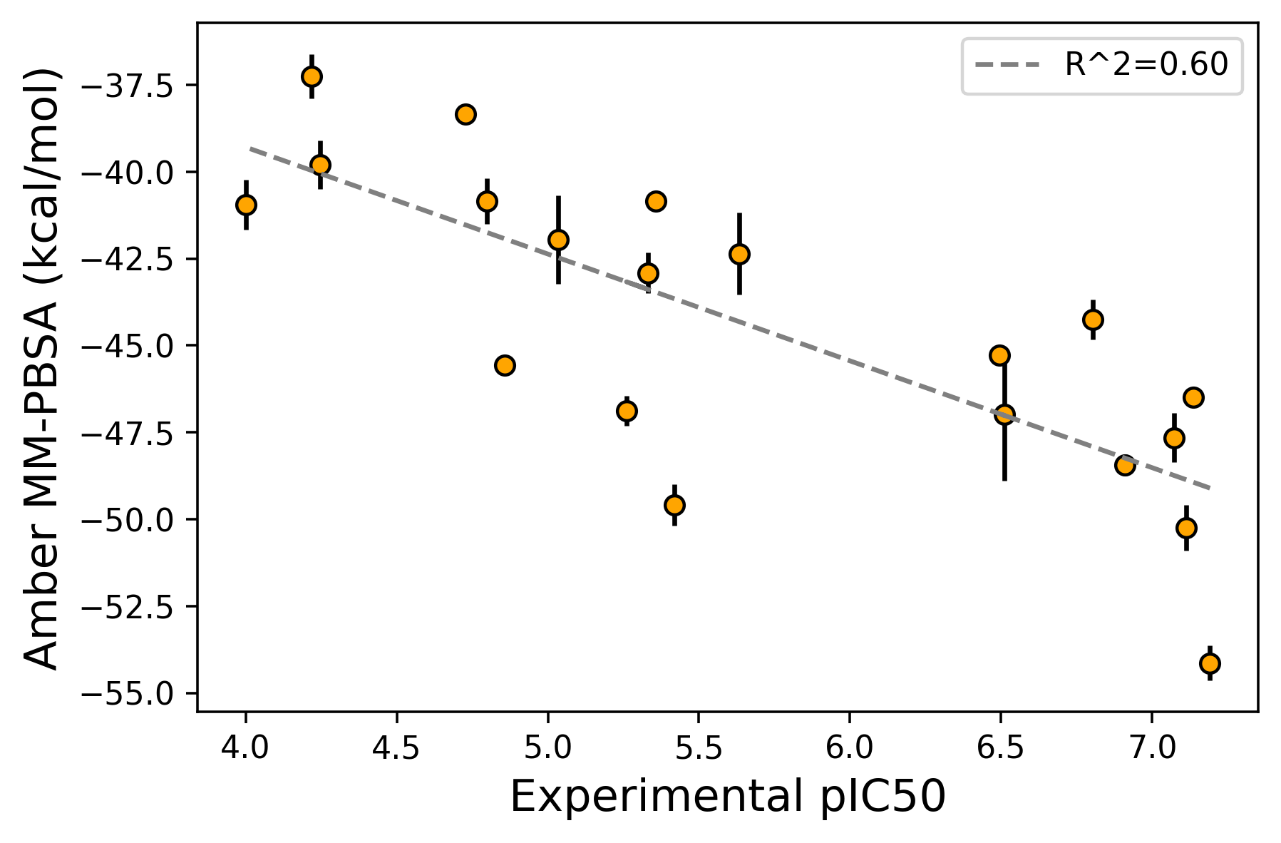
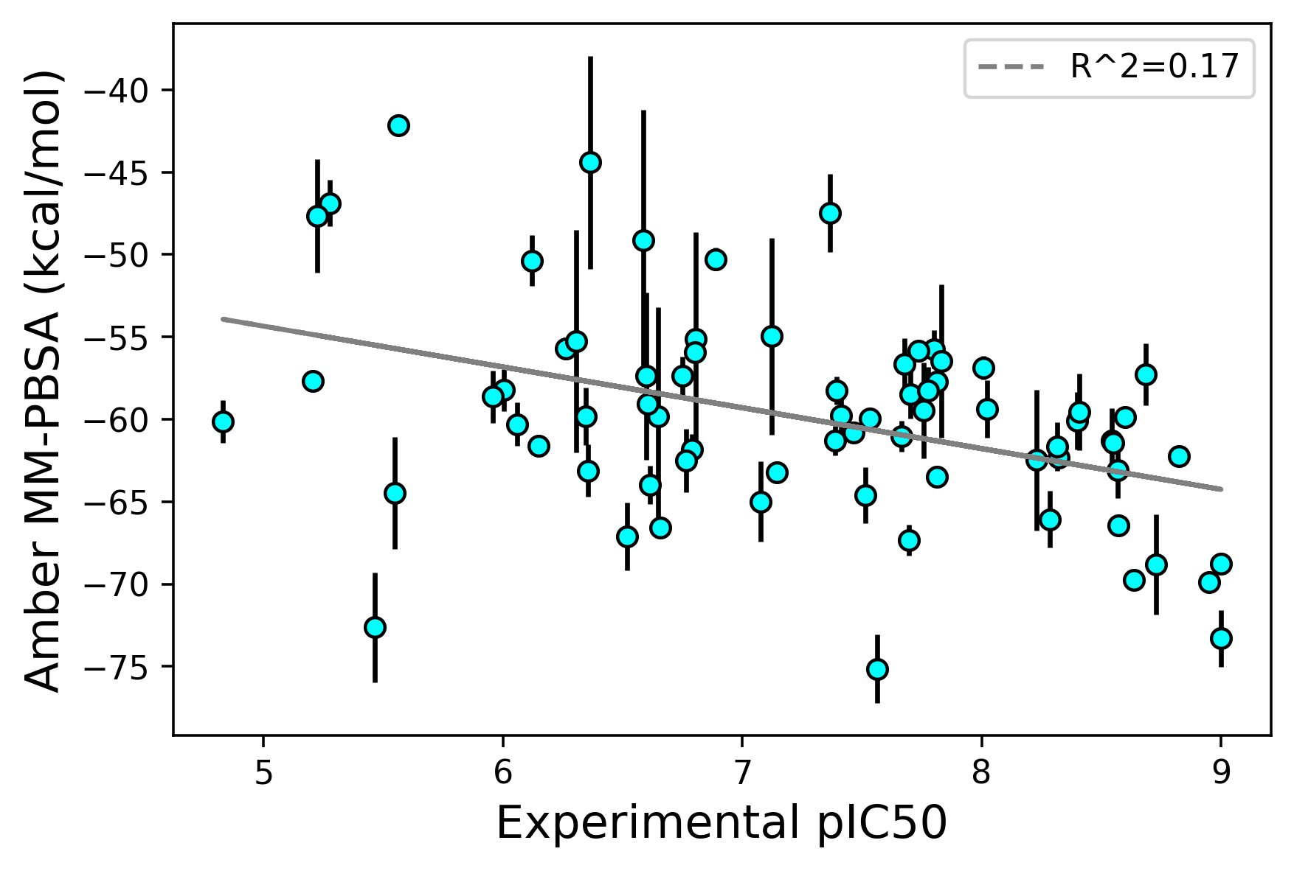
Benchmarking Amber MM-PBSA for affinity scoring
Retrospective (N=20)
Prospective (N=72)*
Protocol:
2x repeat runs
5 ns production
ff14SB / parm@Frosst
*includes pK_{a} modulation analogs

Slide 19
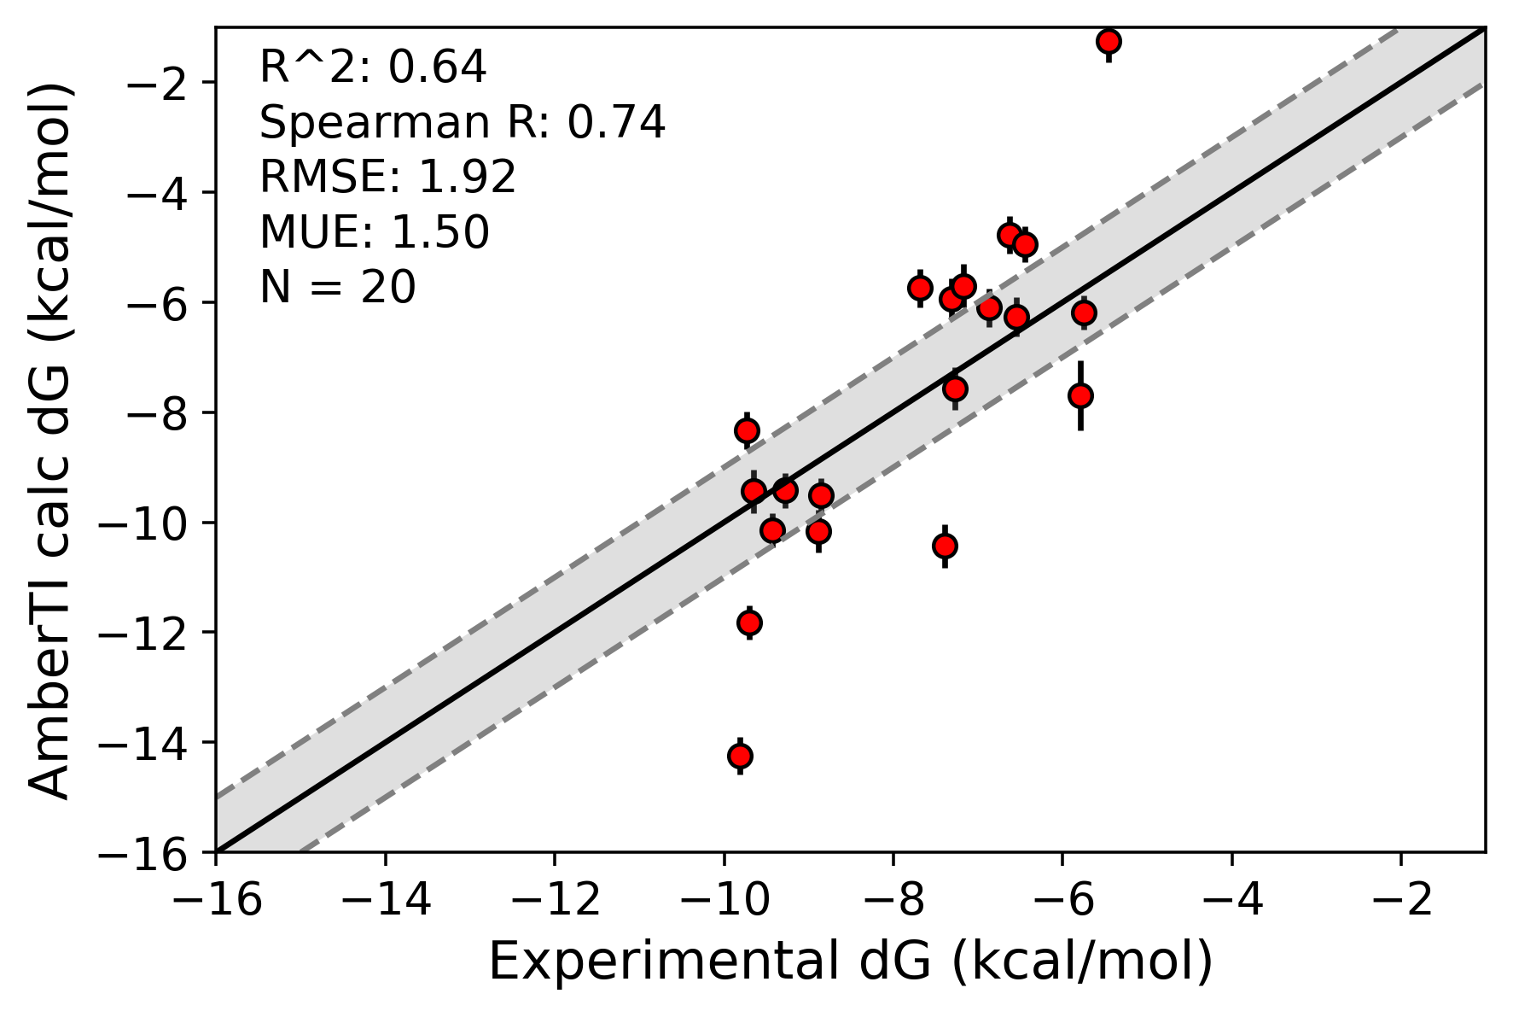
Benchmarking Amber TI for affinity scoring
Retrospective (N=20)
Typical prioritization workflow
assay limit
Ligand docking (Glide)
Short MD simulation
QM strain analysis and property calculation (ReSCoSS)
Pymol session + properties
Only selected analogs progressed to AmberTI (novel interaction question, etc)
Protocol:
2x repeat runs
12 lambda windows
5 ns production
ff19SB / parm@Frosst
ReSCoSS: a flexible quantum chemistry workflow identifying relevant solution conformers of drug-like molecules | Journal of Computer-Aided Molecular Design

Slide 20
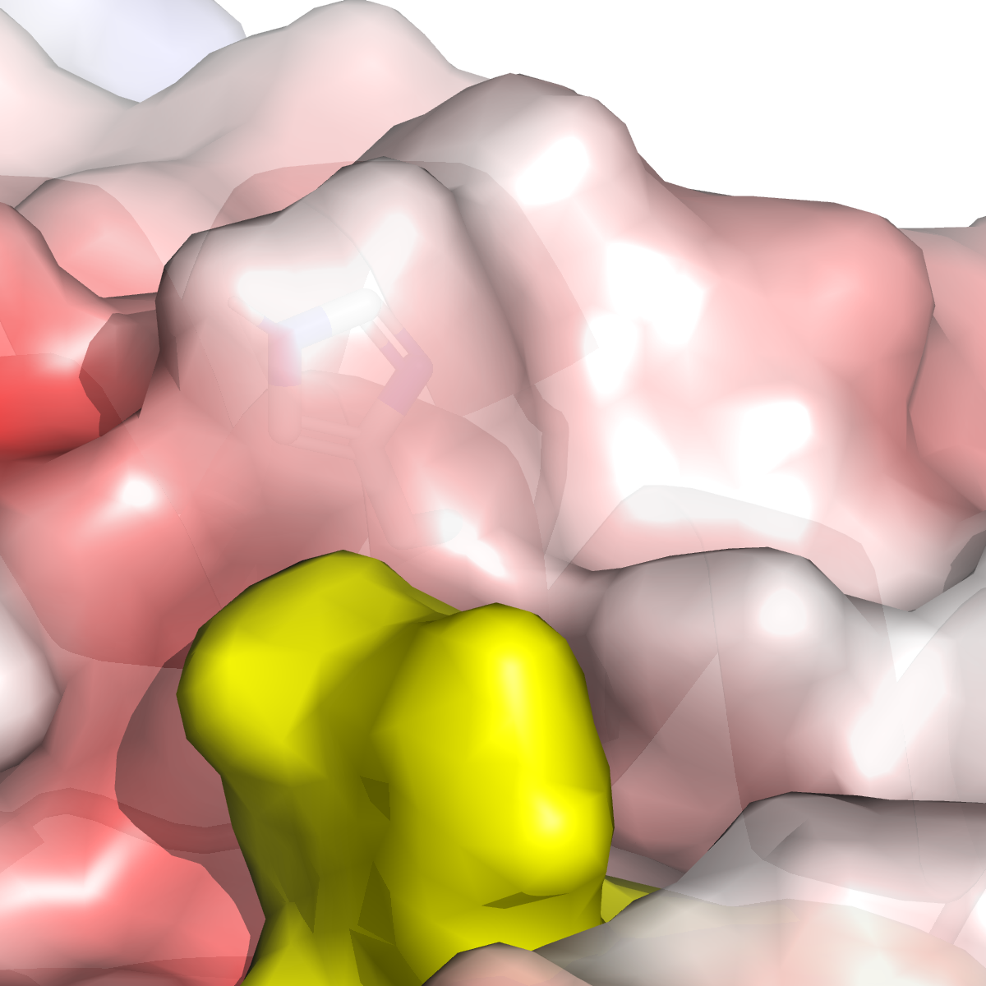
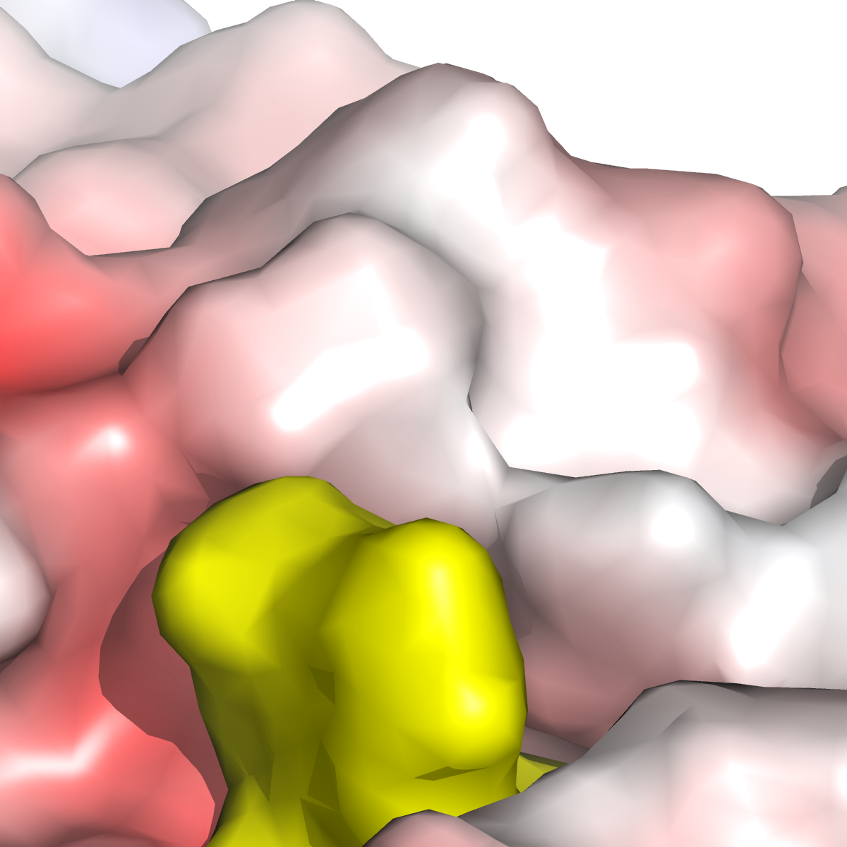
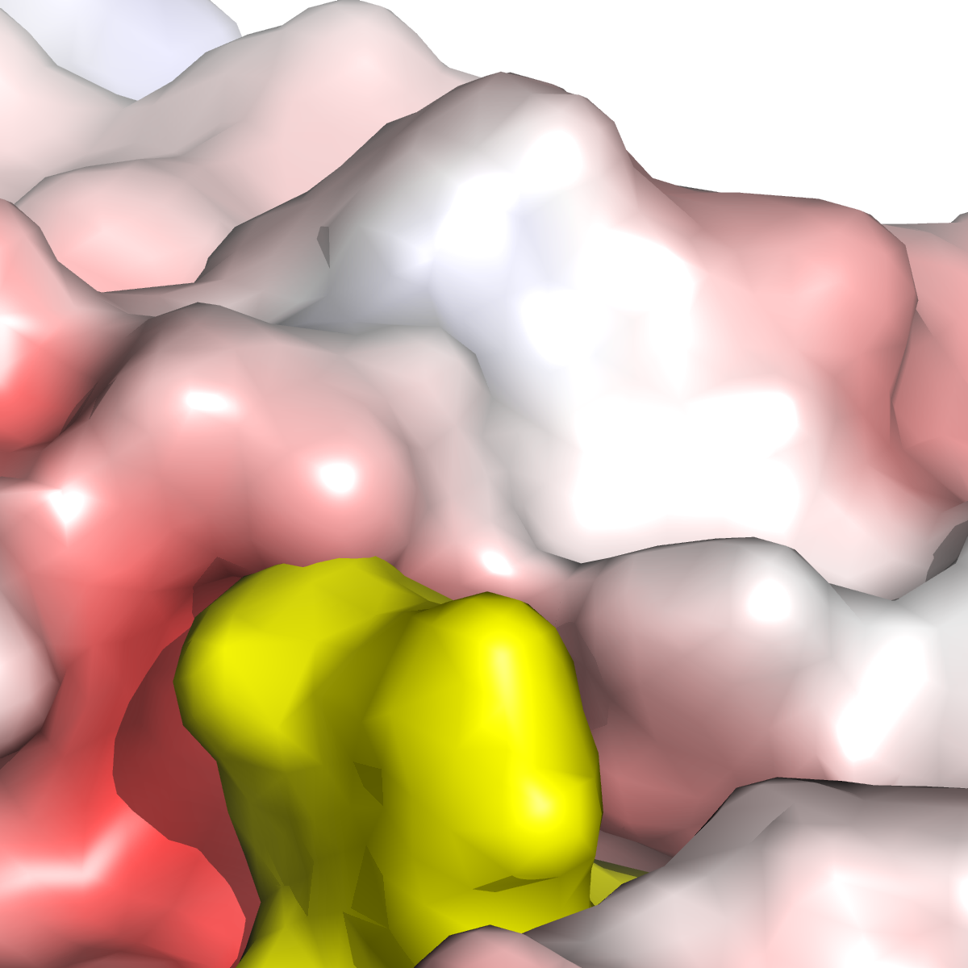
Understanding and optimizing selectivity
Productive histidine interaction
Histidine at the top of the pocket presents an opportunity for selectivity over off-targets
Despite attempts at numerous different interactions, selectivity could not be gained
target
off-target 1
off-target 2
histidine
Notes:
L (1) and Q (2)

Slide 21
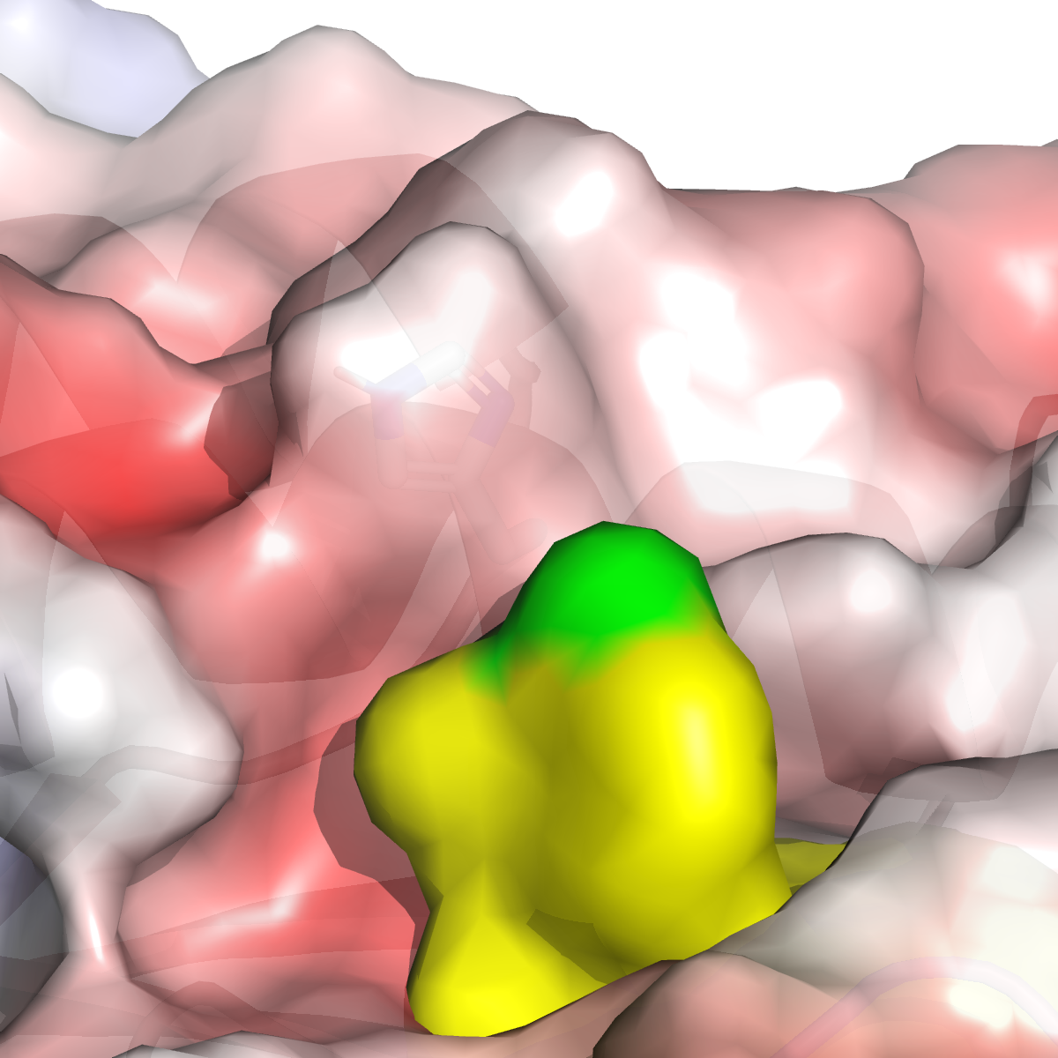
Understanding and optimizing selectivity
Productive histidine interaction
Histidine at the top of the pocket presents an opportunity for selectivity over off-targets
Despite attempts at numerous different interactions, selectivity could not be gained
pi-pi
cation-pi (confirmed by x-ray)
 | Cmpd 1 | Cmpd 2 | Cmpd 3
Fold selectivity off-target 1 / 2 | 0.7 / 1 | 0.4 / 2 | 2 / 2.1

Slide 22
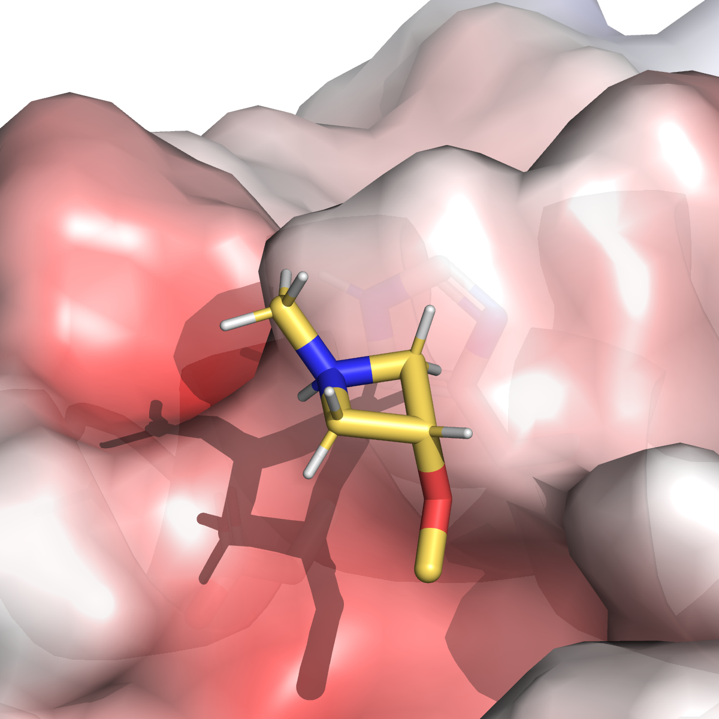
Understanding and optimizing selectivity
Cmpd 3
Modelling cmpd 3 prior to x-ray structure indicated a CH-pi interaction to histidine
Could a more rigid piece stabilize this interaction?
 | Cmpd 3
Fold selectivity off-target 1 / 2 | 2 / 2.1

Slide 23
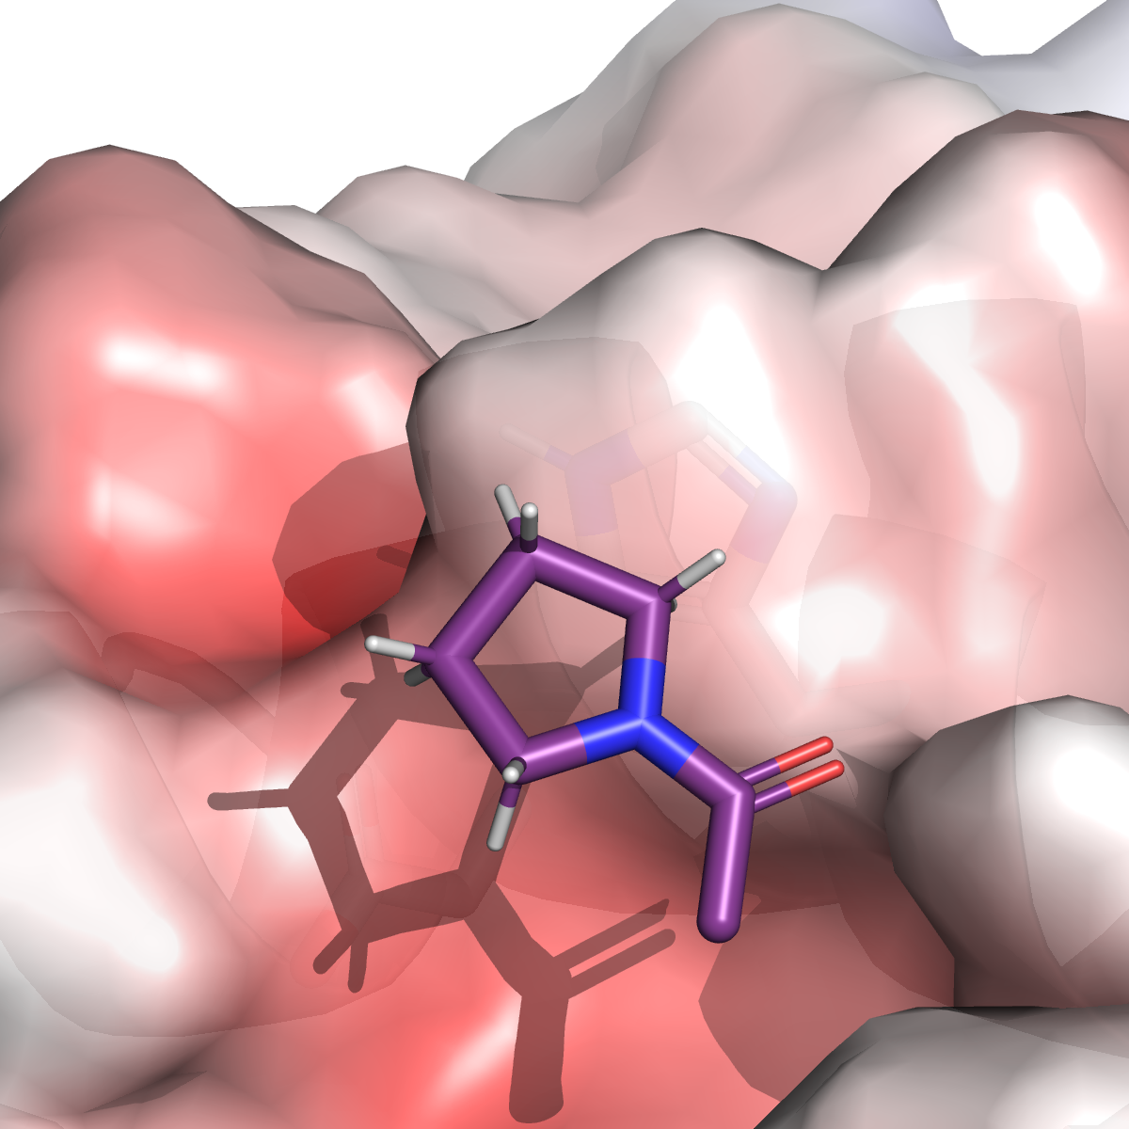
Understanding and optimizing selectivity
Cmpd 4
Pyrrolidine modelled well with more consistent CH-pi interaction during simulations
Increased on-target affinity and greater selectivity over off-target 2
 | Cmpd 3 | Cmpd 4
Fold selectivity off-target 1 / 2 | 2 / 2.1 | 1.5 / 3.8

Slide 24
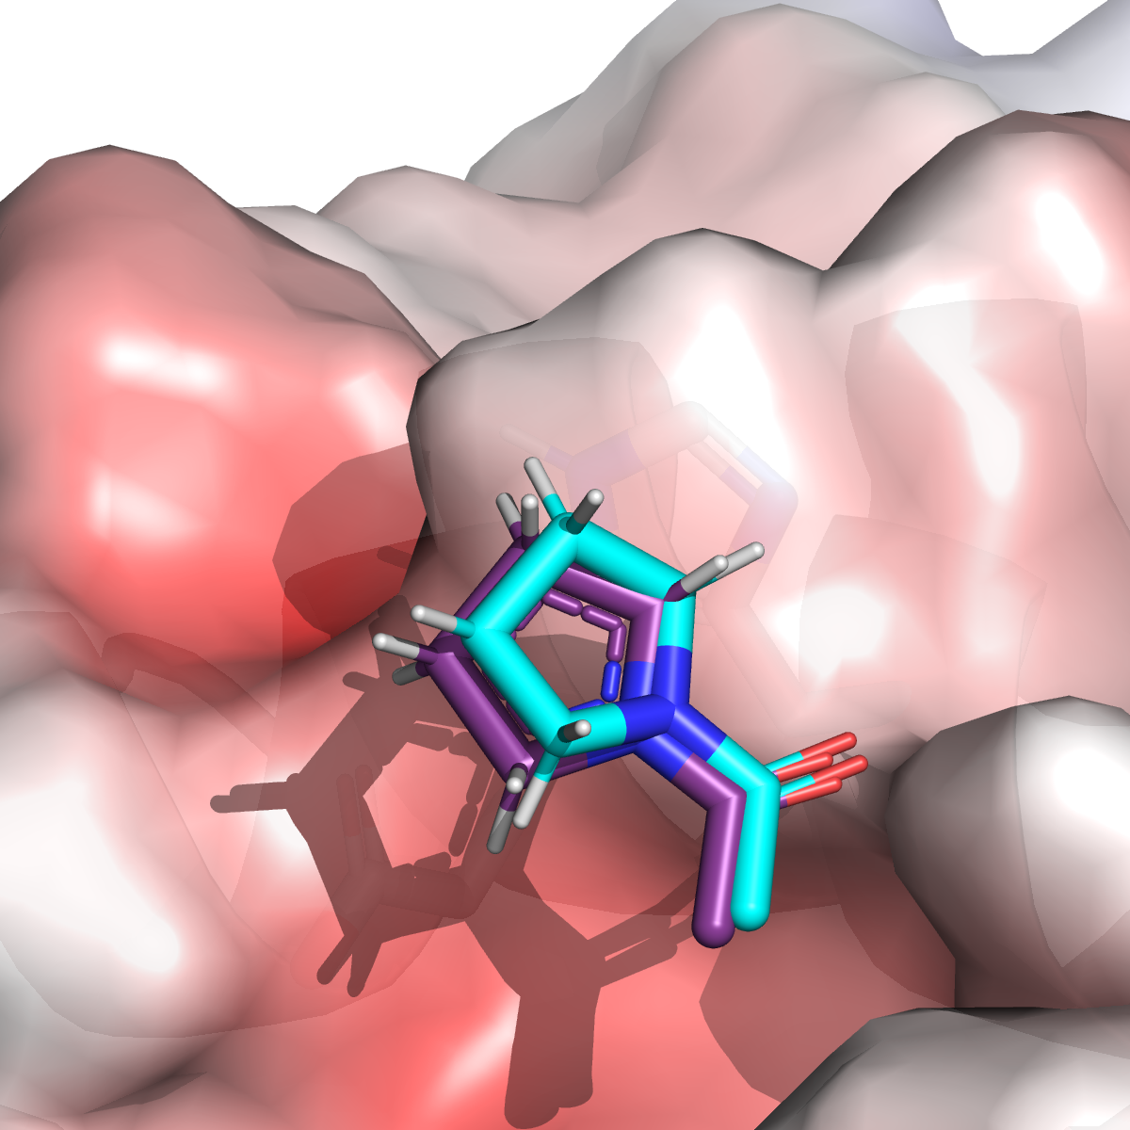
Understanding and optimizing selectivity
Cmpd 4
On solving of crystal structure, binding mode was consistent with that from simulations
Alignment between model and x-ray RMSD = 0.5 Å
 | Cmpd 3 | Cmpd 4
Fold selectivity off-target 1 / 2 | 2 / 2.1 | 1.5 / 3.8

Slide 25
Exploring further CH-pi substituents
Enumeration, docking and MD ranking of a virtual library
Position was amenable to amide-coupling library
Enumerate all primary, secondary amines
Property filtering (MW, functional groups)
Docking with Glide and MCSS constraint
Short MD simulation (RMSD,
MM-PBSA)
Amber TI and selection
50 K
10 K
3 K
6
Maintain CH-pi interaction to histidine
Grow hydrogen bond donor to acidic residue
Steric/electrostatic clash with off-targets 1 & 2
Acidic residue
interesting virtual hits

Slide 26
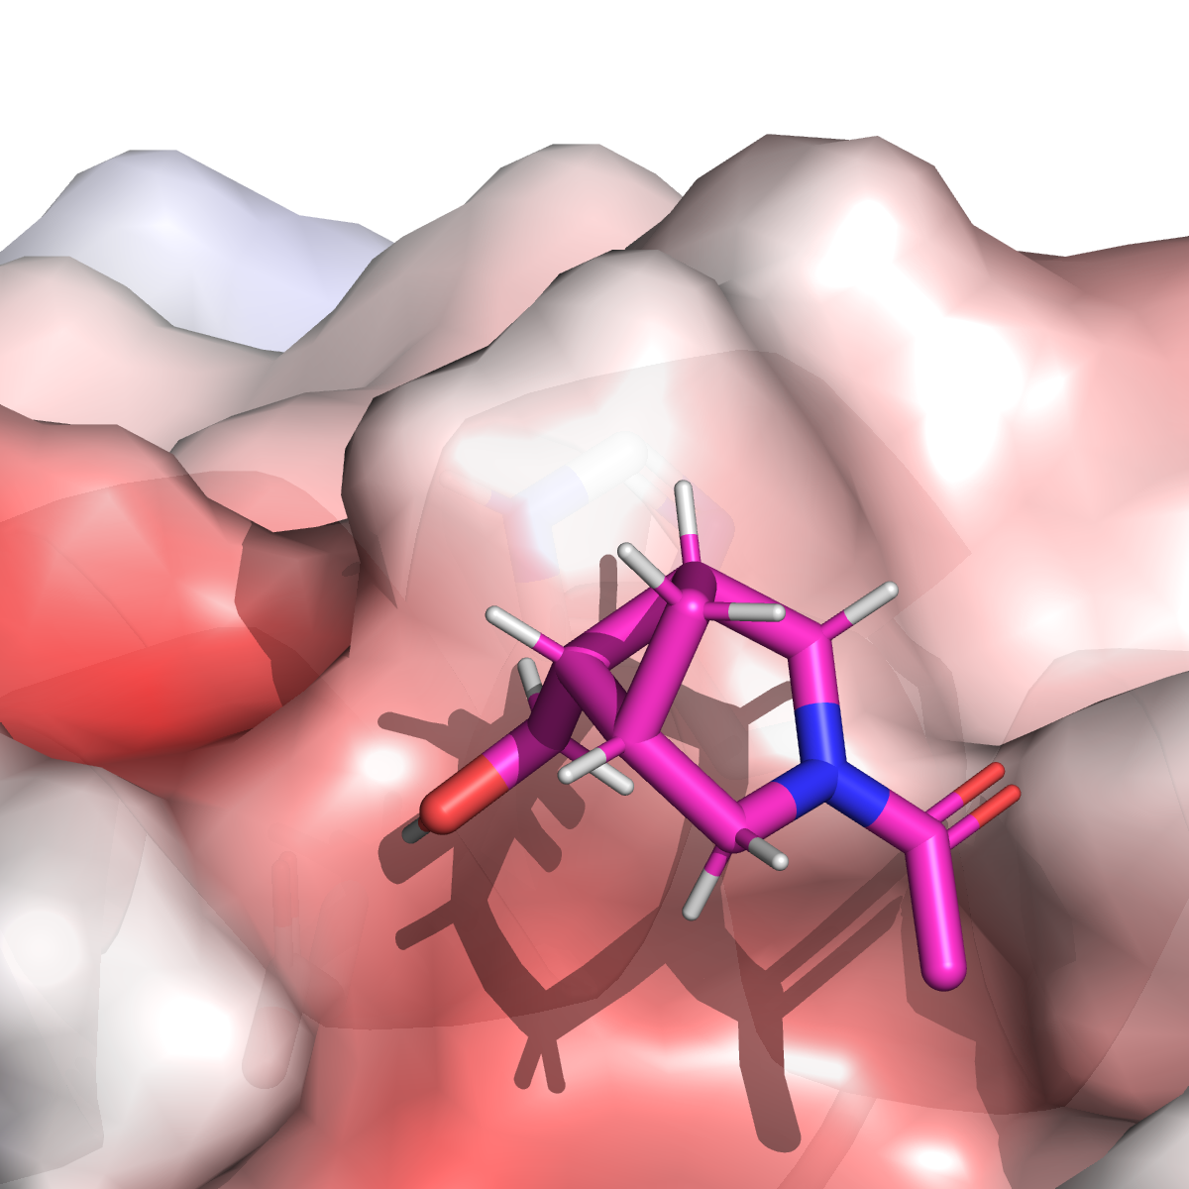
Exploring further CH-pi substituents
Enumeration, docking and MD ranking of a virtual library
Synthesis of only two of the top selected virtual hits
Final exploration of this strategy to obtain selectivity
Both molecules improved potency and selectivity
 | Cmpd 1 | Cmpd 5 | Cmpd 6
Fold selectivity off-target 1 / 2 | 0.7 / 1 | 3.4 / 6.8 | 6.9 / 11.9

Slide 27
Combining free energy and machine learning
Series B

Slide 28
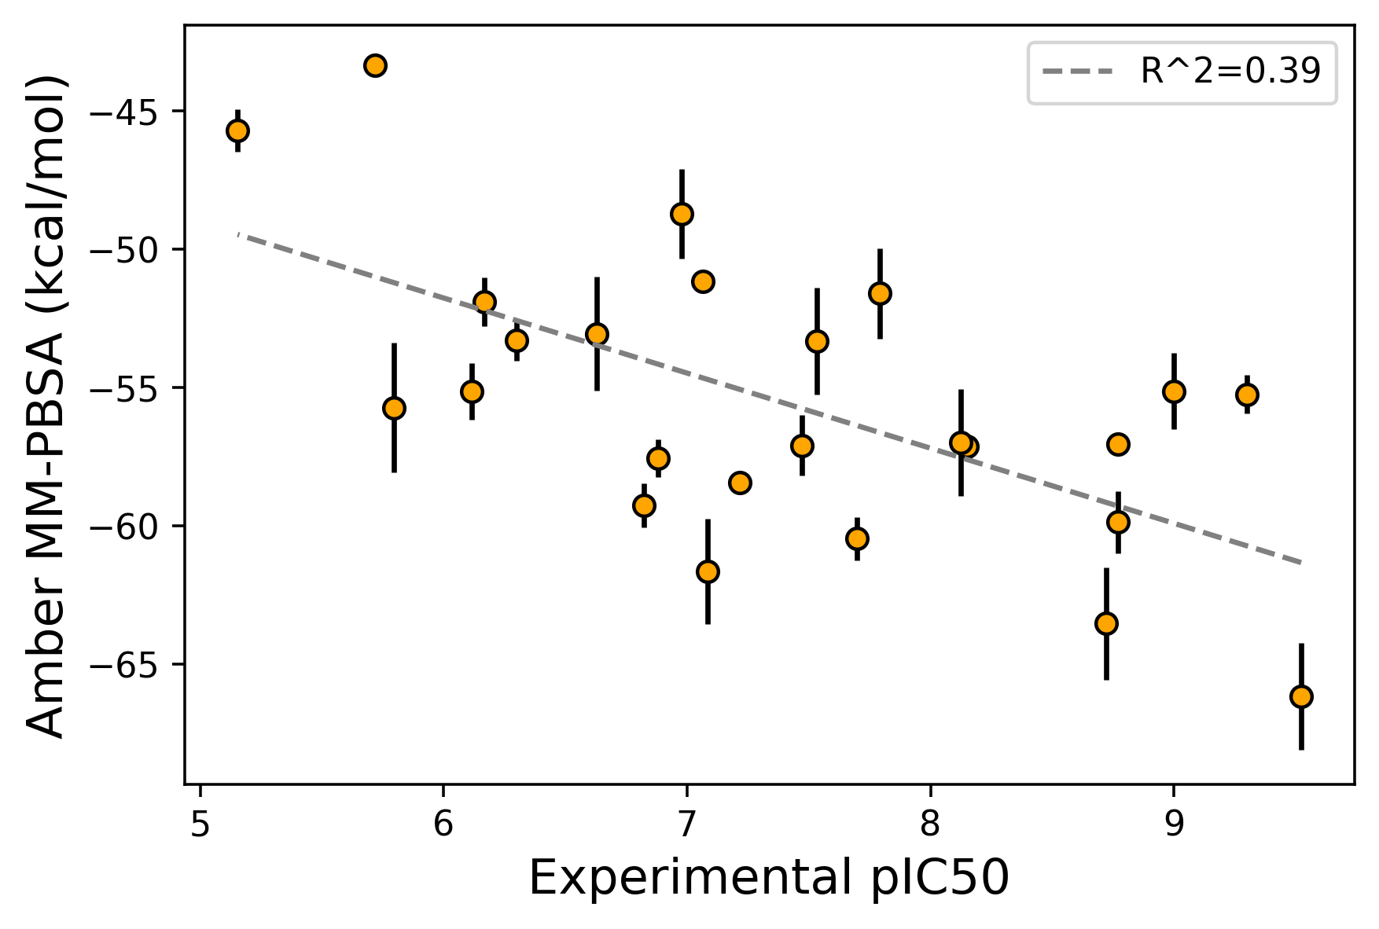
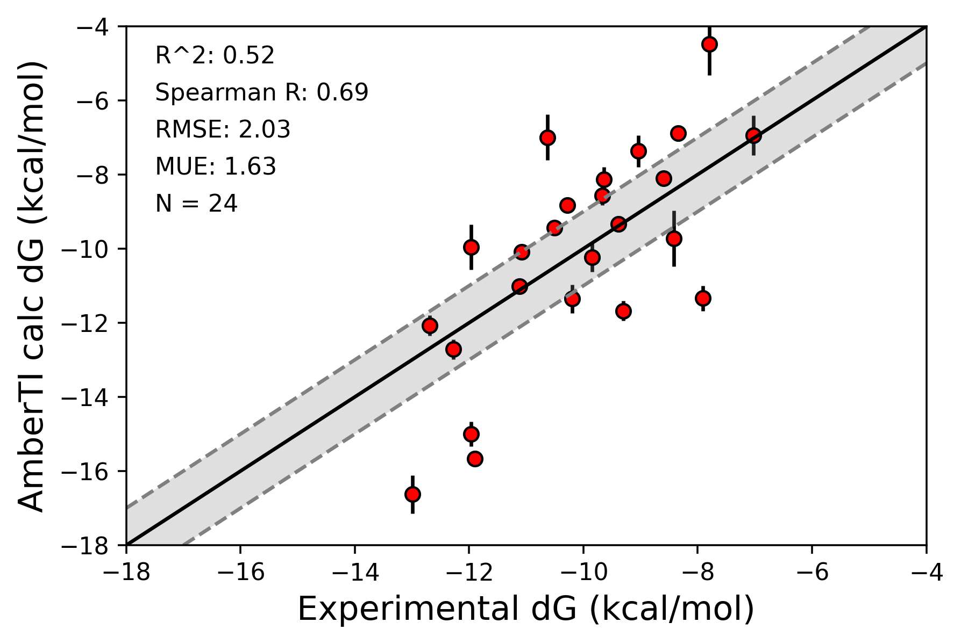
Project shifted focus to series B
Docking, molecular dynamics, MM-PBSA and AmberTI remained effective tools
molecular dynamics scoring
free energy scoring
pK_{a} modulation
N=24
External data

Slide 29
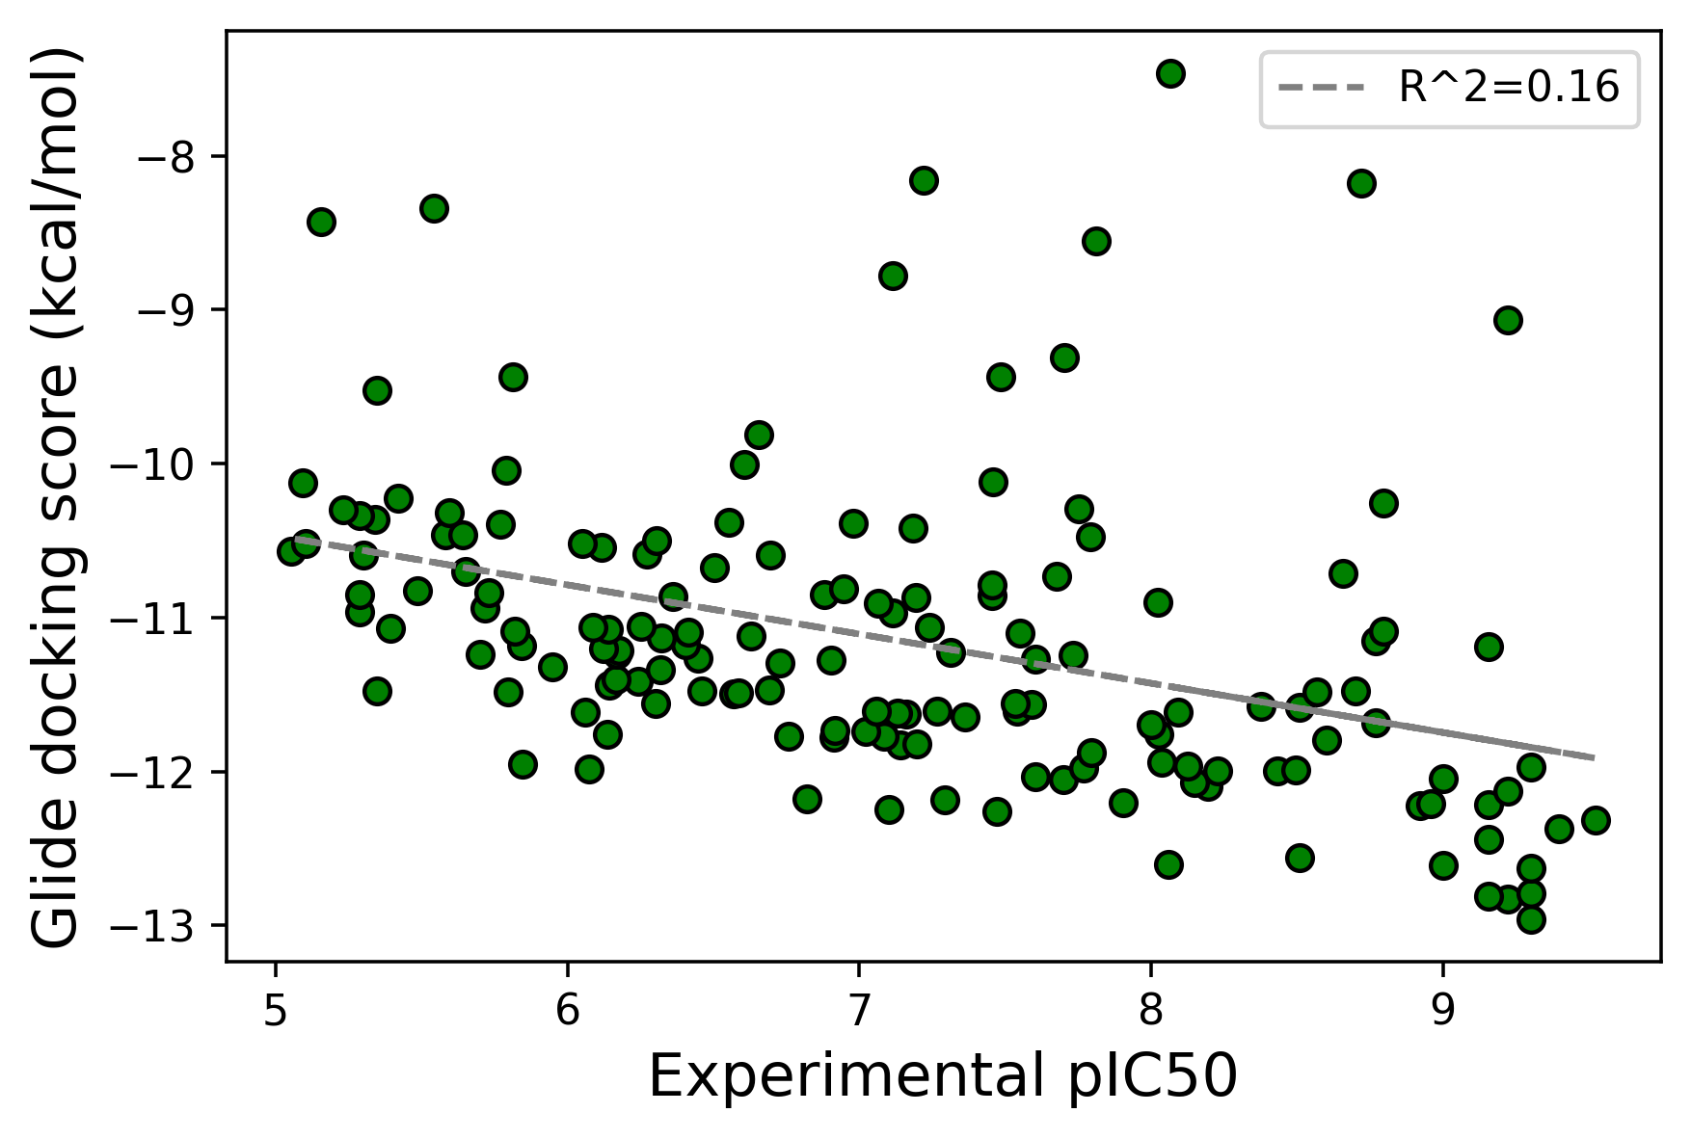
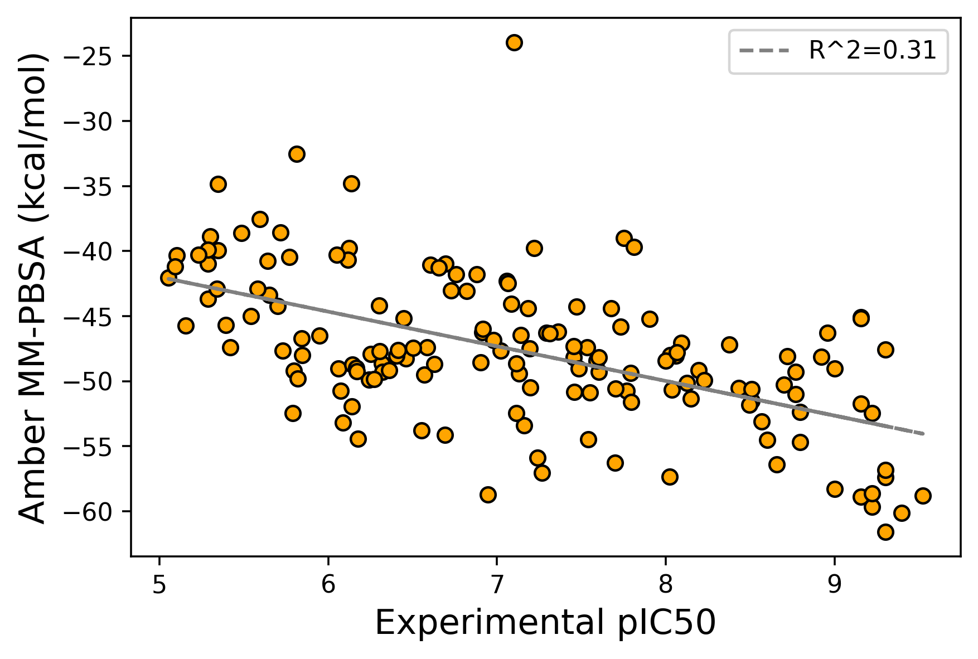
Project shifted focus to series B
Evaluation on a larger compounds set
docking
molecular dynamics scoring
N=158
External data

Slide 30
Exploration of side-chain position
Potency exploration but also permeability (pK_{a} modulation, polarity)
18 K
2 K
2 K
Docking with Glide and MCSS constraint
Short MD simulation (RMSD,
MM-PBSA)
Can we sample best predicted binders with AmberTI?
Enumerate all alcohols
side-chain
Active learning free energy protocol
 | Reference
Potency | Single digit nM
MDCK-LE P_{app} (cm/s x 10⁻⁶) | 1.9

Slide 31
Exploration of side-chain position
Active learning relative binding free energy
Run 30-40 RBFE
AmberTI RBFE
Star map, 9 λ windows, 5 ns
Balance exploration & exploitation
ML model on ∆∆G prediction
Select top candidates
Random Forest
2D descriptors
Thompson et al, Artificial Intelligence in the Life Sciences, 2022

Slide 32
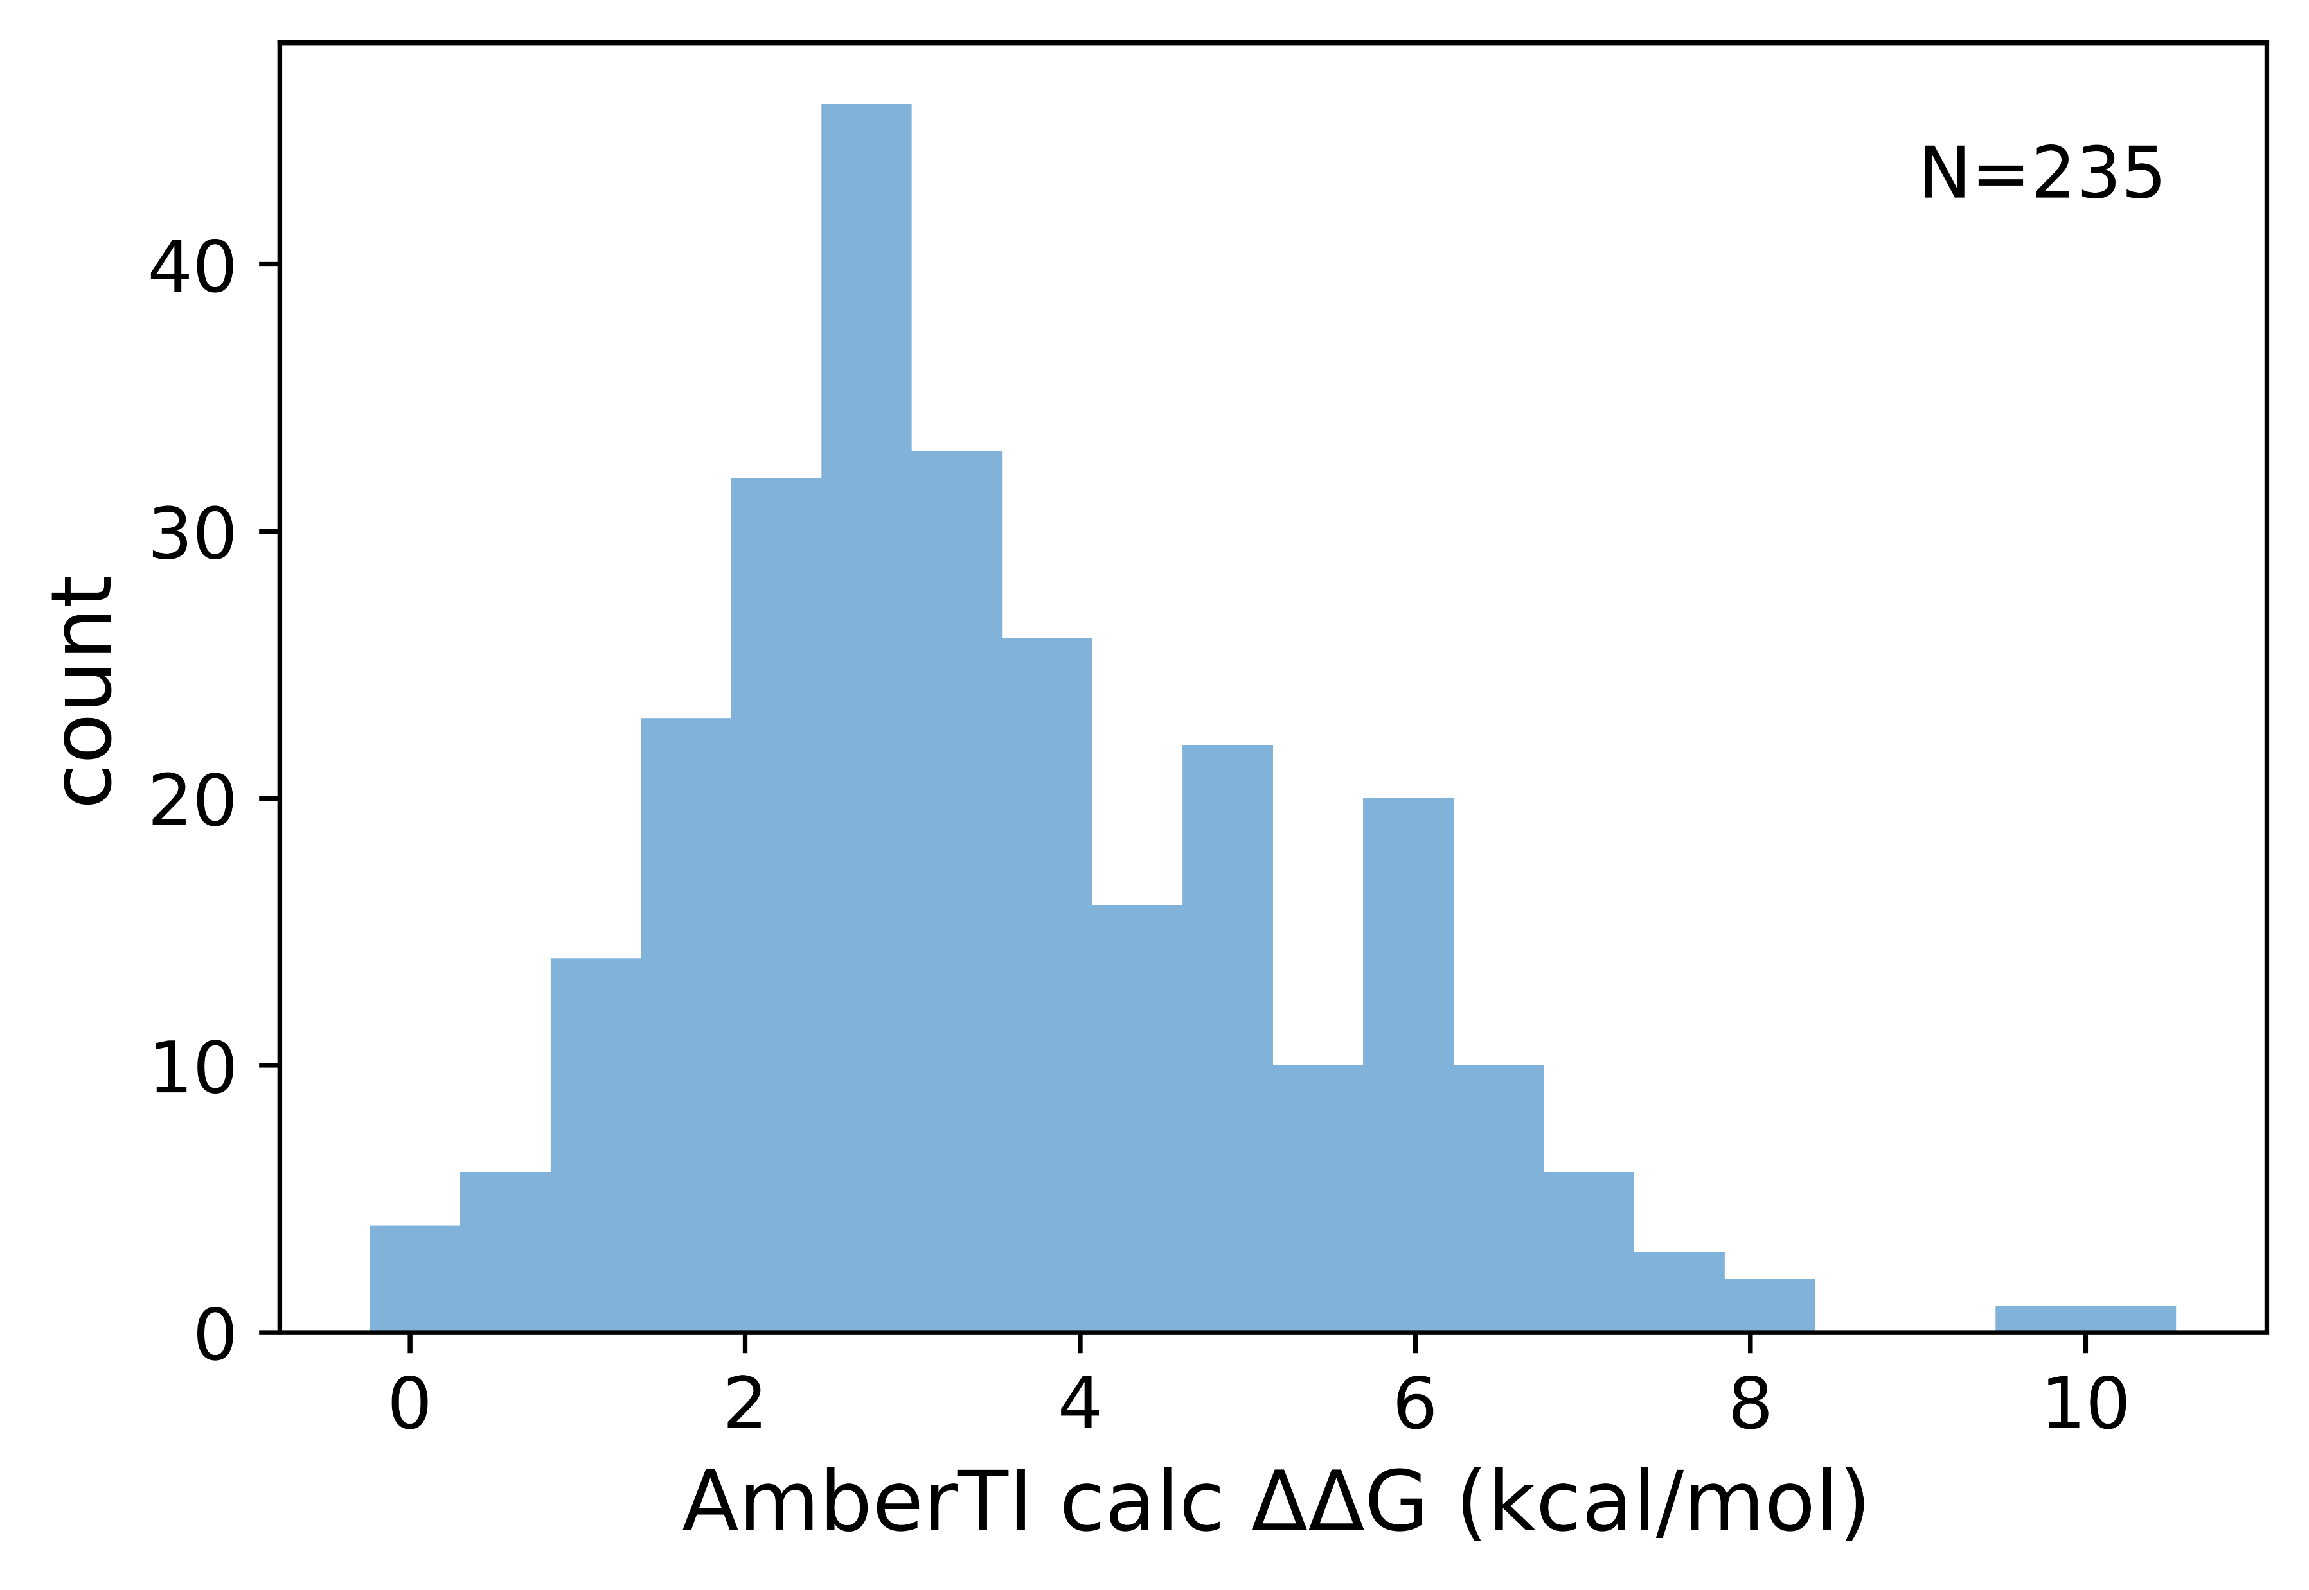
Exploration of side-chain position
Active learning relative binding free energy
Total of three rounds and 235 side-chains sampled
Reference molecule was well optimized and a replacement group was difficult to identify
very few predicted better than reference

Slide 33
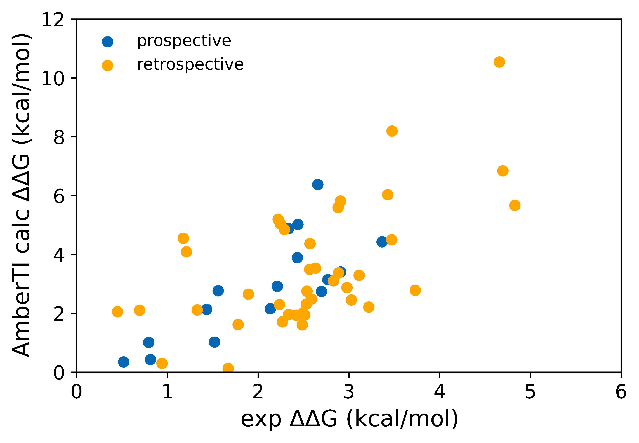
Exploration of side-chain position
Star map relative binding free energy was predictive
Of 56 compounds synthesized, 16 had prospective predictions
Diversity, permeability prediction and pK_{a} modulation were additional selection criteria
 | prospective | retrospective | overall
N | 16 | 40 | 56
r² | 0.62 | 0.37 | 0.43
spearman | 0.78 | 0.55 | 0.59
RMSE (kca/mol) | 1.45 | 1.91 | 1.79
All transformations involved morphing +1 charged reference side-chain to +1 charge proposal (charge movement). Free energy results are not corrected for pK_{a} change.

Slide 34
Exploration of side-chain position
Novel side-chains were identified
The most potent side-chain from the library was also predicted active by AmberTI
Although slightly weaker (2-fold potency drop), provided chemical diversity
Passive permeability however was not improved
 | Reference | Cmpd 1
ΔΔG exp (kcal/mol) | - | 0.54
ΔΔG calc (kcal/mol) | - | 0.19 +/- 0.27
MDCK-LE P_{app} (cm/s x 10⁻⁶) | 1.9 | 0.39

Slide 35
Conclusions
Atropisomers can be predicted with quantum chemical methods
Large virtual exercise enabled identification of best combination of R-groups for stable atropisomers
Structural and physics-based methods can be successful in optimizing selectivity and potency
Novel R-groups bringing selectivity identified from large virtual space
Chemically diverse side-chains of similar potency prioritized by relative binding free energy calculations enabled by active learning protocol
Future work: combine potency prediction with property MPO score

Slide 36
Current research: one-sliders

Slide 37
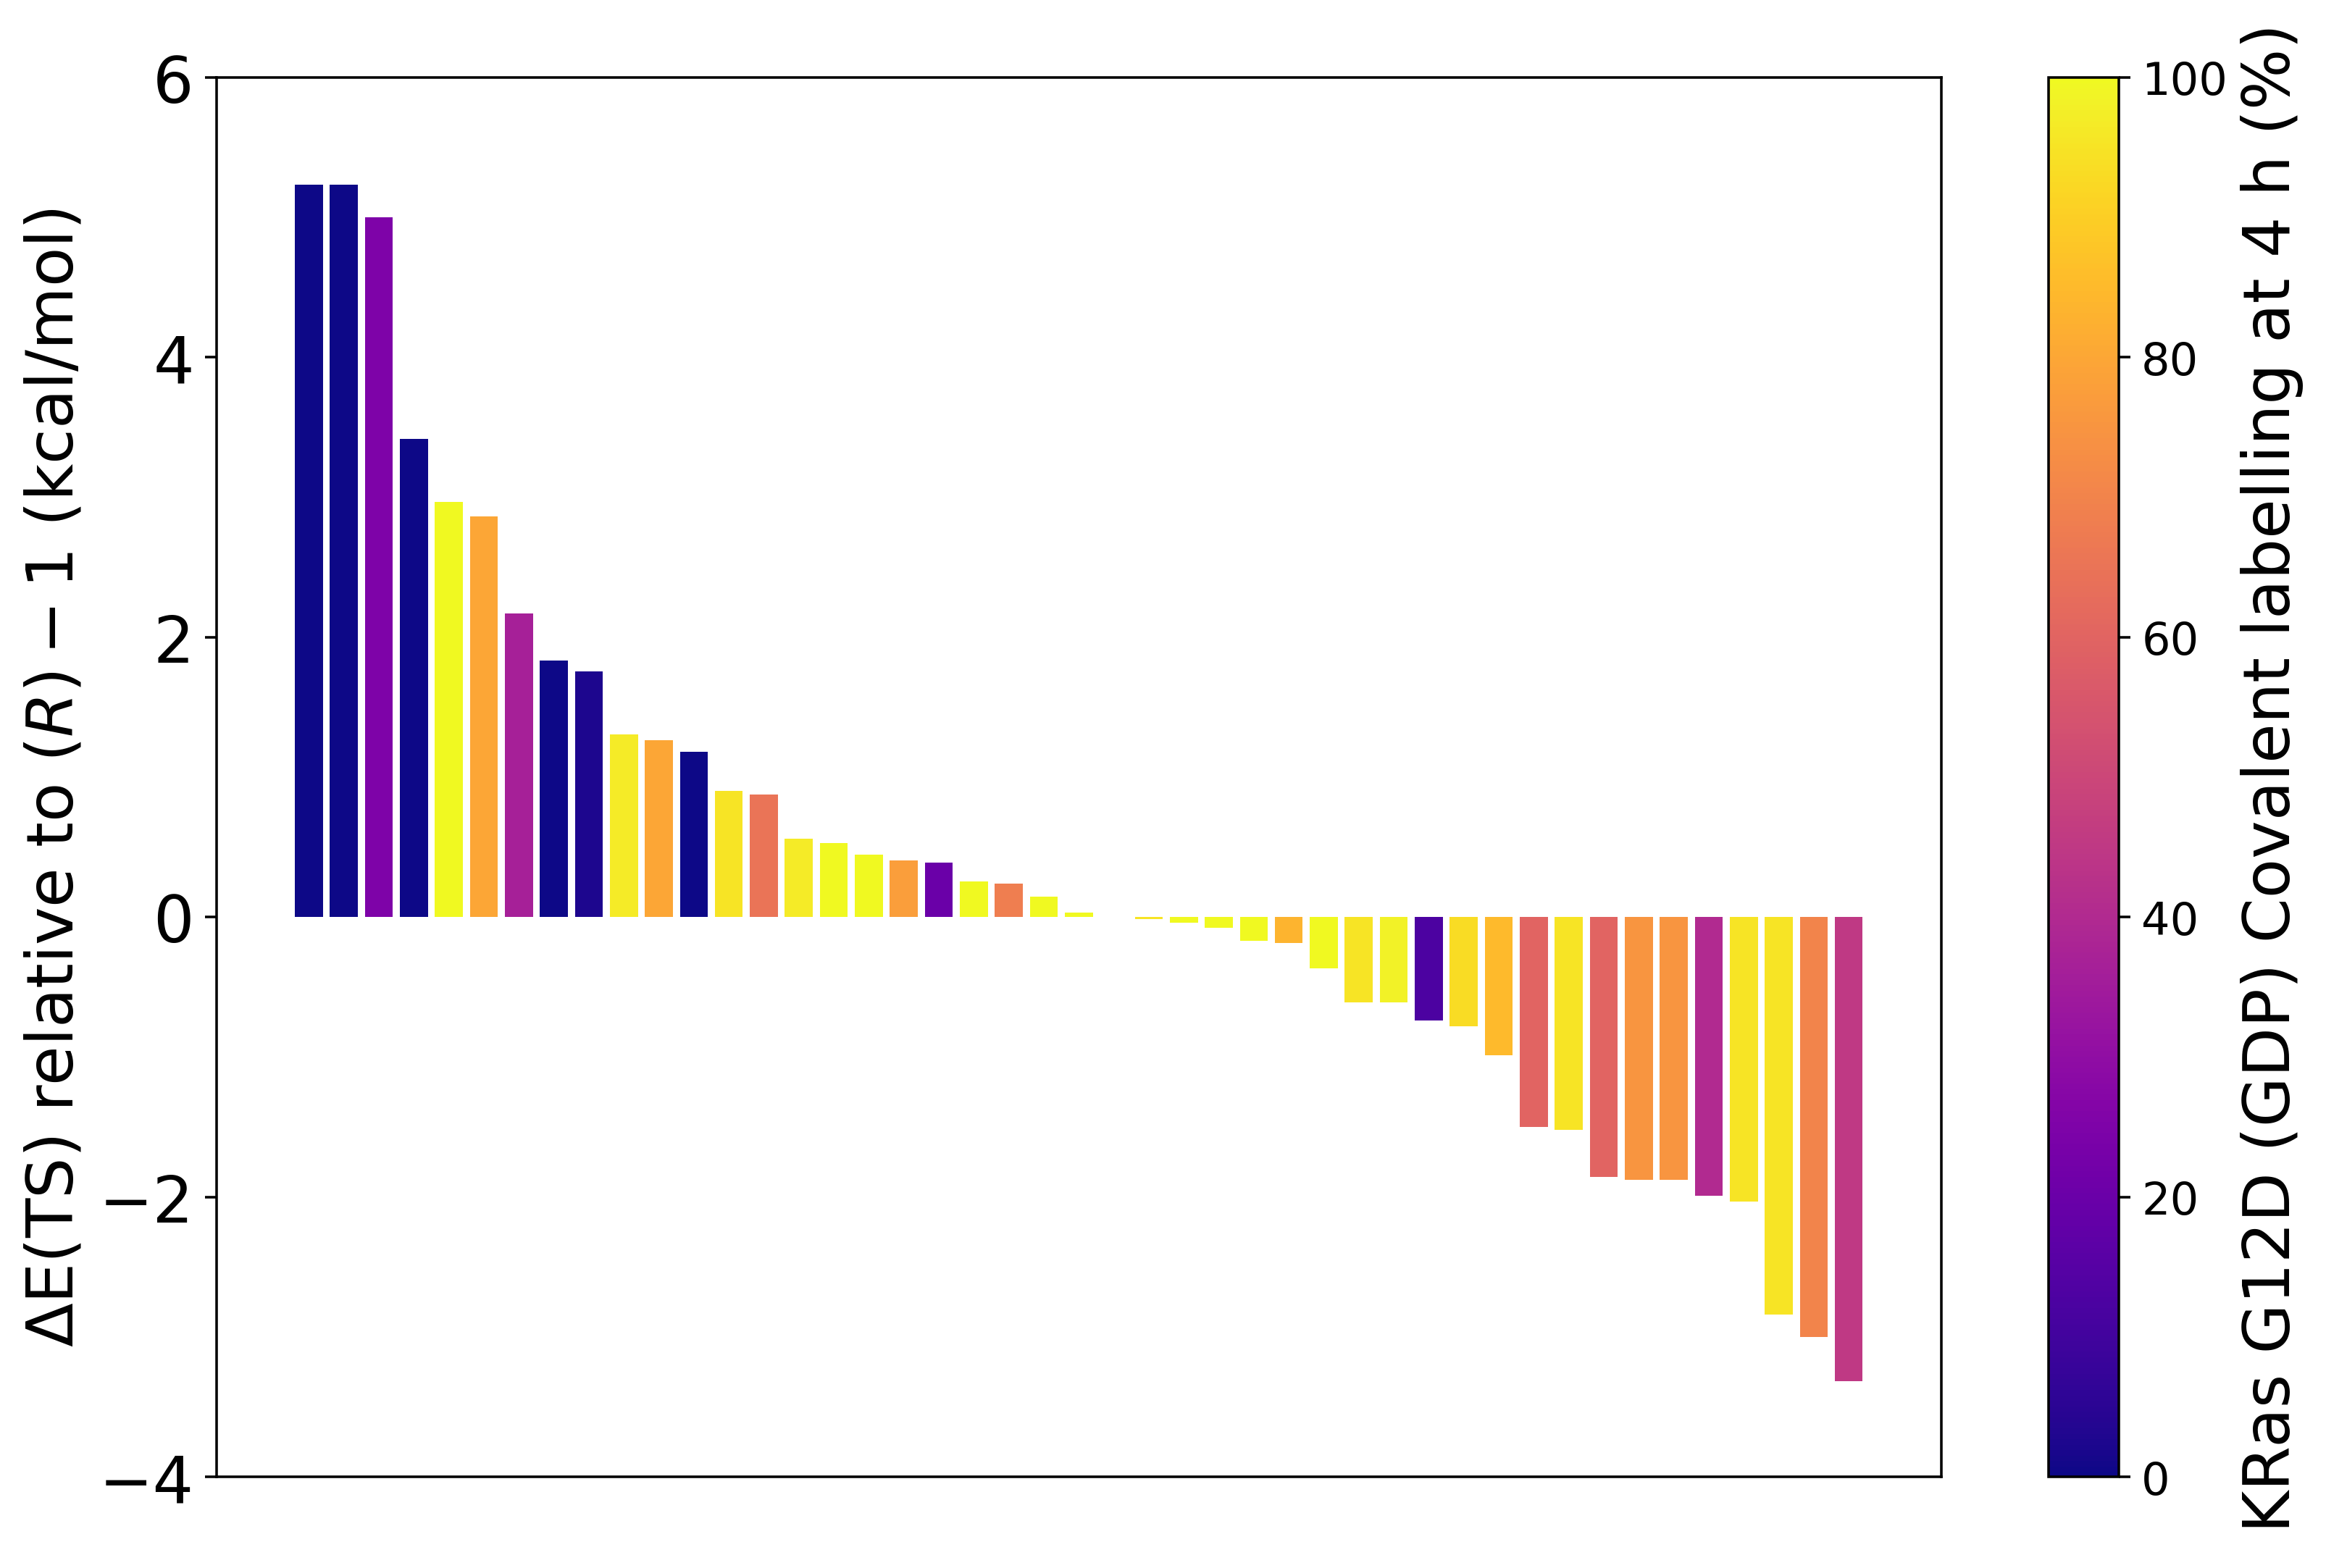
Quantum mechanical transition state scanning
Understanding and predicting reactivity with transition state (TS) scans
Development of TS scanning workflow to screen ~30 novel reactive warheads per design cycle
Progress lowest energy to Gaussian optimization / transition state search
(B3LYP/6-31g* PCM water)
Generate 20 starting geometries (RDKit ConstrainedEmbed)
XTB optimization with dihedral constraints
Confirm reaction coordinate (imaginary frequency)
transition state
ΔE_{TS}
ΔE_{TS} (kcal/mol) vs reference
% covalent labelling (MS 4 hrs)
reactants
product

Slide 38
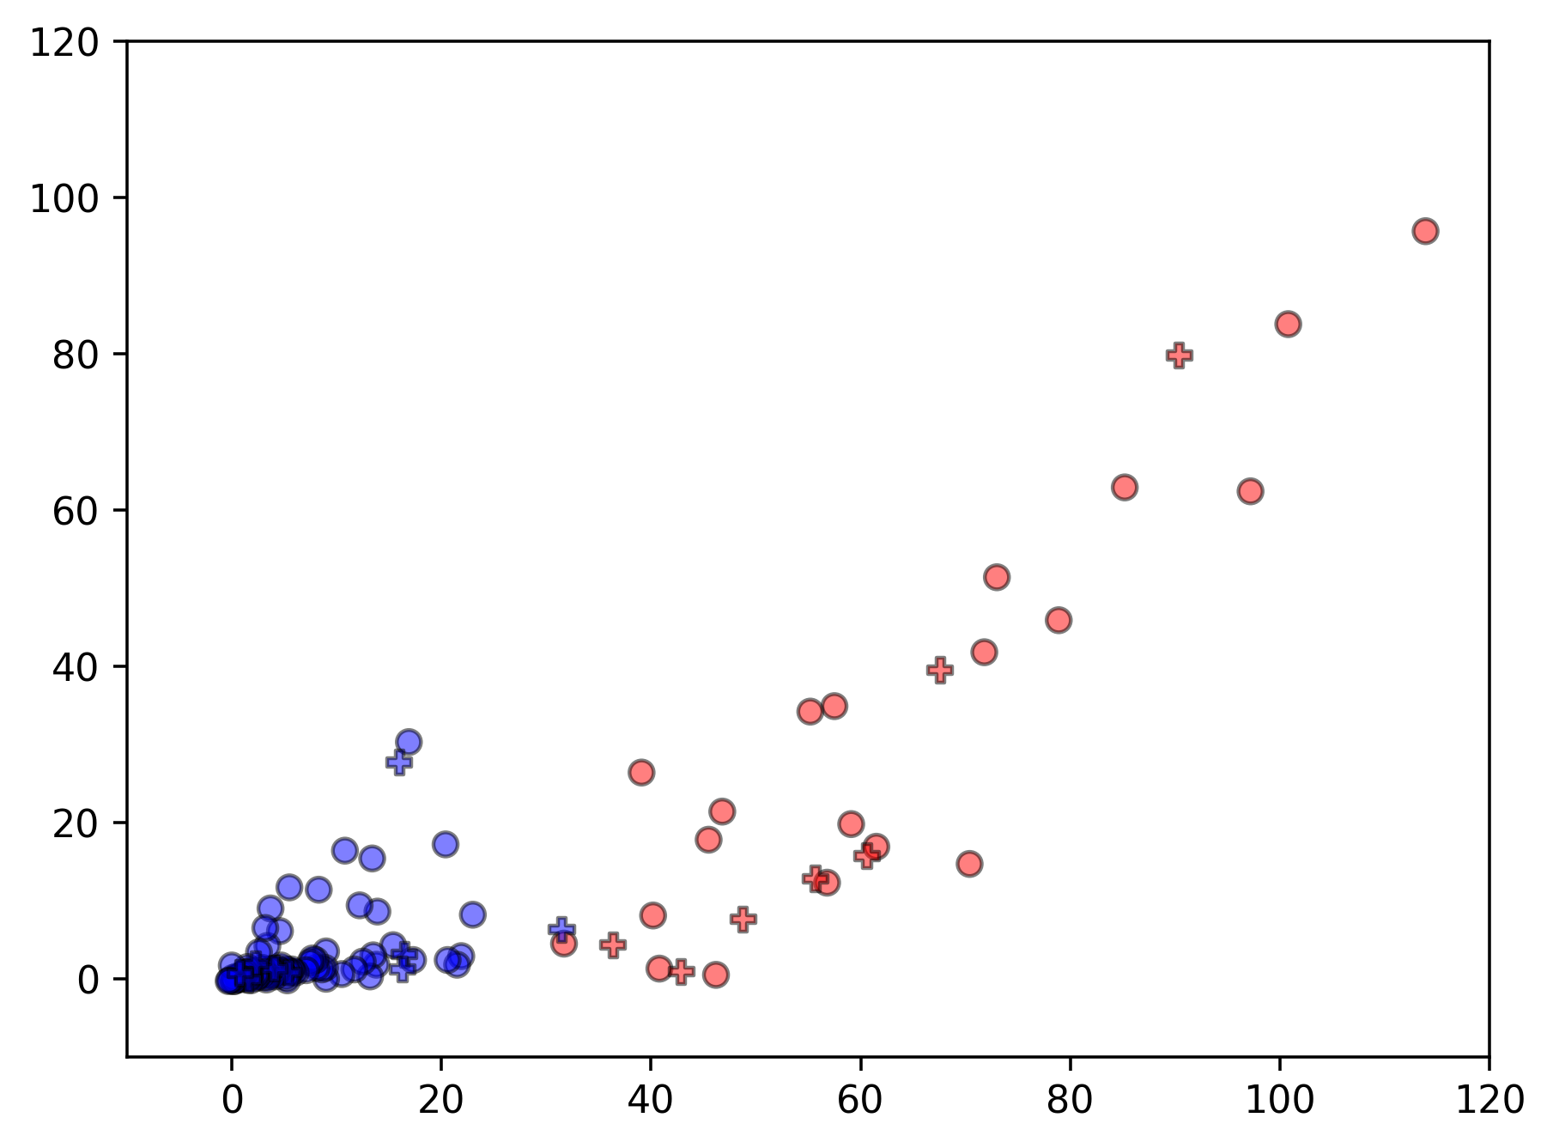
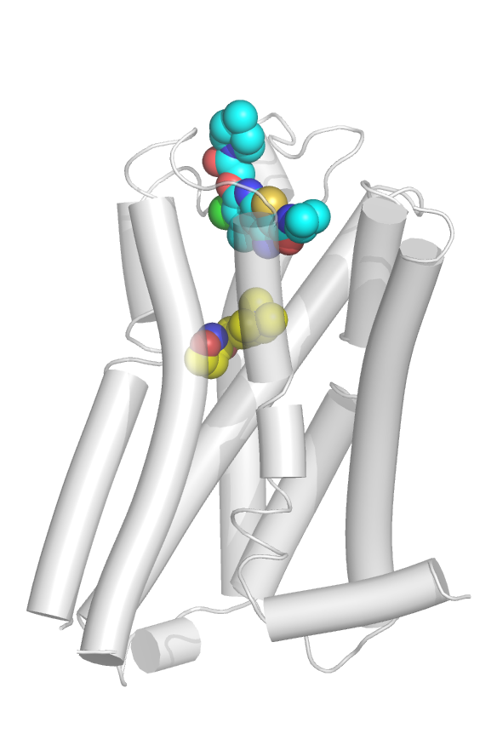
Strategy and virtual screening of Enamine REAL 10 B
Prioritization of allosteric pockets for GPCR target & hit identification from REAL space
Evaluation of allosteric sites for desired cross-reactivity
Docking Enamine REAL space yielded novel hits
Filter Enamine Diverse 97 M ->20 M (phys chem space)
Target B (% response at 10 uM)
allosteric
Openeye Orion Gigadock Warp
orthosteric
Re-scoring and hit analysis
Target A (% response at 10 uM)
Enamine request | 150
Synthesized + delivered | 124 (82 %)
Hits | 27 (Hit rate 21.7 %)
AC50 < 5uM | 9 (Hit rate 7.25 %)
2D search in 10 B ->hit expansion
Docking, re-scoring, final selection
*orthogonal hit validation in progress

Slide 39
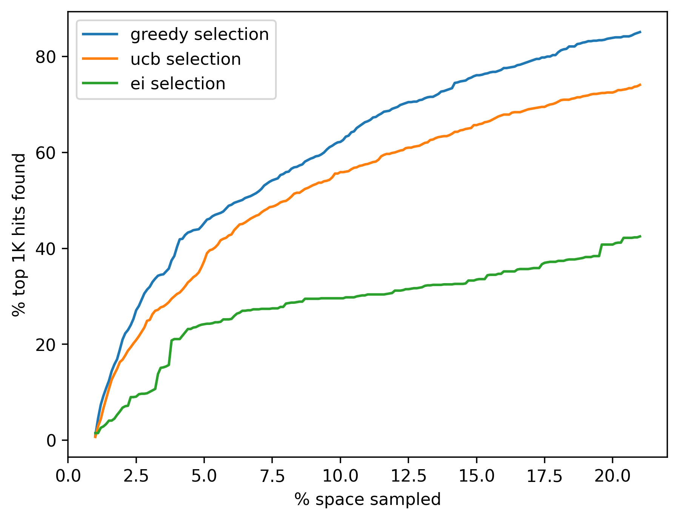
Methods to search large make-on-demand spaces
Current work in progress to explore combinatorial chemically accessible virtual spaces
Benchmarking active learning methods
Genetic Algorithm
Thompson Sampling
ComboBO (Coley lab)
Enamine REAL: 275592
Acylated-acylated diamine: diamine (mono Boc) + acid + acid

Slide 40
Acknowledgements
Novartis Biomedical Research – CADD group (Cambridge / Basel / California)
Cihan Soylu – machine learning models, active learning strategies
Mike Fortunato – active learning strategies
Matthias Bauer – free energy
Aaron Danilack – quantum mechanics
Rainer Wilcken (former) – quantum mechanics
Troy Smith – Enamine REAL space orders
John Manchester, Jose Duca, Viktor Hornak (former) – leadership
Novartis Biomedical Research – Oncology
Oncology chemistry teams
Novartis Biomedical Research – Cardiovascular & Metabolism
CVM chemistry teams
Novartis Biomedical Research – Research Informatics
HPC team
Amber MD developers
TI Free energy code & tutorials
Enamine
Enamine chemistry

Slide 41
Thank you

Slide 42
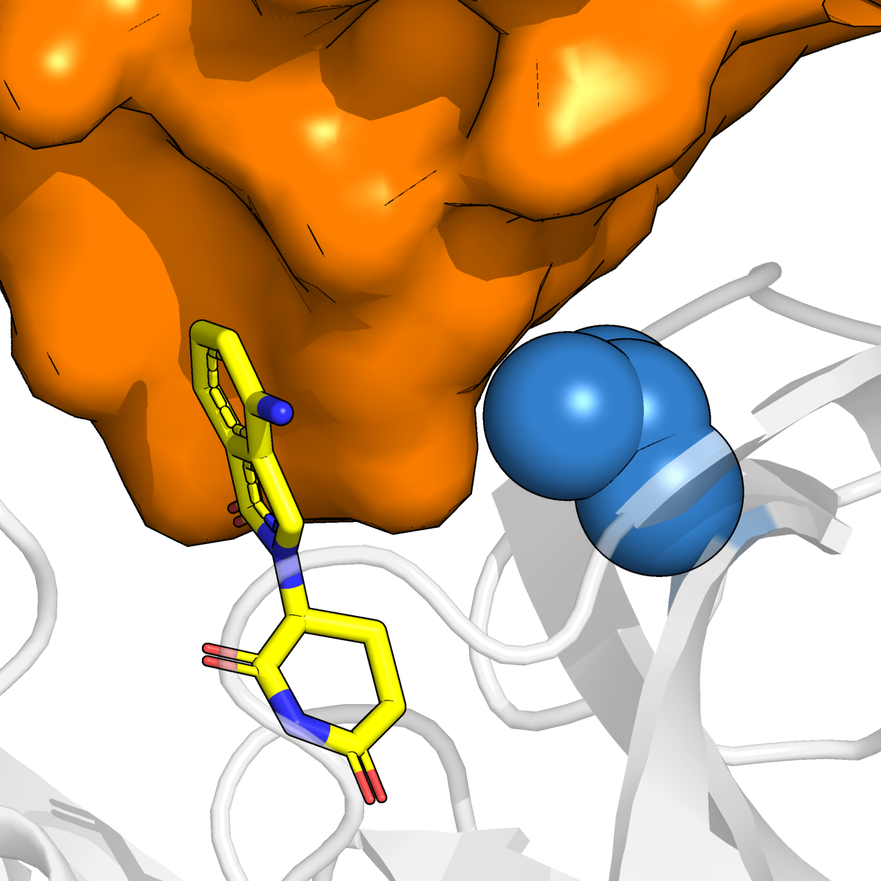
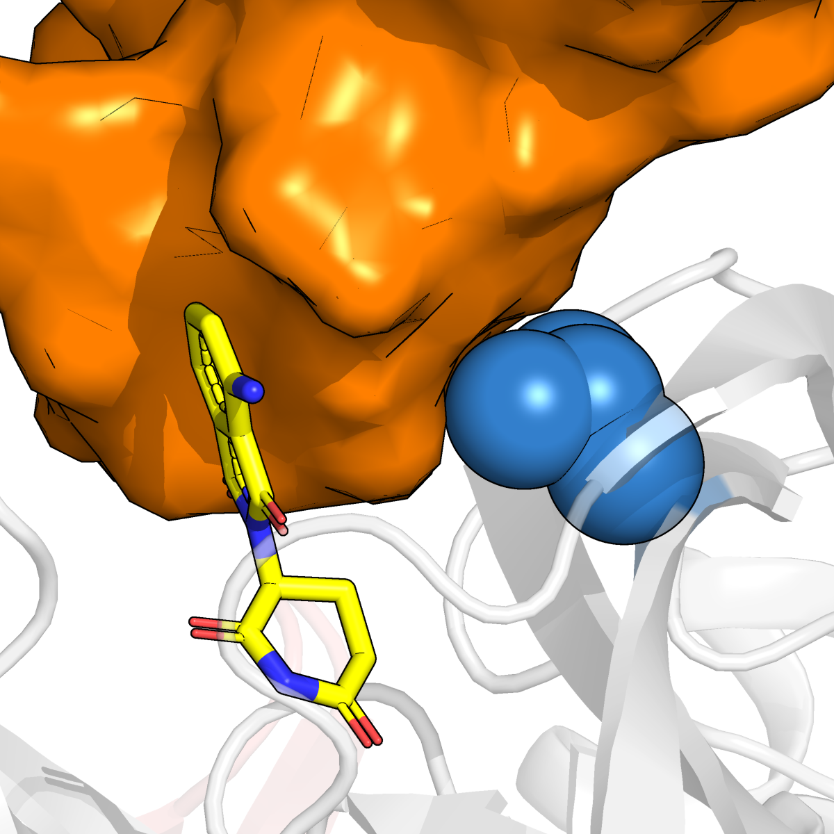
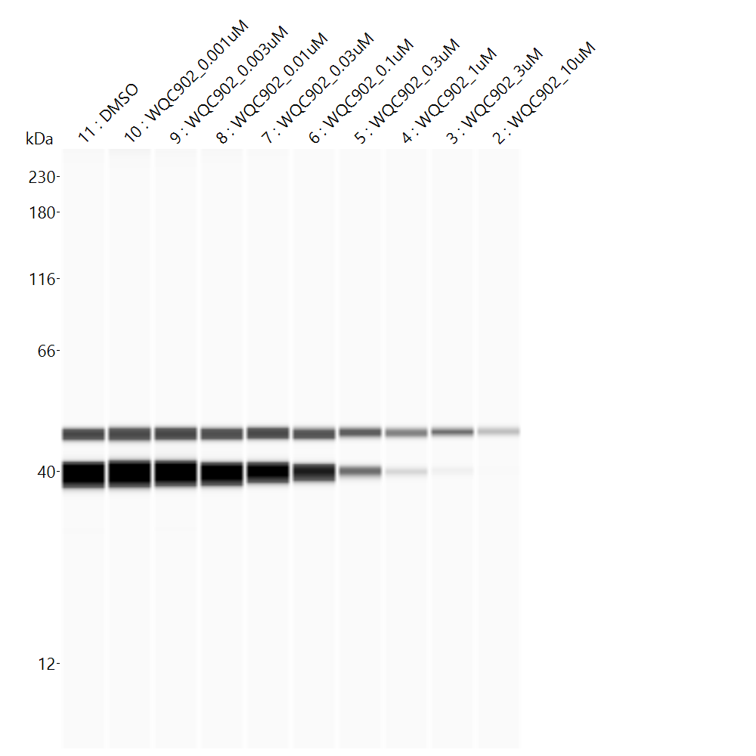
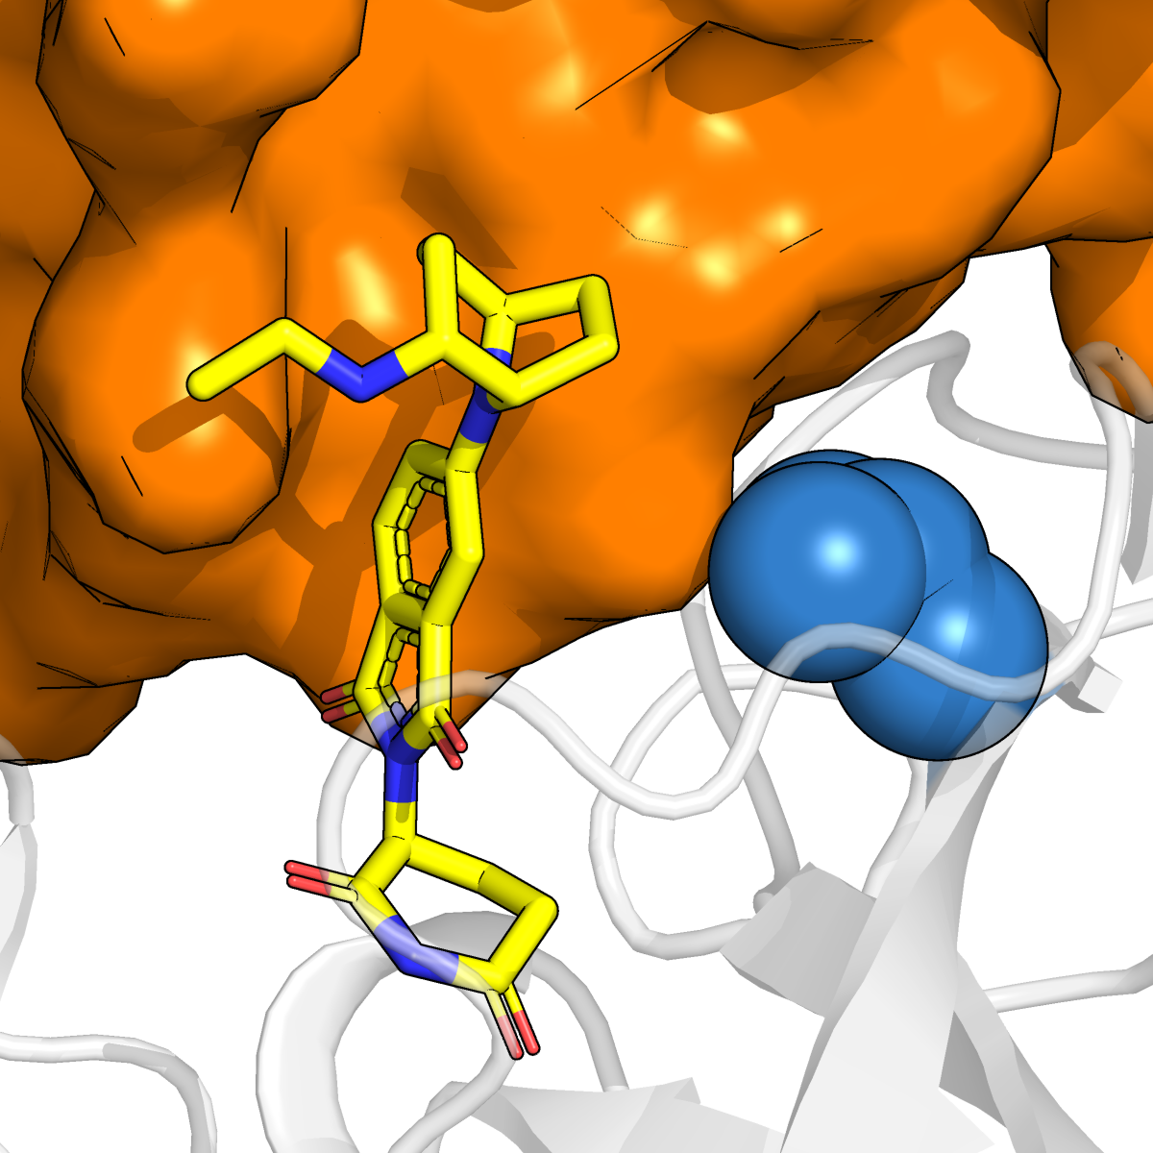
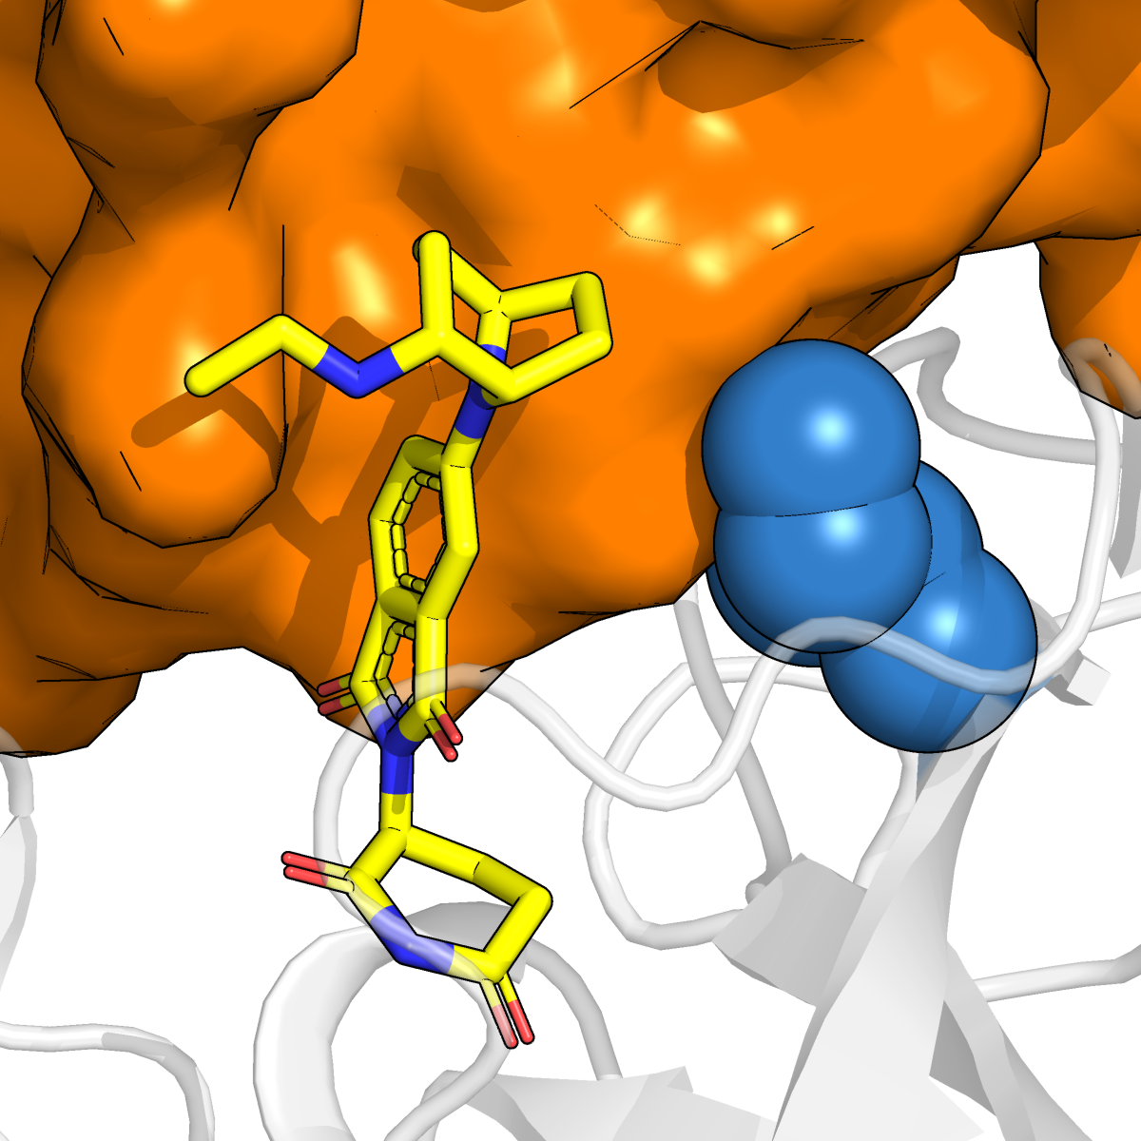
NK7-902 degrades both human and mouse NEK7
Human PBMCs
NK7-902
NK7-902 (nM) – 18h treatment
CK1α
IKZF1
DMSO
10000
0.009
0.038
156.2
2500
0.15
625
0.6
2.4
9.7
39
β-Actin
40 -
NEK7
DC₅₀ = 1.6 nM, D_{max} > 95%
Mouse primary splenocytes
NK7-902 (nM) – 18h treatment
DMSO
1000
10000
1
3
10
30
100
300
3000
β-Actin
40 -
NEK7
DC₅₀ = 54.2 nM, D_{max} > 95%
hNEK7
mNEK7
V388
V388I
Sylvain et al, BioRxiv, 2024

Slide 43
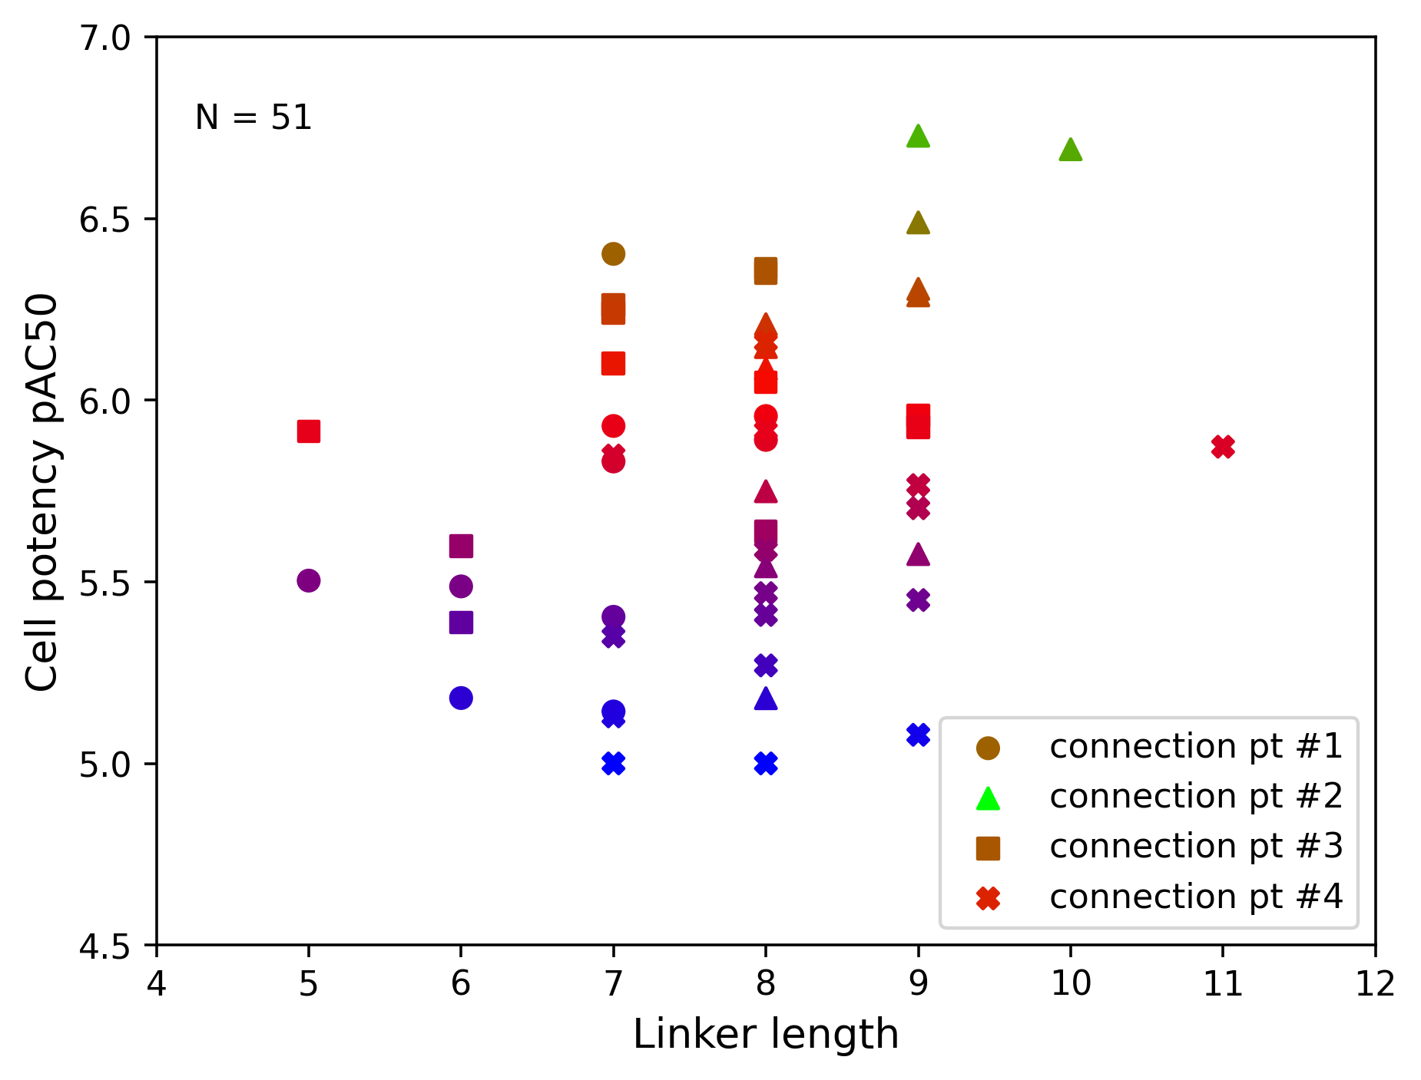
Bifunctional degraders: enabling linker library design via ternary complex prediction
POI

Slide 45
 | K_{D} (uM) | ΔG (kcal/mol)
1 nM | 0.001 | -12.27
10 nM | 0.01 | -10.91
100 nM | 0.1 | -9.55
1 uM | 1 | -8.18
2 uM | 2 | -7.77
10 uM | 10 | -6.82
100 uM | 100 | -5.45
1 mM | 1000 | -4.09

Slide 46
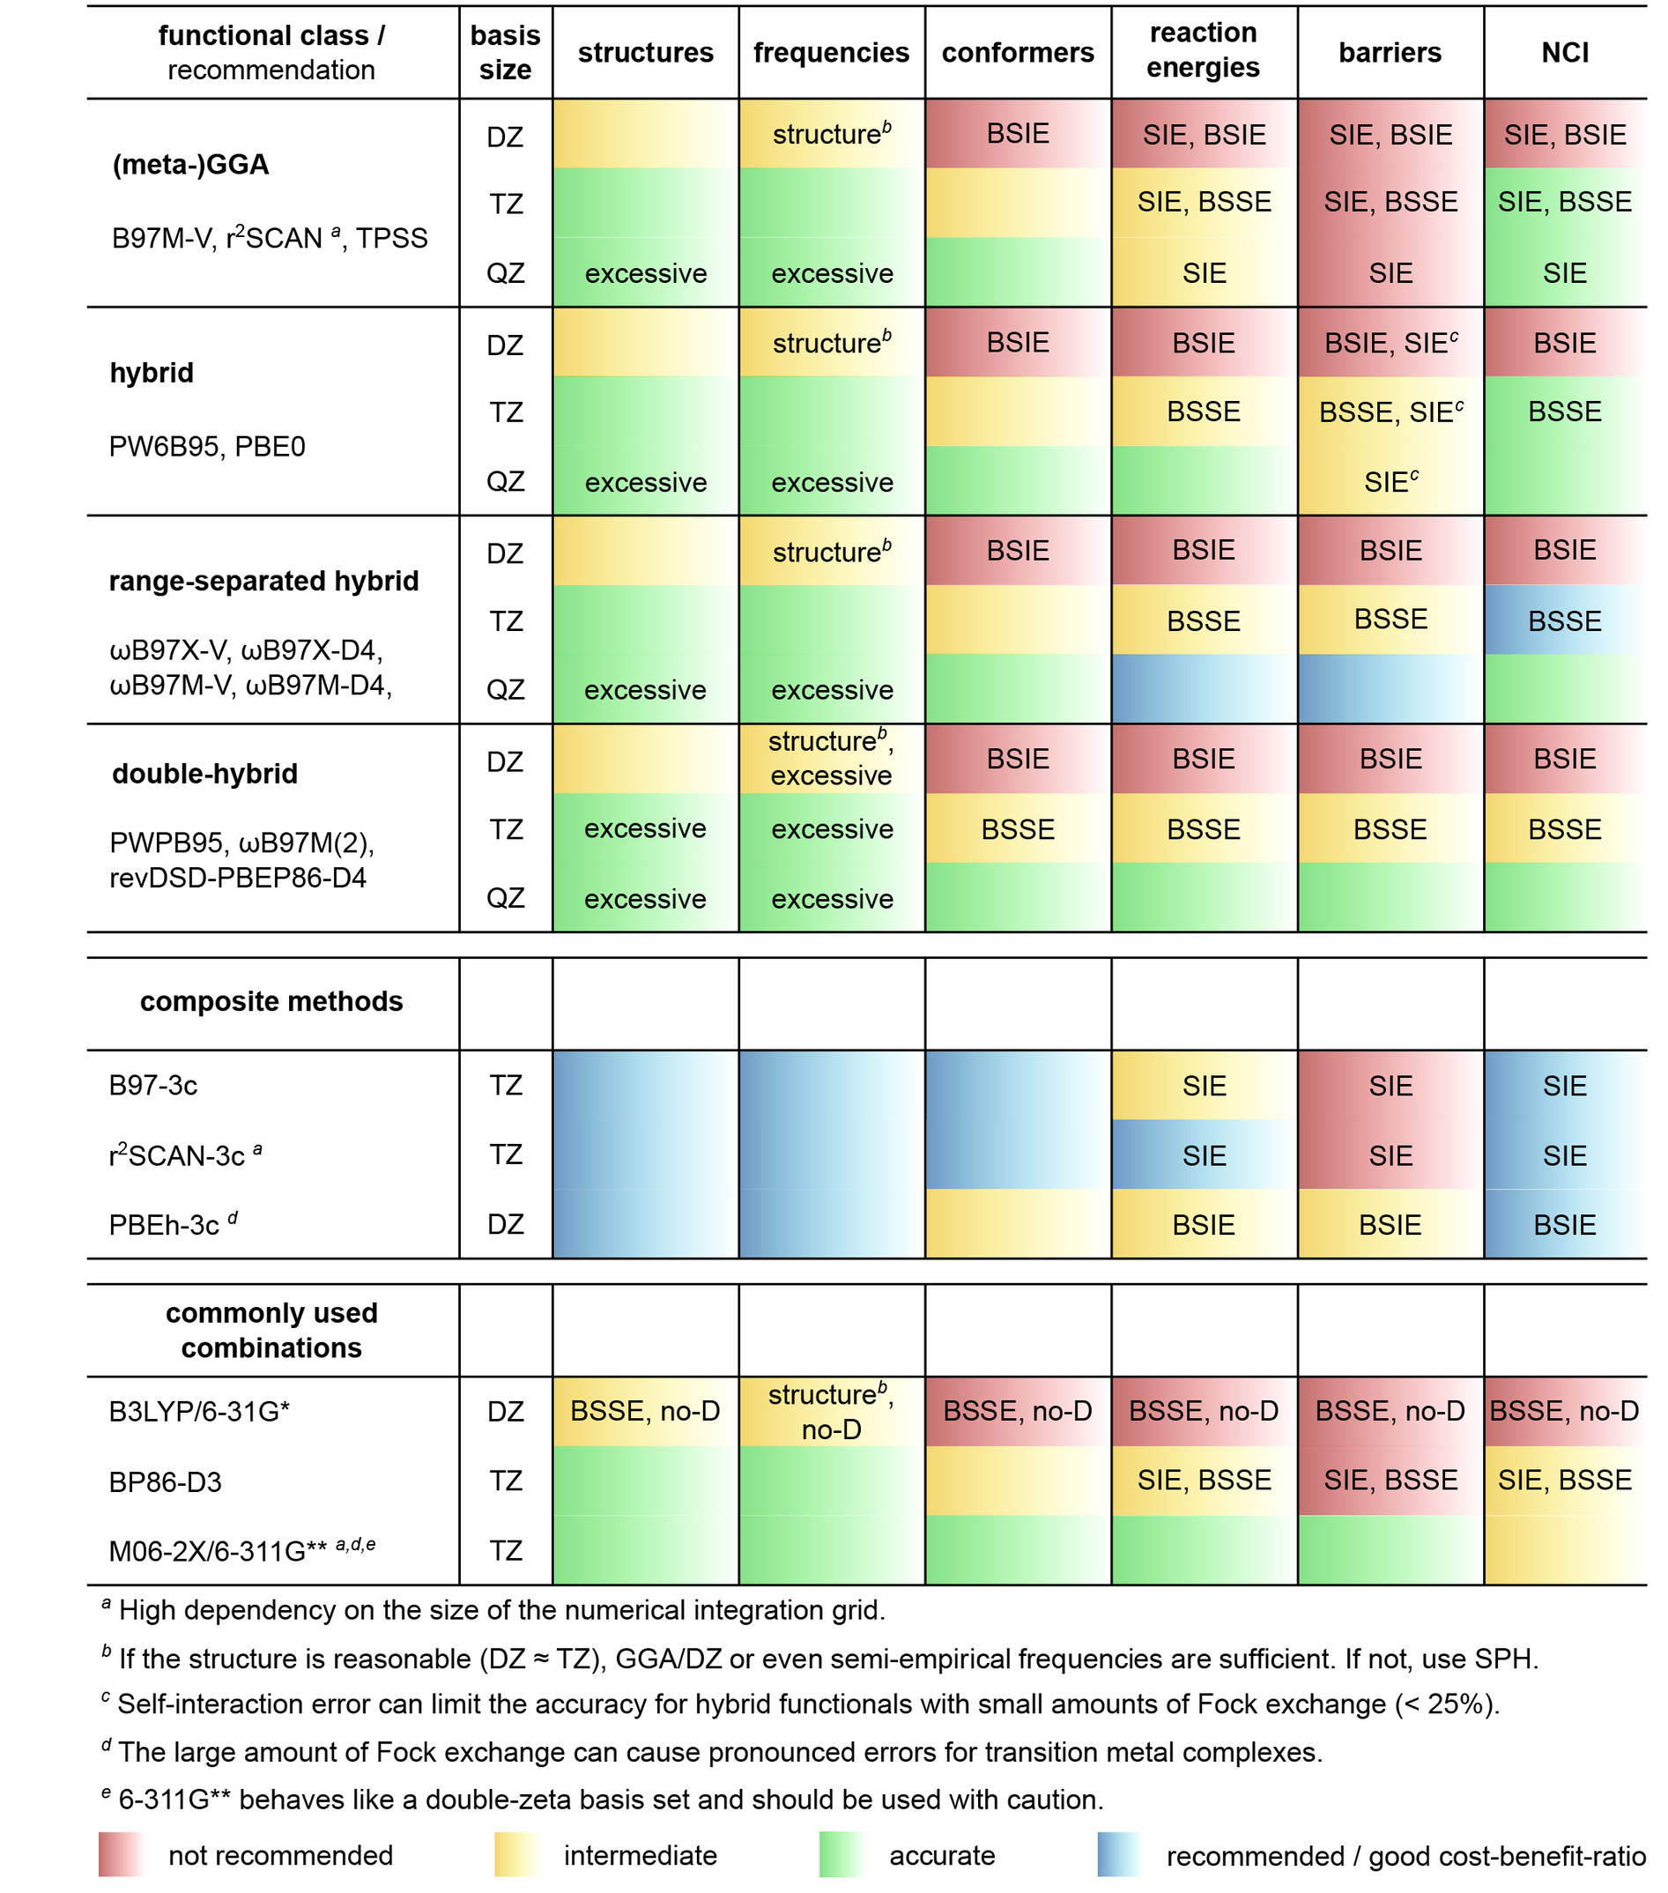
Although in common use, B3LYP/6-31G* has known drawbacks for DFT computation:
missing London dispersion effects (“over-repulsiveness”)
strong basis set superposition error (BSSE)
As such, composite methods such as B97-3c are recommended as a “go-to” DFT level. B97-3c is a relatively recent refit of the B97-D functional combined with a reduced triple-ζ basis (mTZVP) and strikes an ideal balance between speed and accuracy.
COSMO-RS is the recommended implicit solvation model to couple with B97-3c via Turbomole. σ-surfaces in the COSMO-RS framework describes the screened charge densities of each tessellated surface segment of the molecule. Reducing this to per-atom level provides an estimation of donor/acceptor strength.
BSSE: The common interpretation is that orbitals in one fragment can employ basis functions from the other fragment in the complex, and vice versa, and the combined basis set in the complex is thus closer to the complete basis set than for the fragments.
Best‐Practice DFT Protocols for Basic Molecular Computational Chemistry** - Bursch - 2022 - Angewandte Chemie International Edition - Wiley Online Library

Slide 47
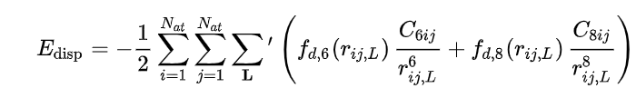

Grimme D3 dispersion correction in Gaussian
EmpiricalDispersion=GD3
The following expression for the vdW dispersion energy-correction term is used:
The dispersion coefficients C6ij are geometry-dependent as they are calculated on the basis of the local geometry (coordination number) around atoms i and j.
The damping function is given by:

Slide 48
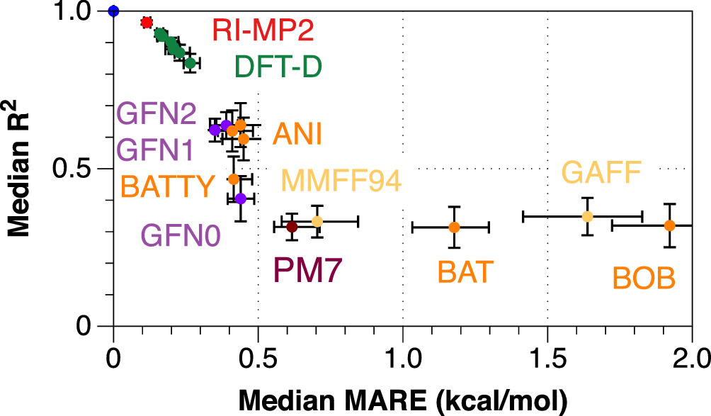
GFN2-xTB is a semiempirical tight-binding model, primarily designed for the fast calculation of structures and noncovalent interaction energies for molecular systems with roughly 1000 atoms.
"GFN" stands for Geometries, Frequencies, and Non-covalent interactions, for which it has been parametrized
Inclusion of anisotropic second order density fluctuation effects via short-range damped interactions of cumulative atomic multipole moments
The GFN methods are consistently parameterized for all elements up to Rn and are thus applicable to a large chemical space throughout the periodic table
GFN2-xTB—An Accurate and Broadly Parametrized Self-Consistent Tight-Binding Quantum Chemical Method with Multipole Electrostatics and Density-Dependent Dispersion Contributions | Journal of Chemical Theory and Computation
vs DLPNO-CCSD(T) energy
Assessing conformer energies using electronic structure and machine learning methods - Folmsbee - 2021 - International Journal of Quantum Chemistry - Wiley Online Library

Slide 49
Gaussian09 Transition State (TS) optimization and frequency calculation
opt=(calcfc,ts,modredundant,noeig) freq b3lyp/6-31g(d) scrf=(iefpcm,solvent=water)
CalcFC. Specifies that the force constants be computed at the first point
Confirm only one imaginary frequency (IF) exists -> TS is identified. In practice, since dihedral constraints were applied, sometimes an additional small IF existed.
TS is a critical point on a Potential Energy Surface (PES) that is a minimum in every dimension but one.
opt=ts keyword. For this method, the coordinates in your input file are those for the TS structure. Bond breaking: lengthen the bond along the reaction coordinate.
Most of the time when you use the opt=ts keyword the calculations crashes because of an error in the number of eigenvalues, you can avoid it adding noeigen.
Not performed: IRC. To ensure that the transition structure we’ve identified connects the products and the reactants. We do this using the intrinsic reaction coordinate (IRC). The IRC is the minimum energy reaction pathway between the transition state of a reaction and its reactants and products.
NB Repeated key warheads at the wB97-xd/cc-pVTZ level of theory to confirm identical rank ordering with b3lyp/6-31g(d).
Transition State Search (QST2 & QST3) and IRC with Gaussian09 – Dr. Joaquin Barroso's Blog

Slide 50
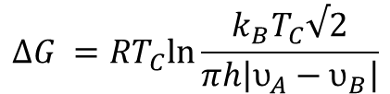



Study of atropisomers by experimental methods.
VT-NMR: Line-shape analysis, 2D exchange spectroscopy (EXSY), or kinetic analyses (class I fast interconversion)
Time-course NMR (class II medium interconversion)
Chiral HPLC (class III slow interconversion)
Variable-temperature NMR (VT-NMR) studies proved a highly useful tool in assessing the activation energy barrier (ΔG⧧) for atropisomer interconversion. For compounds with low interconversion barriers (ΔG⧧), spectral line broadening (and/or merging) at elevated temperatures allowed for the direct calculation of ΔG⧧, ΔH⧧, and ΔS⧧ from the exchange rate constants (k) or half-lives (t1/2).
When two species co-exists, two separate peaks are observed in the NMR spectra. At the coalescence temperature (T_{C}), the two peaks coalesce and the rate constant of rotation at T_{C} can be calculated:
$υ_{A}$and $υ_{B}$are the chemical shift of each species at lower temperatures where they are in slow exchange.
$$k=\frac{π\left|υ_{A}−υ_{B}\right|}{\sqrt{2}}$$
where
$$k=\frac{k_{B}T}{h}e^{−\frac{ΔG}{RT}}$$
so
$$ΔG ={RT}_{C}ln\frac{k_{B}T_{C}√2}{πh\left|υ_{A}−υ_{B}\right|}$$
Addressing Atropisomerism in the Development of Sotorasib, a Covalent Inhibitor of KRAS G12C: Structural, Analytical, and Synthetic Considerations | Accounts of Chemical Research
NMR determination of the rotational barrier in N,N-dimethylacetamide. A physical chemistry experiment | Journal of Chemical Education

Slide 51



Torsion scanning – the quality of results and computational cost are affected by various factors on a non-trivial PES, such as dependence on the chosen scan direction and the lack of efficient approaches to integrate results started from multiple initial guesses.
“Wavefront propagation” – initiate constrained optimizations in both directions.
2D torsion scan example
Driving Torsion Scans with Wavefront Propagation | Theoretical and Computational Chemistry | ChemRxiv | Cambridge Open Engage (2020)

Slide 52

Active learning free energy study (Google/Relay)
RBFE data on 10 K molecules at Tyk2 (patent enumeration)
Batch size: 20-100
ML model: Elastic Net (ENET),Random Forest (RF), Gradient Boosting Machine (GBM), Multi-layer Perceptron (MLP), Gaussian Process Regressor (GPR). RDKit Morgan fingerprints with a radius of 3 and size of 2048 as input features.
Acquisition function: Greedy, Half Sampling (HS), Probability of Improvement (PI), Expected Improvement (EI), Upper Confidence Bound (UCB)
Warm-up: Random, Worst by ΔG, Farthest by ΔG, Kmeans
Ability of different AL variants to recover the 100 molecules with the most negative ΔG
Surprisingly, performance was relatively insensitive to ML method or acquisition function. Batch size was the most important parameter.
Probability of Improvement (PI)
Assign probability of improvement I(x)>0 via f(x) – f(x*), where f(x*) is best observed value
Expected Improvement (EI)
As per PI, but EI also factors in the magnitude of expected improvement
Upper Confidence Bound (UCB)
Balance exploitation via weight term λ
μ(x) + λ α(x)
Optimizing active learning for free energy calculations - ScienceDirect

Slide 53




Human dose
dose is more sensitive to changes in half-life than changes in unbound clearance when half-lives are shorter than 2 h
Fluorine can have impact of increasing Vssu or lowering CLu
where CL_{P} is plasma clearance
Strategy for Extending Half-life in Drug Design and Its Significance | ACS Medicinal Chemistry Letters
Impact of lipophilicity
Do not bias away from high clearance/high logP cmpds, as V_{d} may balance effects
V_{SS,U} and CL_{U} correlate with logP
Integrating the Impact of Lipophilicity on Potency and Pharmacokinetic Parameters Enables the Use of Diverse Chemical Space during Small Molecule Drug Optimization | Journal of Medicinal Chemistry

