Slide 1
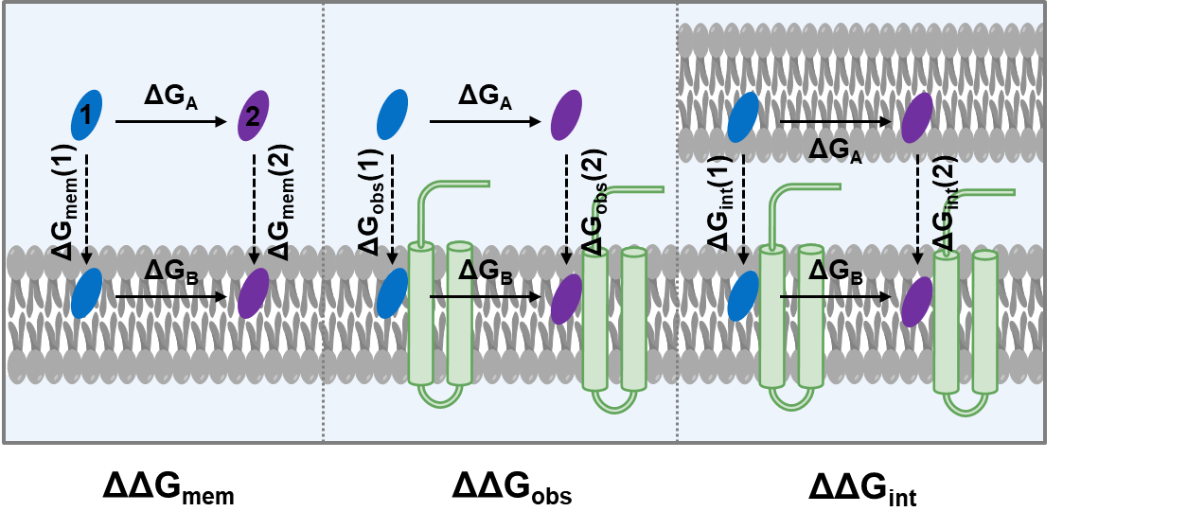
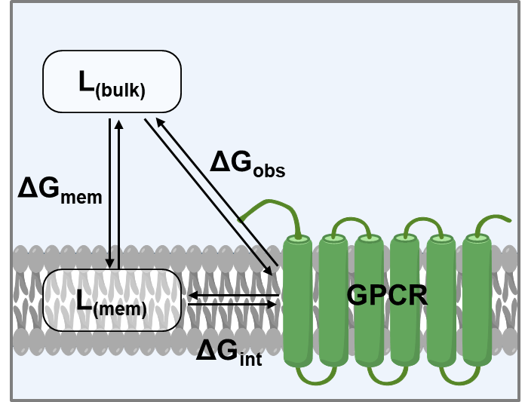
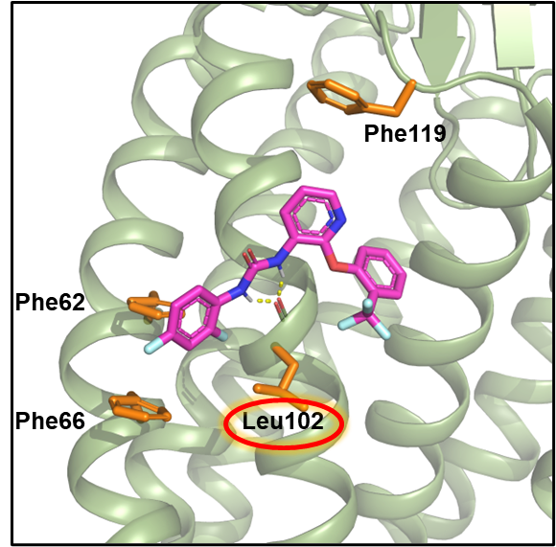
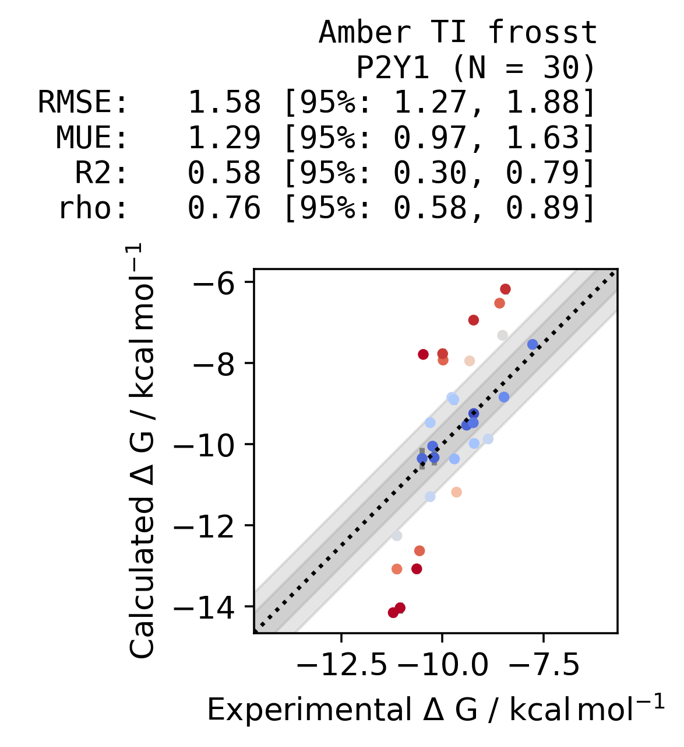
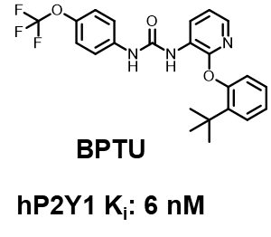
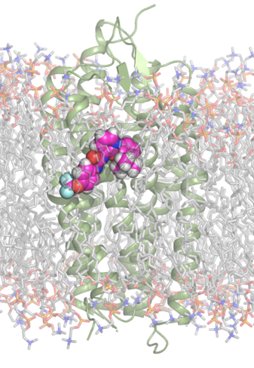
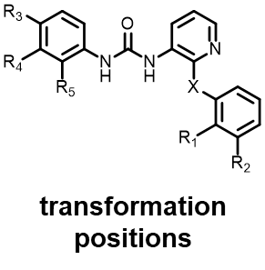
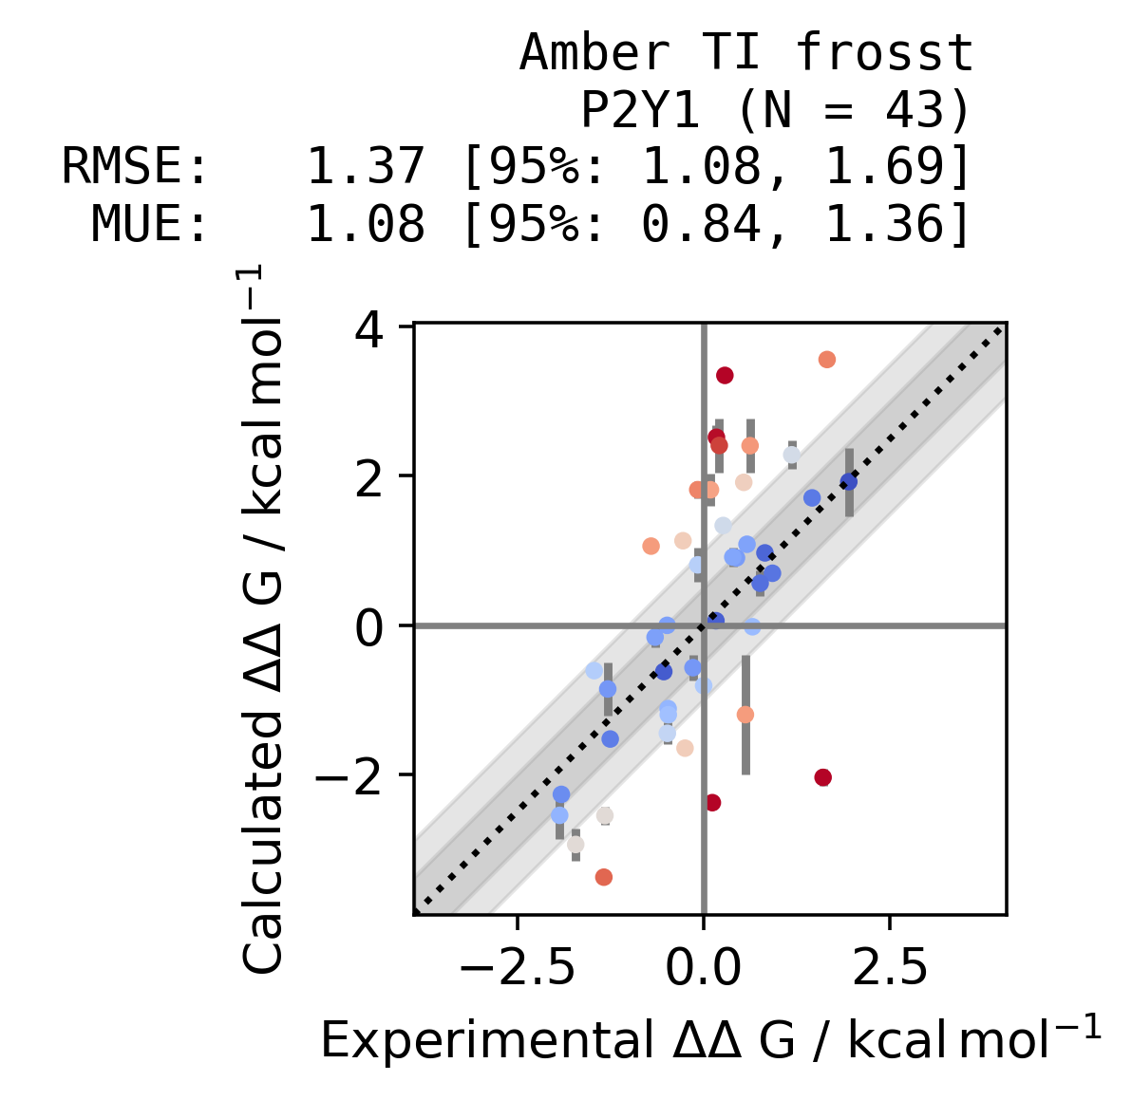
Relative binding free energy calculations at lipid exposed sites: deciphering hot spots
Callum J. Dickson, Jose S. Duca
Computer-Aided Drug Discovery, Global Discovery Chemistry, Novartis Institutes for BioMedical Research, 181 Massachusetts Avenue, Cambridge, Massachusetts 02139, United States
Ligand-membrane affinity is an integral component of binding lipid exposed sites
Enhanced drug concentration in the membrane compartment
Ligands with higher membrane affinity enhance local concentration around the target and therefore the observed binding affinity^{1,2}
The observed structure-activity relationships (SAR) may be clouded by affinity to bind the membrane alone.
“True” or “intrinsic” binding affinity
From Figure 1, a “true” or “intrinsic” affinity to bind the receptor, in the absence of membrane binding may be determined as:
Protocol to uncouple intrinsic and membrane binding
Extend RBFE calculations to ∆G_{int} and ∆G_{mem} cycles
∆G_{int} transforms ligands at binding site and while membrane embedded.
∆G_{mem} transforms ligands in water and while membrane embedded.
k_{a} = [L]. k_{on} + k_{off}
∆G_{int} = ∆G_{obs} - ∆G_{mem}
Figure 1: Ligand binding to a lipid-exposed site can be uncoupled into two steps.
Figure 3: Thermodynamic cycles to calculate ∆G_{mem}, ∆G_{obs} and ∆G_{int}.
R1 substituents improve intrinsic affinity; R2 improves membrane binding
Transform | R1 | R2 | exp ΔΔG_{obs} (kcal/mol) | calc ΔΔG_{obs} (kcal/mol) | calc ΔΔG_{int} (kcal/mol) | calc ΔΔG_{mem} (kcal/mol) | Closure (ΔΔG_{obs} - ΔΔG_{int} - ΔΔG_{mem})
11a-> 11b | H-> C(CH₃)₃ | H | -2.79 | -4.93 ± 0.03 | -3.34 ± 0.50 | -2.67 ± 0.08 | 1.08
11a-> 11f | H-> CF₃ | H | -1.45 | -1.71 ± 0.24 | -0.33 ± 0.59 | -1.07 ± 0.43 | -0.32
11a-> 11c | H | H-> C(CH₃)₃ | -2.43 | -2.39 ± 0.44 | -0.07 ± 0.78 | -2.32 ± 0.53 | 0.01
11a-> 1 | H | H-> CF₃ | -1.95 | -2.00 ± 0.001 | 0.37 ± 0.81 | -2.16 ± 0.18 | -0.21
P2Y1 antagonist relative binding free energy calculations
Application of relative binding free energy (RBFE) to dataset of 30 P2Y1 antagonists^{3,4}
AmberTI protocol using 12λ windows, 5 ns equilibration and 5 ns production.
RBFE successfully rank orders antagonists with Spearman ρ = 0.76.
Figure 4: Uncoupling ∆G_{obs} into ∆G_{mem} and ∆G_{int} reveals R1 substituents access hydrophobic hotspot Leu102.
Conclusions
RBFE may successfully rank order ligand affinity at lipid-exposed sites.⁵
Protocol to uncouple ∆G_{obs} into ∆G_{mem} and ∆G_{int} may aid SAR interpretation and reveal binding hot spots.
Drug discovery projects at membrane embedded sites should seek to optimize ∆G_{int} to improve specific activity and/or functional efficacy and minimize off-target effects.
References
Figure 2: Calculation of ∆G_{obs} for 30 P2Y1 antagonists binding a lipid exposed site.
Sykes DA, et al. Mol. Pharmacol. 2014;85:608–617.
Dickson CJ, et al. J. Med. Chem. 2016;59:5780–5789.
Chao H, et al. J. Med. Chem. 2013;56:1704–1714.
Zhang D, et al. Nature 2015;520:317–321.
Dickson CJ, et al. J. Chem. Inf. Model. 2021;61,12:5923–5930

