Slide 1

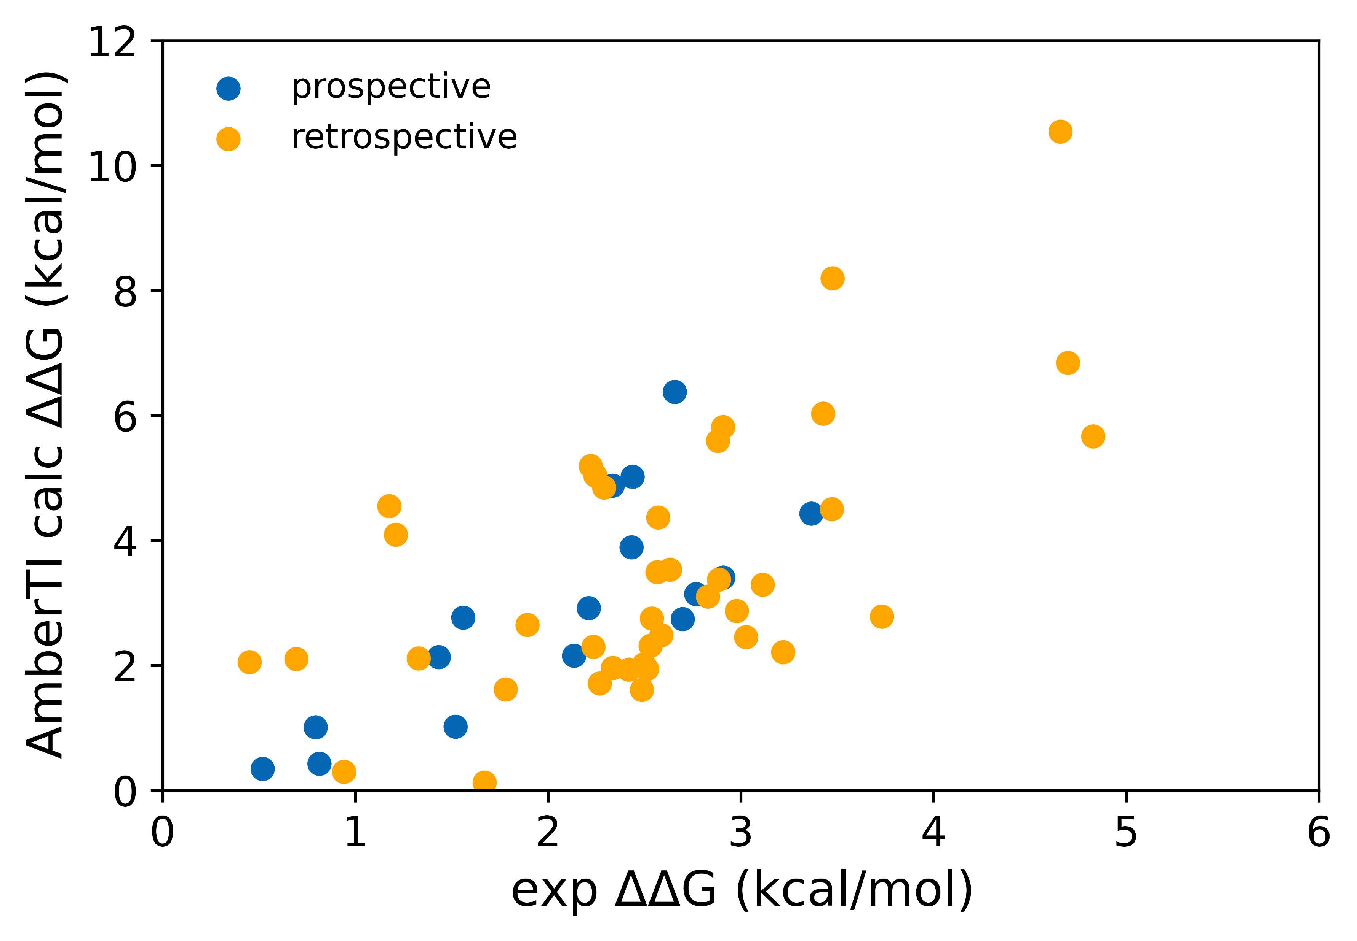
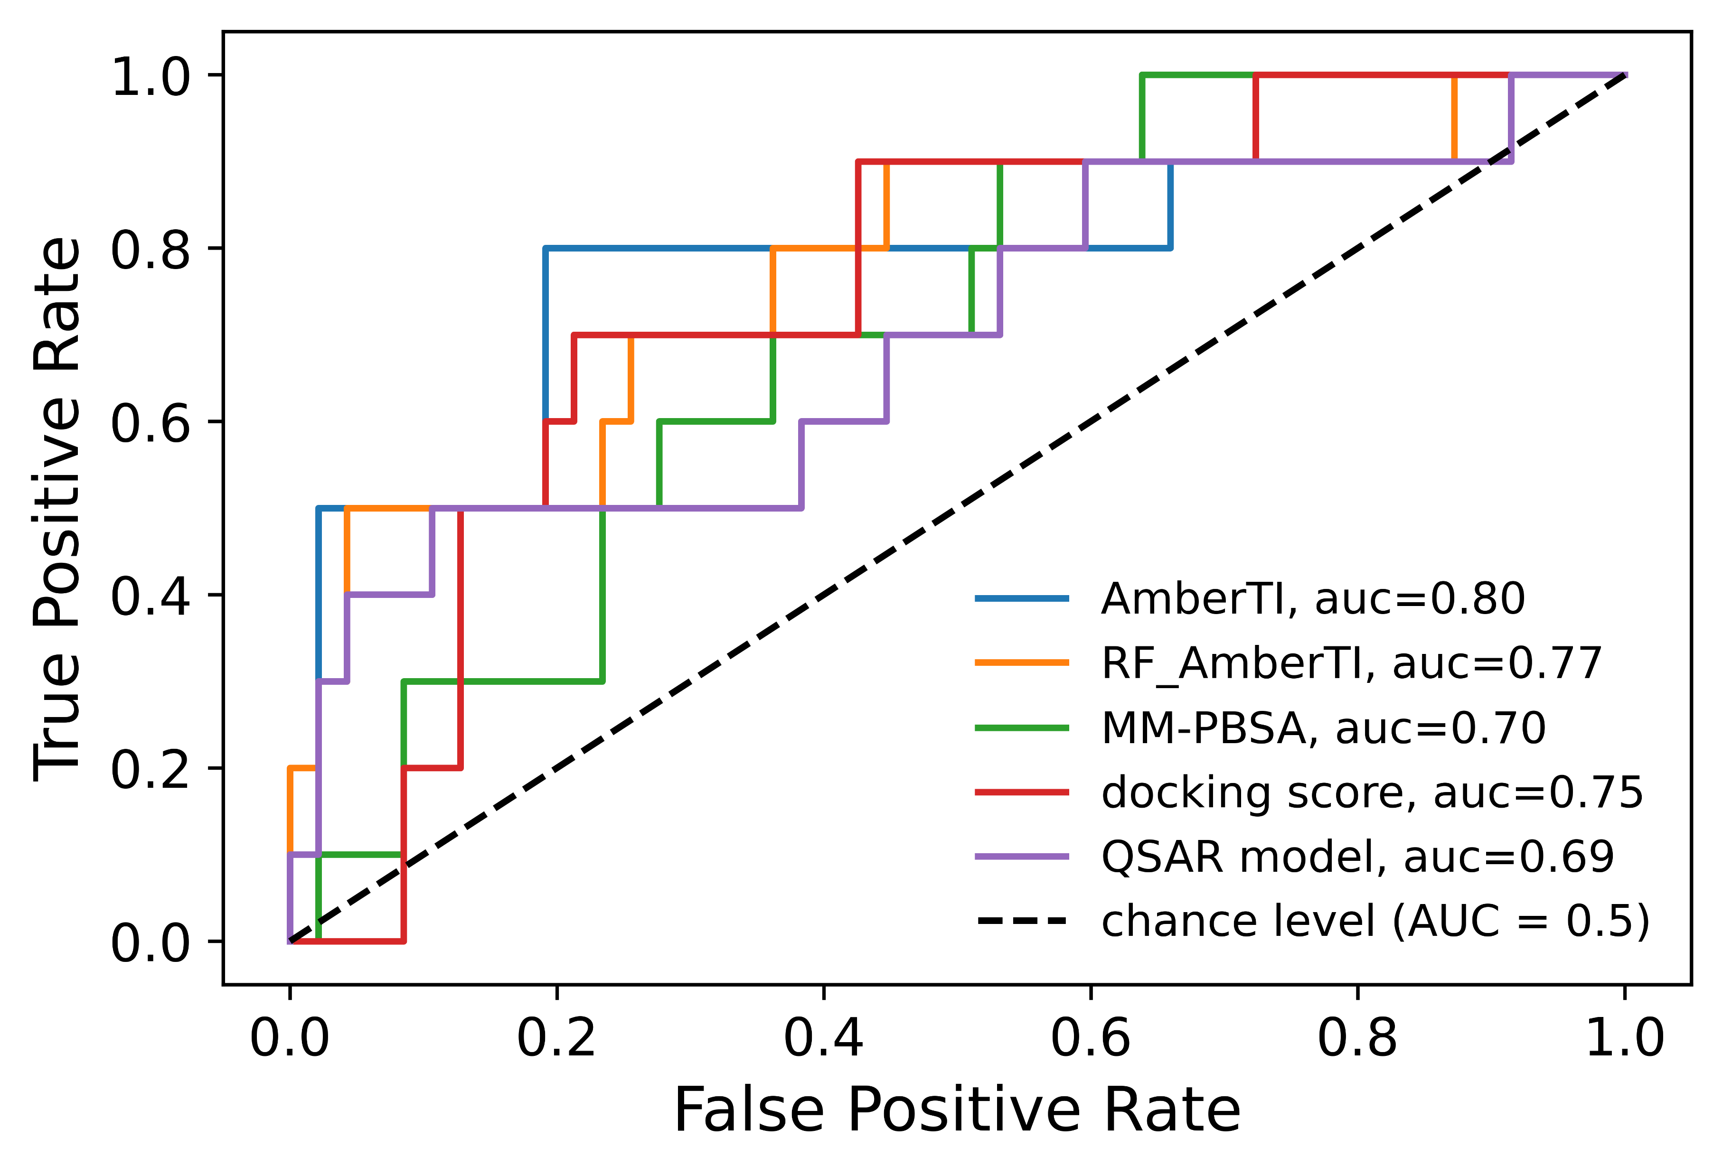
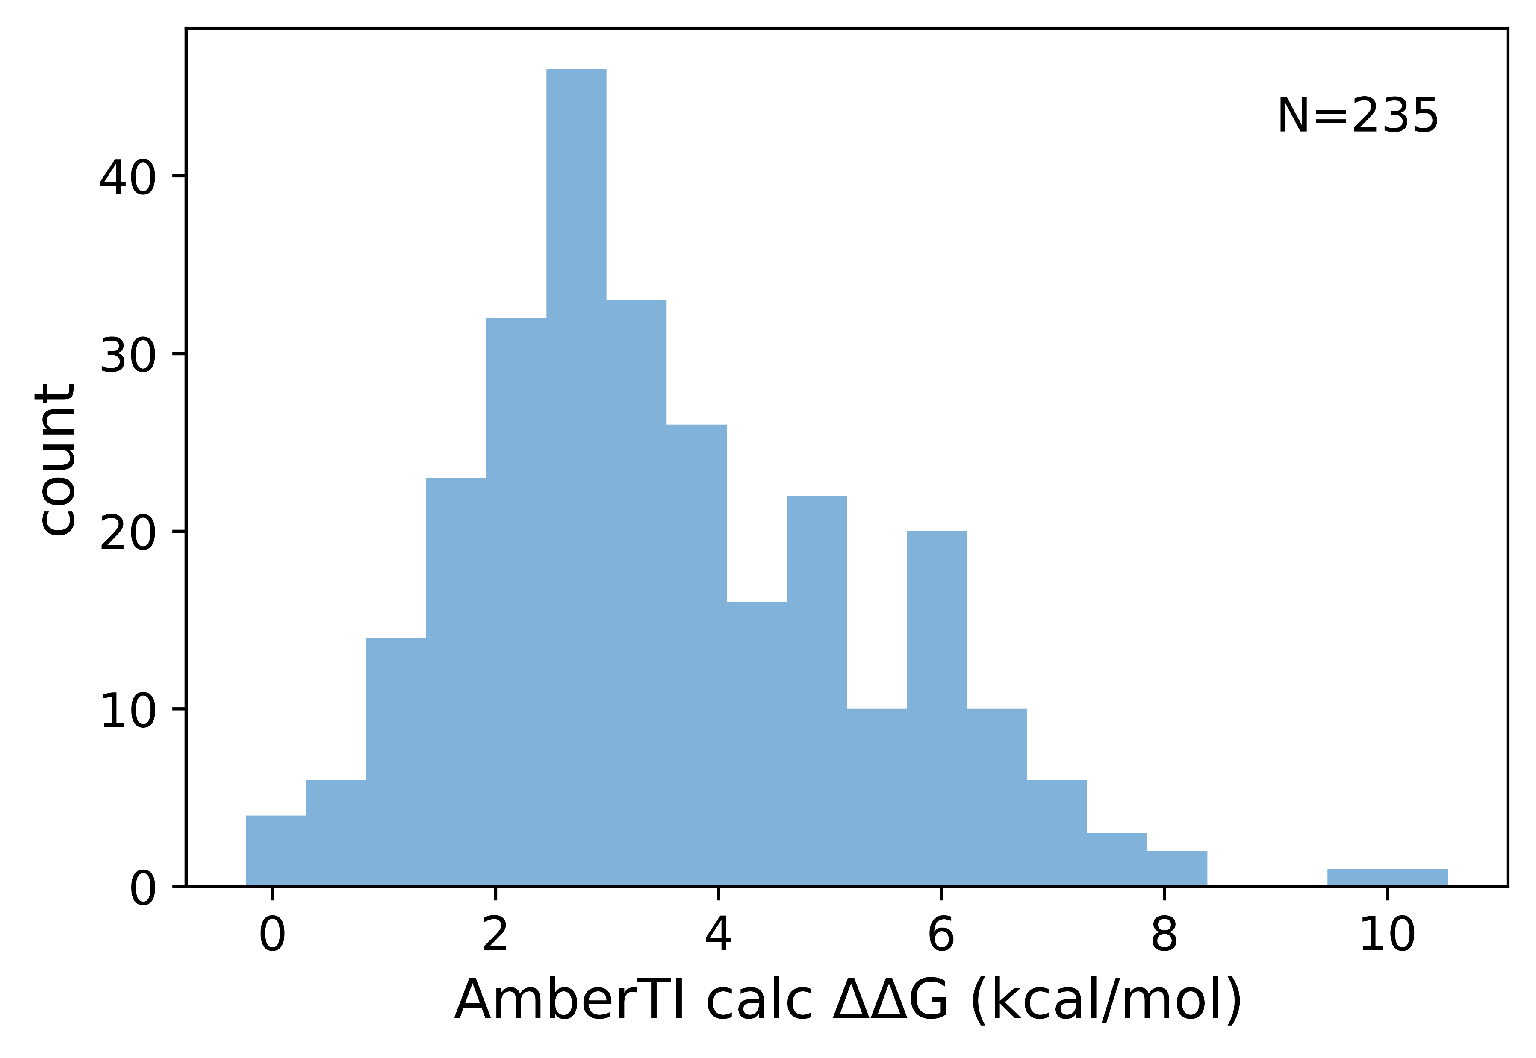
Active learning free energy cycles for potency prediction on project focused libraries
Callum J. Dickson,¹ Cihan Soylu,¹ Cristina Nieto-Oberhuber,² Rainer Wilcken,³ Viktor Hornak,⁴ Jose S. Duca¹
¹Computer-Aided Drug Discovery, Global Discovery Chemistry, Novartis BioMedical Research, 181 Massachusetts Avenue, Cambridge, Massachusetts, 02139, United States
²Global Discovery Chemistry, Novartis BioMedical Research, 4002, Basel, Switzerland
³Present Address: Flare Therapeutics, Cambridge, Massachusetts, 02142, United States
⁴Present Address: Merck Research Laboratories, 33 Avenue Louis Pasteur, Boston, Massachusetts, 02115, United States
Project focused libraries explore single positions on a lead scaffold
Typically, ~100 novel R-groups are selected
Aim to optimize potency, or other properties under consideration.
Desire to pick from a large (10 – 100 K) virtual chemical space makes relative binding free energy (RBFE) prohibitive for potency prediction.
Star map RBFE provides accurate prospective predictions
Of 56 synthesized, 16 compounds had prospective RBFE
Selections made by entire team, taking into account novelty, physiochemical properties and passive permeability in addition to potency prediction.
enumeration
18 K
docking, molecular dynamics, MM-PBSA
2 K
Figure 2. Correlation between experiment and RBFE predictions for 16 prospective and 40 retrospective calculations.
relative binding free energy
?
 | prospective | retrospective | overall
N | 16 | 40 | 56
r² | 0.62 | 0.37 | 0.43
spearman | 0.78 | 0.55 | 0.59
RMSE (kca/mol) | 1.45 | 1.91 | 1.79
Active learning free energy cycles allow potency prediction on large virtual spaces
We used iterative rounds of RBFE and machine learning
Table 1. Performance metrics of AmberTI RBFE.
AmberTI RBFE
Star map, 9 λ windows, 5ns
Run 30-40 RBFE
Balance exploration & exploitation
ML model on ∆∆G prediction
Select top candidates
Random Forest
2D descriptors
Figure 3. Ability of several potency prediction methods to separate true and false positives. Actives are defined as any molecule being within 10-fold IC50 of the reference.
Conclusions
The reference molecule was highly tuned and a more potent R-group was difficult to identify – this was reflected in the prospective calculations.
Star map RBFE predictions correlated with experimental potencies; the ML model built on free energies also performs well.
Not all active molecules returned on library synthesis were sampled by our method, indicating the RBFE->ML cycles could be optimized.¹
Potency predictions could be combined with phys chem properties into an MPO score for final selections.
References
¹Thompson et al, Artif Intell Life Sci, 2022
Acknowlegements
We would like to thank the Kim Beyer lab for binding assays. We would also like to thank Martin Eberle, Sophie Racine and Enamine for PFL synthesis.
Total 3 rounds completed and 235 compounds in RBFE
Figure 1. Distribution of AmberTI RBFE predictions.
Very few predicted better than reference

