Slide 1
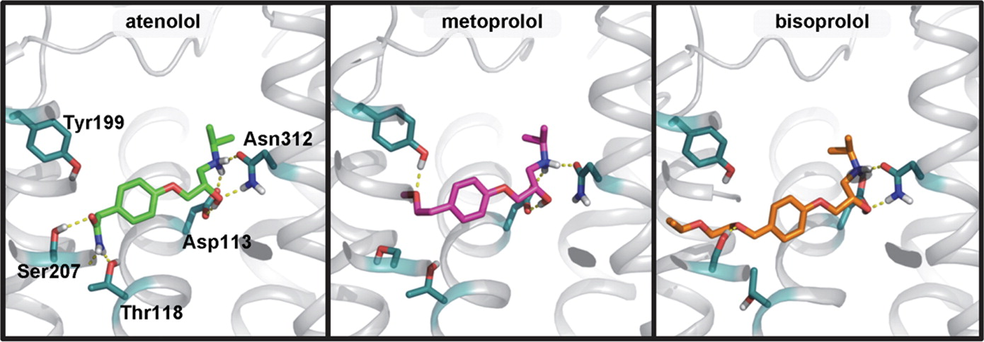
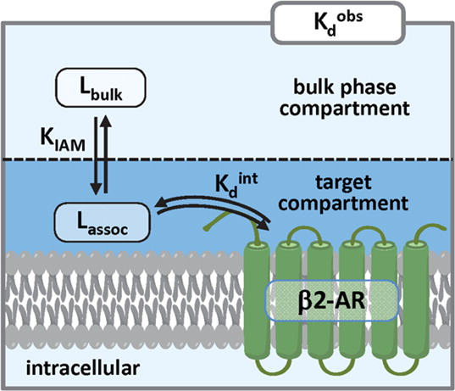
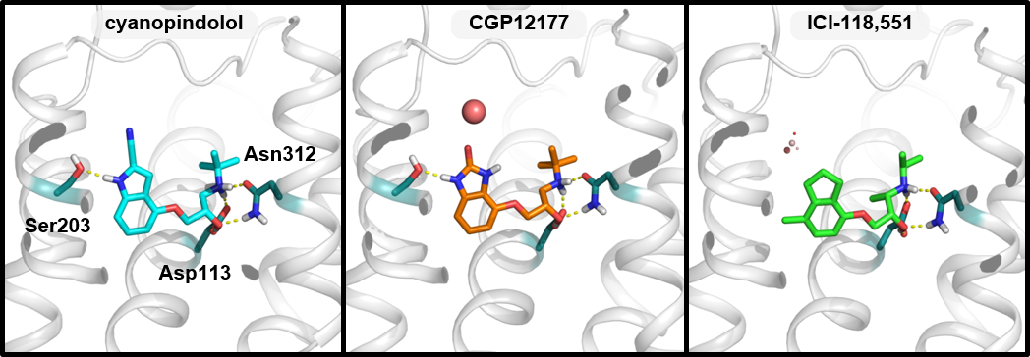
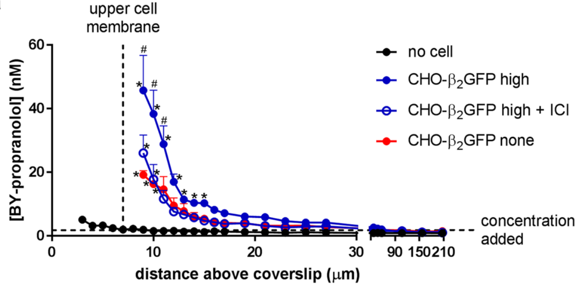
Uncoupling the structure-activity relationships of β2 adrenergic receptor ligands from membrane binding
Callum Dickson, Viktor Hornak
Computer Aided Drug Discovery, Global Discovery Chemistry, Novartis Institutes for Biomedical Research, Cambridge MA, USA.
Introduction
Observed experimental binding to membrane proteins may be significantly influenced by association of ligands to the membrane, which obscures structure-activity relationships (SAR)^{1,2}.
Intrinsic (i.e. “actual”) protein binding can be obtained by “subtracting” membrane binding from the observed binding.
Intrinsic binding affinities should allow the meaningful derivation of SAR, that can then aid in traditional structure-based drug design.
similar K_{d}^{obs}, different K_{d}^{int}
atenolol
metoprolol
bisoprolol
K_{d}^{obs} [nM]:
K_{d}^{int} [nM]:
logK_{IAM}:
260
1,200
0.7
130
15,500
2.1
150
33,000
2.4
Binding hypothesis and the effect of membrane binding
While all three are roughly equipotent in K_{d}^{obs}, there is greater than 10-fold difference in intrinsic affinity (K_{d}^{int}) of atenolol vs metoprolol & bisoprolol.
different K_{d}^{obs}, different K_{d}^{int}
cyanopindolol
CGP12177
ICI-118,551
K_{d}^{obs}
K_{d}^{int}
K_{IAM}
...
...
...
observed experimental affinity (assay is on membrane preps)
intrinsic binding affinity to β2-AR
K_{IAM} approximates membrane association
K_{d}^{obs} [nM]:
K_{d}^{int} [nM]:
logK_{IAM}:
0.001
0.7
2.9
0.2
19
2.1
0.3
630
3.4
Membrane binding (K_{IAM}) will effectively decrease the intrinsic affinity (K_{d}^{int}) to the receptor:
K_{d}^{int} = K_{d}^{obs} × K_{IAM}
The effect of membrane association on intrinsic binding affinity to the receptor (K_{d}^{int}) can be considerable:
if K_{d}^{obs} = 1 nM and:
logK_{IAM} = 1 (K_{IAM} = 10) → K_{d}^{int} = 10 nM
logK_{IAM} = 3 (K_{IAM} = 1000 ) → K_{d}^{int} = 10,000 nM
Propose that structure-activity relationships (SAR) should be derived relative to K_{d}^{int} rather than K_{d}^{obs}.
Even though cyanopindolol’s intrinsic affinity is decreased 700-fold due to its high K_{IAM}, at 0.7nM, it remains ~30-fold more potent than CGP12177 and ~900-fold more potent than ICI-118,551.
Conclusions
Binding data of membrane proteins has to be interpreted with care – the effect of membrane binding needs to be taken into account.
The intrinsic activities derived from experimental data (after membrane correction) are more consistent with the x-ray structure of the β2-AR binding pocket and the available ligand SAR.
Imaging drug-membrane association
Local concentration of drug at membrane quantified by fluorescence correlation spectroscopy and BODIPY-propranolol.³
References
Sykes, D. A.; Parry, C.; Reilly, J.; Wright, P.; Fairhurst, R. A.; Charlton, S. J., Observed drug-receptor association rates are governed by membrane affinity: the importance of establishing “micro-pharmacokinetic/pharmacodynamic relationships” at the β2-adrenoceptor. Mol. Pharmacol. 2014, 85 (4), 608-617.
Dickson, C. J.; Hornak, V.; Velez-Vega, C.; McKay, D. J. J.; Reilly, J.; Sandham, D. A.; Shaw, D.; Fairhurst, R. A.; Charlton, S. J.; Sykes, D. A.; Pearlstein, R. A.; Duca, J. S., Uncoupling the Structure–Activity Relationships of β2 Adrenergic Receptor Ligands from Membrane Binding. J. Med. Chem. 2016, 59 (12), 5780-5789.
Gherbi, K.; Briddon, S. J.; Charlton, S. J., Micro-pharmacokinetics: Quantifying local drug concentration at live cell membranes. Scientific Reports 2018, 8 (1), 3479.

