Slide 1
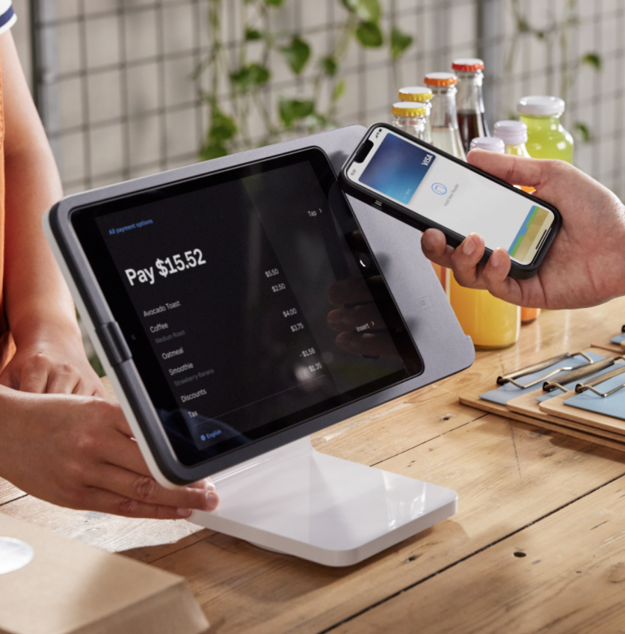
What do economists do?
Economists study how people use money and how people make choices

Slide 2
Prices $
What is a price?
Where do prices come from?
How will you decide how to price items at the market?

Slide 3
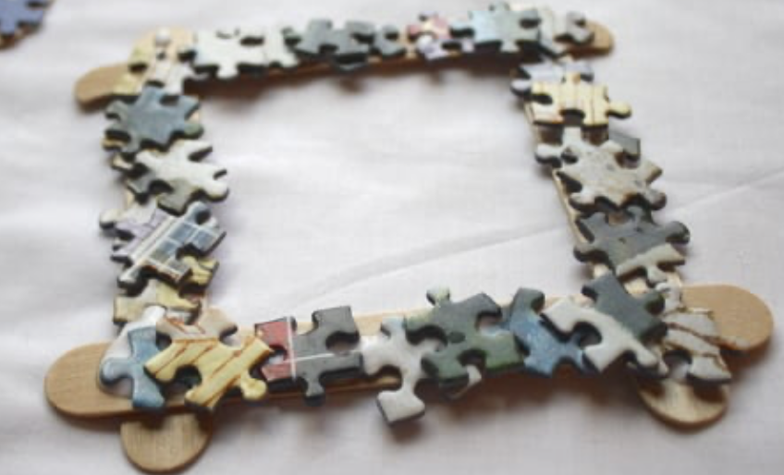
Competition also matters
$5
?

Slide 4
Money

Slide 5
What is Money?
Money is something you give in exchange for goods and services

Slide 6
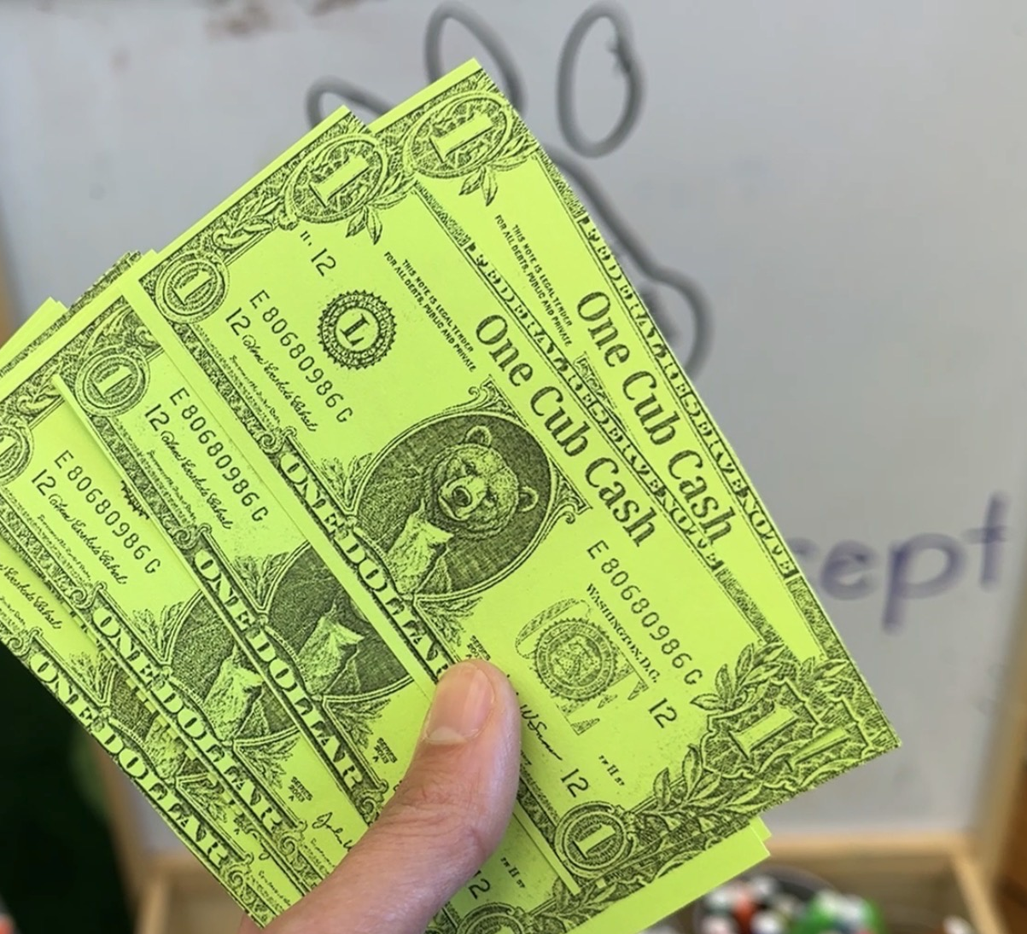
Cub Cash

Slide 7
Money Around the World
Different countries use different money.

Slide 8
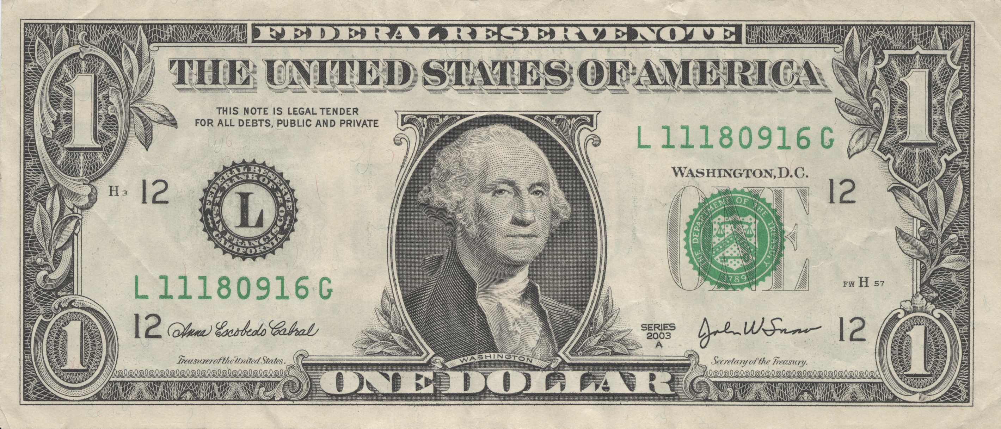
🇺🇸 United States Dollar
The U.S. uses dollars ($).

Slide 9
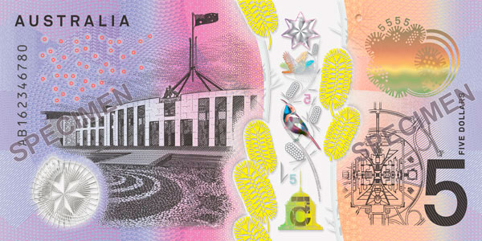
🇦🇺 Australian Dollar
Australia uses colorful plastic banknotes.

Slide 10
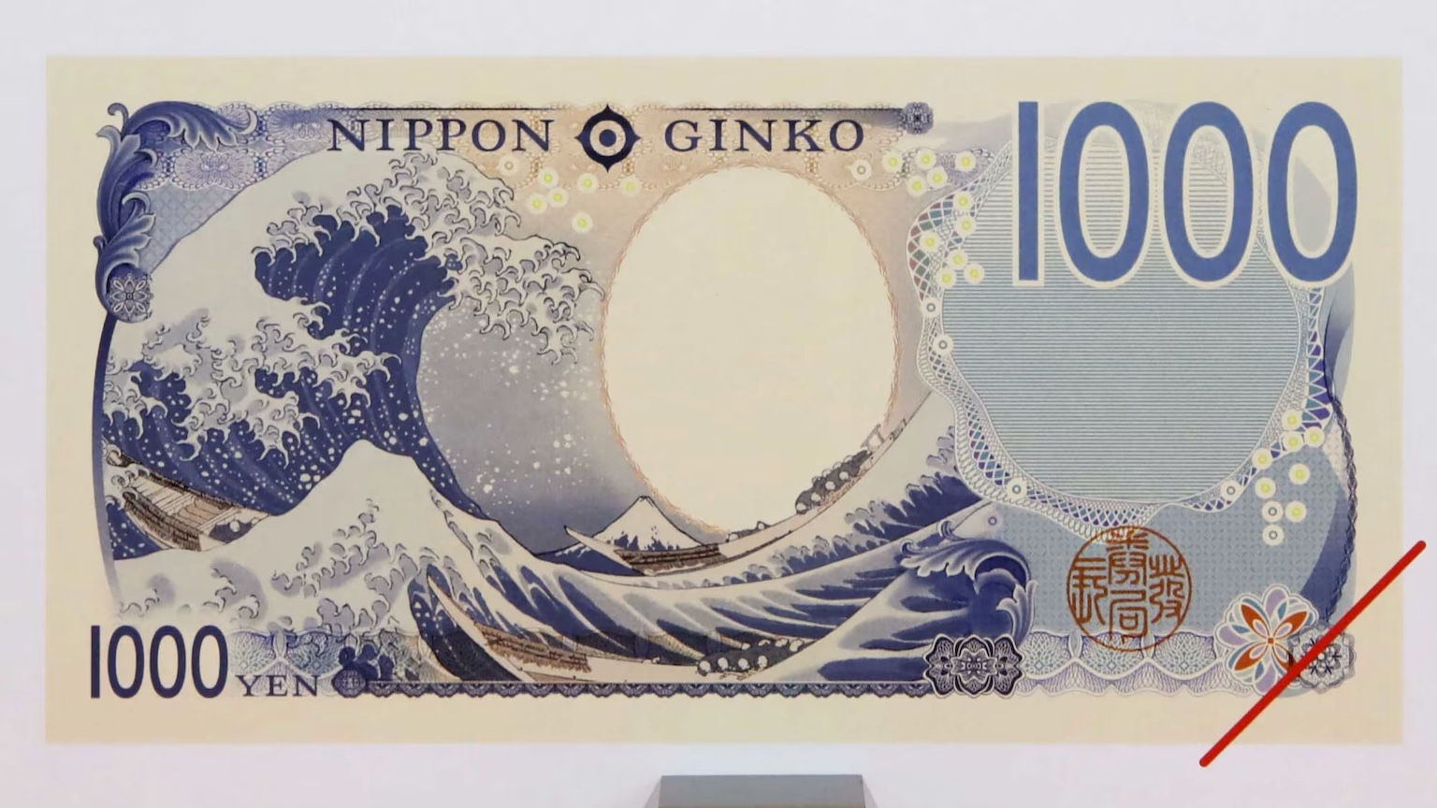
🇯🇵 Japanese Yen
Japan uses yen (¥).

Slide 11
Some Features of Cash
• A number showing value
• Pictures
• Colors
• Hard to copy

Slide 12
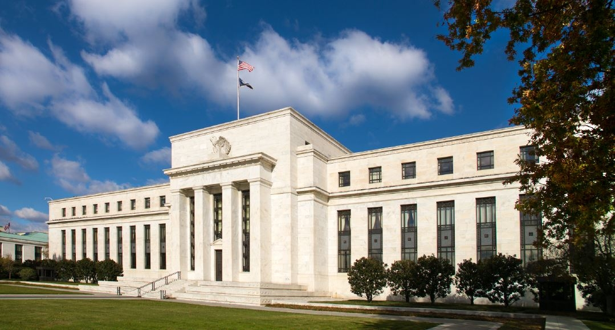
Where is money made?
• Money is made by a central bank

