Slide 1
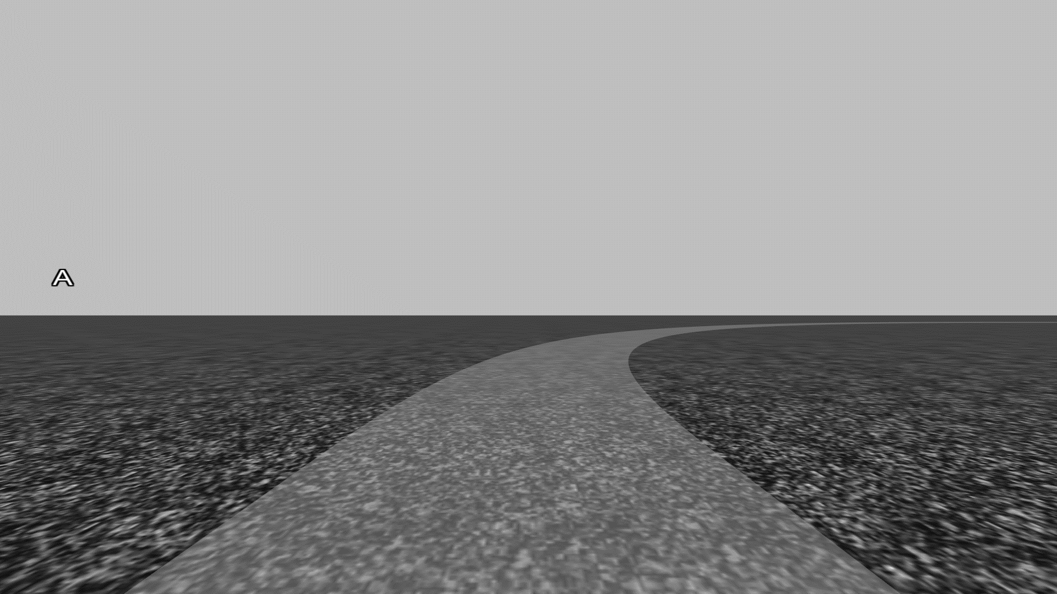

v
How many Os did you hear?
Press a single gear pad to register your count
1
Listen out for:
B
O
How many Bs did you hear?
3
How many Os did you hear?
1
Repeat
3

