Slide 1


TRANSITION Modelling – Experiment Design
13/12/18

Slide 2
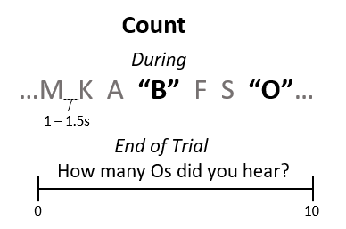
Experiment Aim
Work into Student Projects for 2018-19.
The Student Projects are on Cognitive Load and Transitions. They have three Cog Load manipulations: NoLoad / Easy/ Hard
The design of the transition scenario should provide useful data for modelling..

Slide 3
Transition Scenario
Discrete bends provide experimental control for modelling
On such experimentally controlled bends, cued take-overs risk simply measuring ‘reaction time’ rather than manual control recovery based on perceived need for manual control.
Silent failures are an alternative option, with applied relevance.

Slide 4
Transition Scenario : Silent Failures
3. Take-over mode
Gear Pads to disengage.
Avoids complications with assessing how much Steering angle change constitutes being ‘in control’.
2. A yaw-rate offset is introduced.
6 Offsets:
3 large (understeering. Leave road before trial ends)
3 small (around centre. Do not leave road)
50% requirement to intervene
2 radii:
Sharp (60), Gradual (90?)
Need to introduce variability into the trajectories
4. Trial Length
Variable, dependant on take-over time.
Probably only need 5 s after take-over.
Small offset ‘catch trials’ will be a constant length of 15 s (unless a take-over occurs).
1. Every trial starts with a few seconds of midline trajectory
Loose instructions to ‘keep within the road edges, intervene if you feel that it is necessary’
Running Time:
36 conditions (6 offsets * 2 radii * 3 Cog Load) x 6 (no.trials) x 15 s (estimated trial length) = 54 minutes. (conservative estimate)

Slide 5
Considerations
False Positives:
Small cost of taking over compared to leaving road, participants may be conservative and take-over even when the vehicle is clearly not leaving the road. The false positive rate is expected to depend on amount of catch trials. If a high FP rate is observed during piloting we could include a points system that penalises against taking control unnecessarily
Simulation to decide appropriate offsets based on length of time to leave the road.
Use complete cancellation of yaw-rate as upper-bound for simulations
Realistic automated trajectories
The design means that the automated vehicle trajectories will be pre-determined, with constant yaw-rates (then a constant yaw-rate offset). This may cause conditions where it is artificially easy to discriminate differences between conditions. Needs piloting.

