Slide 1
ENGI 301 Guitar Auto-tuner Proposal
10/4/2020
Callum Parks

Slide 2
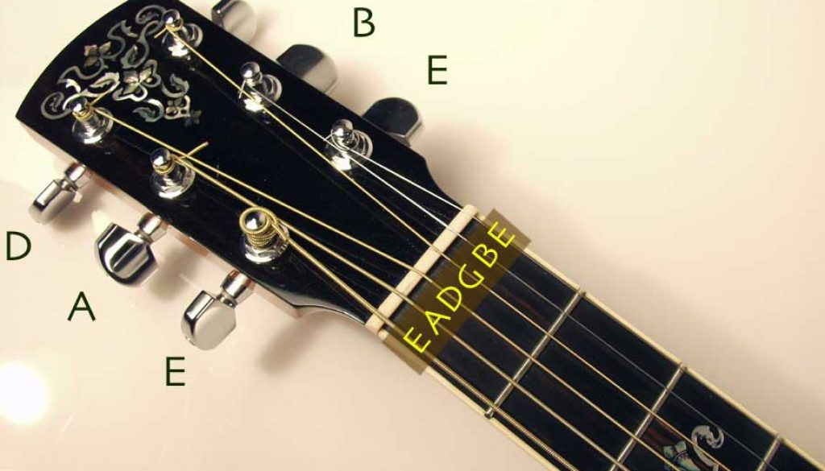
Background Information
Like any string instrument, guitars go out of tune. Tuning is an arduous task. A user will play the string and rotate tuners until the strings vibrate at the correct frequency. However, the issue with this process is that tuners can be inconsistent. It would be nice to click a button and have a device turn the tuners for you.
My proposal is for a handheld servo-run device which will listen to the frequency of a string, display the string’s frequency, and have buttons to rotate the servo allowing an user to
Rotating tuners
Notes:
Go in depth on instructions.

Slide 3
How this works
Sound input
Display note on the screen

Slide 4
System Block Diagram
MAX9814
Feedback 360
Display
Create a System Block Diagram
Label interfaces / pins
Components (part numbers if possible)
Button
Pocketbeagle
Gpio 52
Gpio 59-57
Gpio 60
Gpio 19
Micro USB power

Slide 5
Power Block Diagram
100mA
1.2 A
160mA
Create a Power Block Diagram
Label voltages / currents of components
MAX9814
Feedback 360
Display
6 volts
5 volts
Button
2 volts
Pocketbeagle
Gpio 52
Gpio 59-57
Gpio 60
Gpio 19
Micro USB power
5 volts
1 A
Notes:
Lock for 5v adapter 2.5a
Block for barrel jack
Pb has pwer and gnd for mic
Provide for display and button too
Mic pin 18 17(gnd) p1 go into 19.
Specify pins better

Slide 6
Components / Budget
Component | Need to Buy | Cost
https://www.adafruit.com/product/1713?gclid=EAIaIQobChMIwpvRsfqb7AIVSODICh10GAIwEAQYAiABEgJSLfD_BwE | Yes | 7.95
https://www.adafruit.com/product/3614 | Yes | 27.99
https://adafruit.it/865 | No | 3.95
PocketBeagle Board | No | 38
Button | No | .50
https://www.adafruit.com/product/276 | Yes | 7.95
https://www.adafruit.com/product/368?gclid=Cj0KCQjwoJX8BRCZARIsAEWBFMKLKonJh2rwlF8zYJFWhqgTz3il9I4ElfN9N32iJgf-WoJdIJmE6rkaAmzPEALw_wcB | Yes | 2.00
Notes:
Pull power off for servo.
Power jack: 2-3 amp? Barrel power jack to screw terminal.
Take FFT of analog input for fundamental frequencies.
Backup microphone, thry with first one first.

