Slide 1
ENGI 301 Motorized Guitar Tuner
10/4/2020
Callum Parks

Slide 2
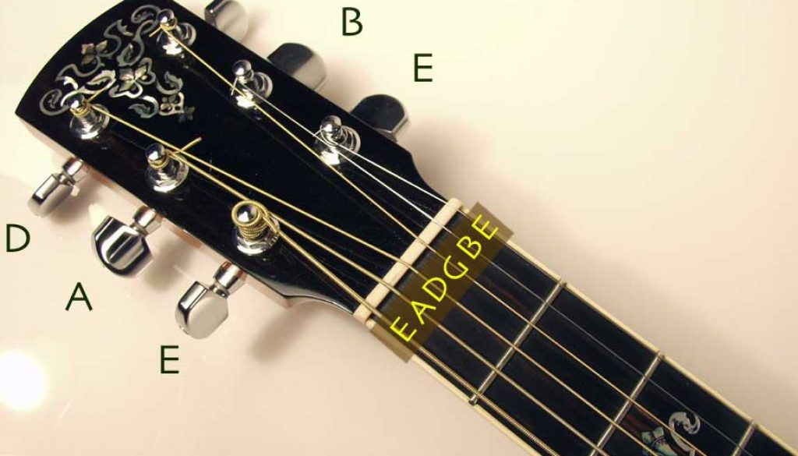
Background Information
Like any string instrument, guitars go out of tune. Tuning in itself is not an arduous task. A user will play the string and rotate tuners until the strings vibrate at the correct frequency. However, the issue with this process is finding the right pitch and rotating the tuners. It would be nice to have a device to play the desired frequency and allow a user to tune with a motorized device.
My proposal is for a handheld servo-run device which will listen to the of a string and allow a user to rotate the guitar tuners to achieve the desired pitch.
Rotating tuners
Notes:
Go in depth on instructions.

Slide 3
System Block Diagram
Potentimeter
360 Servo
Display
Create a System Block Diagram
Label interfaces / pins
Components (part numbers if possible)
Button
Pocketbeagle
P2_1
P2_9-13
P2_2
Button
Gpio 19
P2_4
Buzzer
P2_3
Micro USB power

Slide 4
Power Block Diagram
Potentimeter
360 Servo
Display
Create a Power Block Diagram
Label voltages / currents of components
SYS V-OUT
3.3V
Button
1.8V
Pocketbeagle
3.3V
P2_1
P2_9-13
P2_2
Button
P2_4
3.3V
Gpio 19
Buzzer
P2_3
1.8V
Micro USB power
Notes:
Lock for 5v adapter 2.5a
Block for barrel jack
Pb has pwer and gnd for mic
Provide for display and button too
Mic pin 18 17(gnd) p1 go into 19.
Specify pins better

Slide 5
Components / Budget
Component | Need to Buy | Cost
https://www.adafruit.com/product/239 | Yes | 5.95
https://www.adafruit.com/product/154 | Yes | 11.95
https://adafruit.it/865 | No | 3.95
PocketBeagle Board | No | 38
Button x2 https://www.adafruit.com/product/367 | No | 1.25
https://www.adafruit.com/product/376 | Yes | 7.95
1k ohm resistor x3 | Yes | 2.00
https://www.adafruit.com/product/1536 | No | 0.95
https://www.adafruit.com/product/4179 | No | 34.99
https://www.adafruit.com/product/1911 | No | 9.95
Notes:
Pull power off for servo.
Power jack: 2-3 amp? Barrel power jack to screw terminal.
Take FFT of analog input for fundamental frequencies.
Backup microphone, thry with first one first.

