Slide 1
Automated End-to-End Testing Of Microservices-Based Web Applications and How It Complements the SDLC
Keywords: Automated software testing, DevOps, containerisation
A final year project by Callum Van Zyl
Supervised by Dr Pat Parslow

Slide 2
Background

Slide 3
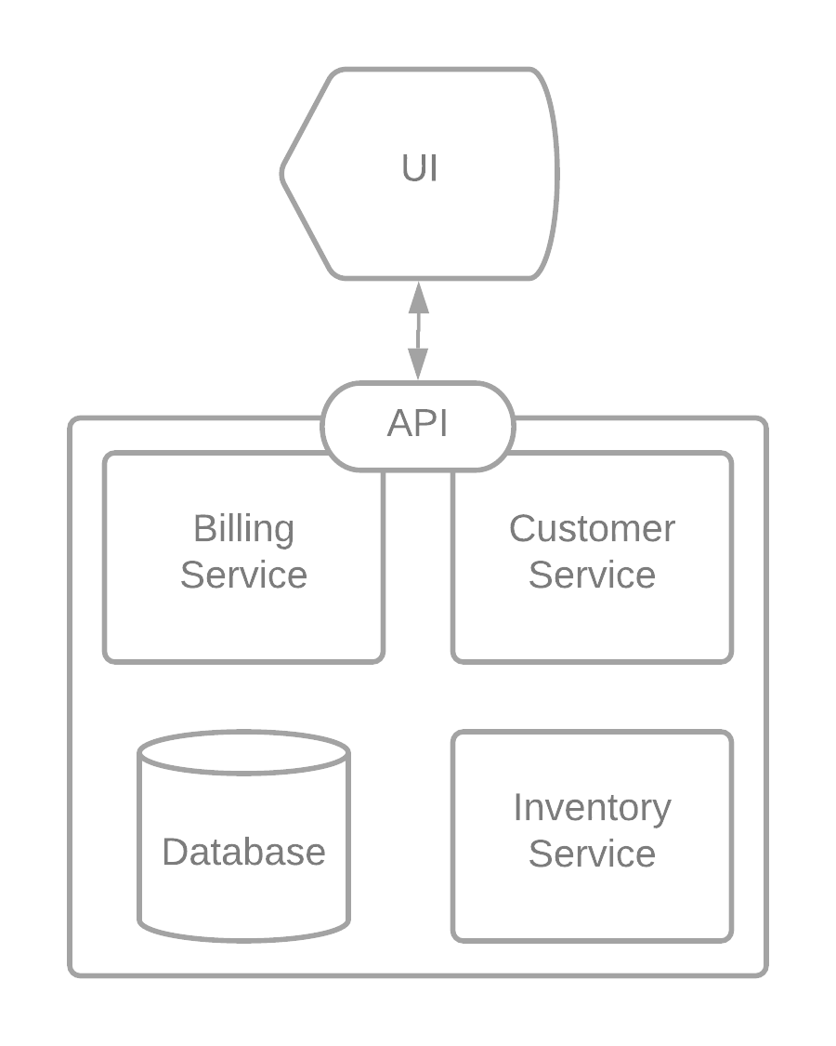
Monoliths and Microservices 1
Software using a monolithic architecture has just one codebase containing all the associated services and business logic.
This approach can produce an unmaintainable codebase, imagine how many components a complex enterprise software application includes.
High-level overview of a monolithic software architecture

Slide 4
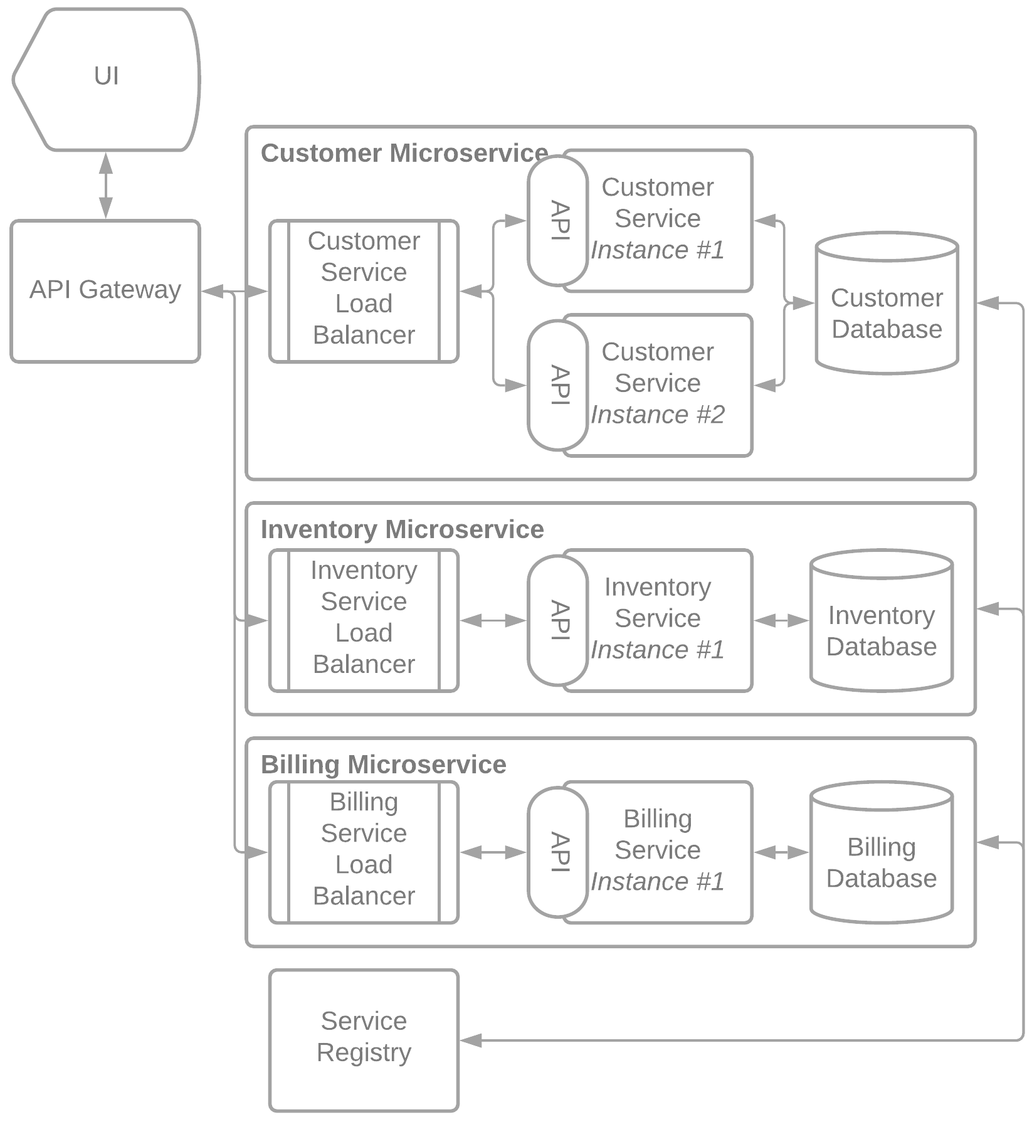
Monoliths and Microservices 2
A microservice-based architecture subdivides an application into several applications with independent codebases, with each encapsulating one business process.
Microservices can communicate with each other via a service registry, but can run on different (virtual) machines.
If one microservice crashes, it won’t take the entire application down with it!
High-level overview of a microservice-based software architecture

Slide 5


Containerising technologies such as Docker and Kubernetes are quickly maturing.
Popular cloud computing platforms such as AWS and DigitalOcean are introducing approachable ways to deploy and orchestrate microservices-based applications.
A survey of tech leaders show that microservices are the future of enterprise application software*, companies that fail to adapt will fail to compete.
But how do we test these microservice-based applications?
* Kong HQ. (2021, April 20). 2021 Digital Innovation Benchmark. Retrieved from https://konghq.com/resources/digital-innovation-benchmark-2021/

Slide 6







Potential Solutions

Slide 7
Problem Definition
Microservices-based architectures are rapidly becoming a popular approach to software development.
Despite this, research has illustrated a lack of standalone testing tools providing a developer with the ability to write automated end-to-end test cases for applications using a microservices-based architecture.
As a result, a developer taking this approach must resort to either adapting existing testing tools or sinking time into creating a tool for their specific use case.
This project aims to develop a comprehensive testing platform that can be used by a developer to run behaviour-driven end-to-end test cases on the user-facing components of web applications with a microservices-based architecture.
The results of this project will be used to justify this approach to testing when used in the modern software development lifecycle.
The project is called Touchstone!

Slide 8
Planning & Design

Slide 9







Technologies

Slide 10
Component 1: The API
Objective 1: Where appropriate, validate data structures that the user submits to an API endpoint. This objective would be achieved when the application can assign constraints to certain data structures and return an error response if the user submits data that violates these constraints.
Objective 2: Secure the API using a standard methodology such as web tokens. This objective would be achieved when the application can authenticate a user based on stored information and then authorised access to endpoints and resources on a case-by-case basis.
Objective 3: Use a database and suitable database management system to save and retrieve persistent data. This objective would be achieved when the application can serialise, save, and later retrieve data that can be mapped to structures such as test cases and test results.
This component is the primary point of interaction between the application and the end user. It is responsible for processing most data that flows through the application and providing a method for the end user to retrieve and review such data where appropriate.

Slide 11
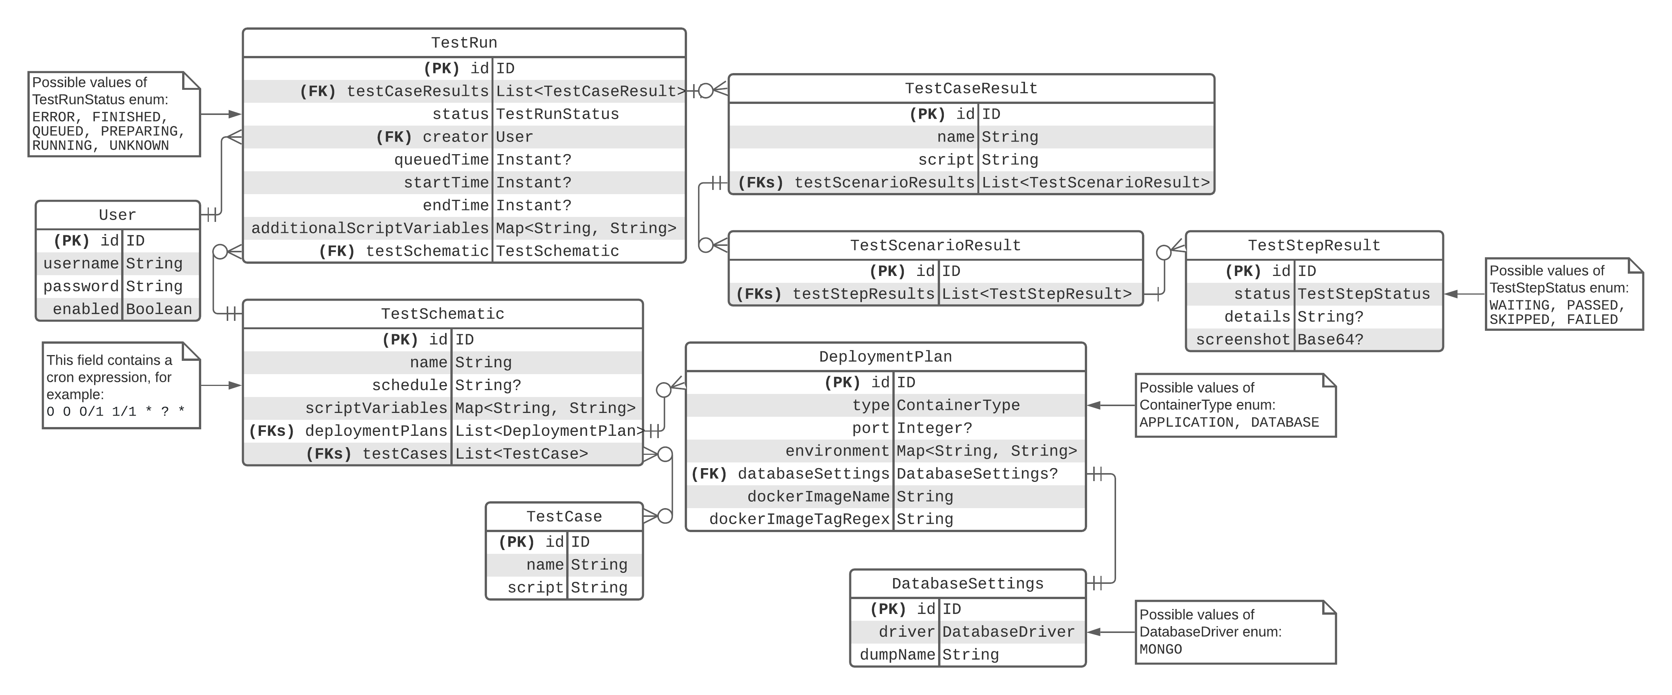
Internal System Design
High-level overview of the internal application architecture

Slide 12
Component 2: The DSL
Objective 1: The DSL should allow the user to provide pass and fail conditions for test cases which are evaluated whilst the test is executed. This objective would be achieved when a user can provide instructions to validate the presence of an element on the screen and have the DSL evaluate the state of the web browser to pass or fail the step depending on whether this element exists.
Objective 2: Implement tight integration between the DSL and container orchestrator. This objective would be achieved when a script written in the DSL can reference the name, address, and port that each test container is serving on. This will effectively allow the user to write test cases for microservice-based applications.
Objective 3: Allow a developer to easily extend the DSL to better fit their use case. This objective would be achieved when the DSL has been implemented in a modular way, making it possible for a developer to define their own instructions and then have the DSL successfully execute scripts containing said instructions.
This components provides the user a way to provide the validation criteria of their microservices-based applications. It allows the user to write simple test cases in human-readable syntax and have these steps carried out on their web application.

Slide 13
Syntax Design
Feature: Reading University website Scenario: I navigate to the homepage Given I navigate to the web page &uni-url& Then verify the text "Study and life" is on the page Scenario: I press the 'View Courses' button Given I navigate to the web page &uni-url& When I click on [css]"#header>header>div>div>div>section.component.additional-features.cf>ul.nav-promo>li.primary-cta>a" Then verify the text "CHOOSE A SUBJECT" is on the page Scenario: I navigate to a non-existent page Given I navigate to the web page &uni-url&/ThisPageDoesntExist Then verify the text "Not Found" is on the page
Script variables, the user can define these on a per-schematic and per-run basis
Select elements via CSS, ID, or XPATH

Slide 14
Component 3: The Test Runner
Objective 1: Develop a container orchestrator that can use a template provided by the user to autonomously deploy interconnected application and database containers using the Docker engine. It is important that these containers can openly exchange data with each other as if they were running behind a service registry in a production environment.
Objective 2: Where appropriate, allow a developer to run test cases against a containerised database containing entries restored from a dump, this will allow test cases to be functionally ‘pure’ without requiring explicit rollback of data committed during the test run. This objective would be achieved when a developer can upload a dump and assign it to a microservice within their deployment plan.
This component is responsible for preparing and executing test runs according to the deployment plans supplied by a user. It can build isolated test environments consisting of multiple containerized microservices and collates the results of test cases when executed on this environment.
Objective 3: Allow for the scheduling of recurrent test runs. This objective would be achieved when the user can associate a cron expression with a test schematic and have the system automatically create a test run at the provided frequency.

Slide 15
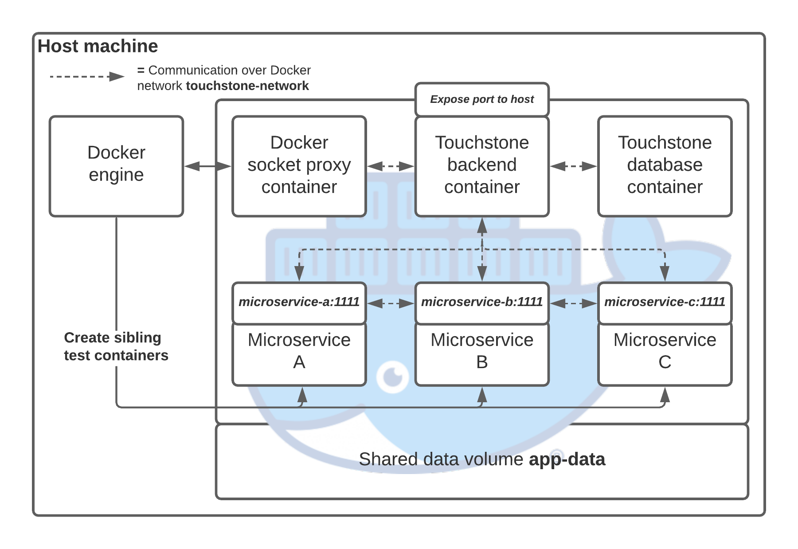
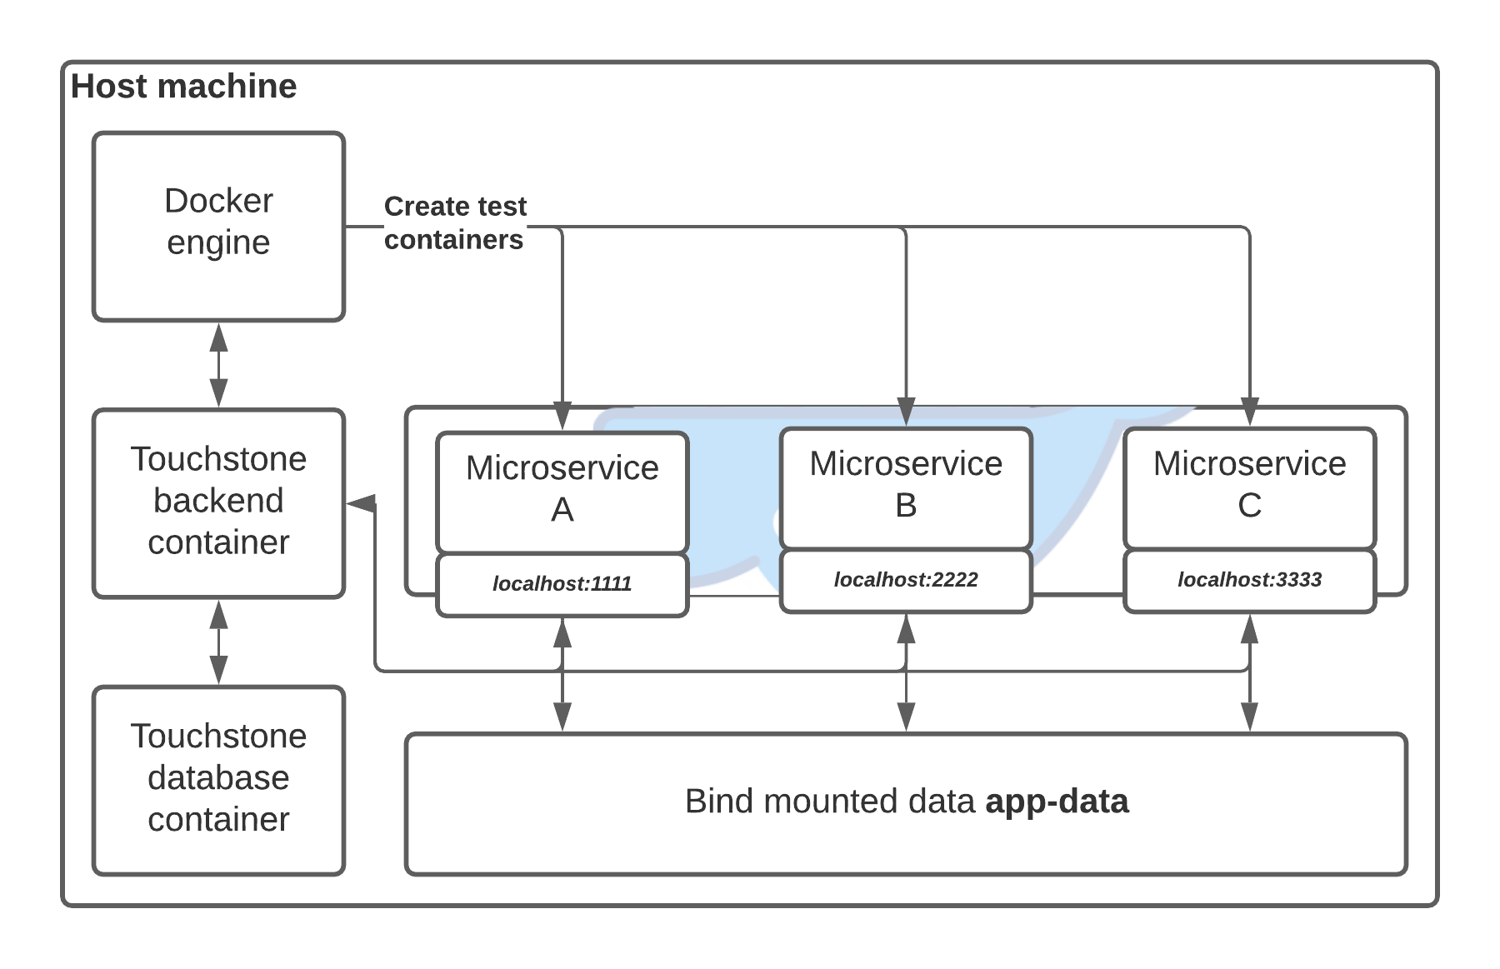
External System Design
High-level overview of the external application architecture when running within a Docker container
High-level overview of the external application architecture when running on a Docker host machine

Slide 16
Implementation & Results

Slide 17
In conclusion…
This project successfully developed a comprehensive testing platform for the front-ends of microservices-based applications.
We met the objectives that I set at the start of the project.
We showed this by developing several containerised and non-containerised test suites during this demonstration.
We proved the validity of this approach to testing by implementing a CI/CD pipeline which made the Touchstone application self-testing.

Slide 18
Reflection
I believe that this is a new an innovative approach to software testing.
Implementing an actual front-end would have increased the usability of the application for non-technical users. This was an aim of the project but my inexperience with JavaScript made implementation difficult.
The application is missing some quality of life features which make it more usable, decreasing the scope of the project may have allowed me to implement features more completely.
In the future, I hope to develop this tool further.

Slide 19
Unused Slides

Slide 20
Scope and Limitations
This project will focus on testing microservice-based web applications, meaning that it will validate user-facing components. Testing the pure functional interactions between microservices is out of scope.
One instance of the application can run one test suite at a time; multithreading is out of scope for the sake of simplicity.
I was initially planning on implementing a comprehensive front-end for the project, but instead decided to focus on implementing the back-end.
Web tests will be run on the Chrome web browser using the Chrome web driver. Many other modern web browsers (including Edge and Opera) are Chromium-based*, so good coverage will be provided regardless.
* Shankland, S. (2021, April 20). Google gets web allies by letting outsiders help build Chrome’s foundation. Retrieved from CNET: https://www.cnet.com/news/google-gets-web-allies-by-letting-outsiders-help-build-chromes-foundation/

Slide 21
Component 4: The GUI
Objective 1: Allow the user to authenticate with the API using a form. This objective would be achieved when the user can access restricted pages after providing a valid username and password pair via a suitable interface.
Objective 2: Show the user the test runs that they have executed. This objective would be achieved when the user can access a page that, if they are authenticated, will show them a table containing all the test runs that they have executed.
This component is a simple UI that will be used to demonstrate a potential application of the API. In addition, it will be used as part of the validation stage of this project.

Slide 22
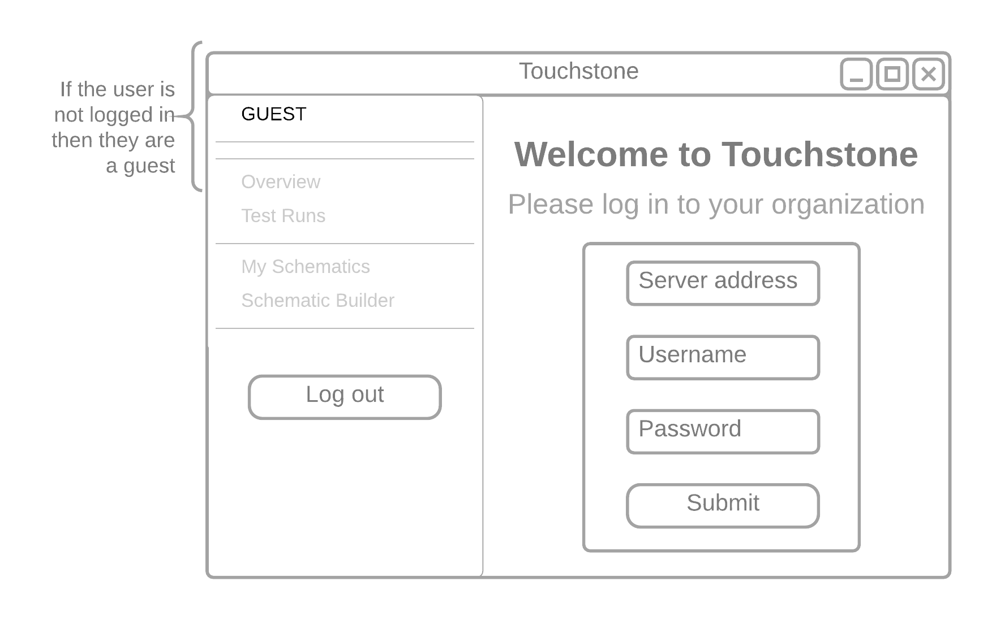
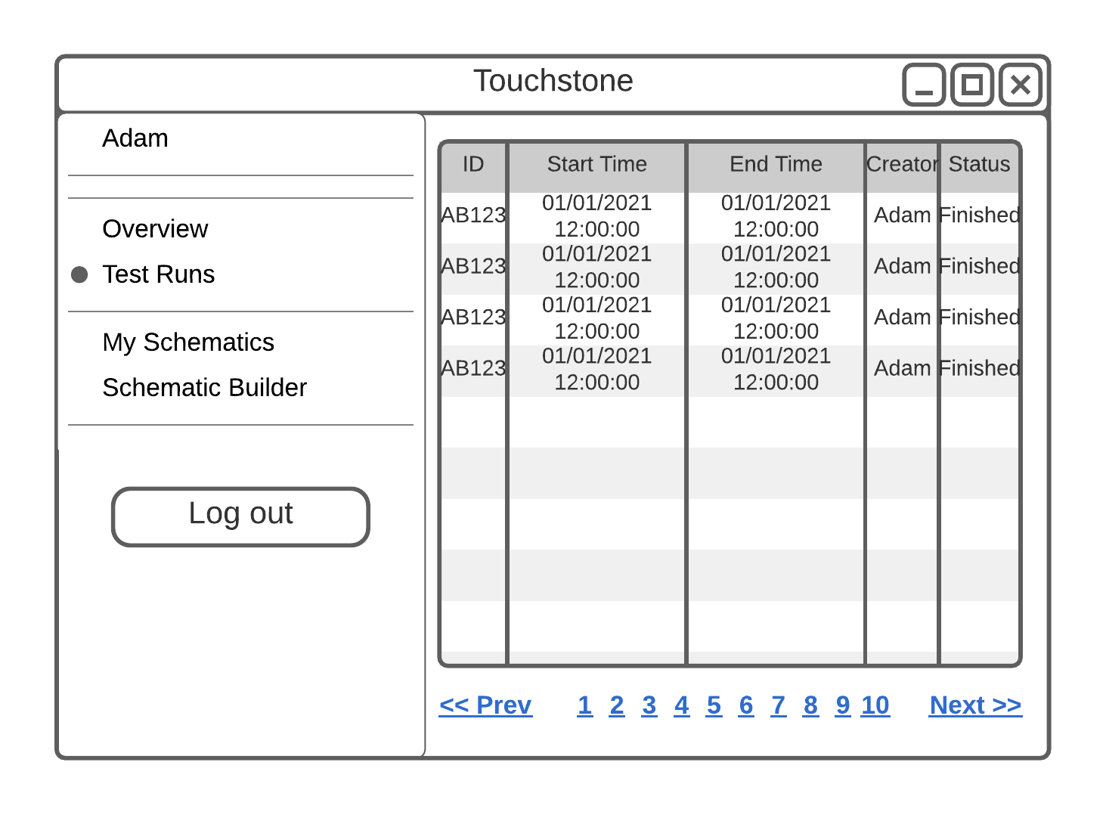
GUI Mock-ups
Mock-up of the login page
Mock-up of the test runs table

Slide 23
Component 5: CI/CD Integration
Objective 1: Allow a developer to report on test runs that they have executed. This objective would be achieved when a user can make a call to an API endpoint that generate a comprehensive report of a test run, containing the test results as JSON, the logs of each container, and screenshots of the Chrome web browser at each step.
Objective 2: Make test runs flexible in a way that allows a developer to run the same test on different versions of the same application without any additional configuration. This objective would be achieved when a user can pass in the tag or ID of an image alongside the run request, the test runner would then deploy a test environment using this image.
Objective 3: Implement a CI/CD pipeline using Touchstone as a validation tool. This objective would be achieved when a Touchstone test run can be automatically triggered upon pushing commits to a remote code repository. The test run would cause a build to either pass or fail depending on the result and provide the user with actionable feedback if appropriate.
This component allows us to evaluate the project when during the validation stage of a CI/CD pipeline. In addition, it will allow us to justify this approach to testing as part of the modern software development lifecycle.

Slide 24
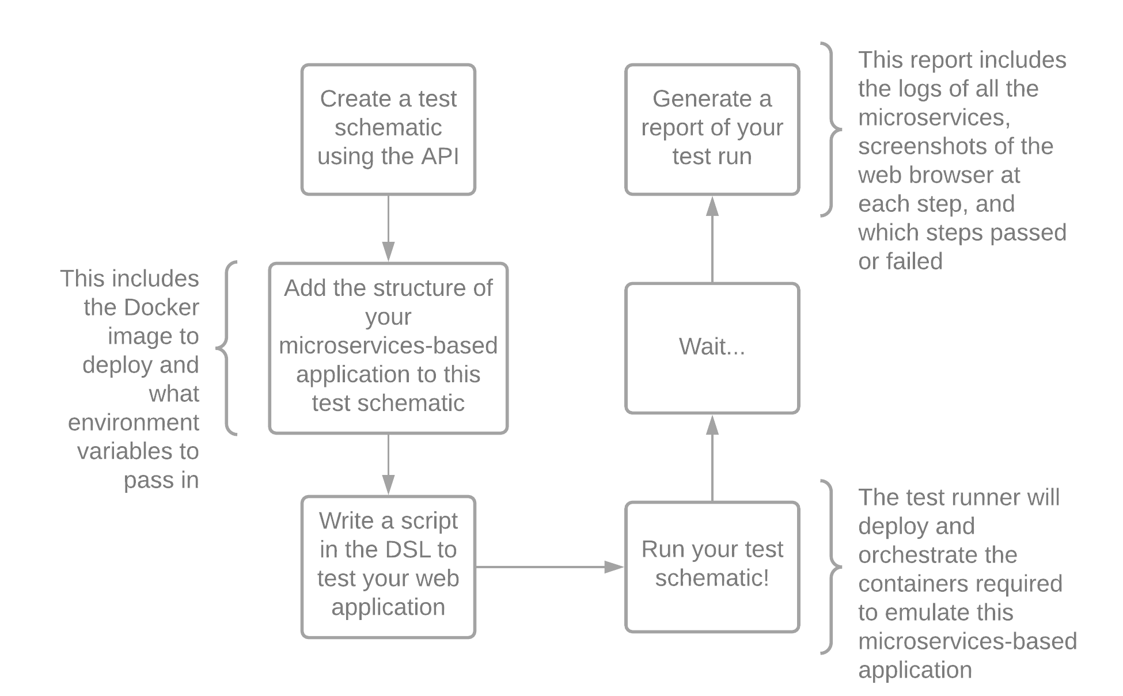
Putting it all together…

