Slide 1
Credit Card Fraud Detection Using Logistic Regression And XG boost
By
Navin Chokhat
Siddharth Naik

Slide 2
Abstract:
This project aims to detect fraudulent credit card transactions using machine learning, specifically Logistic Regression. The rise in global credit card fraud necessitates effective measures to prevent unauthorized account usage.
By identifying and stopping fraudulent transactions, customers' funds can be safeguarded, and they won't be held liable for purchases they didn't make. The project will apply Logistic Regression to a credit card transaction dataset, optimizing the model with GridSearchCV and RandomizedSearchCV. Key evaluation metrics include accuracy, precision, recall, F1-score, AUC-ROC, and the confusion matrix.

Slide 3
Introduction:
The datasets contains transactions made by credit cards in September 2013 by Eroupean cardholders. This dataset presents transactions that occurred in two days, where we have 492 frauds out of 284,807 transactions. The dataset is highly unbalanced, the positive class (frauds) account for 0.172% of all transactions.
It contains only numerical input variables which are the result of a PCA transformation.
Due to confidentiality issues, there are not provided the original features and more background information about the data.

Slide 4
Business Understanding:
More and more people are falling victim to credit card fraud, where their card information is stolen and used to make unauthorized transactions. This can lead to financial difficulties, as victims are left with large debts they cannot pay back. If left unchecked, this can have severe consequences, including imprisonment. To combat this issue, we need to develop effective methods to detect and prevent fraudulent credit card transactions, ensuring the security and financial well-being of customers.

Slide 5
Data Understanding
In the Data understanding phase, it was critical to obtain a high-quality dataset as the model is based on it, the dataset was explored by taking a closer look into it which gave the knowledge needed to confirm the quality of the dataset, additionally to reading the description of the whole dataset and each attribute. It’s also important to have a dataset that contains several mixed transaction types “Fraudulent and real” and a class to clarify the type of transaction, and finally, identifiers to clarify the reason behind the classification of the transaction type.

Slide 6
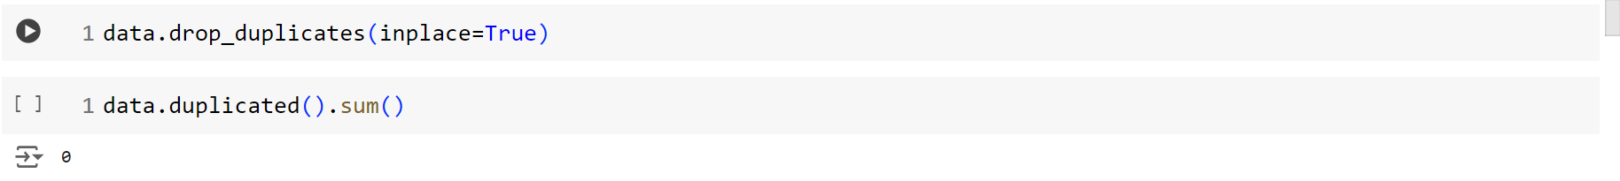
Data Exploration, Processing & Cleaning
Loading the Dataset: The first step is to load the dataset into a pandas DataFrame, which provides a flexible data structure for handling and manipulating data.
Handling Missing Values: Missing data can lead to biased or misleading results. Identifying and handling missing values appropriately is essential, either by imputing them or removing affected records.

Slide 7
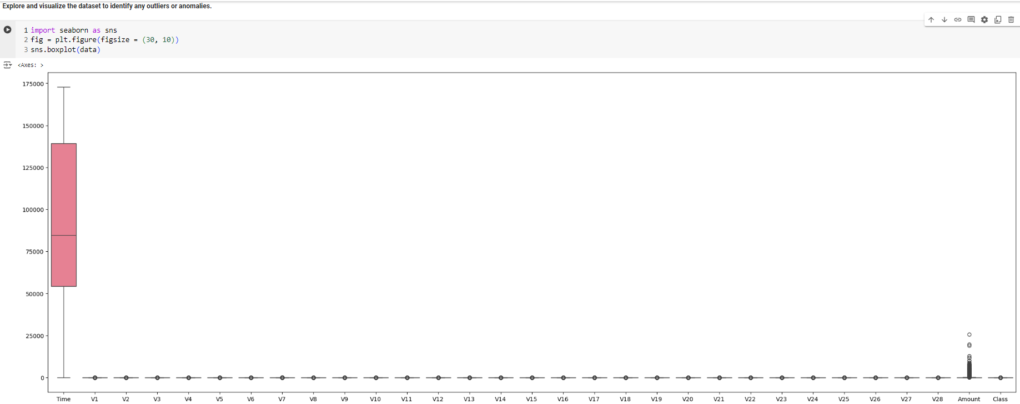
Exploration and Visualization:

Slide 8
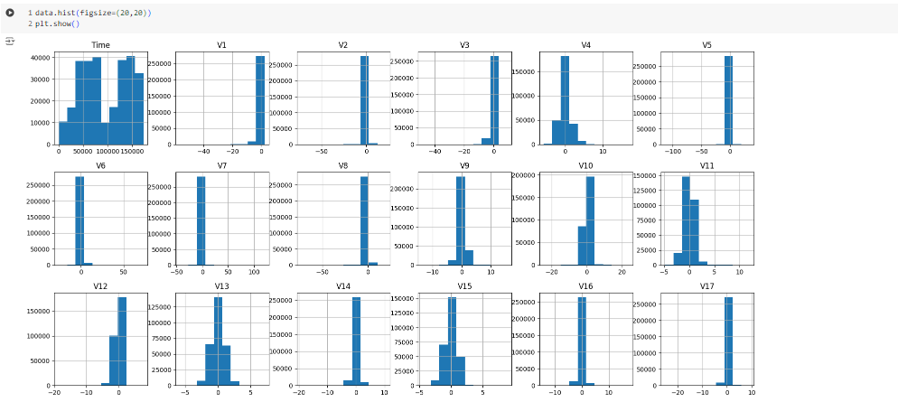
For visualising skewness of data we had used histogram

Slide 9
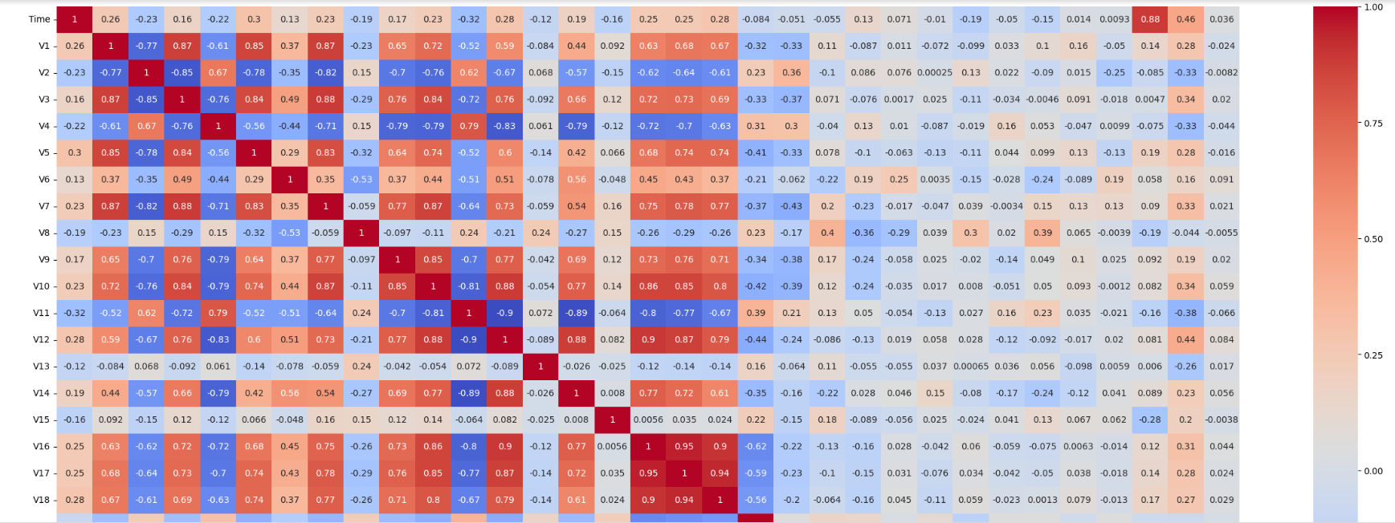
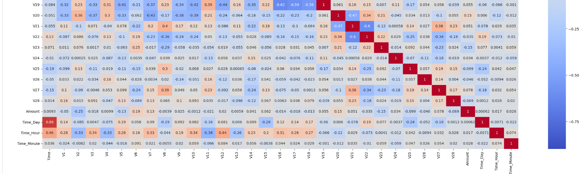

Slide 10
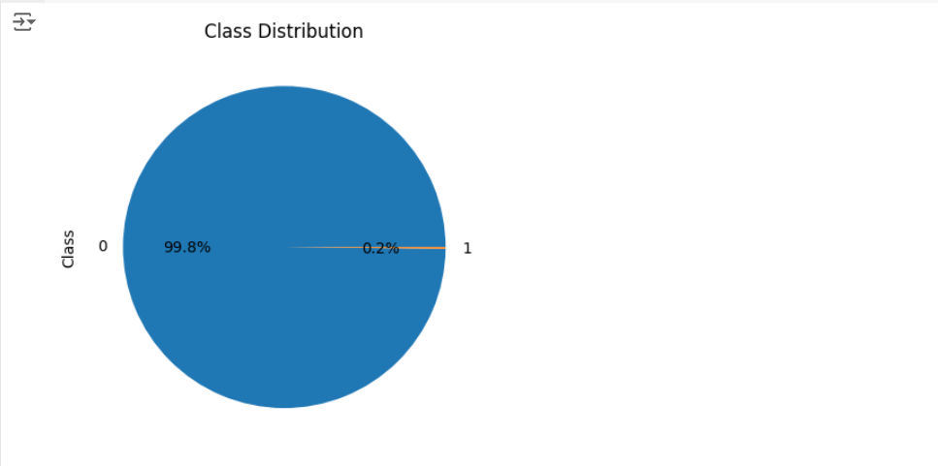
Unbalanced class distribution in percentage using pie chart

Slide 11
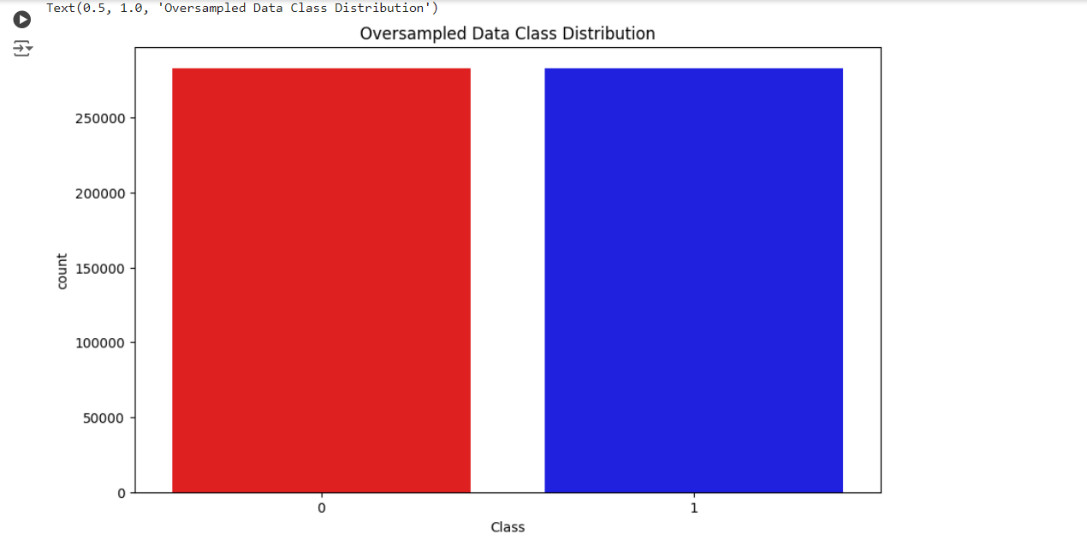
Oversampled data class distribution

Slide 12
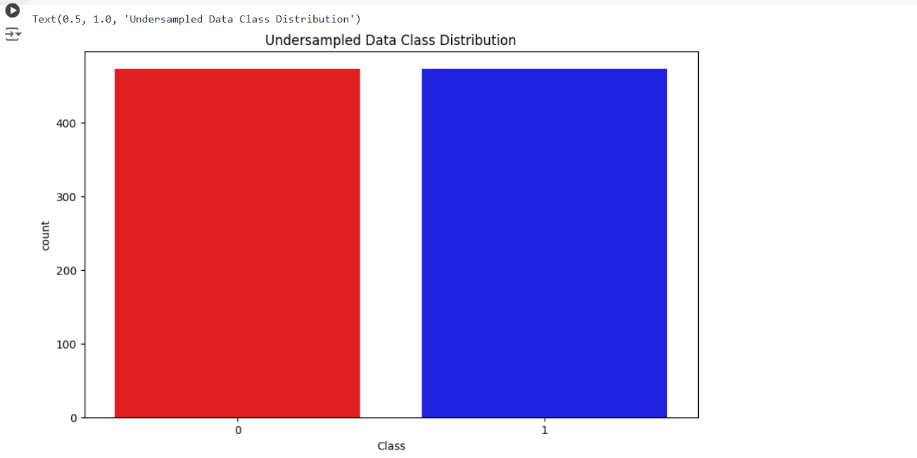
Undersampled data class distribution

Slide 13
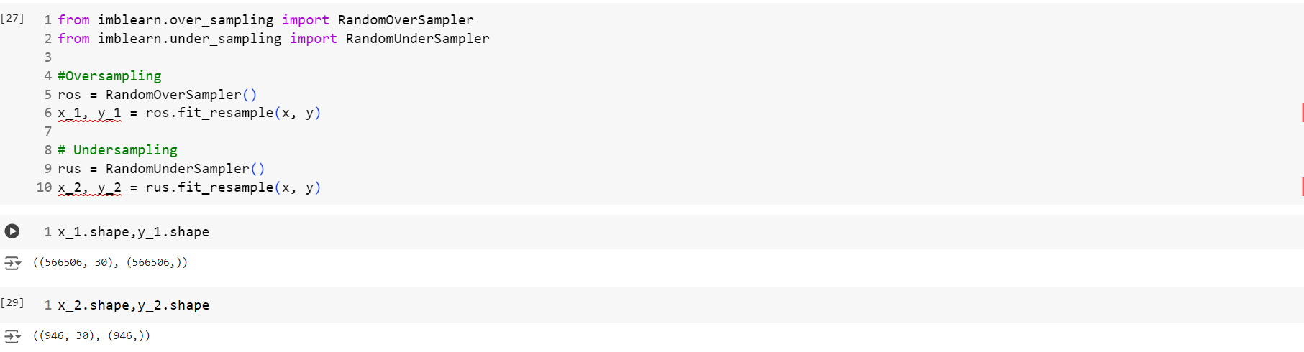
Balancing the Dataset
Credit card fraud detection typically involves imbalanced datasets, where fraudulent transactions are far fewer than legitimate ones. Techniques like undersampling the majority class (non-fraudulent transactions) or oversampling the minority class (fraudulent transactions) can help balance the dataset and improve model performance.

Slide 14
Comparison between undersampling and oversampling

Slide 15
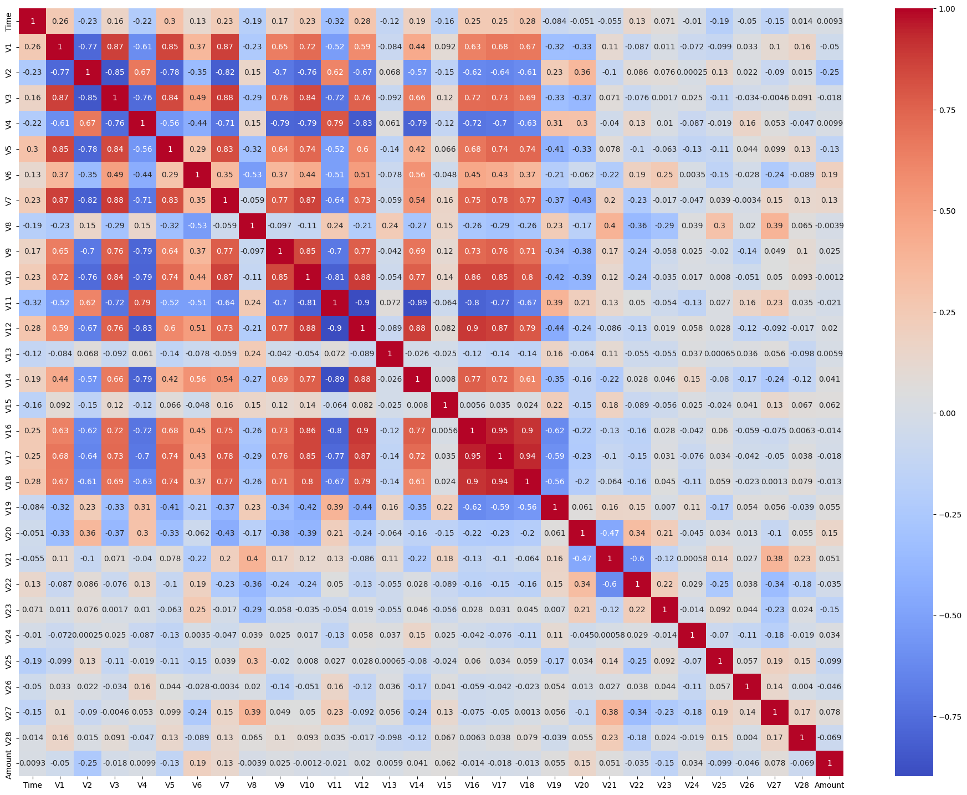
Feature Selection & Engineering:
Relevant Feature Identification: Selecting relevant features is crucial for model accuracy. Irrelevant features can introduce noise and reduce model performance. This step involves identifying and keeping only those features that contribute meaningfully to predicting fraud. This was the corelation matrix for Randomoversampling.

Slide 16
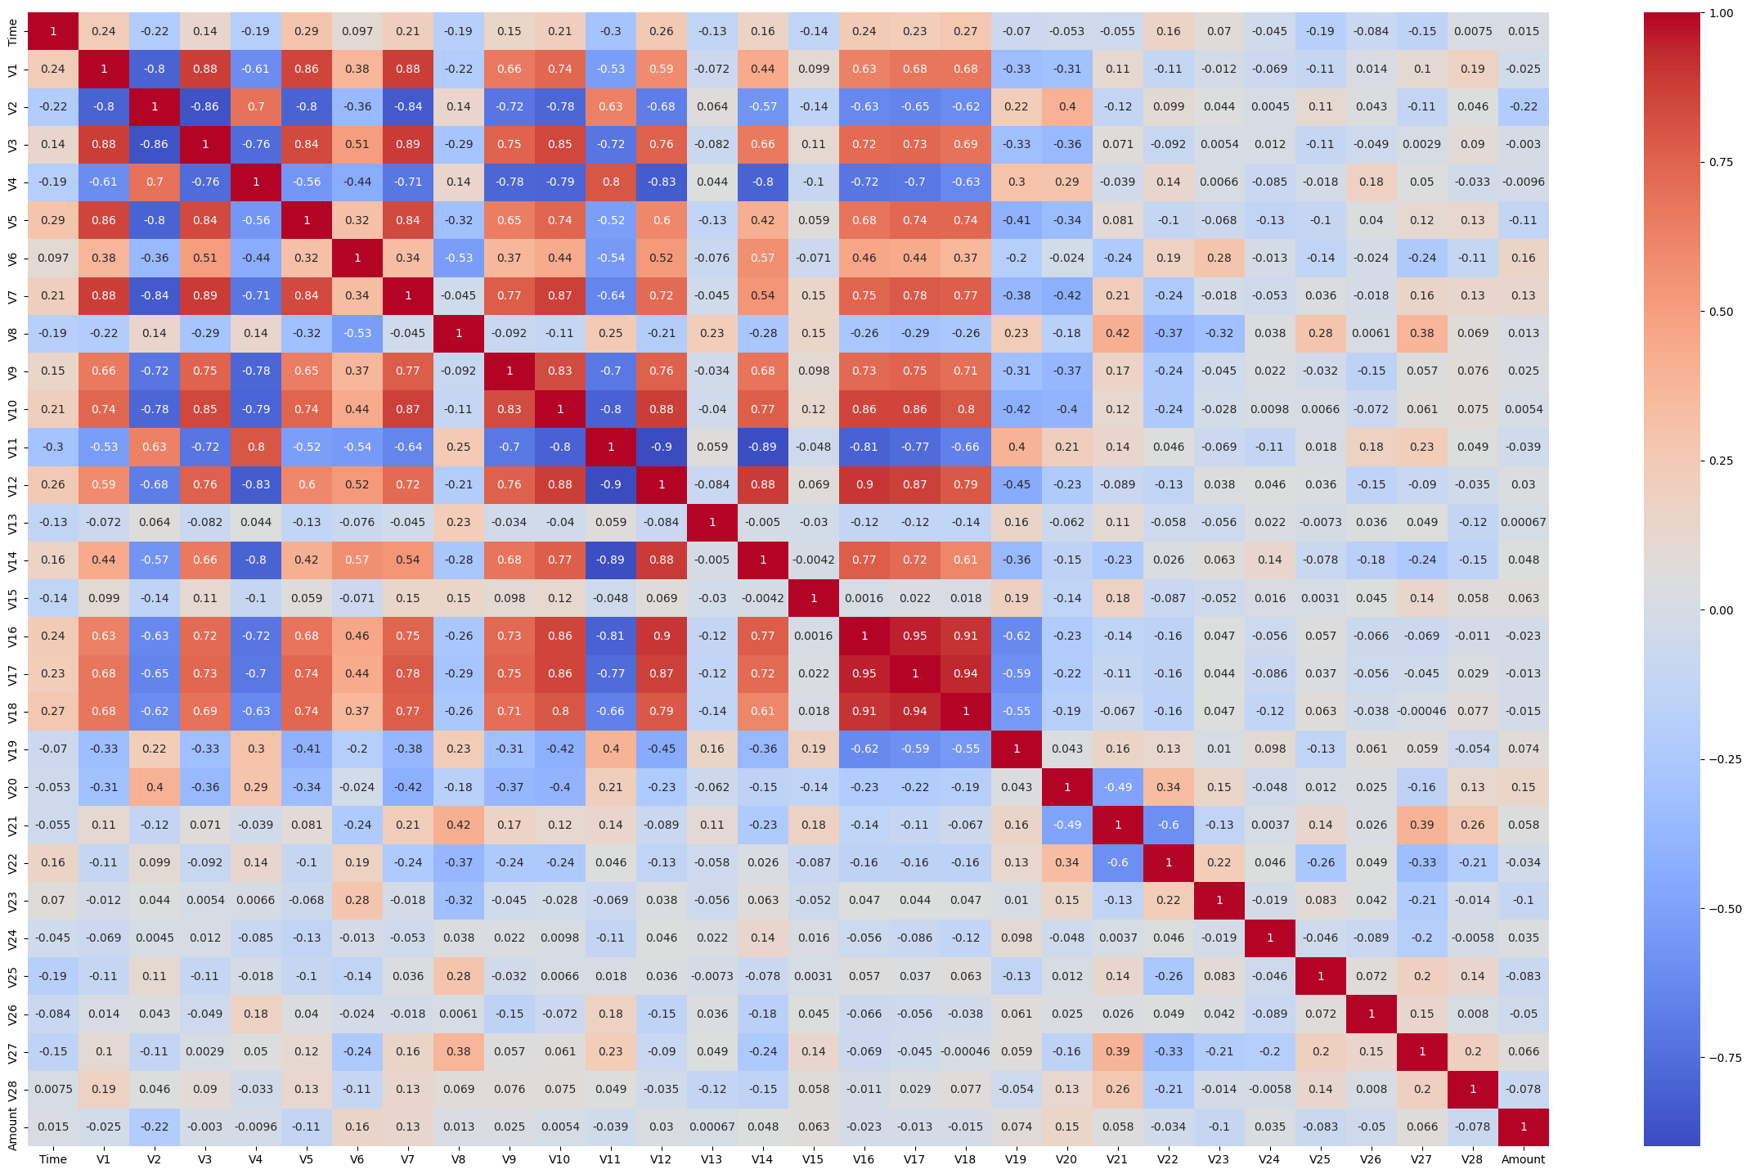
Correlation matrix Random undersampling

Slide 17
Normalising
Normalization: Normalizing numerical features ensures that all features contribute equally to the model, preventing any single feature from disproportionately influencing the outcome due to its scale.

Slide 18
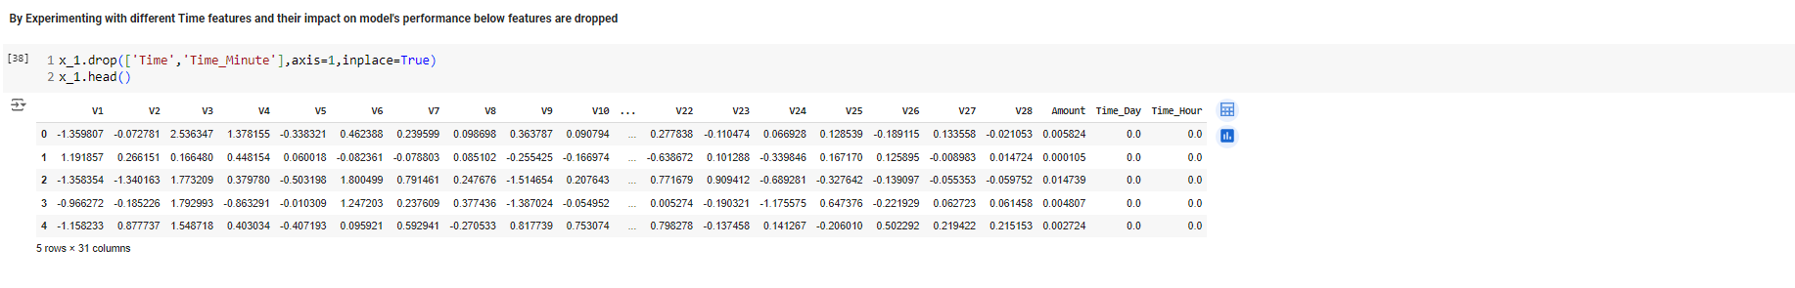
Feature Engineering
Creating new features that capture underlying patterns in the data can enhance model accuracy. For example, time-based features might capture fraudulent activities at specific times of the day.

Slide 19
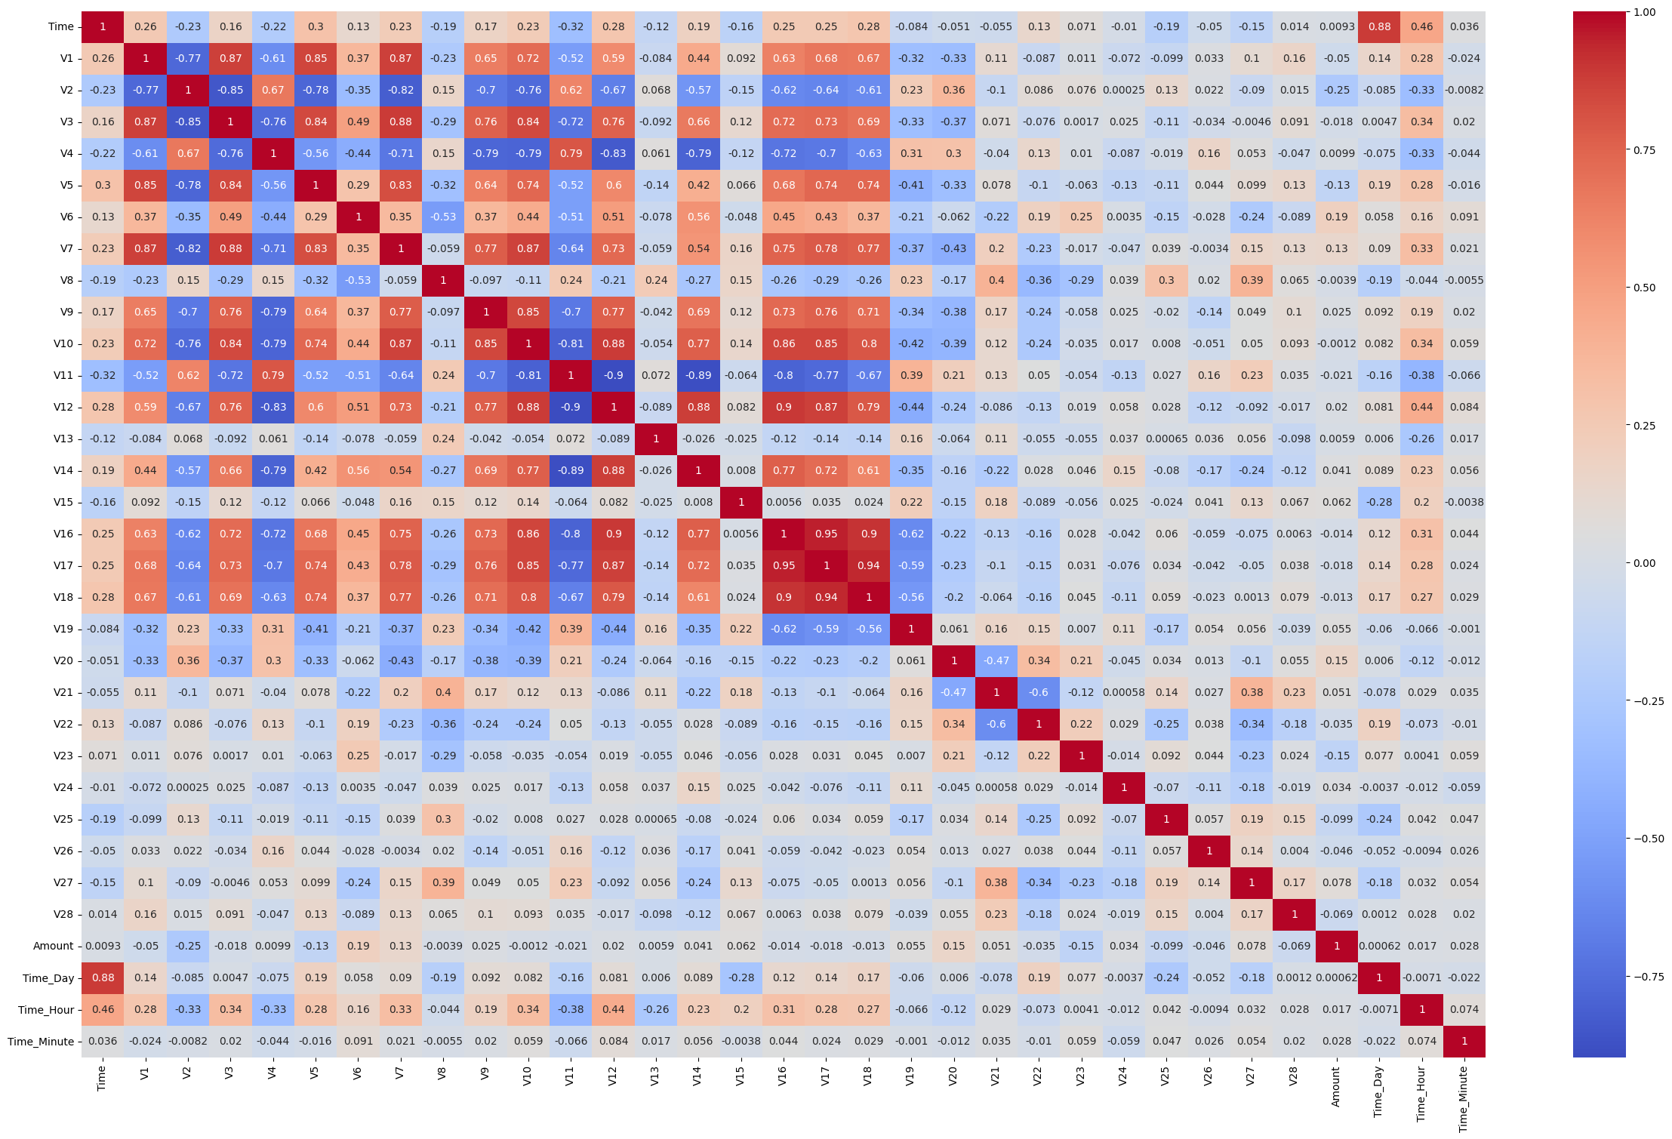
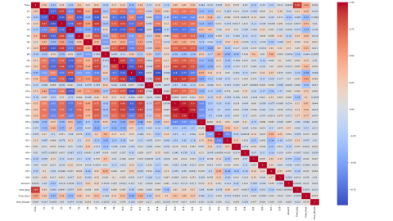


Slide 20
3. Model Building:
3.1 Model Selection
Choosing Logistic Regression: Logistic Regression is selected as the classification algorithm due to its simplicity and effectiveness in binary classification problems like fraud detection. It models the probability that a given input point belongs to a particular class.
3.2 Import Necessary Libraries
Importing Libraries: Before proceeding, necessary libraries such as LogisticRegression from sklearn.linear_model are imported. This ensures that all the tools required for model building and evaluation are available.

Slide 21
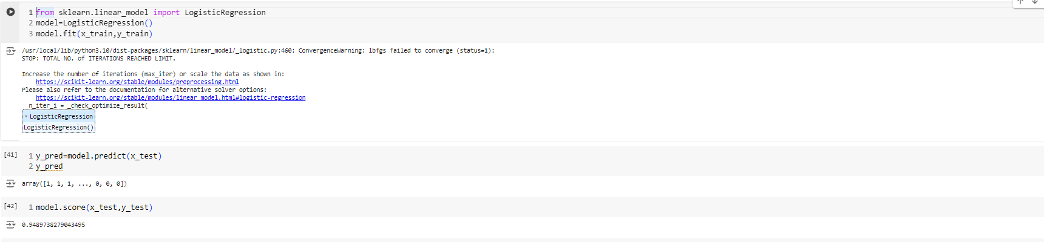
3.3 Understand Logistic Regression
Overview of the Algorithm: Logistic Regression estimates the probability of a binary outcome (fraud or no fraud) by fitting data to a logistic curve. It is crucial to understand its parameters, such as the regularization term, for effective model configuration.
3.4 Model Training
Training the Model: The training process involves using the fit method to learn from the training data. This step is critical as it allows the model to understand patterns in the data that distinguish fraudulent from non-fraudulent transactions.

Slide 22
3.3 Understand Logistic Regression
Overview of the Algorithm: Logistic Regression estimates the probability of a binary outcome (fraud or no fraud) by fitting data to a logistic curve. It is crucial to understand its parameters, such as the regularization term, for effective model configuration.
3.4 Model Training
Training the Model: The training process involves using the fit method to learn from the training data. This step is critical as it allows the model to understand patterns in the data that distinguish fraudulent from non-fraudulent transactions.

Slide 23
4. Model Tuning
4.1 Hyperparameter Tuning
Using GridSearchCV or RandomizedSearchCV: These techniques automate the process of hyperparameter tuning by testing different combinations of hyperparameters and selecting the best-performing model.
4.2 Import Necessary Libraries
Importing Libraries: Libraries such as GridSearchCV and RandomizedSearchCV from sklearn.model_selection are imported to facilitate hyperparameter tuning.

Slide 24
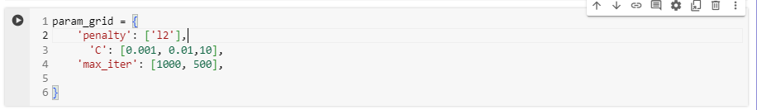
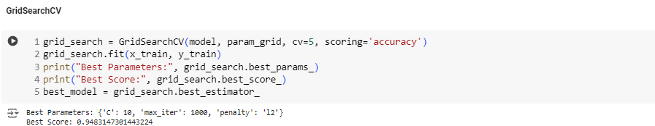
4.3 Define Hyperparameter Grid
Creating a Hyperparameter Grid: This involves defining the hyperparameters to be tuned, such as the regularization strength for Logistic Regression, and their respective ranges.
4.4 Initialize and Fit the Search Method
Running the Search: The search method is run on the training data to identify the best combination of hyperparameters.

Slide 25
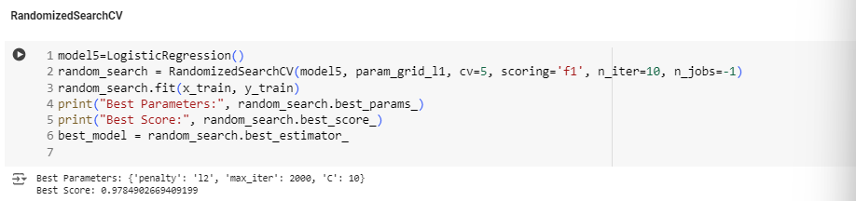

Slide 26
5. Model Evaluation
5.1 Model Testing
Predicting on Testing Set: Once the model is trained, it is tested on unseen data (the testing set) to evaluate its performance. This involves predicting the class labels and obtaining probability scores.
5.2 Evaluation Metrics
Calculating Performance Metrics: Key metrics like accuracy, precision, recall, F1-score, and AUC-ROC are calculated to assess the model's effectiveness. In fraud detection, recall (sensitivity) is often more critical than precision due to the high cost of false negatives.
5.3 Import Necessary Libraries
Importing Metrics: Libraries such as accuracy_score, precision_score, recall_score, f1_score, and roc_auc_score from sklearn.metrics are imported to facilitate the calculation of evaluation metrics.

Slide 27
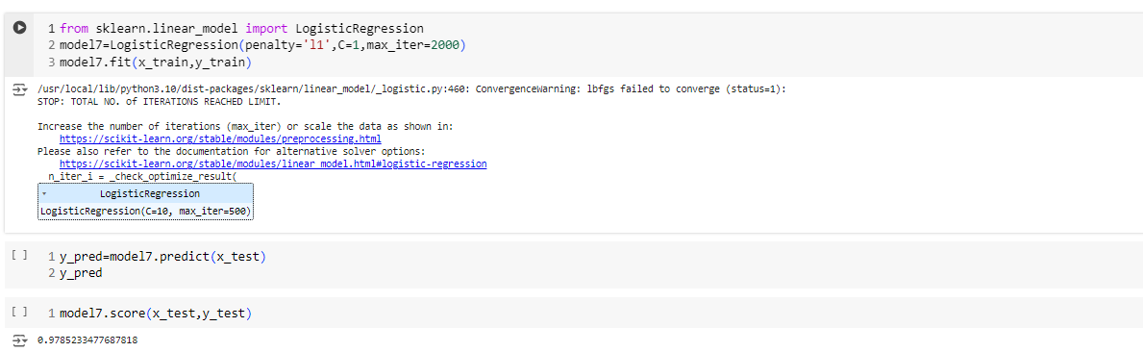

Slide 28
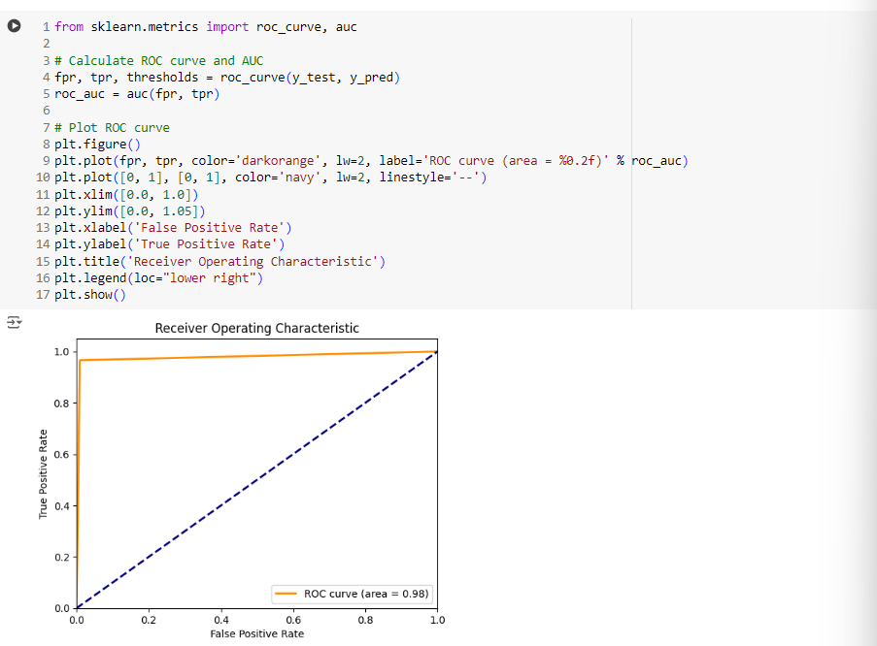
5.4 Calculate and Interpret Metrics
Interpreting Results: Each metric provides insights into the model's strengths and weaknesses. For example, high recall with moderate precision may indicate that the model is good at identifying fraud but may also produce false alarms.

Slide 29
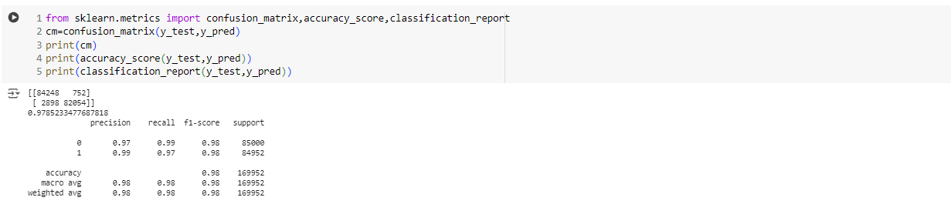
6. Confusion Matrix
6.1 Plot and Analyze Confusion Matrix
Understanding Confusion Matrix: The confusion matrix provides a detailed breakdown of the model's performance, showing the number of true positives, true negatives, false positives, and false negatives.
6.2 Import Necessary Libraries
Importing Libraries: Libraries such as confusion_matrix and ConfusionMatrixDisplay from sklearn.metrics are imported to create and visualize the confusion matrix.

Slide 30
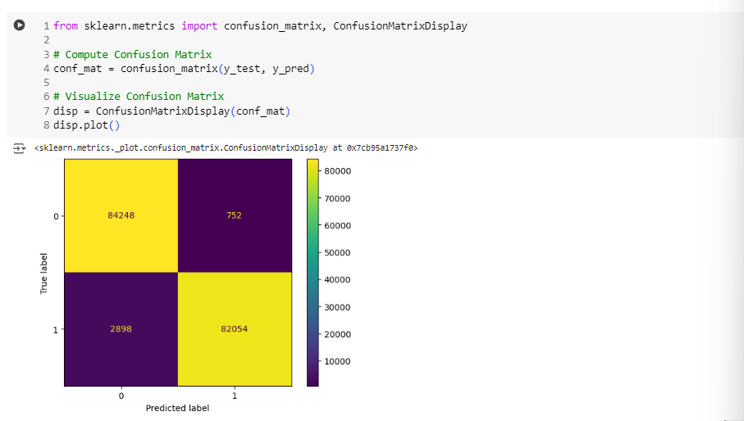
6.3 Compute and Visualize Confusion Matrix
Analyzing the Matrix: The confusion matrix identifies areas where the model might be making mistakes, helping to fine-tune the model further or adjust the classification threshold.
Keywords: Credit Card Fraud Detection, Logistic Regression, Hyperparameters, Evaluation Metrics.
4o

Slide 31
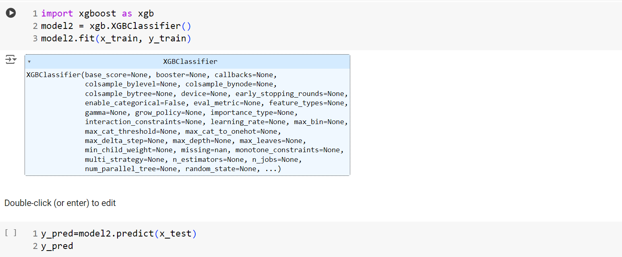
XGBoost: XGBoost is an optimized distributed gradient boosting library designed to be highly efficient, flexible and portable. It implements machine learning algorithms under the Gradient Boosting framework.

Slide 32
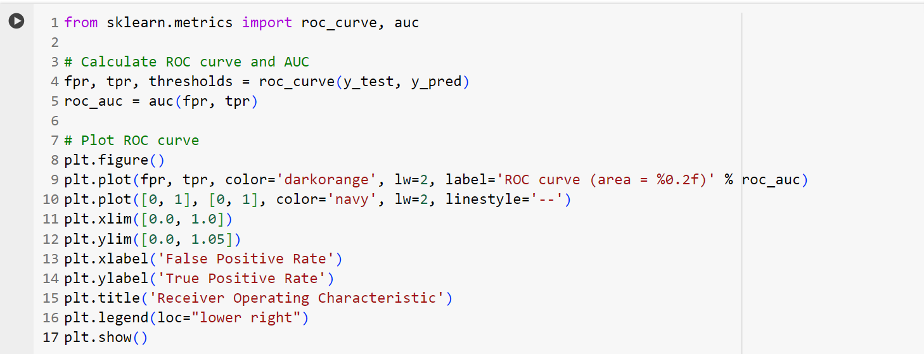
Calculate and Interpret Metrics:
Each metric provides insights into the model's strengths and weaknesses. For example, high recall with moderate precision may indicate that the model is good at identifying fraud but may also produce false alarms.

Slide 33
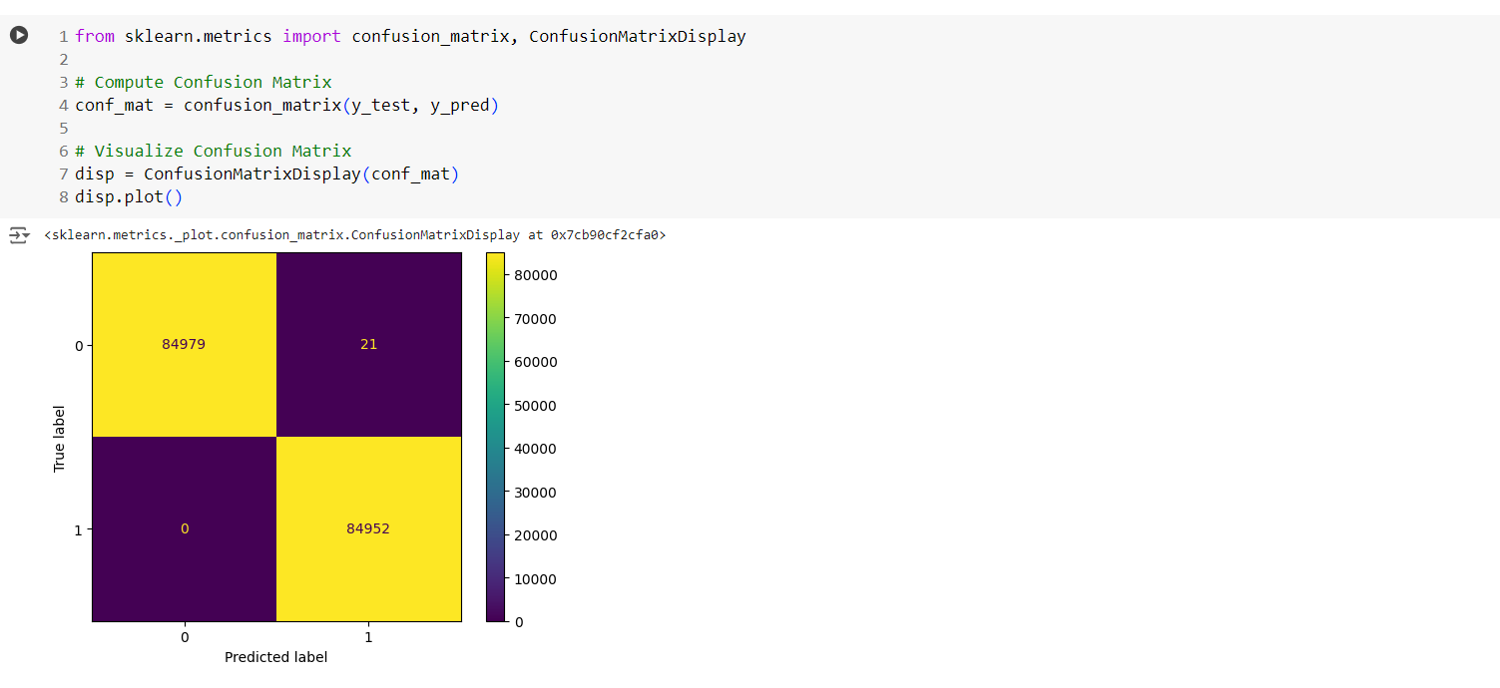

Slide 34
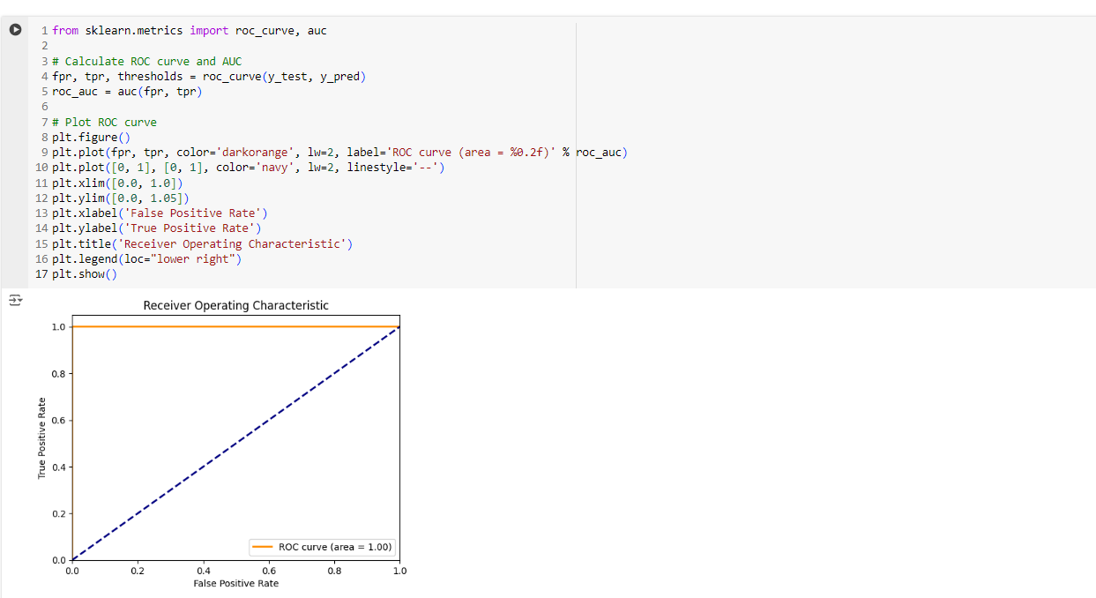

Slide 35
Conclusion: From the above used model it was observed that 1.While using Smote Oversampling Technique with Logistic Regression model is giving recall 0.97 for fraud class and 0.99 for normal class with accuracy 0.9791. 2.After hyperparameter tuning model is giving recall 0.97 for fraud class and 0.99 for normal class with accuracy 0.9793, which is slightly better. 3.On the other side after using xgboost model is giving recall and f1 score for both normal and fraud class was 1 with accuracy 0.9998. Hence it is concluded that xgboost model is the best in Credit Card Fraud Detection.

