Slide 1
Cryptographic Hash Functions

Slide 2
PROJECT TOPICS
Signature protocols
Authentication protocols
System security
Firewall designs and operations
Digital Signatures

Slide 3
Introduction
A hash function H accepts a variable-length block of data M as input and produces a fixed-size hash value, h = H(M).
The kind of hash function needed for security applications is referred to as a cryptographic hash function.

Slide 4
Introduction
A cryptographic hash function is an algorithm for which it is computationally infeasible to find either;
  A data object that maps to a pre-specified hash result (the one-way property). Which means after hashing a message, it should be impossible to regenerate the original message.
  Two data objects that map to the same hash result (the collision-free property). There should not be any case where that two different messages would produce the same hash result after applying a hash function.

Slide 5
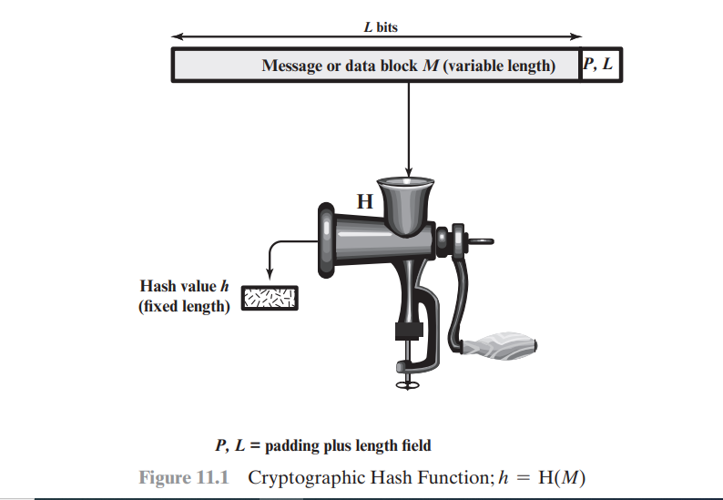
Diagram

Slide 6
APPLICATIONS OF CRYPTOGRAPHIC HASH FUNCTIONS
Message Authentication
Digital signature
Other applications - can be used for one-way password, intrusion detection and virus detection.

Slide 7
Message Authentication
Message authentication is a mechanism or service used to verify the integrity of a message.
Message authentication assures that data received are exactly as sent (i.e., there is no modification, insertion, deletion, or replay).
When a hash function is used to provide message authentication, the hash function value is often referred to as a message digest.

Slide 8
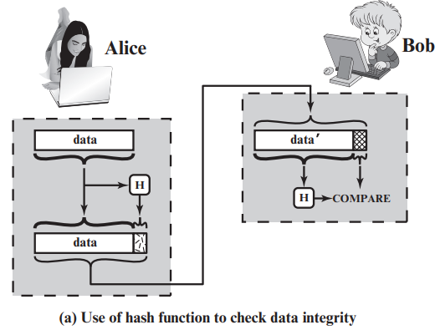
Message Authentication
The sender computes a hash value as a function of the bits in the message and transmits both the hash value and the message.
The receiver performs the same hash calculation on the message bits and compares this value with the incoming hash value.

Slide 9
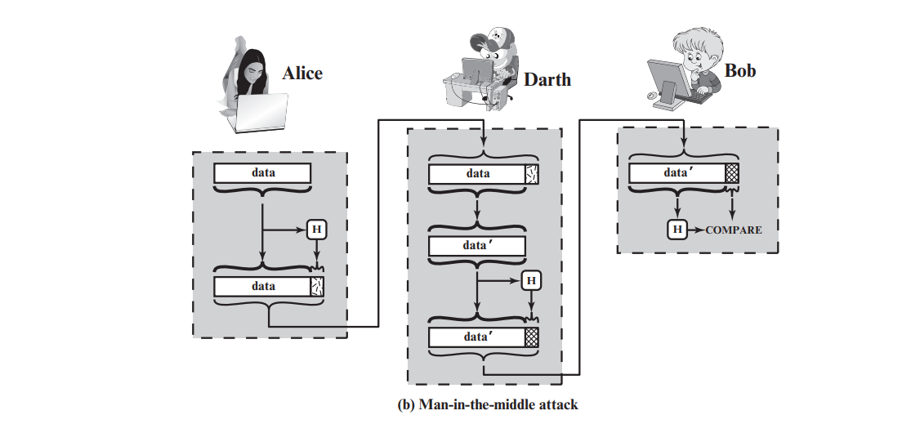
Message Authentication
The hash value must be transmitted in a secure fashion. That is, the hash value must be protected so that if an adversary alters or replaces the message, it is not feasible for adversary to also alter the hash value to fool the receiver.

Slide 10
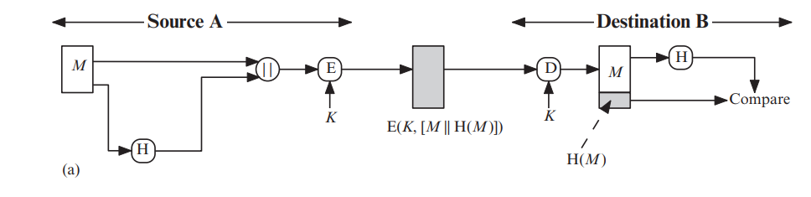
Ways in which a hash code can be used to provide message authentication
The message plus concatenated hash code is encrypted using symmetric encryption. Because only A and B share the secret key, the message must have come from A and has not been altered.
The hash code provides the structure or redundancy required to achieve authentication. Because encryption is applied to the entire message plus hash code, confidentiality is also provided.

Slide 11
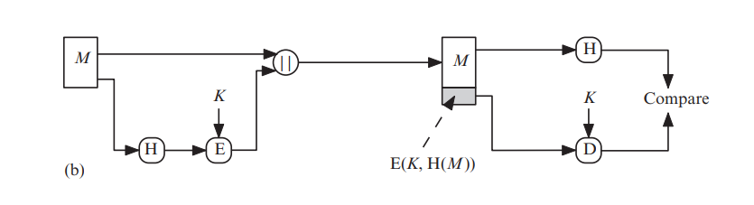
Ways in which a hash code can be used to provide message authentication
Only the hash code is encrypted, using symmetric encryption. This reduces the processing burden for those applications that do not require confidentiality.

Slide 12
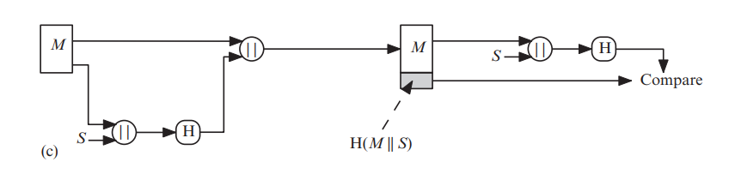
Ways in which a hash code can be used to provide message authentication
It is possible to use a hash function but no encryption for message authentication. The technique assumes that the two communicating parties share a common secret value S.
A computes the hash value over the concatenation of M and S and appends the resulting hash value to M. Because B possesses S, it can recompute the hash value to verify. Because the secret value itself is not sent, an opponent cannot modify an intercepted message and cannot generate a false message.

Slide 13
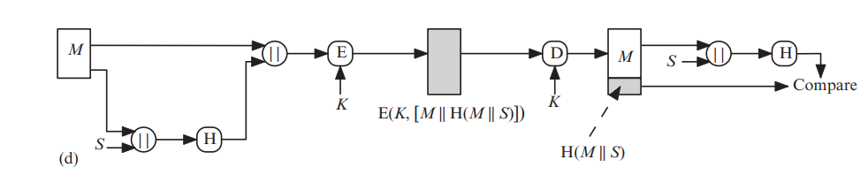
Ways in which a hash code can be used to provide message authentication
Confidentiality can be added to the approach of method (c) by encrypting the entire message plus the hash code.

Slide 14
Ways in which a hash code can be used to provide message authentication
When confidentiality is not required, method (b) has an advantage over methods (a) and (d), which encrypts the entire message, in that less computation is required.
However, there has been growing interest in techniques that avoid encryption.

Slide 15
Reasons to avoid encryption
Encryption software is relatively slow. Even though the amount of data to be encrypted per message is small, there may be a steady stream of messages into and out of a system.
Encryption hardware costs are not negligible. Low-cost chip implementations of DES are available, but the cost adds up if all nodes in a network must have this capability.

Slide 16
Cont…
Encryption hardware is optimized toward large data sizes. For small blocks of data, a high proportion of the time is spent in initialization / invocation overhead.
Encryption algorithms may be covered by patents, and there is a cost associated with licensing their use.

Slide 17
Message Authentication
More commonly, message authentication is achieved using a Message Authentication Code (MAC), also known as a keyed hash function.
Typically, MACs are used between two parties that share a secret key to authenticate information exchanged between those parties.

Slide 18
Digital signature
In a digital signature, the hash value of a message is encrypted with a user’s private key.
Anyone who knows the user’s public key can verify the integrity of the message that is associated with the digital signature.
In this case, an attacker who wishes to alter the message would need to know the user’s private key.

Slide 19
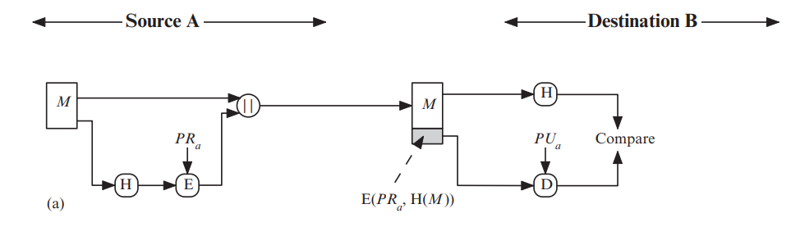
How a hash code is used to provide a digital signature
The hash code is encrypted, using public-key encryption with the sender’s private key.
It also provides a digital signature, because only the sender could have produced the encrypted hash code. In fact, this is the essence of the digital signature technique.

Slide 20
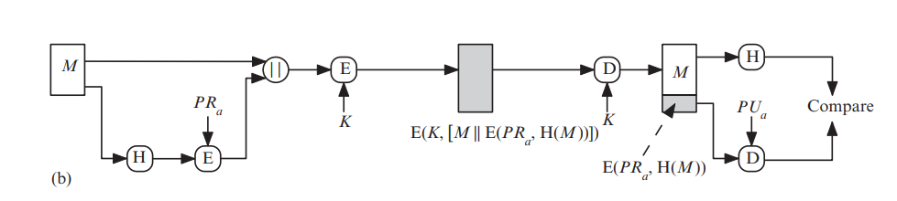
How a hash code is used to provide a digital signature
If confidentiality as well as a digital signature is desired, then the message plus the private-key-encrypted hash code can be encrypted using a symmetric secret key.
This is a common technique

Slide 21
Requirements and Security
For a hash value h = H(x), we say that x is the preimage of h. That is, x is a data block whose hash value, using the function H, is h.
Because H is a many-to-one mapping, for any given hash value h, there will in general be multiple preimages.
A collision occurs if we have x ≠ y and H(x) = H(y).
Notes:
Pigeonhole Principle
If the number of possible inputs is greater than the number of possible outputs, then at least two inputs must map to the same output.

Slide 22
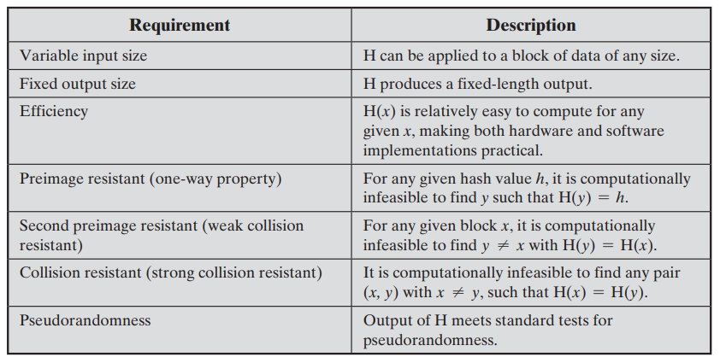
Requirements for a Cryptographic Hash Function

Slide 23
Categories of attacks on hash functions
As with encryption algorithms, there are two categories of attacks on hash functions: brute-force attacks and cryptanalysis.
A brute-force attack does not depend on the specific algorithm but depends only on bit length.
A cryptanalysis, in contrast, is an attack based on weaknesses in a particular cryptographic algorithm.

Slide 24
Brute-force
PREIMAGE AND SECOND PREIMAGE ATTACKS
  For a preimage or second preimage attack, an adversary wishes to find a value y such that H(y) is equal to a given hash value h. The brute-force method is to pick values of y at random and try each value until a collision occurs.
  For an m-bit hash value, the level of effort is proportional to 2m. Specifically, the adversary would have to try, on average, 2m-1 values of y to find one that generates a given hash value h.

Slide 25
Brute-force
COLLISION RESISTANT ATTACKS
  For a collision resistant attack, an adversary wishes to find two messages or data blocks, x and y, that yield the same hash function: H(x) = H(y).
  This turns out to require considerably less effort than a preimage or second preimage attack.

Slide 26
Cryptanalysis
COLLISION RESISTANT ATTACKS
  Cryptanalytic attacks on hash functions seek to exploit some property of the algorithm to perform some attack other than an exhaustive search.
  The way to measure the resistance of a hash algorithm to cryptanalysis is to compare its strength to the effort required for a brute-force attack.
  That is, an ideal hash algorithm will require a cryptanalytic effort greater than or equal to the brute-force effort.

Slide 27
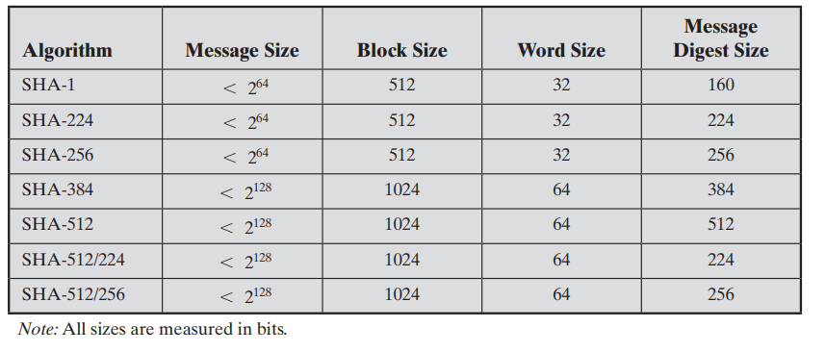
Secure Hash Algorithm (SHA)
SHA was developed by the National Institute of Standards and Technology (NIST) and published as a federal information processing standard (FIPS 180) in 1993.

Slide 28
A multinational company is implementing a new security policy framework to protect its critical data and IT infrastructure. The security team is tasked with designing access control policies, data classification procedures, and incident response plans.
As part of the policy rollout, the company faces several challenges, including:
Employees bypassing security controls to improve workflow efficiency.
Difficulty in enforcing password complexity policies.
Managing data ownership and sharing policies across multiple departments
Use the scenario above to answer the questions below:
Explain THREE (3) key elements of an effective security policy and how they help address the challenges above.
Discuss TWO (2) importance EACH of role-based access control (RBAC) and least privilege principles in enforcing access policies.
Describe how security awareness training can mitigate risks related to policy violations.

