Slide 1

GROUP 4
Project:
Student report card system

Slide 2
GROUP MEMBERS
1. BIGUT CHIN PETER ---- UEB3201524
2. Kyereme Richronney ---- UEB3201224
3. Aasozie Punana Doris ------ UEB3200924
4. Npong Bemokibiba Frank ---- UEB3201324

Slide 3
PROJECT OVERVIEW
The Student Report Card System is a simple program that manages student academic records. It lets you add new student names and scores, automatically calculates averages and assigns grades, displays all stored data, saves records to a file, and loads saved data when needed. The program repeatedly shows a menu after each action, allowing you to manage records until you choose to exit.

Slide 4
PROÇEDURE/ALGORITHM
25. ELSE IF choice is 3 THEN
26. Open file
27. Save all student info to file
28. Close file
29. Show “Saved!”
30. ELSE IF choice is 4 THEN
31. Open file
32. Read all student info from file
33. Add them to the list
34. Close file
35. Show “Loaded!”
36. ELSE IF choice is 5 THEN
37. Show “Exiting the program”
38. ELSE
39. Show “Wrong choice. Try again.”
40. UNTIL choice is 5
41. END
12. IF choice is 1 THEN
13. Ask how many students
14. FOR each student
15. Ask for name
16. Ask for 8 scores
17. Calculate average
18. Give grade based on average
19. Add student to list
20. END FOR
21. ELSE IF choice is 2 THEN
22. FOR each student
23. Show name, average, and grade
24. END FOR
1. START
2. Create a list to store student records
3. Set student count to 0
4. REPEAT
5. Show menu:
6. Enter new students
7. Show all students
8. Save to file
9. Load from file
10. Exit
11. Ask user for a choice

Slide 5
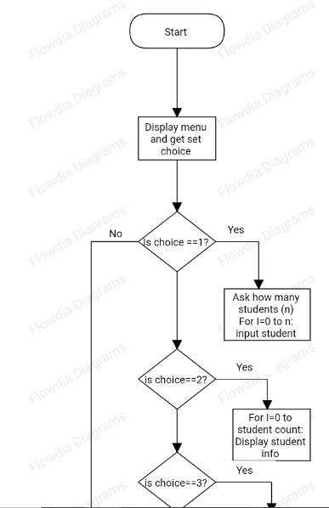
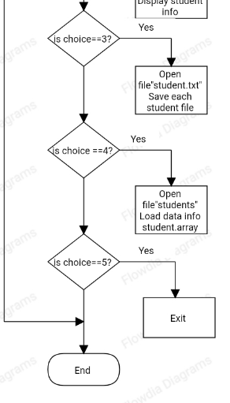
FLOWCHART ILLUSTRATION

Slide 6
CODE SNIPPET
#include <iostream>
#include <fstream>
using namespace std;
class Student {
public:
string name;
int scores[8];
float average;
char grade;
void input() {
cout << "Enter student name: ";
cin >> name;
cout << "Enter scores for 8 courses:\n";
int sum = 0;
for (int i = 0; i < 8; i++) {
cout << "course " << i + 1 << ": ";
cin >> scores[i];
sum += scores[i];
}
void input() {
cout << "Enter student name: ";
cin >> name;
cout << "Enter scores for 8 courses:\n";
int sum = 0;
for (int i = 0; i < 8; i++) {
cout << "course " << i + 1 << ": ";
cin >> scores[i];
sum += scores[i];
}
average = sum / 8.0;
assignGrade();
}
void assignGrade() {
if (average >= 80)
cout << "grade = A";
else if (average >= 75)
cout << "grade = B+";
else if (average >= 70)
cout << "grade = B";
else if (average >= 65)
cout << "grade = C+";
else if (average >=60)
cout << "grade = C";
else if (average >=55)
cout << "grade = D+";
else if (average >=50)
cout << "grade = D+";
else if (average >=45)
cout << "grade = E";
else if (average <44)
cout << " grade = F";
}
void display() {
cout << "Name: " << name << "\nAverage: " << average << "\nGrade: " << grade << "\n";

Slide 7
CODE CONTINUATION
}
void saveToFile(ofstream &outfile) {
outfile << name << " ";
for (int i = 0; i < 8; i++) {
outfile << scores[i] << " ";
}
outfile << average << " " << grade << "\n";
}
void loadFromFile(ifstream &infile) {
infile >> name;
int sum = 0;
for (int i = 0; i < 8; i++) {
infile >> scores[i];
sum += scores[i];
}
infile >> average >> grade;
}
};
int main() {
Student students[100];
int n, choice;
do {
cout << "\n--- Student Report Card System ---\n";
cout << "1. Enter new student records\n";
cout << "2. Display all student records\n";
cout << "3. Save records to file\n";
cout << "4. Load records from file\n";
cout << "5. Exit\n";
cout << "Enter your choice: ";
cin >> choice;
static int studentCount = 0;
switch (choice) {
case 1:
cout << "How many students? ";
cin >> n;
for (int i = 0; i < n; i++) {
students[studentCount].input();
studentCount++;
}
break;
case 2:
for (int i = 0; i < studentCount; i++) {
cout <<

Slide 8
CODE CONTINUATION
"\nStudent " << i + 1 << ":\n";
students[i].display();
}
break;
case 3: {
ofstream outfile("students.txt");
for (int i = 0; i < studentCount; i++) {
students[i].saveToFile(outfile);
}
outfile.close();
cout << "Data saved to students.txt\n";
break;
}
case 4: {
ifstream infile("students.txt");
studentCount = 0;
while (!infile.eof()) {
students[studentCount].loadFromFile(infile);
studentCount++;
}
infile.close();
cout << "Data loaded from students.txt\n";
break;
}
case 5:
cout << "Exiting program.\n";
break;
default:
cout << "Invalid choice. Try again.\n";
}
} while (choice != 5);
return 0;
}

