Slide 1
Cloud Computing Planning
Dr. John Kwao Dawson

Slide 2
Before deploying applications to cloud, it is necessary to consider your business requirements. Following are the issues one must consider:
Data Security and Privacy Requirement
Budget Requirements
Type of cloud - public, private or hybrid
Data backup requirements
Training requirements
Dashboard and reporting requirements
Client access requirements
Data export requirements

Slide 3
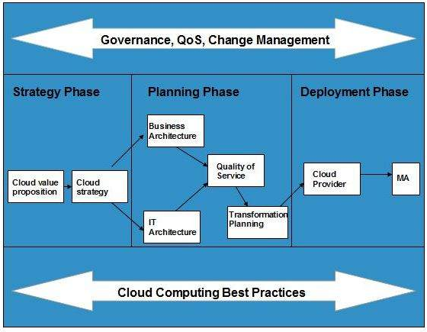
To meet all of these requirements, it is necessary to have well-compiled planning. The various planning phases that must be practized by an enterprise before migrating the entire business to cloud. Each of these planning phases are described in the following diagram:

Slide 4
Strategy Phase
In this phase, we analyze the strategy problems that customer might face. There are two steps to perform this analysis:
Cloud Computing Value Proposition
Cloud Computing Strategy Planning

Slide 5
Cloud Computing Value Proposition
In this, we analyze the factors influencing the customers when applying cloud computing mode and target the key problems they wish to solve. These key factors are:
IT management simplification
operation and maintenance cost reduction
business mode innovation
low cost outsourcing hosting
high service quality outsourcing hosting.

Slide 6
Cloud Computing Strategy Planning
The strategy establishment is based on the analysis result of the above step.
In this step, a strategy document is prepared according to the conditions a customer might face when applying cloud computing mode.

Slide 7
Planning Phase
This step performs analysis of problems and risks in the cloud application to ensure the customers that the cloud computing is successfully meeting their business goals. This phase involves the following planning steps:
Business Architecture Development
IT Architecture development
Requirements on Quality of Service Development
Transformation Plan development

Slide 8
Business Architecture Development
In this step, we recognize the risks that might be caused by cloud computing application from a business perspective.
IT Architecture Development
In this step, we identify the applications that support the business processes and the technologies required to support enterprise applications and data systems.
Requirements on Quality of Service Development
Quality of service refers to the non-functional requirements such as reliability, security, disaster recovery, etc. The success of applying cloud computing mode depends on these non-functional factors.

Slide 9
Transformation Plan Development
In this step, we formulate all kinds of plans that are required to transform current business to cloud computing modes.

Slide 10
Deployment Phase
This phase focuses on both of the below two phases. It involves the following two steps:
Selecting Cloud Computing Provider
Maintenance and Technical Service
Selecting Cloud Computing Provider
This step includes selecting a cloud provider on basis of Service Level Agreement (SLA), which defines the level of service the provider will meet.

Slide 11
Maintenance and Technical Service
Maintenance and Technical services are provided by the cloud provider. They need to ensure the quality of services.

