Slide 1
UNIT I
CLOUD COMPUTING
By: Dr. John Kwao Dawson

Slide 2
Cloud Computing - Overview
Helps access applications as utilities.
Using the Internet.
It allows us to create and configure.
Customize applications online.

Slide 3
Cloud Computing refers to manipulating, configuring, and accessing applications online.
It offers online data storage.
Infrastructure and application.

Slide 4
What is Cloud?
Cloud refers to a Network or Internet.
Is present at remote location.
Cloud provides services over network.
Public networks or on private networks, i.e., WAN, LAN or VPN.
Applications such as e-mail.
Web conferencing.
Customer relationship management (CRM),all run in cloud.

Slide 5
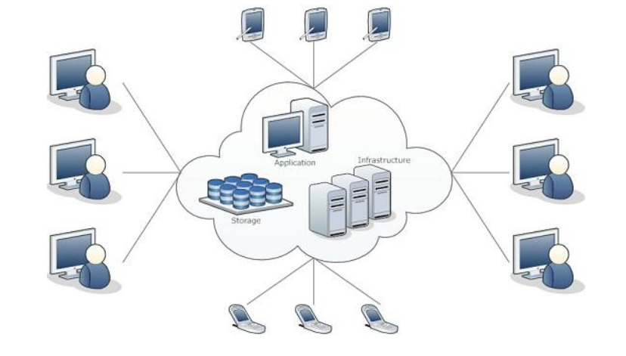
Diagram of cloud computing

Slide 6
We need not to install a piece of software on our local PC and this is how the cloud computing overcomes platform dependency issues.
Hence, the Cloud Computing is making our business application mobile and collaborative

Slide 7
Basic Concepts
There are certain services and models working behind the scene making the cloud computing feasible and accessible to end users.
Following are the working models for cloud computing:
Deployment Models
Service Models

Slide 8
DEPLOYMENT MODELS
Deployment models define the type of access to the cloud
How the cloud is located?
Cloud can have any of the four types of access:
Public
Private
Hybrid
Community.

Slide 9
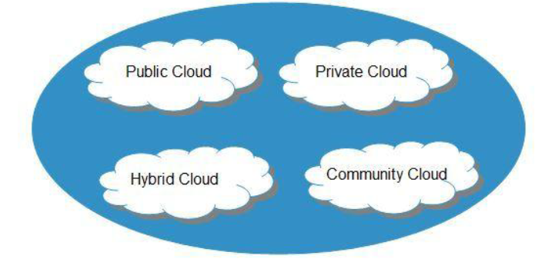
Cloud Computing Deployment Models

Slide 10
PUBLIC CLOUD
The Public Cloud allows systems and services to be easily accessible to the general public.
Public cloud may be less secure because of its openness,
Example: e-mail

Slide 11
PRIVATE CLOUD
The Private Cloud allows systems and services to be accessible within an organization.
It offers increased security because of its private nature.

Slide 12
COMMUNITY CLOUD
The Community Cloud allows systems and services to be accessible by group of organizations.
HYBRID CLOUD
The Hybrid Cloud is mixture of public and private cloud.
The critical activities are performed using private cloud while the non-critical activities are performed using public cloud.

Slide 13
SERVICE MODELS
Service Models are the reference models on which the Cloud Computing is based.
These can be categorized into three basic service models as listed below:
Infrastructure as a Service (IaaS)
Platform as a Service (PaaS)
Software as a Service (SaaS)

Slide 14
There are many other service models all of which can take the forms like;
Anything as a Service (XaaS).
Examples
Network as a Service
Business as a Service
Identity as a Service
Database as a Service
Strategy as a Service.

Slide 15
The Infrastructure as a Service (IaaS) is the most basic level of service.
Each of the service models make use of the underlying service model
Each inherits the security and management mechanism from the underlying model, as shown in the following diagram:

Slide 16
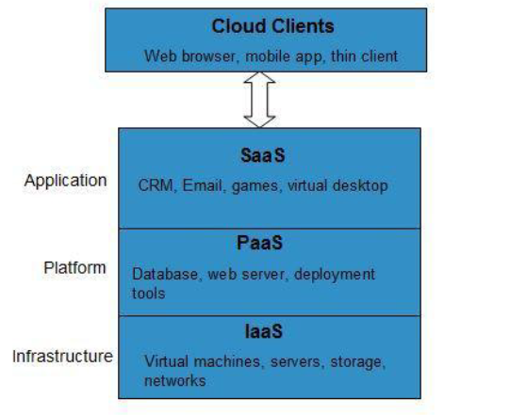
Cloud Service Models

Slide 17
INFRASTRUCTURE AS A SERVICE (IAAS)
IaaS provides access to fundamental resources such as
virtual machines
virtual storage
PLATFORM AS A SERVICE (PAAS)
PaaS provides the runtime environment for
applications
development
deployment tools, etc.

Slide 18
SOFTWARE AS A SERVICE (SAAS)
SaaS model allows to use software applications as a service to end users.
Example Google Docs.

Slide 19
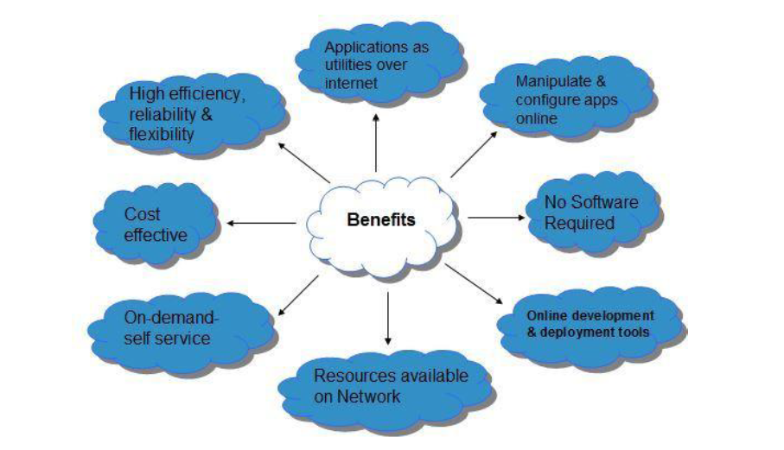
Benefits

Slide 20
Risk associated with cloud computing
SECURITY & PRIVACY
It is the biggest concern about cloud computing.
Third-party Management
Although the cloud computing vendors ensure more secure password protected accounts, any sign of security breach would result in loss of clients and businesses.

Slide 21
LOCK-IN
It is very difficult for the customers to switch from one Cloud Service Provider (CSP) to another.
It results in dependency on a particular CSP for service

Slide 22
ISOLATION FAILURE
This risk involves the failure of isolation mechanism that separates storage, memory, routing between the different tenants.

Slide 23
MANAGEMENT INTERFACE COMPROMISE
In case of public cloud provider, the customer management interfaces are accessible through the Internet.
INSECURE OR INCOMPLETE DATA DELETION
It is possible that the data requested for deletion may not get deleted.
It happens either because extra copies of data are stored but are not available or disk destroyed also stores data from other tenants.

Slide 24
Characteristics
There are four key characteristics of cloud computing. They are shown in the following diagram:

Slide 25
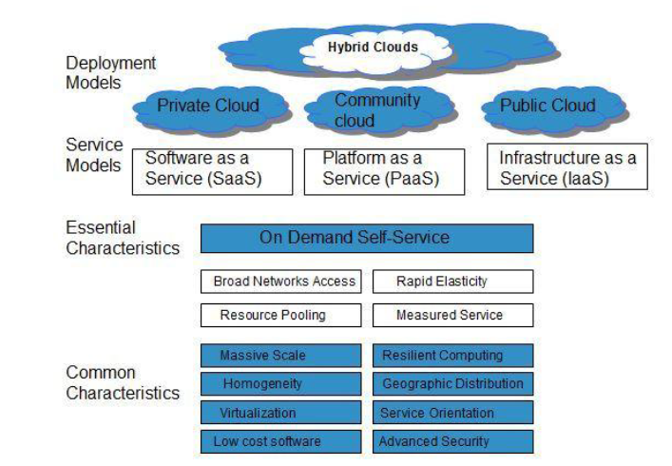
Characteristics of Cloud Computing

Slide 26
ON DEMAND SELF-SERVICE
Cloud Computing allows the users to use web services and resources on demand.
One can logon to a website at any time and use them.
BROAD NETWORK ACCESS
Since Cloud Computing is completely web based, it can be accessed from anywhere and at any time.

Slide 27
RESOURCE POOLING
Cloud Computing allows multiple tenants to share a pool of resources.
One can share single physical instance of hardware, database and basic infrastructure.
RAPID ELASTICITY
It is very easy to scale up or down the resources at any time.
Resources used by the customers or currently assigned to customers are automatically monitored and resources

