Slide 1
Basic of DeFi

Slide 2
1. What is Blockchain
Block + Chain + Cryptography Ledger
Feature of Blockchain
Decentralized
Transparency
Security
Type of Blockchain Networks
Public
Private
Hybrid

Slide 3
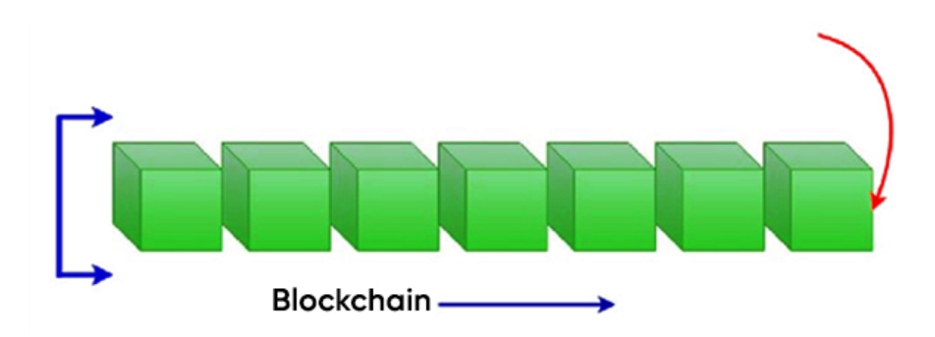
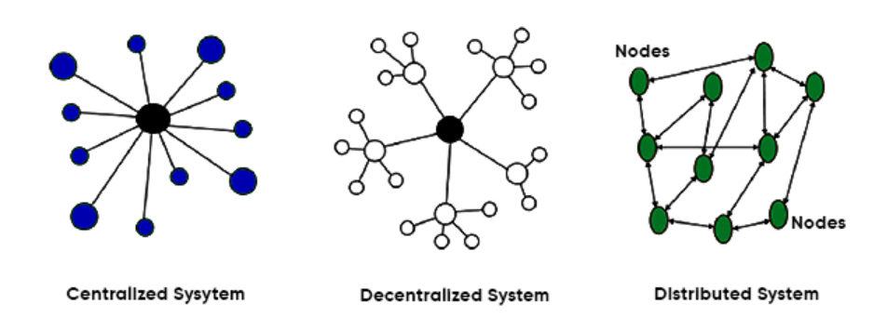

Slide 4
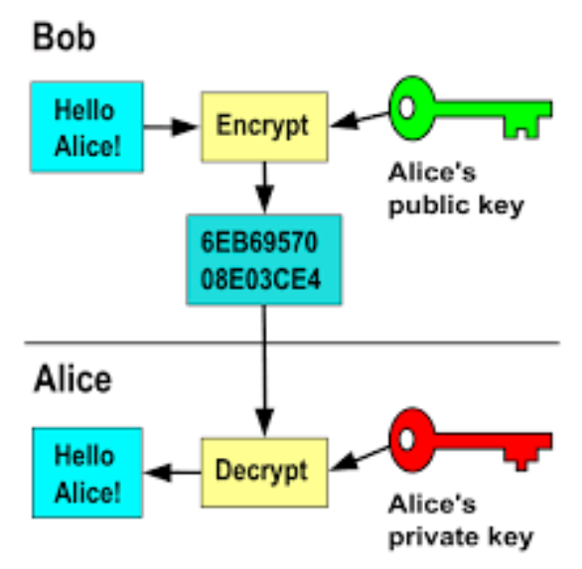
Public Encryption
How does it different from other payment system
Privacy
Global transaction
Security

Slide 5
2. Concept of Bitcoin
POW (Proof of work)
Miner
Node
Gas
POS (Proof of Staking)

Slide 6
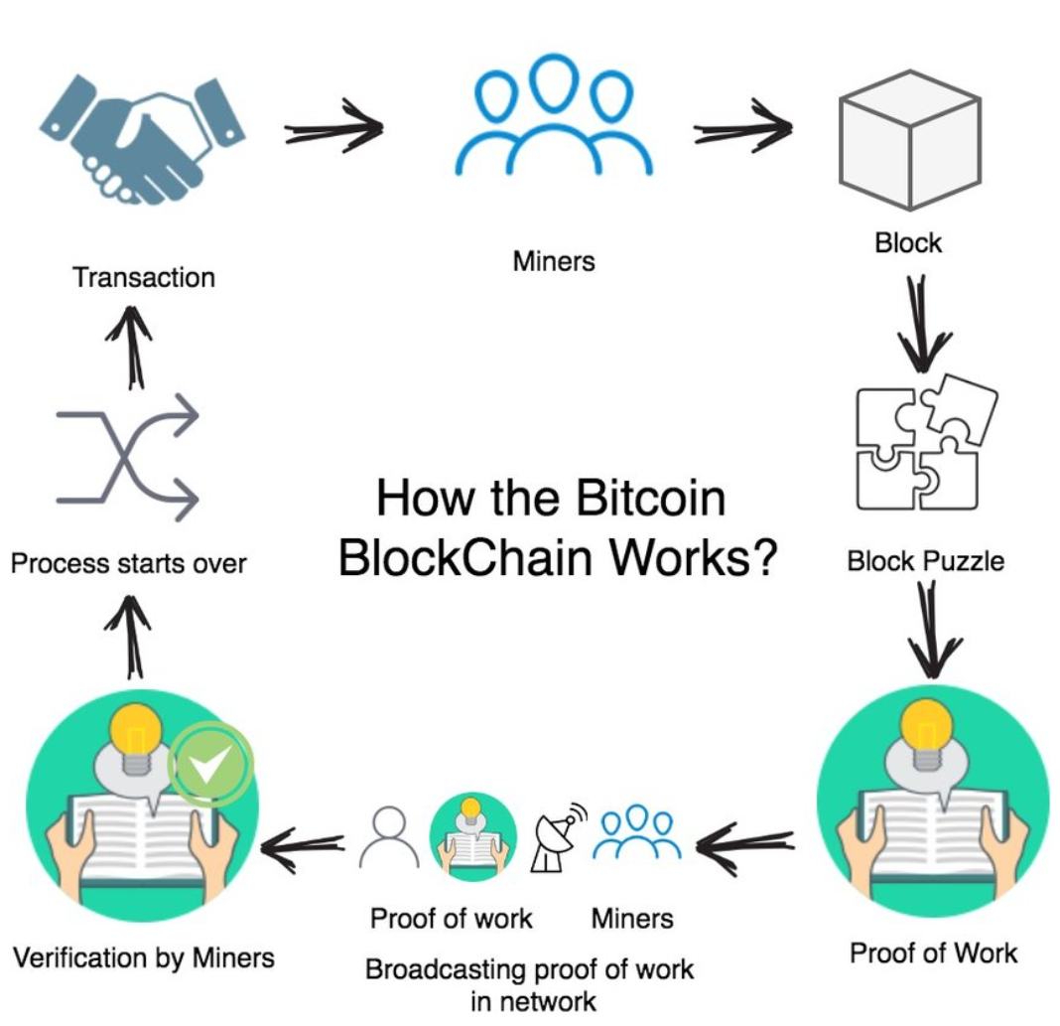

Slide 7
3. Which kind of Blockchains are there
Bitcoin
EVM chains
Ethereum, BSC, Arbitrum, Optimism, Polygon…
Solidity, Viper
Non-EVM Chains
Solana => Rust
TON => Func
Zilliqa => Scilla
Cardano => Haskell

Slide 8
4. What is smart contract
Robust + Autonomous Program
Traditional Contracts => Legally enforceable
Smart Contract => Self-enforcing

Slide 9
5. What kind of assets are there
Coin
Token
Fungible
Stable Token => Payment
USDT, USDC, DAI, CEUR
Defi Tokens
Cake, UNI
Non-Fungible

Slide 10
6. Basic keywords
Blockchain Developer
Core Developer
Application Developer
DApp (Decentralized Application)
Open source
Secured
DeFi (Decentralized Finance)
New Wave of DApp
Advantage: Human Error, Immutability, Transparency
Disadvantage: Scalability, Liquidity, Shared resposibility
Web2, Web3

Slide 11
7. How to exchange crypto
Centralized Cryptocurrency Exchange
Bianace, Coinbase, Huobi, MEXC, Gate.io
Decentralized Cryptocurrency Exchanges
Uniswap, 1inch, Raydium, dYdX
Custodial Wallet vs Non-Custodial Wallet
Metamask, Exodus

Slide 12
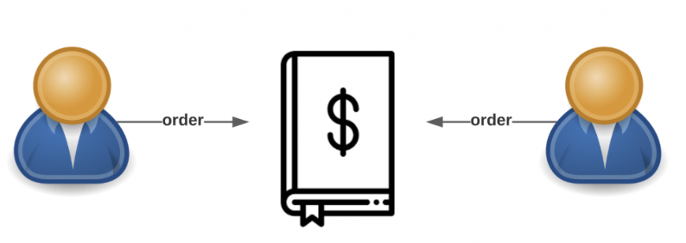
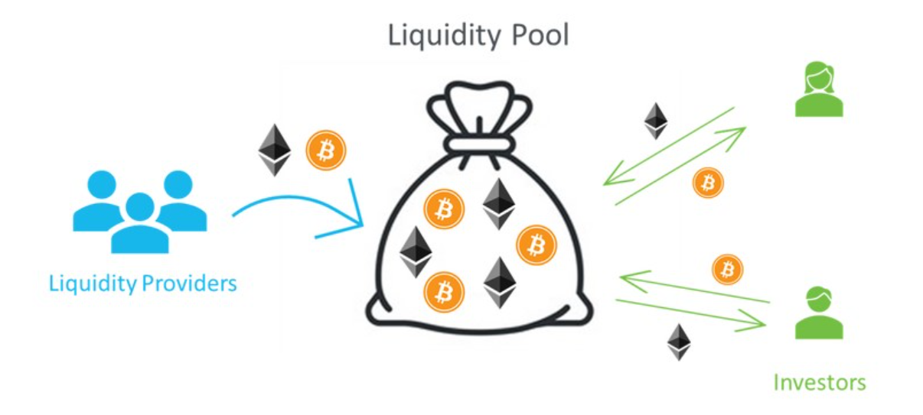
Traditional Exchange Order Book
Automated Market Maker (AMM)

Slide 13
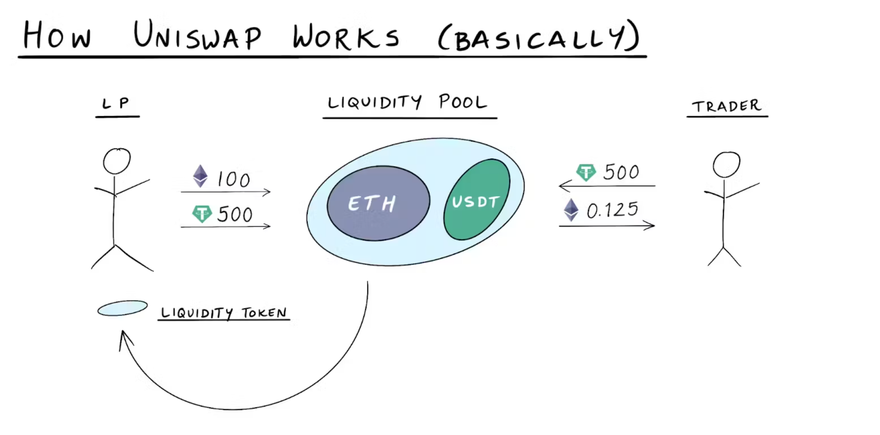
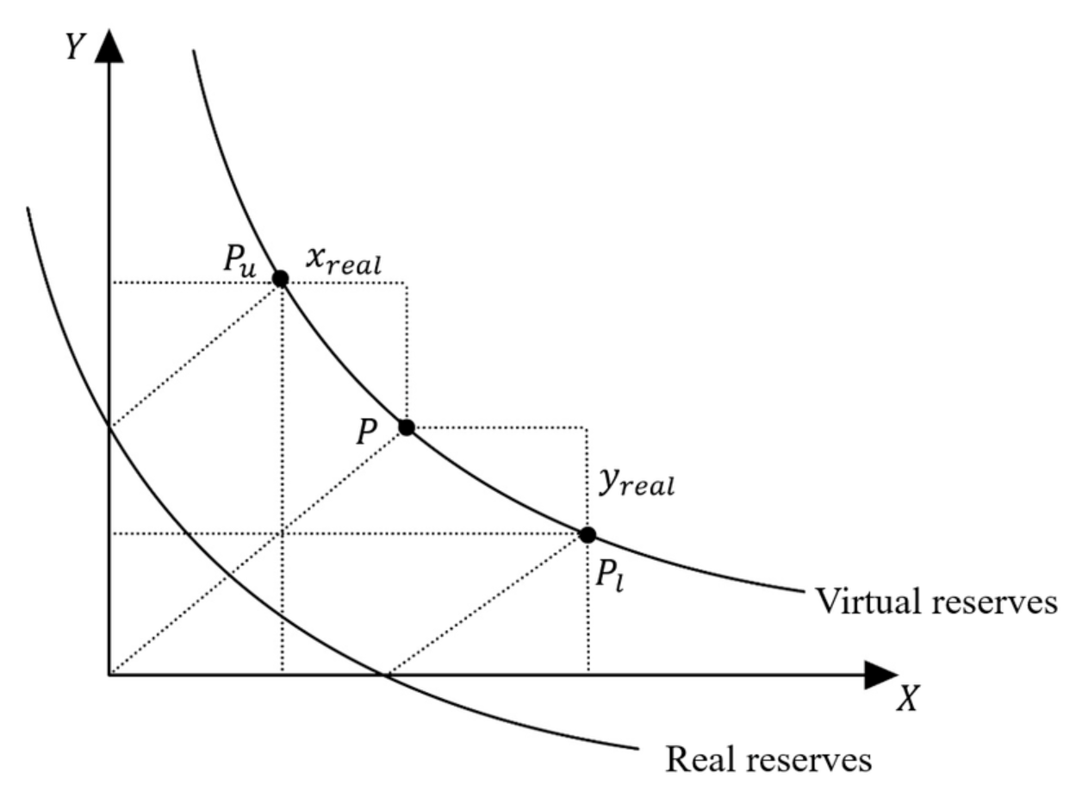

Slide 14
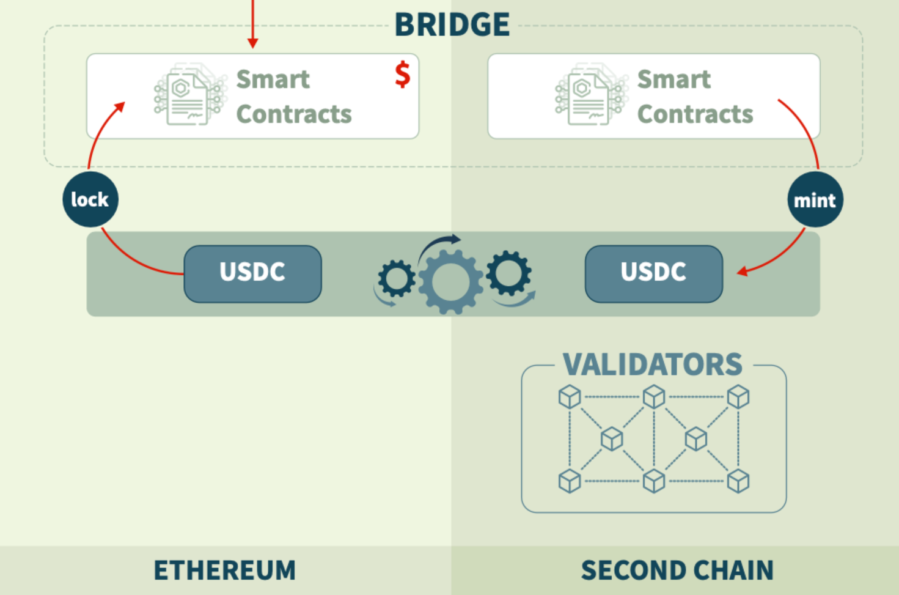
8. What is cross-chaining
Transfer data and token between different blockchains

Slide 15
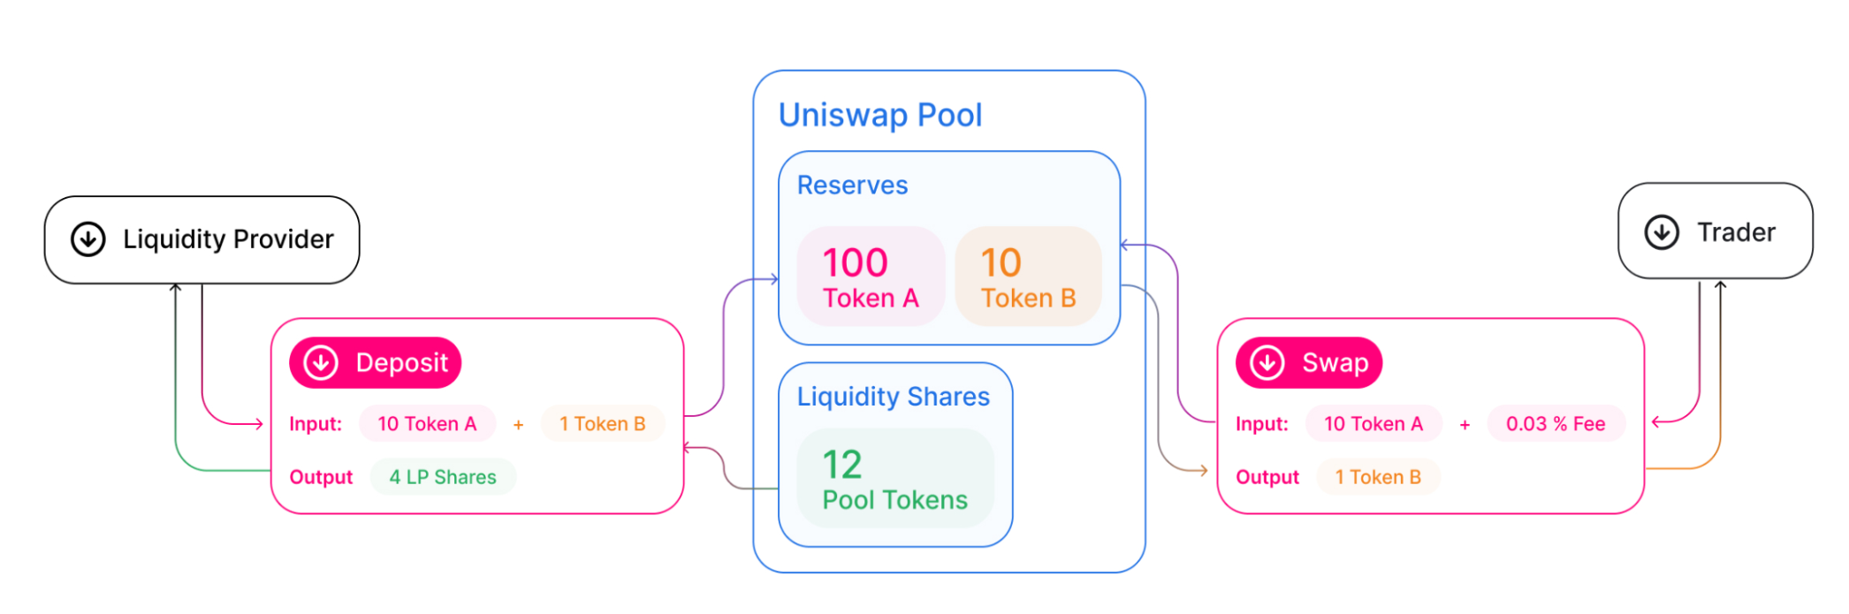
9. How DEX & Bridge make profit
Market Cap
Volume

Slide 16
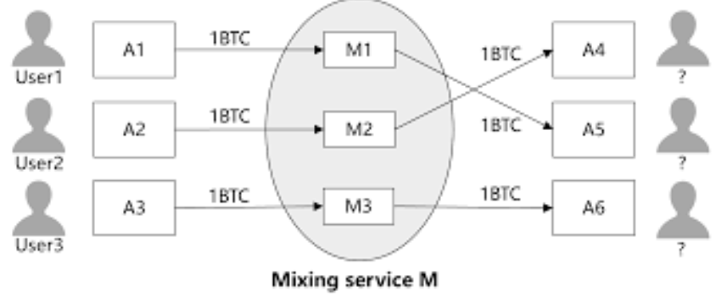
10. Mixer
Hide Origin & Destination
Whirlpool, Mixero, Tumbler.io

